Slide 1
TYPES OF COMPUTER
PREPARED BY
Sonalisa Behera
Tapaswini Parei
Suprabha Sahu
Class- IX
GUIDED BY
MR. PRAHALLAD BADAPANDA
FCSA

Slide 2
Types of computer
Type of computer
Digital computer
Micro Computer
Home
PC
Main frame
Computer
Super Computer
Mini Computer
Analog computer
Hybrid Computer

Slide 3
Analog computer
Analog computer measures and answer the questions by the method of “HOW MUCH”. The input data is not a number infect a physical quantity like temp, pressure, speed, velocity.
Signals are continuous of (0 to 10 V)
Accuracy 1% Approximately
High speed
Output is continuous
Time is wasted in transmission time

Slide 4
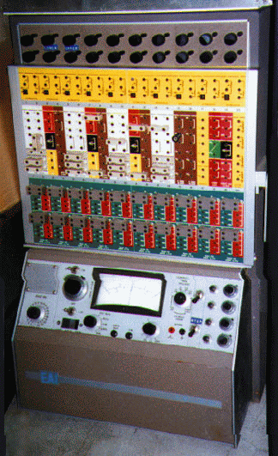
Analog computer

Slide 5
Digital Computers
Digital computer counts and answer the questions by the method of “HOW Many”. The input data is represented by a number. These are used for the logical and arithmetic operations.
Signals are two level of (0 V or 5 V)
Accuracy unlimited
low speed sequential as well as parallel processing
Output is continuous but obtain when computation is completed.

Slide 6
Micro Computer
Micro computer are the smallest computer system. There size range from calculator to desktop size. Its CPU is microprocessor. It also known as Grand child Computer.
Application : - personal computer, Multi user system, offices.

Slide 7
Mini Computer
These are also small general purpose system. They are generally more powerful and most useful as compared to micro computer. Mini computer are also known as mid range computer or Child computer.
Application :- Departmental systems, Network Servers, work group system.

Slide 8
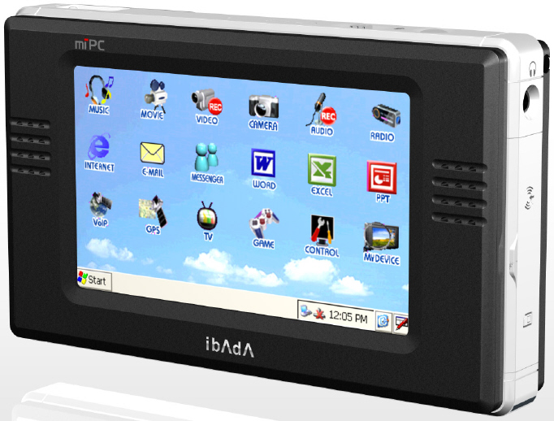
Mini computer

Slide 9
Main Frame Computer
Mainframe computers are those computers that offer faster processing and grater storage area. The word “main frame” comes from the metal frames. It is also known as Father computer.
Application – Host computer, Central data base server.

Slide 10
Super Computer
Super computer are those computer which are designed for scientific job like whether forecasting and artificial intelligence etc. They are fastest and expensive. A super computer contains a number of CPU which operate in parallel to make it faster. It also known as grand father computer.
Application – whether forecasting, weapons research and development.

Slide 11
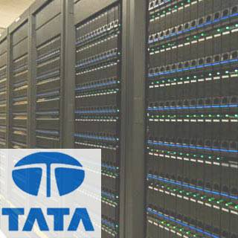
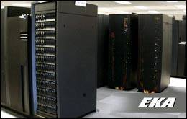
Super computer

Slide 12
Classification of Digital computer
Desktop
Workstation
Notebook
Tablet PC
Handheld computer
Smart Phone

Slide 13
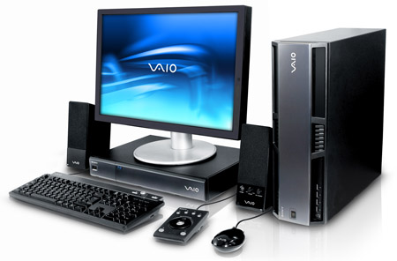
workstation

Slide 14
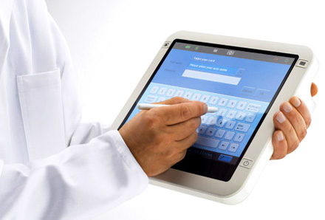
Tablet PC

Slide 15
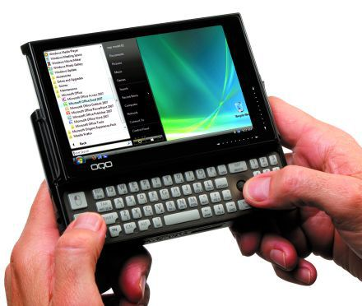
Handheld PC(PDA)

Slide 16
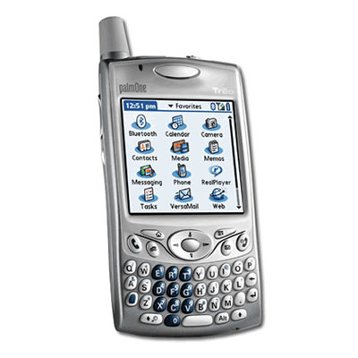
Smart phone

