Slide 1
DATABASES
WHAT IS A DATABASE?
A database is a collection of data that is organized so that its contents can easily be accessed managed and updated
To create a database, we need to have a Database Management Software (DBMS)
Notes:
Prepared by: MK SOLUTIONS

Slide 2
DATABASES
Problems that databases are made to address
Unnecessary duplication of data
Boredom and time wastage while searching for a record
Misleading reports due to poor data entry and organization
Poor update of records

Slide 3
DATABASES
Common examples of DBMS - Software
Microsoft Access
Lotus Approach
MySQL
DbaseIV
FoxPro
Oracle -dBASE -Libre Office Base

Slide 4
DATABASES
Functions of DBMS
Allow users to delete or add records
Update and modify existing records
Organize data for easy access, retrieval and manipulation of records
Ensuring the security of data
Keep statistics of data in the database.

Slide 5
DATABASES
Database Models
Databases can be classified according the method used to organize data namely:
Flat file
Hierarchical
Network
Relational
Object Oriented Models
A data model is a collection of concepts and rules for the description of the structure of the database. Structure of the database means the data types, the constraints and the relationships for the description or storage of data respectively.

Slide 6
DATABASES
Database Models- Flat File
In flat file model, a database holds only one set of data and its neither different from manual files
Either
In databases a flat file refers to data files that contain records with no structured relationships. Flat files may contain only basic formatting, have a small fixed number of fields

Slide 7
DATABASES
Database Models- Hierarchical models
Data items are arranged in tree form. To access level two data items, you have to first access level 1 data item called the root component
LEVEL1
LEVEL2
LEVEL3
LEVEL3
LEVEL2
LEVEL3
LEVEL3

Slide 8
DATABASES
Database Models- Network Model
Links are used to express the relationship between different data items, forming a network of items. Accessing to one item can be through multiple paths
item1
item2
item3
item4
item5
item6
item7
item8
item9

Slide 9

DATABASES
Database Models- Relational Model
Related data items are stored together in structures called relations or tables. Relationship can be created between tables such that a record or records from one table relates to another or other records in another table.
Relational database model

Slide 10
DATABASES
Database Models- Object Oriented Models
Object-oriented models define a database as a collection of objects with features and methods
Other database models include Object-Relational model
This is database model extended by some basic object-oriented concepts. These allow us to work with the widely know relational database model but also have some advantages of the object-oriented model without its complexity.

Slide 11
DATABASES
Features of DBMS Software
DBMS software comes with features that help the user to manipulate the database. These features include:
Tables
Queries
Report generators
Form interface
Macros and
Modules

Slide 12
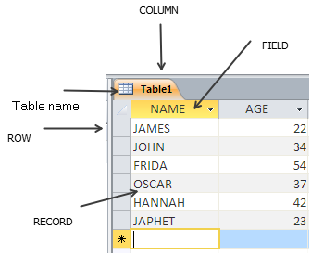
DATABASES
Features of DBMS Software - Tables
Tables in a database are used to hold related data items
Tables are arranged in rows and columns with each row representing a record and columns represent common fields

Slide 13
DATABASES
Features of DBMS Software - Queries
A query is a statement used to extract, change, analyze or request for specific data from one or more tables
For example, you might only want to see how many individuals in your database live in a given city. Or you might only want to see which individuals have registered with your database within a given time period.
As with many other tasks, you can query a database either programmatically or via a user interface.

Slide 14
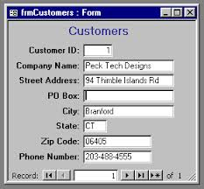
DATABASES
Features of DBMS Software – Forms/Input Screen
A form is a graphical interface that resembles an ordinary paper form. They are used to enter and view data in a database

Slide 15
DATABASES
Features of DBMS Software – Forms/Input Screen
Report carry the output from the database.
Reports are used in decision making and analysis

Slide 16
DATABASES
Features of DBMS Software – Macros & Modules
Macros is used to automate processes in the database
When the database becomes more and more complex, a programming language is used to further automate the processes, these languages are included in a module in the software

Slide 17
DATABASES
Data Organization in a database
Data is organized from the simplest form called a field to a very complex structure called a database
These forms are:
    Fields
    Records
    Tables
    Database

Slide 18
DATABASES
Data Organization in a database- Fields
A field is a character or a logical combination of characters that represent a data item.

Slide 19
DATABASES
Data Organization in a database- Records
A record is a collection of related fields that represent a single entity.

Slide 20
DATABASES
Data Organization in a database- Tables
A table is a collection of related records.

Slide 21
DATABASES
Data Organization in a database- Database
A database holds related files or tables

