Slide 1





Weather and Climate – an introduction
These icons indicate that teacher’s notes or useful web addresses are available in the Notes Page.
This icon indicates the slide contains activities created in Flash. These activities are not editable.
For more detailed instructions, see the Getting Started presentation.
1 of 33
© Boardworks Ltd 2005

Slide 2


Learning objectives
By the end of this lesson we will be able to:
Discuss reasons why geographers study the weather
Describe the difference between 'weather' and 'climate‘
List the main weather elements
Match the main weather elements with the instruments for measuring these elements

Slide 3
Success Criteria
We will know we are successful if:
we can give reasons for studying the weather
we can identify a weather and a climate statement
we can match words to the correct weather element
we can complete a table summarising the main elements, words and instruments

Slide 4
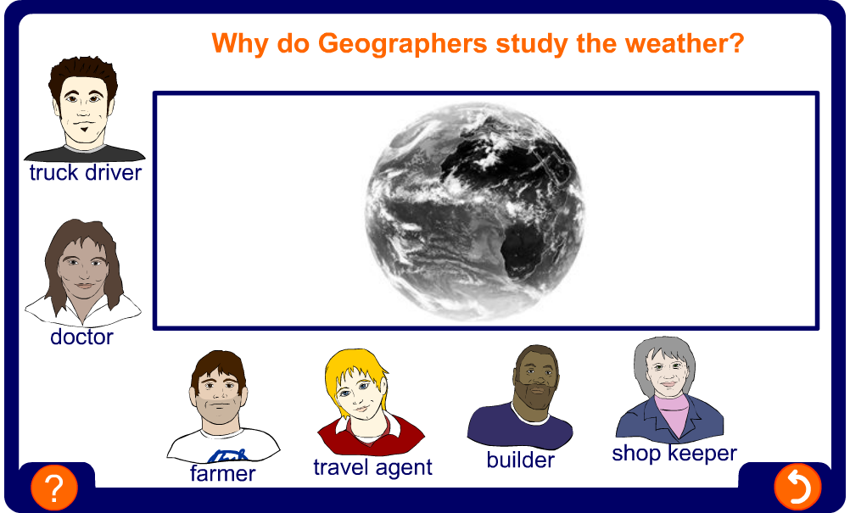
Why do geographers study the weather?
The weather has an impact on many of the things that we do! Can you explain how the weather affects these people?
Notes:
Images represent – doctors, drivers, shopkeepers, builders, tour operators and farmers. There are of course many more groups that could have been included…
Opportunity to ask pupils to come up with other reasons as to why the weather is important?
The ‘weatherwise’ section of the BBC’s website is a good site for further information http://www.bbc.co.uk/weather/

Slide 5

What is the difference between weather and climate?
Weather is the day to day changes in the atmosphere.
temperature
precipitation
wind speed
humidity
wind direction
cloud cover
air pressure
sunshine
Notes:
This is animated so that the teacher can allow the class the opportunity to brainstorm what the changes in the atmosphere may include!

Slide 6
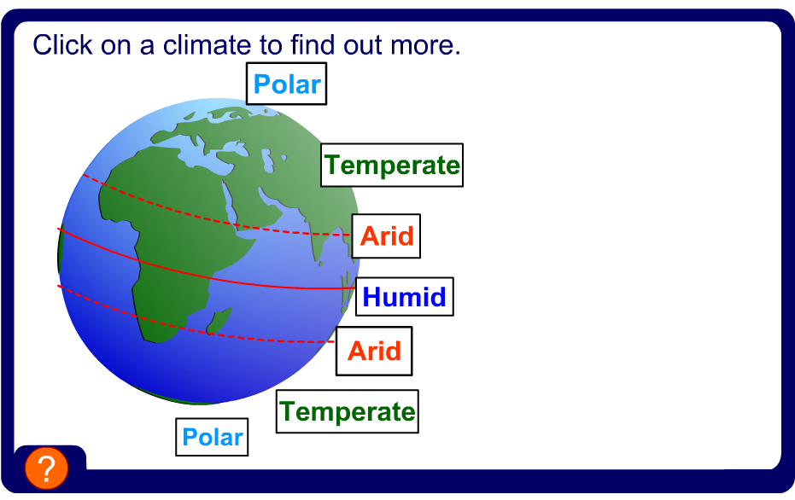
What is the difference between weather and climate?
Climate is the overall pattern of weather, usually based on an average over 30 years.
Click on the buttons to find out about these types of climate.

Slide 7
Key Ideas
Geographers study the weather because it has an impact on people’s daily lives and the activities that they do.
Weather is the day to day changes in the atmosphere.
Climate is the overall pattern of weather, usually based on an average over 30 years.
The British Isles has a temperate climate. This means that it is not too hot, not too cold, not too dry and not too wet!

