Slide 1
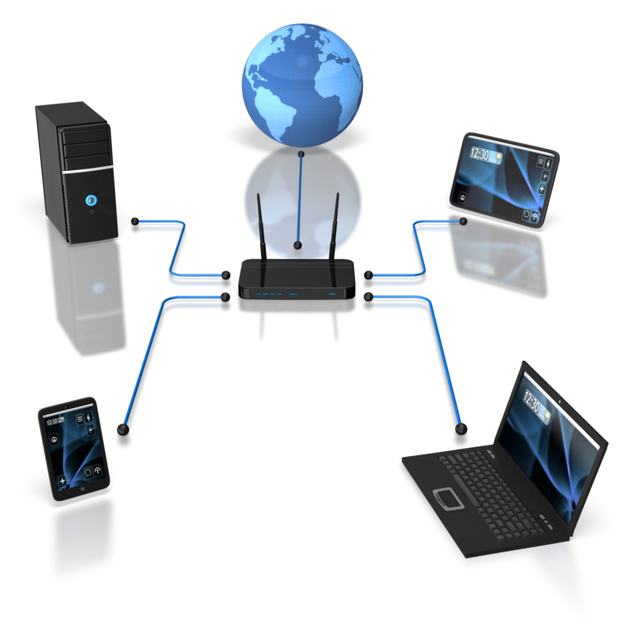
Setting up a Network
GCSE ICT

Slide 2
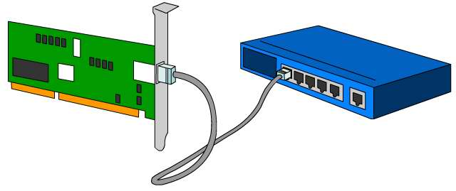
Network hardware
Every computer on a network needs a network interface card (NIC) which is connected to the motherboard inside the computer.
NIC
switch
A cable plugs into the card, and the other end of the cable plugs into a switch.
The switch is then linked to the server.

Slide 3
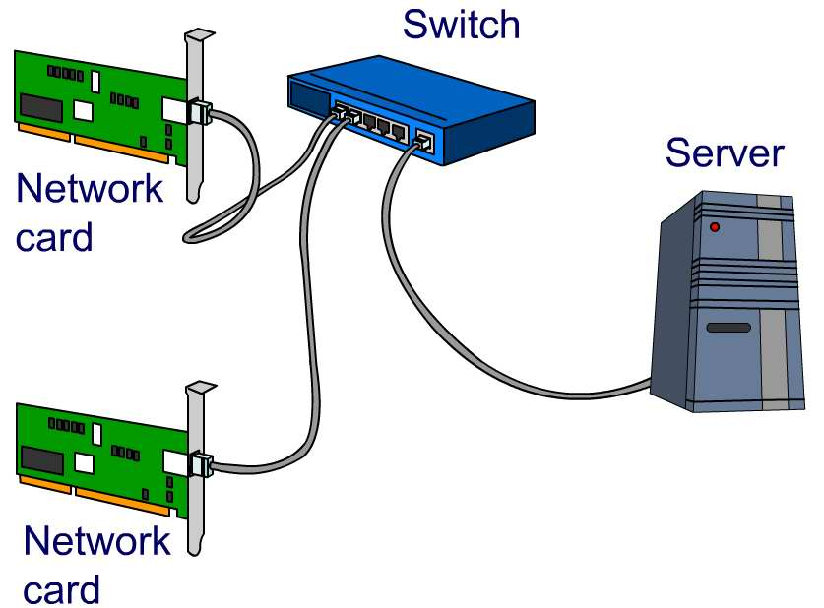
Building a network

Slide 4
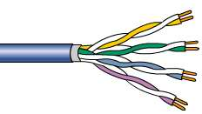


Cables
Most networks use cables to connect the computers.
Twisted-pair cables are the most common. The cabling is often called Ethernet cabling. Category 5 (Cat5) twisted-pair cables can carry 100Mb per second over distances of up to 100 metres.
Coaxial cable is better at resisting interference and can be run for longer lengths, but it isn’t as flexible.
Fibre optic cable can transfer data at higher speeds over longer distances, and can be used outside buildings, but it is much more expensive. It has a central core made of glass and transmits the signals using light.

Slide 5
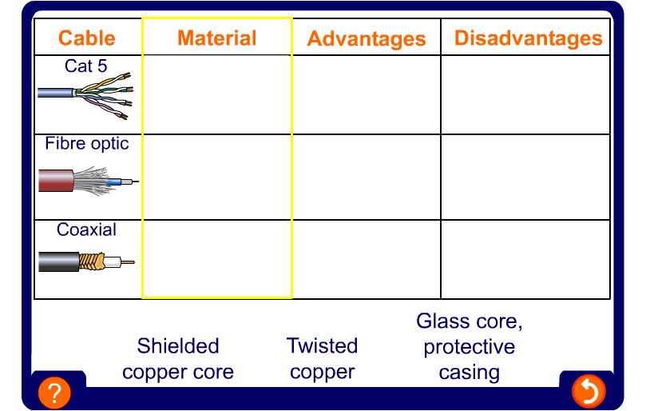

Slide 6

Network topologies
The way networks are arranged is called a network topology.
Networks can be a single topology or a mixture of more than one.
Packet for IP address 216
Whatever the topology, each computer has to have a network address so that the packets of data (chunks of data, split into small parts to find the quickest route, and reassembled when they reach their destination) from other computers on the network know where to go.
This is an IP address, just as it is on the Internet.

Slide 7
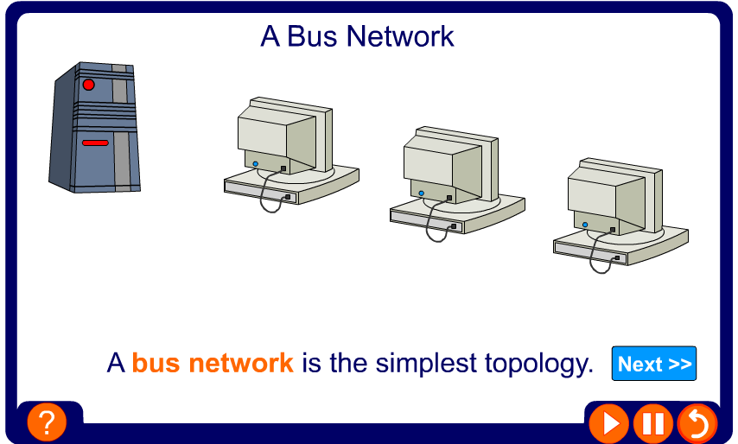
Bus network

Slide 8
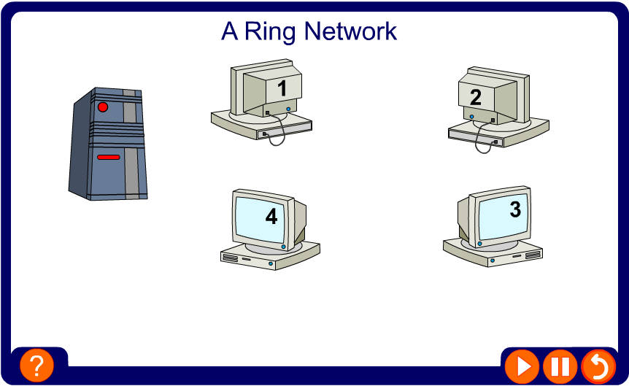
Ring network

Slide 9
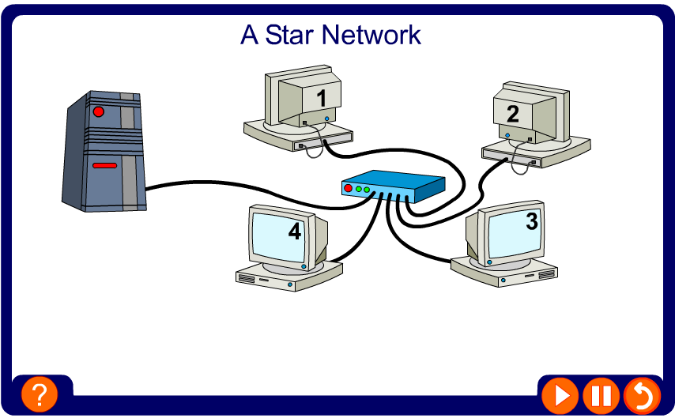
Star network

Slide 10
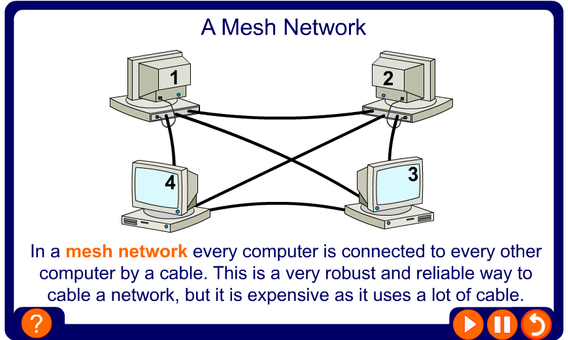
Mesh network

Slide 11
Wireless networks
Wireless networks are becoming easier to set up, and they are very popular because they are so flexible. They can be used to provide access to other computers and the Internet.
Wireless WANs use roof antennas to connect to a central network via satellite or radio transmitters and have a range of many kilometres.
Wireless LANs use radio waves to connect computers to existing Ethernet LANs, and have a range of many metres.
Wireless PANs (personal area networks) use Bluetooth or infrared technology to connect devices which are within a few metres of each other.

Slide 12
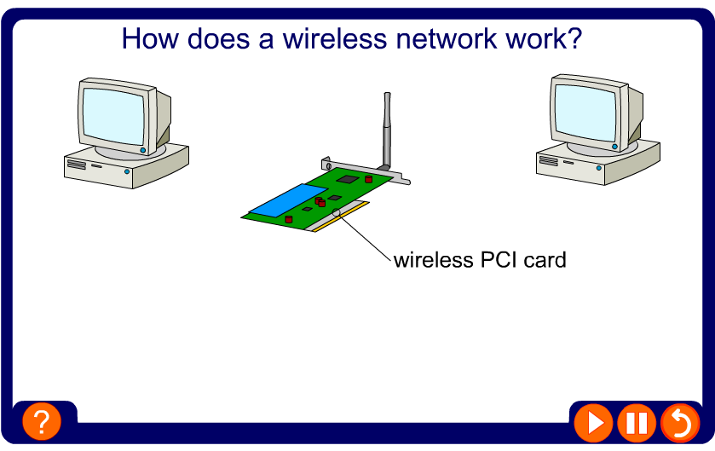
Wireless network

Slide 13
Advantages and disadvantages
Wireless networks:
are expensive to set up, but fairly cheap to run
have some security issues, though lots of work is being done to solve these
are very useful in listed buildings where cables would not be allowed
are very flexible, allowing users to log on from anywhere within range
have slower data access speeds than Ethernet
technology in this area is changing very quickly, and equipment can soon become out of date.

Slide 14
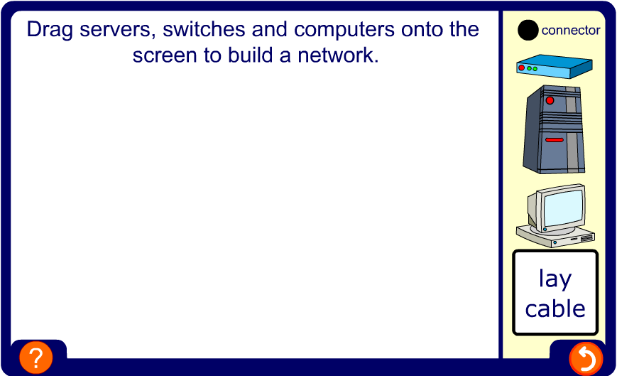
Build your own network

Slide 15

Summary
Computers on a network each need a network interface card (NIC) and cable to connect them, often through switches. Wireless networks are connected using radio waves.
There are different cables that can be used including Cat5, coaxial cable and fibre optic cable.
The way a network is arranged is called a topology.
Network topologies can be bus, star, ring, mesh or wireless.
Some networks use more than one topology – we call them hybrids.

