Slide 1
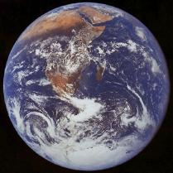
Land Biomes

Slide 2
Land Biomes
Biome- geographic areas that have similar climates and ecosystems

Slide 3
Land Biomes
The 6 most common biomes are:
Tundra
Taiga
Temperate Deciduous Forest
Tropical Rain Forest
Grassland (Prairie, Tropical Savanna, Chapparal)
Desert

Slide 4
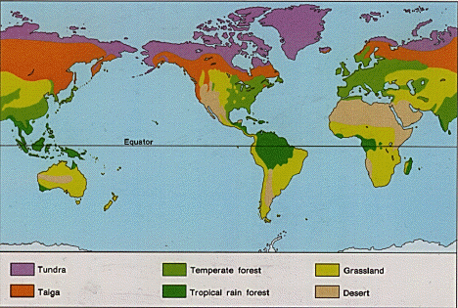
Land Biomes

Slide 5
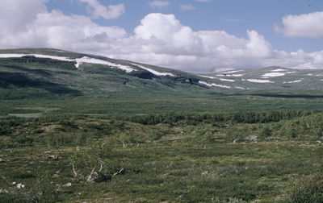
Tundra
Found in parts of Canada, Alaska, and Siberia

Slide 6
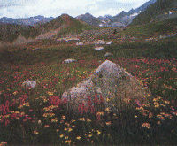
Tundra –
“The Cold Desert”
Found at latitudes around the North Pole
Less than 25 cm precipitation yearly
Very cold year round (-40ºC in winter)
Cold, dry, treeless region

Slide 7
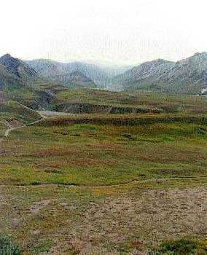
Tundra –
“The Land of the Midnight Sun”
Winter lasts 6 to 9 months with no daylight
Summer is short and cold with 24 hours of sunlight a day

Slide 8
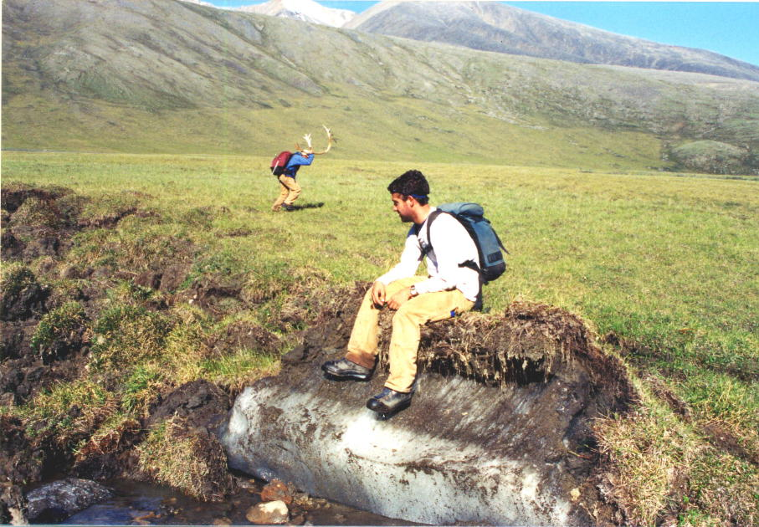
Tundra-
Soil is poor
Permafrost
Layer of permanently frozen soil

Slide 9
Plants of the Tundra
Tundra plants are resistant to drought and cold
Examples:
Reindeer moss (a lichen!)
Lichens
True mosses
Grasses
Small shrubs and flowers

Slide 10
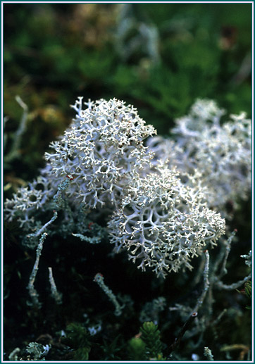
Plants of the Tundra
Reindeer moss – It’s a lichen!

Slide 11
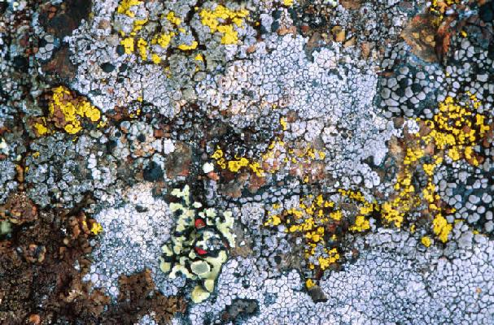
Plants of the Tundra
Lichens

Slide 12
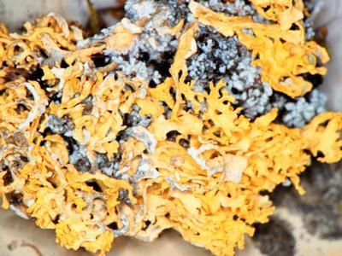
Plants of the Tundra
Lichen

Slide 13
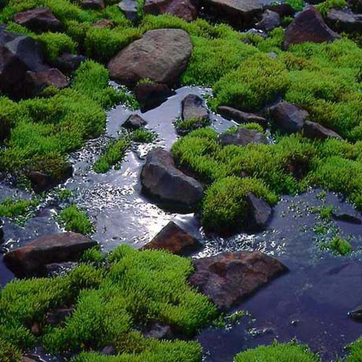
Plants of the Tundra
True Mosses

Slide 14
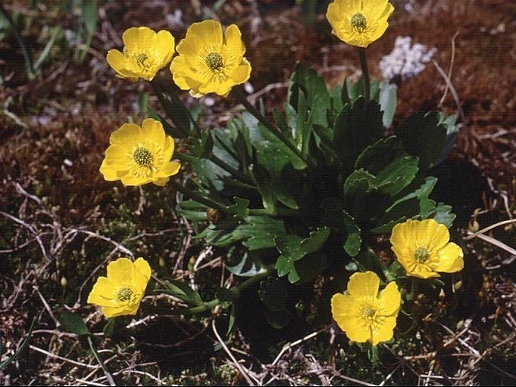
Plants of the Tundra
Small shrubs and flowers

Slide 15
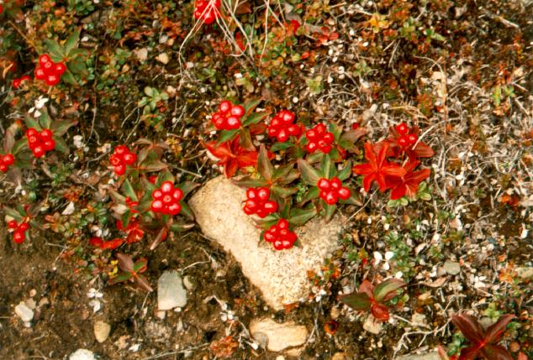
Plants of the Tundra
Small shrubs and flowers

Slide 16
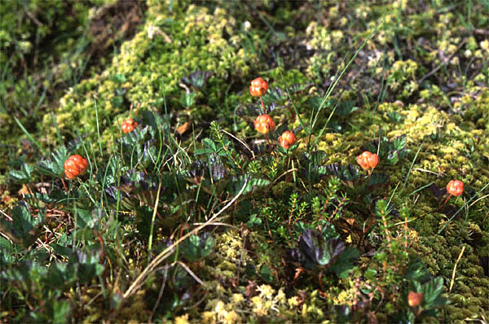
Plants of the Tundra
Small shrubs and flowers

Slide 17
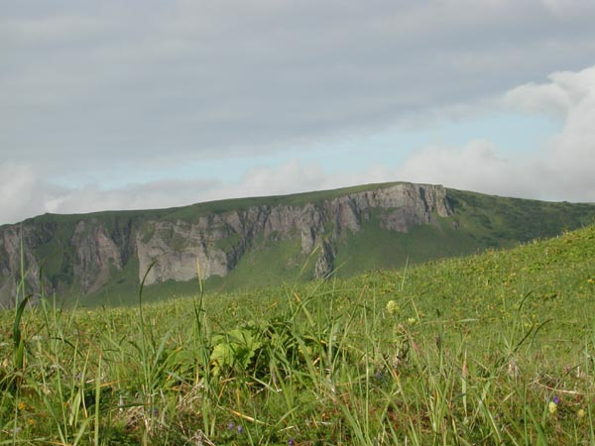
Plants of the Tundra
Grasses

Slide 18
Animals of the Tundra
Many animals of the tundra migrate there during the short summer
Examples:
Biting insects
Snowy owls
Arctic hares
Caribou
Musk oxen
Lemmings

Slide 19
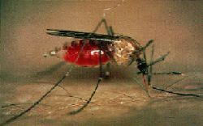
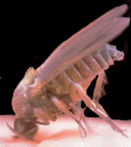
Animals of the Tundra
Biting insects
Mosquito Blackfly

Slide 20
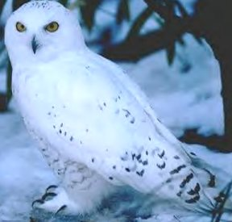
Animals of the Tundra
Snowy owl

Slide 21
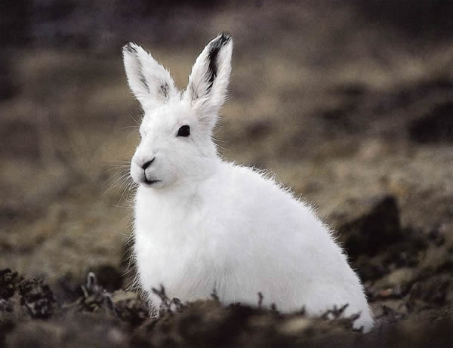
Animals of the Tundra
Arctic hare

Slide 22
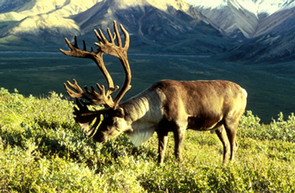
Animals of the Tundra
Caribou – “Reindeer”

Slide 23
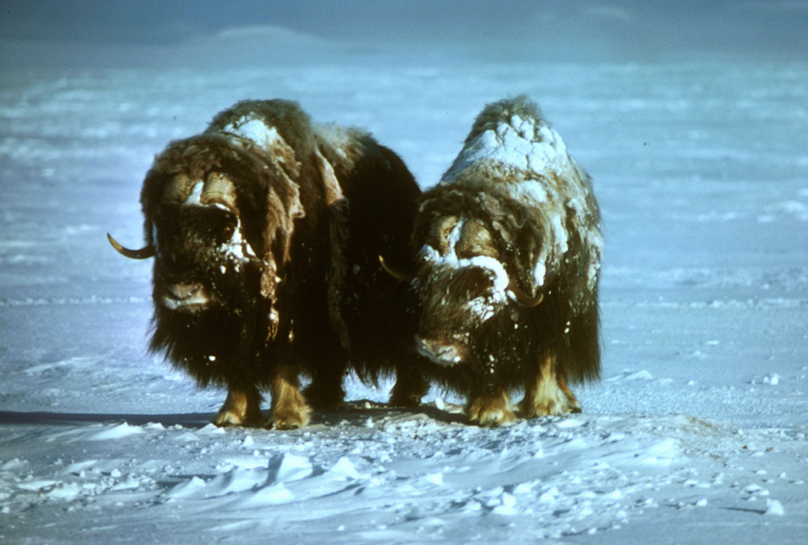
Animals of the Tundra
Musk oxen

Slide 24
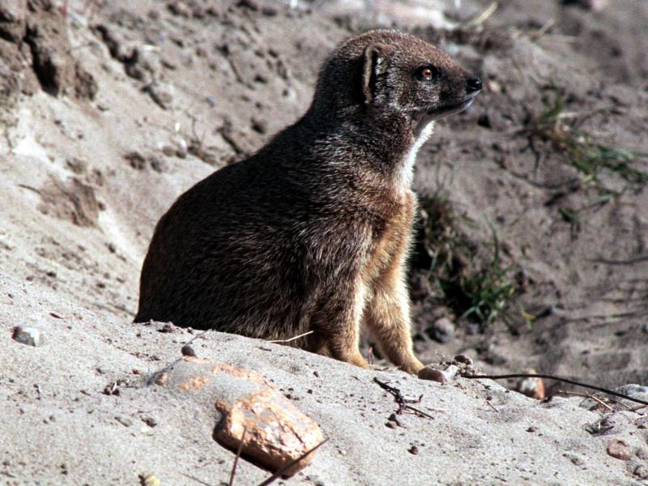
Animals of the Tundra
Lemmings

Slide 25
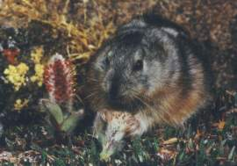
Animals of the Tundra
Lemmings

Slide 26
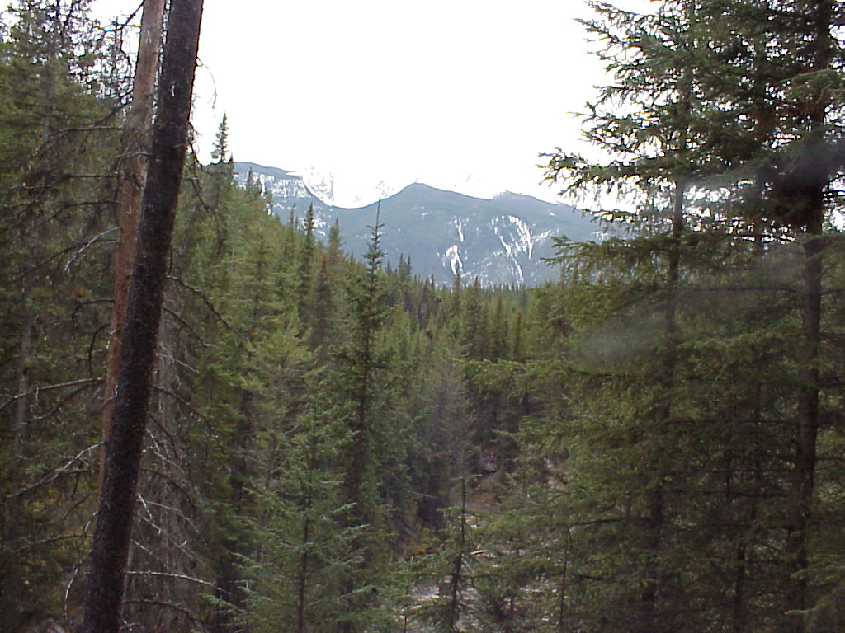
Taiga or Coniferous Forest
Found in parts of Canada, Alaska, and Russia

Slide 27
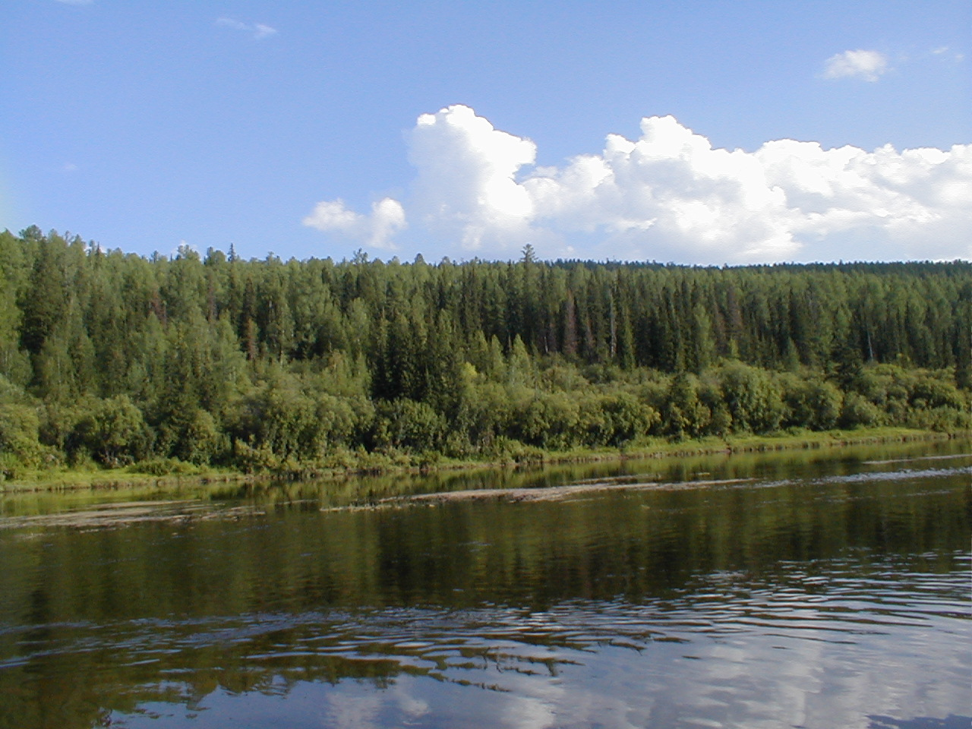
Taiga or Coniferous Forest
World’s largest land biome
Latitudes between 50ºN and 60ºN

Slide 28
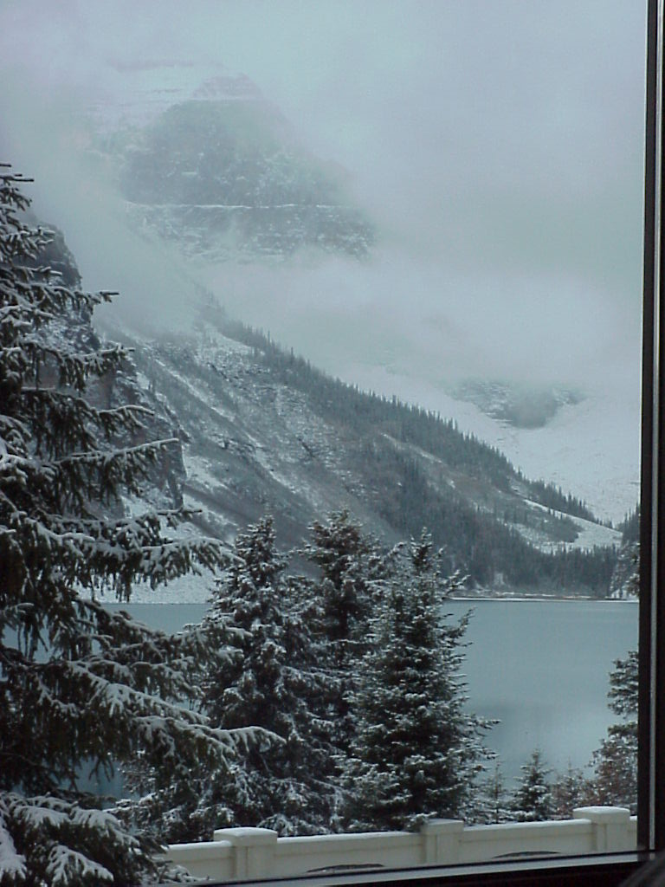
Taiga-
Warmer and wetter than the Tundra
Winters are long and cold
35 to 40 cm of precipitation yearly (mostly snow)

Slide 29
Plants of the Taiga
There is no permafrost, so trees can grow. Mosses and lichens grow on the forest floor.
Examples:
Cone-bearing Evergreen trees
Firs
Spruces
Pines
Hemlocks
Cedars

Slide 30
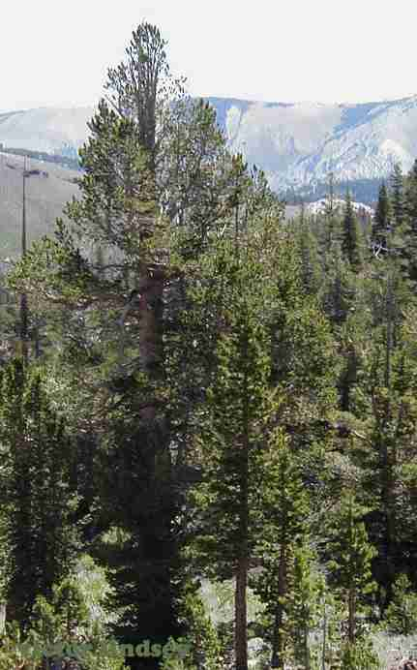
Plants of the Taiga
Fir tree

Slide 31
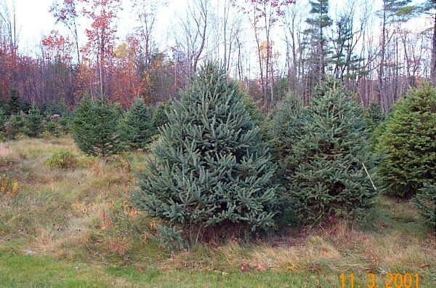
Plants of the Taiga
Spruce tree

Slide 32
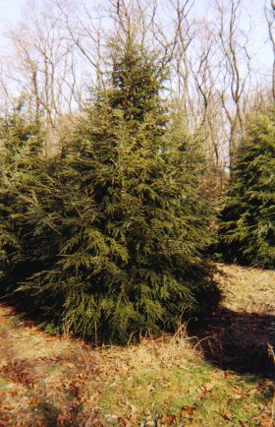
Plants of the Taiga
Hemlock tree

Slide 33
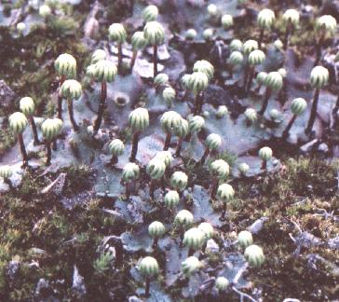
Plants of the Taiga
Liverwort (a moss)

Slide 34
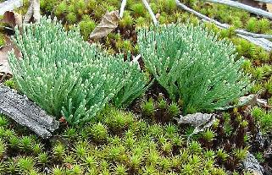
Plants of the Taiga
Mosses

Slide 35
Animals of the Taiga
Many animals live in the Taiga.
Examples:
Moose
Black Bear
Lynx
Wolves
Badgers
Wolverines
Ermines
Deer

Slide 36
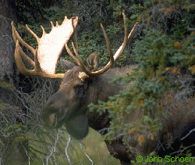
Animals of the Taiga
Moose

Slide 37
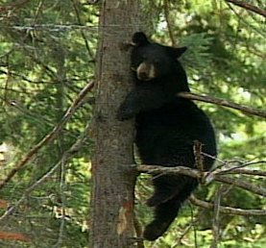
Animals of the Taiga
Black bear

Slide 38
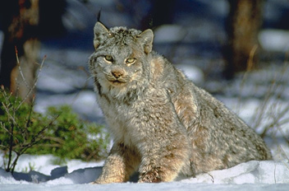
Animals of the Taiga
Lynx

Slide 39
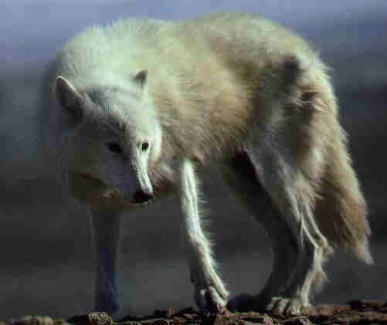
Animals of the Taiga
Wolf

Slide 40
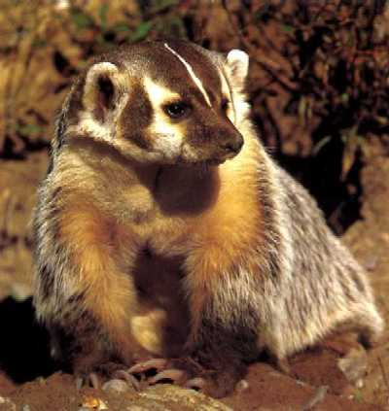
Animals of the Taiga
Badger

Slide 41
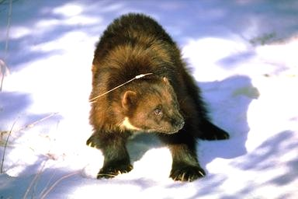
Animals of the Taiga
Wolverine

Slide 42
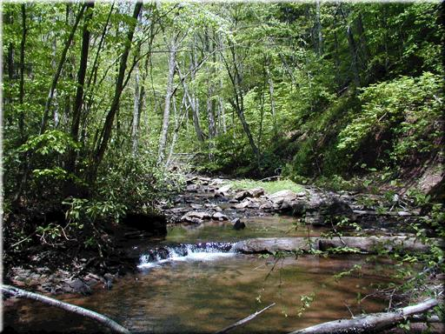
Temperate Deciduous Forest
Found in Europe, the eastern part of the U.S.A., and China

Slide 43
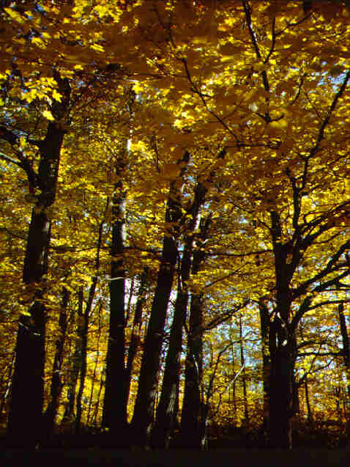
Temperate Deciduous Forest
Found below 50ºN latitude
75 to 150 cm precipitation yearly

Slide 44
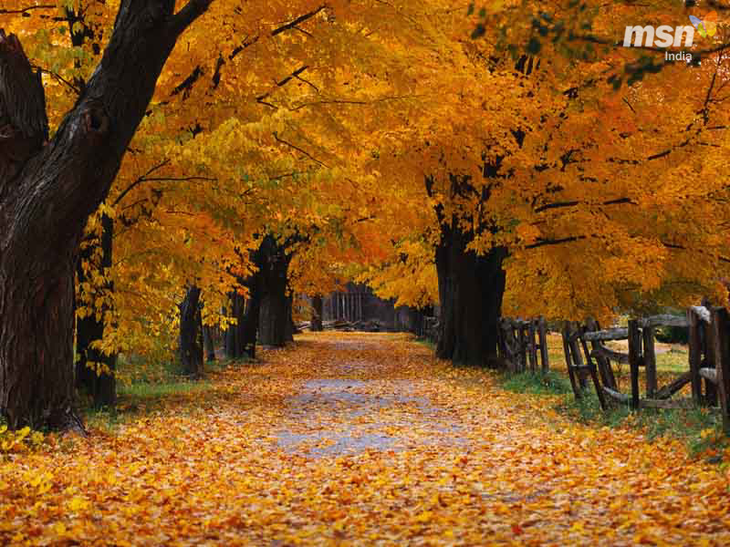
Temperate Deciduous Forest
Wide range of temperatures with 4 seasons
Below freezing in winter to 30ºC in summer

Slide 45
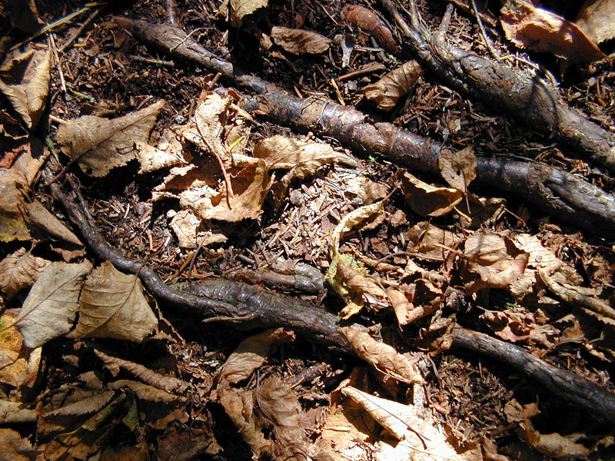
Temperate Deciduous Forest
Soil is rich in nutrients from layers of decomposing leaves

Slide 46
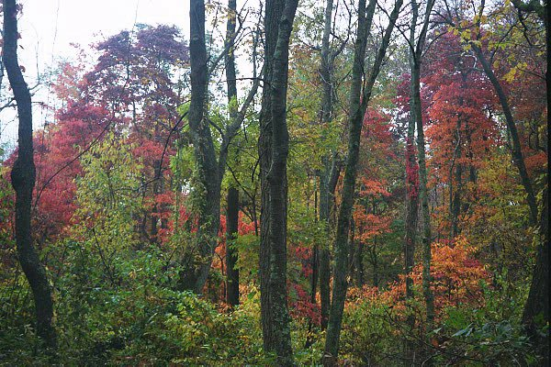
Temperate Deciduous Forest
Layers of vegetation
Canopy
Understory
Forest floor

Slide 47
Layers of Vegetation
Canopy- tree tops that shade the ground below
Understory- shrub layer
Forest floor- dark and moist layer of dead leaves, twigs, and seeds

Slide 48
Layers of Vegetation
Canopy

Slide 49
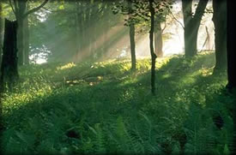
Layers of Vegetation
Understory

Slide 50
Layers of Vegetation
Forest floor

Slide 51
Life in the Temperate Deciduous Forest
The mild climate and rich soil of the temperate deciduous forest supports a wide variety of plant and animal life.

Slide 52
Plants of the Temperate Deciduous Forest
Plant life is abundant.
Examples:
Oak trees
Hickory trees
Maple trees
Shrubs
Wildflowers
Ferns

Slide 53
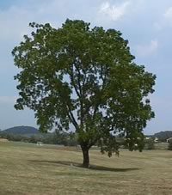
Plants of the Temperate Deciduous Forest
Oak tree

Slide 54
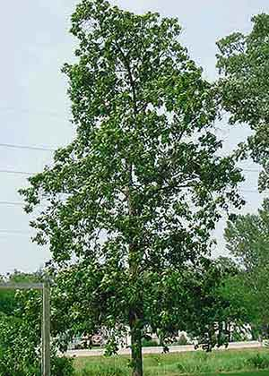
Plants of the Temperate Deciduous Forest
Hickory tree

Slide 55
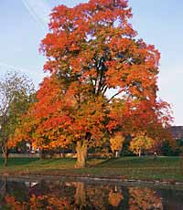
Plants of the Temperate Deciduous Forest
Maple tree

Slide 56
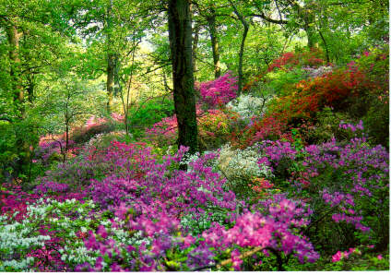
Plants of the Temperate Deciduous Forest
Shrubs (Azalea)

Slide 57
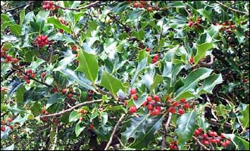
Plants of the Temperate Deciduous Forest
Shrubs (Holly)

Slide 58
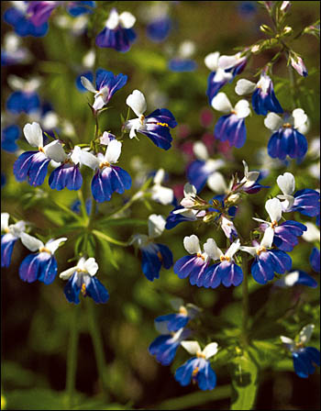
Plants of the Temperate Deciduous Forest
Wildflowers

Slide 59
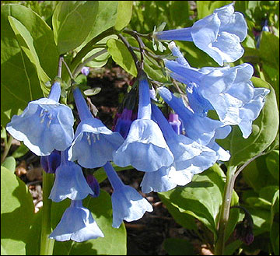
Plants of the Temperate Deciduous Forest
Wildflowers

Slide 60
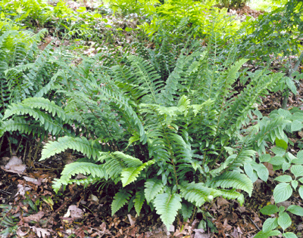
Plants of the Temperate Deciduous Forest
Ferns

Slide 61
Animals of the Temperate Deciduous Forest
Animal life is diverse.
Examples:
Deer
Foxes
Snakes
Bears
Birds
Raccoons
Amphibians
Small mammals

Slide 62
Animals of the Temperate Deciduous Forest
Deer

Slide 63
Animals of the Temperate Deciduous Forest
Fox

Slide 64
Animals of the Temperate Deciduous Forest
Snakes (Eastern Garter Snake)

Slide 65
Animals of the Temperate Deciduous Forest
Snakes (Copperhead)

Slide 66
Animals of the Temperate Deciduous Forest
Black bear

Slide 67
Animals of the Temperate Deciduous Forest
Birds (Bald Eagle)

Slide 68
Animals of the Temperate Deciduous Forest
Birds
(Barn Owl)

Slide 69
Animals of the Temperate Deciduous Forest
Birds
Woodpecker Cardinal

Slide 70
Animals of the Temperate Deciduous Forest
Raccoon

Slide 71
Animals of the Temperate Deciduous Forest
Amphibians
Wood frog Leopard Frog

Slide 72
Animals of the Temperate Deciduous Forest
Amphibians
Spotted Salamander Jefferson Salamander

Slide 73
Animals of the Temperate Deciduous Forest
Small Mammals
Field Mouse Squirrel

Slide 74
Tropical Rain Forest
Found near the equator in Africa, South America, Australia, and the Pacific Islands

Slide 75
Tropical Rain Forest
Found near the equator
200 to 225 cm precipitation yearly

Slide 76
Tropical Rain Forest
Hot and humid all year
Temperatures are fairly constant around 25ºC

Slide 77
Tropical Rain Forest
Soil is nutrient poor and acidic
Most plants have shallow roots

Slide 78
Tropical Rain Forest Layers of Vegetation

Slide 79
Life in the Tropical Rain Forest
The tropical rain forest is a lush, productive ecosystem containing more than half of all the species that live on Earth.

Slide 80
Plants of the Tropical Rain Forest
A rain forest may contain more than 700 species of trees and over 1000 species of flowering plants.
Examples:
Mahogany trees
Bromeliads and orchids
Giant ferns
Many flowering plants

Slide 81
Plants of the Tropical Rain Forest
Mahogany tree
Notice how the roots rise above the ground to help support this giant tree!

Slide 82
Plants of the Tropical Rain Forest
Bromeliads

Slide 83
Plants of the Tropical Rain Forest
Orchids

Slide 84
Plants of the Tropical Rain Forest
Giant ferns

Slide 85
Plants of the Tropical Rain Forest
Flowering plants

Slide 86
Animals of the Tropical Rain Forest
The rain forest is home to a huge number of animals.
Examples:
Monkeys
Exotic birds
Snakes
Sloths
Bats
Insects
Large cats
Exotic mammals

Slide 87
Animals of the Tropical Rain Forest
Monkeys

Slide 88
Animals of the Tropical Rain Forest
Exotic birds
Toucan Parrots

Slide 89
Animals of the Tropical Rain Forest
Exotic birds
Cockatoo Hummingbird

Slide 90
Animals of the Tropical Rain Forest
Snakes (Anaconda)

Slide 91
Animals of the Tropical Rain Forest
Snakes
Albino Ball Python Green Mamba

Slide 92
Animals of the Tropical Rain Forest
Sloths

Slide 93
Animals of the Tropical Rain Forest
Bat (Fruit bat)

Slide 94
Animals of the Tropical Rain Forest
Insects
Butterfly Beetle

Slide 95
Animals of the Tropical Rain Forest
Large Cats (Jaguar)

Slide 96
Animals of the Tropical Rain Forest
Large Cats (Sumatran Tiger)

Slide 97
Animals of the Tropical Rain Forest
Large Cat (Ocelot)

Slide 98
Animals of the Tropical Rain Forest
Exotic mammals
Paca Peccary

Slide 99
Animals of the Tropical Rain Forest
Exotic mammals
Agouti Nutria

Slide 100
Tropical Savanna

Slide 101
Characteristics of the Savanna
Tropical, rolling grassland scattered with shrubs and isolated trees
Not enough rainfall to support forests
Long dry winter with 4” rainfall and rainy summer with 15 – 50 inches of rainfall annually
90ºF in dry season; 70ºF in summer
Clay and sand mixed soils

Slide 102
Savanna Producers
Tall, wild grasses
Acacia trees
Small shrubs

Slide 103
Savanna Consumers
Large herbivores such as antelope, gazelles, giraffes, elephants, zebras, wildebeests
Large carnivores such as lions, hyenas, and leopards

Slide 104
Animals of the African Grassland
Gazelle

Slide 105
Animals of the African Grassland
Wildebeest

Slide 106
Animals of the African Grassland
Lion

Slide 107
Animals of the African Grassland
Elephant

Slide 108
Animals of the African Grassland
Giraffe

Slide 109
Grassland - Prairie
“The Bread Basket of the World”
Found on every continent.

Slide 110
Grassland
Grasslands are known by many names.
U.S.A. – Prairie or Plains
Asia – Steppe
South America – Pampas
Africa –Veldt or Savanna
Australia - Savanna

Slide 111
Grassland
Wet seasons followed by a season of drought
25 to 75 cm precipitation yearly

Slide 112
Grassland
The soil is rich and fertile.
The grass has extensive root systems, called sod.

Slide 113
Plants of the Grassland
Grassland regions of the world are important farming areas. Cereal and grains grow here.
Examples:
Wheat
Rye
Barley
Corn

Slide 114
Plants of the Grassland
Wheat

Slide 115
Plants of the Grassland
Rye

Slide 116
Plants of the Grassland
Barley

Slide 117
Plants of the Grassland
Corn

Slide 118
Animals of the Grassland
The most noticeable animals in grassland ecosystems are usually grazing mammals.

Slide 119
Animals of the American Grassland
Bison

Slide 120
Animals of the American Grassland
Prairie Dog

Slide 121
Animals of the American Grassland
Pronghorn

Slide 122
Animals of the American Grassland
Coyote

Slide 123
Animals of the Australian Grassland
Long Nosed Bandicoot

Slide 124
Animals of the Australian Grassland
Wallaby

Slide 125
Animals of the Australian Grassland
Wombat

Slide 126
Chapparal (Scrub)

Slide 127
Chapparal Characteristics
Cross between a grassland and a forest
May contain mountain slopes and plains
Hot, dry summers and mild winters
Average winter temperature ~ 46ºF
Average summer temperature ~ 72ºF
Annual rainfall 15 - 40 inches
Nutrient poor soil with low moisture

Slide 128
Chapparal Organisms
Producers
Consumers
Trees such as oak
Shrubs with thick waxy coverings to conserve water
Aardvark
Coyotes
Lynx
Chipmunks

Slide 129
Chapparals

Slide 130
Animals of the Australian Grassland
Australian grassland animals are marsupials
Kangaroo

Slide 131
Desert
Found on every continent.
The driest biome on Earth

Slide 132
Desert
Extreme temperatures- Very hot during the day and cool at night

Slide 133
Desert
Very little rainfall
Less than
25 cm precipitation yearly

Slide 134
Desert
The soil ranges from gravel to sand.
Soil is nutrient poor.

Slide 135
Plants of the Desert
Desert plants have evolved adaptations to help them survive in the extreme temperatures and dryness of this biome.
Examples:
Cactus
Mesquite
Joshua trees
Wildflowers
Creosote

Slide 136
Plants of the Desert
Cactus
Saguaro Prickly Pear

Slide 137
Plants of the Desert
Mesquite

Slide 138
Plants of the Desert
Joshua tree

Slide 139
Plants of the Desert
Wildflowers

Slide 140
Plants of the Desert
Creosote

Slide 141
Animals of the Desert
The animals of the desert are adapted to the hot temperatures.
Examples:
Lizards
Camels
Snakes
Scorpions
Kangaroo rat
Gila Monster
Predatory birds
Tarantula

Slide 142
Animals of the Desert
Lizards
Desert Iguana Frilled Lizard

Slide 143
Animals of the Desert
Camel

Slide 144
Animals of the Desert
Snakes
Diamondback Rattlesnake Sidewinder

Slide 145
Animals of the Desert
Scorpion

Slide 146
Animals of the Desert
Kangaroo rat

Slide 147
Animals of the Desert
Gila Monster

Slide 148
Animals of the Desert
Predatory birds
Great Horned Owl Kestrel

Slide 149
Animals of the Desert
Tarantula

