Slide 1
C2a
Understanding of ICT Systems in Everyday Life

Slide 2
The Basic components of a computer system?
Processor
  where decisions are made and calculations carried out
Internal Memory
  to store data and programs in current use
Input Devices
  for the user to communicate with the computer
Output Devices
  for the computer to communicate with the user
Backing storage
  for long-term storage of programs and data

Slide 3
Components of a Computer
Monitor/VDU
Floppy drive
CPU
CD/DVD drive

Slide 4
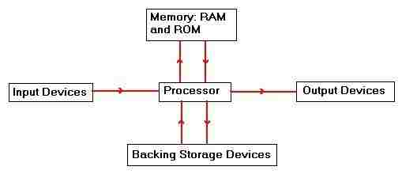
What is a computer system
A computer system is the hardware and software that work together to perform a useful task.
Hardware - equipment and cables that can be physically touched.
Software is not visible to the human eye because it consists of a program and data stored electronically The hardware for a computer system can be simplified to:

Slide 5
Operating Systems
An operating system is software which controls the general operation of a computer. An operating system
controls the loading
...and running of programs (interpreting and executing each command)
controls the use of peripherals such as disc drives and printers
organises the use of the computer’s memory.
handles interrupts (signals from devices)
maintains security (passwords etc)

Slide 6
RAM and ROM
RAM and ROM are the two different types of main memory inside the computer
RAM – Random Access Memory – memory that the user can use to store programs and data that are being used at the moment. Wiped when the computer is switched off.
ROM – Read Only Memory – memory which is permanently set when it is made. Contains instructions and data that are needed all the time. Is permanent, so not lost when the computer is switched off.

Slide 7
Cache Memory
Modern software usually requires a large amount of memory in a computer in order to operate.
Most computers use a part of the hard disk as extra memory. Data stored in memory which is not actually needed immediately is temporarily moved into the disk cache and moved back into memory when it is needed. The computer will seem to have more memory than it really has.

Slide 8
How Computer Memory Is Measured
1 Bit | 1Byte | 1 (Kb) | 1 (Mb) | 1 (Gb) | 1 (Tb)
A single digit 0 or 1 | 8 Bits e.g. A | One thousand Bytes | One million Bytes | One thousand million Bytes | One trillion Bytes

Slide 9
Input Devices
Mouse, rolled on a table and a ball underneath sends details to the computer
Tracker ball, like an upside-down mouse, where the ball is moved by your hand
Light pen, often used to actually point at the screen
Touch screen, where you use your finger to point at points on the screen
Touch pad, often found on portable computers, where you just move your finger around the pad
Joy stick, where you hold a stick and move it around.

Slide 10
OMR
Optical Mark Recognition – it detects marks made on paper
The OMR reader shines light on the paper and measures the amount of light reflected back, so finding out where marks are on the paper.
Used to automatically mark multiple exam papers (eg SATs), and for lottery tickets

Slide 11
OCR
Optical Character Recognition – similar to OMR but the computer recognises the shape of printed characters.
Used by scanners to recognise text
By places such as gas companies to automatically read customer numbers on bills when they are paid

Slide 12
MICR
Magnetic Ink Character recognition. Special ink containing iron filings is used to create specially formed characters that can be read in a machine that magnetises the ink.
Almost impossible to forge but more expensive than other methods.
The only common use is for the characters at the bottom of cheques.

Slide 13
Concept Keyboards
A touch sensitive pad where a paper overlay can be used to show different areas.
Used in McDonalds etc,
in supermarkets such as Safeway where fruit and veg are weighed,
in schools where young children can touch pictures on the overlay keyboard more easily than type things on a normal keyboard.

Slide 14
Video Digitiser
An interface between a video / video camera and a computer. Converts the signals from the video into signals that can be used by the computer.
Used when you want to use images from TV programmes in work on a computer

Slide 15
Graphics Tablets
An input device which is usually about the size of A4 paper, using a pen and a touch-sensitive surface.
Used for inputing accurate diagrams with a CAD package

Slide 16
MIDI
Musical Instrument Digital Interface
Used to connect a musical instrument such as a keyboard to a computer
So that music can be played on the instrument and stored and processed on the computer
Also used to link more than one instrument together.

Slide 17
Printers
Ink Jet
Laser
Dot matrix
Speed
Middle
Fastest
Slowest
Quality
Middle
Highest
Poorest
Purchase cost
Middle
Highest
Cheapest
Running cost
Highest
Middle
Cheapest
Noise
Quiet
Quiet
Noisy
Carbon copies?
No
No
Yes
Colour?
Usually
In the most expensive models
Sometimes

Slide 18
Plotters
A device that uses pens to draw out diagrams on paper
Used with CAD programs for creating large, accurate, high quality drawings and plans

Slide 19
CD-ROMs, floppy discs and hard discs
CD-ROM
Floppy disc
Hard disc
Speed
Middle
Slowest
Fastest
Cost
Middle
Cheapest
Most expensive
Permanence of data
Permanent
Can be changed
Can be changed
Capacity
About 650 Mb – middle
1.4 Mb – the smallest
Now usually gigabytes – biggest
Removable?
Yes
Yes
No

Slide 20
Magnetic Tape
Magnetic tapes can be on large reels (like you see on the films!) or on small cassettes.
Large tapes are often used as backing storage for mainframe computers
Cassettes are used on micro-computers
Tapes use SERIAL ACCESS only so it is not quick to access the data – you have to go through everything in the order in which it was stored
Tapes are often used for backup (we use a tape to backup the hard discs on the network) or for archiving (storing old versions of files)

Slide 21
The main features of a Windows environment (GUI)?
Windows you can move around the screen,
Icons you can click on to load programs and files
Menus to choose from
Pointer you can move around the screen
REMEMBER: W.I.M.P!

Slide 22
The alternative to a GUI
Command line user interface, where the user types commands Eg MS DOS
The user must learn lines of command language to operate software

Slide 23
Advantages and disadvantages of a GUI over a command line interface
Advantages:
  GUI easier for a beginner – no commands to learn
  Less likely to make mistakes – easy to type a command in wrongly
Disadvantages:
  GUI take up more memory and need more powerful machine to run
  GUI often slower to use if you are a quick typist
  Some people with physical difficulties, eg poor hand control, blind people, find GUI difficult or impossible to use.

Slide 24
The main functions of an operating system
Communicating with the user,
controlling peripheral devices such as printers,
sharing network resources (processing time etc) between users on a network
checking passwords

Slide 25
C2b
Information Systems

Slide 26
Information and Data
An information system consists of hardware and software working together, takes data as input and converts it into information.
An information system processes the data to produce information

Slide 27
Data capture form
Most organisations use a form to collect data – paper based or screen based
A form should include
  A title
  A logo (if appropriate)
  A prompt which represents each item of data to be collected
  A suitable place to enter each item of data, the space can be on a line or in the form of a box, tick box or radio button
  Suitable instructions, either on or with the form
  Suitable text on the purpose of the form
When designing a form the following should be considered
  Suitable font for intended audience
  Fonts should vary in size to emphasis section and headings
  Colour should be used to enhance the form where appropriate
  Images should not obscure areas of the form
  Instructions should clearly explain the purpose of the form

Slide 28
Data verification
When a paper based form is used it is necessary to enter the data into the computer
Most common form of verification is to key data in twice by two different operators and the computer compares the two sets of data – mismatched data is rejected and rejected data is renentered
Another method of verification is proofreading

Slide 29
Data validation
Data collected using a data entry screen must be checked by the software before it is accepted by the computer system to ensure that it is acceptable and sensible – known as validation
Validation of data ensures that the data is present, of the correct type, in the correct range and of the correct length
A validation check is made automatically by the system and error message is displayed if the data is incorrect

Slide 30
Validation Types
Type | How it works | Example of use
Check digit | The last one or two digits on a code are used to check the other digits are correct | Bar code readers in supermarkets use check digits
Format check | Checks the data is in the right format | A National Insurance number is in the form LL 99 99 99 L where L is any letter and 9 is any number
Length check | Checks the data isn't too short or too long | A password which needs to be six letters long
Lookup table | Looks up acceptable values in a table | There are only seven possible days of the week
Presence check | Checks that data has been entered into a field | In most databases a key field cannot be left blank
Range check | Checks that a value falls within the specified range | Number of hours worked must be less than 50 and more than 0
Spell check | Looks up words in a dictionary | When word processing

Slide 31
Data Portability
Data portability is the ability to transfer data from one system or software application to another without having to re-enter the data. The format in which data is held will indicate whether or not data is portable between different software applications and different computer systems.

Slide 32
Data Compression
When storing a file, a program can be run which compresses the data so that the data takes up less storage space. This is useful when files are to be transmitted over a network or attached to an email as the transfer will take less time.
A disadvantage is that the file will need to be decompressed before it can be used.
A special program is needed for compression and for decompression although some compressed files will automatically decompress themselves.

Slide 33
Database Terms
File
  A complete collection of related data, eg a file of books in a library
Record
  All the data about one item in a file, eg one book
Field
  An item of data in a record, eg Title of book

Slide 34
What is a database
Databases are organised collections of data stored on a computer system.
Data can be stored in tables
In most tables there is a key field – a unique field that identifies a record

Slide 35
Databases allow the user to..
define the data structure (field names and types)
enter and edit data
import data from saved files or other applications
search for data by using queries (including AND, OR and NOT)
sort data into alphabetic or numeric order
validate data on entry
output reports which may include totals, averages etc...
set security levels

Slide 36
Different types of data
Text (sometimes called alphanumeric, character or string)
Numeric (sometimes split into integer (whole numbers) and real (any numbers)
Boolean (sometimes called yes/no)
Date

Slide 37
Relational Databases
A Relational database is a database with relationships between its tables of records based on common fields.
Consider the two tables of records on the next slide:

Slide 38
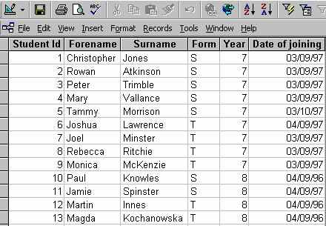
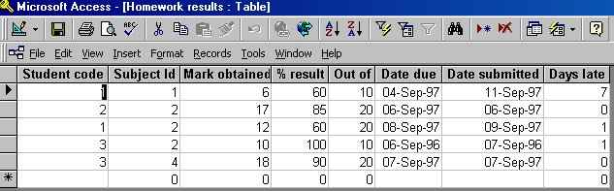
This table, called Homework Results, stores student marks. The Student Code is equivalent to the Student Id. By knowing the Student Id we can find all the homework records for that particular student. The relationship between the two tables is based on the common Student Id field, even though they are slightly differently named.
The first table called Pupils, stores the student records with basic information about the student. Each student has a unique Student Id.
A relational database contains much more than simply records. It may contain several tables, related in some way, as you have seen.

Slide 39
Data coding
Codes take up less space in the memory of the computer and on the disc
Codes are quicker to type in than long names
Less likely to make mistakes typing short codes than long names
NB: Coding is NOT the same thing as encryption!

Slide 40
The difference between coding and encryption
Coding
  Replacing long words and phrases with short ones for storing on computer, eg M/F for Male/Female
Encryption
  A “secret code” which scrambles data for security purposes so that unauthorised people cannot understand it.

Slide 41
Bitmap images
A bit map package, eg Microsoft Paint, produces images out of tiny rectangles (pixels).
If you enlarge the image you can see the pixels.
The program records the image by storing the address and colour of each pixel
Even simple images take up a lot of memory
You can zoom in and edit individual pixels
It is not easy to edit shapes once drawn, as the computer does not store them as shapes

Slide 42
Vector Images
A vector graphics package, eg the drawing facility on Microsoft Word, produces images by storing shapes as mathematical formulas
If you enlarge the image you do not lose the clarity of the image – there are no pixels to see.
The program records the image by storing an equation for every line or shape.
Vector images usually take up a lot less memory than bit maps. The more complex the image the more space it takes up.
It is easy to edit or move shapes once drawn.

Slide 43
Transferring Images and Sounds
Images and sound require large amounts of data.
To reduce download time, the files are usually compressed as
  JPEG (Joint Picture Experts Group) This can compress photographs up to one tenth of their original size)
  GIF (Graphics Interchange Format). This is often used for web page components such as buttons
  MPEG (Moving Picture Experts Group) Used for moving pictures. Digital satellite television makes use of such a technique. Compression allows many TV programmes to be sent on the same channel

Slide 44
C2c
Digital Communications Systems

Slide 45
What is a network?
A network is where a number of computers are linked together, usually by cables (although wireless networks using radio signals are becoming common)
There is usually a file server – a main computer holding all the main programs and data
There is usually a printer server – sometimes a computer, sometimes a dedicated “box”, controlling the queues for the printers.

Slide 46
There are TWO types of Networks:
Local Area Networks:
Found in ONE locality (School, Factory etc)
Uses PRIVATE cables

Slide 47
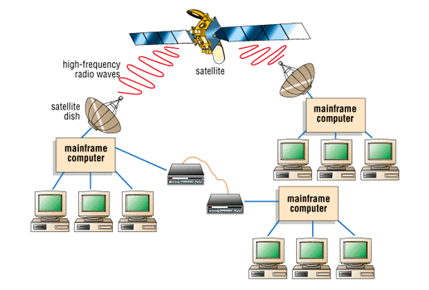
Wide Area Networks:
Large computer systems linked over a wide area.
Using Public Telecommunications links (BT, Mercury etc).

Slide 48
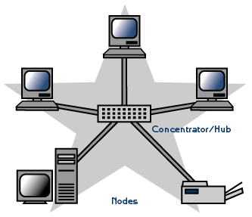
Star Network
Fast communication
A cable break will only affect one computer

Slide 49
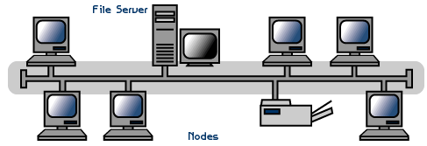
Bus network
Needs less cable than a star
Doesn’t need extra hardware eg hubs, which a star network needs

Slide 50
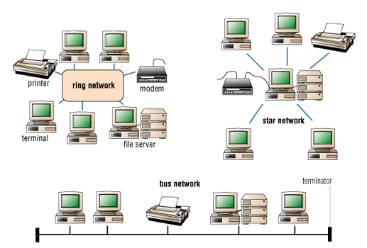
Ring Networks
Needs less cable
Doesn’t need extra hardware eg hubs, which a star network needs
Not as slow as a bus

Slide 51
Advantages of networks
Computers can share data
Computers can share peripheral devices such as printers
You can access your files from any computer
Programs can be updated more quickly – just from one computer, rather than having to go round every computer
You can use electronic mail to communicate with people elsewhere on the network
NB: People often think that it will save money because you only have to buy one copy of the software. This is not true – you still need a licence.

Slide 52
Disadvantages of networks
The cabling and network interface cards (needed for every computer) are expensive. So is the network operating software
You usually have at least one computer – the file server – which can’t be used for anything else
You need much more technical expertise to manage a network
If the file server goes down then no machines can be used
Networked machines run more slowly than stand-alones, especially when the network is busy.

Slide 53
What is the Internet?
Computers all over the world linked together
Links can be ordinary telephone lines, optical cables, satellite links, radio
If you connect to one of these computers you can get information to and from any other one

Slide 54
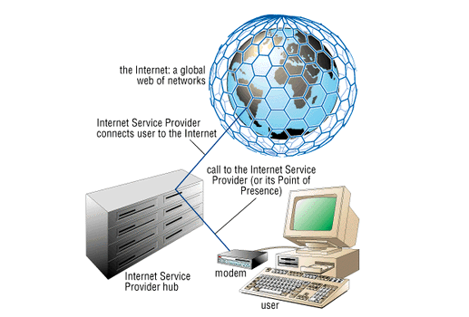
Requirements for connection to the Internet
To use the Internet, you use a Modem and phone line to link to an Internet Service Provider (ISP), such as Freeserve, AOL, BT Internet etc.

Slide 55
The Internet stores the World Wide Web (WWW).
The World Wide Web is made up of Pages which are stored on Servers (ie the large computers that make up the Internet)
You can link to any other page on the WWW using a Hyperlink. Pages that include hyperlinks are called Yypertext.
When pages also include other media (ie sound, moving video, pictures etc) they are called HYPERMEDIA
To allow this to be possible every page in the WWW needs an address so it can be located. This is called its URL (Uniform Resource Locator).
Eg: http://www.ibm.com/homepage.html
(this is http://Servername/webpage name)

Slide 56
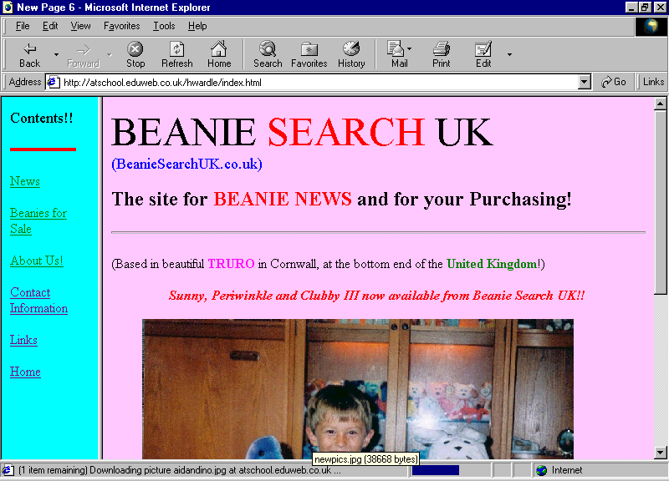
To view pages you need a program called a BROWSER. Internet Explorer is our Browser.
Back & Forward buttons
Search button
URL
Main Title of page
Hyperlinks

Slide 57
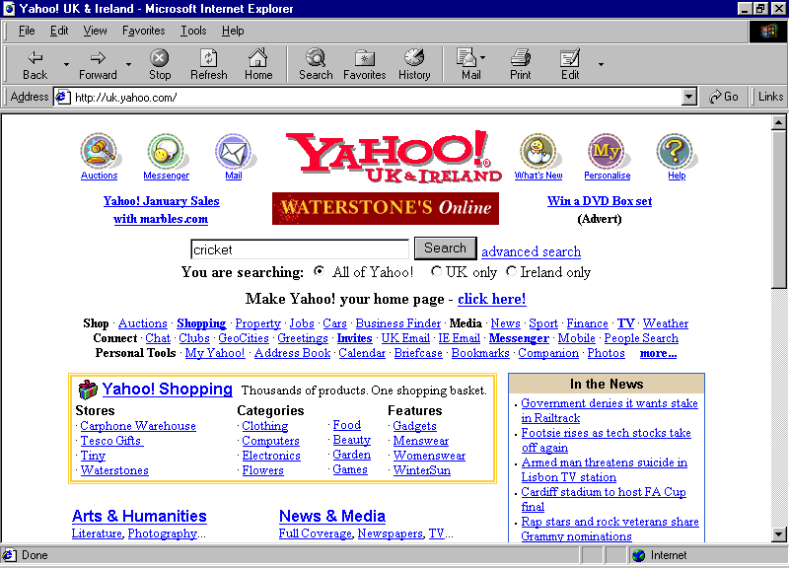
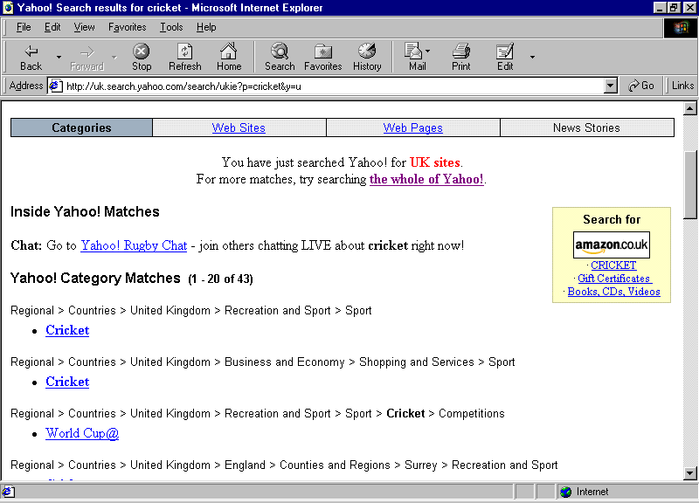
Search Engines are programs which allow you to find pages of a particular topic.
For example, you could use www.yahoo.co.uk to find information about cricket...
You will then be given a list of hyperlinks so you can go to the desired pages.

Slide 58
The main features of the Internet
The World Wide Web – pages of information created by anyone from Universities, professionals, school children…
Electronic mail for communication with other people
Chat, where you can use the keyboard and screen to communicate on-line to other people who are on line at the same time
Bulletin boards where you can leave messages for a wider audience

Slide 59
The main advantages of the Internet
Fast access to a large amount of information on almost any subject
Information is more likely to be up to date than information from other sources
Fast communications with individuals and groups
You can buy goods on-line without leaving the house
Allows people to work from home because they can transfer files and communicate easily

Slide 60
The main disadvantages of the Internet
Cost – you need a modem, a subscription to an Internet Service Provider (although there are many free ISP’s now) and the cost of telephone calls
Since anyone can put information there you cannot always rely on the accuracy of the information you find
E-mail can be intercepted by hackers
Viruses can be transmitted through attachments to e-mails
There is a lot of undesirable material on the WWW, especially pornographic and extreme political propaganda

Slide 61
What is a modem? Why is it needed?
Converts digital signals from a computer into analogue sounds that travel down telephone lines, and converts sounds from telephone lines to digital signals.
Necessary so that digital computers can use analogue telephone lines to transmit and receive data.

Slide 62
Intranet,WWW
Intranet: a group of computers within an organisation configured to communicate with each other.
The World Wide Web is part of the Internet

Slide 63
Advantages of an Intranet
A major advantage of having an intranet is that once the information is uploaded it can be viewed by everybody within the organisation at any time
Communications will improve within an organisation which in turn will improve employee’s view of the organisation’s vision and strategies

Slide 64
Mobile Phone Technology
Use radio frequency to transmit data
WAP (Wireless Applications Protocol) enable mobile phones can be used to access the Internet
WAP is a communication protocol – used to access network services and information using mobile devices
Micro browsers are used to display information
WAP phones can be used to
  View train timetables
  View traffic information
  Check weather conditions
  Send and receive email
  Look up sports results

Slide 65
Mobile Phone Technology
Communication using a mobile phone can be made via a voice telephone call or by using SMS (Short Message Service) – text messaging facility associated with a mobile phone
Many phone can be used to take digital photographs or short movies
Email can be sent through SMS through a gateway, which converts the SMS to email format

Slide 66
Electronic Mail
Where messages are sent from one computer to another.
After typing the message it is saved on the users computer,
then sent, usually using a modem and telephone line, to the users Internet Service Provider.
It is then sent, via other computers if necessary, to the Internet Service Provider of the person the message is for.
The message stays here until that person next connects to the Internet, then when they check their mail they are told that they have a message and it is sent to their computer where it is saved and displayed on a screen.

Slide 67
The main advantages of e-mail over traditional forms of communication
Advantages over post – immediate, don’t have to leave the house to send, cheaper – only the cost of a local phone call
Advantages over telephone – the recipient doesn’t have to be in, messages are received in writing so avoids confusion, diagrams and files can be sent as well as text, cheaper than long conversations or long distance calls
Fax – can send files as well as paper based information. Fax machines can be engaged, e-mails are sent straight away

Slide 68
Video Conferencing
Where a number of people log onto a particular computer or web site at the same time. Whatever one types is seen on all the other people’s screens. Often you can have sound and pictures too by using digital cameras and microphones.
People don’t waste time and money travelling, organisations don’t have to hire meeting rooms. Conferences can be arranged quickly.

Slide 69
Equipment needed for Video Conferencing
A video camera or webcam to transmit pictures
A microphone and sound system to transmit and receive sound
A screen to view other participants
A high bandwidth telecommunications line
Video conferencing software

Slide 70
Electronic Commerce
It is the use of technology for conducting business over the Internet. Referred to as B2B (business to business).
Never sleeps. Goods and services can be purchased online 24 hours a day.
One of the fastest growing industries on the Internet is the music business, downloadable MP3 files, CDs, or good old-fashioned sheet music.

Slide 71
The Telephone Network in Computing
PSTN – public switched telephone network
PSDN – public switched data network
ISDN – integrated services digital network
ADSL – Asymmetric digital subscriber line

Slide 72
Bandwith and Connection Types
Connection Type |  | Features
PSTN | Public Service Telephone Network | Uses the traditional telephone system to allow access to WANs and the internet. Low bandwidth 28kbps (Kilobits per second) up to 56 kbps. Dial up connection
ADSL | Asymmetric Digital Subscriber Line ADSL provides high bandwidth known as broadband. | Transmits digital information at high bandwidth down a copper telephone cable. It is permanently switched on; there is no need to dial up. Telephone or fax messages can be received or made while the user is online. ADSL provides high speed internet access; up to 1mb per second.
ISDN | Integrated services digital network | Called integrated services because many applications can be supported, for example video conferencing, fax, voice application. High speed digital communication line with bandwidth up to 128kbps. There are two channels for data transfer. An ISDN adapter is required to translate data between the computer and the telecommunication line. Users must dial up to connect to the internet.

Slide 73
Bandwith and Connection Types
Connection Type |  | Features
Fibre optic cable | Complete fibre optic cable, made up of a number of single optical fibres | Fibres of glass used to carry signals (which can be voice data or computer data) as pulses of light. Very high bandwidth. Lighter and thinner than copper cabling. Immune to interference by radio signals etc. and so is more secure. They are expensive. Specialised skills required to join cables together. Used to connect telephone substations.
Cable |  | Users who subscribe to a cable TV company such as NTL can connect to the internet using their cable connection. A cable modem is also required to connect to the internet.
Satellite |  | Computer connects tot the internet and receives and sends information via a satellite dish. Useful in rural areas where the telephone system is not up to date and where there is no cable TV available. Satellite connection is expensive. Users must purchase a satellite dish.
Wireless |  | Currently being provided by mobile phones companies using either WAP technology or a device which is plugged into a laptop to enable it to dial up and connect to the internet. No cables required and users can connect from anywhere in the world. Expensive to use, dial - up calls are charged per minute.

Slide 74
Communication protocols
Computers which communicate with each other must send and receive data using the same format and method – they must speak the same language and use rules for transmitting data and the computer.
There are many different communication protocols
  TCP/IP (Transmission Control Protocol/Internet Protocol) which makes sure that data is not lost as it travels from one computer to another. The protocol used to transmit data around a school network may be different. If your computer is connected to the Internet then the computers must be able to understand the TCP/IP protocol. The router used to connect the two networks together will perform a translation function and allow computers of differing protocols to communicate
Protocols are needed to make sure that data is not lost and that computers can send and receive data successfully. If every computer tried to transmit data in a different way, no data would ever reach its destination of if it did, the receiving computer would not understand it

Slide 75
Digital v Film Cameras
Digital Cameras
Expensive to buy
Photos can be downloaded to PC – edited, manipulated using a graphic package
Not all photos need to be printed – user can delete unwanted photos
No expensive developing costs – photos printed on a home computer
No waiting to see photos – can be viewed on LCD screen immediately
Quality of photos can vary according to the output device producing them
Photos are generally in jpeg format and can be emailed or placed into other documents
Conventional Cameras
Cheaper to buy
Only hardcopy o f photograph is produced
All photos in the film have to be printed – wasteful and expensive if the photos are not of good quality
The film from the camera has to be taken to a specialist so that photos can be printed.
The photographer has to wait until photos are developed before viewing them
Photos produced are of high quality
Hardcopy of the photos have to be scanned if they are used in digital documents

Slide 76
Teleconferencing
Teleconferencing allows people in different locations to talk to each other as a group. This is also known as an Audio-conference or simply a 'Conference Call'
It works by each person 'logging on' to the conference call. When you switch on your conference call device and enter your user ID number, an automatic voice saying something like "Mr Jones has joined the conference" is

Slide 77
Teleconferencing
Advantages
This saves on travelling costs and on travelling time. It is very convenient for routine business meetings between distant offices.
Disadvantages
It is sometimes difficult to exchange ideas when people cannot see each other face to face.

Slide 78
Broadband
Broadband is the name given to a data communication channel that has a wide bandwidth and can carry a large quantity of data. Many UK schools are now connected to the Internet using a broadband connection with typical data speeds of 2Mbps. This connection could be by:
  Copper wire using ASDL connections
  Fibre –optic cable
  Microwave links

Slide 79
Digital TV V Analog
Conventional TV is transmitted using analogue signals
Digital signals are used to transmit digital TV channels – digital signal is decoded so that normal TV shows the images and sounds – done by using a decoding box – eg Sky

Slide 80
Digital V Analogue TV
Digital TV signals can be compressed easier than analogue signals; therefore the amount of data which can be sent on a digital signal is much greater
Digital communications lines can transmit and receive data; therefore digital TV can be interactive
Analogue TV can suffer interference. Digital TV is less affected by interference, so the digital channel will provide a sharper, clearer picture
Digital TV outputs high quality stereo sound using MPEG technology
More channels are available on digital TV because of the larger bandwidth available
Digital TV allows viewers to look at pictures from different camera angles

Slide 81
Network security
The network must be protected from
  Unauthorised access by users or hackers
  Viruses
  Authorised users who might damage important files
  Unexpected breakdown resulting in the loss of data
  Physical damage
The network must protect
  User data
  The software on the file server
  The resources which are shared by users

Slide 82
Network security
Each user is given a unique user name and password to stop unauthorised users on the network
Users can be given different access rights – in school teachers, pupils have different levels of access called tiered access – protecting the network from damage from its users
File server could have virus protection software installed

Slide 83
Data backup on a LAN
Most network systems use a backup process to make sure there is a copy of the data that can be loaded onto the system if the original data is lost
Backup data is stored on magnetic tape – usually every day, using a different tape.
Backup normally takes place at night as backup activity may slow the network down as it uses system resources.

Slide 84
Data backup on a PC
Users of a standalone PC should also keep regular backups of data files.
Windows XP has a special utility which makes it easy for users to backup data. Users are prompted by a wizard and guided through steps to backup data (Backup or Restore Wizard)
Backups can be made to the existing hard disk or to removable storage medium with suitable capacity, such as CD-ROM or DVD

Slide 85
C2 d
Applications

Slide 86
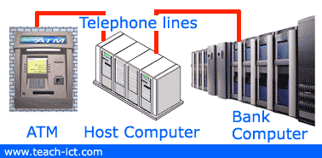
ATMs
Modern ATMs provide customers with their bank account balance, they can issue money, print statements and even take cash deposits. Customers are able to use almost any ATM in any bank, supermarket or garage. And in this country it is normally a free service.
How an ATM works.
Behind the ATM is a host computer that sends the correct messages to the customer’s bank.

Slide 87
What is EFT?
Electronic Funds Transfer (EFT)
EFT is simply automated electronic transfers between bank accounts. Since almost everyone has a bank account, it is the most commonly used method of payment other than using cash.
A lot of payments by EFT take place in shops where customers pay by either debit card or credit card.
This is known sometimes as EFTPOS – Electronic Funds Transfer at Point of Sale.

Slide 88
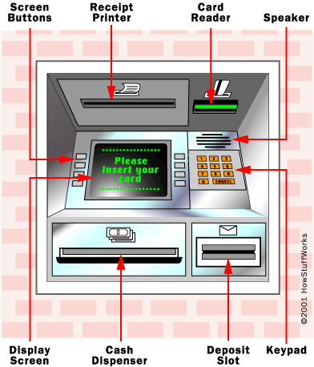
What is an ATM?
You're short on cash, so you walk over to the automated teller machine (ATM), insert your card into the card reader, respond to the prompts on the screen, and within a minute you walk away with your money and a receipt.

Slide 89
Virtual Reality
Virtual Reality (VR) is a computer simulation which allows the user to interact with the system. Special interfaces give the user the feel, sound and view of the virtual system. The user wears a head-mounted display through which the virtual world can be seen .
Examples of the use of VR...
  some surgical techniques can be simulated.
  military conflict situations
  architecture - walk through a building
  design work (CAD)
  games

Slide 90
Data Handling
When it comes to handling input data, there are three main ways of doing it :-
As quick as possible - (real-time) as soon as an input occurs, it is processed. Short delay - (transaction) the processing is delayed slightly to allow the computer to do other things. At another time - (batch) Inputs are stored for a while then they are all processed as one 'batch'. Batch processing may mean every few minutes, hours or days.

Slide 91
Real Time Processing
This approach is used when it is essential that the input request is dealt with quickly enough so as to be able to control an output properly.
Examples
  Traffic lights
  Heart rate monitoring
  Aircraft control
  Computer games

Slide 92
Transaction Processing
Inputs are noted by the computer, but it deals with them after a short delay. It spends that delay handling other inputs and managing data movements.
Examples
  Booking pop-concert tickets
  Ordering books online
  Handling bank accounts

Slide 93
Batch Processing
It is often not desirable to deal with the inputs until a certain number have occurred or a set time has passed. So they are stored until the system comes online to process the data in one 'batch'.
Batch processing is usually fully automatic unlike 'real-time' or transaction processing which are interactive.
For example
  A stock control programme may store records of every item sold in a shop that day. Then, at the end of each day it calculates what needs to be ordered.
  An online competition stores all the entries until it is time to find the winner.
  Electricity, gas and telephone bills are usually calculated on a monthly basis.

Slide 94
Swipe Card V Smart Card
Swipe Cards
Cards which have a magnetic strip containing simple information such as an account number.
Examples of swipe cards are debit cards, credit cards, store cards, door passes etc. A recent development of the swipe card has been the Smart Card.
Smart Cards
A smart card looks like an ordinary credit card, but stores information on a microchip embedded in the card.
The latest innovation is a multi-function smart card that is embedded with an all-powerful micro-chip which empowers one card to cope with the different methods we use to pay for our everyday goods and services.

Slide 95
EPOS
EPOS stands for Electronic Point of Sale. This is a general name for the computerised tills that you see in shops and supermarkets.
EFTPOS stands for Electronic Funds Transfer at Point of Sale. This is where customers can pay for goods using credit or debit cards.

Slide 96
How an EPOS system works:
A product's bar code is scanned by a laser scanner on the till.
The computer system finds the current price in its database.
The price is sent back to the till which adds it to the current sale.
The till prints an itemised receipt.
The computer reduces the recorded stock by one.
If an item's stock falls below a pre-set "reorder level", an order for more stock is sent to the warehouse or supplier.
EPOS systems can be linked to loyalty card databases or analysis software to help shops predict trends in sales and more effectively order items in the future.

Slide 97
On line Service for a Business
Advantages
Worldwide client access
Communicate with customers immediately
Advertise new products
New clients can be found without the need for employing salespeople
Update product information frequently
Quick and cheap method of market research on customer views
Assess the impact of the Internet by using a count of who visits the site
Disadvantages
Lack of human interaction between employees can lead to isolation
Modern technology can be expensive to purchase and maintain for a business

Slide 98
Online services for a customer
Advantages
Home PCs now Internet ready – cheap calls
A range of product reviews can be obtained before you decide to make a purchase
Goods are normally cheaper than buying on the high street – free delivery on a certain amount
Goods can be bought from anywhere in the world
Search engines can assist the user to precisely locate what they need
Multimedia format of the Internet makes it attractive and easier for customers to use
Email can be used to request more information
Disadvantages
No guarantee the information on the website is accurate or up to date
Large amount of undesirable material such as pornography is readily available
Large telephone bills can result if Internet is used during peak hours
Excessive use of the Internet could result in a lack of interaction with others – a decline in social skills
Going online runs the risk of hackers gaining access to your personal details or downloading a virus onto your hard drive
Many customers are worried about credit card fraud when buying goods

Slide 99
The main features of a spreadsheet package
Ability to create formulas,
format numbers as currency, to different decimal places etc,
create graphs,
sort,
lock cells,
colour and outline cells…

Slide 100
Computer Modelling
Computer modelling is using a computer to represent a real situation
Flight simulators
Financial modelling – using spreadsheets
Modelling the weather to create predictions
Computer Aided Design – modelling designs

Slide 101
Why computer modelling is used.
Elements can be changed and the effects of these changes can be found
It is often much less expensive than building real models (eg bridges, vehicles)
Effects of changes can be seen much more quickly than building lots of real models
It is often much too dangerous to try out the real thing (eg flight simulators

Slide 102
Computer Control
Where a computer / processor controls some external device, eg a motor, light, sound.
Automatic control – no need for human intervention,
More accurate than people,
More consistent than people,
Can work where it would be dangerous for people…

Slide 103
Data Logging
Use of sensors with computers to measure things, eg in Science experiments or in weather monitoring.
Can measure more accurately, over very long or very short periods of time,
Can convert data automatically to graphs,
People can do other jobs whilst the data is being automatically logged,
Data can be automatically imported into spreadsheets for analysis

Slide 104
Sensors
Temperature – for measuring temperature changes in a science experiment
pH – for measuring pollution in rivers
Sound – for monitoring sound levels in a factory
Pressure – put under mats in a home security system
Passive Infra Red (PIR) – for detecting movement in a security system
Light – for detecting when a robot is approaching an obstacle

Slide 105
Sensors
Reed switch / Magnetic switch (sometimes called a proximity sensor) – comes in two parts. Put one part on a door and the other in the frame, will detect when the door is closed
Angle sensor – detects how far round a robot arm has moved
Vibration sensor – put on windows in a security system to detect if someone is trying to break the window

Slide 106
Computer Control
The output from a computer may be in the form of a signal to a hardware device. In a control system, sensors are used to measure a physical quantity and send input to the controlling computer.
The computer responds by sending an output signal to a control interface which activates various devices eg a switch or an alarm.
The output signal may be sent a to an actuator which activates a mechanical device such as a motor.

Slide 107
Analogue and Digital Data
Analogue data is continuously changing, eg sound, light, temperature… Most measurements in the real world are analogue.
Digital data goes up and down in separate steps, eg a lap counter, a light switch. Computers use digital data

Slide 108
Feedback
Where input from sensors is used to change output in a control program
  eg in a heating system information from temperature sensors is used by the computer to decide when to turn heaters on and off. The heaters change the temperature which then affects the next readings of the sensors – a feedback loop
Sensors
Processor
Output device

Slide 109
Data security
Use of passwords
Locking machines away
Not saving on networks or hard discs, only on removable discs that are locked away
Use of encryption

Slide 110
Computer Aided Learning CAL
Maths program (such as our ILS or Maths Blaster) where the program asks questions, the child answers and the computer says whether it is right or not. The computer then gives new questions of different difficulty according to whether or not the child got previous answers right or wrong.
Most children find this more interesting and concentrate for longer
Feedback is immediate so children don’t spend a whole lesson doing something the wrong way
Children can work at their own pace
Work is always at the right level for individual children
Teachers can get automatic reports of what children have done and where they are having problems

Slide 111
C3

Slide 112
Impact of ICT on employment
The introduction of information technology has caused some unemployment, for example:
Computer-controlled warehouses need only a handful of staff to operate them.
Computer-controlled robots are now common on production lines, replacing human workers.
The old skills of workers in the printing industry are now out-of-date.
Some jobs have disappeared as they can now be done automatically e.g. checking football pools coupons, marking multiple choice exam papers.
However, it is fair to say that the development of information technology has led to many new jobs such as computer technicians, programmers, web designers and systems analysts.

Slide 113
Impact of ICT on employment
IT is more likely to have changed someone's work rather than led to them losing their job. This probably meant that people have had to be retrained to use modern technology:
Secretaries now use word-processors and not typewriters.
Travel agents book holidays by computer, not by phone or letter.
Telephone banking has meant that many bank staff now work by phone in front of a computer, instead of being behind a counter.
De-skilling has taken place. Some jobs which needed a high level of skill in the past can now be done more easily. For example, print workers today can use DTP software to lay out their work.
Designers now use CAD software rather than pencil and paper on a drawing board.

Slide 114
Better quality products
Products made with computers should be of a better quality than before. For example, car bodies are welded more accurately by robots than by humans.
Robots don't get tired so the quality of work is consistent.
Machines controlled by computer are more reliable than those controlled by humans.
Miniaturisation - many electrical items, such as mobile phones and video cameras, have become much smaller due to developments in technology.

Slide 115
Effects of E-commerce
Shops, banks, travel and entertainment companies have adapted to the Internet by developing websites that often do parallel business to their shops based in the high street. They can sometimes offer a discount for ordering online as it reduces their costs.
The many effects of E-commerce include:
Distances are reduced. People can find even specialist shops in their living rooms on the computer.
Isolation is reduced. Banking and other services that used to be concentrated in the town are now available wherever an Internet connection is available.
Competition is encouraged. The Internet allows people to research their shopping or other needs very thoroughly, checking prices and product details.
Job availability. E commerce can take business away from local shops and businesses and so affects the availability of jobs. But many companies have also started and developed based on E-commerce alone. Others have developed it as a response to competition.
Increased convenience. For consumers buying on the Internet has become convenient and safe.
Increased dependence on the Internet. Now, both for companies and individuals, there is pressure to have Internet access to do everyday things such as submit orders or look up details in a catalogue. There are initiatives to make as many services available on the Internet as possible, including E-government, where government departments such as the Inland Revenue can be dealt with using secure websites.

Slide 116
IT in everyday life
We have more automatic devices in the home
We have more leisure time because of these devices
We have more devices such as videos, games, for home entertainment
We can communicate with people in other places much more easily
We have access to much more information, quickly and easily
More people are able to work from home
Many people have had to be retrained as their jobs have changed

Slide 117
IT in everyday life
Some people have lost their jobs in traditional manufacturing industries, largely because of the use of robots
Some industries have almost died out, like traditional watch making
Many people are now employed in call centres
Contd…

Slide 118
How IT changed peoples lives
Some people have lost their jobs in banks as “holes in the wall” (Automatic Teller Machines) and on-line banking have become more popular
Some people now have jobs in industries that never existed before, such as IT manufacture, maintenance and support
Many people now have their work monitored much more closely
There are fewer jobs available for people without qualifications
Etc…

Slide 119
Data Protection Act
Personal Data must be gained and processed fairly and lawfully
Personal Data must be accurate and where necessary kept up to date
Personal Data must be kept under adequate security
Personal Data must not be kept longer than necessary
Personal Data must only be used for the purpose registered
Data users must register to say what data they keep, who they pass it on to and what they use it for
Data subjects have the right to see the data kept about them and, if it is wrong, to have it put right.
Personal Data cannot be sent outside the European Union

Slide 120
Who does it apply to?
A Data Subject is anyone who has information about them stored on a computer.
A Data User is anyone who uses or stores data i.e. banks, building societies and most commercial businesses.
The act allows us to find out
    What information is held on us;
    Change or challenge the information;
    Claim compensation for any damage.
The original Act only covered information that was processed electronically i.e. using a computer. Paper files were not covered. However the 1998 Act included manual records (Paper files ) as well.
The Data Commissioner is the person who enforces the Data Protection Act

Slide 121
The main features of a word processing package
Ability to edit text,
print text,
change the format of text (bold, italic, different fonts, colours, sizes,
change line length,
centre text,
add headers and footers,
add tables…

Slide 122
The Computer Misuse Act
The Computer Misuse Act covers three essential areas:
  Hacking
  Virus Distribution
  Fraud
These are listed more accurately in the Act as:
Unauthorised access to computer material.
Unauthorised access with intent to commit or facilitate commission of further offences.
Unauthorised modification of computer material.

Slide 123
Hackers
Individuals who gain unauthorized access to computer systems for the purpose of stealing and corrupting data

Slide 124
Viruses
A program written to disrupt the way a computer works, it copies itself.
Some can be very harmful, wiping hard disc, deleting important lines from programs, making text “drop off” the screen.
Some are not harmful but just irritating, putting messages on the screen etc.

Slide 125
Virus Detection
You can detect a virus if strange things start happening on your computer,
or (better) by regularly running an anti-virus program.
You can prevent viruses by checking all floppy discs and files imported from networks or the internet using an anti-virus program,
or by not using floppy discs, not connecting to a network and not downloading files from the Internet.

Slide 126
How Computers can affect your Health
Headaches
use a screen filter, have blinds and diffused lighting to avoid glare.
Backache
use an adjustable chair, footrest, desk of the correct height
Repetitive Strain Injury (RSI)
use a tilted keyboard, wrist rests, take a 10 minute break every two hours (this can help prevent any injury)

Slide 127
The main features of a DTP package
Ability to mix text and graphics on a page,
to add borders,
to move objects,
to rotate and flip objects,
to print documents as booklets,
preset templates…

Slide 128
The main features of a database package
Ability to set fields,
set validation,
sort,
search (simple and complex),
create graphs

Slide 129
The main features of a graphics package
Ability to draw shapes,
freehand draw,
fill with colours,
enlarge,
rotate shapes,
add text…

Slide 130
CAD - The main advantages of using CAD rather than drawing by hand
Computer Aided Design – drawing accurate plans and designs.
Able to copy parts of a diagram to other places quickly and easily,
easy to alter parts without starting again,
can use a library of pre-drawn designs,
can view designs from different angles,
can change things and see the effect…

