Slide 1
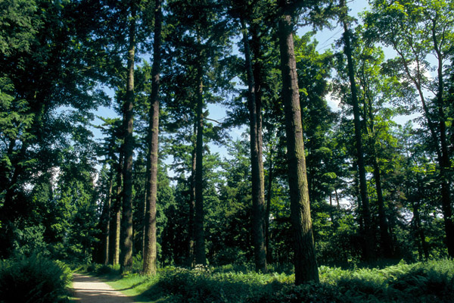
Coniferous Forest Biome
"The clearest way into the universe
is through a forest wilderness." - John Muir

Slide 2
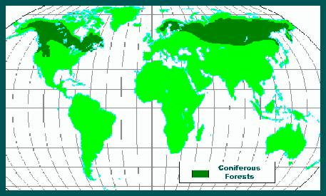
Location
The coniferous forest biome is south of the Arctic tundra. It stretches from Alaska straight across North America to the Atlantic Ocean and across Eurasia.
The largest stretch of coniferous forest in the world, circling the earth in the Northern Hemisphere, is called the “taiga.”
It supplies the bulk of the world's commercial softwood timber, which is used to make paper.

Slide 3
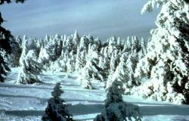
Climate
Long cold winters (average temperature -15oC) with extreme temps (-30oC).
Short summers with long days – short growing season (3 months).
Low precipitation (500mm) cold air unable to hold much water vapour. Winter snowfall melts only in spring.

Slide 4
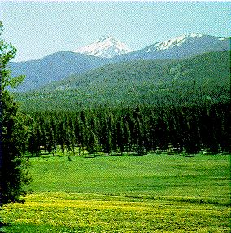
Tree Adaptation
Coniferous forests often cover mountainsides.
Trees are tall and narrow, so snow will slide off the branches without breaking them.
The trees grow close together for protection from the wind.
They also have thick bark, which resists damage from low-heat summer fires.

Slide 5
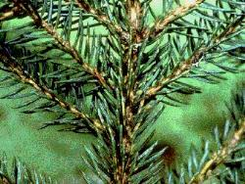
Tree adaptation
Trees that produce their seeds in cones, such as pine or fir trees, dominate the Coniferous forest.
These trees often have shallow roots that spread out widely to take advantage of the moisture in the upper levels of the ground, which only thaws occasionally.
They are also shallow because of the poor soil and rocky conditions.
Trees have pine needles instead of broad leaves. They are an important adaptation due to the climate. Pine needles contain very little sap, so freezing is not much of a problem.
Being dark in colour they absorb what little light falls on their surfaces.

Slide 6
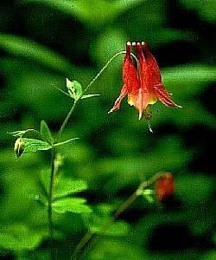
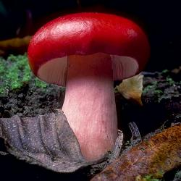
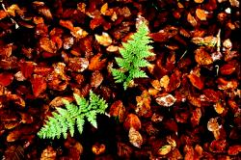
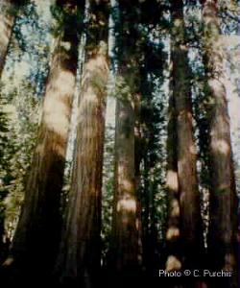
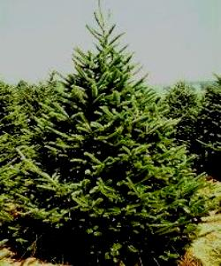
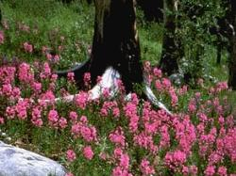

Slide 7
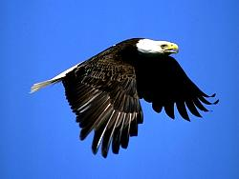
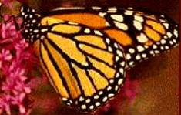
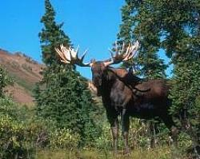
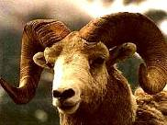
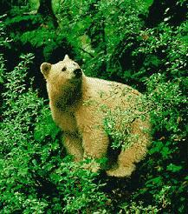
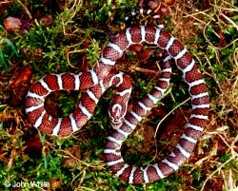
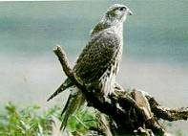
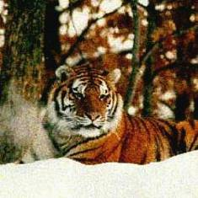
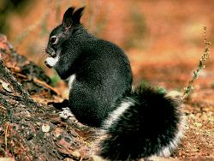
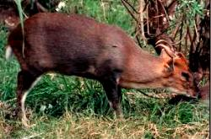

Slide 8
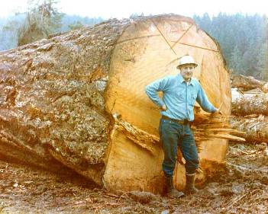
Human Use
The forests are very productive because of large biomass.
Most forests are commercially managed.
Tall straight trunks provide excellent softwood planks for the building industry.
Softwood provides wood pulp for the paper industry.

Slide 9
Recap Questions
Where can the coniferous forest biome be found?
What is the coldest temperature in the winter?
What is meant by the growing season?
How do you think bears are adapted to living in this biome?
How are trees adapted to the cold climate? Look at the “trees of the cold forest climate” sheet and complete the activities.

Slide 10
What do you think are the threats to the forest?

Slide 11
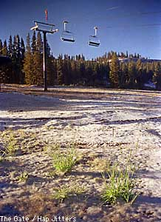
Threats to the Coniferous Forests
Logging is the biggest threat to the Coniferous forest!
Trees are replanted after logging but only of one species of tree which then leads to monocultures and there is no biodiversity.
Deforestation leads to soil erosion and destroys wildlife habitats.
Land is being cleared for ski slopes, landfills, housing, new roads, etc.

Slide 12
In Canada, one acre
of forest is cut every 12.9 seconds!

Slide 13
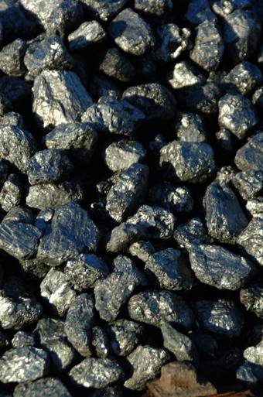
Mining operations are a threat to the Coniferous forests because of the chemicals used in mining and the silt released by mining.

Slide 14
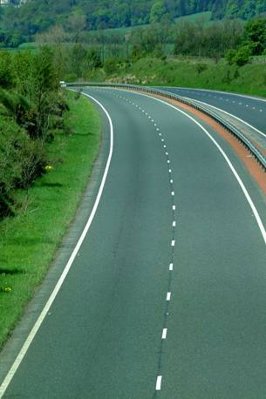
Road construction destroys the forest and also acts as a barrier to wildlife. Roads isolate populations of species from feeding grounds, natural migration routes and limits breeding between larger groups (therefore limiting the gene pool).

Slide 15
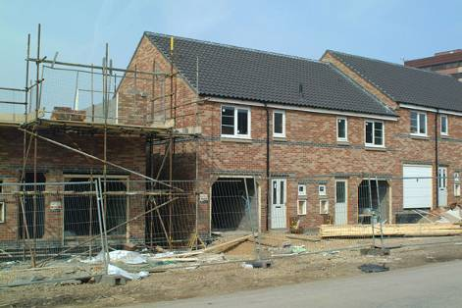
As the Earth's population continues to increase and people continue to move out of the city and into the suburbs, more and more forests will be lost to urbanization.

Slide 16
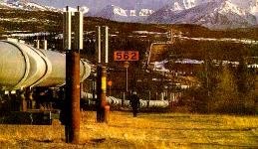
The possibility of extensive oil exploration, drilling, and piping looms like a dark cloud on the Coniferous forests' horizon.

Slide 17
Since the mid-1800s, about 320 billion tons of carbon have been pumped into the atmosphere from the burning of fossil fuels.
The destruction of the world's forests, increases the concentrations of carbon dioxide in the atmosphere by about 25 percent.
It is estimated that a doubling of CO2 in the atmosphere will increase the Earth's temperature by about 3 degrees Celcius by the end of the next century.

Slide 18
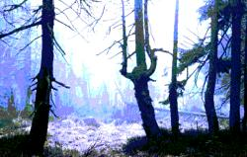
Acid Rain
Over the years, the rain in many areas of the world has become more acid.
These pollutants come from coal burning, power plants and other factories. The trees die and stand like grey skeletons against the sky due to acid rain.

Slide 19
What can you do to help protect the forests?

Slide 20
Things You Can Do To Help
1. Logging should be banned in all Coniferous forests and replaced with eco-forestry methods, including selective logging, which preserve biodiversity. People who live in the worst areas afected can vote for those candidates who will support this.
2. Decrease the use of fossil fuels. Fossil fuels are used in home heating systems. Try doing the following to cut down on your consumption:
turn your thermostat down on your heater so you are not using so much energy.
If you feel cold, put on a sweater or change into warmer clothes. Do no turn up the thermostat!
3. Use public transport more so that plans to start large-scale road building projects are cancelled.

Slide 21
4. Help lessen the demand for paper products and you lessen the need for logging the Coniferous forests. Try doing the following:
Reuse brown paper bags. Use them to line rubbish bins!
Recycle newspapers! Every Sunday, more than 500,000 trees are used to produce 88% of newspapers that are never recycled! Better yet, discontinue home delivery and read the news online!
Send e-cards instead of paper cards to everyone you know who has Internet access!
5. Exhaust from cars is a major source of acid rain. Drive your car less! Ask for a lift from a neighbour so you share a lift or ride the bus!
6. With global warming, summers are getting hotter and dryer. The dry conditions are highly conducive to forest fires. Those forest fires that start as a result of a naturally occurring event (lightning, spontaneous combustion, etc.) can be beneficial. Manmade fires are not. Be careful when camping. Drown all campfires, stir them and drown again. Never throw cigarettes out of car windows!

Slide 22
7. Reduce your use of wood products. Begin doing the following and be sure to start today!
Instead of buying new furniture, recover or refinish what you have, or buy used furniture and recover or refinish it.
Never buy wood cut from old growth forests! Look for the FSC (Forest Stewardship Council) label. It signifies that the wood came from trees grown in well-managed, independently certified forests!
8. Make it your business to know about any proposed drilling, mining, or logging operations for Coniferous forest areas - read newspapers, search the web, watch television programs, attend town meetings. If everyone, worldwide, takes responsibility for their own area, these destructive operations can be held in check!
9. Instead of moving to the suburbs to build a new home, look for an already built home in town and consider remodeling it. This will save wildlife habitat and the wildlife that lives there.

