Slide 1
Introduction to Multimedia
Communicating Information
Notes:
Photo credit: ©2007 JupiterImages Corporation

Slide 2



Learning objectives
Discover how multimedia can make learning more interactive.
Know about the different types of multimedia and their associated devices.
Understand how new devices have made multimedia more accessible.
2 of 10
© Boardworks Ltd 2008

Slide 3

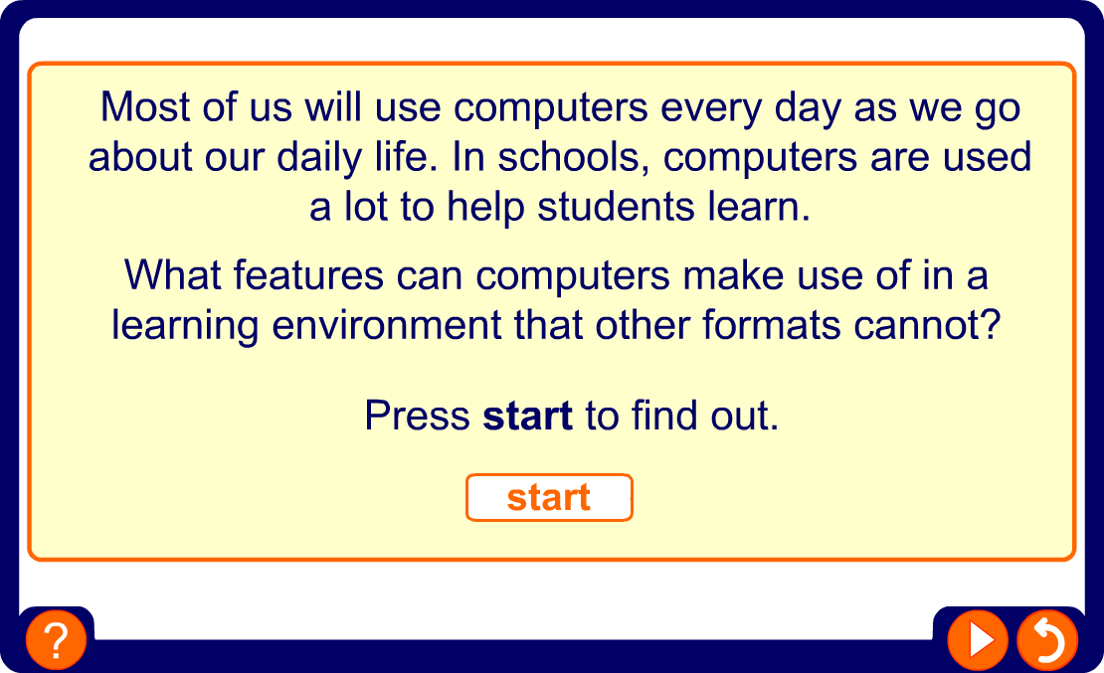
Why use a computer?

Slide 4

Learning to learn
When you learn, you are trying to understand and remember a lot of information.
Multimedia allows you to receive the information in different ways to make learning easier.
Some people learn visually – they like to see things like charts and pictures.
Some people are auditory learners – they like to hear things like speech and sounds.
Some people are kinaesthetic learners – they like to do things like flash activities.
Multimedia can help students learn effectively.
Notes:
Photo credit: ©2007 JupiterImages Corporation

Slide 5
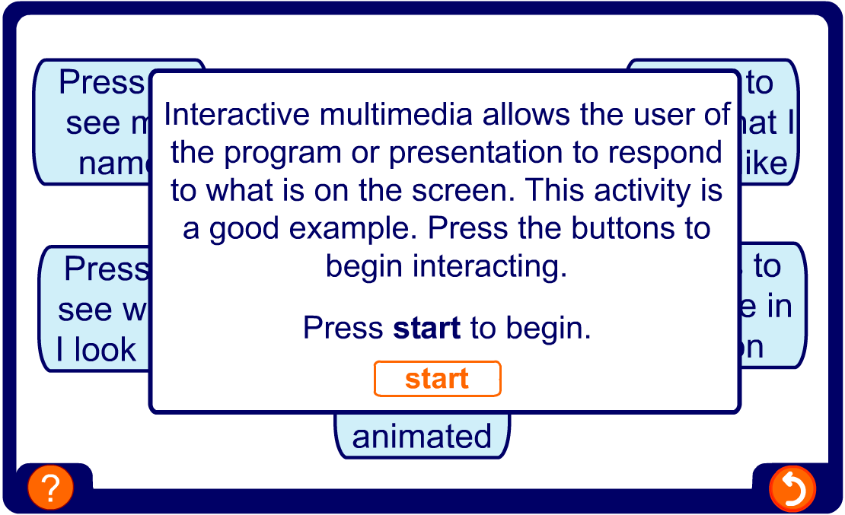
Let’s interact
Let’s interact

Slide 6

Why are we still reading?
If multimedia files are so good, why is there still so much text about?
Text is easy to carry around, you do not need complicated technology to read it.
You control the reading speed.
Text is quite easy to produce.
Text is still a very good way to explain things and is easy to go back and revise from.
Text files don’t take up much memory and are quick to download.
Notes:
Photo credit: ©2007 stockxchange

Slide 7
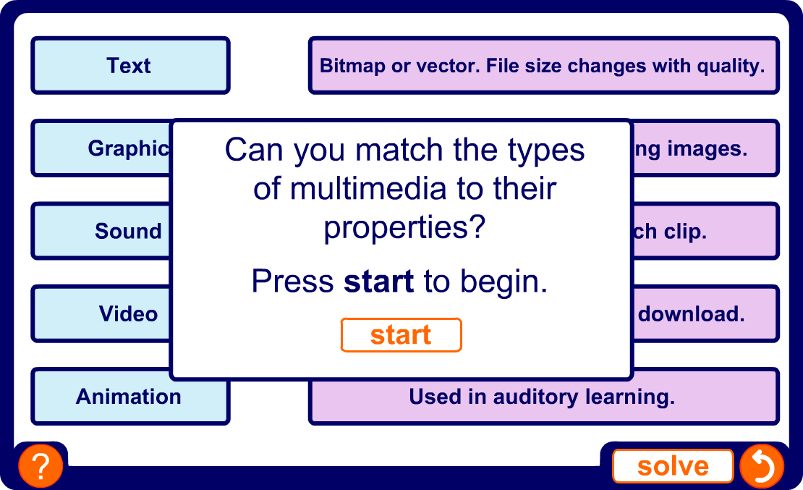
The properties of multimedia

Slide 8
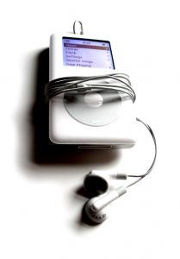
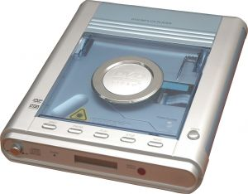
Multimedia on the move
Until recently, the only practical way you could use multimedia was at home on a TV or computer. How things have changed.
MP3 players can carry hundreds of songs in a device the size of your thumb.
MP4 players can stream video from the Internet.
Portable DVD players mean you can watch movies anywhere.
You can download your favourite programme as a podcast and listen on the way to school.
Notes:
Photo credits: ©2007 stockxchange

Slide 9
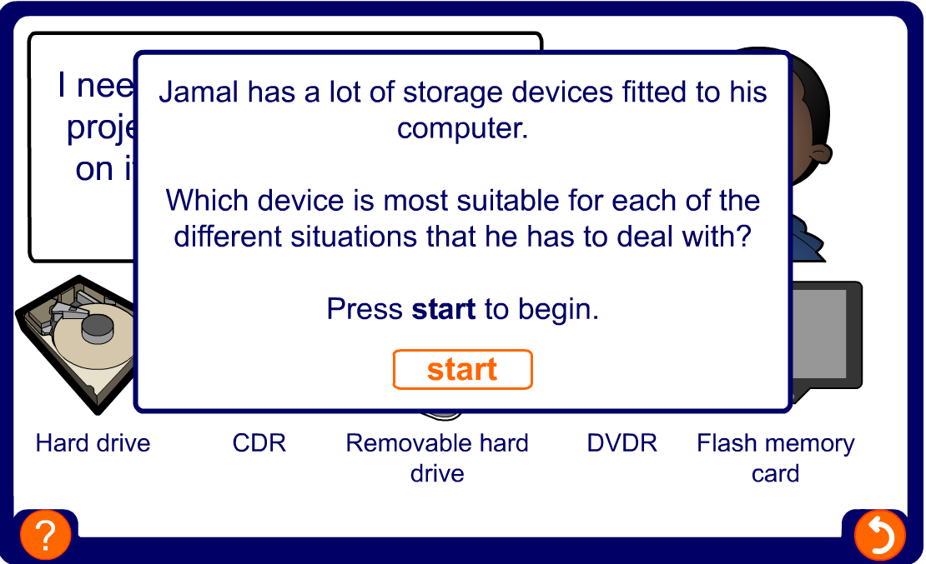
Saving multimedia files

Slide 10
Summary
Multimedia is a combination of text, graphics, sound, animation and video.
It can be used to explain things and make them more interesting.
It can help people with different learning styles.
Multimedia can be captured using a number of different devices.
Media files can be large, so storage needs careful thought.
New playing devices have made multimedia more portable.

