Slide 1
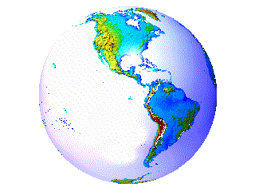
EXTERNAL LANDFORM PROCESSES

Slide 2
Rocks & Landforms
3 influences
  Crust movement = Landform creation (endogenic)
  Rock movement
    Reactions to crustal stresses
    Weak (greatly affected by weathering & erosion)
    Strong (less affected by weathering & erosion)
  Mineral composition of rocks affects soils
    Also affects the degree to which it can be weathered and the type of weathering to which it is most susceptible.

Slide 3
Exogenic Forces
Weathering
Erosion – reaction to the force of gravity overcoming inertia
  Mass wasting
  Moving water
  Moving air
  Moving ice (glaciers)
Deposition – the flip side of erosion

Slide 4
Weathering
Process of breaking rock into pieces
First step in formation of soil
  Chemical weathering,
    Process of breaking down rock by:
      Exposure to air and water
      Acids released by decaying vegetation
      Oxidation
      Leaching
      Decomposition of calcium carbonate
  Mechanical weathering
    Process of rocks breaking down by physical force

Slide 5
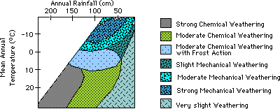
Weathering and Climate
The combinations of temperature and precipitation affect the speed and extent of weathering.

Slide 6
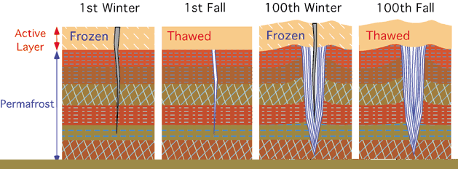
Mechanical Weathering: Ice
Ice contracts as the temperature drops to a point around 4ºF – below that temperature, it begins to expand
This is the same process that prepares streets for potholes in the winter.

Slide 7
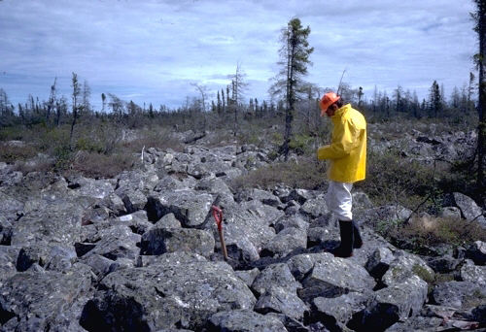
Freezing & Thawing at Work
frost shattered granite bedrock in Manitoba, Canada – similar occurrences in Siberia.

Slide 8
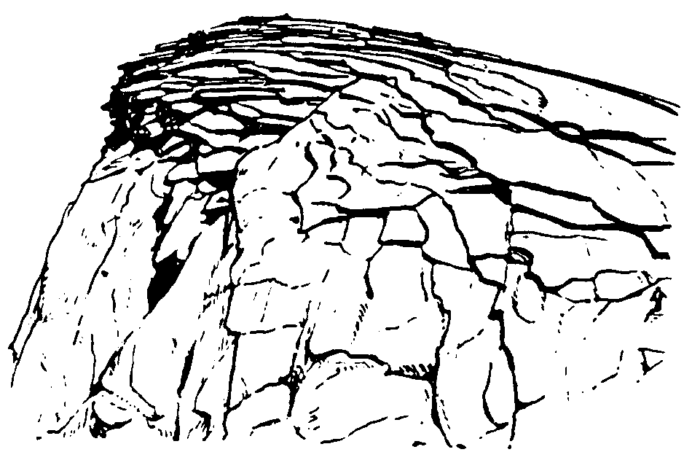
Mechanical Weathering: Exfoliation
Some rock seems to have layers that peel off, hence the name
The surface of the rock expands and contracts more readily and to a greater degree than the interior. This weakens bonds and the surface breaks off.

Slide 9
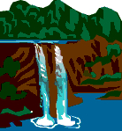
Movement of Weathered Material
Mass movement (Mass wasting)
  Slow gradual movement occurring near the surface, soil creep
  Dramatic movements such as rock slides, landslides and mudflows
Surface erosion
  Caused mostly by rainfall
  Runoff (overland flow)

Slide 10
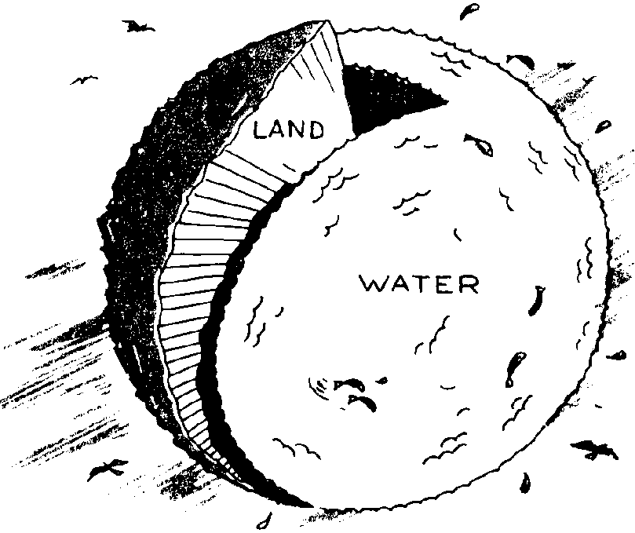
Agents of Erosion and Deposition
Running Water
  Stream Landscapes
    in Humid Areas
    in Arid Areas
Groundwater
Glaciers
Waves and Currents
Wind
Gravity
70%
We live on a water world where water is a very active force

Slide 11
Humans Are the #1 Earth Movers
Source:
Discover
Magazine,
October
2004

Slide 12
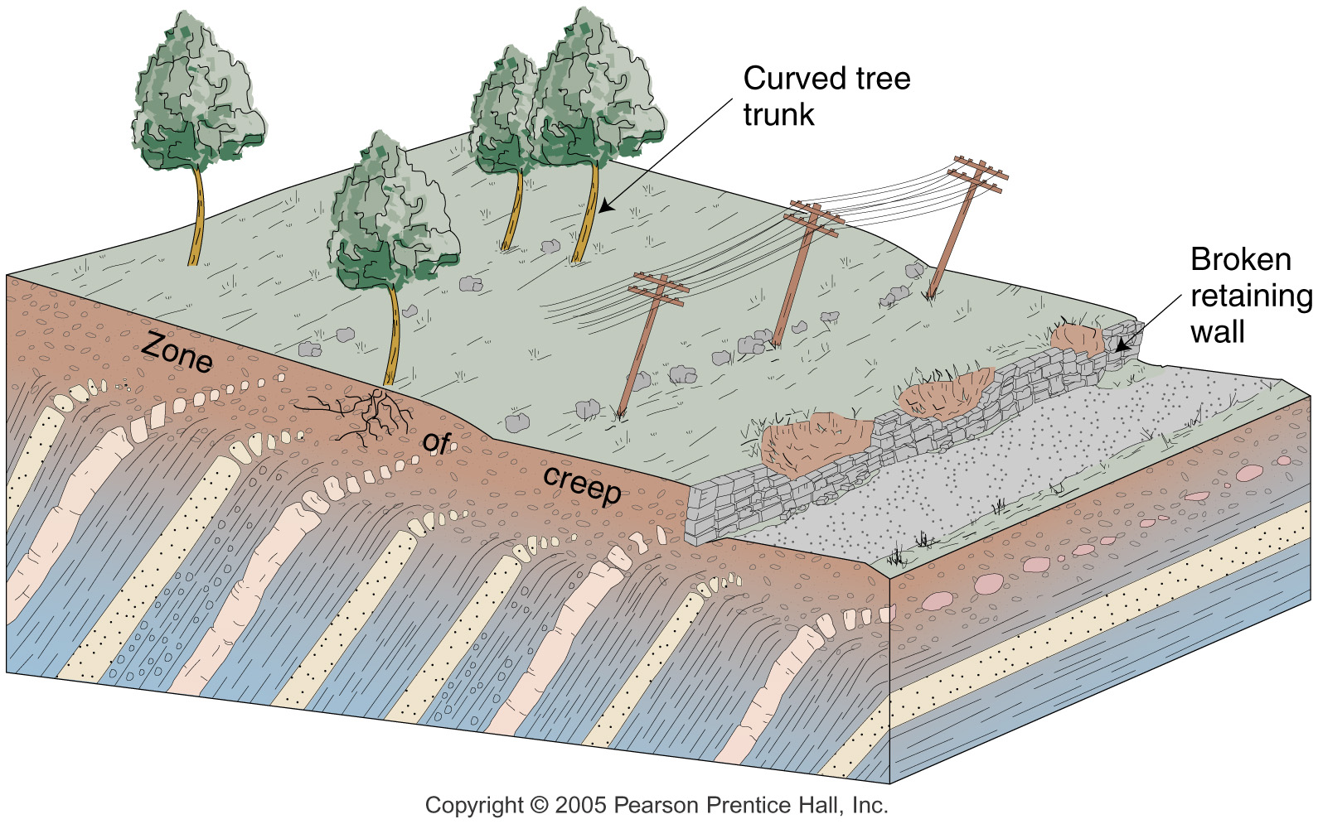
Remember the damaged houses in Black Jack, Missouri in the 1970s?

Slide 13
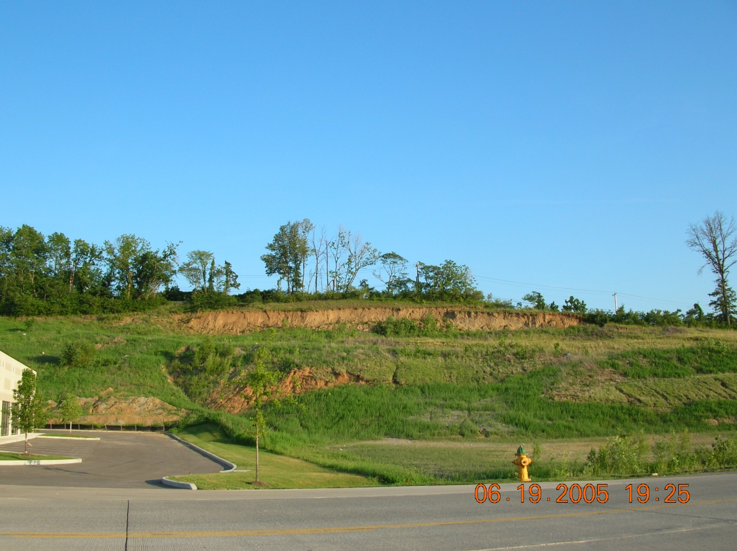
Soil Creep at Missouri Bottoms

Slide 14
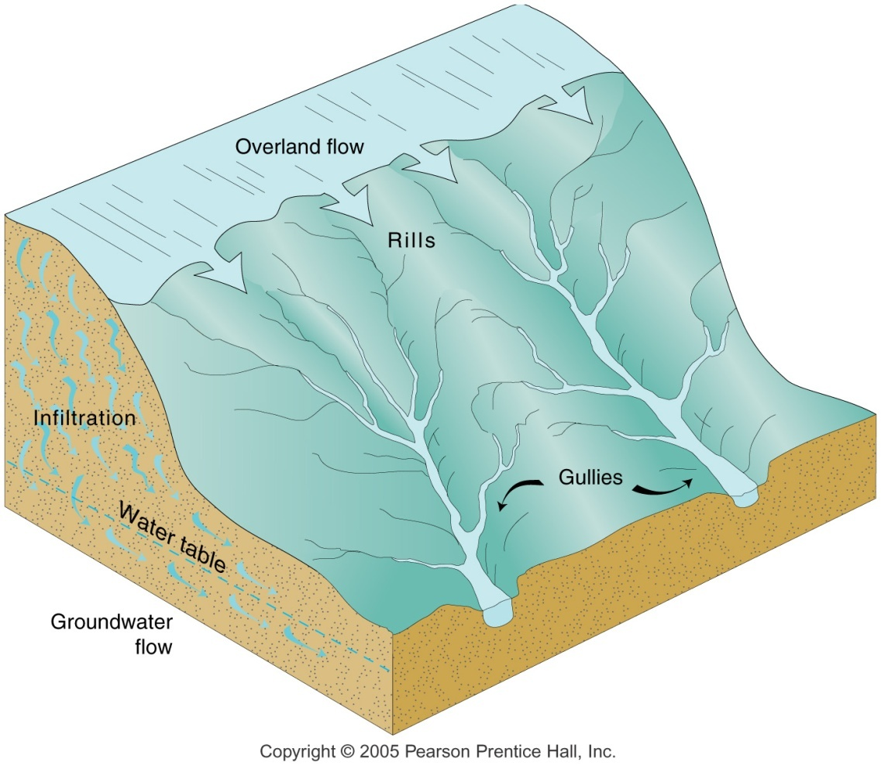
Stream Drainage
2 sources
  Ground water
  Overland flow
Drainage basin
Discharge
  Volume of water
  carried per unit time
Sediment transport
  Movement of material
  l Deposition

Slide 15
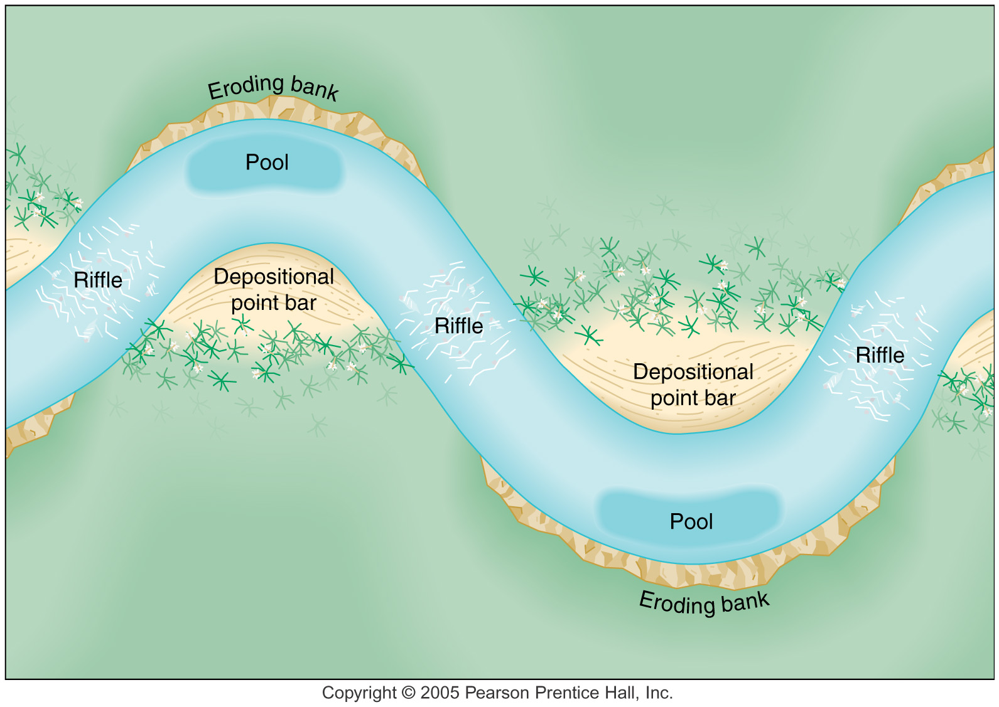

Slide 16
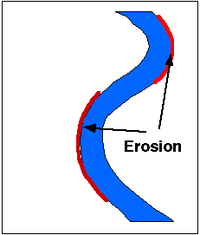
Side-cutting by streams
As the grade becomes less steep (as one approaches the mouth of the stream), side-cutting action becomes more active than down-cutting and the valley widens and the stream meanders.

Slide 17
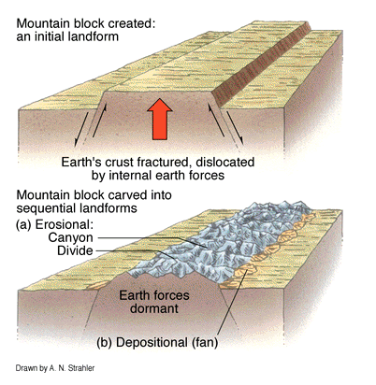
Running Water: Erosion and Deposition
Weathering breaks rock down into smaller pieces which can then be carried away by moving water with sufficient speed and volume.

Slide 18
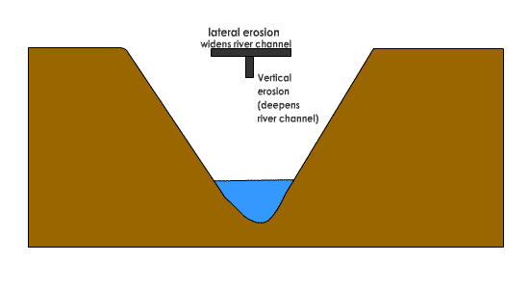
Erosion and stream (valley) formation
Where the slope is steep, the down-cutting action is greatest
Where the slope is slight, the side-cutting action is greatest.

Slide 19
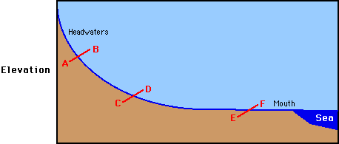
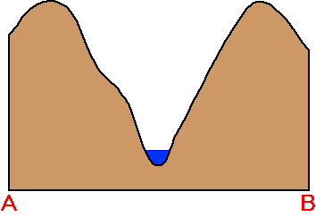
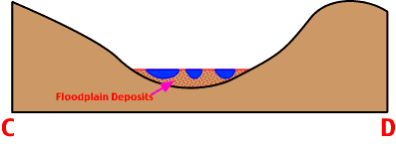
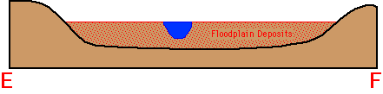
Stages of Stream Development
Youthful – V-shaped – relatively straight course
Mature – U-shaped – moderate meandering & possible braiding
Old Age – wide floodplain – meandering stream and ox-bow lakes

Slide 20
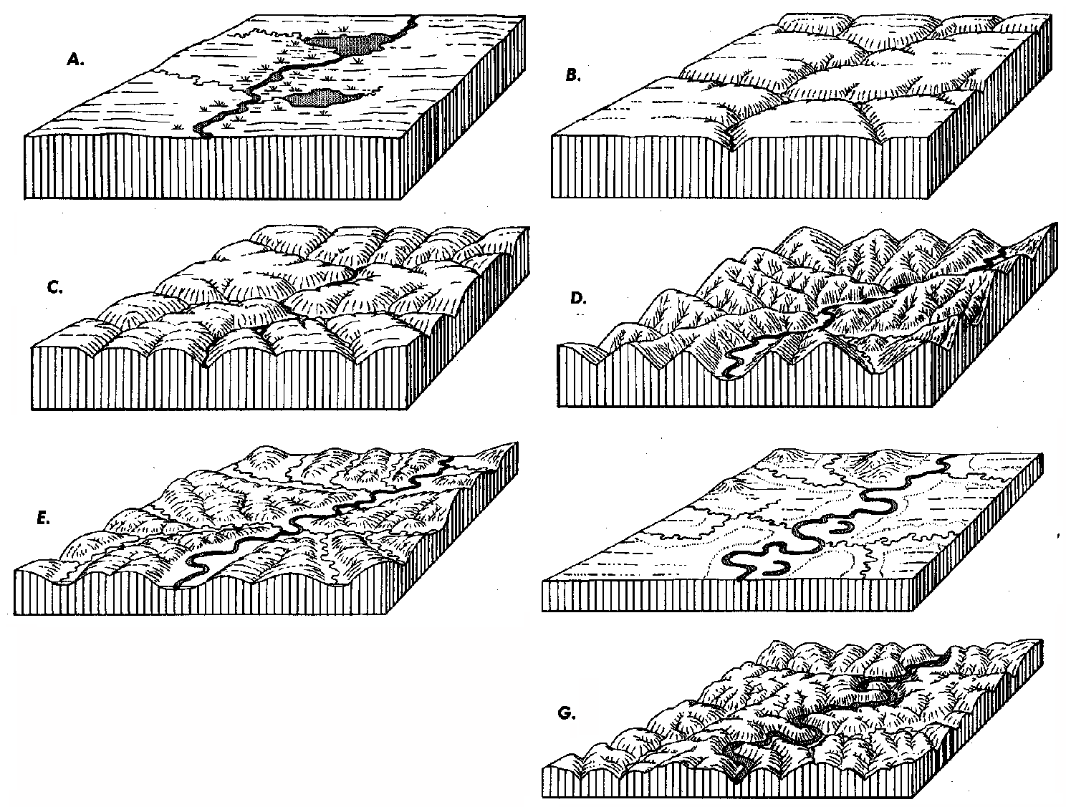
Stream Action in Humid Areas
Cycle of Landmass Denudation

Slide 21
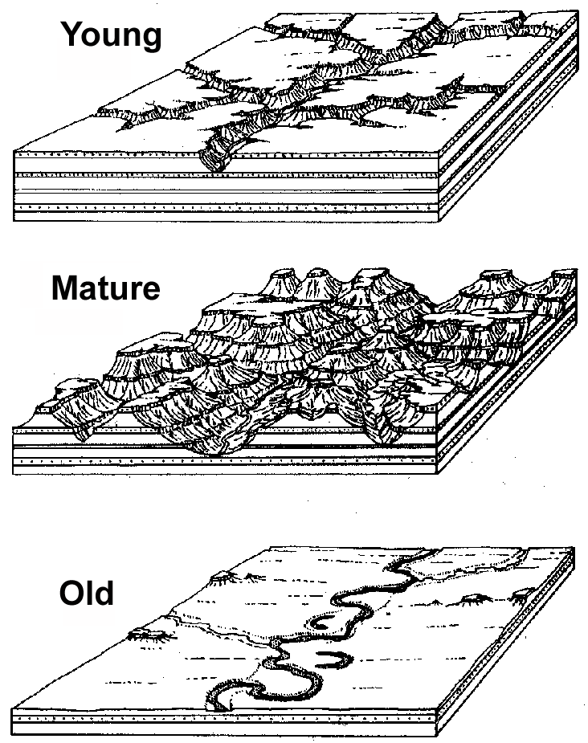
Stream Action in Arid Areas – less rounded and more angular landforms
Moving water is the major erosional and depositional force even in desert areas!

Slide 22
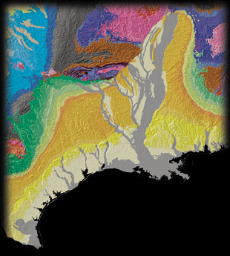
Stream Gradation
Exogenic forces operate to reduce all earth land features to sea level. Click the picture below to see the video

Slide 23
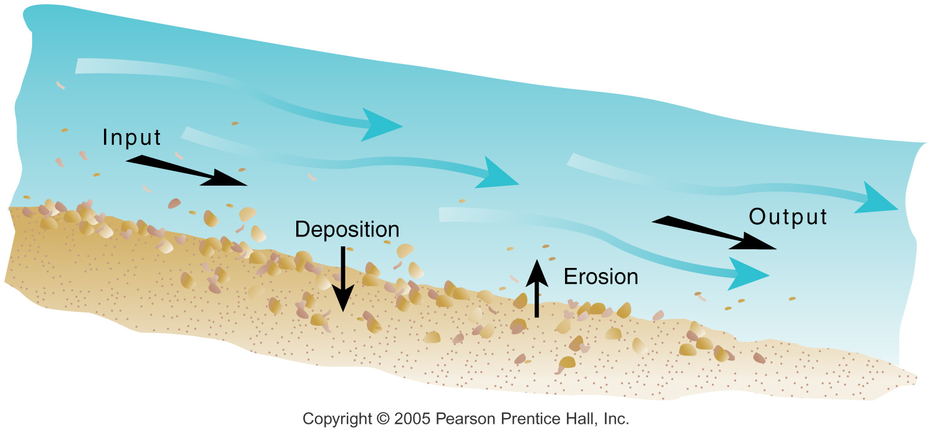

Slide 24
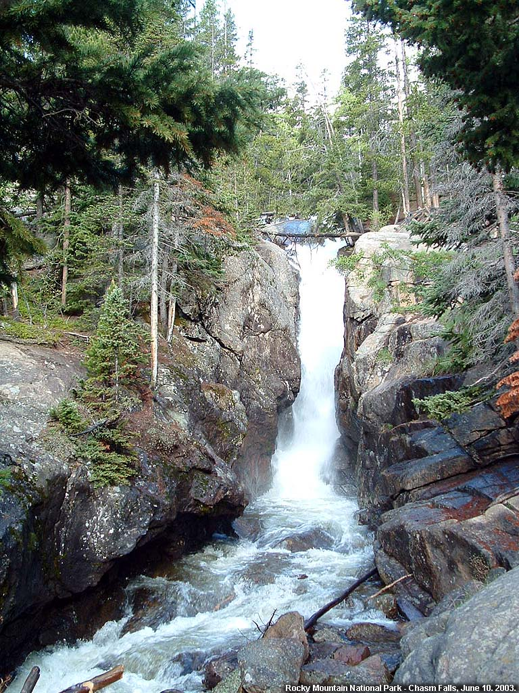
Waterfalls
Click on the picture below to see the video

Slide 25
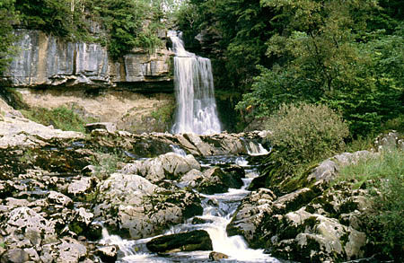
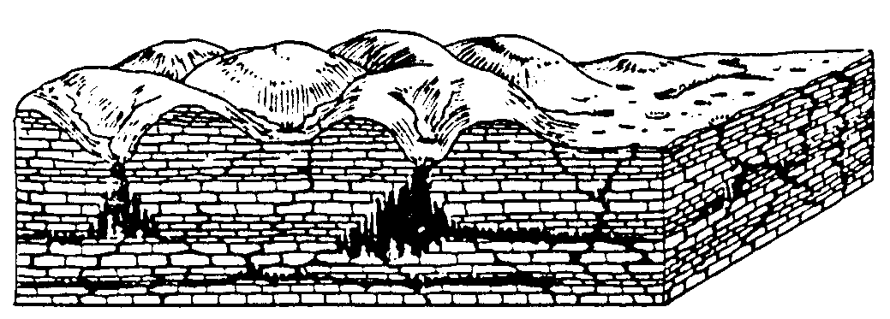
KARST TOPOGRAPHY
This involves the combination of chemical weathering and moving water to create a very unique kind of topography found where there are deep layers of limestone.

Slide 26
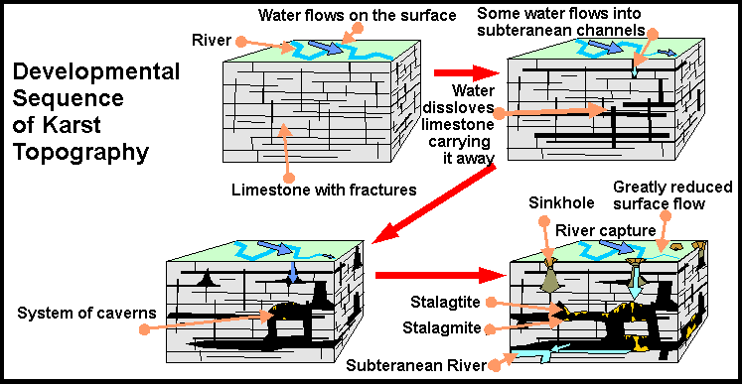
Karst Topography Development
St. Louis, MO, is located in a karst area.

Slide 27
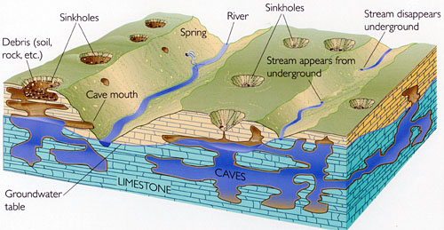
Diagram of Karst Features
When large caverns collapse, large depressions are formed

Slide 28
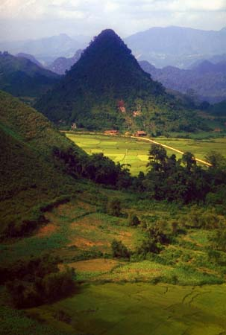
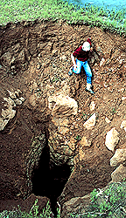
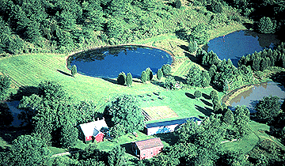
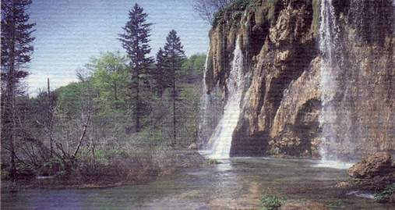
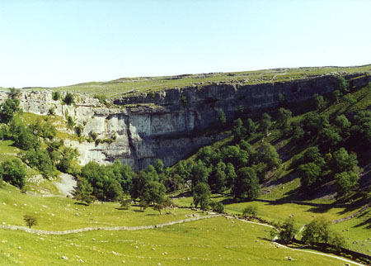
Karst Features
Sinkhole
Illinois
Vietnam
UK
Springs

Slide 29
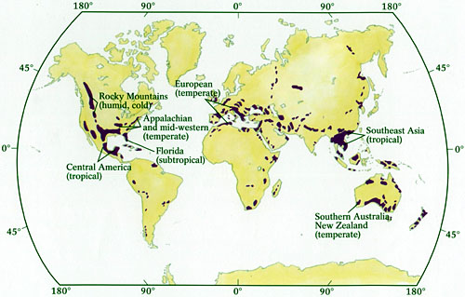
Karst Regions

Slide 30
Erosion from Human Activity
Faster than that which occurs geologically
  Accelerates natural processes
Sharply increase amount of sediment in streams
  Increasing the possibility of and extent of flooding.
Major contributors include:
  Deforestation – clear-cutting in particular
  Agricultural development
  Urban development – particularly choosing land not well suited for development, i.e., floodplains

Slide 31
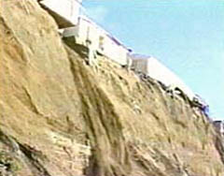
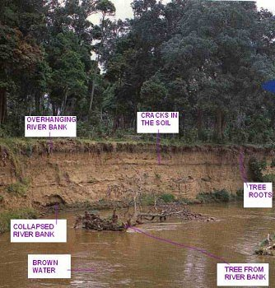
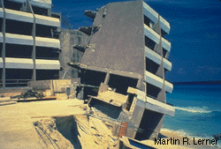
Human-enhanced erosion by water
Homes in danger
Sea surges undercut hotel

Slide 32
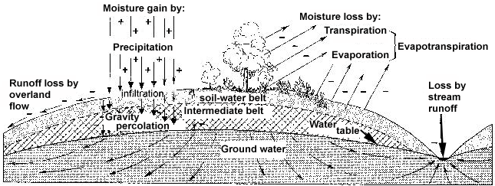
Movement of Water in Soil
This is a major part of the hydrologic cycle.

Slide 33
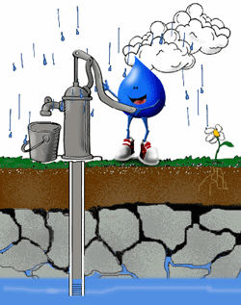
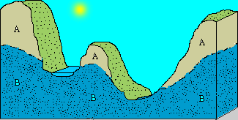
Using Water Table Water
The Water table reflects the surface somewhat
Water drawn from the water table is the major source for life in some areas.

Slide 34
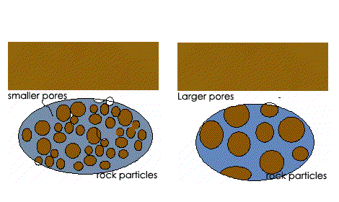
Soil and ground water
More porous soil (right) allows more water to percolate down into the soil & move slowly move toward streams, raising them gradually
Less porous soil (left) allows more water to run off and raise stream levels more quickly

Slide 35
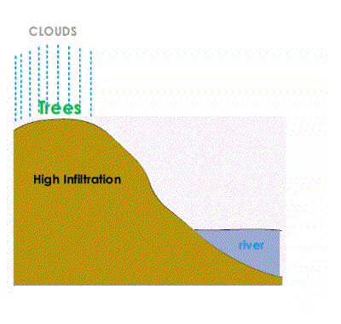
Vegetative cover encourages water absorption by soil
Vegetation temporarily holds & water releases it slowly so it can be more easily absorbed by the soil.
Where vegetation is absent, water may fall faster then bare earth can absorb it and run downhill to streams causing floods

Slide 36
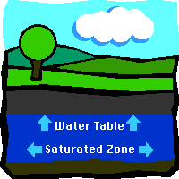
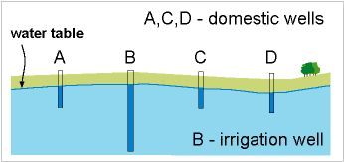
Groundwater Use
Recharging
Withdrawing
When the rate of withdrawing groundwater exceeds the rate of recharging, the water table drops. Wet years with flooding = high water table & drought years – low water table

Slide 37
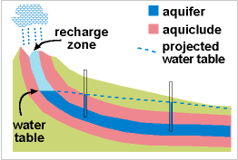
Artesian systems
When water is withdrawn at a rate greater than the recharge rate, the aquifer is gradually emptied – it will take nature much longer to recharge it than humans to drain it.
Aquiclude (impermeable rock layer) above and beneath the aquifer holds or “traps” the water under pressure.
Often used to irrigate crops in arid areas.

Slide 38
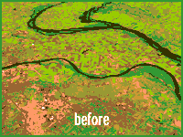
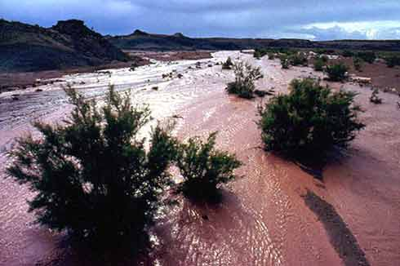
Flooding can cause big changes
1993 N. Mississippi Basin Flashflood in northern Arizona
THEY CALL IT A FLOOPLAIN BECAUSE FLOODING IS A NATURAL OCCURANCE – IT IS THE “RELEASE VALVE” OF THE DRAINAGE BASIN

Slide 39
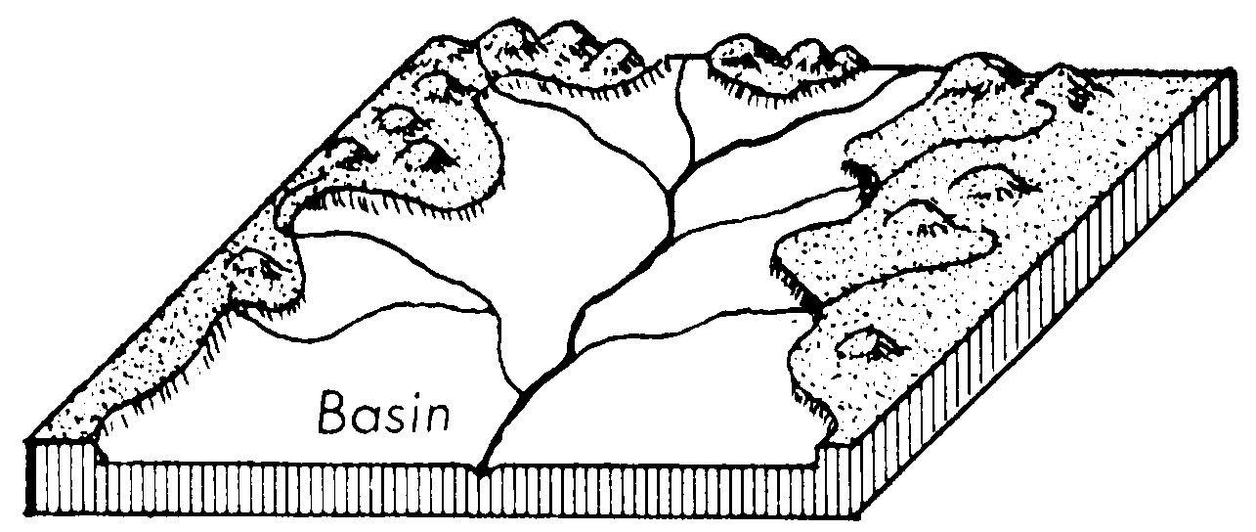
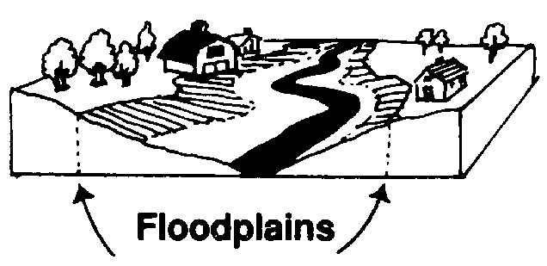
FLOODPLAINS
Floodplains are not appropriate places for intensive, expensive developments.
Appropriate uses of floodplains include farming, wildlife preserves, parks, recreation areas for camping boating, etc.

Slide 40
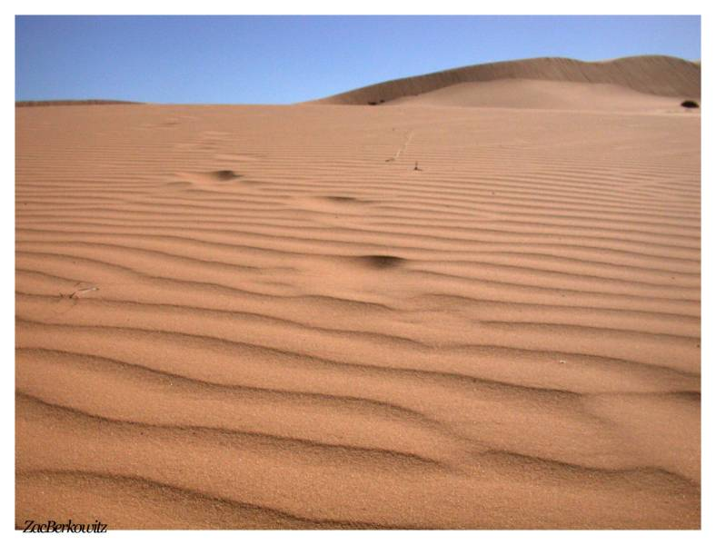
Ice, Wind & Waves
Glaciers – currently not very active
Wind causes erosion wherever soil is bare
  Deserts
  Farmlands
  Coastal areas
Coastal areas
  Active areas of erosion
  Pounding waves and surf
  Land lost or gained

Slide 41
MOVING ICE: GLACIAL ACTION
Glaciers are melting back more than they are advancing today. When glaciers advance, erosion is the major action; however, when they melt back, deposition is the major action.

Slide 42
Alpine Glaciers
Rivers of ice flowing from colder to warmer regions
Act like conveyor belts picking up sediment and dropping it in depositional areas
  Moraines
    Terminal moraines
    Lateral moraines
    Medial moraines

Slide 43
Two Primary Categories
Alpine or valley glaciers – in the last 100 years, these have been greatly reduced in number and size due to melting back.
Continental glaciers – those that cover large expanses of land – Antarctica and Greenland are the last two remaining areas of this type. There is evidence that both are thinning and shrinking.

Slide 44
Glacier Terms:
Fjord (fiord): As tidewater glaciers retreat, the steep-sided valleys fill in with sea water.
Calving: Tidewater glacier sheds icebergs off its face into the sea -- sections as large as huge buildings.
Moraines:The accumulation of eroded rock that a glacier picks up and drops as it recedes. This can be seen at the face of a glacier (end moraine), the side of a glacier (lateral moraine) or at the glacier's farthest point of advance (terminal moraine). Underwater moraine shoals can decrease the depth of a fjord from hundreds of feet to less than ten feet over very little distance.
Terminus:The front or termination of a glacier. The beginning of a glacier is called its head.

Slide 45
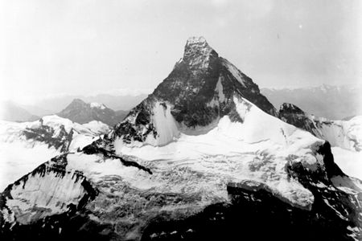
Glaciers
Click on the picture to see the video

Slide 46

Valley Glaciers (Alpine) Merging

Slide 47

Mountains before glaciation
Before

Slide 48

Mountains after glaciation
Horn
Pater noster lakes
Bridal veil fall
After

Slide 49

Glacial Valleys & Fjords
Fiords form when rising sea levels fill the bottom of coastal glacial valleys after melt back occurs.

Slide 50

Coastal Glaciers
Icebergs present a hazard to shipping lanes
Calving
Small fiord
Icebergs

Slide 51



Some Glacial Landforms

Slide 52




Drumlins & Kames

Slide 53



Continental Glaciation

Slide 54

4 Advances in North America

Slide 55
Glacier Facts #1
Presently, 10% of land area is covered with glaciers.
Glaciers store about 75% of the world's freshwater.
Glacierized areas cover over 15,000,000 square kilometers.
Antarctic ice is over 4,200 meters thick in some areas.
In the United States, glaciers cover over 75,000 square kilometers, with most of the glaciers located in Alaska.
During the last Ice Age, glaciers covered 32% of the total land area.
If all land ice melted, sea level would rise approximately 70 meters worldwide.
Glacier ice crystals can grow to be as large as baseballs.

Slide 56
Glacier Facts #2
The land underneath parts of the West Antarctic Ice Sheet may be up to 2.5 kilometers below sea level, due to the weight of the ice.
North America's longest glacier is the Bering Glacier in Alaska, measuring 204 kilometers long.
The Malaspina Glacier in Alaska is the world's largest piedmont glacier, covering over 8,000 square kilometers and measuring over 193 kilometers across at its widest point.
Glacial ice often appears blue because ice absorbs all other colors and reflects blue.
Kutiah Glacier in Pakistan holds the record for the fastest glacial surge. In 1953, it raced more than 12 km in three months, averaging 112 meters per day

Slide 57
Glacier Facts #3
In Washington state alone, glaciers provide 470 billion gallons of water each summer.
Antarctic ice shelves may calve icebergs that are over 80 kilometers long.
Almost 90% of an iceberg is below water--only about 10% shows above water.
The Antarctic ice sheet has been in existence for at least 40 million years.
From the 17th century to the late 19th century, the world experienced a "Little Ice Age," when temperatures were consistently cool enough for significant glacier advances.

Slide 58


Slide 59
Impact of Past Glaciations
Soils
  Advance and retreat of glaciers leave behind highly fertile soil
Water supply
  Retreating glaciers left sand and gravel deposits yielding large supplies of ground water
Transportation routes
  Water transport is heavily influenced by glacial melt water channels left behind by receding glaciers
    Check Ohio & Missouri River courses!

Slide 60


WIND ACTION
Wind is most active in arid regions, but never as important as water in altering the earth surface and creating landforms

Slide 61
Effects of Wind on Landforms
Significant shaper of landforms in dry regions and regions not well covered by vegetation
Carries great quantity of fine grained sediment such as sand and loess

Slide 62

Wind Speed
As the wind speed increases, larger particles can be carried by the wind (erosion)
As the wind speed decreases, larger particles begin to settle to the surface first (deposition)

Slide 63
Arid Landscapes
Erosion and deposition by wind helped create this landscape, BUT moving water was the more active shaping force here.

Slide 64

Land shaping water in the desert
Water carved this canyon and wind and mass wasting assisted.

Slide 65
Coastal Erosion
Waves
  Form of energy traveling horizontally along the boundary between water and air
Longshore currents
  Currents traveling parallel to the shore, caused by repeated breaking of waves. Capable of carrying enormous amounts of sediment
Sea-level change
  Continuing to rise as seawater volume increases from glacial melting
  Causes increased erosion as waves break closer to shore

Slide 66

Oceans, Waves, & Gradation
Wave action erodes and builds the coastal margins of islands and continents

Slide 67


Slide 68


Slide 69


Slide 70

Dynamic Waves and Currents
The shoreline is constantly changing – click on the picture below to see the video

Slide 71
Rates of Landform Change
Horizontal movement
Vertical movement
Human activity

Slide 72


Slide 73

Landform Regions
Plains
Hills and Low Tablelands
High Tablelands
Mountains
Widely Spaced Mountains
Basins or Depressions

Slide 74

Major Landform Types
Major Landforms in Profile
Escarpment
Plains: level to gently rolling land at a low elevation
Plateaus: level to gently rolling land at a higher elevation and often with a sharp drop-off or scarp (escarpment) on at least one side.
Hills: rounded landforms with little level land and at moderate elevations (1,000 to 5,000 ft.)
Mountains: steeply sloped landforms with narrow ridges and practically no level land – found at high elevations usually above 5000 feet.

Slide 75
Environmental Hazards
Environmental processes
  Natural
      Tornadoes, landslides, earthquakes
  Human vulnerability
      Rebuilding after natural disaster
      Seawalls
      Levees

