Slide 1



Rocks and Weathering

Slide 2
Contents
8G Rocks and Weathering
Physical weathering
Biological weathering
Chemical weathering
After weathering
Summary activities

Slide 3
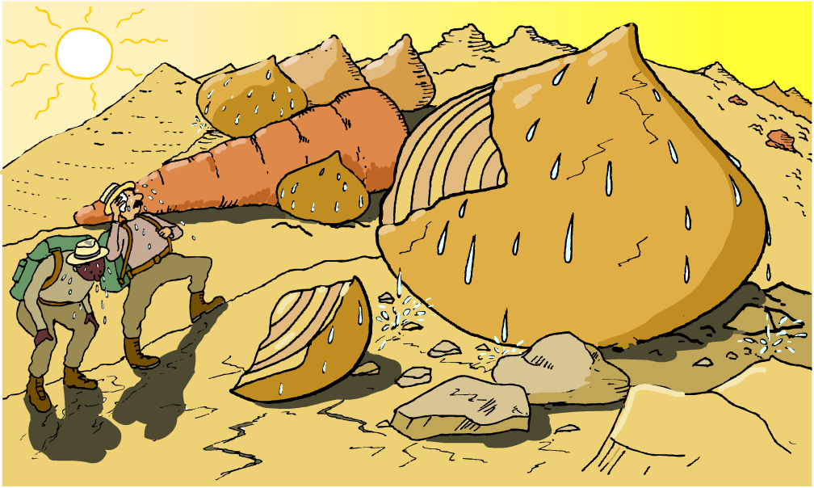
Rocks and weathering
Why are rocks all different shapes and sizes?

Slide 4
Rocks and weathering
Rocks are different shapes and sizes because they are changed by the conditions
in their environment.
The breakdown of rocks into smaller fragments is called weathering.
There are three types of weathering:
physical weathering
chemical weathering
biological weathering
What factors cause these different types of weathering?

Slide 5
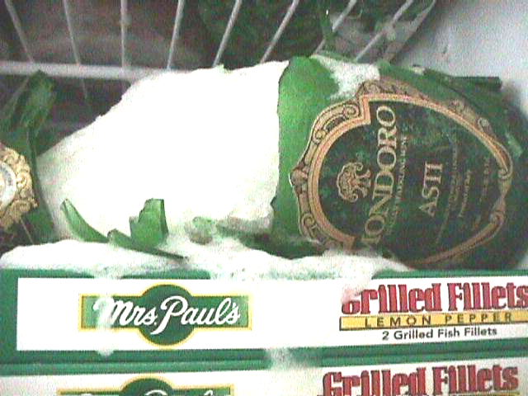
How can freezing cause damage?
What will happen to a glass bottle containing a liquid if it is left in a freezer for too long?
It shatters!
It shatters!
The liquid inside the bottle expands as it freezes.
The ice formed creates huge forces on the glass which then cause the bottle to break!
How does this explain why water pipes often burst in winter?

Slide 6

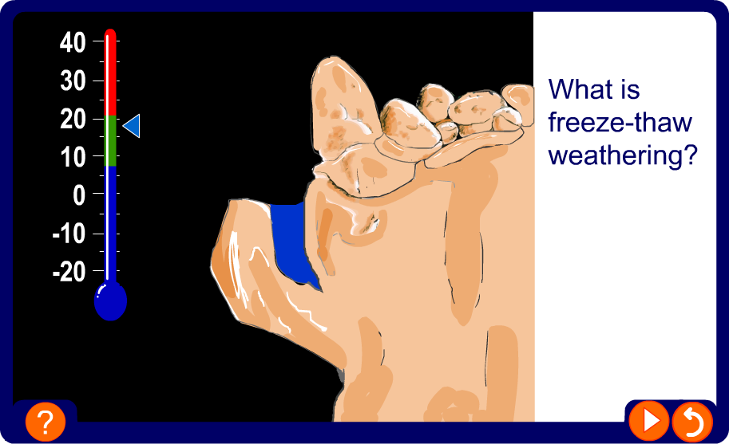
Freeze-thaw weathering

Slide 7
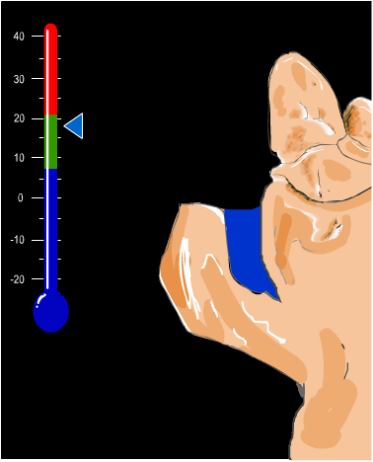
How does freeze-thaw weathering happen?
1. Water finds its way into small cracks in the rock.
What will happen to the water if the temperature drops to 0 °C or below?

Slide 8
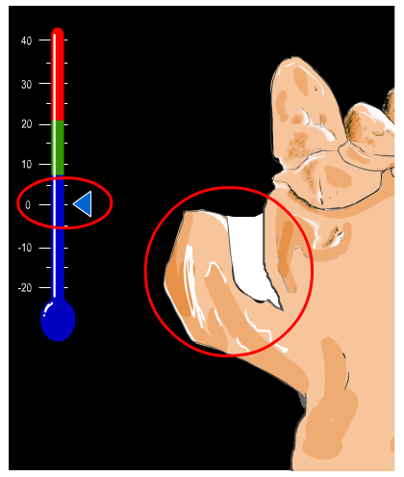
How does freeze-thaw weathering happen?
2. At night-time, when the temperature
drops to 0°C or below, the water in the crack freezes forming ice.
The water expands as it freezes creating huge forces on the surrounding areas of the rock.
These forces make the crack in the rock get bigger.

Slide 9
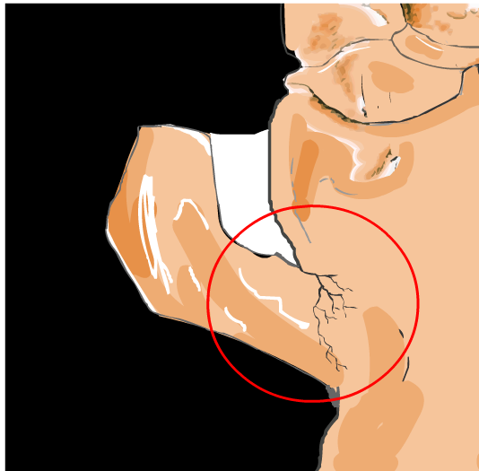
How does freeze-thaw weathering happen?
3. During the day, when the temperature warms up again, the frozen water thaws.
At night-time this water freezes again.
This cycle of freezing and thawing is repeated over and over again.
The huge forces created cause more cracks to appear in the rock.

Slide 10
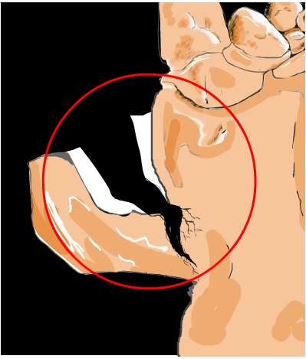
How does freeze-thaw weathering happen?
4. Finally a fragment of the rock breaks away completely.
This process is called freeze-thaw weathering.
Freeze-thaw weathering is a
type of physical weathering.

Slide 11
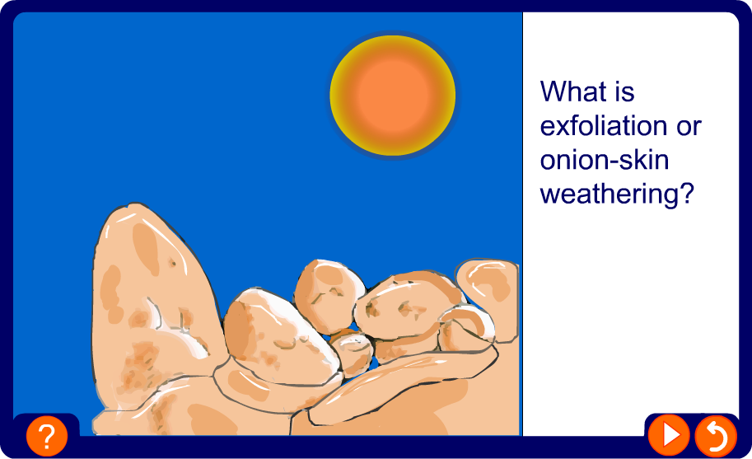
Exfoliation or onion-skin weathering

Slide 12
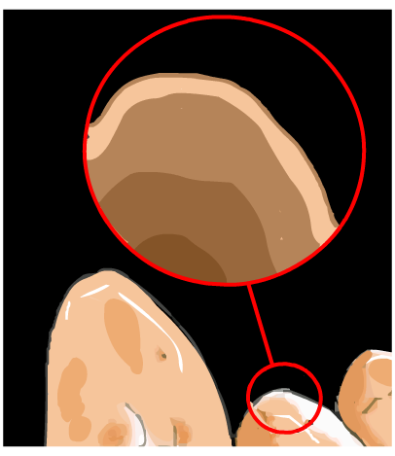
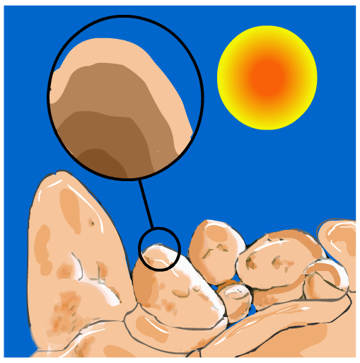
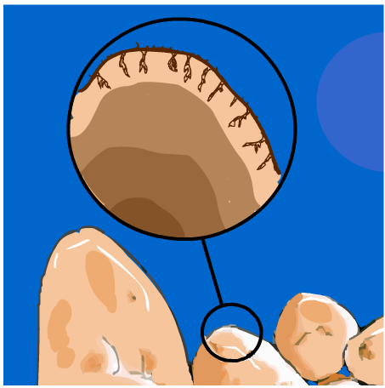
How does onion-skin weathering happen?
Onion-skin weathering is a type of physical weathering.
1. During the day the sun heats up the surface of the rock causing the rock to expand.
2. During the night the rock cools down and contracts.
3. As the rock keeps expanding and contracting, pieces of surface rock begin to flake and fall off.

Slide 13
Contents
8G Rocks and Weathering
Physical weathering
Biological weathering
Chemical weathering
After weathering
Summary activities

Slide 14
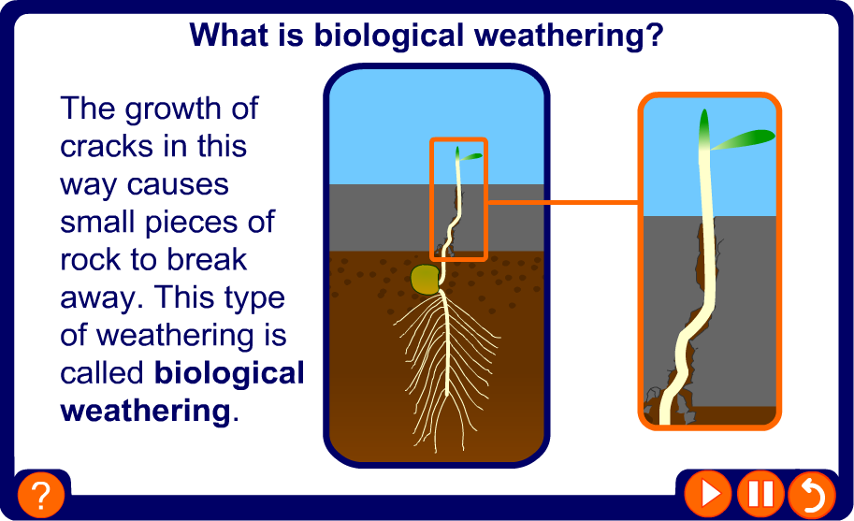
What is biological weathering?

Slide 15
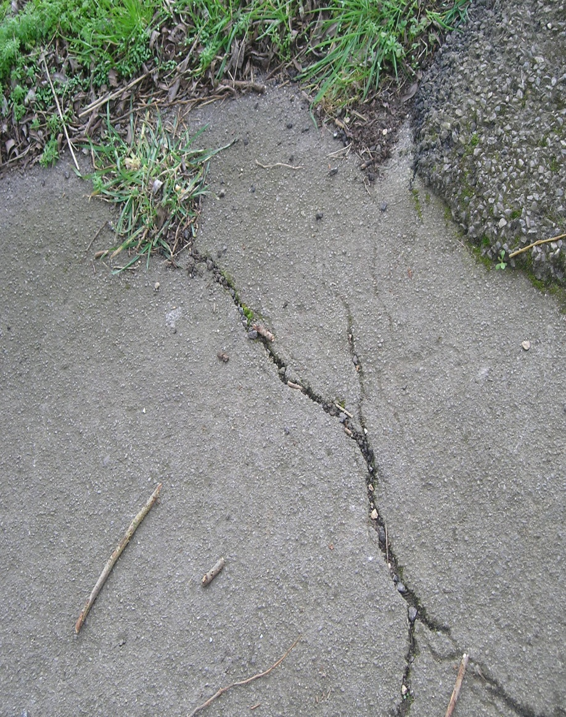
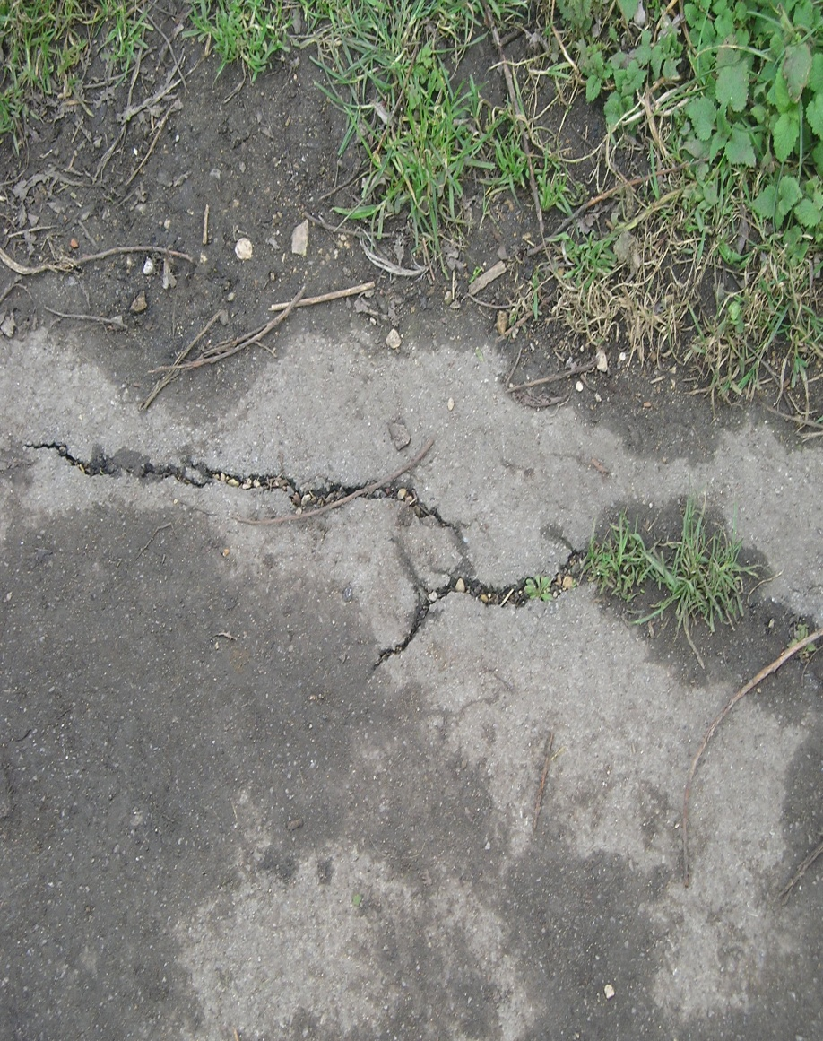
Examples of biological weathering
How has biological weathering caused these cracks to form?

Slide 16
Contents
8G Rocks and Weathering
Physical weathering
Biological weathering
Chemical weathering
After weathering
Summary activities

Slide 17
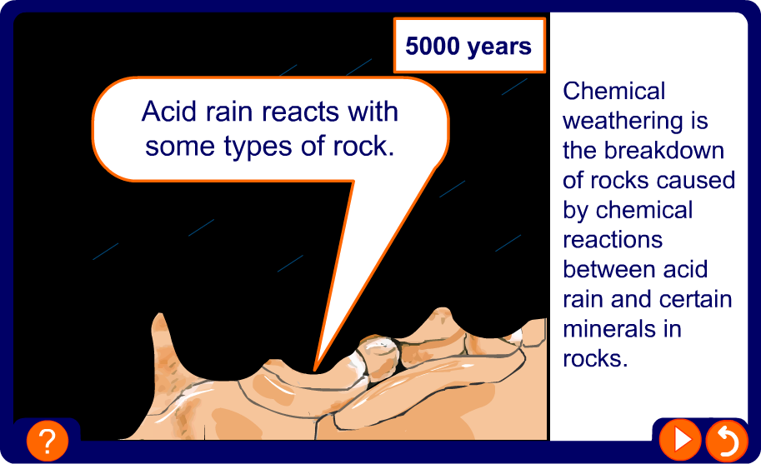
What is chemical weathering?

Slide 18
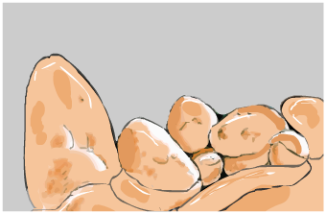
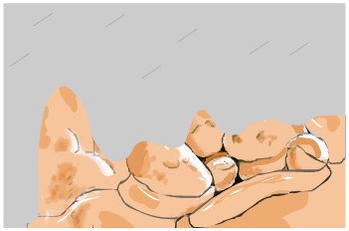
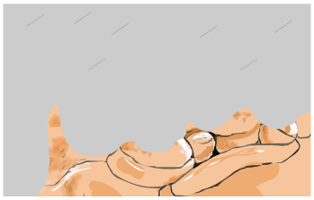
Slow and rapid chemical weathering
Slow chemical weathering
Rapid chemical weathering
Rainwater is naturally acidic because carbon dioxide in
the air reacts with rainwater
to form carbonic acid.
This type of acid rain is weakly acidic and reacts slowly with minerals in rock.
The burning of fossil fuels produces oxides of sulphur and nitrogen which make rainwater more acidic.
This type of acid rain reacts quickly with minerals and weather rock more rapidly.

Slide 19
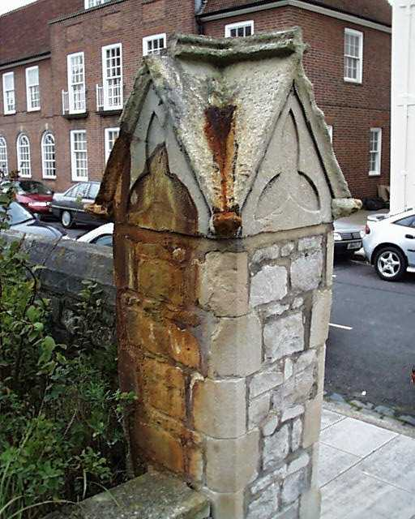
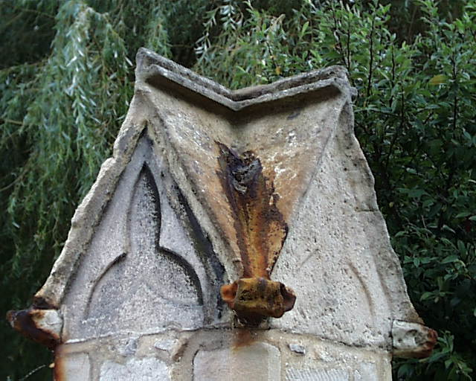
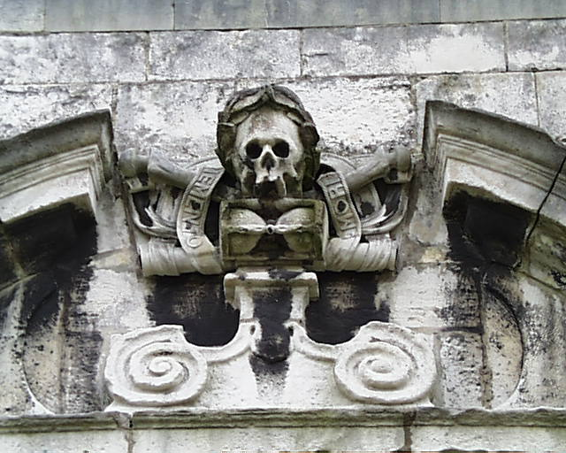
Examples of chemical weathering
How has chemical weathering affected these rocks?

Slide 20
Contents
8G Rocks and Weathering
Physical weathering
Biological weathering
Chemical weathering
After weathering
Summary activities

Slide 21
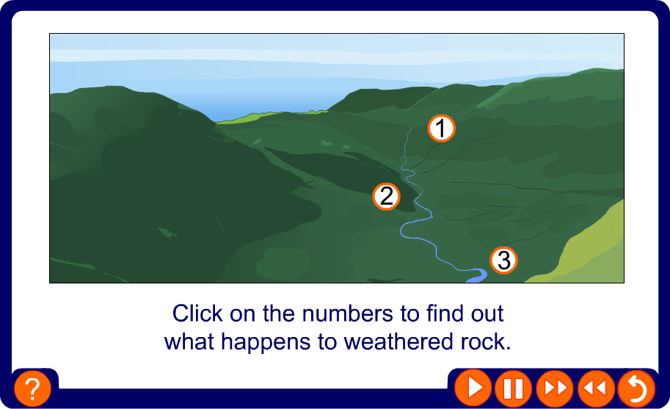
What happens to weathered rock?

Slide 22
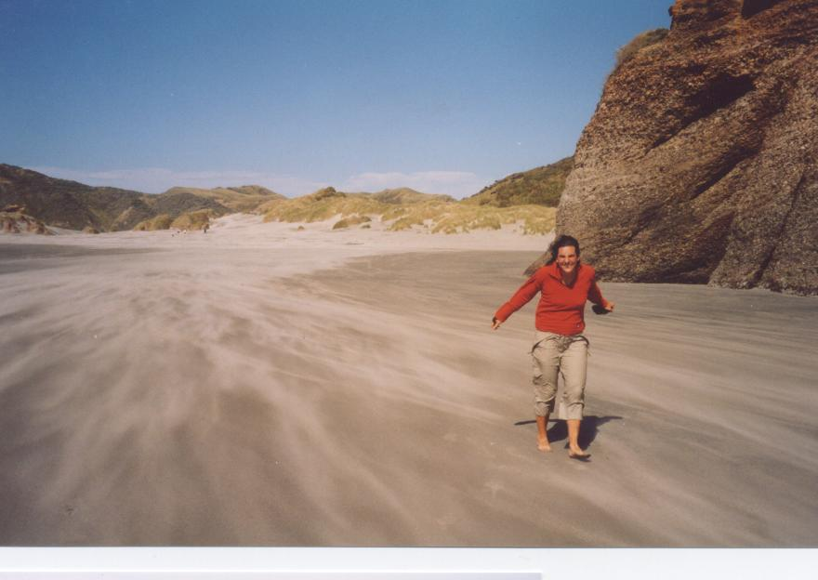
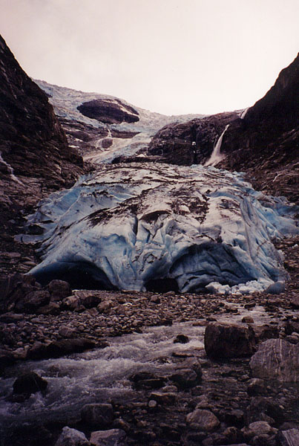
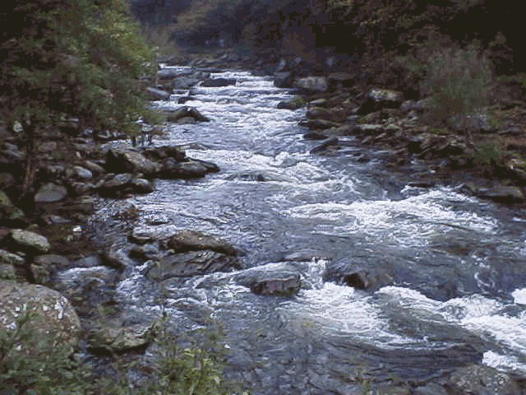
What is transportation?
Transportation is the movement of rock fragments from one place to another. The rock fragments can be transported in different ways:
by strong winds
by strong winds
by rivers
by rivers
by glaciers
by glaciers

Slide 23
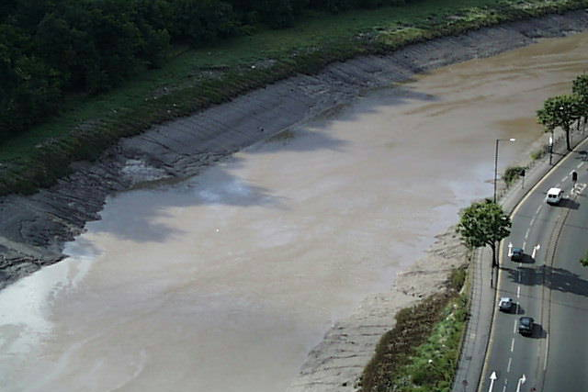
What is deposition?
Deposition occurs when pieces of weathered rock sink
to the bottom of the river bed or sea forming sediment. Dead creatures can get trapped in sediment and form fossils.

Slide 24
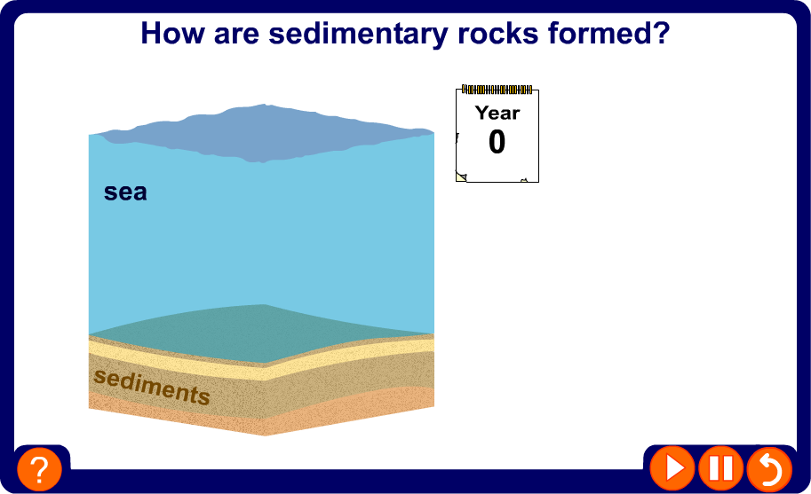
How are sedimentary rocks formed?

Slide 25

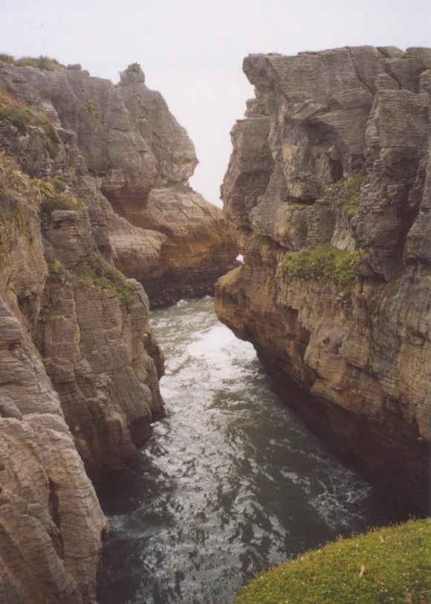
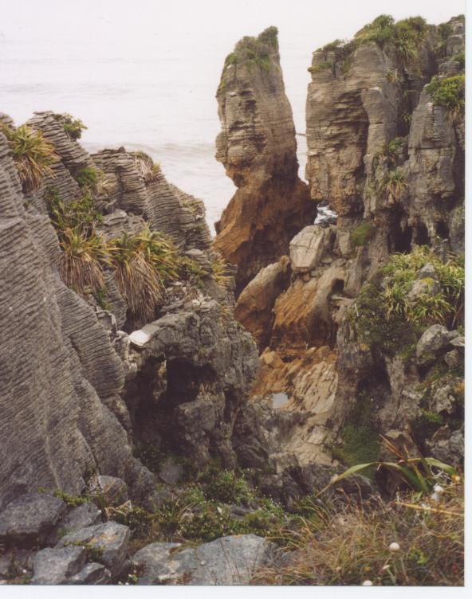
Examples of sedimentary rocks
How can you tell that these are sedimentary rocks?
Notes:
Limestone rocks at Punakaiki on the west coast of the South Island of New Zealand. They are known as the Pancake Rocks because their appearance resembles thin pancakes stacked on top of each other.

Slide 26
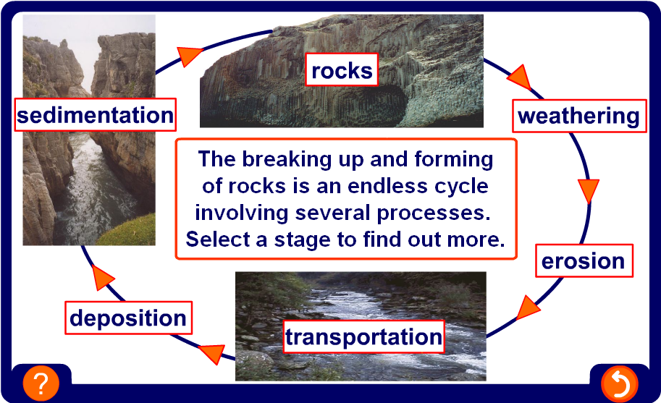
From weathering to sedimentation

Slide 27
Contents
8G Rocks and Weathering
Physical weathering
Biological weathering
Chemical weathering
After weathering
Summary activities

Slide 28
Glossary
deposition – The settling of rock fragments after transportation.
erosion – The process of weathering and transportation.
exfoliation – Weathering of rocks caused by repeated heating and cooling, also called onion-skin weathering.
freeze-thaw – Weathering of rocks caused by the repeated freezing and thawing of water in cracks in rocks.
grain – A small piece of a mineral which makes up a rock.
mineral – A solid substance, usually a compound, which is found in rocks.
rock – A mixture of minerals.
transportation – Movement of rock fragments from one place to another.
weathering – The breakdown of rocks into smaller
pieces by physical, chemical and biological processes.

Slide 29
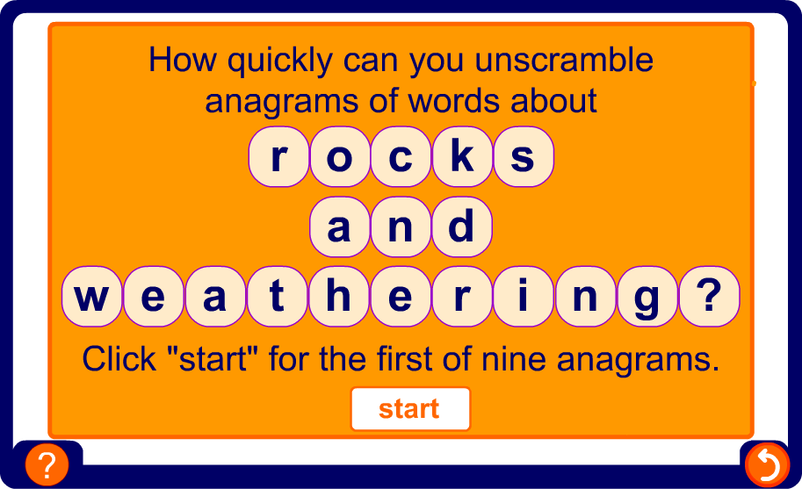
Anagrams

Slide 30
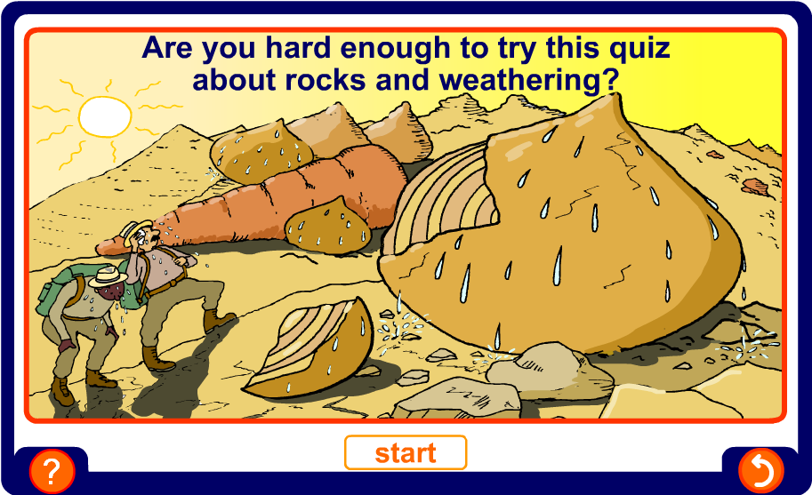
Multiple-choice quiz

