Slide 1
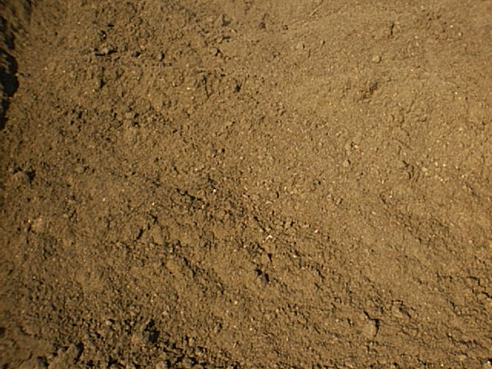
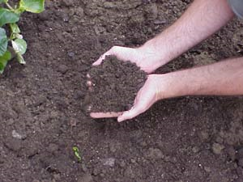
The Geography of Soils Chapter 18 GEOG 1011 Kristina Klos Wynne September 28th, 2005
Notes:
Review and soil formation:
Monday: Remember the ways in which rock is weathered: chemical weathering (hydrolysis, carbonate weathering, and oxidation) and physical weathering (exfoliation, crystallization, etc.)
Why is that important? Because soil is simply formed from the weathering of some parent material and is characterized by that parent material and weathering.
Why is soil important? It is not dirt! it is a dynamic system made up of mineral, organic matter, water, and biological components. If you eat, you should pay attention to soils
-medium for plant growth
-medium for infrastructure and building
-soil affects the hydrologic cycle to some extent
-it is a habitat
-it is in some ways, natures recycling center, compost, etc.
-soil is formed extremely slowly but can be eroded and wasted very quickly (pg 565, Dust Bowl) management
-in some areas (OK) soil is the largest water pollutant
Who knows about soils?
-soil scientists, researchers, agricultural extension services, United States department of agriculture/natural resource conservation service, us department of agriculture. These people conduct soil surveys all over the country in order characterize soils for the reasons listed above.

Slide 2
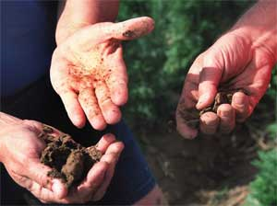
What is soil made of?
clay
sand
silt
base cations
biota
organic matter
water
pore spaces (air)
http://soils.usda.gov/sqi/concepts
Notes:
What is soil made of?
clay, sand, silt, base cations, alkalinity
-these things are determined by the parent material or transported material
-physical framework
-determines texture
-affects water drainage
-affects nutrient availability
biota, organic matter
-worms, etc. physically mix the soil up
-microbes recycle
-legumes fix nitrogen
-produce acids that effect chemical reactions and pH
-increases ability of soil to hold moisture
water, and pore spaces (air is just as important as the other things)
-aeration
-gases and water for microbes
-soil water transports chemicals

Slide 3
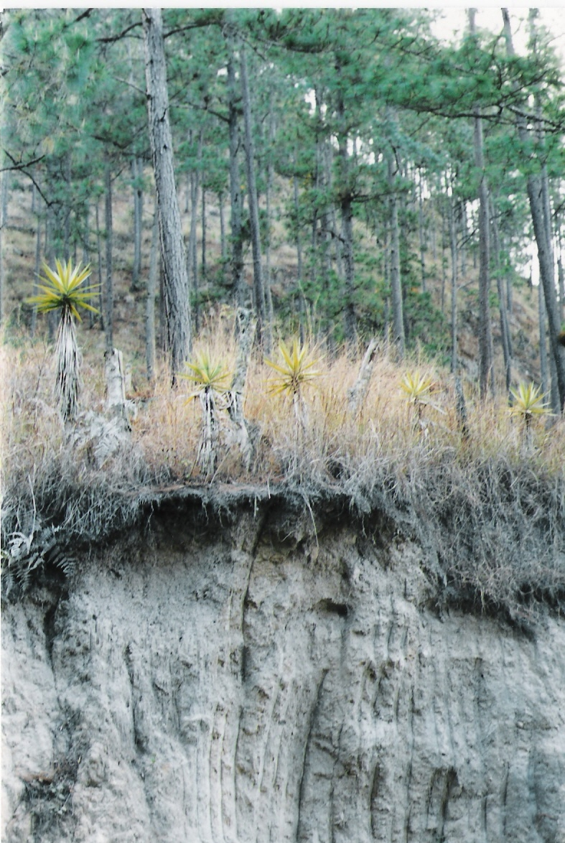
Soil Forming Factors
Climate
Organic matter
Relief
Parent material
Time
Cl.O.R.P.T
Notes:
Soil Forming Factors (C.L.O.R.P.T) (write this on the board to look at the whole time)
climate
organic matter
relief (think shear stress)
parent material
time

Slide 4
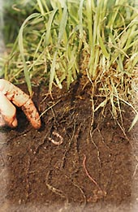
Soil Properties
Soil Color
Soil Texture
Soil Structure
Soil Chemistry
Soil Acidity
Alkalinity
Soil nutrients
www.Jordforsk.no/english/soilquality.htm
Notes:
Soil Properties
color
texture
structure
chemistry
How do we organize soils?
color-can be deceptive, hue, value, chroma
structure-arrangement of soil particles
texture-soil triangle, size of soil particles
chemistry-ions in soil-CEC, water, air, acidity, has an effect on soil productivity
Based on these distinctions, we call general soil groups orders

Slide 5
Munsell Soil Color Chart
Figure 18.3
Notes:
Color is only a diagnostic tool
Determining factors include the amount of
organic matter (black)
oxidized or reduced iron (red, grey/gleyed soil with no O2)
leaching (whitish

Slide 6
Soil Texture Triangle
Figure 18.4
Notes:
WHAT COULD DETERMINE TEXTURE?
parent material, organic matter
% of sand, silt, and clay are determined by feel, ribbon test

Slide 7
Types of Soil Structure
Figure 18.5
Notes:
Soil structure is determined by the composition of the soil, the environment
Soil structure is an important factor for farming, road building, and construction

Slide 8
Soil Colloids and CEC
Figure 18.6
Notes:
Soil colloids are tiny particles of clay or organic material that hold on to ions , they are chemically active. Kind of like static, they attract cations
Cations are simply positively charged particles
CEC(cation exchange capacity) is a measure of how well the colloids can trade out ions for different ions. CEC is a measure of soil productivity because more cations mean that there are more nutrients for the plants to adsorb.
If a soil is overworked, I suppose it could loose some of its CEC

Slide 9
Soil Sampling and Mapping Units
Figure 18.1
Notes:
Put the pieces together to classify soils more generally: color, texture, structure, and chemistry
Soil horizons-a horizontal distinct layer exposed in a pedon (the basic sampling unit used in soil surveys). Soil horizons are sometimes easily distinguished in the field (sometimes not) and are the basic way in which we classify soil types.

Slide 10
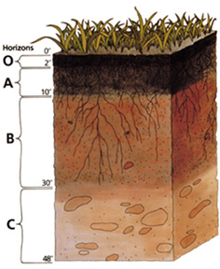
O Horizon
Humus-mixture of decomposed and synthesized organic materials, usually dark in color.
Microorganisms work on this layer and it is generally 20%-30% organic material.
Important because it can hold water and supply nutrients
www.soils.usda.gov
Notes:
Not all soils have an O horizon or a well developed O horizon (example would be desert soils)

Slide 11
A Horizon
Humus and clay particles supply nutrients for plant growth
Usually richer in organic matter (from above) than horizons below
Darker in color than horizons below
Impacted by plowing/human activity
www.soils.usda.gov
Notes:
The link between soil nutrients and plants
How could plowing be bad for soils? We’ll talk about it later

Slide 12
E Horizon
Zone of elluviation or leaching
Clays and oxides are leached out of the soil by water and then are collected in the E horizon
Very light in color
Because small particles such as clay are removed, this horizon is sandier
www.soils.usda.gov

Slide 13
B Horizon(s)
Distinguished by the deposition of the clays that leached out of the A and E horizons
Reddish or yellowish (minerals and oxides) in color
In B horizon, some material can come from above, some may come from regolith below
www.soils.usda.gov
Notes:
There can be any number of B horizons depending on the age of the soil and differentiated by the soil properties (particularly the presence of clay)
Review, what makes minerals red in color? → exposure to oxygen → oxidation
What types of areas would oxidation not occur? → very wet system where there is no oxygen, it is a reduced environment

Slide 14
C Horizon
Regolith- weathered bed rock or parent material
Not really any biological interactions here
Lacks clay, more like rock
www.soils.usda.gov

Slide 15
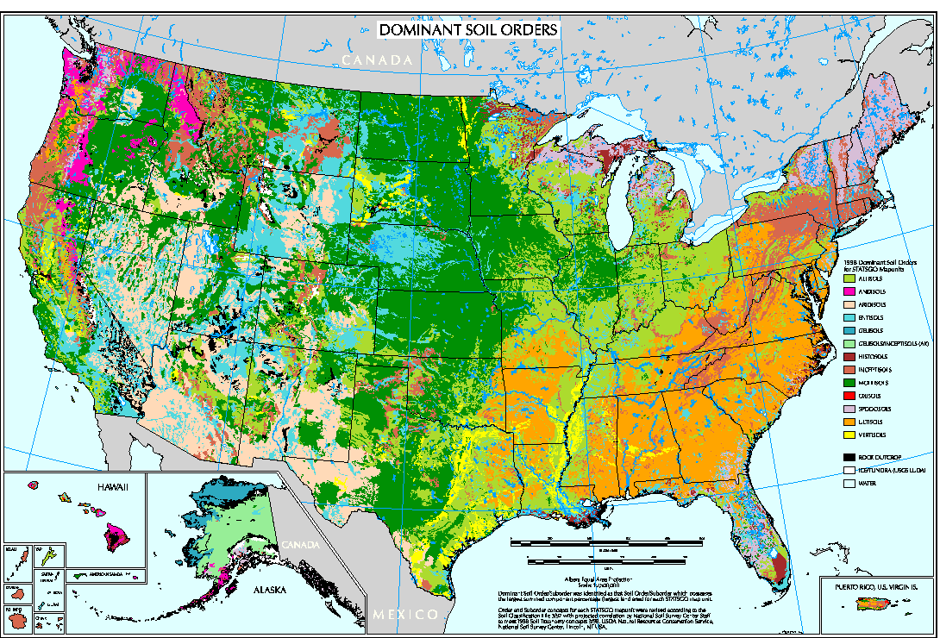
Soils vary geographically
Notes:
Why are soils different in different places?→Because of the soil forming factors that we have discussed (see chalk board), soils vary regionally.
Notice the distinct line in the middle of the country, discuss that differences in climate correspond with the different soil types (east of the 100th meridian there is more rain, more than about 20 inches on average)
Each state has a state soil
Now, soils are classified by soil taxonomy, different types are called orders. However, before that system pedogenic regimes were used to describe soils. These regimes link the soil forming process to the climatic regions in which they occur. We'll talk about them together.

Slide 16
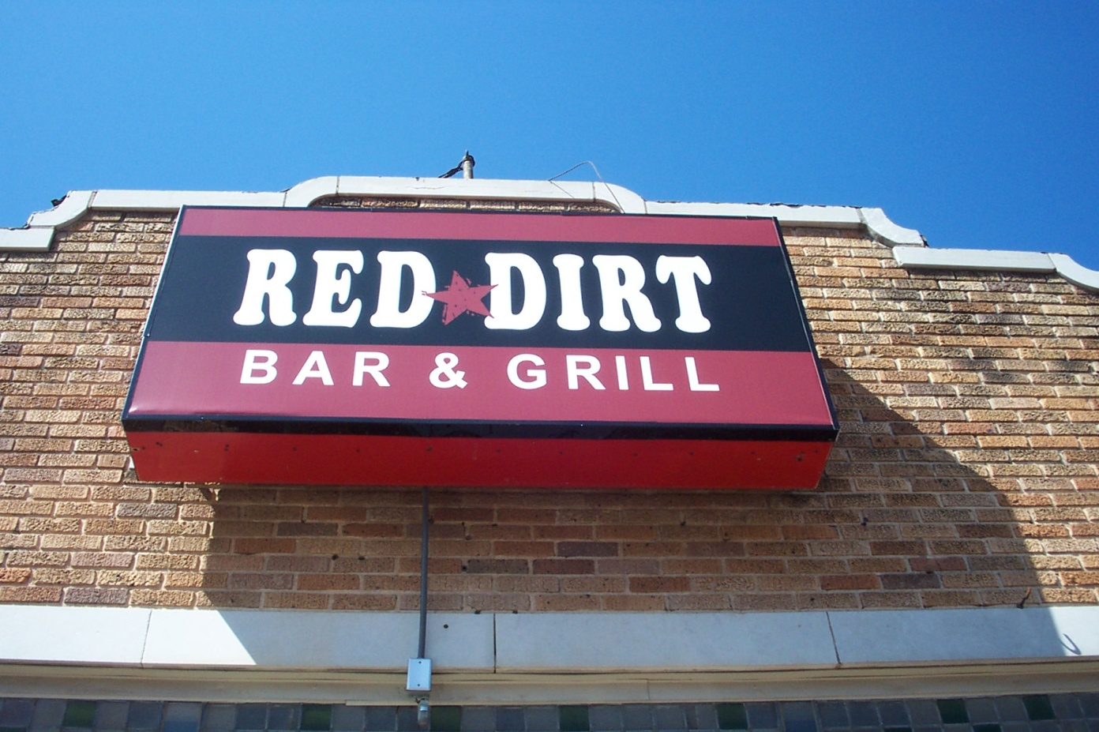
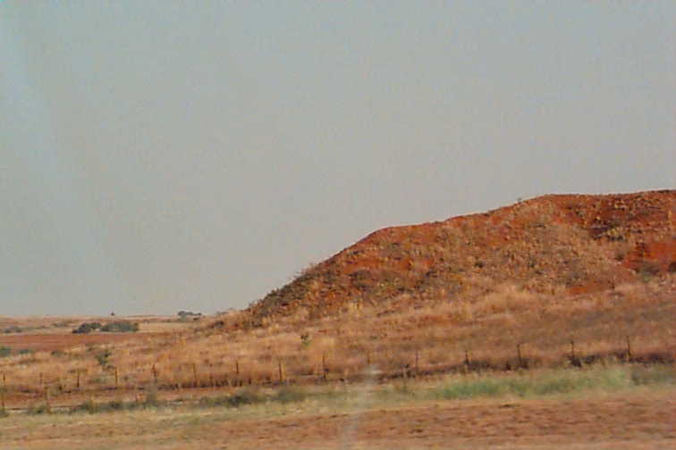
Soils vary geographically

Slide 17
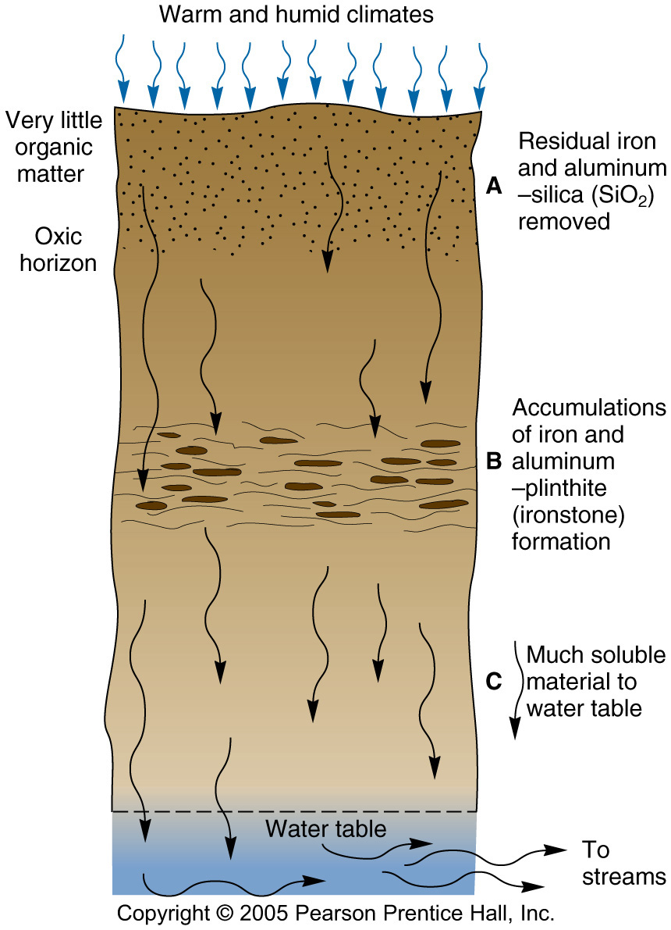
Laterization
Leaching process that occurs in humid and warm climates
Soil Orders:
Oxisols: Amazon region
Ultisols: SE USA
l
Notes:
What does leaching cause?→E horizon, light in color, sandy, clays and minerals are removed by water.
Warm climates also excelerate chemical reactions

Slide 18
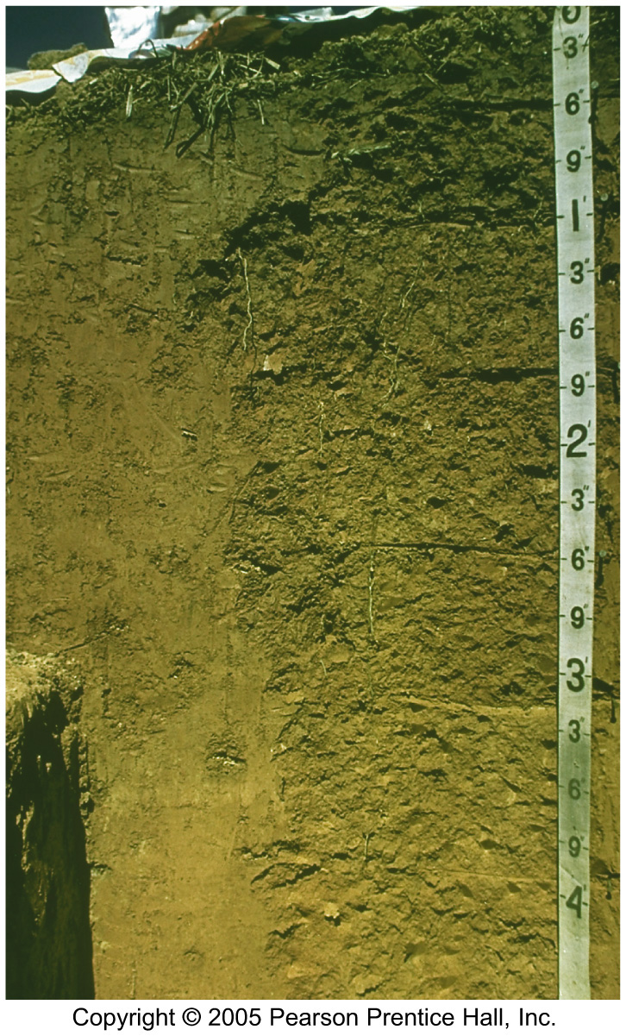
Oxisols
deeply weathered.
Precipitation >> PET
Soluble minerals weathered from A horizon
A horizon can be more than 10-m deep
A horizon characterized by iron and
aluminum oxides, often in high enough
concentration to be commercial ores
Results in reddish to yellow color
Little CEC
Low in fertility
Wet tropical areas
Amazon rain forest classic example
Ultisols are similar, characteristic of sub-
tropical areas such as SE USA

Slide 19
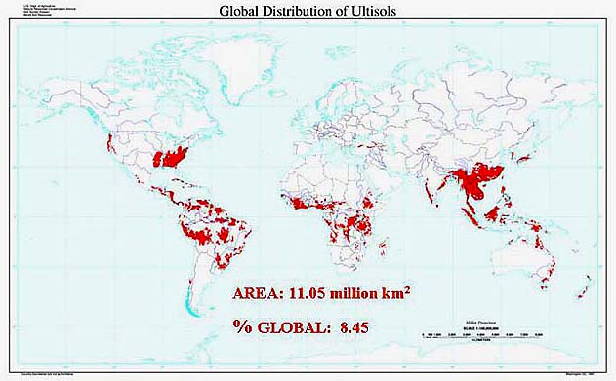
Notes:
Warm climates, rain forests. If oxisols are not fertile, what problems might arise with slash and burn agriculture?

Slide 20
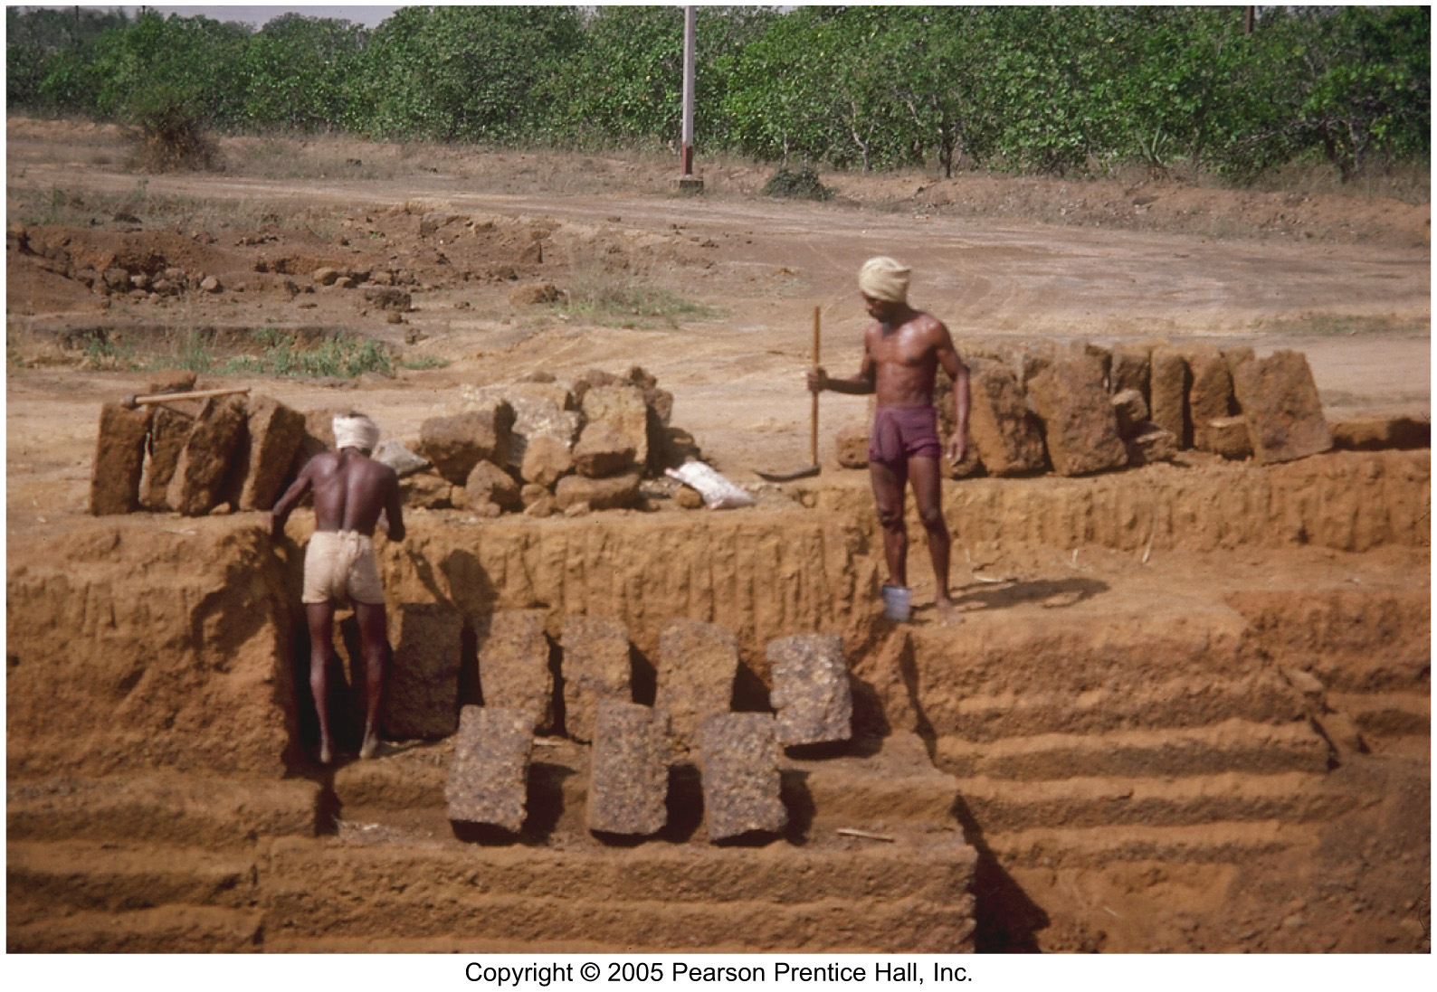
Oxisols being used for building materials in India
Notes:
Another use for soil.

Slide 21
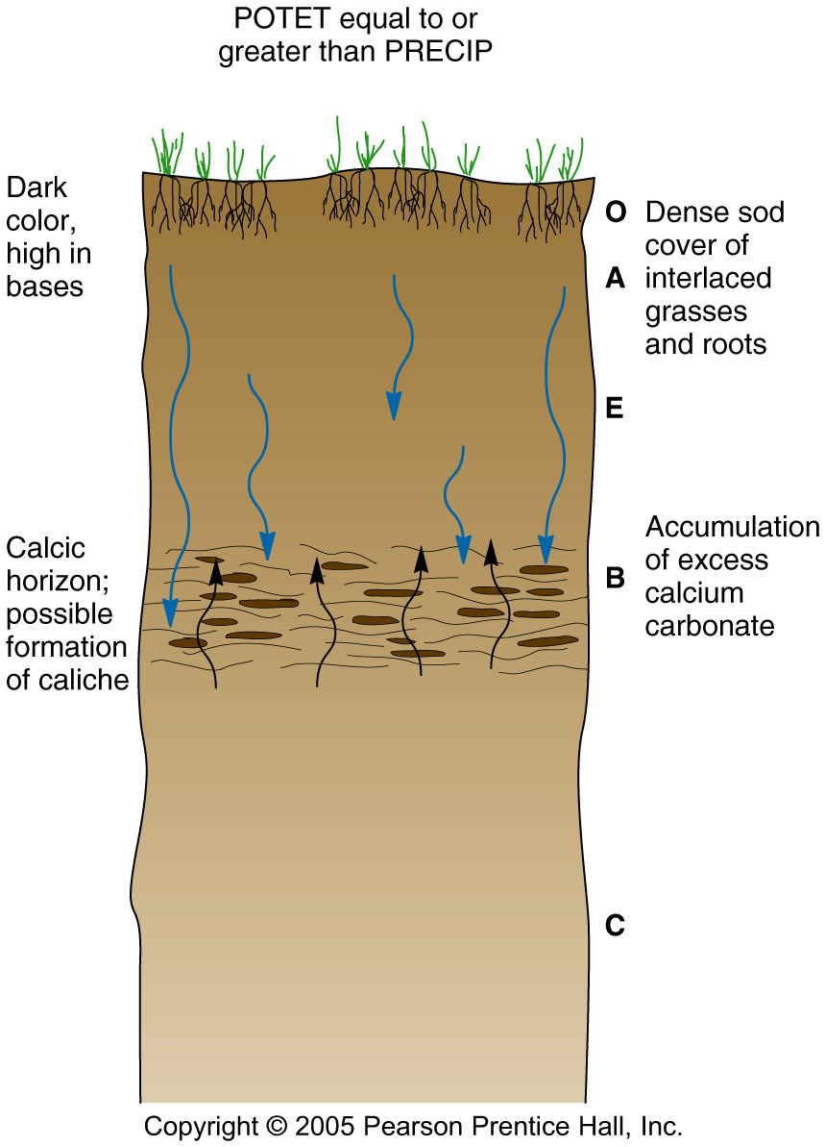
Calcification
Accumulation of calcium carbonate (B horizon) in continental climates
Large amounts of organic matter in O and A horizons, dark color
Soil orders:
Mollisol: Great Plains
Notes:
Accumulation occurs as illuviation in B horizon

Slide 22
Mollisol
Dark O horizon above the 1
Dark A horizon between 1 and 2
-these indicate lots of organic matter
B horizon below the 2
-the white particles are carbonate
nodules
Calcification regime
-ppt about equal to ET
Great plains area
Very fertile soils if add water
Figure 18.2
Notes:
Great Plains are where so much of our food comes from although it comes at the price of irrigation

Slide 23
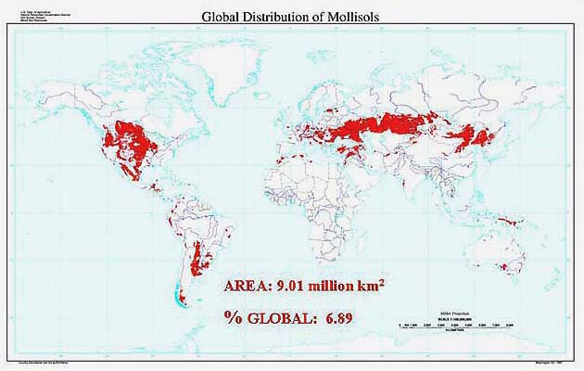
Notes:
Notice the Grain Belts in both US and Europe/Russia

Slide 24
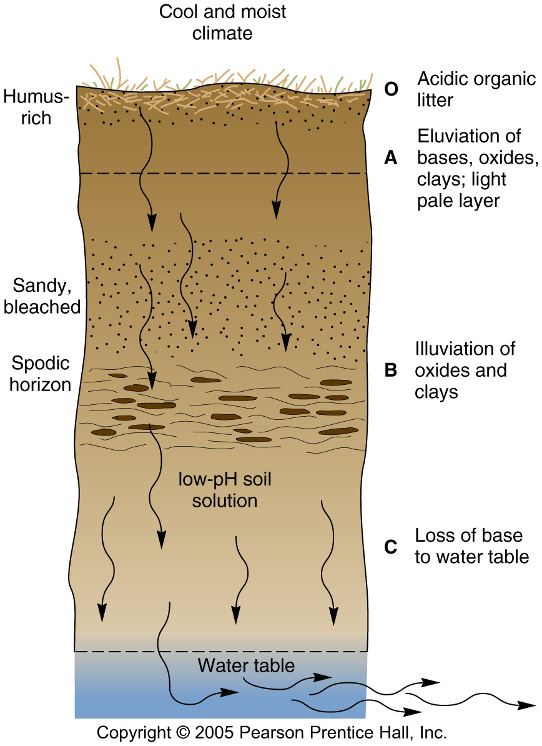
Podzolization
Soil acidification due to forest soils cool climates
Soil Orders:
Spodosols: NE, Boreal forests worldwide
Notes:
Temperate rain forests have what type of trees? →Conifers, the needles are acidic, cool climates limit chemical reactions

Slide 25
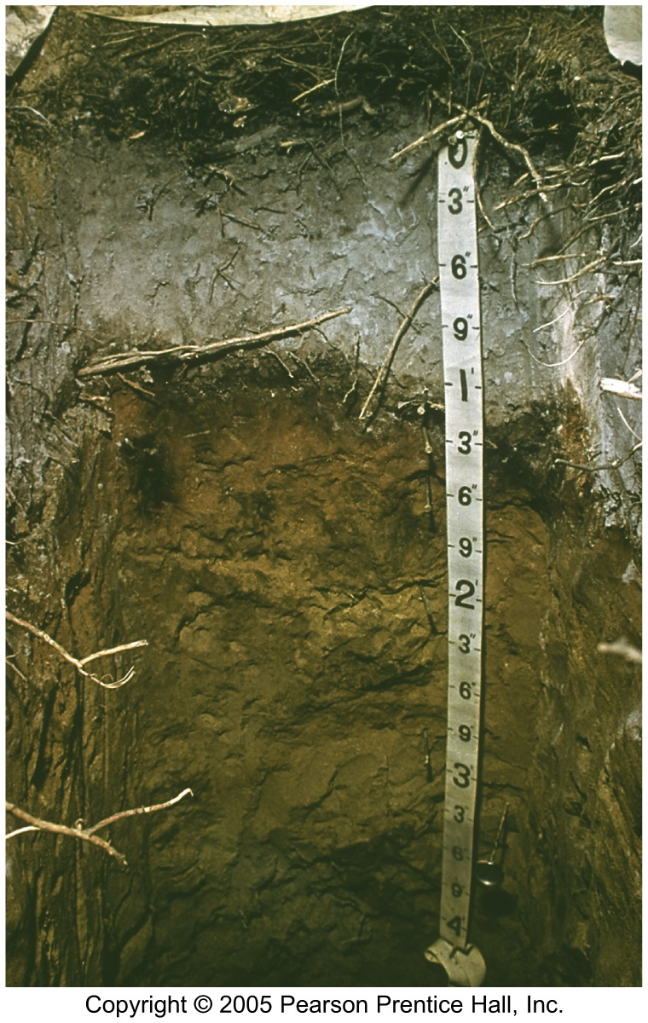
Spodosols
Cold, forested, moist regimes, acidic
Precip > PET
Generally an E or spodic horizon
of leached/bleached gray/white
A horizon heavily leached, lack humus and clay
Iron and aluminum oxides in B horizon
Low CEC
Infertile soils
Notes:
Notice the large E horizon

Slide 26
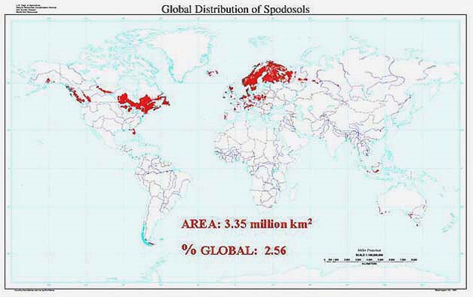
Notes:
Cool, moist climates

Slide 27
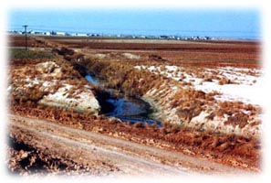
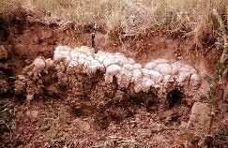
Salinization
Accumulation of salts in arid areas
PET >> precipitation
Soil orders: Aridisols
Notes:
Where might these soils occur?

Slide 28
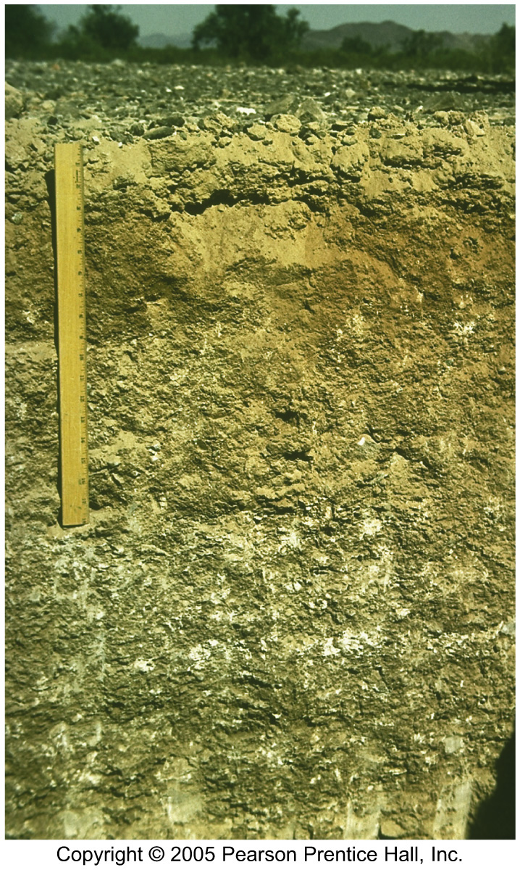
Aridisols
PET >> Precipitation
Desert soils
Pale, light color near surface
Long periods of soil moisture deficit
Little if any organic matter
High CEC
Very fertile if add water
Salinization is common
Here the white color is from salts that have precipitated in the soil
Largest soil order
Notes:
This is perhaps how they can have big produce operations in the central valley of California-irrigation is the answer for fertility

Slide 29
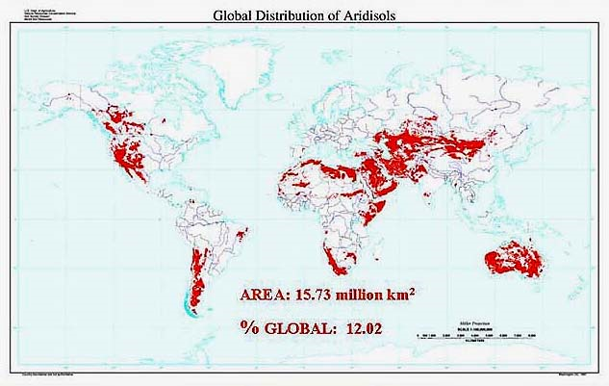
Notes:
Book say percentage is 19% of globe

Slide 30
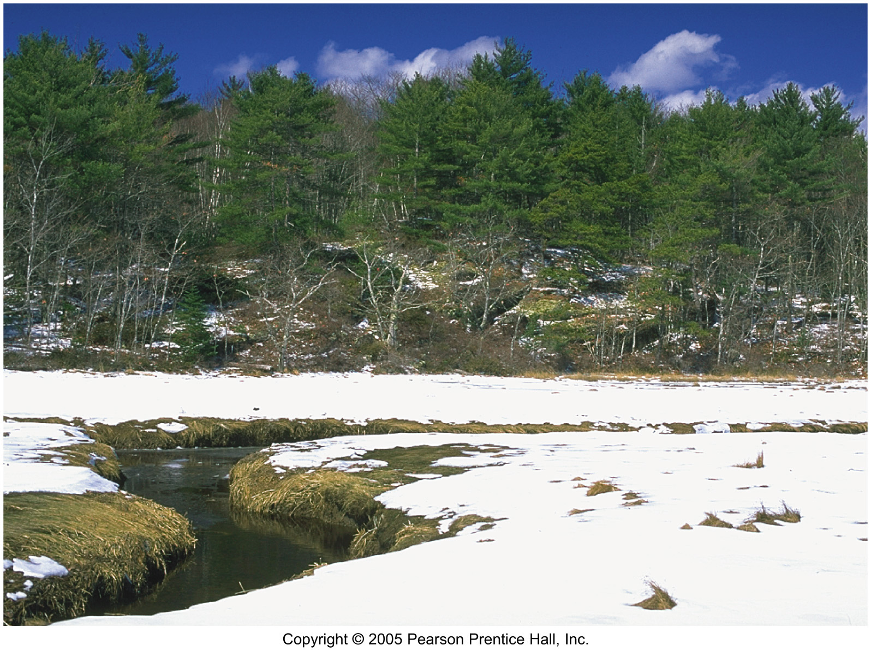
Histosols: poorly-drained areas, high OM, wetlands and peat areas
Notes:
Very high latitudes, hardly any time for the soils to warm up and decompose the organic matter (remember that chemical reactions happen faster at higher temperatures)

Slide 31
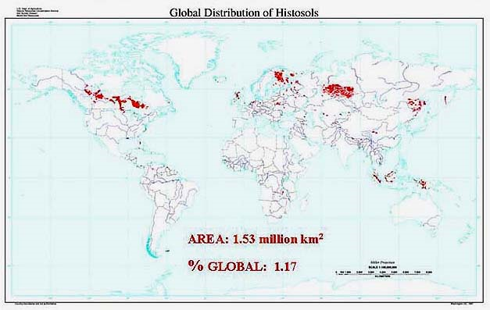

Slide 32
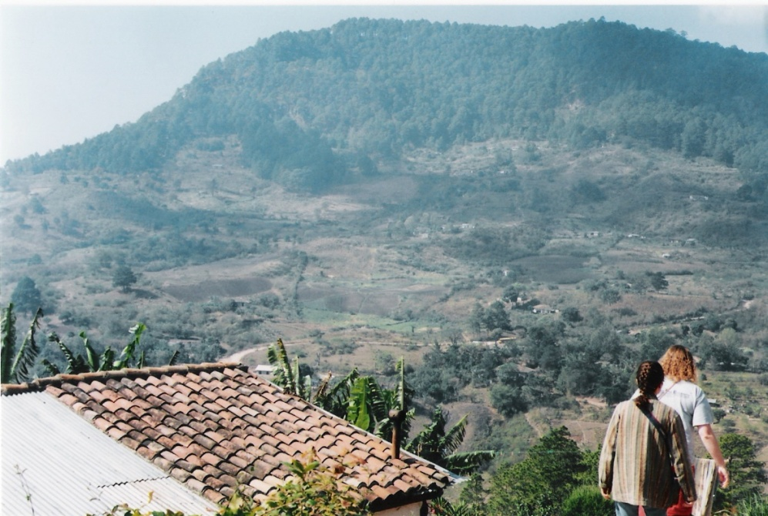
Soil Management
Soil is often affected by human impacts, particularly agriculture.
2 examples:
The Dust Bowl
Kesterson National
Wildlife Refuge
Notes:
Picture: agricultural operations in the hills of south western Honduras. Keep in mind how different agricultural practice and the availability of irrigation could affect soil.
soil is formed extremely slowly but can be eroded and wasted very quickly (pg 565, excessive soil erosion is still happening,Dust Bowl) management
-in some areas (OK) soil is the largest water pollutant

Slide 33
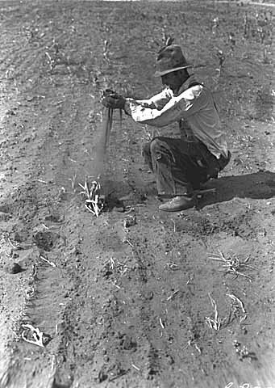
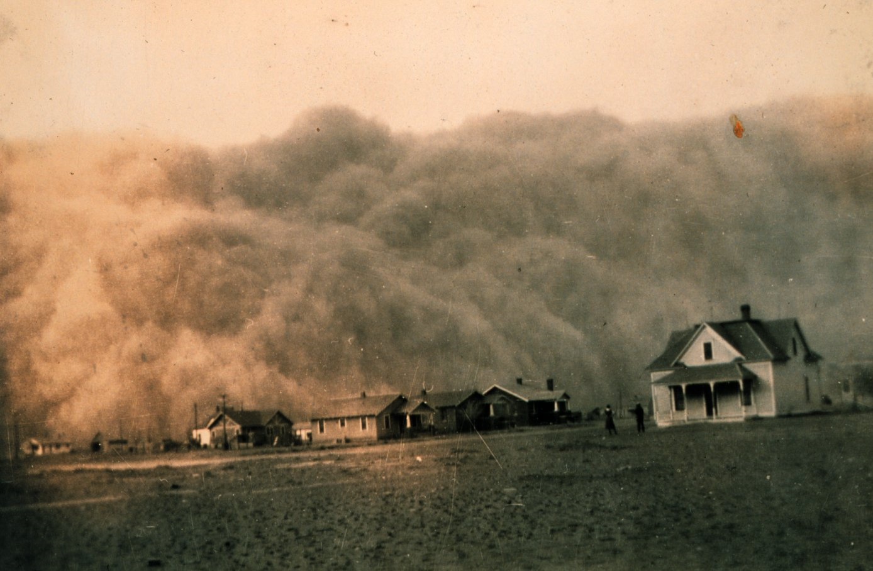
The Dust Bowl
Southern Plains, 1930s
Heavy planting and plowing plus prolonged drought reduced the amount of topsoil and ground-cover
Could it happen again?
Notes:
Poor agricultural practices and years of sustained drought caused the Dust Bowl.
Plains grasslands had been deeply plowed and planted to wheat.
During the years when there was adequate rainfall, the land produced bountiful crops. But as the droughts of the early 1930s deepened, the farmers kept plowing and planting and nothing would grow.
The ground cover that held the soil in place was gone.
The Plains winds whipped across the fields raising billowing clouds of dust to the sky. The skies could darken for days, and even the most well sealed homes could have a thick layer of dust on furniture. In some places the dust would drift like snow, covering farmsteads.

Slide 34
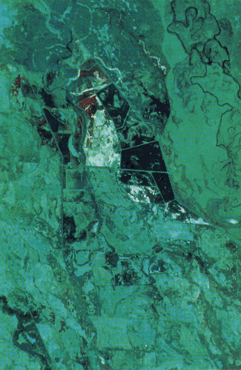
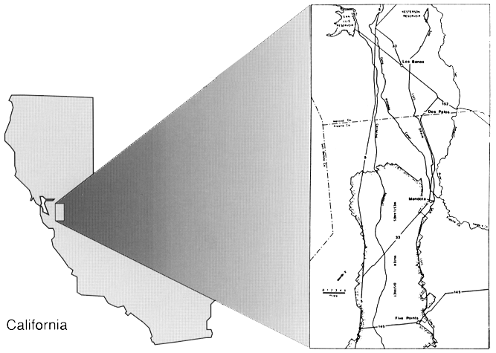
Kesterson Reservoir
The Kesterson Reservoir in the San Joaquin Valley of California is the recipient of water drained from agricultural fields. Studies of the freshwater wetlands at Kesterson have shown that the water entering Kesterson has brought with it boron, selenium and other trace elements. These material have accumulated to toxic levels in plant and animal communities.

Slide 35
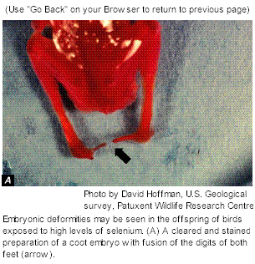
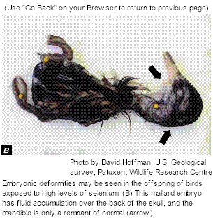
Notes:
"What happened at Kesterson NWR provides one more illustration of the long-known fact that irrigation projects without adequate outlets for drainage create unacceptable levels of salinity. The unexpected part of the scenario was that, given the right soils and geology, the process of drainage on irrigated lands can also concentrate trace elements to levels that can cause real harm to the biota." National Research Council
Tar Creek in Pitcher, Oklahoma is a similar example of soils contaminated by lead and zinc. Many children have brain defects from breathing in and being exposed to the soils

Slide 36
Geophagy
People around the world eat clay, dirt or other pieces of
the lithosphere for a variety of reasons. Commonly, it is
a traditional cultural activity which takes place during
pregnancy, religious ceremonies, or as a remedy for
disease. Most people who eat dirt live in Central Africa
and the Southern United States. While it is a cultural
practice, it also fills a physiological need for nutrients.
And of course, kids all over the world still eat dirt.
Notes:
FYI, just for fun

