Slide 1
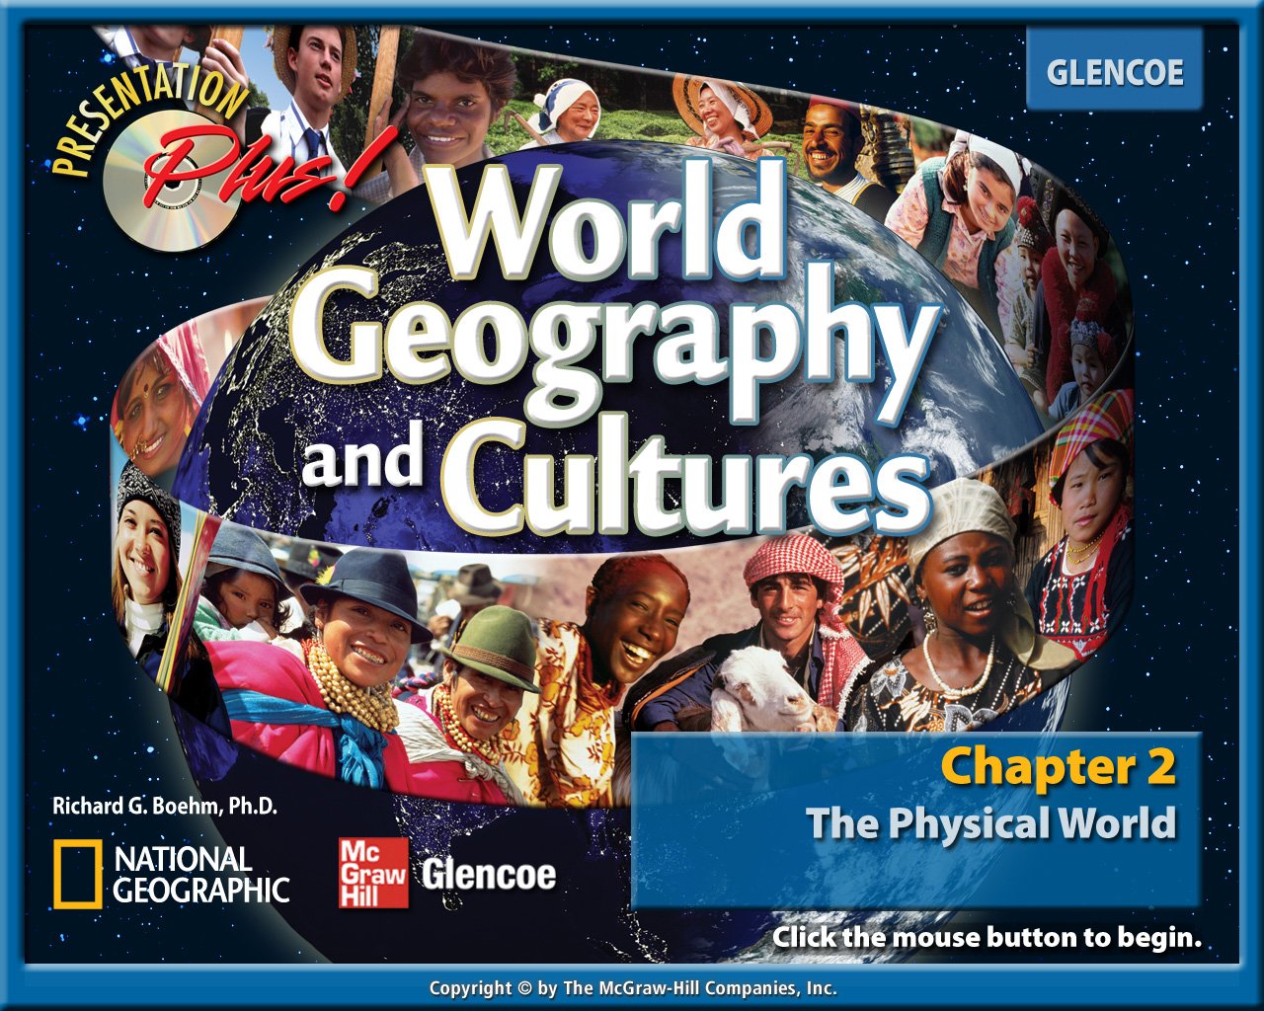
Splash Screen

Slide 2
Chapter Menu
Introduction
Section 1:
Planet Earth
Section 2:
Forces of Change
Section 3:
Earth’s Water
Visual Summary

Slide 3


Chapter Intro 1
Understanding that Earth is part of a larger physical system called the solar system helps us understand how life on our planet is possible. Earth’s physical systems—air, landforms, and water—are affected by natural forces such as earthquakes and volcanoes that can influence human activities on the planet.

Slide 4

Chapter Intro 2
Section 1:
Planet Earth
Physical processes shape Earth’s surface. As part of a larger system called the solar system, Earth has water, land, and air that make the planet suitable for plant and animal life.

Slide 5
Chapter Intro 3
Section 2:
Forces of Change
Physical processes shape Earth’s surface. The surface of the Earth has been shaped by the internal forces of tectonic activity, as well as by the external forces of weathering and erosion.

Slide 6
Chapter Intro 4
Section 3:
Earth’s Water
Physical processes shape Earth’s surface. The water cycle keeps the amount of water on Earth, both freshwater and salt water, fairly constant.

Slide 7
Chapter Preview-End

Slide 8

Section 1-GTR
Planet Earth
Earth is part of a larger system called the solar system. Earth has water, land, and air that make it suitable for plant and animal life.

Slide 9


Section 1-GTR
Planet Earth
hydrosphere
continental shelf
lithosphere
atmosphere
biosphere
approach
features
assistance

Slide 10

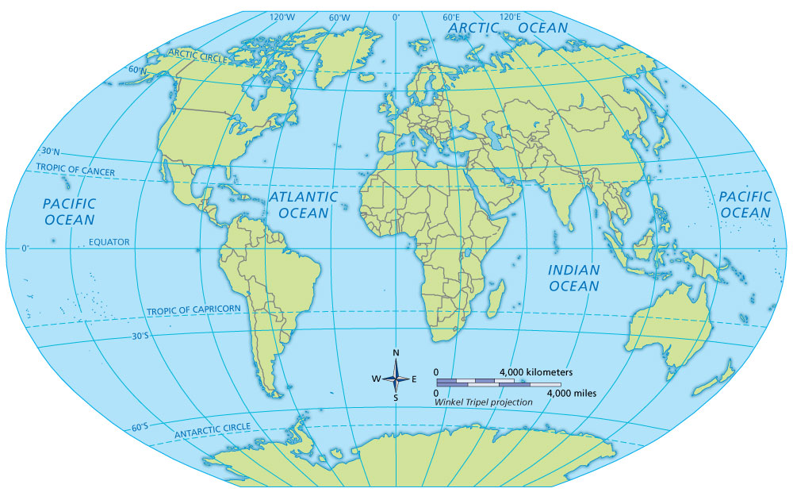





Section 1-GTR
Planet Earth
A. Isthmus of Panama
B. Sinai Peninsula
C. Mount Everest
D. Dead Sea
E. Mariana Trench

Slide 11

Section 1
Planet Earth
Which of the following is at the center of our solar system?
A. Earth
B. Sun
C. Mars
A
B
C

Slide 12

Section 1
Our Solar System
Earth is part of a larger physical system that contains other planets, moons, and stars.
At least eight planets exist, and each is in its own orbit around the sun:
  Mercury
  Venus
  Earth
  Mars

Slide 13
Our Solar System
Jupiter
Saturn
Uranus
Neptune

Slide 14
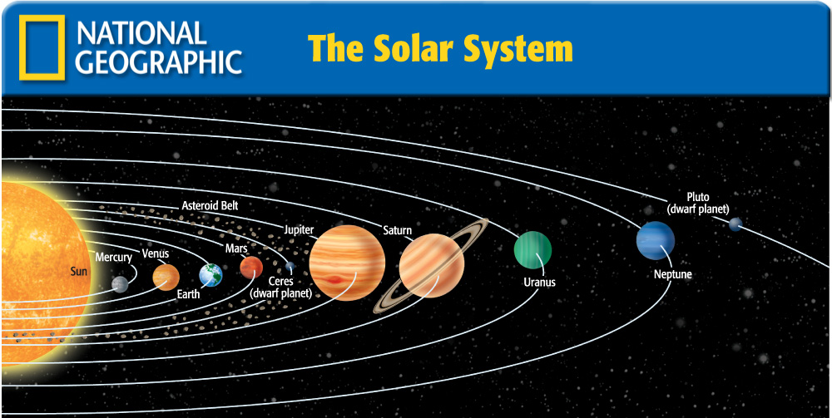

Slide 15
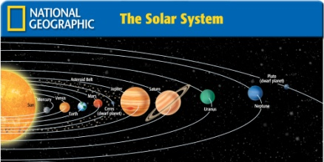
Section 1
Our Solar System (cont.)
Ceres and Pluto are dwarf planets.
All of the planets are grouped into two types—terrestrial and gas giant planets.
Thousand of smaller objects—including asteroids, comets, and meteoroids—revolve around the sun.
The Solar System

Slide 16
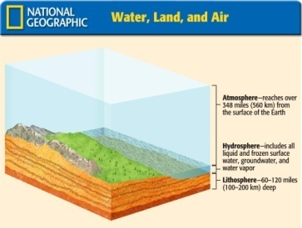
Section 1
Getting to Know Earth
Earth’s surface is a complex mix of landforms and water systems.
About 70% of the surface of the Earth is made up of water and is called the hydrosphere.
About 30% of the surface of the Earth is land, including continents and islands.
The air we breathe is part of the Earth’s atmosphere.
Water, Land, and Air

Slide 17


Slide 18
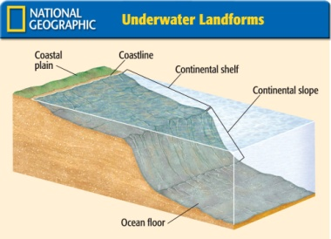
Section 1
Getting to Know Earth (cont.)
The part of the Earth that supports life is the biosphere.
Landforms
Landforms and bodies of water are the natural features of the Earth’s surface.
Underwater landforms are as diverse as those found on dry land.
Seen from space, Earth’s most visible landforms are the seven continents.
Underwater Landforms

Slide 19


Slide 20
Section 1
Getting to Know Earth (cont.)
Earth’s Heights and Depths
The highest point on Earth is Mount Everest, which is 29,035 feet above sea level.
The lowest dry land point is the shore of the Dead Sea, which is 1,349 feet below sea level.
Earth’s deepest known depression is the Mariana Trench, which is 35,827 feet deep.

Slide 21

Section 1-End

Slide 22
Section 2-GTR
Forces of Change
Internal and external forces shape the Earth’s surface.

Slide 23
Section 2-GTR
Forces of Change
core
accretion
spreading
fold
fault
faulting
weathering
erosion
glacier
moraine
mantle
crust
continental drift
plate tectonics
magma
subduction

Slide 24
Section 2-GTR
Forces of Change
releasing
constantly
tension

Slide 25


Section 2-GTR
Forces of Change
A. Himalaya
B. San Andreas Fault
C. Kōbe
D. San Francisco
E. Ring of Fire
F. Greenland
G. Antarctica

Slide 26
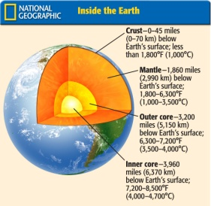
Section 2
Earth’s Structure
The Earth’s internal and external structure, including the tectonic plates, is responsible for the creation of continents, oceans, and mountain ranges.
The Earth is composed of three main layers:
  The core
  The mantle
  The crust
Inside the Earth

Slide 27
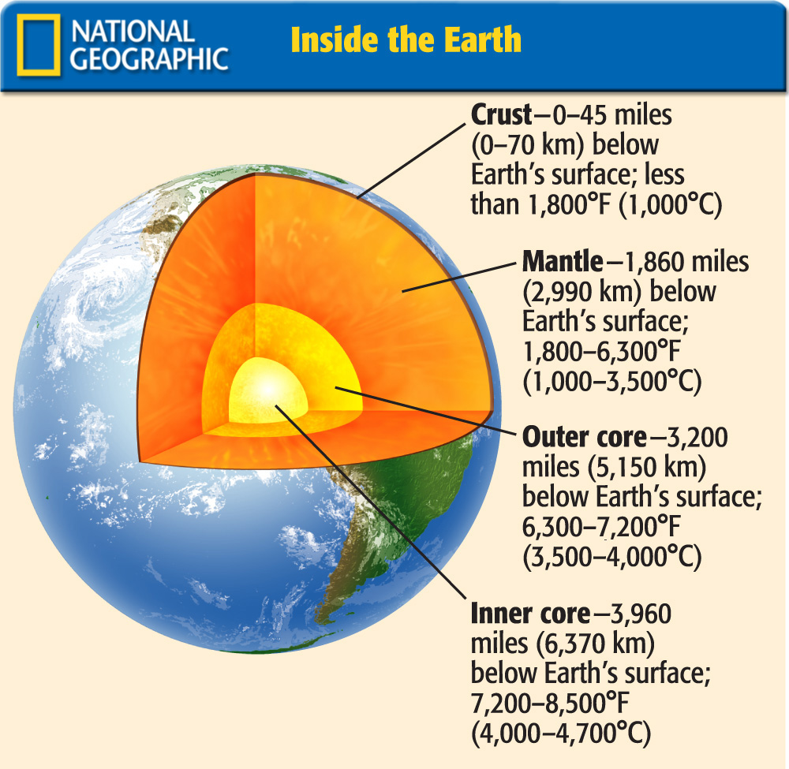

Slide 28
Section 2
Earth’s Structure (cont.)
Many scientists believe that most of the landmasses forming our present-day continents were once part of one gigantic supercontinent called Pangaea.
Due to continental drift, they slowly separated.
Due to plate tectonics, the physical features of the planet are constantly changing.

Slide 29
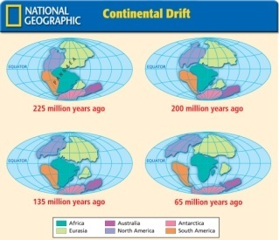
Section 2
Internal Forces of Change
Plate tectonics is responsible for folding, lifting, bending, and breaking parts of the Earth’s surface.
Mountains are formed when:
  giant continental plates collide
  a sea plate collides with a continental plate (called subduction)
Continental Drift

Slide 30
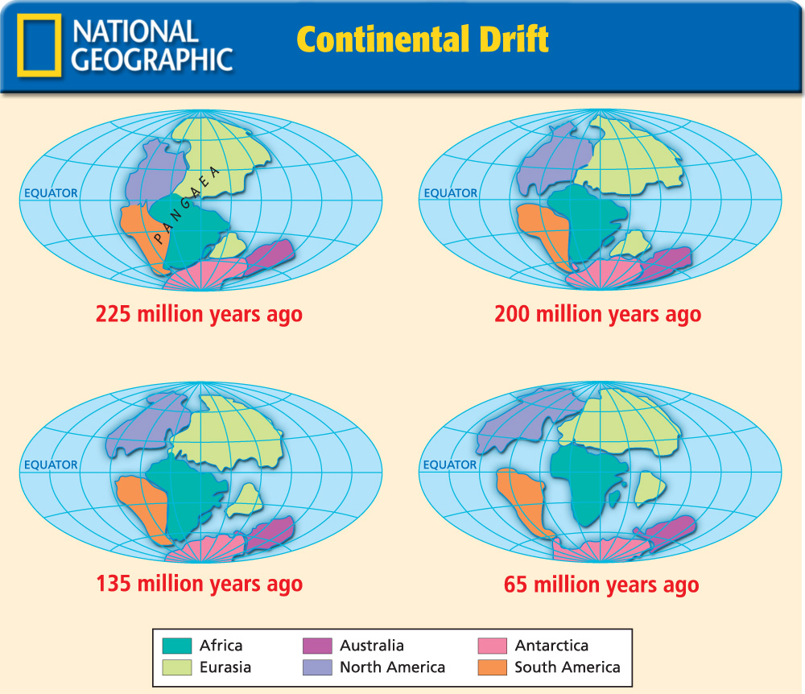

Slide 31
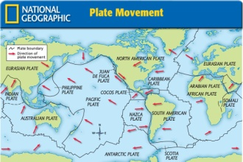
Section 2
Internal Forces of Change (cont.)
During accretion, continents can grow outward.
If two sea plates converge, an island chain may form.
If spreading occurs, the magma that rises will form undersea volcanic mountains or ridges and some islands.
Plate Movement

Slide 32
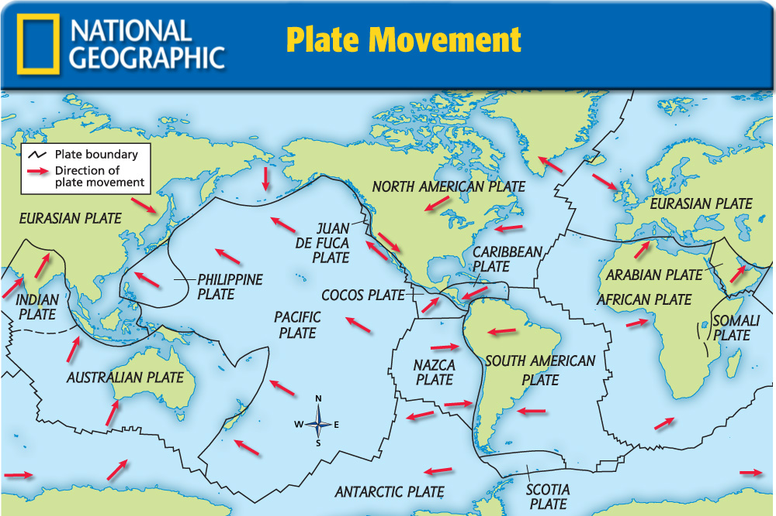

Slide 33
Section 2
Internal Forces of Change (cont.)
Folds and Faults
Moving plates may squeeze the Earth’s surface until it buckles (called folds).
Plates may also grind or slide past each other, creating cracks in the Earth’s crust (called faults).
One famous fault is the San Andreas Fault in California.

Slide 34
Section 2
Internal Forces of Change (cont.)
Earthquakes
Sudden, violent movements of tectonic plates along a fault line are known as earthquakes. These shaking activities dramatically change the surface of the land and the floor of the ocean.
Earthquakes often occur where plates meet. Tension builds up along fault lines as the plates stick
The Ring of Fire is one of the most earthquake-prone areas on the planet.

Slide 35
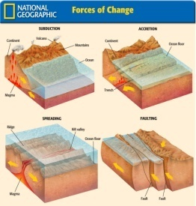
Section 2
Internal Forces of Change (cont.)
Volcanic Eruptions
Volcanoes are mountains formed by lava or by magma that breaks through the Earth’s crust.
Volcanoes often rise along plate boundaries where one plate plunges beneath another, as along the Ring of Fire. In such a process, the rocky plate melts as it dives downward into the hot mantle.
Forces of Change

Slide 36
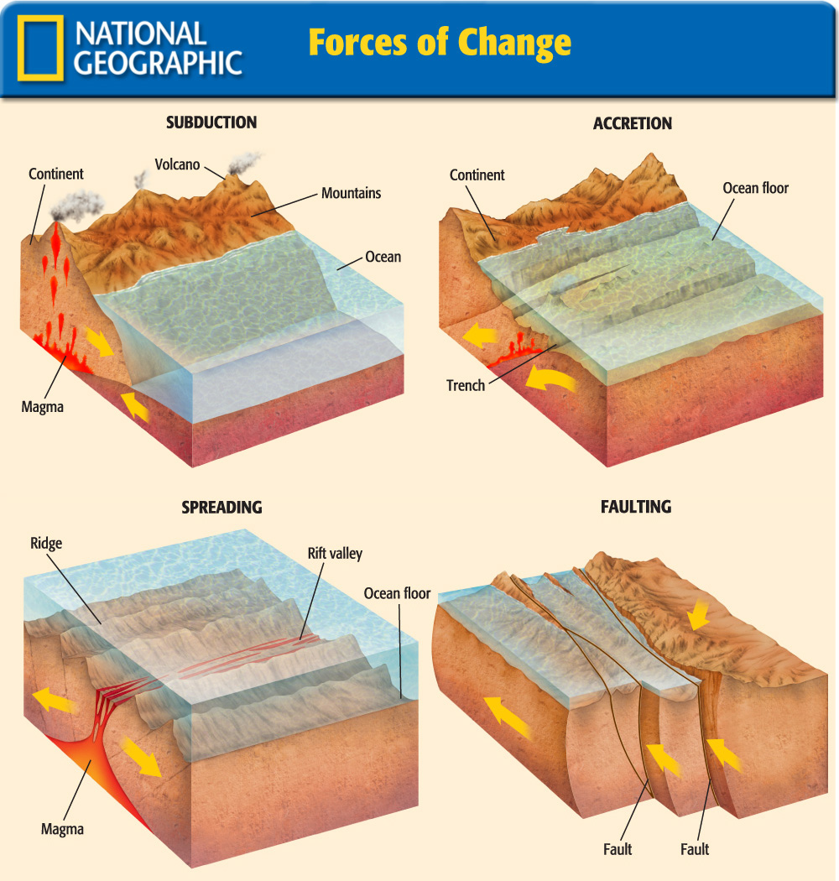

Slide 37
Section 2
External Forces of Change
External forces such as weathering and erosion also shape the surface of the Earth.
The Earth is changed by two basic kinds of weathering:
  Physical weathering – occurs when large masses of rock are physically broken down into smaller pieces.
  Chemical weathering- changes the chemical makeup of rocks. For example, rain water that contains carbon dioxide from the air easily dissolves certain rocks, such as limestone.

Slide 38
Section 2
External Forces of Change (cont.)
Wind Erosion
Wind erosion involves the movement of dust, sand, and soil from one place to another.
Plants help protect the land from wind erosion; however, in dry places where people have cut down trees and plants, winds pick up large amounts of soil and blow it away.
Wind erosion can provide some benefits. The dust carried by wind often forms large deposits of mineral rich soil.

Slide 39
Section 2
External Forces of Change (cont.)
Glacial Erosion
As glaciers move, they may destroy forests, carve out valleys, alter courses of rivers, and wear down mountaintops, changing the landscape.
There are two types of glaciers:
Sheet glaciers- flat, broad sheets of ice. Today sheet glaciers cover most of Greenland and all of Antarctica.
Mountain glaciers- located in high mountain valleys where the climate is cold, gouge out round U-Shaped valleys as they move downhill

Slide 40
Section 2
External Forces of Change (cont.)
Water Erosion
Water erosion begins when springwater and rainwater flow downhill in streams, cutting into the land, and wearing away the soil and rock.

Slide 41

Section 2
Which external force of change is responsible for the Grand Canyon?
A. Weathering
B. Erosion
A
B

Slide 42

Section 2-End

Slide 43
Section 3-GTR
Earth’s Water
Earth’s water cycle keeps the amount of water on our planet, both freshwater and salt water, fairly constant.

Slide 44
Section 3-GTR
Earth’s Water
water cycle
desalination
groundwater
aquifer
evaporation
condensation
precipitation
area
source
focus

Slide 45
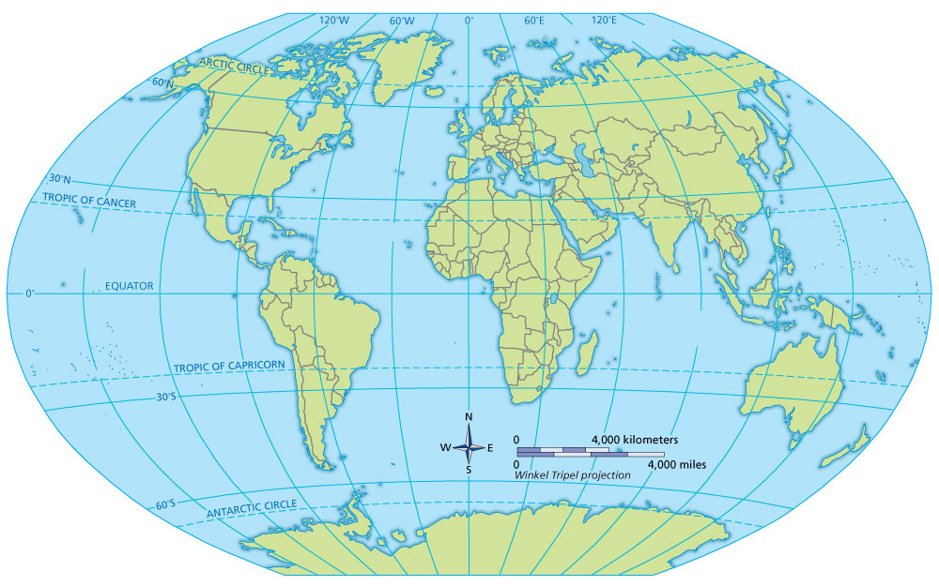
Section 3-GTR
Earth’s Water
A. Pacific Ocean
B. Atlantic Ocean
C. Indian Ocean
D. Arctic Ocean
E. Mediterranean Sea
F. Gulf of Mexico

Slide 46
Section 3
Earth’s Water
The total amount of water on earth
A. Always changes.
B. Never changes.
C. Sometimes changes.
A
B
C

Slide 47
Section 3
The Water Cycle
The amount of water on Earth remains fairly constant and moves in the water cycle.
The Earth’s water is constantly moving—from the oceans to the air to the land and finally back to the ocean.

Slide 48
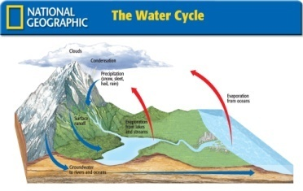
Section 3
The Water Cycle (cont.)
The process involves:
Evaporation
Condensation
Precipitation
The Water Cycle

Slide 49
Section 3
In which part of the water cycle does vapor change back into liquid?
A. Evaporation
B. Condensation
C. Precipitation
A
B
C

Slide 50
Section 3
Bodies of Salt Water
Salt water covers much of the Earth’s surface.
Oceans
  About 97% of the Earth’s water is saltwater in the form of oceans, seas, gulfs, and bays.

Slide 51
Section 3
Bodies of Salt Water (cont.)
The four oceans are:
The Pacific
The Atlantic
The Indian
The Arctic

Slide 52
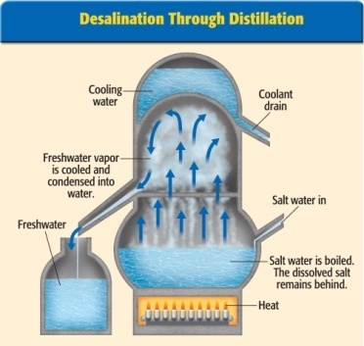
Section 3
Bodies of Salt Water (cont.)
Salt Water to Freshwater
Today, efforts focus on ways to meet the world’s increasing need for freshwater, such as turning ocean water into freshwater by removing the salt (called desalination).
Desalination Through Distillation

Slide 53
Section 3
Which ocean is the largest?
A. Pacific
B. Atlantic
C. Indian
D. Arctic
A
B
C
D

Slide 54
Section 3
Bodies of Freshwater
Although there is a small amount of freshwater on Earth, it is necessary to sustain life.
Lakes, Streams, and Rivers
  Lakes, streams, and rivers contain less than 1% of the Earth’s freshwater.

Slide 55
Section 3
Bodies of Freshwater (cont.)
Groundwater
About 0.5% of the Earth’s freshwater is found beneath the surface also called groundwater.
Wells and springs tap into groundwater and are important sources of freshwater for people.
The majority of Earth’s freshwater is used in agriculture.

Slide 56
Section 3
How much of the Earth’s total water supply is freshwater?
A. 1%
B. 2%
C. 3%
D. 4%
A
B
C
D

Slide 57

Section 3-End

Slide 58
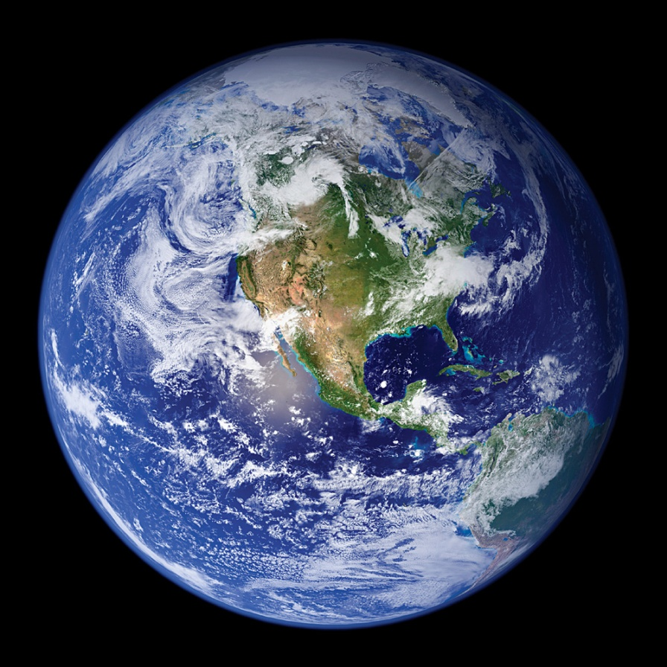
VS 1
Planet Earth
Earth is the third planet from the sun in our solar system. It is one of 4 planets with a solid, rocky crust, and the only planet with liquid water on its surface.
Earth’s proximity to the sun allows for liquid water on the surface needed to sustain life.
Earth also has an atmosphere that protects life from the harmful effects of the sun and keeps the Earth at a temperature suitable for a variety of life forms.

Slide 59
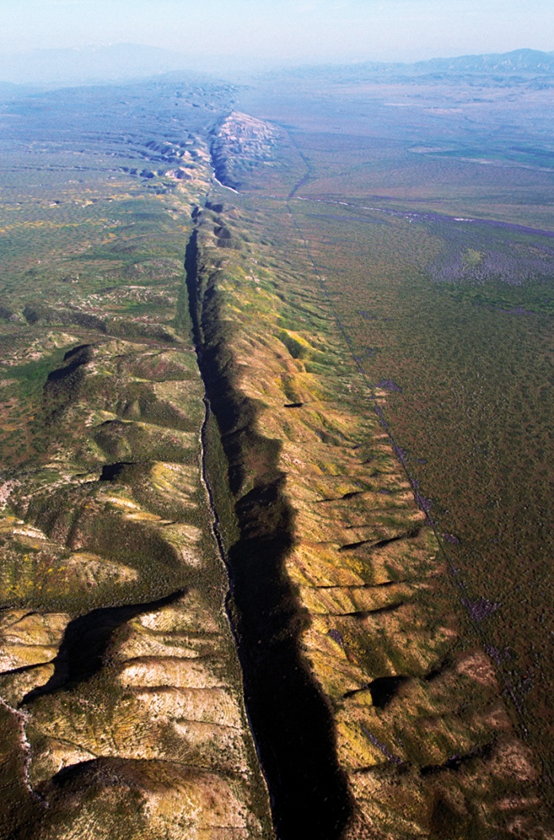
VS 2
Forces of Change
The Earth is shaped by internal and external forces.
Inside the Earth is a superheated, solid inner core.
A liquid outer core is covered
by the hot rock of the mantle.
The Earth’s crust, made up of more than a dozen slabs, rests on a melted layer of mantle. These slabs move around the globe, creating physical features.
Wind and water erosion shape the surface of the Earth.

Slide 60
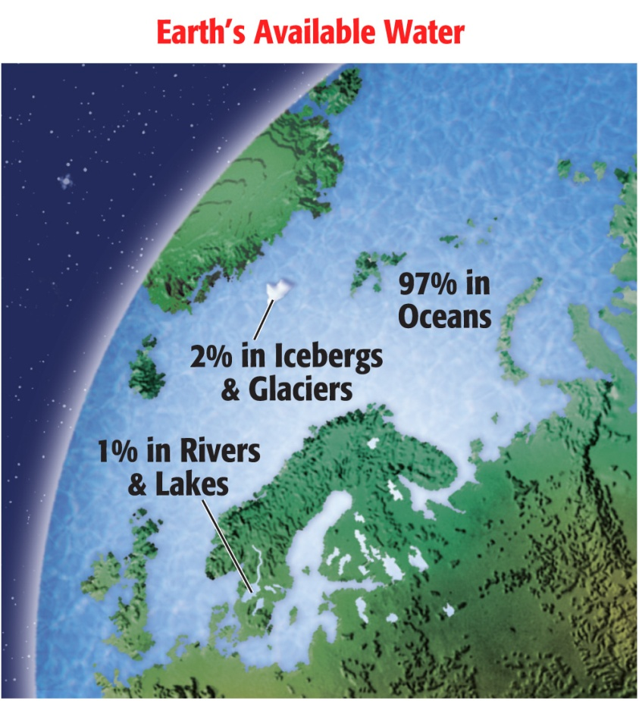
VS 3
Earth’s Water
The water cycle keeps Earth’s water constantly moving—water evaporates from oceans, lakes and streams. Then it cools, becomes condensation, and falls to Earth as precipitation.
Most of Earth’s water is found in the oceans. The rest is frozen in glaciers, found underground, or in lakes, rivers and streams.
Because most of Earth’s water is salty ocean water, people have found a way to remove the salt from water. Desalination is expensive, but useful in places where freshwater is scarce.

Slide 61

VS-End

Slide 62
Figure 1

Slide 63
Figure 2

Slide 64
Figure 3

Slide 65

Figure 4

Slide 66

Figure 5

Slide 67
Figure 6

Slide 68
Figure 7

Slide 69
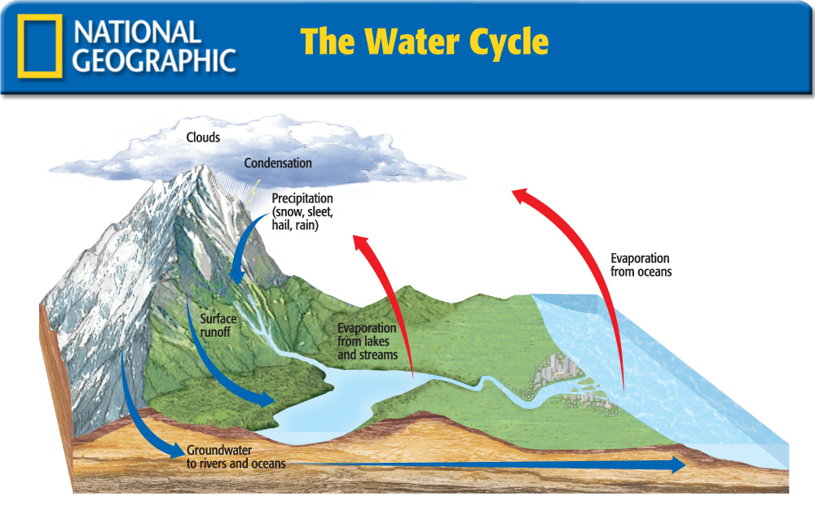
Figure 8

Slide 70
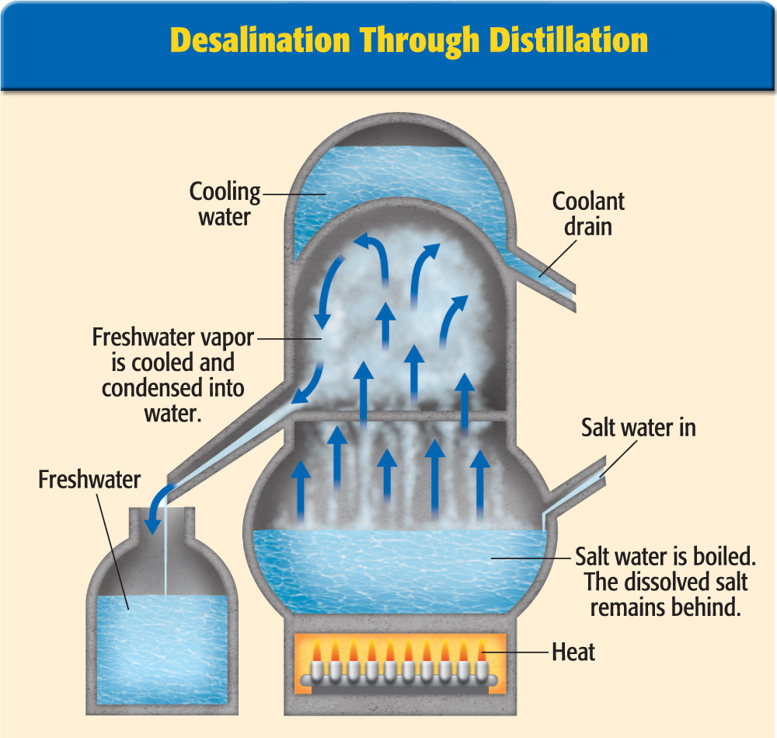
Figure 9

Slide 71
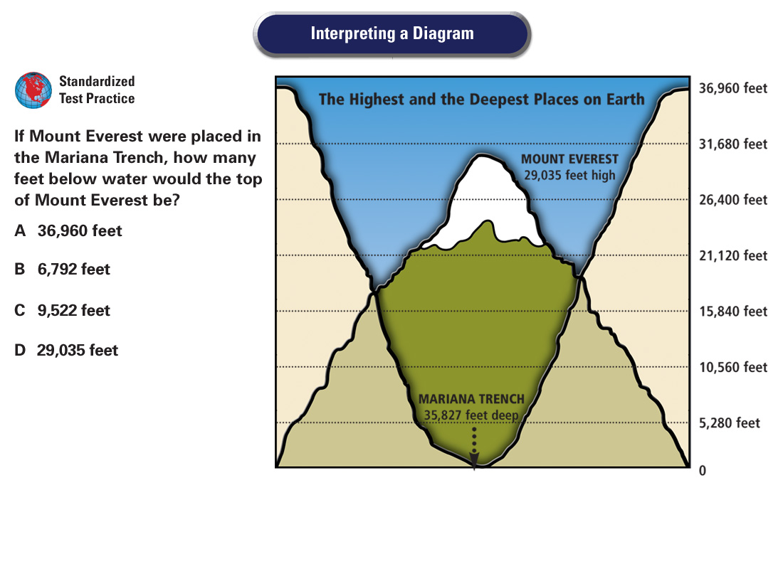
DFS Trans 1

Slide 72
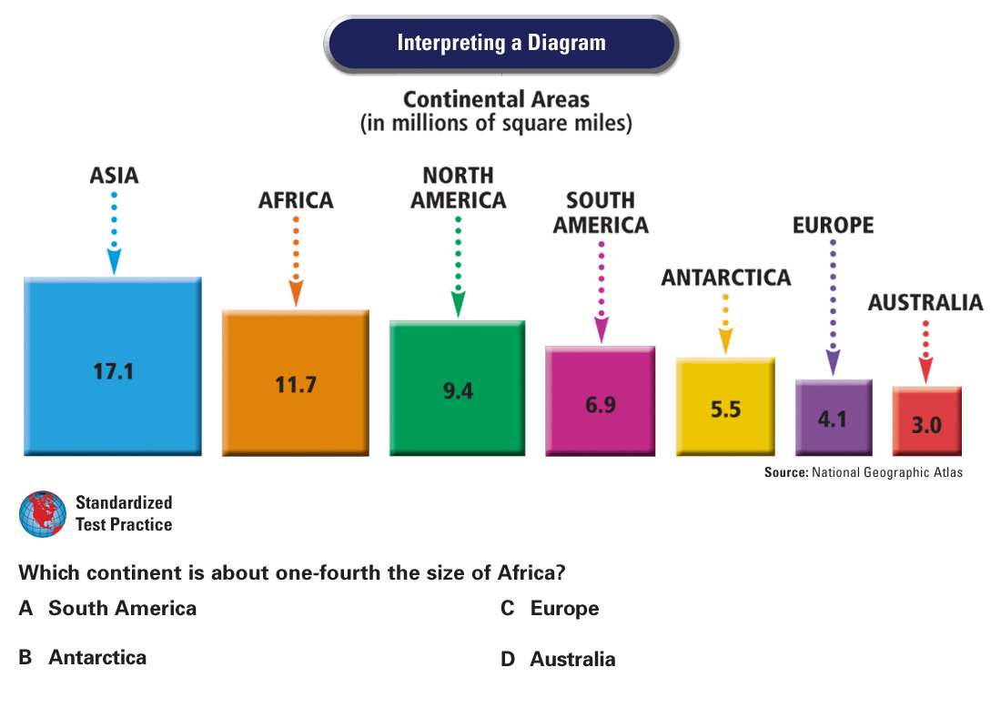
DFS Trans 2

Slide 73
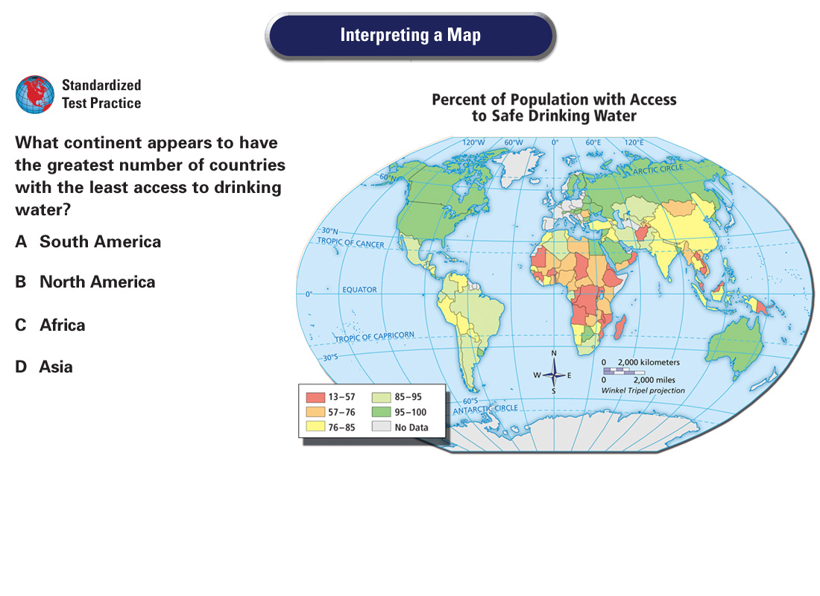
DFS Trans 3

Slide 74
Vocab1
hydrosphere
the watery areas of the earth, including oceans, lakes, rivers, and other bodies of water

Slide 75
Vocab2
lithosphere
surface land areas of the earth’s crust, including continents and ocean basins

Slide 76
Vocab3
atmosphere
a layer of gases that surrounds the Earth

Slide 77
Vocab4
biosphere
the part of the Earth where life exists

Slide 78
Vocab5
continental shelf
the part of a continent that extends underwater

Slide 79
Vocab6
core
the innermost layer of the Earth. Made up of a super-hot but solid inner core and a liquid outer core

Slide 80
Vocab7
mantle
thick middle layer of the Earth’s interior structure, consisting of dense, hot rock

Slide 81
Vocab8
crust
the rocky shell forming the Earth’s surface

Slide 82
Vocab9
continental drift
the theory that the continents were once joined and then slowly drifted apart

Slide 83
Vocab10
plate tectonics
the term scientists use to describe the activities of continental drift and magma flow which create many of Earth’s physical features

Slide 84
Vocab11
magma
molten rock that is pushed up from the Earth’s mantle

Slide 85
Vocab12
subduction
a process by which mountains can form as sea plates dive beneath continental plates

Slide 86
Vocab13
accretion
a slow process in which a sea plate slides under a continental plate, creating debris that can cause continents to grow outward

Slide 87
Vocab14
spreading
a process by which new land is created when sea plates pull apart and magma wells up between the plates

Slide 88
Vocab15
fold
a bend in layers of rock, sometimes caused by plate movement

Slide 89
Vocab16
fault
a crack or break in the Earth’s crust

Slide 90
Vocab17
faulting
a process of cracking that occurs when folded land cannot be bent any further

Slide 91
Vocab18
weathering
chemical or physical processes, such as freezing, that break down rocks

Slide 92
Vocab19
erosion
wearing away of the Earth’s surface by wind, flowing water, or glaciers

Slide 93
Vocab20
glacier
large body of ice that moves across the surface of the earth

Slide 94
Vocab21
moraine
piles of rocky debris left by melting glaciers

Slide 95
Vocab22
water cycle
regular movement of water from ocean to air to ground and back to the ocean

Slide 96
Vocab23
evaporation
process of converting into vapor

Slide 97
Vocab24
condensation
the process of excess water vapor changing into liquid water when warm air cools

Slide 98
Vocab25
precipitation
moisture that falls to the earth as rain, sleet, hail, or snow

Slide 99
Vocab26
desalination
the removal of salt from seawater to make it usable for drinking and farming

Slide 100
Vocab27
groundwater
water within the Earth that supplies wells and springs

Slide 101
Vocab28
aquifer
underground water-bearing layers of porous rock, sand, or gravel

Slide 102








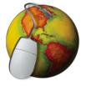
Help
To navigate within this Presentation Plus! product:
Click the Forward button to go to the next slide.
Click the Previous button to return to the previous slide.
Click the Return button to return to the main presentation.
Click the Home button to return to the Chapter Menu.
Click the Help button to access this screen.
Click the Exit button or press the Escape key [Esc] to end the
chapter slide show.
Links to Maps in Motion, static maps and charts, and transparencies appear near the bottom of slides as they are relevant.
Links to the Reference Atlas and Geography Online are located on the navigation bar of most screens.

Slide 103
End of Custom Shows
This slide is intentionally blank.

