Slide 1
EARTH IN SPACE

Slide 2
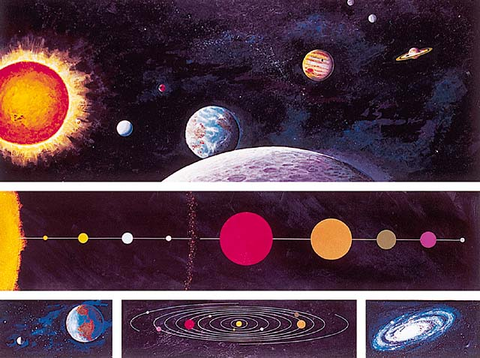
Artist's concept of the solar system. Shown are the orbits of the planets, Earth being the third planet from the Sun, and the other planets and their relative sizes and distances from each other and to the Sun. Also shown is the solar system as seen looking toward Earth from the Moon.

Slide 3
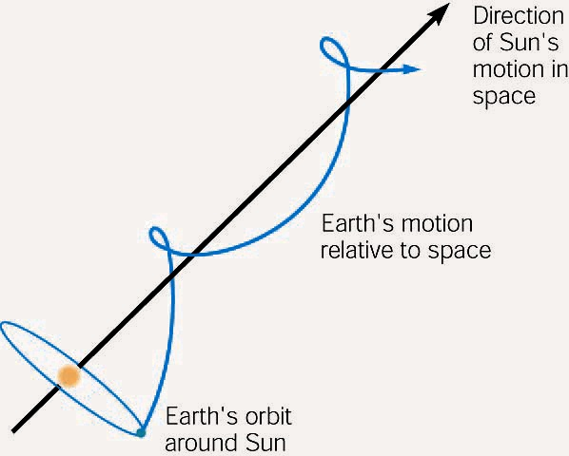
Earth undergoes many different motions as it moves through space. There are seven more conspicuous motions, three of which are more obvious on the surface. Earth follows the path of a gigantic helix, moving at fantastic speeds as it follows the Sun and the galaxy through space.

Slide 4
Eratosthenes calculated the size of Earth's circumference after learning that the Sun's rays were vertical at Syene at noon on the same day they made an angle of a little over 7^{O} at Alexandria.
  He reasoned that the difference was due to Earth's curved surface.
  Since 7^{O} is about 1/50 of 360^{O}, then the size of Earth's circumference had to be fifty times the distance between the two towns. (The angle is exaggerated in the diagram for clarity.)

Slide 5
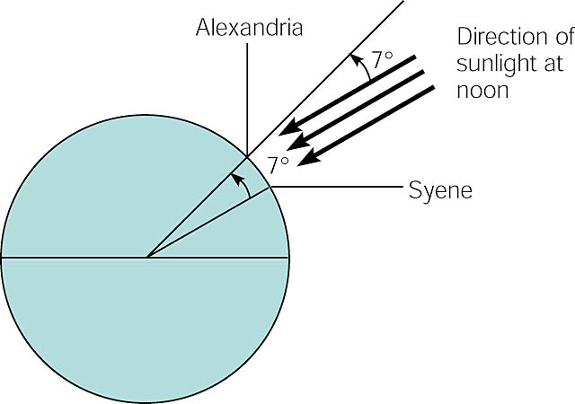

Slide 6
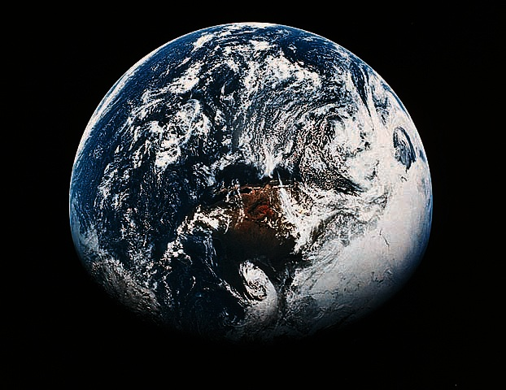
Earth as seen from space.

Slide 7
Shape and Size of the Earth

Slide 8
The solar system is a disk shaped nebula with a turning, swirling motion.
Plane of the ecliptic
Ancient Greeks though the Earth was round due to:
  Since a sphere was perfect as was the Earth, it made perfect sense that the Earth should be a sphere.
  The Earth cast a circular shadow on the moon during a lunar eclipse.
  As ships sailed away they were observed to disappear over the horizon.

Slide 9
The Earth is not round.
  It is now known that the Earth is not a perfect sphere.
  The Earth is actually oblate.
    Flattened at the poles.
    Has an equatorial bulge.
  The North Pole is slightly higher and the South Pole slightly lower than the average surface
  The Equator has a bulge and the Pacific Ocean and a depression at the Indian Ocean.

Slide 10
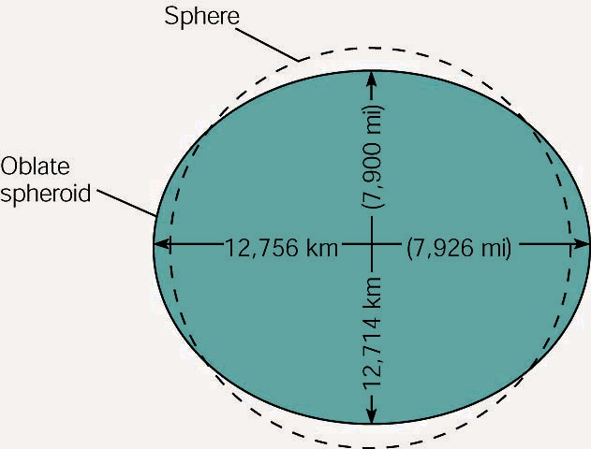
Earth has an irregular, slightly lopsided, slightly pear-shaped form. In general, it is considered to have the shape of an oblate spheroid, departing from a perfect sphere as shown here.

Slide 11
Motions of Earth

Slide 12
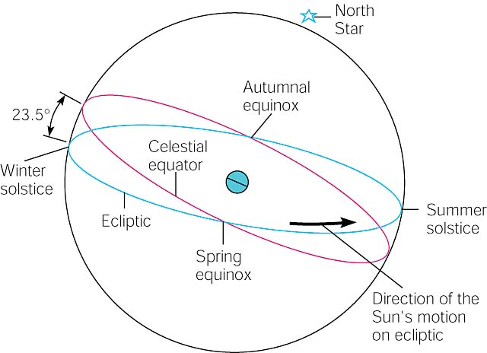
The position of the Sun on the celestial sphere at the solstices and the equinoxes.

Slide 13
Introduction
  The Earth has 3 motions that are independent of the motion of the Sun and the Galaxy
    The Earth has a yearly rotation around the Sun
    The Earth rotates on its axis once approximately every 24 hours.
    The Earths axis wobbles slowly as it revolves.

Slide 14
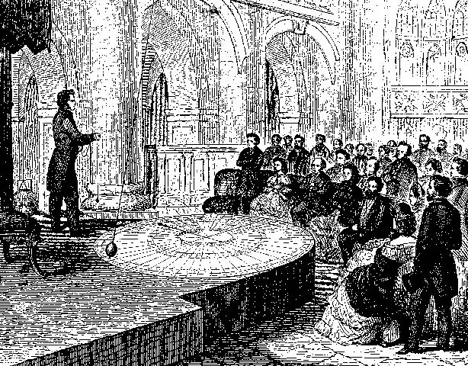
As is being demonstrated in this old woodcut, Foucault's insight helped people understand that the earth turns. The pendulum moves back and forth without changing its direction of movement, and we know this is true because no forces are involved. We turn with the earth and this makes the pendulum appear to change its plane of rotation. Thus we know the earth rotates.

Slide 15
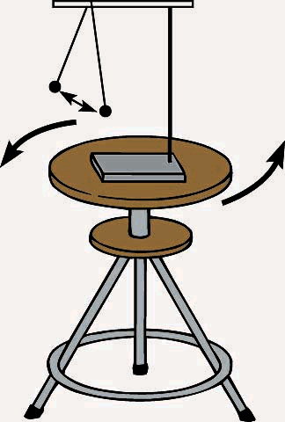
The Foucault pendulum swings back and forth in the same plane while a stool is turned beneath it. Likewise, a Foucault pendulum on the earth's surface swings back and forth in the same plane while the earth turns beneath it. The amount of turning observed depends on the latitude of the pendulum.

Slide 16
Revolution
  Earth’s orbit is slightly elliptical and requires approximately one year to complete.
  All points in the Earth’s orbit form a plant called the plane of the ecliptic
  The average distance from the Sun to the Earth is 150 million km (about 93 million mi).
  The Earth moves fastest when it is closest to the Sun at perihelion, in January, and moves slowest when it is farthest from the Sun in aphelion, in July

Slide 17
  Solstices
    Summer Solstice
      Occurs about June 22
      The Sun at noon has the highest altitude.
    Winter Solstice
      Occurs about December 22.
      The noon Sun has the lowest altitude

Slide 18
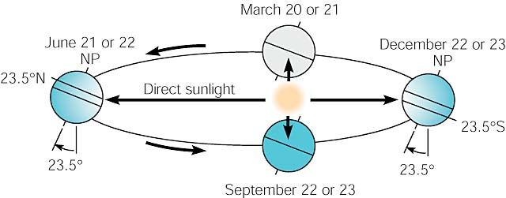
The consistent tilt and orientation of Earth's axis as it moves around its orbit is the cause of the seasons. The North Pole is pointing toward the Sun during the summer solstice and away from the Sun during the winter solstice.

Slide 19
  Equinox
    When the Sun is halfway between the Summer and Winter Solstice
    At this time the Earth’s axis is perpendicular to line between the center of the Sun and Earth and daylight and night are of equal length.
    Spring Equinox
      Occurs on March 21
      Beginning of Spring
    Autumnal Equinox
      Occurs on September 23
      Beginning of Fall

Slide 20
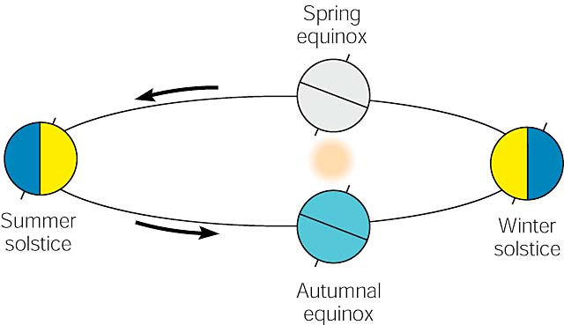
The length of daylight during each season is determined by the relationship of Earth's shadow to the tilt of the axis. At the equinoxes, the shadow is perpendicular to the latitudes, and day and night are of equal length everywhere. At the summer solstice, the North Pole points toward the Sun and is completely out of the shadow for a twenty-four-hour day. At the winter solstice, the North Pole is in the shadow for a twenty-four-hour night. The situation is reversed for the South Pole.

Slide 21
Rotation
  We know that the Earth rotates due to
    The other planets rotate
    A pendulum changes its plane at different latitudes
    The observation of something moving above the Earth’s surface, such as a jet.
  The rotation of the Earth causes the Coriolis Effect which is an apparent deflection of moving objects to the right in the Northern Hemisphere and to the left in the Southern Hemisphere.

Slide 22
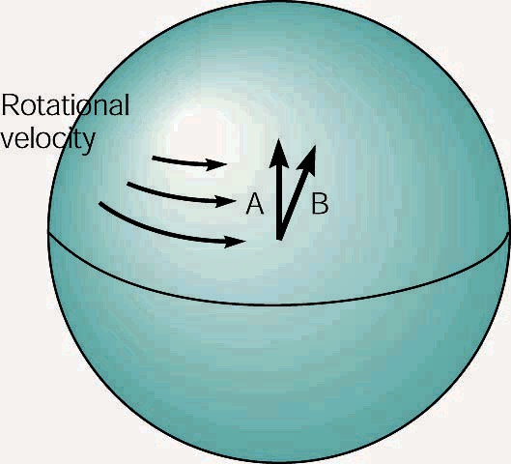
The earth has a greater rotational velocity at the equator and less toward the poles. As an object moves north or south (A), it passes over land with a different rotational velocity, which produces a deviation to the right in the Northern Hemisphere (B) and to the left in the Southern Hemisphere.

Slide 23
Precession
  This is the slow wobble of the Earth on its axis
  Causes the Earth to swing in a slow circle like a top.

Slide 24
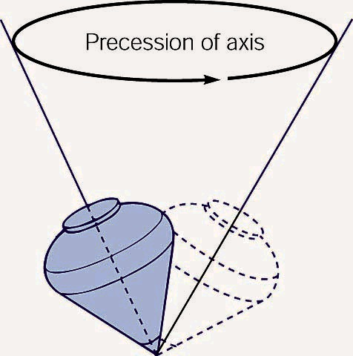
A spinning top wobbles as it spins, and the axis of the top traces out a small circle. The wobbling of the axis is called precession.

Slide 25
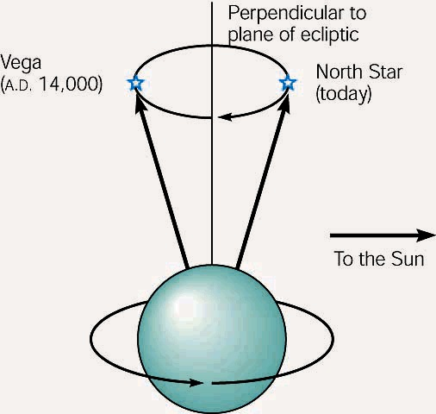
The slow, continuous precession of the earth's axis results in the North Pole pointing around a small circle over a period of about 26,000 years.

Slide 26
Place and Time

Slide 27
Identifying Place
  The Earth’s axis identifies the north-south referent
  East west parallel circles on the Earth are called parallels
    The distance from the equator to a point on a parallel is called a latitude.
  North south running arcs are called meridians.
    The Prime meridian is the referent meridian that runs through Greenwich Observatory near London, England.
    The distance from the prime meridian east or west is the Longitude.

Slide 28
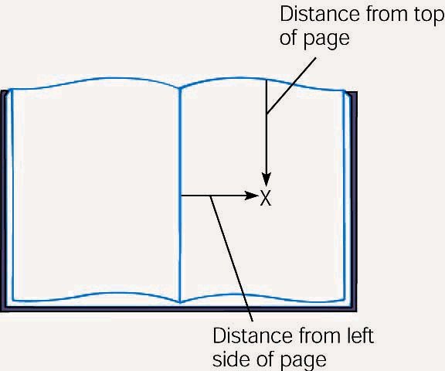
Any location on a flat, two-dimensional surface is easily identified with two references from two edges. This technique does not work on a motionless sphere because there are no reference points.

Slide 29
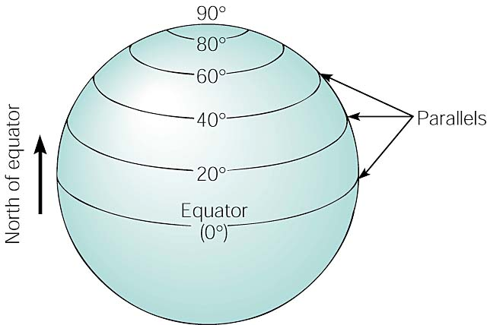
A circle that is parallel to the equator is used to specify a position north or south of the equator. A few of the possibilities are illustrated here.

Slide 30
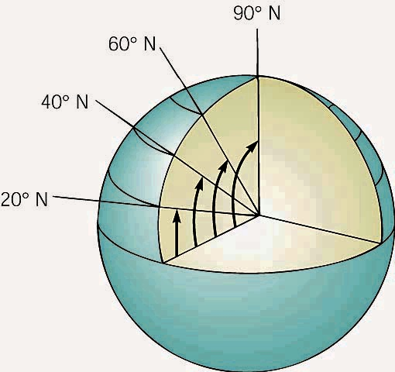
If you could see to the earth's center, you would see that latitudes run from 0^{O} at the equator north to 90^{O} at the North Pole (or to 90^{O} south at the South Pole).

Slide 31
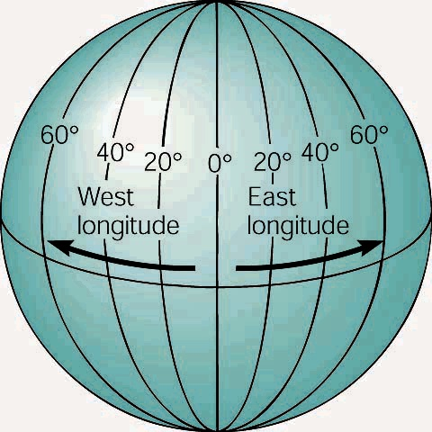
Meridians run pole to pole perpendicular to the parallels and provide a reference for specifying east and west directions.

Slide 32
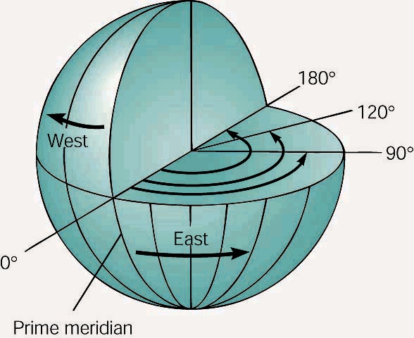
If you could see inside the earth, you would see 360^{O} around the equator and 180^{O} of longitude east and west of the prime meridian.

Slide 33
  Some parallels are important for climate changes
    Tropic of Cancer
      23.5^{O}N parallel
    Tropic of Capricorn
      23.5^{O}S parallel
    Both of these are the parallels where the limit of the tilt of the Earth toward the Sun is reached.
    Artic Circle
      66.5 ^{O}N
    Antarctic Circle
      66.5^{O}S
    These two parallels identify the limits to where the Sun appears above the horizon all day during the summer time

Slide 34
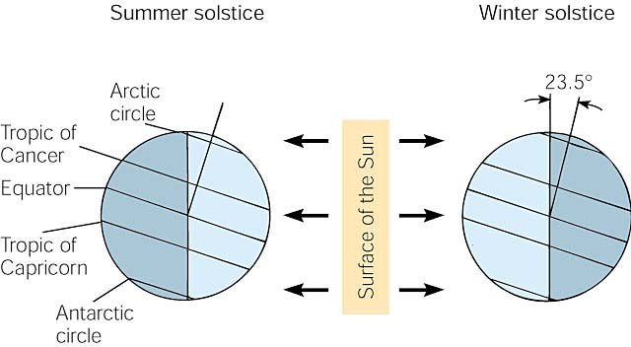
At the summer solstice, the noon Sun appears directly overhead at the tropic of Cancer (23.5(N) and twenty-four hours of daylight occurs north of the Arctic circle (66.5(N). At the winter solstice, the noon Sun appears overhead at the tropic of Capricorn (23.5(S) and twenty-four hours of daylight occurs south of the Antarctic circle (66.5(S).

Slide 35
Measuring Time
  Daily time
    A sidereal day is 23 hours, 56 minutes, and 4 seconds
      This corresponds to the interval between two crossings of the celestial meridian by a particular star.
    A mean solar day is 24 hours long

Slide 36
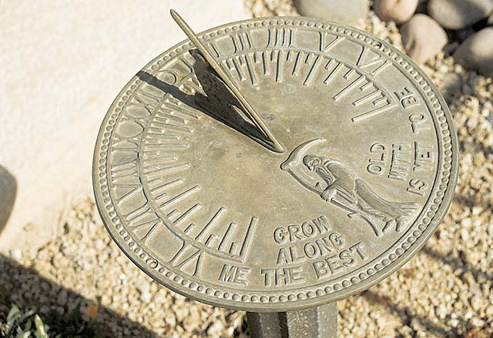
A sundial indicates the apparent local solar time at a given instant in a given location. The time read from a sundial, which is usually different from the time read from a clock, is based on an average solar time.

Slide 37
  Yearly time
    The time required for the Earth to make one complete revolution around the Sun.
    A tropical year is the time between two spring equinoxes
    A sidereal year is the time required for the Earth to move around the Sun once.
      A sidereal year is 365.25636 mean solar days.
      This leaves about ¼ of a day per year unaccounted for.
      The Julian calendar accounts for this by adding a day every 4th year.
      The Gregorian calendar drops the leap year 3 out of four century years.

Slide 38
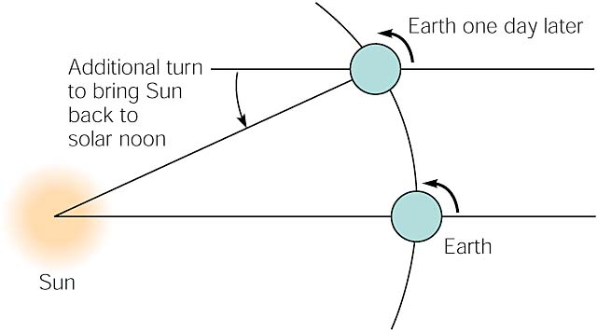
Because earth is moving in orbit around the sun, it must rotate an additional distance each day, requiring about 4 minutes to bring the sun back across the celestial meridian (local solar noon). This explains why the stars and constellations rise about 4 minutes earlier every night.

Slide 39
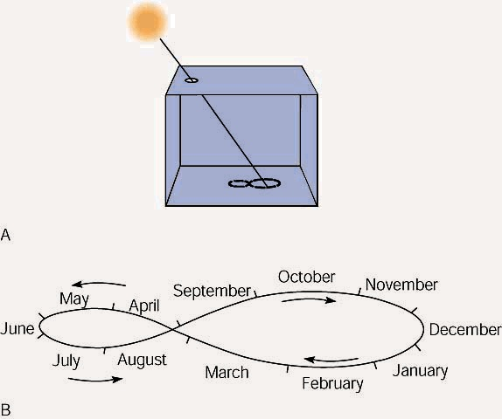
(A)During a year, a beam of sunlight traces out a lopsided figure eight on the floor if the position of the light is marked at noon every day. (B) The location of the point of light on the figure eight during each month.

Slide 40
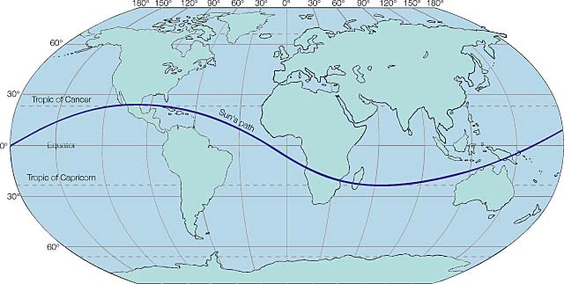
The path of the Sun's direct rays during a year. The Sun is directly over the tropic of Cancer at the summer solstice and high in the Northern Hemisphere sky. At the winter solstice, the Sun is directly over the tropic of Capricorn and low in the Northern Hemisphere sky.

Slide 41
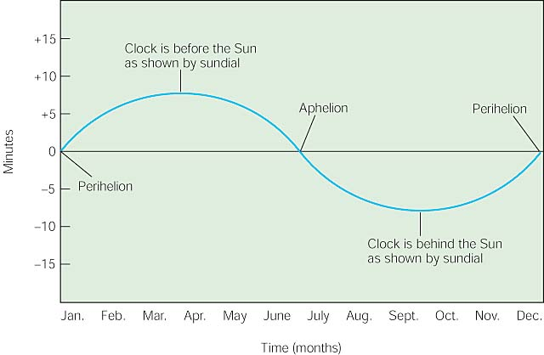
The difference in sundial time and clock time throughout a year as a consequence of the shape of the earth's orbit. This is not the only factor that causes a difference in the two clocks.

Slide 42
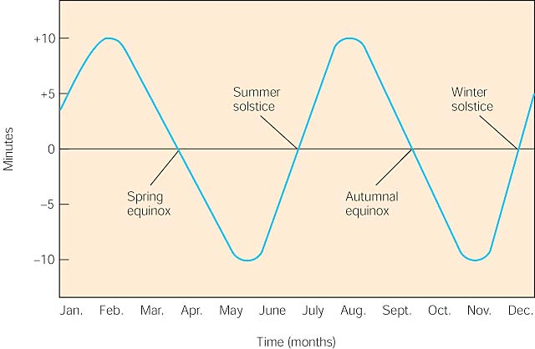
The difference in sundial time and clock time throughout a year as a consequence of the angle between the plane of the ecliptic and the plane of the equator.

Slide 43
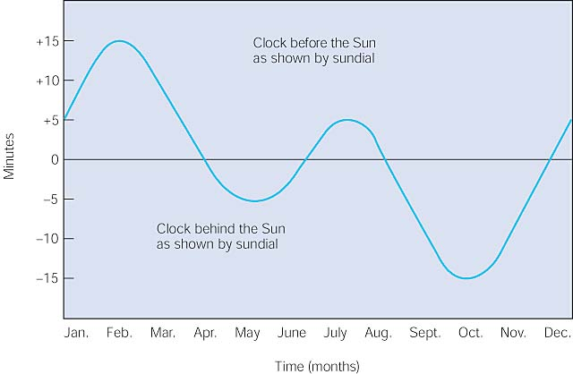
The equation of time, which shows how many minutes sundial time is faster or slower than clock time during different months of the year.

Slide 44
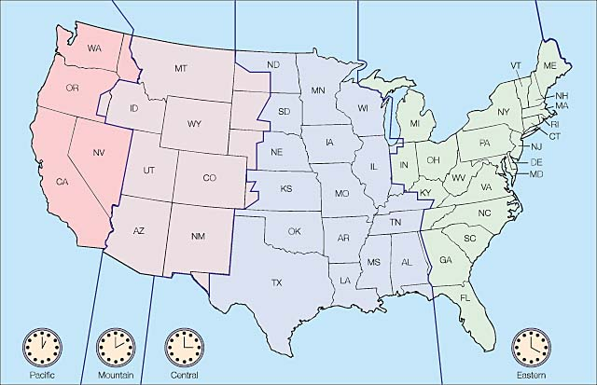
The standard time zones. Hawaii and most of Alaska are two hours earlier than Pacific Standard Time.

Slide 45
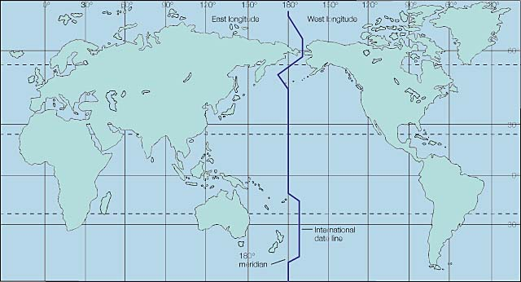
The international date line follows the 180^{O} meridian but is arranged in a way that land areas and island chains have the same date.

Slide 46
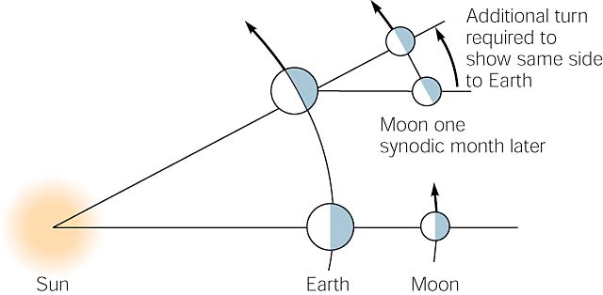
As the Moon moves in its orbit around Earth, it must revolve a greater distance to bring the same part to face Earth. The additional turning requires about 2.2 days, making the synodic month longer than the sidereal month.

Slide 47
  Monthly time
    The current calendar divides the year into 12 months (unequal)
    A sidereal month is about 27 ½ days which is the time it takes for two consecutive crossings of any star.
    A synodic month is 29 ½ days which is the interval between two new Moons.

Slide 48
The Moon

Slide 49
Composition and features
  Covered by 3 m of fine gray dust with microscopic glass beads.
  Rocks are mostly basalt
  Contains a significant amount of radioactive materials
  Crust is about 65 km (40 mi) on the side that faces the Earth and twice that thick on the side that faces away from the Earth
  There is a molten core at about 900 km (600 mi) beneath the surface.

Slide 50
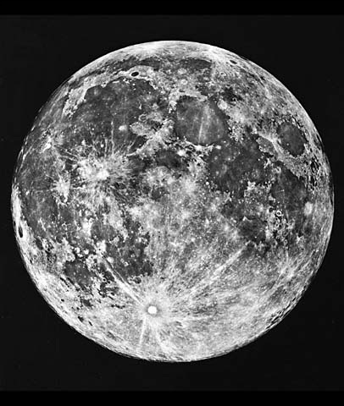
You can easily see the light-colored lunar highlands, smooth and dark maria, and many craters on the surface of Earth's nearest neighbor in space.

Slide 51
History of the Moon
  Origin Stage – 3 theories
    Fission theory
      Formed from part of the Earth that broke away early in the Earths history
    Condensation theory
      Moon and Earth formed at the same time in the solar nebula
    Capture theory
      Moon was captured by Earth’s gravitational field after its formation.

Slide 52
  Molten Surface stage
    Heat melted the entire lunar surface
    Thought to have been heated by impact of rock fragments
  Molten interior stage.
    Radioactive decay slowly heated the interior
    Light and heavy rocks separated during this time
    Molten lava flowed into the basins and formed the maria that are seen today.
  cold and quite stage.
    Moon cooled and has changed little over the last 3 billion years.

Slide 53
The Earth-Moon system

Slide 54
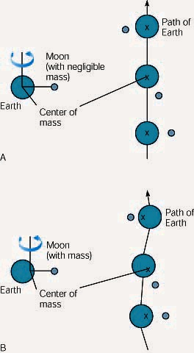
(A)If the Moon had a negligible mass, the center of gravity between the Moon and Earth would be Earth's center, and Earth would follow a smooth orbit around the Sun. (B) The actual location of the center of mass between Earth and Moon results in a slightly in and out, or wavy, path around the Sun.

Slide 55
Phases of the Moon
  Result of the changing relative positions of the Earth, the Moon, and the Sun as this system moves around the Sun.
  Full moon
    When the moon is on the dark side if the Earth.
    The moon is fully illuminated by the Sun and we see the entire surface of the Moon
  New Moon
    When the Moon is on the lighted side of the Earth.
    The side of the Moon away from the Earth is illuminated
  First Quarter
    When the Moon is ¼ of the way around its orbit we see ½ of its lighted surface
    The lighted part is shaped like an arc
  Last Quarter
    Same as the first quarter, but occurs between the full moon and the new Moon.

Slide 56
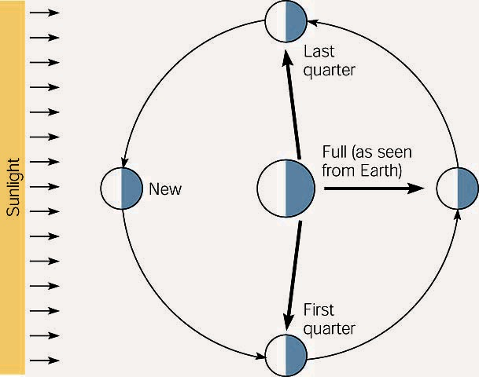
Half of the Moon is always lighted by the Sun, and half is always in the shadow. The Moon phases result from the view of the lighted and dark parts as the Moon revolves around Earth.

Slide 57
Eclipses of the Sun and Moon
  An eclipse is when the shadow of one object falls on the illuminated surface of another.
  The Earth and moons shadows point away as a cone.
    The inner cone of this shadow is called the umbra
    The outer cone of this shadow is called the penumbra
  Total solar eclipse occurs when the umbra of the Moon’s shadow falls on the Earth.
  An annular eclipse occurs when the umbra fails to reach the Earth and the Sun forms a ring around the Moon.
  When the Earth, the Moon, and the Sun are lined up so that the shadow of the Earth falls on the Moon it is called a Lunar Eclipse

Slide 58
Tides
  There is an intricate relationship between the motions of the Moon and tides in the Earth’s oceans.
  The greatest range of tides occurs at full and new Moon phases.
  The least range of tides occurs at quarter Moon phases.
  The time between two high tides or between two low tides in 12 hours and 25 minutes which is ½ of the time for passes of the Moon across the celestial meridian.

Slide 59
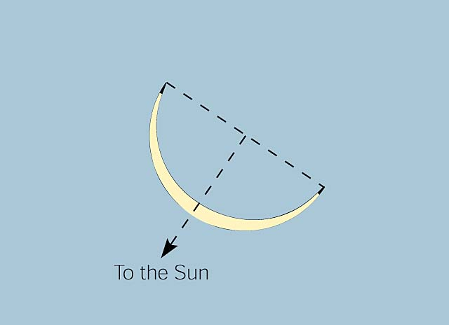
The cusps, or horns, of the Moon always point away from the Sun. A line drawn from the tip of one cusp to the other is perpendicular to a straight line between the Moon and the Sun.

Slide 60
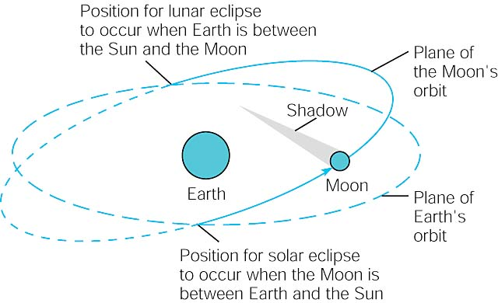
The plane of the Moon's orbit is inclined to the plane of the Earth's orbit by about 5^{O}. An eclipse occurs only where the two planes intersect, and Earth, the Moon, and the Sun are in a line.

Slide 61
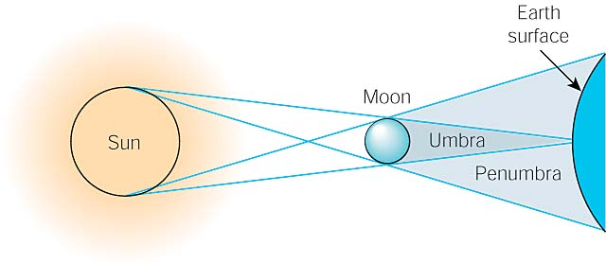
People in a location where the tip of the umbra falls on the surface of the Earth see a total solar eclipse. People in locations where the penumbra falls on the Earth's surface see a partial solar eclipse.

Slide 62
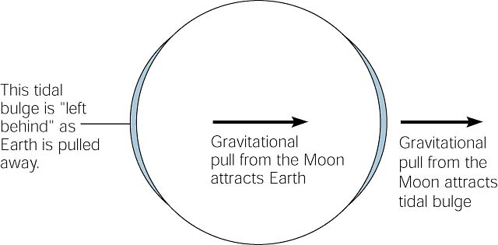
Gravitational attraction pulls on Earth's waters on the side of Earth facing the Moon, producing a tidal bulge. A second tidal bulge on the side of Earth opposite the Moon is produced when Earth, which is closer to the Moon, is pulled away from the waters.

