Slide 1
The Earth as a System
Earth’s Spheres

Slide 2
Earth System Science (ESS)
The study of the interactions between and among events and Earth’s spheres
A relatively new science (1988)

Slide 3
Earth’s Sphere
Atmosphere
Hydrosphere
Lithosphere
Biosphere
Cryosphere
Anthrosphere

Slide 4
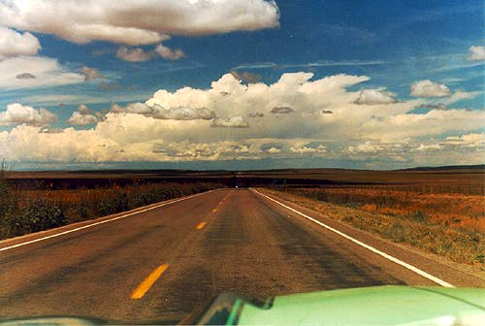
Atmosphere
A gaseous sphere and it envelopes the Earth,
Consists of a mixture of gases composed primarily of nitrogen, oxygen, carbon dioxide, and water vapor.

Slide 5
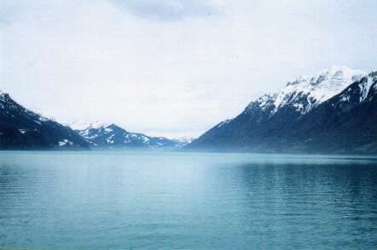
Hydrosphere
All of the water on Earth
71% of the earth is covered by water and only 29% is terra firma

Slide 6
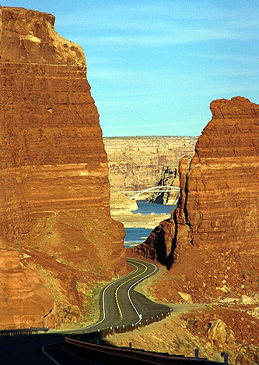
Lithosphere
The Earth's solid surface, often called the crust of the earth. It includes continental and oceanic crust as well as the various layers of the Earth's interior.

Slide 7
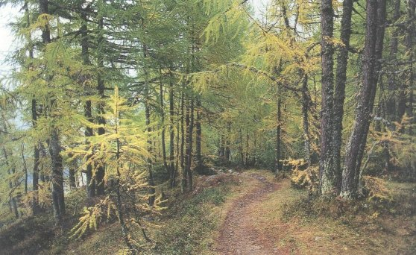
Biosphere
All life on earth, including man, and all organisms.
The life zone on our planet distinguishes our planet from the others in the solar system.

Slide 8
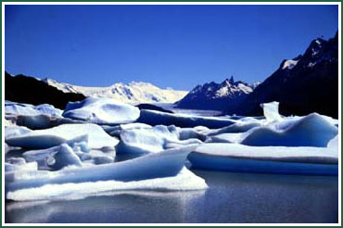
Cryosphere
The portion of the Earth's surface where water is in a solid form
Snow or ice: includes glaciers, ice shelves, snow, icebergs, and arctic climatology

Slide 9
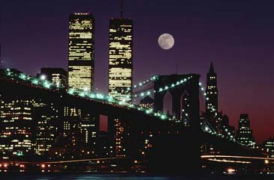
Anthrosphere
Man and his direct ancestors, hominids.
The human population, it’s buildings,dams, and other constructions.

Slide 10
Interconnected Spheres
Spheres are closely connected
Changes are often chain reactions
A change in one sphere results in changes in others - called an event
  Forest fire destroys plants in an area
Interactions between spheres
  No plants => erosion
  Soil in water => increased turbidity
  Turbidity => impacts water plants/animals

Slide 11
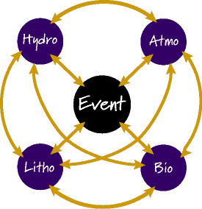
Event <=> Sphere
Causes & Effects
Interactions
Event <=>Sphere
Sphere<=>Sphere

Slide 12
ESS Analysis
Events
  Cause-effect events
  Interactions
  Natural events
    Earthquake, hurricane, forest fires
  Human caused events
    Oil spill, air pollution, construction

Slide 13
ESS Analysis
What spheres caused the event?
Sphere Event
What are effects of the event on the spheres?
Event Spheres
How do changes in one sphere impact on other spheres?
Sphere Sphere

Slide 14
Understanding Interactions
Global implications
Helps people predict outcomes
Preparation for natural disasters
Environmental impacts of human activities

Slide 15
ESS Analysis
An Example - handout
  Yellowstone Forest Fire
Group activity
  Mt St Helen’s eruption, 1980
  Hurricane Andrew, 1992

