Slide 1
Input and Output Devices
31 Input & Output Devices
Keyboards
Numeric Keyboards
Mice (Mouse)
Touchpads
Trackerballs
Remote Controls
Joysticks
Touch Screens
Magnetic stripe readers
Sensors
Graphic tablets
Light Pens
3D Inkjet Printers
Dot Matrix
Plotters
MIDI instuments
Smart card readers
Chip and PIN readers
Scanners
Barcode readers
OMR
OCR
MICR
Digital Cameras
Webcams
Microphones
CRT
TFT
Laser Printers
Inkjet Printers
Speakers
Projectors

Slide 2
Input Devices
Input devices are used to give date into the computer system
Input devices probably are ranged (wired or not)
Input devices help people to control and use the computer system, most of the times

Slide 3
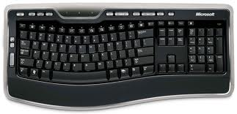
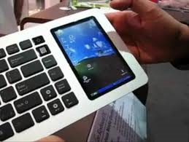
Input Devices (Cont.)
Keyboard
  Most common input device
  input text, numbers, commands, password
  Concept keyboards (Shaped)
  Overlay Keyboards
  Advantages
    Accurate enter date
    Quick entry of text
    Robust
    Help people with dis
  Disadvantages
    Difficult for people with dis
    Not quick compare with barcode, etc
    Take more space

Slide 4
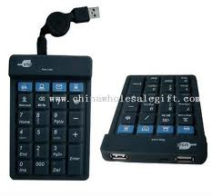
Input Devices (Cont.)
Numeric Keypads
  Enter numbers
  Specific Scenarios such as ATM, PIN, Telephones, EPOS terminals etc
  Advantages
    Small
    Many devices in one machine
    Easy to enter numbers
  Disadvantages
    Difficult to enter text
    Can be too small sometimes

Slide 5
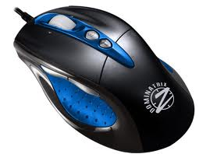
Input Devices (Cont.)
Mice (Mouse)
  Pointing device
  Move pointer
  Buttons with different functions
  Scroll button
  Can be optical
  Can have one ball under the plastic case
  Advantages
    Faster to choice options
    Fast navigation
    Smaller then keyboards
  Disadvantages
    Difficult to use for people with dis
    Easy to damage
    Difficult to enter data like text numbers

Slide 6
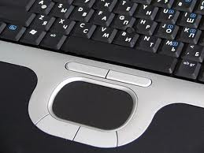
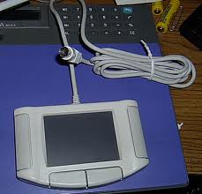
Input Devices (Cont.)
Touchpads
  Used in laptop computers with fingers
  Same operation as mouse
  Advantages
    Same as mouse
    Do not have to be plugged in
  Disadvantages
    Difficult control compare to mouse
    Same as mouse

Slide 7
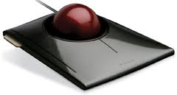
Input Devices (Cont.)
Trackerballs
  Ball on the top of it
  Same functionality with mouse and touchpads
  Control Pointer
  Control Room Environment
  Use for RSI
  Advantages
    People with limitations
    Accurately
    Desk space
  Disadvantages
    Expensive
    Need Training

Slide 8
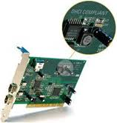
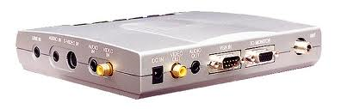
Input Devices (Cont.)
Video digitizers
  Input video to computer
  Convert analogue to digital signals
  Fitted into your computer

Slide 9
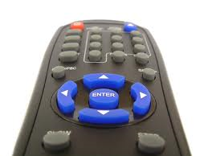
Input Devices (Cont.)
Remote Controls
  Control devices remotely
  Buttons help to choose diff options
  Wireless communication
  Used for home entertainment devices
  Advantages
    Can be in distance from the devices
    Help people with dis
  Disadvantages
    People with RSI diff to use it
    Stop working with obstacle in front of it

Slide 10
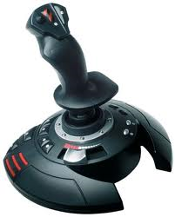
Input Devices (Cont.)
Joysticks
  Similar functions with mouse and trackerball
  Stick, move around to select options
  Move objects around the screen
  Used for games
  Airline pilots
  Advantage
    Control objects in three dimensions
    Faster to choose options
  Disadvantage
    Diff to enter data
    Diff to control pointer than other windows icons, etc

Slide 11
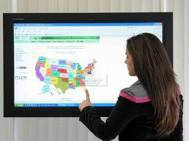
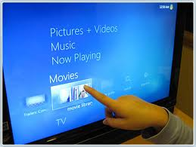
Input Devices (Cont.)
Touch screens
  Can be input and output
  Use fingers or stylus
  Icons on the screen represent buttons
  ATM
  EPOS
  Tourist information kiosk
  PDA
  Interactive whiteboards
  Advantage
    Faster entry of options
    Easier for people with dis
    Less possibilities to choose wrong options
  Disadvantage
    Diff to enter text
    Diff for people with RSI

Slide 12
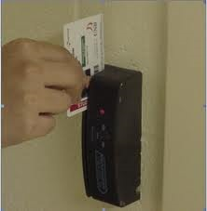
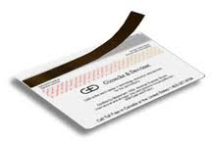
Input Devices (Cont.)
Magnetic strip readers
  Read information form plastic cards
  3 tracks are used to store information
  Banking for example use second track
  ATM
  EFTPOS
  In security
  Advantage
    Faster entry of date
    More accurate
    More secure
    Prevents entry of restricted areas
  Disadvantage
    If damaged, lost speed

Slide 13
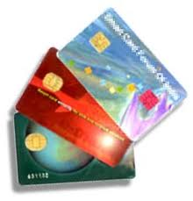
Input Devices (Cont.)
Smart card readers or chip card
  Information is stored on a chip
  Used to store a PIN number
  Payment method
  Satellite broadcasters
  SIM cards
  Passport
  Advantage
    Immediate update, no fraud
    Less damage thought regular use
    More secure
    Enter in restricted areas without card
  Disadvantage
    Hackers can stole information
    if the card lost the owner loses a proportion, if not all the money value of the card

Slide 14
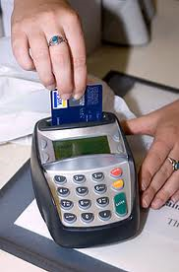
Input Devices (Cont.)
Chip and PIN readers
  Type of smart cards
  EFTPOS terminals
  Has slot for inserting the chip card and keypad for entering the PIN (personal identification number)
  Some of them has slot for magnetic strip cards
  Chip has information but also the PIN
  The card can not be used unless the people know the PIN
  Use for payment methods
  Advantages
    Secure transactions
    Save time compare using cash and cheques
    More robust
  Disadvantages
  No PIN no transactions
  Very careful to protect their PIN

Slide 15
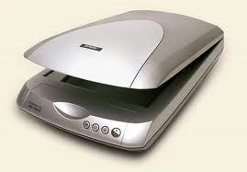
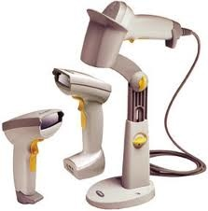
Input Devices (Cont.)
Scanners
  Enter hard copy images
  Flatpad, place the document in front of the glass
  Light source move underneath
  Scanner can also used as OCR
  Barcode readers are used to reader codes
  Use to scan old records
  Scan images for editing
  Used in faxes
  Advantages
    Allow images to be stored
    Save time using as OCR
    Using as barcode, save time and more accurate
  Disadvantage
    Reproduction is limited

Slide 16
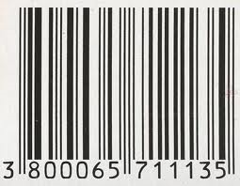
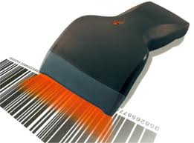
Input Devices (Cont.)
Barcode readers
  Read information in the form of bar code
  Goods are marked with codes
  Uses
    Supermarkets and shops
    Automatic stock control
    Libraries
    Identify items from the database
  Advantages
    Faster
    Accurate
    Improve safety
    Trusted
    Easy update (only central database)
    No individually changes
  Disadvantages
    Expensive
    Barcodes can be swapped

Slide 17
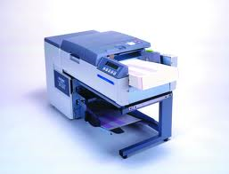
Input Devices (Cont.)
OMR – Optical mark recognition
  Read marks made by pen or pencil
  Uses
    Read multiple choice questions
  Advantages
    Fast
    More accurate
    OMR more accurate than OCR
  Disadvantages
    Forms need to be carefully designed
    Problems, if the forms haven’t been fill corectly

Slide 18
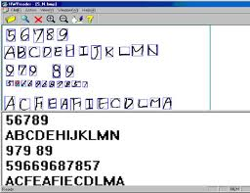
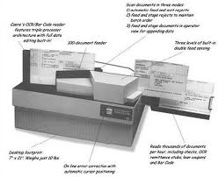
Input Devices (Cont.)
OCR – optical character recognition
  Scan text and convert it into computer readable form
  Uses
    Processing of passport and identity cards
    Used when scanning documents for further manipulation
  Advantages
    Faster data entry
    Reduce number of errors
  Disadvantages
    Difficult to read hand writing
    Not very accurate technique

Slide 19
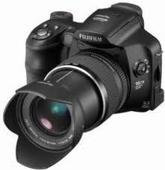
Input Devices (Cont.)
Digital Cameras
  Used like traditional camera
  Photographs can be deleted if they are not good
  Also can be retaken
  Camera can be connected directly to the computer
  Also can use photo editing packages to manipulate photos
  Most cameras has capacity to store many photographs
  Digital cameras can also take short videos
  Used by personal photographers

Slide 20
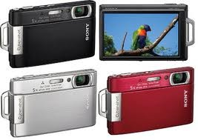
Input Devices (Cont.)
Digital Cameras (cont.)
  Advantages
    Better quality photos than traditional camera
    Quicker to upload images than scan them in
    Quicker and safer than to have a film
    Memory card can hold more images
  Disadvantages
    More expensive
    Batteries need changing more often than with traditional cameras

Slide 21
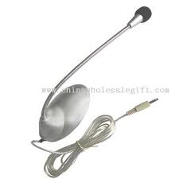
Input Devices (Cont.)
Microphones
  Connected directly to the computer
  Input sounds
  Sounds converted from electrical analogue signal into digital signal in order to be stored and manipulated
  This is done by computer sound cards
  Used to detect text for use with voice recognition software
  Voice cover in slide shows or web pages
  Advantages
    Changes to the sound can be done in real time
    Quicker to input text by speaking rather than typing
  Disadvantages
    Computer can use the input speech for one purpose only at that time
    Not accurate as using keyboard

Slide 22
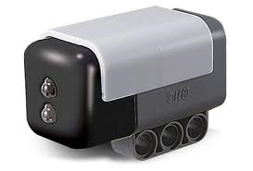
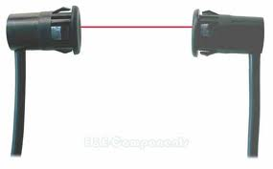
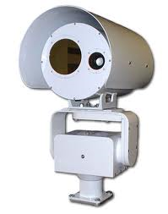
Input Devices (Cont.)
Sensors
  Sensor is used to input date about physical changes in an environment
  Convert analogue date into digital data
  Sensors are used to control and monitoring applications
  Uses
    Temperature sensor
    Pressure sensor
    Light sensor
    Sound sensor
    Humidity sensor
  Advantages
    More accurate
    Readings are continues
    Necessary action will be initiated immediately
    Automatic systems
  Disadvantages
    Faulty sensors can give wrong results
    Power cut, reading can not be taken

Slide 23
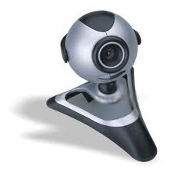
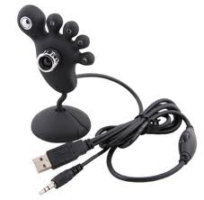
Input Devices (Cont.)
Web cameras
  Smaller than video camera
  Connected directly to the computer though usb
  Laptops have webcams built into the top of the monitor
  Uses
    Chatting online (MSN)
    Enable video conferencing
  Advantages
    Allow people to keep in contact without need to travel
    Activated as required
  Disadvantages
    They need to be connected to the computer
    Limited features and poor quality

Slide 24
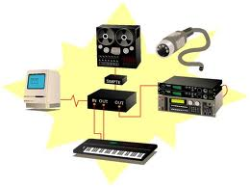
Input Devices (Cont.)
MIDI
  Musical instrument digital interface
  The interface converts the signals into digital
  Uses
    Performance directly recorded to the computer and stored as MIDI file
    MIDI files can supplement other MIDI files
  Advantages
    Errors can be removed
    Files can be manipulated
  Disadvantages
    Music is not spontaneous

Slide 25
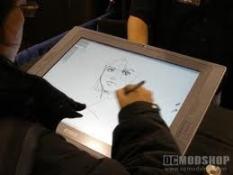
Input Devices (Cont.)
Graphics tablets
  Hand drawn images
  Resulting image appear on the computer monitors for further use
  Uses
    Computer graphics
    Computer aided design
    Chinese and Japanese characters
  Advantages
    Accurate drawing
    Drawings are input rather than letters as happens with scanners
  Disadvantages
    More expensive
    Difficult to use for choosing menu selections

Slide 26
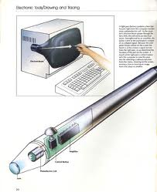
Input Devices (Cont.)
Light pens
  Contain sensors that send signal to computer whenever light change are detected.
  Only work in CRT monitors
  Images built up row by row and refreshed 50 time every second
  Uses
    Selecting objects on CRT screens
    Drawing on screen (CRT)
  Advantages
    More accurate than touch screens
    Small
    Easy to use
  Disadvantages
    Lag
    Only work on CRT
    Not accurate when drawing

Slide 27
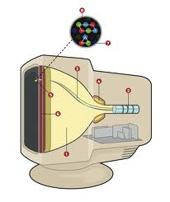
Output Devices (Cont.)
CRT Monitors
  Use an electron gun to fire against phosphor screen
  Dots is colored red, blue, green
  Not expensive
  Uses
    Primary output device of a computer
    Light pens
  Advantages
    Higher quality images than TFT
    Better angle of viewing
    Light pens in CAD
  Disadvantages
    Very hot
    Too heavy
    Need more power
    Eye side problems

Slide 28
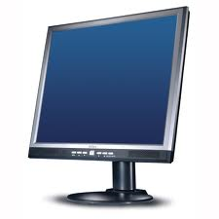
Output Devices (Cont.)
TFT Monitors
  Nowadays are the main output device
  Thousand of pixels
  Each pixel has three transistors, colored red, blue, green
  Uses
    Used on laptops
  Advantages
    Lightweight
    Less glare and radiation
    Less power
  Disadvantages
    Problems when viewed slightly from the side
    Less definition than CRT
    Not used with light pens

Slide 29
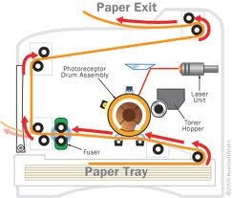
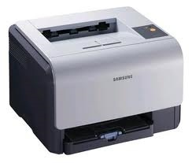
Output Devices (Cont.)
Laser printer
  Very high quality hard copy
  Large buffer memories
  All pages are stored and then printed out
  Uses
    Noise level need to keep low, like in office
    Very high quality hard copy
  Advantages
    Fast in large amount of printing pages
    Handle very large printing jobs
    Lower cost in toner cartridge
  Disadvantages
    Expensive
    Only fast in several copies
    Four cartridges
    Health issue

Slide 30
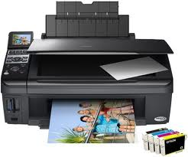
Ouput Devices (Cont.)
Inkjet printer
  Good quality hard copies
  Better than dot matrix
  Printing is done a bit at time
  Uses
    High quality for small job
    Low output volumes
    Very good to produce photo quality printouts
  Advantages
    Cheaper to buy
    High quality
    Lightweight and need small space
    No healthy issues
  Disadvantages
    Slow output for large amount of pages
    Cartridge run out quickly
    Printing can smudge
    Expensive to run if they are used a lot

Slide 31
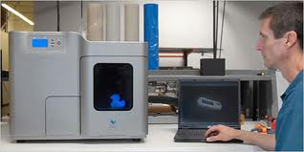
Output Devices (Cont.)
3D inkjet printers
  Produce solid 3D models
  Used technology knows as tomography
  Uses
    Produce prototypes from CAD
    Models are produce in color
    Organic objects (human organs)
  Advantages
    Save a lot of money
    Better idea about end product
    Powders can be reused
  Disadvantages
    Expensive to buy
    Slow producing the output
    The end product can need more work at the end

Slide 32
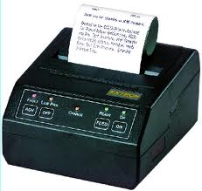
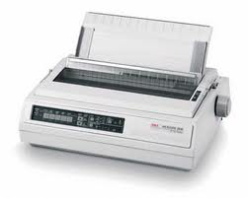
Output Devices (Cont.)
Dot matrix printers
Output is made up of matrix of pins
Uses
  In noisy environment
  Print quality is not very important
Advantages
  can be used in dusty environments
  Multipart outputs can be produced
  Very cheap to run and maintain
  Long printing jobs
Disadvantage
  Very noisy
  More expensive to buy than an inkjet
  Very slow and not good quality

Slide 33
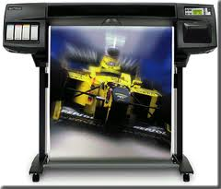
Output Devices (Cont.)
Plotters or graph plotters
  Very large drawings and posters
  No limitations about paper size
  Pen plotters, electronic plotters
  Uses
    Large dewing such as buildings or factories
    Large pictures
    Print on plastic coated paper
    Large signs
  Advantages
    Huge printouts
    Extremely high quality
  Disadvantages
    Slow
    Expensive

Slide 34
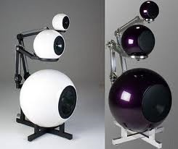
Output Devices (Cont.)
Speakers
  Connected directly to the computer
  Digital signals converted into analogue using digital analogue converter
  Uses
    Output sound
    Home entertainment
    Help blind people
    Play downloaded sounds

Slide 35
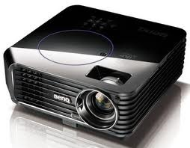
Output Devices (Cont.)
Multimedia projector
  Receive signals that can be digital or analogue
  Images is magnified and projected into large screen
  Uses
    Training presentations
    Advertising presentations
    Home cinema
  Advantages
    More people can see the presentation
  Disadvantages
    Images sometimes be fuzzy
    Expensive
    Setting up projectors can be little different

Slide 36
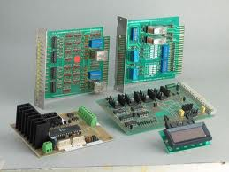
Control Devices
Type of output devices
Control devices are used control processes in conjunction with sensor input devices

Slide 37
Control Devices
Actuators
  Transducers that convert Signals
  Sent signals form computer to the actuators such as motors, pumps, switches etc….

Slide 38
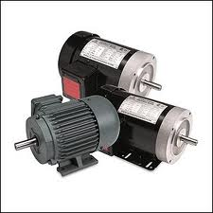
Control Devices
Motors
  Turn on or off by the actuator
  Uses
    Domestic appliances such automatic washing machine, central heading, greenhouses, etc
    Control robot arms
    Fans, disk drivers, DVD drivers

Slide 39
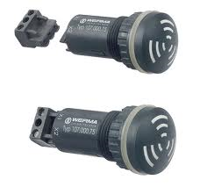
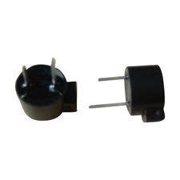
Control Devices
Buzzers
  Turn on or off
  Uses
    Cookers and microwave ovens to tell the operator when the process is complete
    Alarm systems

Slide 40

Control Devices
Lights
  Light is turned on or off
  Uses
    Security lights
    Control lighting conditions

Slide 41


Control Devices
Heaters
  Turn heater on or off
  Uses
    Automatic washing machines
    Control of temperature

Slide 42
Review Questions
A company wants to buy a printer for its office. What factors would be important when deciding what type of printer to buy?
What type of output device would be most suitable for each of the following activities? Give at least one reason for each of your choices.
  General printing on a home computer, including printing letters and other documents.
  Printing in a busy office.
  Printing customer receipts in a supermarket. The printer must produce a second copy for the supermarket to keep on self-replicating paper (paper that copies through where pressure has been applied to the top copy).

Slide 43
Review Questions (Cont)
What type of output device would be most suitable for each of the following activities? Give at least one reason for each of your choices.
  Producing a warning that a library book that has just been returned is overdue and a fine should be paid.
  Showing that a disk drive is in use.
  Producing lists of theatre seats that are available when a customer telephones to book a ticket.
  Producing high quality output for a design studio.
What type of input device would be most suitable for each of the following activities? Give at least one reason for each of your choices.
  ATM
  Supermarket cashier
  Shopping maul map

