Slide 1
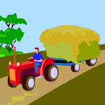
AGRICULTURE

Slide 2
Food Supplies Over the Last 200 Years
Malthus’ prediction
New crops
Transplants and genetic engineering
New cropland
New lands opened by irrigation
Transportation and storage
Faster refrigerated modern methods
Improved storage protects against spoilage and pests
Green revolution
As applied to agriculture not environment
Technological advances

Slide 3
Domestication Sites
On the next map, notice that the early cradles of civilization tended to develop in or very near centers of domestication

Slide 4
Cradles of Civilization
Note the similarity

Slide 5
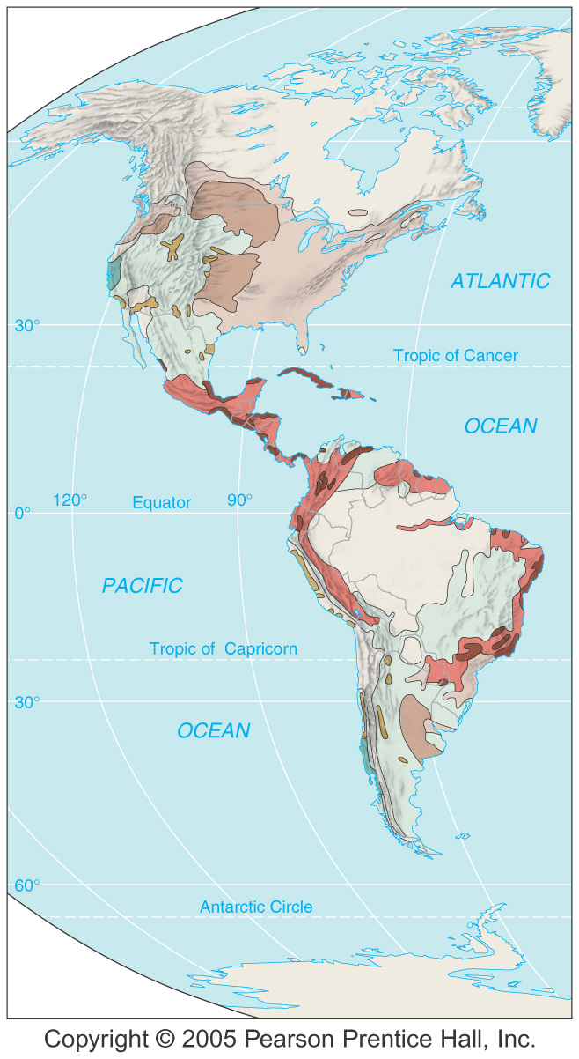
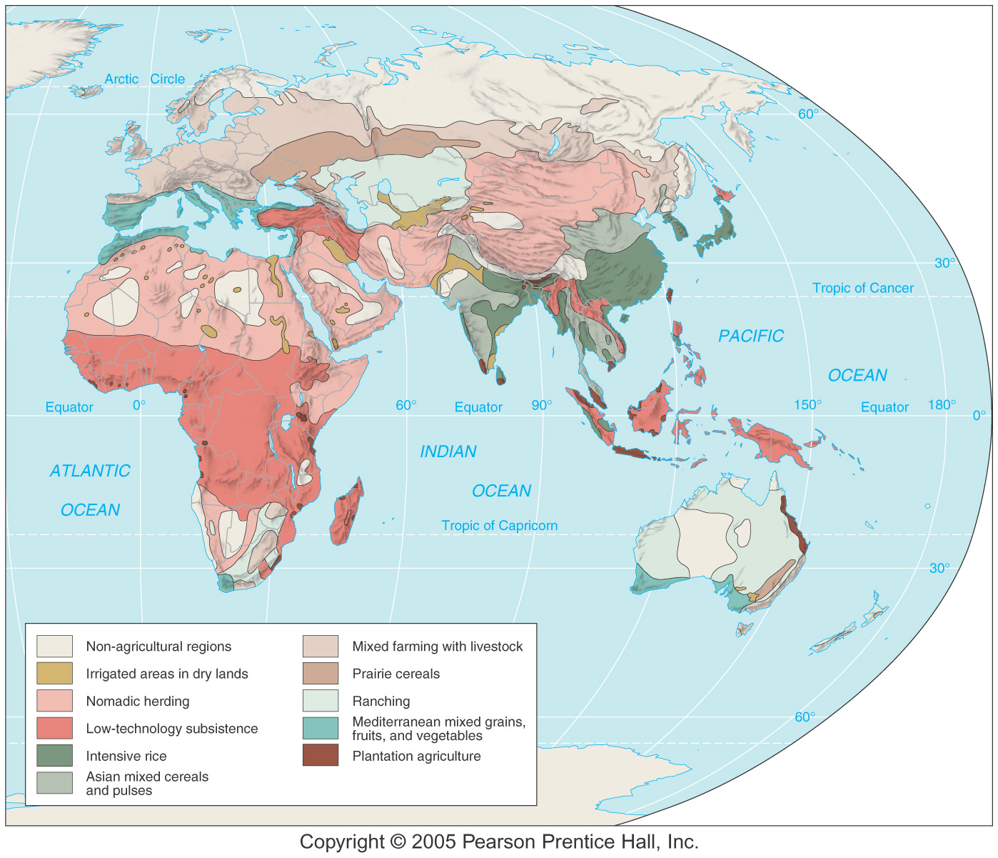
Land Use Regions

Slide 6
No More Virgin Lands
The discovery of the “New World” postponed the consequences of Malthus’ conclusions. All the land is under cultivation now.

Slide 7
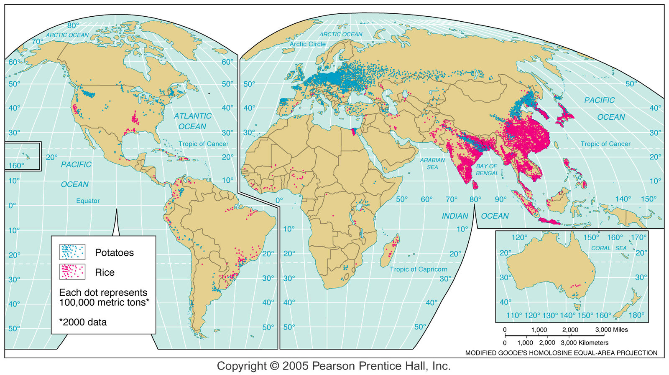
Rice and Potato Production

Slide 8
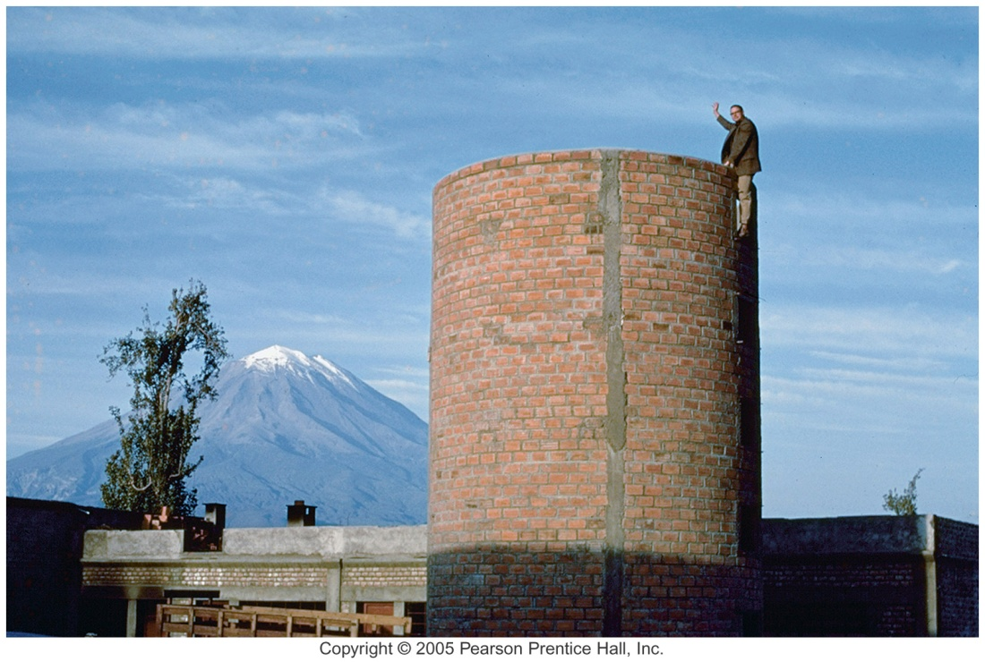
Agriculture Today
Hunter-gatherers – few in remote places
Subsistence agriculture – largely developing countries
Food for self and family
Commercial agriculture – largely in developed countries
Food for sale
Polyculture
Raising a variety of crops
Mixed farming
Interculture
Monoculture
Specializing in one type

Slide 9
Subsistence and Commercial Agriculture
Subsistence Traits
Relies mostly on human labor – little animal or machine power
Low technology use
Smaller average farm size
Most food is consumed by farmer
Commercial Traits
Relies on capital investment in machinery, chemicals, improved seeds
Large average farm size
Products sold to agribusiness companies
Fewer family owned farms

Slide 10
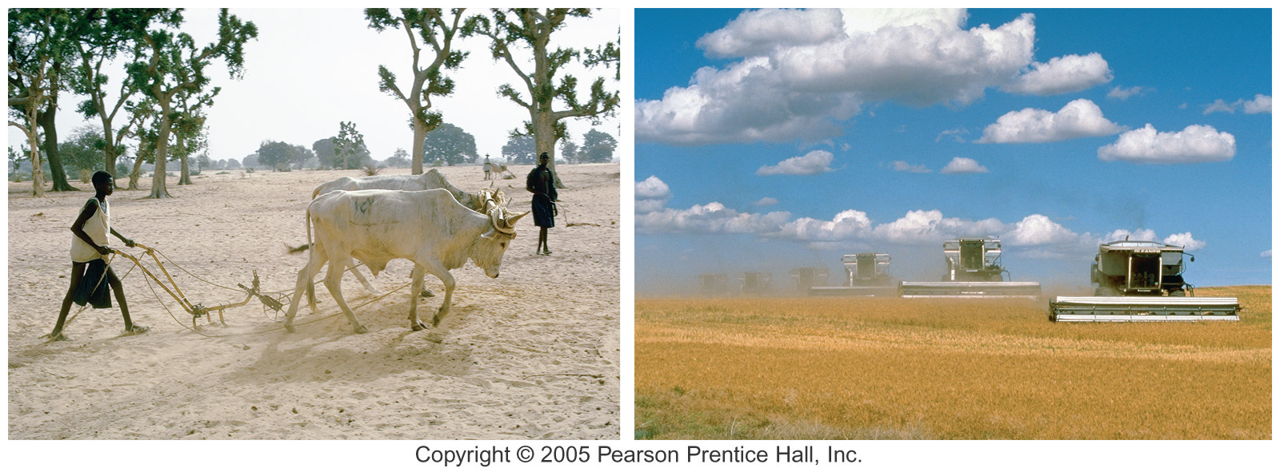
Subsistence Commercial

Slide 11
Types of Agriculture
Defined by five variables
Natural environment (sets initial parameters)
Crops that are most productive in that environment
Degree of technology used
Market orientation
Raised for human or animal consumption
Human
Raw material for industry
Food
Animal – feed

Slide 12
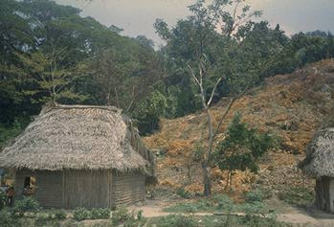
Subsistence Agriculture
Click the picture to see the video

Slide 13
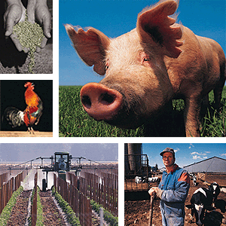
Mechanized, Commercial Agriculture
Click the collage to see the video

Slide 14
10 Categories of Agriculture
Irrigated
Nomadic herding
Low tech subsistence
Intensive rice
Asian mixed cereals/pulses
Mixed farming with livestock
Prairie cereals
Ranching
Mediterranean grains fruits and vegetables
Plantation agriculture

Slide 15
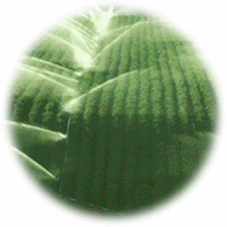
Types of Agriculture
Irrigated
Includes many farming styles from subsistence to intensive production
Nomadic herding
Pastoral nomads
Depend on animals
Animals sold or consumed
12-15 million nomads today
Government settlement

Slide 16
Types of Agriculture
Low-tech subsistence
Slash-and-burn
Swidden = “to singe”
Amazon, Central and West Africa
Supports low levels of population
Intensive rice farming
East, South and Southeast Asia
Work done by hand
Wet rice important source of food
Sawah
Double cropping

Slide 17
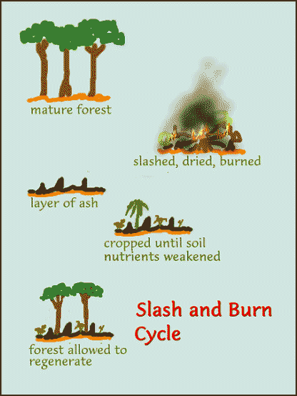
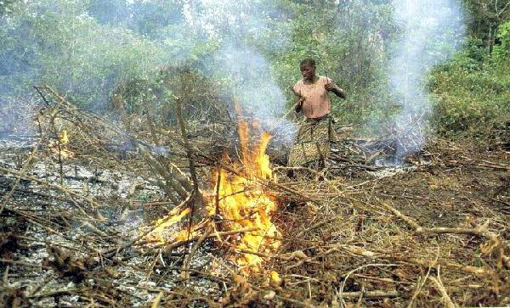
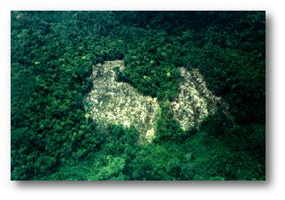
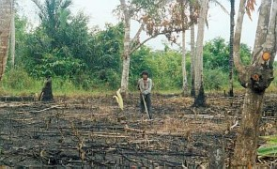
Swidden
Wise use of land!

Slide 18
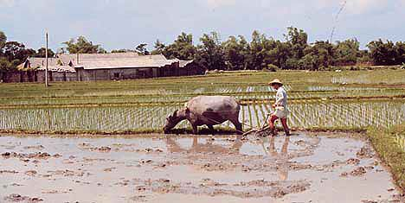
Labor-intensive Rice Harvesting
Click the picture to see the video

Slide 19
Subsistence Farming: processing rice in an African village.
Very simple technology is an improvement over the simplest form of separating husks.

Slide 20
Types of Agriculture
Asian mixed cereal and pulse farming
Interior India and northeast China
Wheat and barley
Pulses = pea or legume family
Mixed farming with livestock
Usually commercial
Crops fed to livestock
Dominant in most of world
Mixed farming in the “corn belt”

Slide 21
Mixed Farming: Dairy Farm
Milk production near cities – cheese, butter, & powdered milk farther away

Slide 22
Dairying
Where the climate is too wet and/or cold for good grain production
Requires heavy capital investment
Requires careful handling (govt. inspects)
90% of cows milk is produced in developed countries
Costs high
Heavy, spoils easily – so high transport costs
Milk production near large urban areas
Easier to ship cheese, butter, & powdered milk farther distances

Slide 23
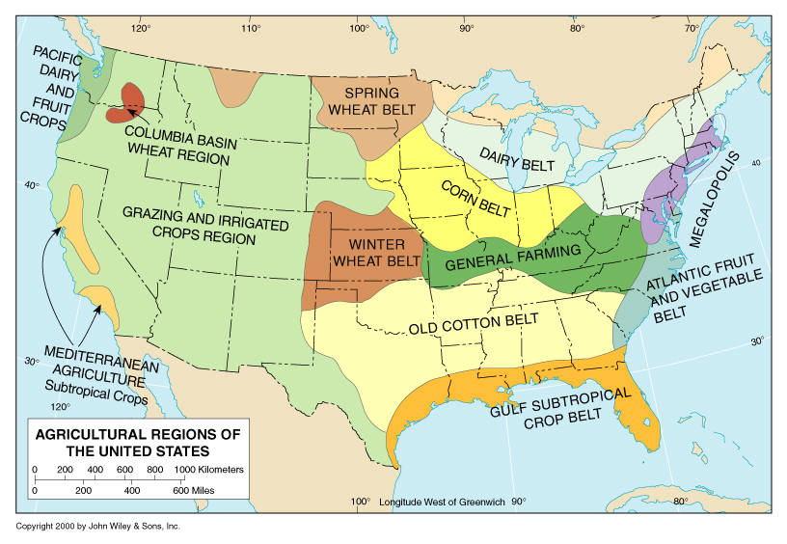
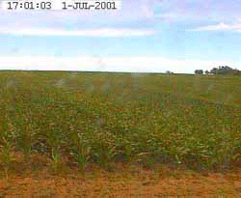
Corn: Human or Animal Food?
USA is agriculturally blessed

Slide 24
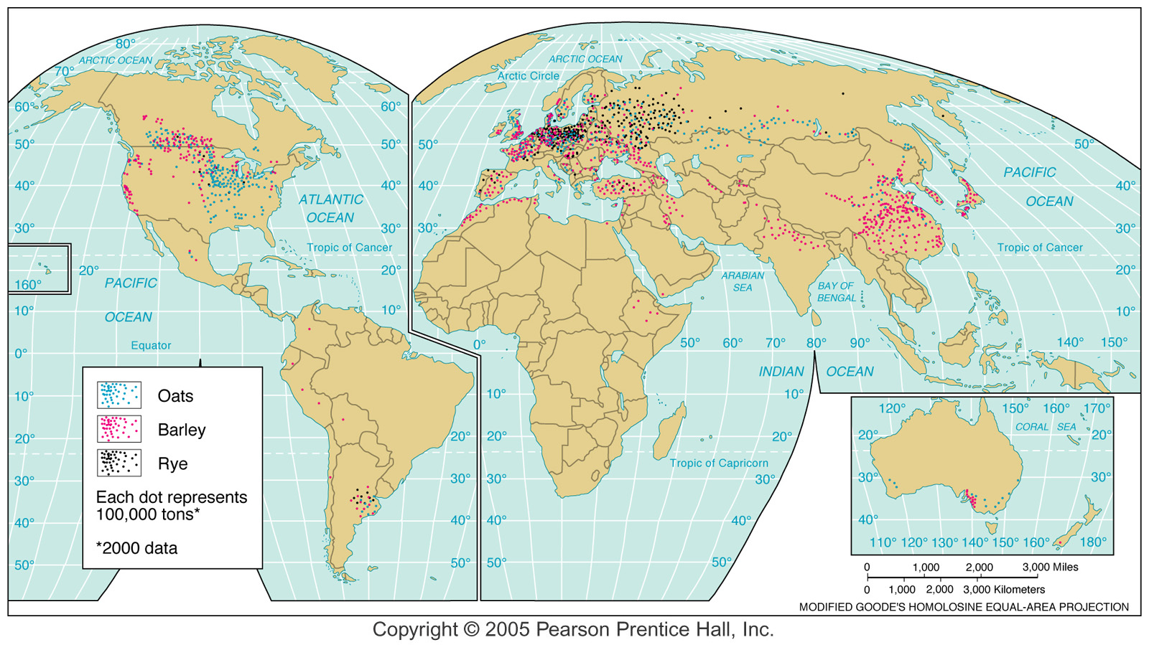
Hardy Grains

Slide 25
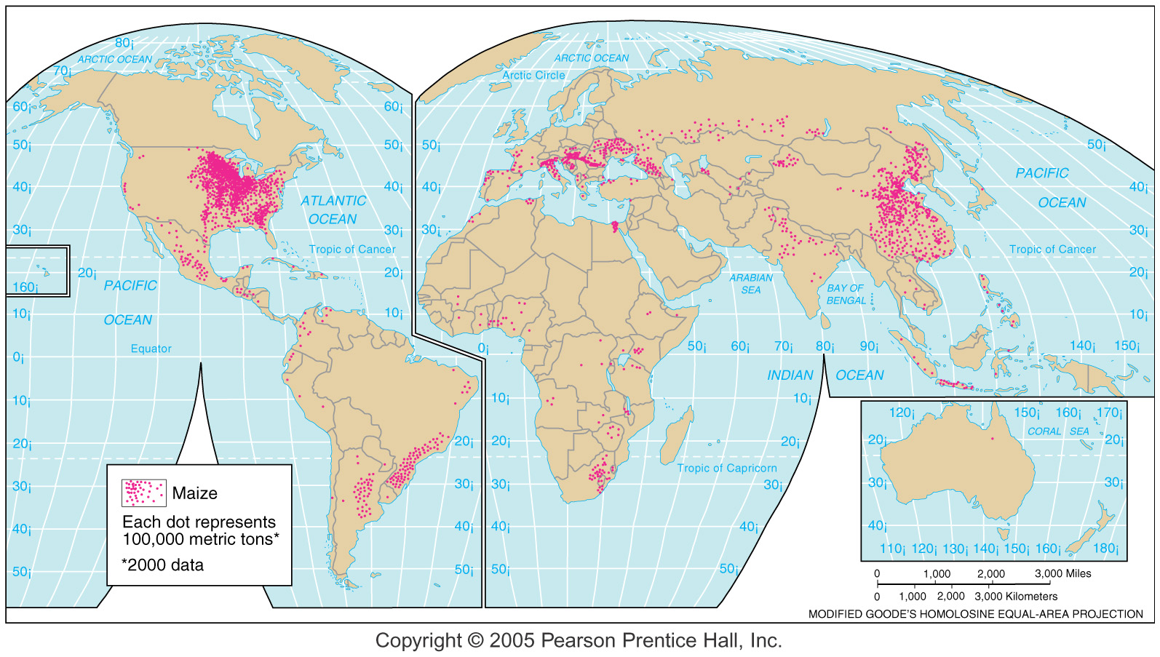
Maize (Corn)
Outside the Western Hemisphere grown mostly for animal feed

Slide 26
1950s focus on improving grain crops
Hybrids
Fertilizers & pesticides
Little research on tropical food crops
Has increased food production, but not in the most needy countries
Costs and risks discourage subsistence farmers
Green Revolution

Slide 27
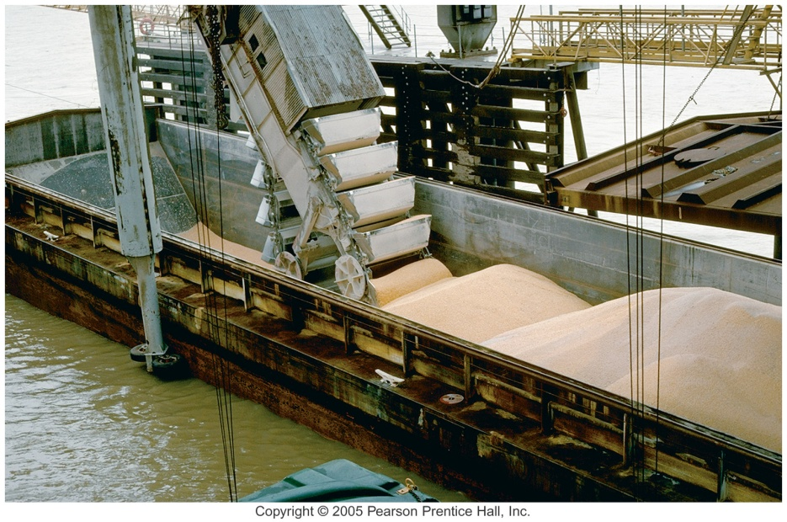
Types of Agriculture
Prairie cereals
Large scale commercial grain production
Wheat
Areas of concentration in North America
Winter wheat belt
Spring wheat belt
Palouse region
Eastern Washington State
Ranching
Commercial grazing
Arid or semiarid land
Cattle – North and South America
Sheep – Australia

Slide 28
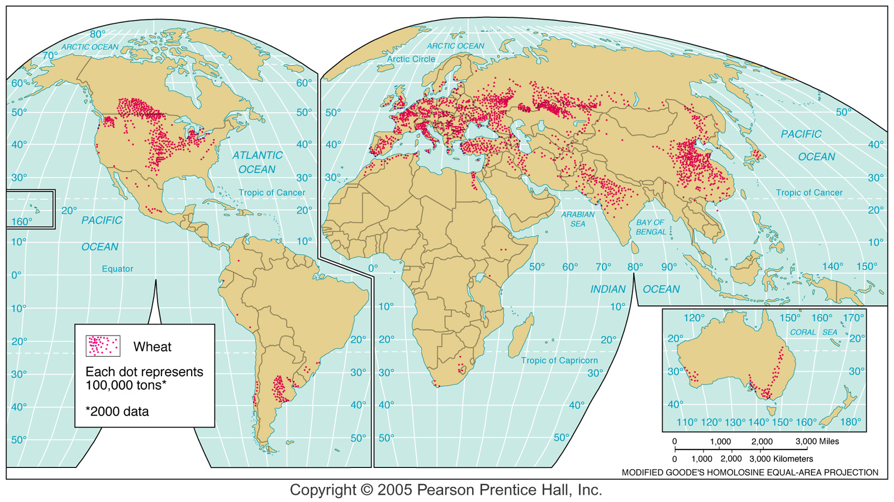
Wheat Production
Palouse Region
Spring Wheat Belt
Winter Wheat Belt

Slide 29
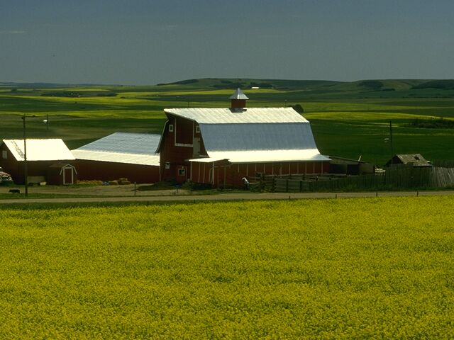
Research & Development: Australian Wheat
Click the picture to see the video
This could expand wheat growing in many parts of the world

Slide 30
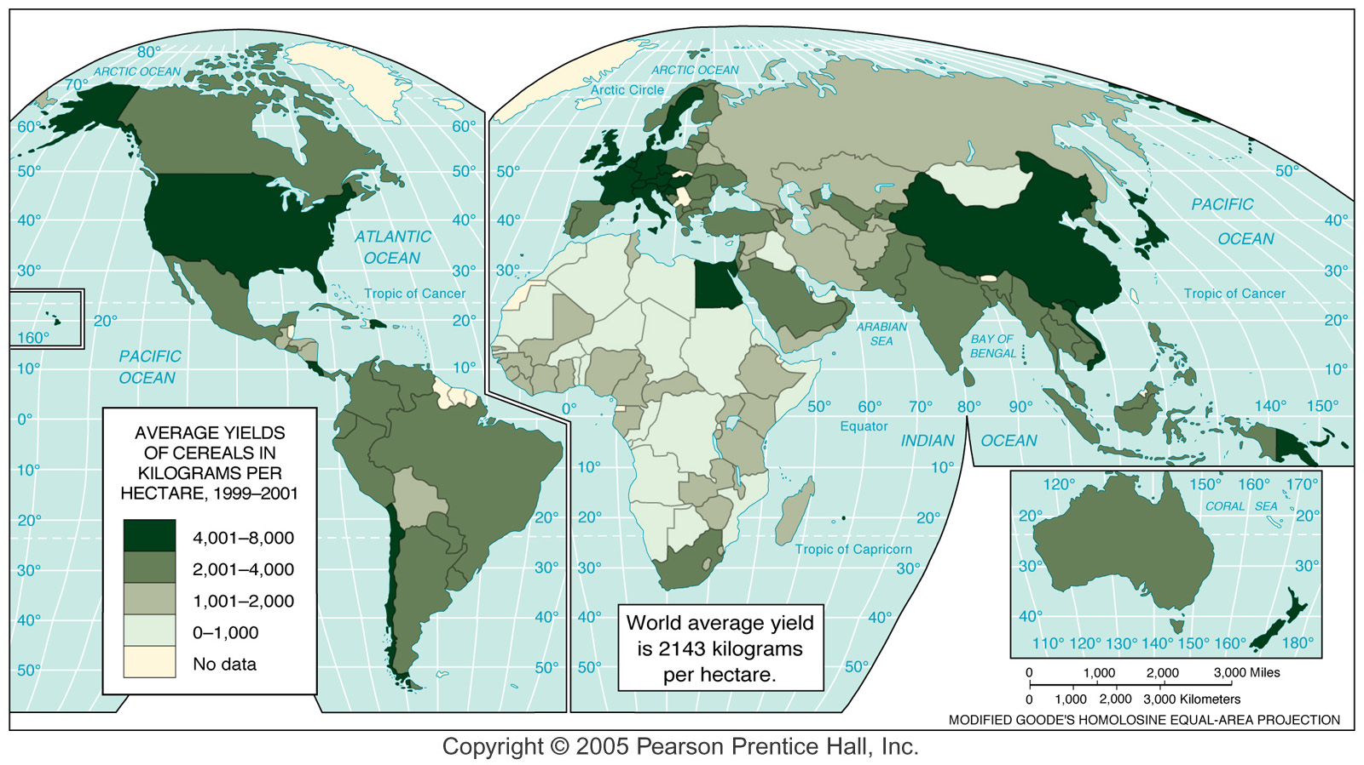
Grain Production

Slide 31
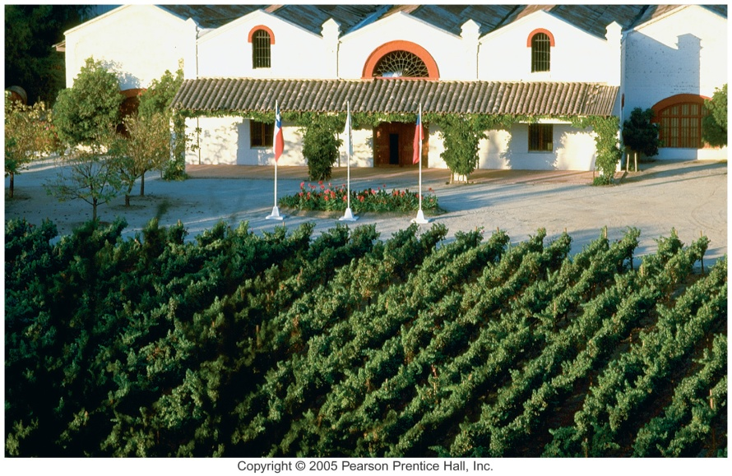
Types of Agriculture
Mediterranean
Mediterranean climates
Hot dry summers, cool rainy winters
Most crops for human consumption
Olives, grapes, fruits and vegetables
Plantation
Large commercial farm
Latin America, Asia, Africa
Coffee, sugarcane, bananas, rubber

Slide 32
Determining Productivity
Capital investment
Technology
Equipment
Fertilizers/pesticides – dangers of overuse
Irrigation
Natural environment
Technology and capital investment lessens the importance (expands the parameters)

Slide 33
Influences on Farmers

Slide 34
Commercial Farming
Requires capital investment, education, and considerable infrastructure to be efficient and profitable. Some good luck from “mother nature” helps too.

Slide 35
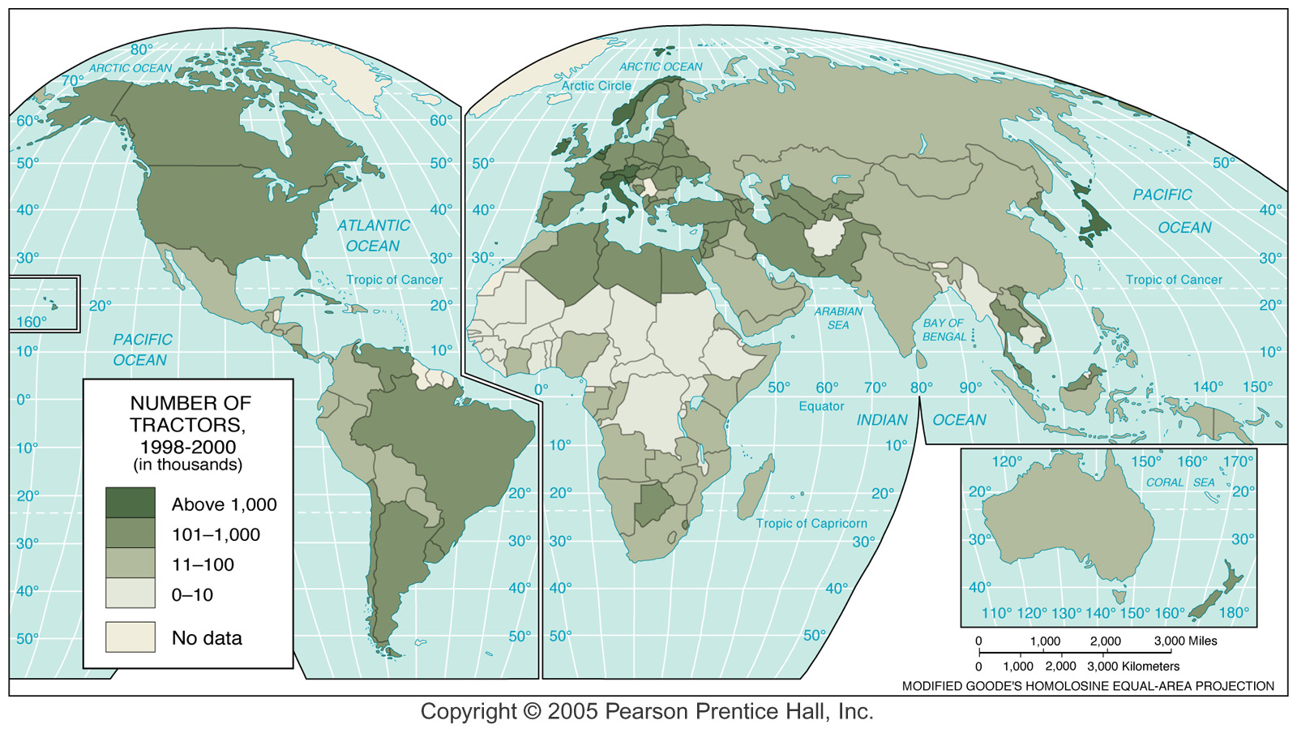
A Measure of Capital Investment

Slide 36
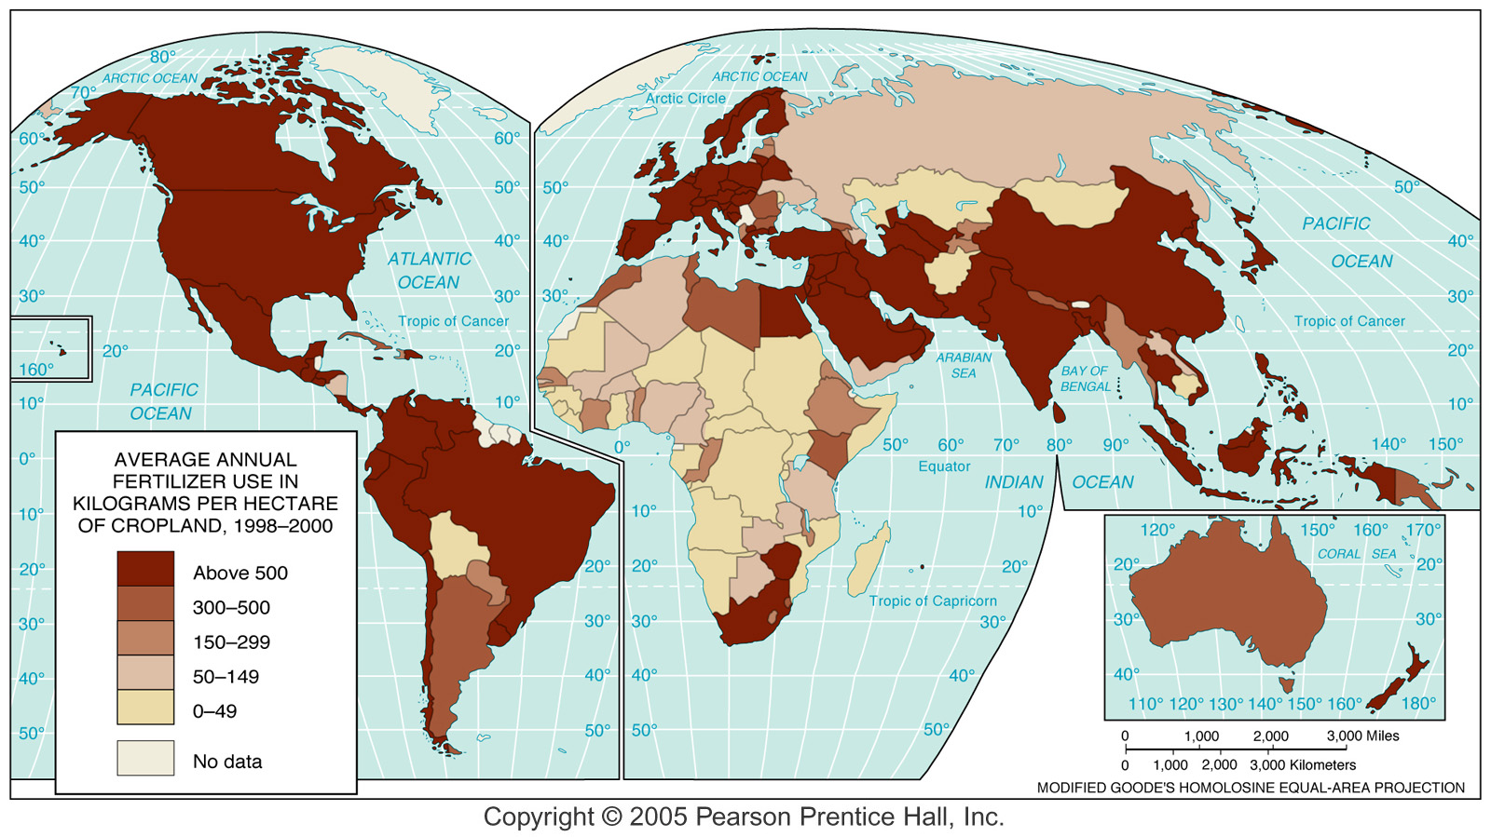
Measure of Technology & Capital

Slide 37
Livestock
Grain consumption
Direct and indirect
Inefficiency of grain-fed animals
Per capita consumption of meat
Problems with animal production
Environmental
Dairy farming
Value added by manufacturing

Slide 38
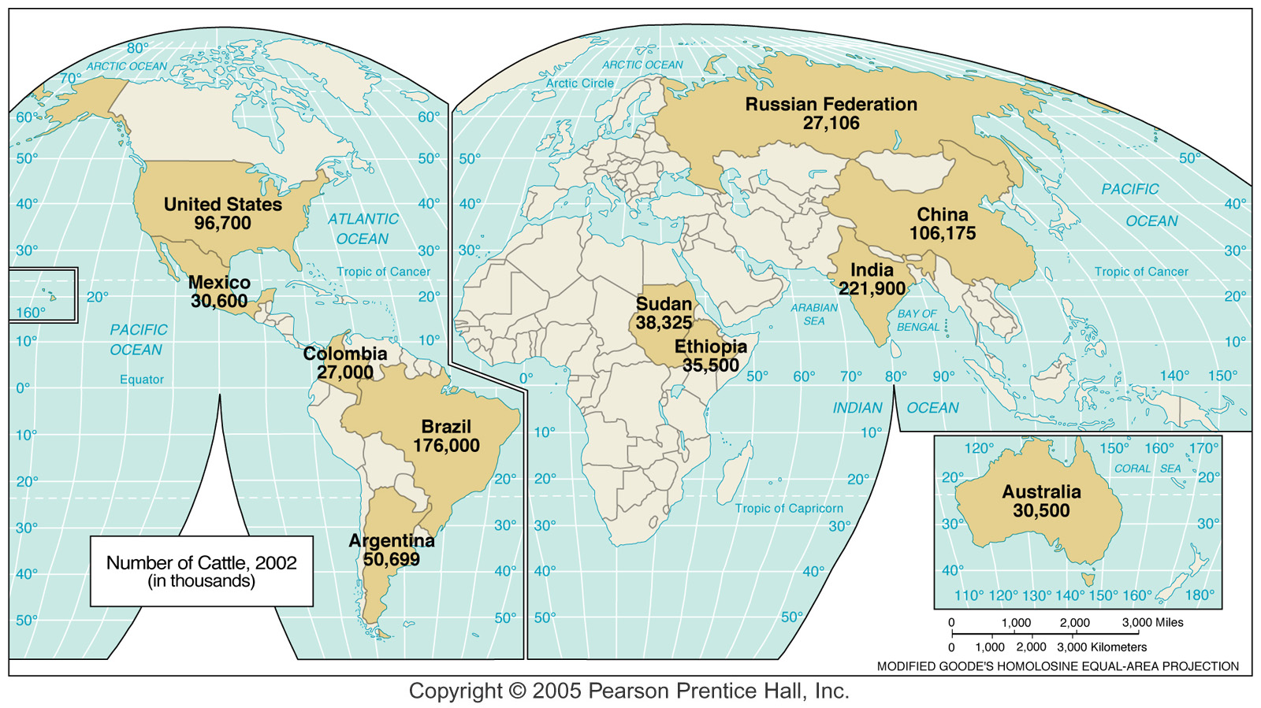
Cattle
Cows are considered sacred by Hindus – not eaten.

Slide 39
Livestock
Best suited to semiarid steppes
Overgrazing leads to desertification
Steppes can easily be overstressed
Controversy: direct or indirect consuming of grain & use of feed additives - hormones
Animal | Lbs. feed grain | Meat produced
Chicken | 4 pounds | 1 pound meat
Pig | 7 pounds | 1 pound pork
Cow | 15 pounds | 1 pound beef
15 lbs. of corn feeds more people than 1 lb. Beef.

Slide 40
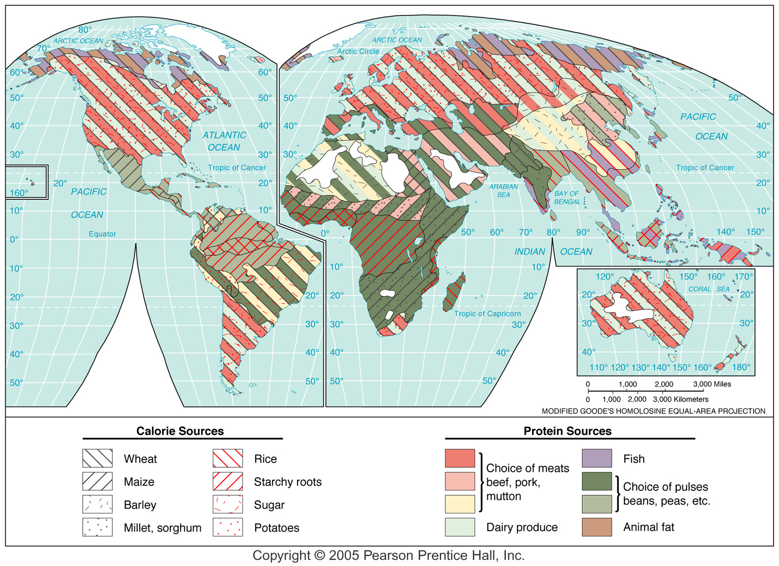

Slide 41
Future Food Supplies
New crop potential
Preserving genetic diversity
Importance of wild plants
Cultural acceptance – High protein maize in Mexico, etc.
Scientific revolution
Gene splicing
Genetically modified (GM) – great controversy
Cloning
Resistance to biotechnology
Religious / cultural / environmental
Global warming – climate change will affect food production

Slide 42
Food For The Future: Challenges
Improved efficiency in irrigation
Only 37% of water reaches plants currently
Improve drip irrigation
Reduced spread of parasitic diseases
Reduced soil salination
Introduce new plants
50 types of potato – U.S. uses 2-3
20 species provide most food today
75,000 plants have edible parts
Culture factor often resists “unusual” foods

Slide 43
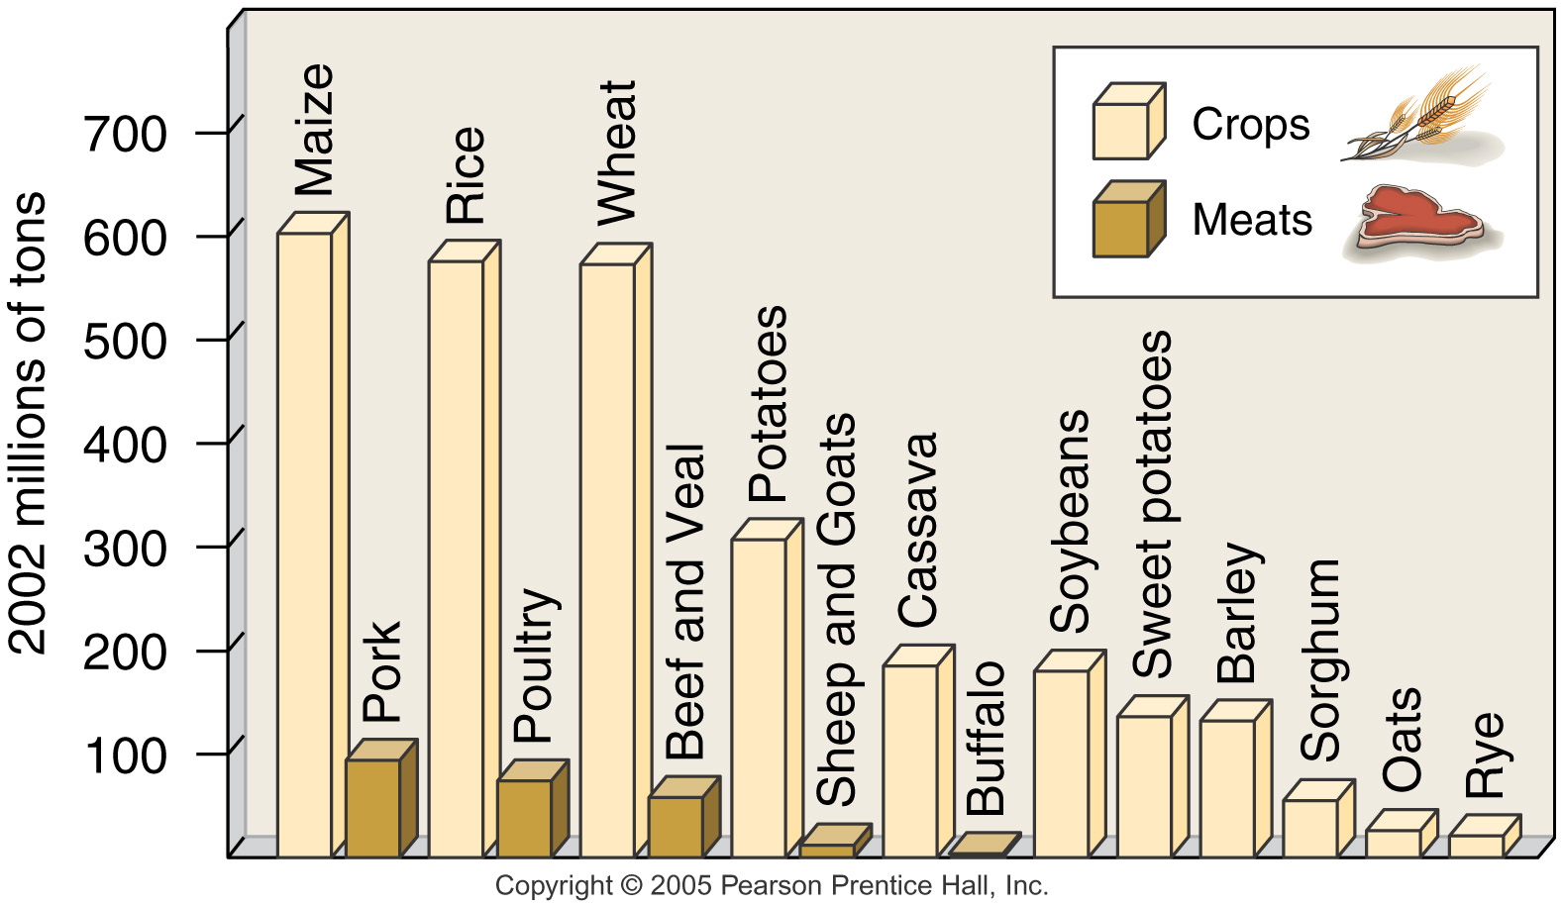
World Food Production

Slide 44
Distribution of Supplies and Production
Enough food for all but poor distribution
Hunger/famine
Sahel
Political strife
Sudan today & Nigeria in 1966-68
Countries import and export food
Increase in production
Green revolution least effective in tropical areas
Improvement in distribution
Costly & difficult – hampered by political factors

Slide 45
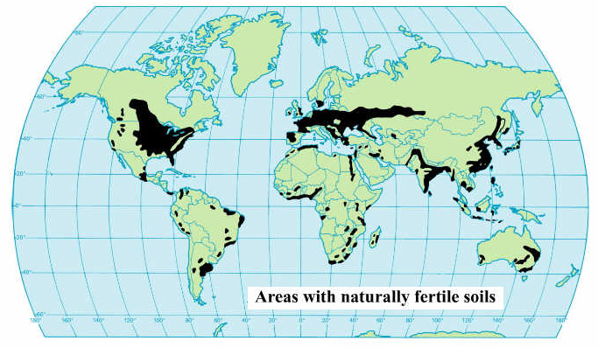
Best areas for productive agriculture
CHECK IT OUT!

Slide 46
What about 500 mil. Malnourished people (1991)?
Largely in Developing Countries
What could, not will, these countries do to end or reduce undernourishment?
Stop subsidizing urban areas Stop discriminating against farmers
End civil wars
Reform landholding systems
Encourage a switch from “cash crops” to crops for domestic consumption

Slide 47
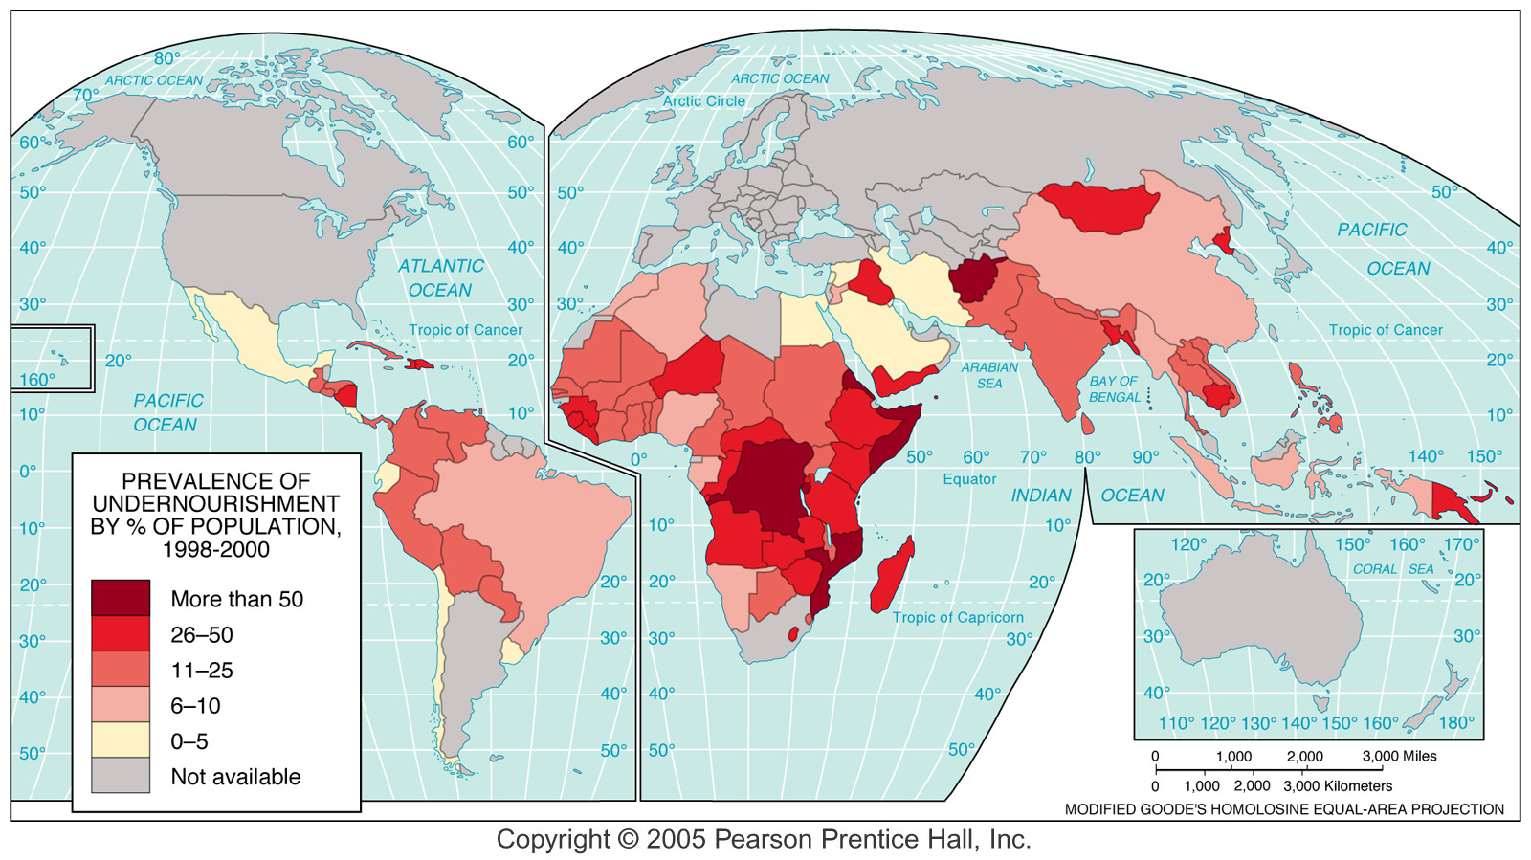
World Undernourishment
?
Hunger in America?

Slide 48
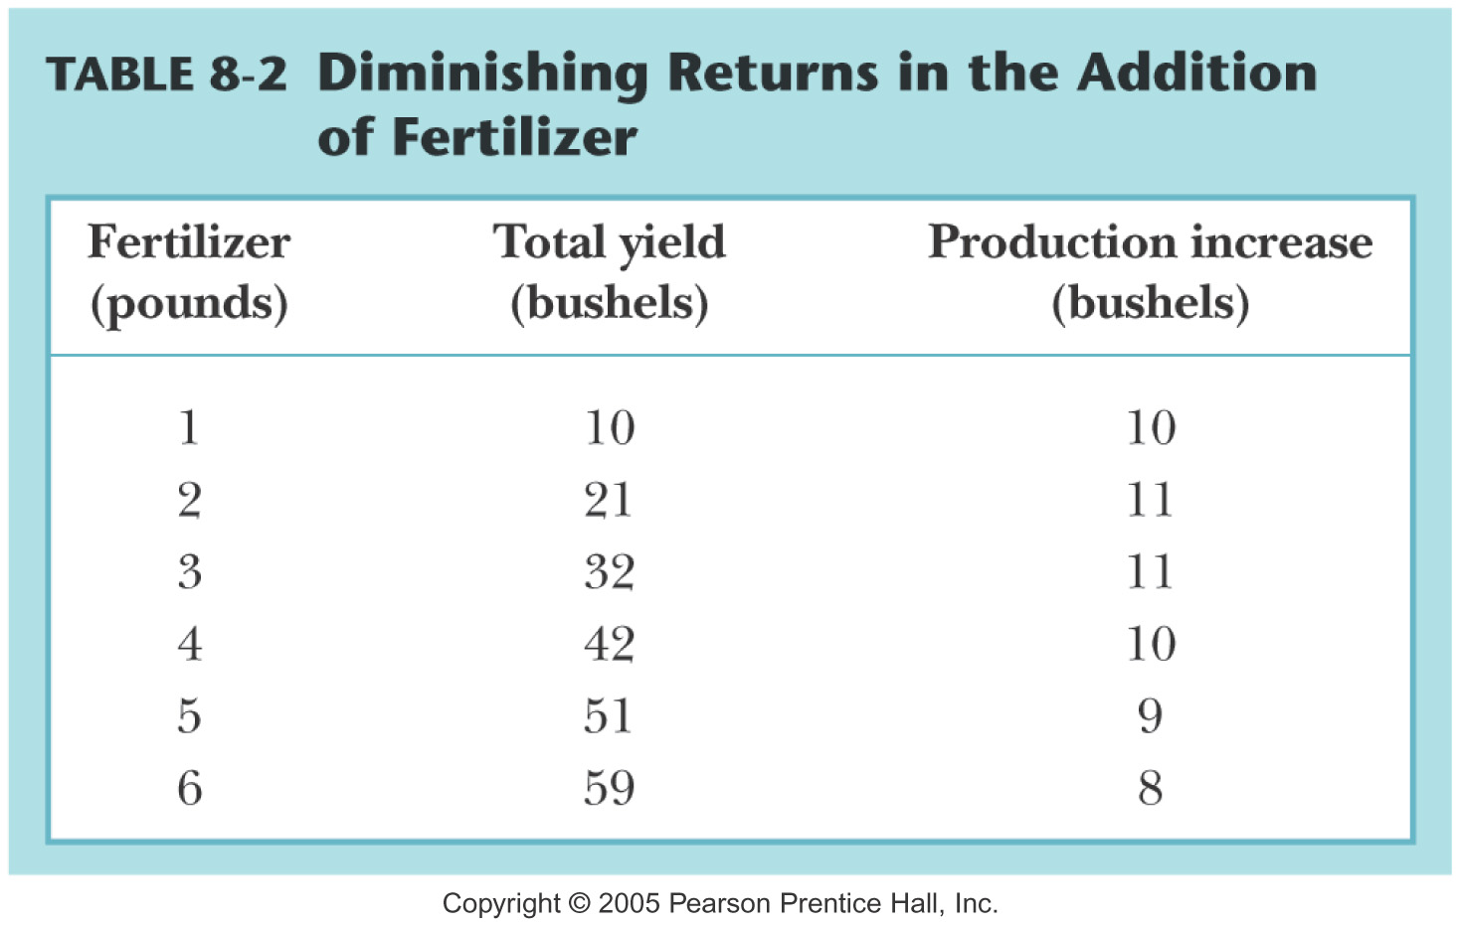

Slide 49
Problems Increasing Food Production
Diminishing returns of fertilizers
Financial incentives
Pricing controls
Taxes
Land ownership
Concentration of ownership
Whither the family farm?
Collective farming/ Communism
Commercial cash crops in developing countries
Leading to economic self sufficiency?
Illegal drugs

Slide 50
Desertification is a major problem, particularly in Africa
Physiologic pressure plus cycles of dry years results in over-stressing the soil and vegetation – thereby increasing the desert
Practices leading to desertification
Overgrazing marginal lands
Planting in the year that a field should lie fallow
Trying to expand agriculture into areas where the rainfall is too unreliable

Slide 51
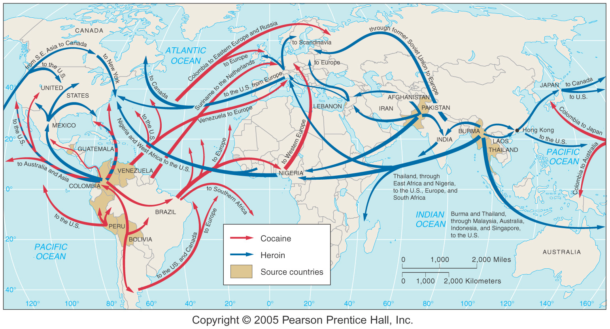
Drug Traffic

Slide 52
Policies of Wealthy Countries
High tariffs to protect markets
Farm subsidies
Encourage surpluses in rich areas
Decrease production in poor areas
Impact on world market

Slide 53
Subsidies: Reasons & Results
Reasons
Protects farmers
National security
Tradition
Political (electoral college)
Results
Low price
Restricts competition
Effect on trade and production

Slide 54
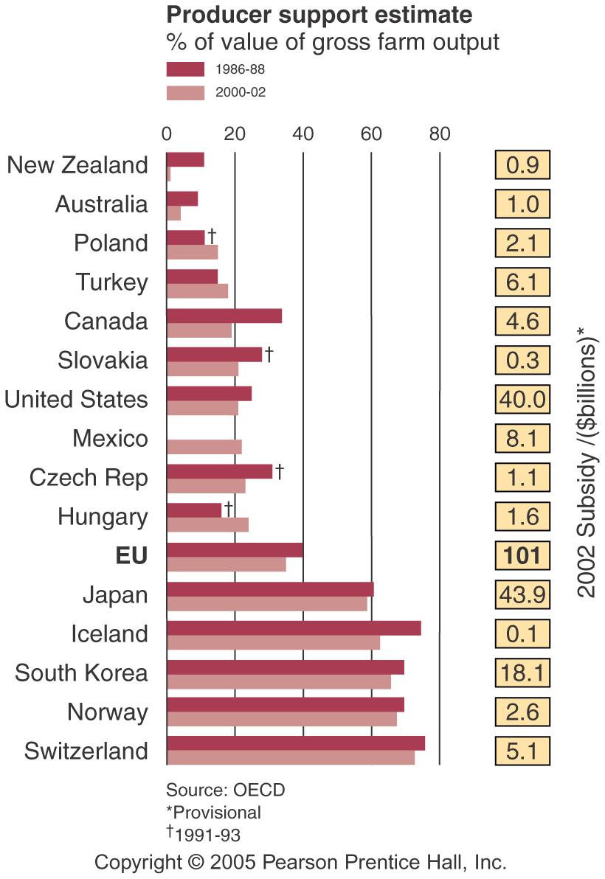

Slide 55
Fish Harvest
Traditional fishing
Physical and financial risks
Small fraction of global catch
Modern fishing
Fisheries
Overfishing and depletion
Increasing regulation
Aquaculture
Herding and domesticating aquatic species
Fertilizer production

Slide 56
World Fishing Grounds

Slide 57
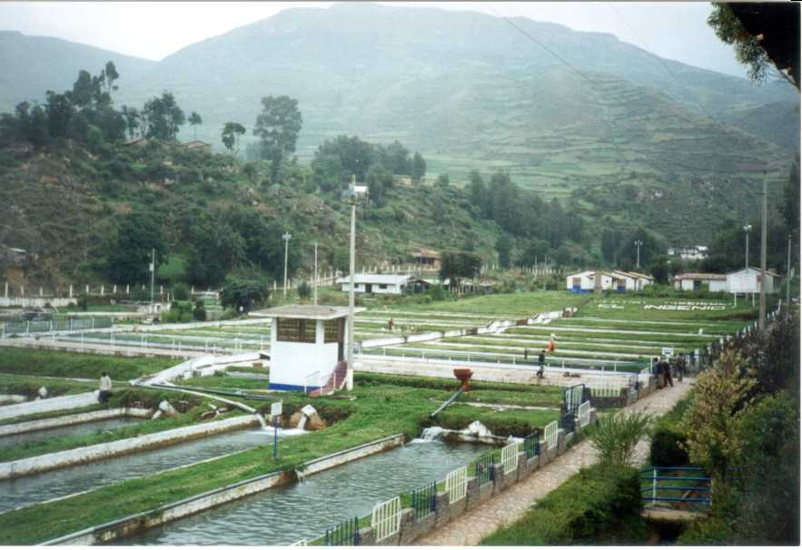
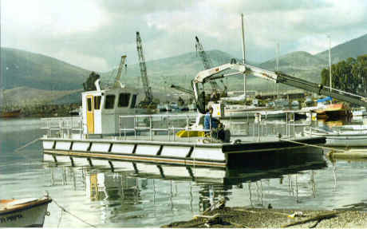
Aquaculture: On Land & Sea
Artificial ponds for fish farming
Boat being built for fish farming
Great potential for using land not suited to farming & preserving fish species

Slide 58
Long-term policy must be “sustained yield”

Slide 59
Sustained Yield is the Goal:
Plans must be developed based on the long-range benefits.
Developers must resist the temptation to seek larger, short-term gains at the expense of the health of ecosystem.
In the “market economy” people usually concentrate more on the latter rather than the former point of view.
The following slides show good agricultural practices that must be encouraged!

Slide 60
Education is Essential
Women = 50% of agricultural workers
Educating women in Kenya

Slide 61
Contour Plowing When Land Isn’t Level

Slide 62
Reasonable, Responsible Use of Aquifer Water for Irrigation

Slide 63
Crop Rotation

Slide 64
Careful Use of Hilly Land
Careful grazing
Orchards & vineyards
Terraced with great care

Slide 65
Protect the Soil
Loss of good soil must be kept to a minimum

Slide 66
Wake Up And Smell The Roses!

Slide 67
Particularly in USA, but not only there – stop urban sprawl on good farmland
Building subdivisions on good farmland makes absolutely not sense in the long-run.
It is difficult to discourage this in a market economy – it requires most people to develop social consciousness and to actually practice what they say they believe.
Some of the richest farmland in the world is in Florissant – how many farms are there today?

