Slide 1
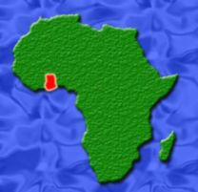
Facts about Ghana and Cocoa

Slide 2
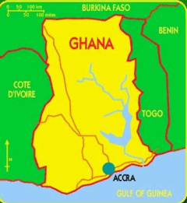
Ghana
Ghana, is a west African country, bounded on the north by Burkina Faso.
On the east it is bounded by Togo
On the south it is bounded by the Atlantic Ocean, and on the west by Côte d'Ivoire.

Slide 3
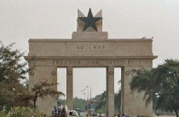
Accra
The capital city of Ghana is Accra
The total population of Ghana is approximately 23,382,848
Languages spoken include Akan, Ewe, Twi and English

Slide 4
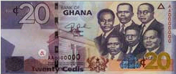
Cedi
The money used in Ghana is the New Ghana Cedi. 1 Ghana Cedi is worth about 78 cents in U.S. dollars.

Slide 5
Democracy
Ghana is a democratic nation with a history of peaceful transfers of power.
Young people can vote at age 18 years of age.

Slide 6
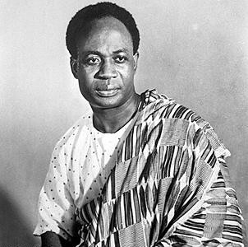
Formerly a British colony known as the Gold Coast, Ghana was led to independence by Dr. Kwame Nkrumah
On the 6th of March, 1957, Ghana became the first sub-Saharan colonial African nation to achieve independence.

Slide 7
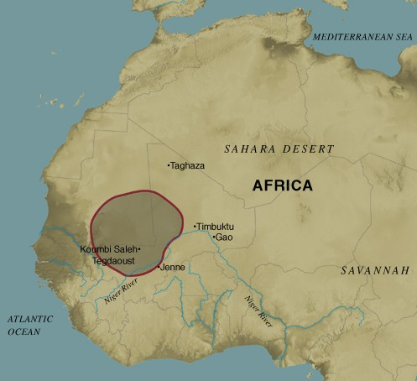
Empire of Ghana
The country is named after the ancient Sudanic empire of Ghana, from which the ancestors of the inhabitants of the present country are thought to have migrated.

Slide 8
Gold and Ghana
In medieval times, Ghana was the source of much of the gold that found its way across the Sahara to North Africa and Europe.
Gold is still an important part of Ghana’s economy but today Ghana is known more for its cocoa .

Slide 9
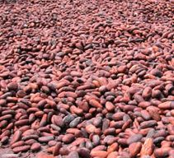
History of Ghana and Cocoa

Slide 10
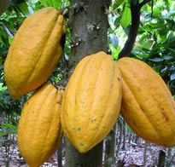
Cocoa from Ghana is considered to be among the finest cocoa in the world.
Most of Ghana’s cocoa production is on small farms of 4 to 5 acres.

Slide 11
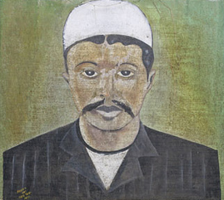
Tetteh Quarshie
Cocoa came to Ghana in 1876 when a Ghanaian named Tetteh Quarshie brought some cocoa pods to Ghana from Equatorial Guinea.
Tetteh Quarshie cultivated the beans on his farm in Ghana and was able to grow several seedlings.

Slide 12
The British colonial governor Sir William B. Griffith encouraged Tettah.
Griffith started a botanical garden and distributed seedlings to farmers.
From the 1900s cocoa growing spread in Ghana.

Slide 13
The first documented shipment of cocoa from the Gold Coast was made in 1893.
By 1911 Ghana was the world’s leading cocoa exporter, supplying the growing European chocolate market.

Slide 14
720,000 cocoa farmers in Ghana
Today there are currently close to 720,000 cocoa farmers in Ghana and approximately 2 million in West Africa.
West Africa supplies 70% of the world’s cocoa and Ghana is the second largest producer.

Slide 15
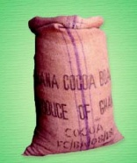
Problems Cocoa Farmers Face

Slide 16

Price of cocoa on the world market
The price of cocoa on the world market changes frequently. Going up and down.
The changing price of cocoa on the international market means cocoa farmers have no long-term security.

Slide 17
Fixed Scales
On the local scene, farmers face additional problems . They are often underpaid by local cocoa buyers using ‘fixed’ scales that show a lower reading than the actual weight of their cocoa beans.

Slide 18
Bounced Checks
Sometimes they are paid with checks that bounce or vouchers which the farmers have trouble cashing.

Slide 19
The problems Ghanaian cocoa farmers face globally and locally often push their incomes below the poverty line.
They lack the money they need to buy, tools, fertilizers and pesticides to grow cocoa.
They also lack the money they need to pay for clothes, medical care, and school fees for their children.

Slide 20
Rich get richer
The experiences of Ghanaian cocoa farmers are like those of many farmers all over the world.
They are caught in a trading system that benefits the multinational companies based in the richest countries.
They are at the mercy of local people who cheat them.

Slide 21

Farmers’ Cooperatives
Farmers in Ghana are forming ‘Fair Trade’ cooperatives to solve the problems they face.

Slide 22
Best of the Best!
Kuapa Kokoo is one of these farmers’ cooperatives.
Kuapa’s motto is: Papapaa or the best of the best!

Slide 23
Kuapa’s Mission
Kuapa works to:
to empower farmers in their efforts to gain a dignified livelihood
to increase women's participation in all of Kuapa's activities
to develop environmentally friendly cultivation of cocoa

Slide 24
Buy Fair Trade Chocolate
You can support farmers and their families by buying Fair Trade chocolate.
Fair prices for chocolate bars means a better life for farmers and their families.

Slide 25
The End

