Slide 1
www.securio.nl

Slide 2
The Netherlands
a short introduction
concerning the main
socio-cultural data

Slide 3
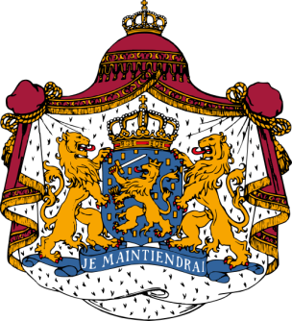
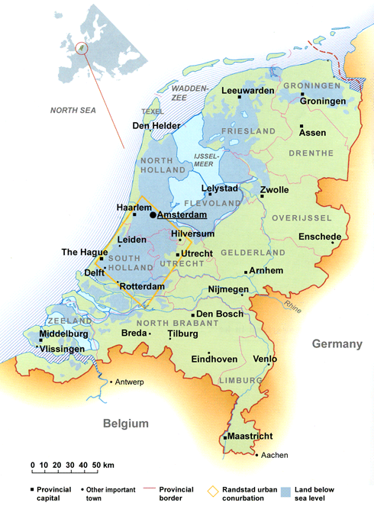
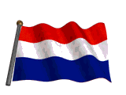
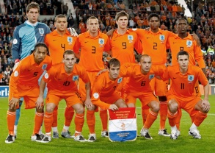
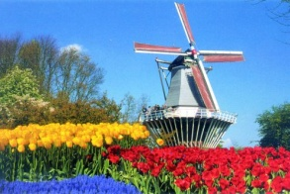
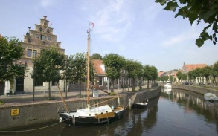
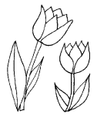

Slide 4
The Netherlands -Dutch: Nederland- are a constituent country of the Kingdom of the Netherlands, located in North-West Europe and with territories in the Caribbean.
It is a parliamentary democratic constitutional monarchy.
Mainland Netherlands borders the North Sea to the north and west, Belgium to the south, and Germany to the east, and share maritime borders with Belgium, Germany and the United Kingdom.
The capital is Amsterdam and the seat of government is The Hague.

Slide 5
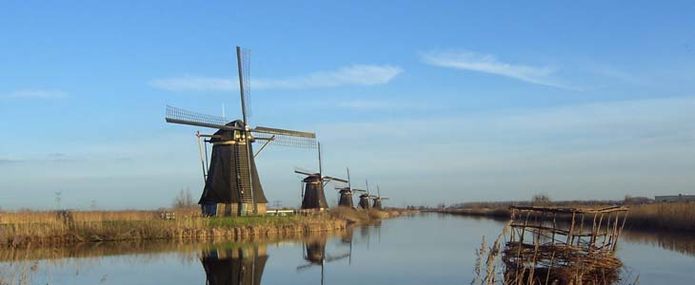
The Netherlands are a geographically low-lying country, with about 25% of its area and 21% of its population located below sea level, with 50% of its land lying less than one metre above sea level.
Significant land area has been gained through land reclamation and preserved through an elaborate system of polders and dikes.
Much of the Netherlands is formed by the estuary of three important European rivers, which together with their distributaries form the Rhine-Meuse-Scheldt delta.

Slide 6
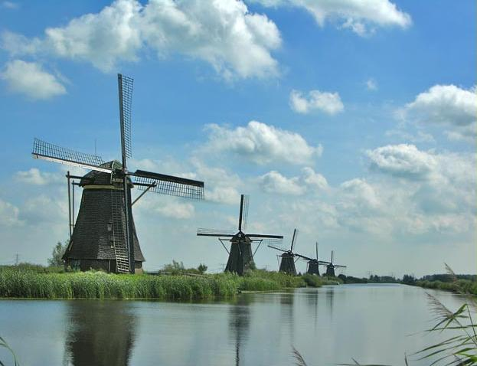

Slide 7
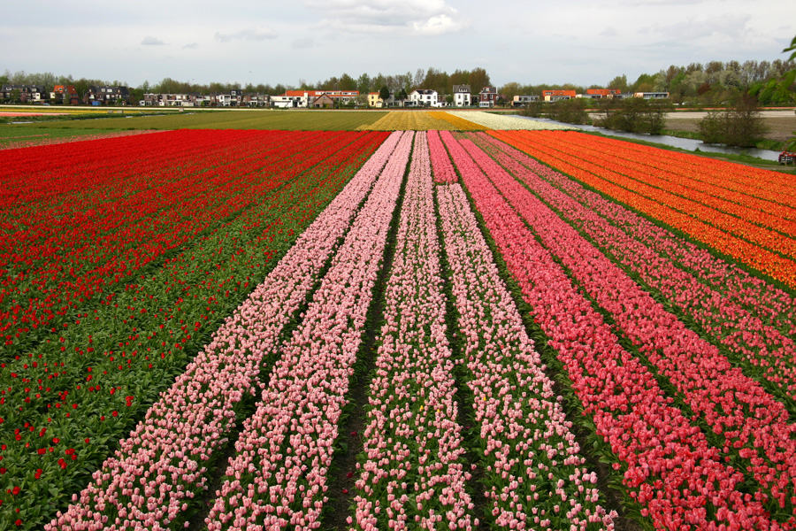

Slide 8
At present the Netherlands have an estimated population of about 17,000,000.
It is the 11th most populous country in Europe and the 61st most populous country in the world.
The Netherlands is the 25th most densely populated country in the world, with 395 inhabitants per km² or 484 inhabitants per km² if only the land area is counted.
The Dutch are among the tallest people in the world, with an average height of 1.81 metres (5 ft 11 in) for adult males and 1.67 metres (5 ft 6 in) for adult females.
People in the south are on average about 2 cm shorter than those in the north.

Slide 9
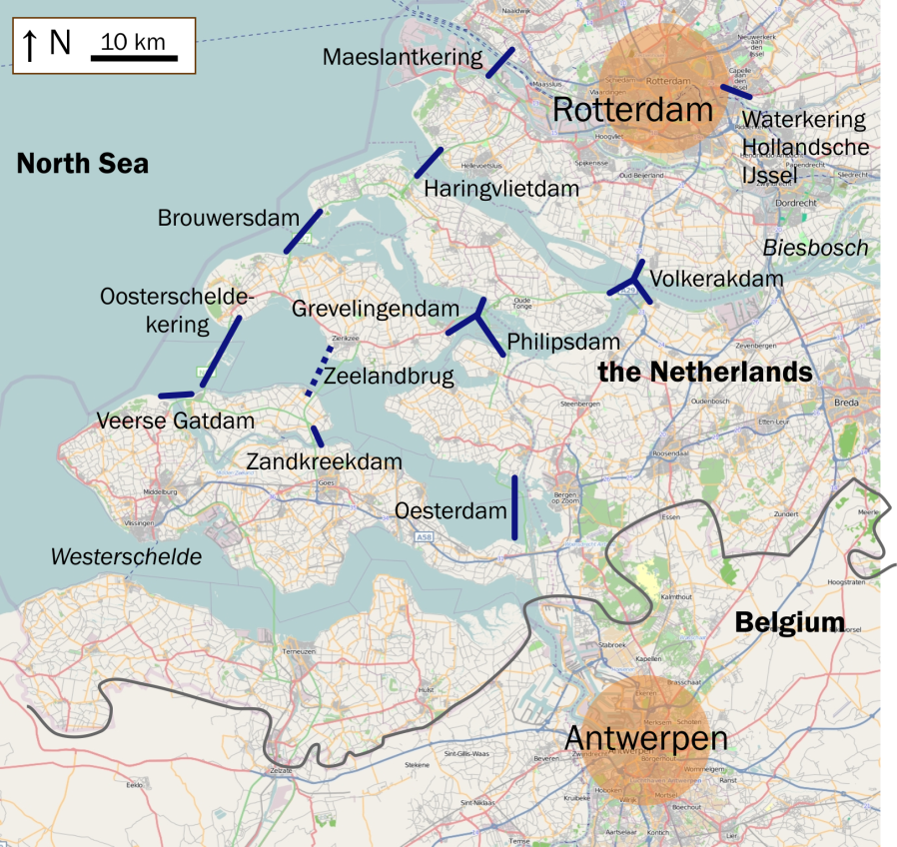
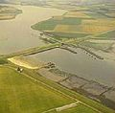
The struggle against the water has culminated so far in the so-called Delta-works. The Delta project, a vast construction effort designed to end the threat from the sea once and for all, was launched in 1958 and largely completed in 1997 with the completion of the Maeslantkering.

Slide 10
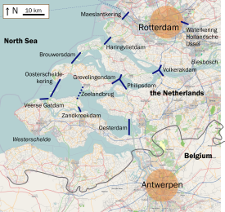
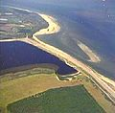
The official goal of the Delta project was to reduce the risk of flooding in South Holland and Zeeland to once per 10,000 years.
(For the rest of the country, the protection level is once per 4,000 years.)
This was achieved by raising 3,000 kilometres (1,864 mi) of outer sea-dykes and 10,000 kilometres (6,214 mi) of inner, canal, and river dikes to "delta" height, and by closing off the sea estuaries of the Zeeland province.
New risk assessments occasionally show problems requiring additional Delta project dyke reinforcements.

Slide 11
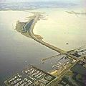
The Delta project is one of the largest construction efforts in human history and is considered by the American Society of Civil Engineers as one of the seven wonders of the modern world.

