Slide 1
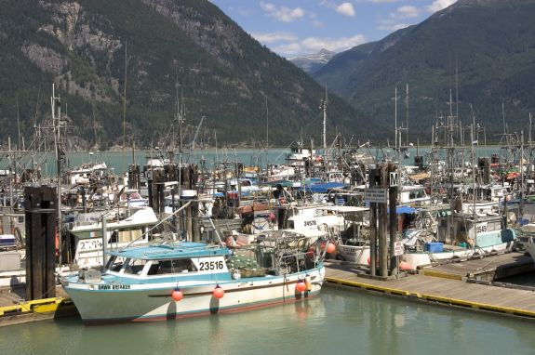
INTRODUCTION TO FISHING
NATURAL RESOURCES OF CANADA

Slide 2

Overview:
History of Fishing in Canada
Types of Fishing
  Recreational/Subsistence/Commercial
Main Sources of Fishing in Canada
  East Coast
  West Coast
  Fresh Water
  Aquaculture
Department of Fisheries Canada
Threats to the Commercial Fishing
Recent Economic Figures

Slide 3
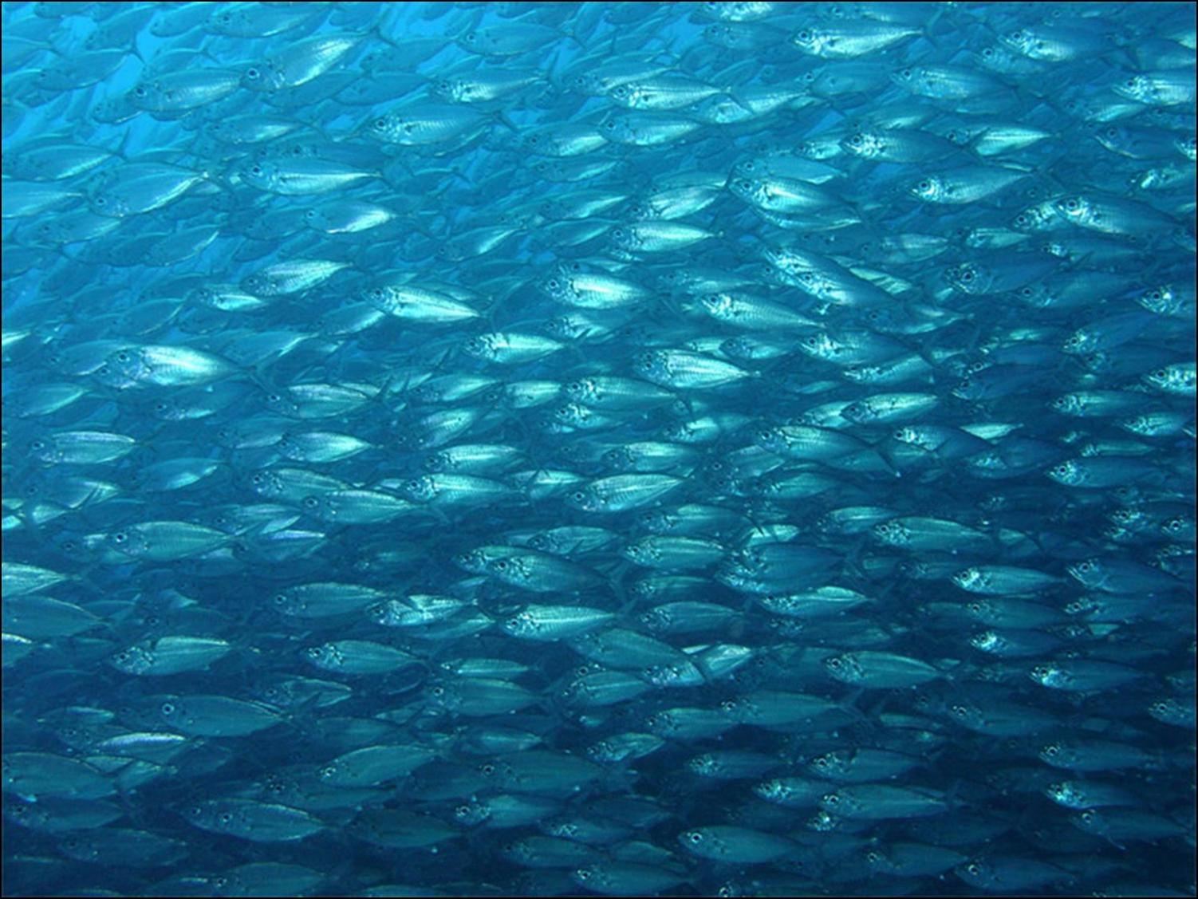
Fish as a Resource:
Fish are a renewable resource – that means with proper management the resource could last forever…

Slide 4
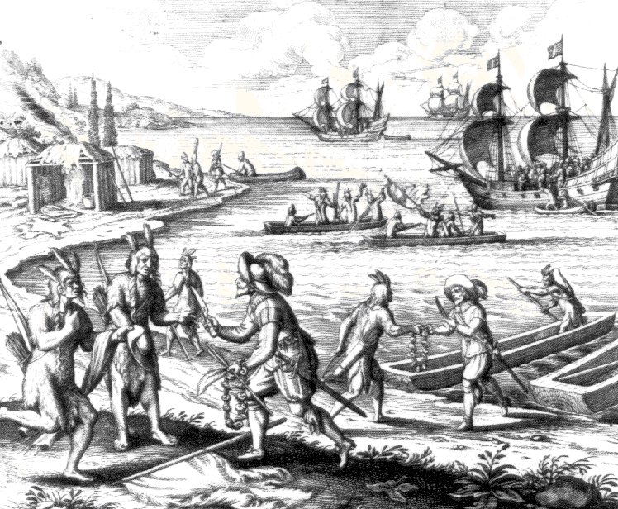
History of Fishing in Canada:
The Beothuk were the native people of Newfoundland, and survived on a diet of fish
Fish was a source of protein for many First Nations peoples
Notes:
With British and French coastal settlements, the Beothuk were forced inland. The lack of their normal food source gradually decreased the Beothuk population. By the 19th Century, the tribe no longer existed.

Slide 5
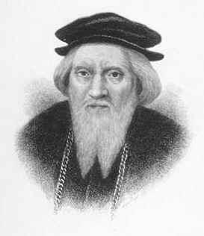
History of Fishing in Canada:
Europeans had been coming to fish near the Atlantic coast of Canada for centuries (Viking, Basque, Portuguese)
After the official discovery of the North America many nations came to the Grand Banks to fish
Heritage Minute
John Cabot
Notes:
These fisherman for the most part would fish for a few months in the summer and would leave in the winter, with the exception of the Viking .

Slide 6
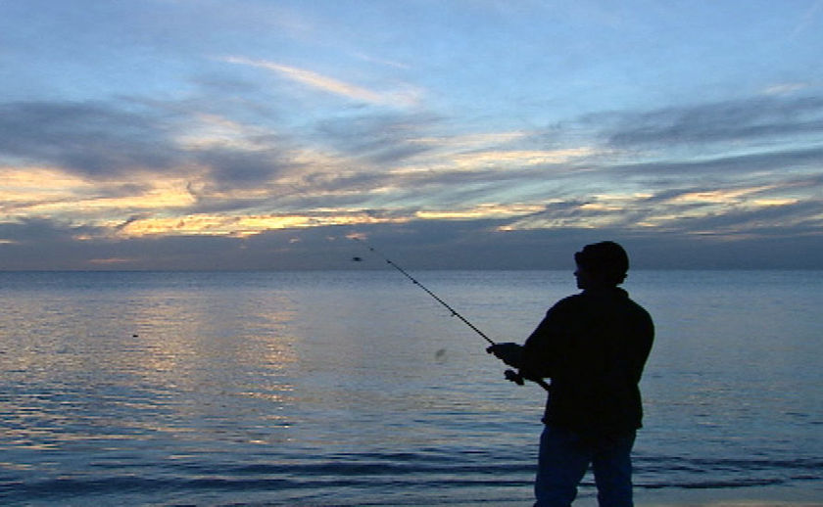
Recreational and Subsistence Fishing:
Recreational fishing, also called sport fishing, is fishing for pleasure or competition
Subsistence fishing is fishing for survival
  For example: the Beothuk and many other First Nations were subsistence fisherman

Slide 7
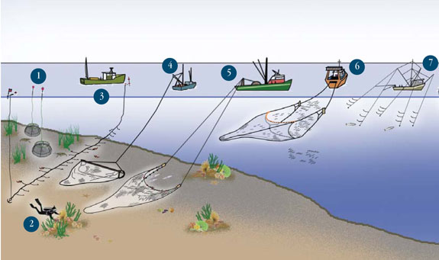
Commercial Fishing:
Commercial fishing: is the activity of capturing fish and other seafood for commercial profit, mostly from wild fisheries
Commercial fishing methods have become very efficient, using large nets and factory ships
Fisheries: refers to commercial fishing operations
1. Prawn Trap 2. Dive 3. Groundfish Bottom Longline 4. Shrimp Beam Trawl 5. Groundfish Otter Trawl 6. Midwater Trawl 7. Hook and Line
Notes:
1. Prawn Trap 2. Dive 3. Groundfish Bottom Longline 4. Shrimp Beam Trawl 5. Groundfish Otter Trawl 6. Midwater Trawl 7. Hook and Line

Slide 8
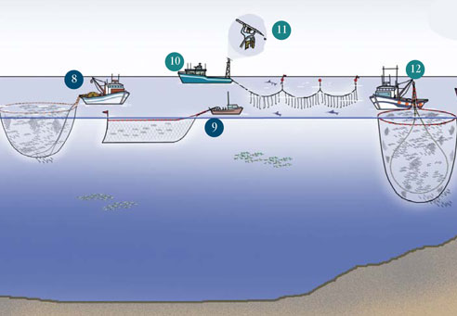
Commercial Fishing:
8. Salmon Purse Seine 9. Midwater Salmon Gillnet 10. Pelagic Longline 11. Harpoon
12. Purse Seine
Notes:
8. Salmon Purse Seine 9. Midwater Salmon Gillnet 10. Pelagic Longline (swordfish longline) 11. Harpoon (swordfish harpoon)

Slide 9
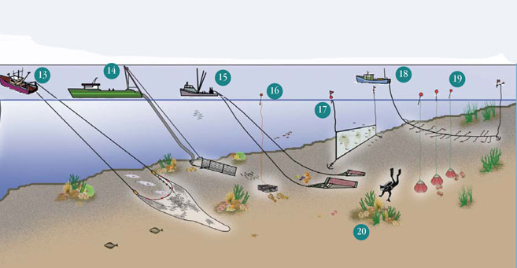
Commercial Fishing:
13. Groundfish Otter Trawl 14. Offshore Hydraulic Clam Dredge 15. Dredge 16. Pot and Trap 17. Bottom Gillnet 18. Groundfish Bottom Longline 19. Pot and Trap 20. Dive
Notes:
12. Purse Seine (herring seine) 13. Groundfish Otter Trawl 14. Offshore Hydraulic Clam Dredge 15. Dredge (scallop dredge) 16. Pot and Trap (lobster trap) 17. Bottom Gillnet (groundfish gillnet) 18. Groundfish Bottom Longline 19. Pot and Trap (crab pots) 20. Dive

Slide 10
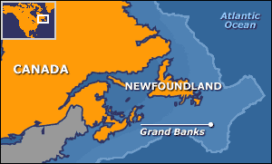
Main Sources of Commercial Fishing:
1) East Coast:
This includes fishing near the Atlantic Ocean and the Grand Banks
The Grand Banks are one of the richest fishing grounds in the world
Species include:
Cod
Haddock
Capelin
Scallop
Lobster
Notes:
The Grand Banks of Newfoundland are a group of underwater plateaus southeast of Newfoundland on the North American continental shelf. These areas are relatively shallow, ranging from 80 to 330 feet (24–100 m) in depth. The cold Labrador Current mixes with the warm waters of the Gulf Stream here.
The mixing of these waters and the shape of the ocean bottom lifts nutrients to the surface. These conditions helped to create one of the richest fishing grounds in the world.

Slide 11
The Grand Banks:
For years there were no regulations or control over fishing in the Grand Banks
This depleted the fish in the area

Slide 12
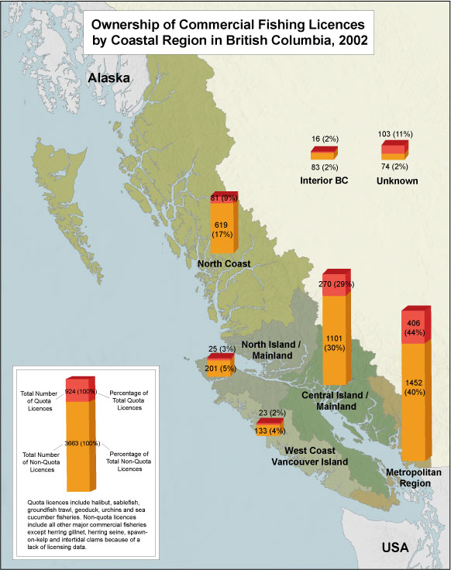
Main Sources of Commercial Fishing:
2) West Coast:
This is the area off the coast of British Columbia, in the Pacific Ocean
Species Include:
Salmon
Herring
Tuna
Shellfish

Slide 13
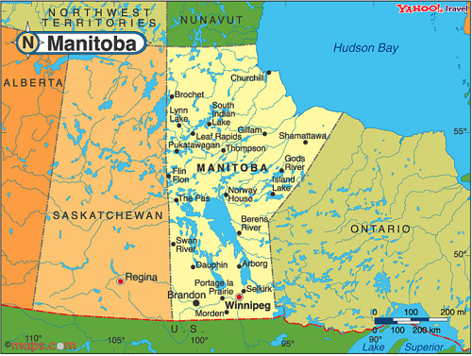
Main Sources of Commercial Fishing:
3) Fresh Water:
Canada’s freshwater system is the largest in the world, encompassing about 2 million rivers and lakes, totalling over 755,000 sq. km
Currently, it is Manitoba's fishing industry that produces about 25% of the freshwater fish in Canada
There are about 13 species of fish that are being harvested commercially: including lake trout, northern pike, whitefish and yellow perch

Slide 14
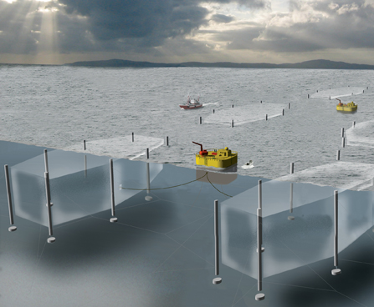
Main Sources of Commercial Fishing:
4) AQUACULTURE:
is the farming of aquatic organisms such as fish, and crustaceans
  The main species are Atlantic and Pacific Salmon, Mussels and Trout
85 per cent of fish harvested is exported
Notes:
Aquaculture involves cultivating freshwater and saltwater populations under controlled conditions, and can be contrasted with commercial fishing (which is the harvesting of wild fish).

Slide 15
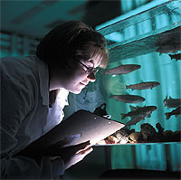
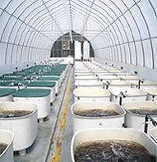
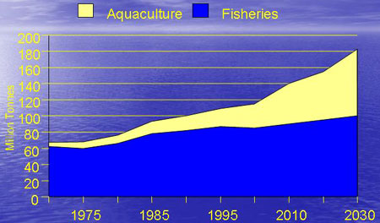
Aquaculture, the future of fishing?
In 2008, wild harvest and aquaculture exports totalled almost $4 billion
The aquaculture industry employed more than 16,000 people
There are aquaculture operations in every Canadian province and in the Yukon Territory
Canada's aquaculture industry is continuing to grow
excess of $1.5 billion expected by 2020
Fish Farm Tour

Slide 16
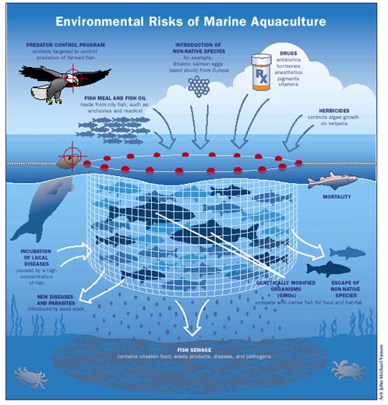
Aquaculture Risks:
Farmed fish can escape their pens and pose biological risks to wild populations
Large releases of nitrogen, phosphorus, and fecal matter from such farming can damage the coastal environment
Questions have also been raised about the nutrition, safety and taste of “farmed” fish

Slide 17

The Department of Fisheries
The fishing industry in Canada is managed and protected by the Department of Fisheries and Oceans (DFO)
DFO is the government agency that sets and implements standards for the development and sustainability of Canada's fishing industry by providing facilities for safeguarding, conservation and research
It is responsible for the health, safety and productivity of Canada's water and aquatic resources
To protect its marine environment, Canada employs the Coast Guard which offers assistance to thousands of small commercial and recreational fishing vessels in case of emergencies

Slide 18
Attempts at Preservation:
The Canadian government wanted to put a freeze on fishing
In 1976, the Canadian government extended its marine jurisdiction to 200 nautical miles which effectively pushed the foreign factory ships off many of the prime fishing and breeding grounds
Quotas were also put in place by the government to reduce the amount of fish being caught

Slide 19
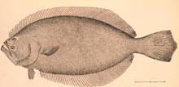
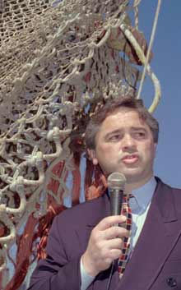
The Turbot War
Despite Canada’s efforts at protection many fishing nations failed to protect the fish stocks
The Turbot War:
The Canadian confrontation with Spain early in 1995 to protect the turbot stocks demonstrates the continued serious challenges to sustainable development
Former Newfoundland and Labrador premier Brian Tobin during the 'turbot war.'

Slide 20
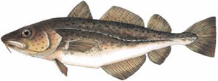
The Collapse of the Cod Industry:
In 1992, the Cod industry in the Grand Banks collapsed
Atlantic cod were declared an endangered species and the federal government put a moratorium on the Newfoundland and Labrador cod fishery
40,000 people lost their jobs in the Maritimes
The communities are still struggling to recover
The marine ecosystem is still in a state of collapse
Was this the end of the commercial fishing industry in Canada?

Slide 21
The Collapse of the Cod Industry:
In the words of Earle McCurdy, president of the Fish, Food, and Allied Workers union: “What we have is not an adjustment problem, but the most wrenching societal upheaval since the Great Depression. Our communities are in crisis. The people of the fishery are in turmoil.”

Slide 22
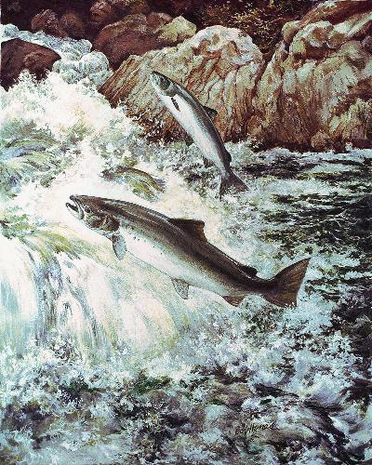
Salmon, the next Cod?
East coast salmon is also quickly disappearing
West coast salmon numbers are also declining
Today 350,000 wild salmon return to Nova Scotia’s Bay of Fundy area (down from 1.5 million in the mid-1970s)

Slide 23
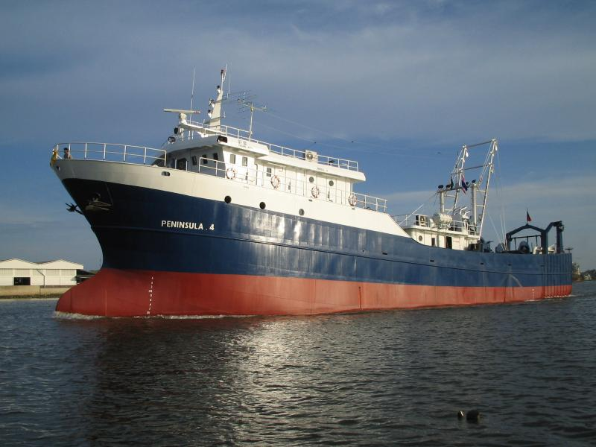
Threats to Commercial Fishing:
Technology
New technology is making it possible to find and capture fish more easily
  Examples: radar, GPS
Trawlers: huge factory ships that make it possible to capture, gut and freeze fish instantly onboard
Dragger: huge net that is dragged along the bottom of the ocean; catches everything in its path and destroys the underlying ecosystem in the process

Slide 24
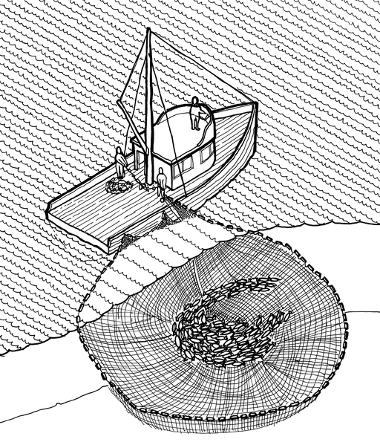
Technology:
Example:
In 1972: it took traditional seine boats 51 days to harvest their quota in the West Coast
In 1994: it took less that four days for modern boats to fill their quota, even with an increased catch allowance!

Slide 25
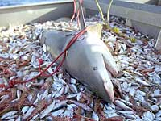
Threats to Commercial Fishing:
Overfishing
Simply means catching too many fish
Bycatch is when nets accidently catch small fish or other marine species
The bycatch is simply thrown overboard
Bycatch is often 80 per cent of the stock

Slide 26
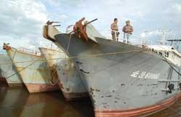
Threats to Commercial Fishing:
Foreign Fisherman:
Up until the 1950s, 250,000 tonnes of Cod were caught in Grand Banks alone
However, after the 1950s foreign fisherman began arriving at the Grand Banks in trawlers (huge factory ships)
Although Canada tries to maintain quotas, it cannot restrict anyone beyond the 200 nautical mile jurisdiction
Notes:
Foreign fisherman came from England, the U.S., the Soviet Union, East and West Germany. Spain, Portugal, Poland and some Asia nations such as Japan and Korea.

Slide 27
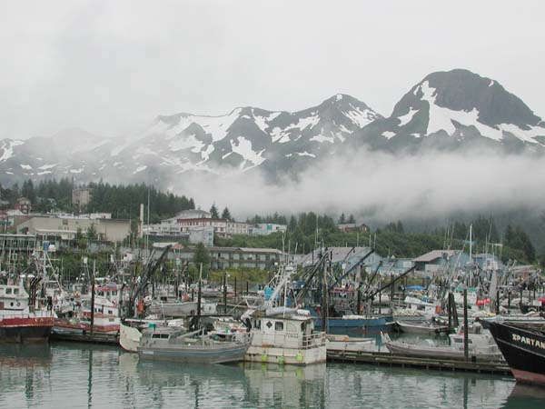
Foreign Fishermen:
The United States has a right to fish in the west coast due to the location of the state of Alaska
The American’s 2,500 Alaskan fleet is being partially blamed for depleting Salmon stocks

Slide 28
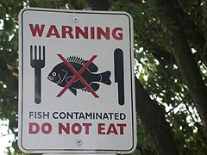
Threats to Commercial Fishing:
Environmental threats include:
Climate Change
Pollution
Accidental introduction of invasive species
Notes:
While the adaptive capacity of the Canadian fisheries sector with respect to climate change is generally poorly understood, there is growing recognition of the need to anticipate and prepare for potential changes, and increased realization that present-day decisions will affect future vulnerabilities. Fish can be exposed to high levels of pollution, as the bodies of water in which they live often receive contaminants from precipitation, storm water runoff and industrial effluents.
Exposure to harmful chemicals can weaken the immune systems of fish and impair reproduction and development. Some of these chemicals can be passed on to other animals and humans that eat them.

Slide 29
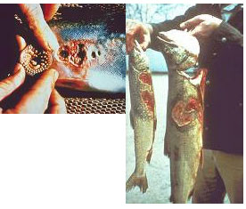
Environmental threats:
  INVASIVE SPECIES: a non-native species, whose introduction will likely cause (or has already caused) damage to the host ecosystem
  Examples:
    Sea lamprey
    Japanese oyster
Notes:
Aquatic invasive species (AIS) have already been responsible for significant devastation of some native fish species and fisheries in Canada. Annually, the problem is responsible for billions of dollars in lost revenue and control measures. Canada, with its huge freshwater resource and extensive coastline, is especially vulnerable to this threat.

Slide 30
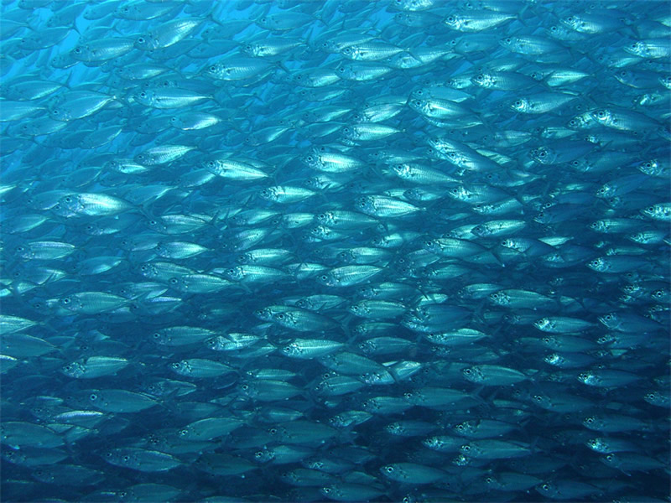
The Commercial Fishing Industry Today:
The fishing industry is still a big source of income in Canada
In 2005 over 1 million tons of commercial fish was harvested, valued at about $2 billion
Businesses belonging to Canada's fishing industry number about 11,000 (includes aquaculture, fish processing, ocean services, engineering and hydrography, among others)
However, this natural resource needs to be protected!

Slide 31
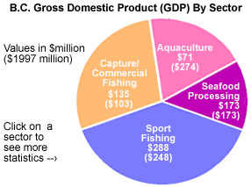
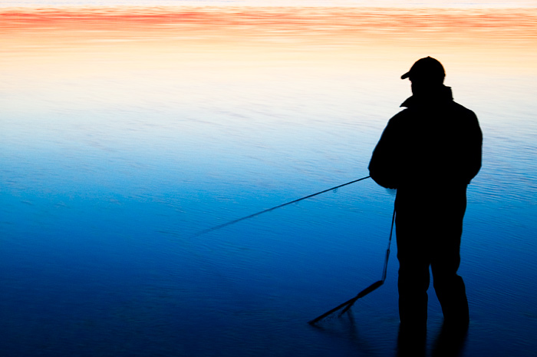
Recreational Fishing:
Millions of dollars a year are also made from recreational fishing, through tourism
Sport fishing generates $288 million a year in GDP in British Columbia alone!

