Slide 1
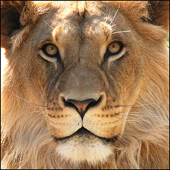
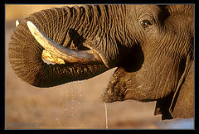
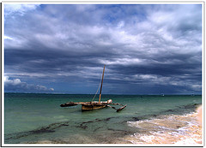
Tourism in Kenya

Slide 2
Aims and objectives
To be able to identify a tourist destination in a LEDC.
Recognise the physical attractions of Kenya.
Recognise the human attractions of Kenya.
To be able to identify the economic, environmental and social impacts of tourism.

Slide 3
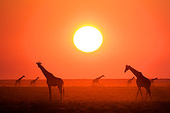
Locating Kenya
Kenya is located in Central Africa with the equator passing through its centre. It is 583 000sq km and the main tourist season is in January and February, since the hot, dry climate is considered to be the most pleasant

Slide 4
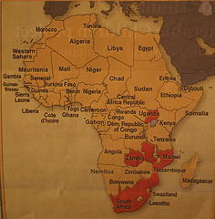
Kenya
Using an Atlas locate Kenya and add it the main physical and human features
Kenya is bordered by 5 other Kenyan countries
Can you name them ?
What is the capital city?

Slide 5
The climate
Month | J | F | M | A | M | J | J | A | S | O | N | D
Temp Degrees | 29 | 30 | 30 | 31 | 27 | 26 | 25 | 26 | 28 | 28 | 29 | 29
Rainfall MM | 9 | 5 | 48 | 128 | 200 | 78 | 67 | 54 | 53 | 63 | 67 | 50
Using the statistics above draw your own climate graph

Slide 6
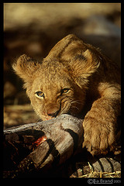
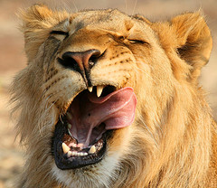
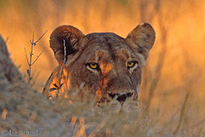
The main attractions
Safari holidays – the wildlife
Lions

Slide 7
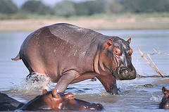
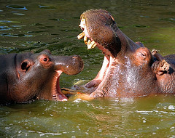
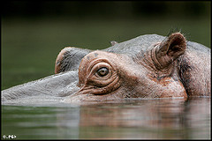
Hippo’s

Slide 8
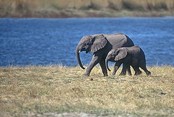
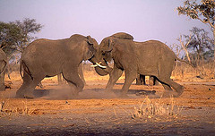
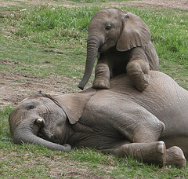
Elephants

Slide 9
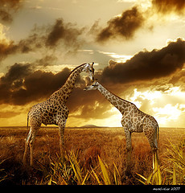
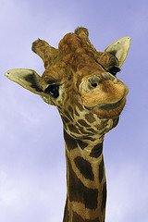
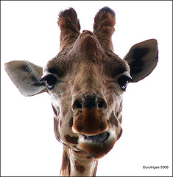
Giraffe

Slide 10
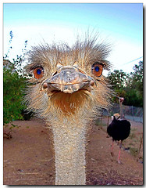
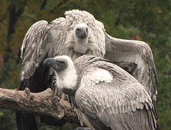
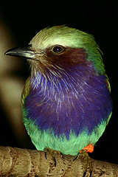
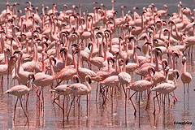
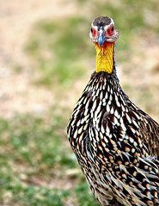
Birds
Vultures
Lilac Roller
Ostrich
Pink Flamingos
Guinea Foul

Slide 11
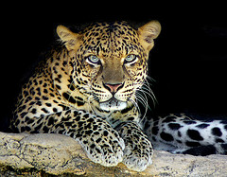
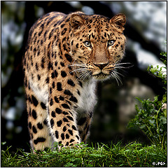
Leopards

Slide 12
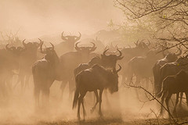
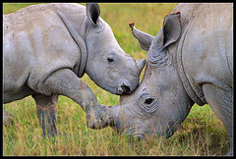
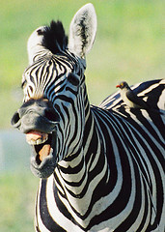
… and more!
Wildebeest
Rhinos
Zebra

Slide 13
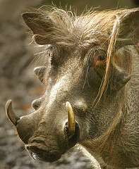
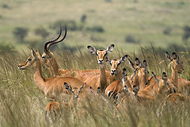
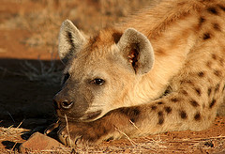
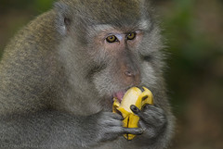
… and more
Warthog
Impala
Hyena
Baboon

Slide 14
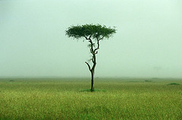
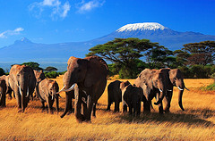
Physical landscape
Savanna
Mount Kenya : 5199m

Slide 15
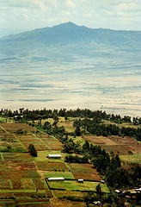
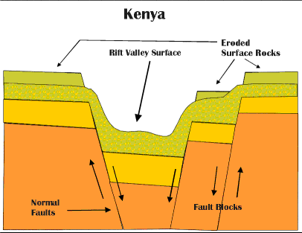
The Rift Valley
Kenyan Rift Valley
Formation of the Rift Valley

Slide 16
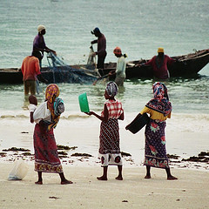
The Coast

Slide 17
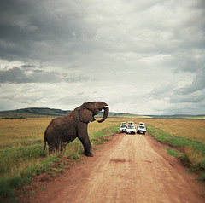
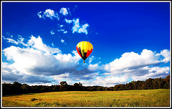
Safari holiday
By minibus……
by air……

Slide 18
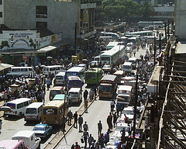
Where to go
Nairobi
Nairobi is the capital of Kenya. It has a well developed Central Business District……however

Slide 19
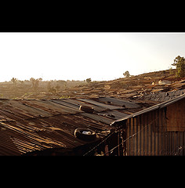
Nairobi
Kibera : slum housing on the outskirts of Nairobi. Population approximately 1.4 million!!

Slide 20
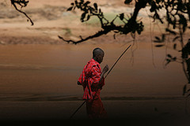
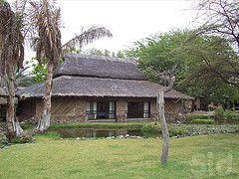
Samburu
National Park
The Samburu Lodge
Samburu warrior

Slide 21
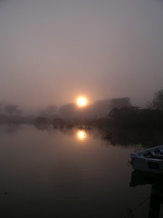
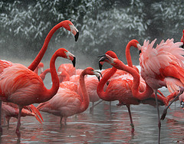
Lake Naivasha
Boat trips
Flamingos
Hungry Hippos!!

Slide 22
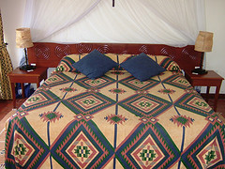
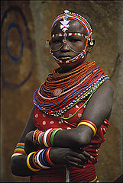
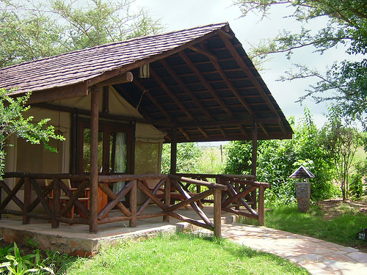
Maasai Mara
National Reserve
Keekerok
The Maasai Mara Game Reserve has an abundance of wildlife and is home to a number of tribes.

Slide 23
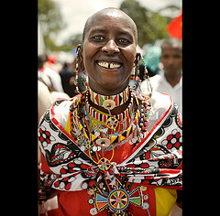
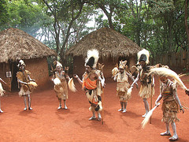
The people
Kikuyu
Maasai
Notice the different shapes of the traditional housing.

Slide 24
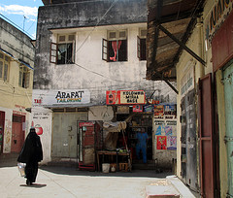


Mombasa
Mombasa’s attractions include the wood carving factory, safaris, beautiful beaches and the old town.
Using an Atlas locate Mombasa and add it to you map

Slide 25
Challenge 1
Kenya is an ideal holiday destination. It has many physical and human attractions.
Create a table like the one below and list as many attractions as possible under the correct heading.
Kenya’s Tourist attractions
Physical attractions The climate Rift Valley | Human attractions Maasai people Nairobi

Slide 26
Impacts of tourism
Kenya appreciates its landscape and wildlife. Tourists bring much money into the country. This can be used to improve services, provide housing, create jobs and generally help the country improve its level of development.
However, tourism also brings problems. The animals maybe frightened, erosion of roads and damage fragile environments.
Tourism can have positive and negative impacts on the wildlife, people and the environment.

Slide 27
Challenge 2
On the next slide you will be shown a number of tourist impacts. Your challenge is to put them under the correct headings. Think carefully if the impact is positive or negative and whether the impact effects the environment, wildlife or people.
What’s affected? | Tourism impacts
 | Positive | Negative
Environment
Wildlife
People

Slide 28
Tourism impacts
Money to improve education, housing and water supply
Safari vans go off track and cause erosion
Traditional skills are lost (eg farming methods), people only want to work within the tourist industry
There has been a bad on hunting the wildlife
Traditional dances are changed to suit the tourists
Provides jobs
Erosion on tracks leads to dust storms
The animals are protected in National Parks
Maasai forced to move from their homelands
Wildlife is disturbed by tourists noise
Special tourist trails and tracks are developed
The Savanna landscape is being protected by Park Rangers

Slide 29
Summary
Kenya is a popular tourist destination, it has many physical (landscape, beaches) and human attractions (Nairobi, Maasai tribe).
Tourists can have a positive and negative effect on the country.
Impacts can effect the environment, wildlife and people.

