Slide 1
Renewable Energy

Slide 2
Specific Questions
What are the current and projected UK energy (fuel + electricity) demands?
How is the demand for electricity currently being generated? In the future?
What contribution can renewable energy make to future fuel and electricity needs?

Slide 3
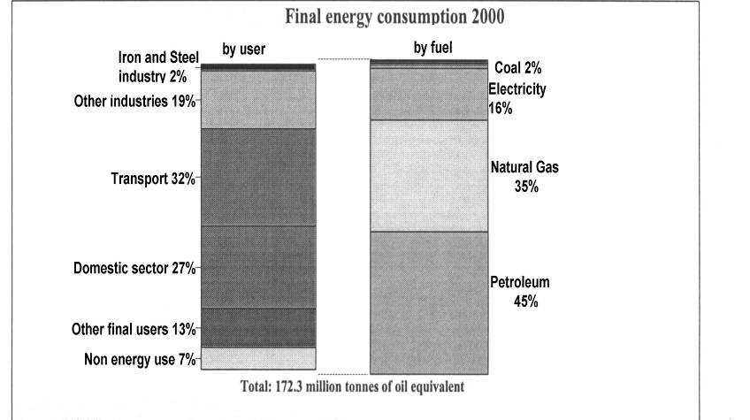
UK Energy Demands 2000
Data from DTI Energy Statistics 2000

Slide 4
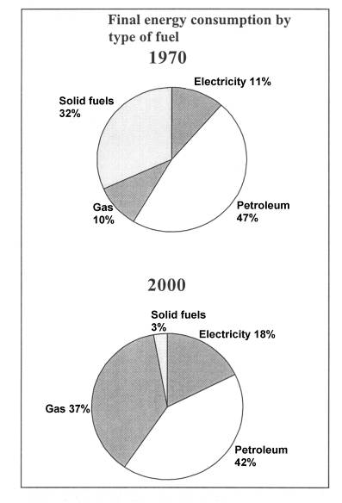
How are energy needs supplied?
Source –DTI energy Statistics

Slide 5
Present Energy
Resources
Fossil fuels - coal, oil, gas are all of limited amounts. Cant be replaced.
Nuclear fuels -limited amounts of uranium for nuclear fission reactors but reprocessing of fuel possible.
Difficult to estimate how long these fuels will last - but is it sustainable economically or environmentally?

Slide 6
How much energy is needed?
DTI Energy Statistics for 2000
308,332 GWh of electricity was distributed to 29.068 million consumers.
  i.e. on average, each consumer used 10, 607 kwh of electricity.
In 2000, the total energy consumed in the domestic sector of the UK was 46,833 thousands tons of oil equivalent.
Dividing this value by the number of consumers and converting to kwh gives the average amount of energy used per household as 18,737 kwh.

Slide 7
Sustainable situation
Renewable energy resources are being replaced / generated at the same rate that they are being utilised.
Hence they will last indefinitely.

Slide 8
Renewable Energy
What is renewable energy?
What forms does it take?
Why is it needed?
Targets exist for renewable energy to generate 10% of electricity by 2010 and 20% by 2020!
Can these be achieved?
What forms of renewable energy will deliver these targets?

Slide 9
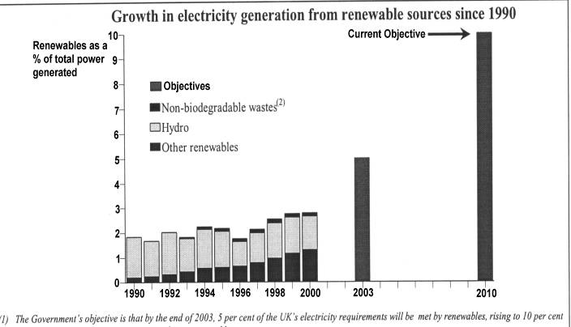
Electricity Generation by Renewables
Source – DTi Energy statistics 2000

Slide 10
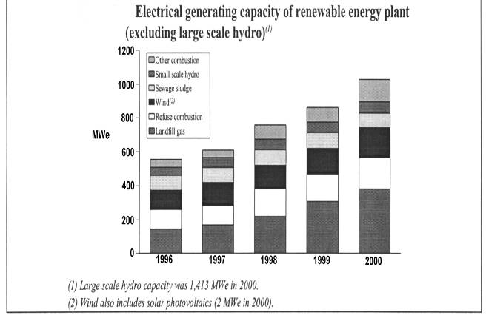
Generating Capacity of Renewable Plants

Slide 11
The DTI List of
Renewable Resources
Wind, Wave and Hydro Power
Photovoltaics Active Solar Heating
Municipal and General Wastes
Landfill Gas Geothermal
Agricultural and Forestry Wastes
Energy Crops Fuel Cells

Slide 12
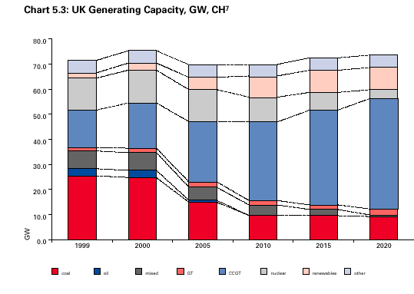
Other
Renewables
Nuclear
Combined Cycle Gas
Turbine
GasTurbine
Coal

Slide 13
Forms of Renewable Energy
All sources of energy ultimately come from the sun.
This is particularly obvious in the case of renewable energies.

Slide 14
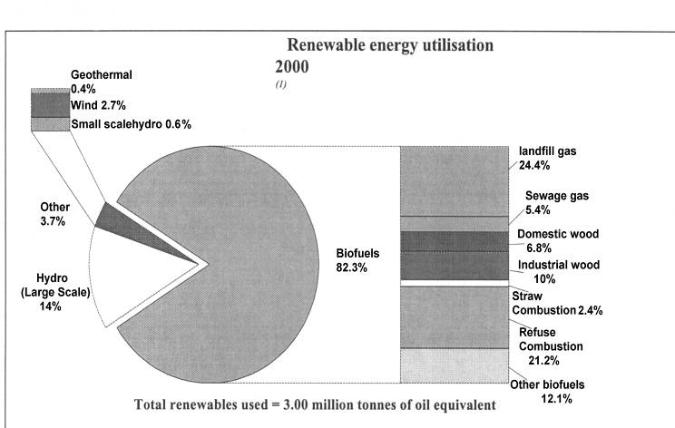
Renewable Energy
Utilisation 2000
Source – DTI Energy Statistics 2000

Slide 15
Solar Radiation
solar heating panels/passive
solar power generation
solar cells / photovoltaic cells

Slide 16
Solar cells
convert light into a small electrical output -milliwatts output.
need a bank/array of cells for useful output.
cost of cells is high but reducing.
efficiency of cells is up to 23%/ improving.

Slide 17
Solar Panels
are situated on roof of building.
absorb heat in the form of radiation from sun.
basically system is like a domestic central heating radiator painted black/insulated.
provides “topping up” of domestic hot water.

Slide 18

Photovoltaics on Buildings
PV arrays, generating around 54kW (peak) with a total area of 430m², form the sloping glazed roofs of the atrium spaces in the four main buildings.
Ove Arup has designed the system to match the annual electricity demand of the supply and extractor fans, effectively providing zero-energy ventilation systems.

Slide 19
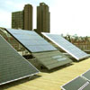
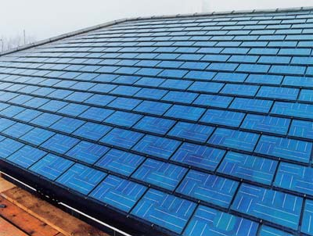
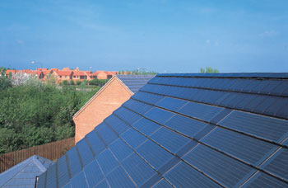
Solar Roof tiles
(Solar Grants now available)
Roof mounted solar panels (Solar century)
Integrated solar tiles installed by Solar Century on a current development in Milton Keynes by English partnership and Bloor homes
Innovative SunSlates installation by
Solar century for Liang Homes

Slide 20
Solar Power Generation
located in desert/high intensity/long sunlight hours
parabolic mirrors reflect/focus sun’s rays onto metal water pipe located along focal axis of mirrors.
High temperature produced - steam - electrical power generated

Slide 21
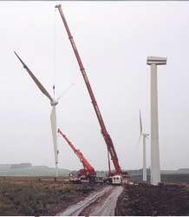
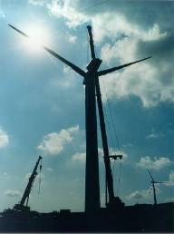
Wind Turbines

Slide 22
Location of UK
Wind Clusters

Slide 23
Windpower
Each windturbine can produce between 1/4 and 2 MW of electrical power.
Windfarm needs to be located where there is a relatively high average wind speed.
Advantages?
Disadvantages?

Slide 24
Calculation of number of households supplied by a windfarm
Assume 24 windturbines each generating 0.25 MW for 70% of time.
In a year this amounts to 3.66 x 10⁷kwhr.
If this figure is divided by average amount of electricity used by a consumer ie 10,607 kwhr in a year,
Answer is 3600 consumers.
But 166 of these wind farms = 1000Mw power station!

Slide 25
Offshore Wind Turbines

Slide 26
Offshore Wind
Cluster Features
Larger average wind speed than onshore
Easier planning consent
Technical expertise exists from oil rig experience
Suitable location

Slide 27
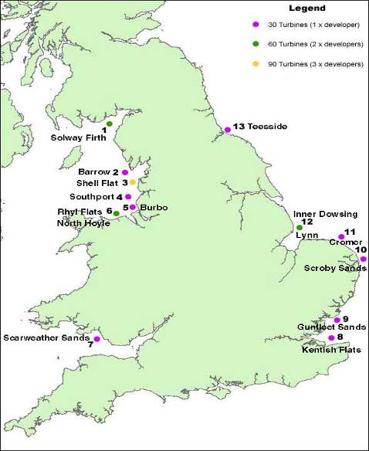
Offshore sites

Slide 28
Hydroelectric
Currently largest source of electricity from renewables.
Needs guaranteed supply of water.
Galloway-West of Scotland - series of lochs and rivers-cascade of flowing water.
Kinetic energy of water rotates turbines which generate electricity.

Slide 29
Tidal Power
Located at some coastal sites - usually estuaries and bays with large tidal range.
Shape of coastal site above and below sea level determines range eg Bay of Funday, Severn.
At high tide reservoir of water is created which is allowed to ebb through turbines located in dam.
Expensive construction.

Slide 30
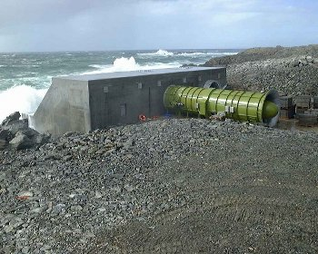
Wave Power
Land Installed Marine Powered Energy Transformer on Islay, West Coast of Scotland.
Wavegen Co.
LIMPET provides 500kW of electricity for the National Grid
Three floating wave power stations at Lewis/1 MW each

Slide 31
Biomass
cycle of sunlight - photosynthesis - plant growth - absorption of CO₂ - emission of O₂.
combustion of wood - heat
some plants - alcohol
decomposition - methane/landfill gas/fuel for heating.

Slide 32
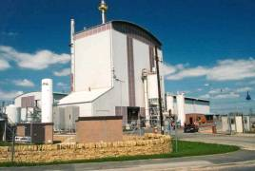
Woodburning Electricity Generation
ARBRE is the first commercial wood-burning plant of its type in Europe.
It produces enough electricity for 33,000 people from clean and sustainable wood fuel sources.
The plant has a 10MW electricity generating capacity and 8MW is exported to the local grid.
The fuel for the plant is wood chips from forestry and short rotation coppice.

Slide 33

Coppice harvesting
First Renewables Ltd
Short rotation coppice harvesting for ARBRE wood-fuelled power station. As trees grow they store energy from the sun in their biomass. At ARBRE’s power plant the energy stored in the biomass is converted to electricity.

Slide 34
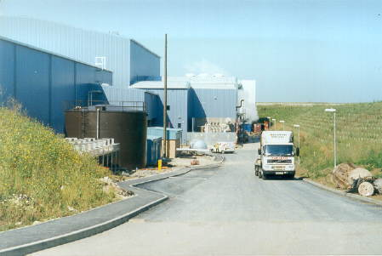
Straw Burning Power Plant
Lorry leaving plant after delivering straw
  Elean Power station near Ely,Cambridgeshire generates 36MW of electricity and is the worlds largest such facility. It supplies 80,000 homes with electricity.

Slide 35
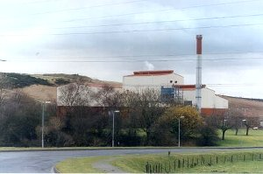
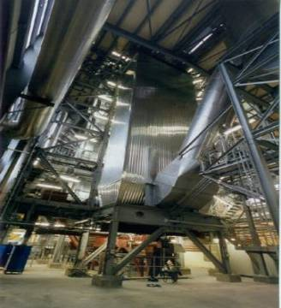
Biomass Plant in Fife
Plant burns poultry litter and produces 10MW of electricity and fertiliser
Fluidised bed boiler ensures efficient burning and low emissions

Slide 36
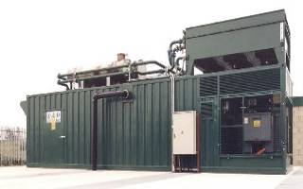
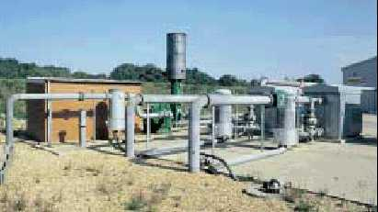
Landfill Gas
1MW generator at Buckden- Biogas Association
  Landfill gas, Dorset

Slide 37
SCENARIO STUDIES
Suggest that delivering 10% of electricity from renewables by 2010 at a cost of 3.5 p/kwh is feasible
Requires 3-4 GW new plant
Dominant technologies –
1) Waste (Municipal/industrial/agricultural)
2) Remainder – landfill gas + hydro (small scale)
3) Longer term - photovoltaics

Slide 38
Conclusions
Major difficulties in attaining target of 10% of electricity generated by renewables by 2010
Main contributors to this target will be :-
Offshore and Onshore windfarms/clusters
Biomass/wood, straw, etc
Photovoltaic
But policies like Climate Change Levy and the Renewables Obligation will help establish renewables.

