Slide 1
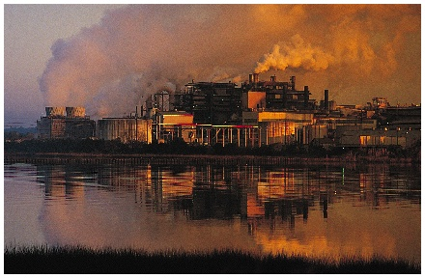
Industrial Geography
The Human Mosaic
Chapter 12

Slide 2
Two great economic “revolutions” occurred in human development
Domestication of plants and animals occurred in our dim prehistory
Ultimately resulted in a huge increase in human population
Greatly accelerated modification of the physical environment
Resulted in major cultural readjustments

Slide 3
Two great economic “revolutions” occurred in human development
The Industrial Revolution, started in the eighteenth century, is still taking place today
Involves a series of inventions leading to the use of machines and inanimate power in the manufacturing process
Suddenly whole societies could engage in seemingly limitless multiplication of goods and services
Rapid bursts of human inventiveness followed
Gigantic population increases

Slide 4
Two great economic “revolutions” occurred in human development
The Industrial Revolution, started in the eighteenth century, is still taking place today
Massive, often unsettling, remodeling of the environment
Today, few lands remain largely untouched by its machines, factories, transportation devices, and communication techniques
On an individual level, no facet of North American life remains unaffected
Just about every object and every event in your life is affected, if not actually created, by the Industrial Revolution

Slide 5
Culture Regions
Industrial Regions
Diffusion of the Industrial Revolution
Industrial Ecology
Industrial Cultural Integration
Industrial Landscapes

Slide 6
Industrial regions
Five types of industrial activity, each occupying culture regions can be distinguished
Primary industries—those involved in extracting natural resources from the Earth

Slide 7
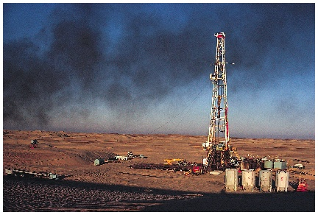

Slide 8
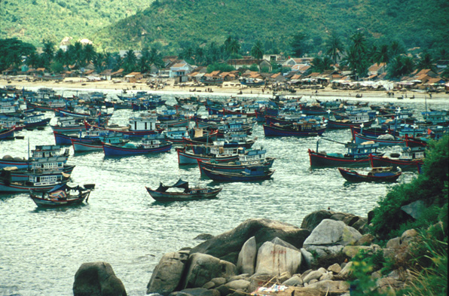
Primary Industry: Nga Trang, Vietnam

Slide 9
Primary Industry: Nga Trang, Vietnam
Fishing is an extractive activity – taking a natural resource, in this case renewable, from the Earth.
Here in the Cai River estuary, a variety of boats fish the South China Sea

Slide 10
Primary Industry: Nga Trang, Vietnam
Nylon nets along with styrofoam and plastic containers are becoming increasingly common.
These are derived from oil, a nonrenewable resource.

Slide 11
Industrial regions
Five types of industrial activity, each occupying culture regions can be distinguished
Secondary industry—processing stage, commonly called manufacturing
Other three types all involve services of some sort, rather than the extraction or production of commodities
Tertiary
Quaternary
Quinary
Next slide reveals worldwide patterns of some primary and secondary industry

Slide 12
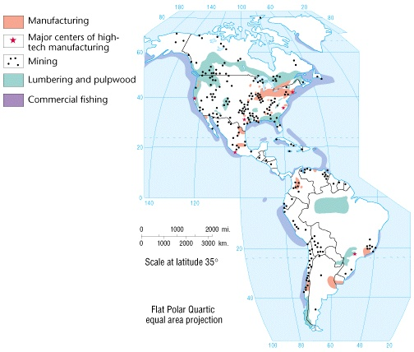
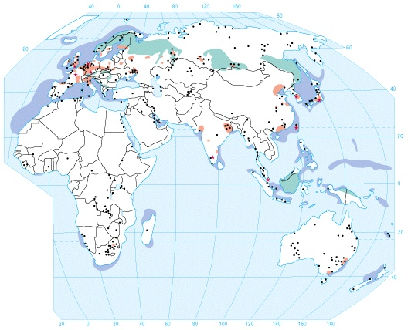

Slide 13
Primary industry
Extract both renewable and nonrenewable sources
Renewable resources—those that can be used without being permanently depleted, such as forests, water, fishing grounds, and agricultural land
Overexploitation of renewable resources does causes depletion
Example of the 1990s worldwide crisis in oceanic fishing industry as result of overfishing
Nonrenewable resources are depleted when used — example of minerals and petroleum

Slide 14
Secondary industry
Most of the world’s industrial activity has traditionally been found in developed countries of the midlatitudes
Especially true in parts of Anglo-America, Europe, Russia, and Japan
In the U.S., secondary industries once clustered mainly in a region called the American Manufacturing Belt

Slide 15
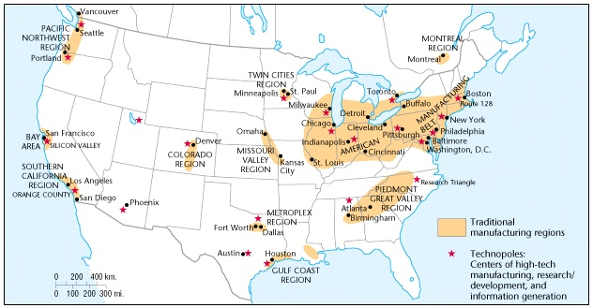

Slide 16
Secondary industry
Most of the world’s industrial activity has traditionally been found in developed countries of the midlatitudes
Manufacturing occupies the central core of Europe, surrounded by a less industrialized periphery

Slide 17
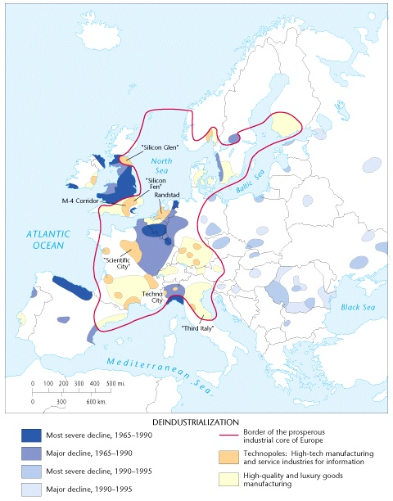

Slide 18
Secondary industry
Most of the world’s industrial activity has traditionally been found in developed countries of the midlatitudes
Japan’s industrial complex lies around the shore of the Inland Sea and in the southern part of the country

Slide 19
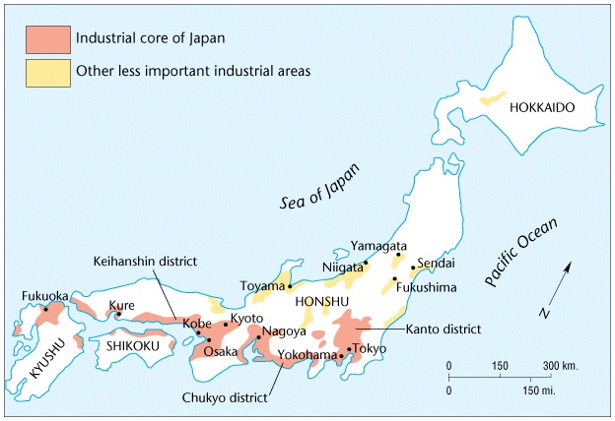

Slide 20
Secondary industry
Industrial regions usually consist of several zones, each dominated by a particular kind of industry
Iron and steel zone
Coal mining in another
Textiles in a third

Slide 21
Secondary industry
Pronounced regional specialization arose with the Industrial Revolution in the 1700s
Core and periphery
Evolving industrial core consisted of developed countries, with their collective manufacturing regions
Periphery had nonindustrial and weakly industrialized lands, including many colonies
Resources extracted from increasingly impoverished peripheries flowed to core

Slide 22
Secondary industry
Core and periphery
Resultant geographical pattern is often referred to as uneven development, or regional disparity
Uneven development has proven to be increasingly and unyieldingly present
Manufacturing dominance of developed core countries persists
A major global shift is currently under way in secondary industry

Slide 23
Secondary industry
Core and periphery
In virtually every core country, much of secondary sector is in marked decline
Especially steel making and other manufacturing requiring a minimally skilled, blue-collar work force
Factories are closing
Blue-collar unemployment rates at highest levels since the Great Depression of the 1930s
In the U.S., a relative decline began about 1950
Nine out of every ten new jobs have been unskilled low-paying service positions

Slide 24
Secondary industry
Manufacturing now booming in core countries mainly requires a highly skilled or artisanal work force
“High-tech” firms produce quality consumer goods
Blue-collar work force has proven largely unable to acquire needed new skills
High-tech manufacturers employ far fewer workers than the former heavy industries
New companies tend to be concentrated in relatively small districts sometimes called technopoles

Slide 25
Secondary industry
Deindustrialization describes the decline and fall of once-prosperous factory and mining areas
Brings demoralization and erosion of the spirit of place
Western Germany’s reaction to deindustrialization
Maintained a high proportion of its work force by reinvesting for high productivity
Offered high wages
Specialized in expensive export-oriented products

Slide 26
Secondary industry
Western Germany’s reaction to deindustrialization
Protected high level of labor skill through a well-developed apprenticeship system
East German regions are now faced with same industries and mining that form core of deindustrialization and decline
Manufacturing industries lost by core countries relocate in newly industrializing lands of the periphery
South Korea, Taiwan, India, Singapore, Brazil, Mexico, Guangdong province in coastal South China, and India have a major expansion of manufacturing

Slide 27
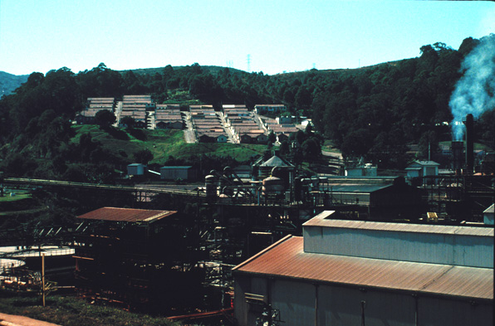
Secondary Industry: Ouro Preto, Brazil

Slide 28
Secondary Industry: Ouro Preto, Brazil
This is Alcan Aluminio do Brasil which fashions bauxite into ingots.
Available hydroelectric power permits this factory to locate near both raw material and market sites.

Slide 29
Secondary Industry: Ouro Preto, Brazil
Bauxite, a non-renewable resource is mined close by and Alcan is part of the greater Sao Paulo region’s industrial landscape.
Company housing is in the background.

Slide 30
Secondary industry
Global corporations
Corporate giants based mainly in the U.S., Europe, and Japan have sweeping control over:
International communications networks
Latest advances in modern technology
Large amounts of investment capital
Corporate giants effectively control economic structure of many developing countries
In Mexico, by 1970, foreign interest controlled 67 percent of metal- products, 84 percent of tobacco industry, and 100 percent of rubber, electrical machinery, and automobile industries
In Argentina they controlled every “top 50” company by 1985

Slide 31
Tertiary industry
Decline of primary and secondary industries has ushered in an era referred to as the postindustrial phase
Part of the postindustrial phases includes:
Transportation, communication, and utility services
Highways, railroads, airlines, and pipelines
Telephones, radios, television, and the Internet
All facilitate the distribution of goods, services, and information
Every industrial district is served by well-developed transport systems

Slide 32
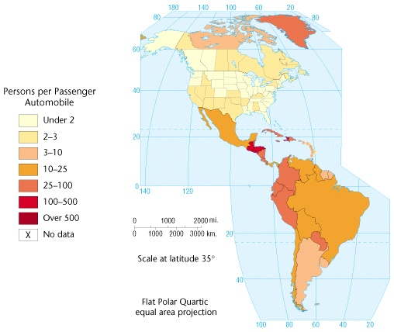
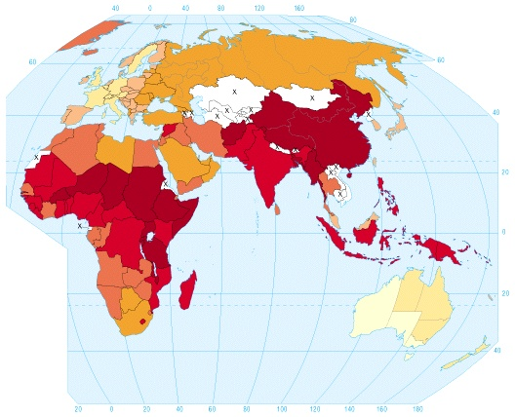

Slide 33
Tertiary industry
Regional differences exist in relative importance of the various modes of transport
In Russia and Ukraine
Highways have little industrial significance
Railroads, and to a lesser extent, waterways carry most of transport load
In the U.S., highways became most important, while railroad system declined
Western European nations rely heavily on greater balance between rail, highway, and waterway transport

Slide 34
Tertiary industry
Regional differences exist in relative importance of the various modes of transport
In most of Africa, interior Asia and other weakly industrialized regions, motorable highways and railroads remain rare
Even in the weakly industrialized regions tertiary activity is increasing
In more developed countries, such services as electronic transfer of funds and telecommunications between computers continents apart increasingly rival traditional importance of railroads or trucks

Slide 35
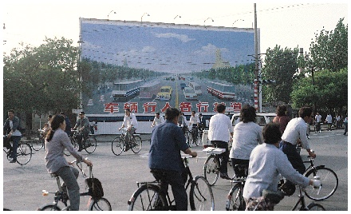

Slide 36
Tertiary Industry: Rotterdam, Netherlands

Slide 37
Tertiary Industry: Rotterdam, Netherlands
Rotterdam, Europe’s busiest port and one of the world’s largest is shipping gateway to Western Europe and major outlet for Germany’s Ruhr and other industrial districts along the Rhine River.

Slide 38
Tertiary Industry: Rotterdam, Netherlands
Container ships carry materials and goods to and from overseas while barges ply the river.
Shipping offices, shipyards and dry docks, warehouses, cargo and container cranes, supertanker berths, and oil storage tanks are only some of the facilities located here.

Slide 39
Tertiary industry
Regional differences exist in relative importance of the various modes of transport
In more developed countries, such services as electronic transfer of funds and telecommunications between computers continents apart increasingly rival traditional importance of railroads or trucks
Utilities also belong in the tertiary sector
Automobiles create a special kind of functional culture region
Sometimes called machine space
As usage increases more space must be devoted to them
Often results in visual blight

Slide 40
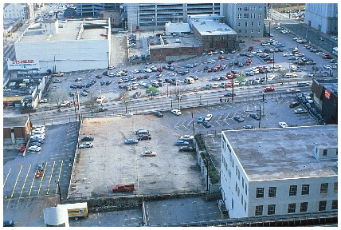

Slide 41
Quaternary industry
Includes those services mainly required by producers
Trade, wholesaling, retailing, and advertising
Banking, legal services, real estate transactions, and insurance
Consulting and information generation
Such activities represent one of the major growth sectors in postindustrial economies
Manufacturing is increasingly shunted to the peripheries

Slide 42
Quaternary industry
Corporate headquarters, markets, and producer-related service activities remain in the core
Multiplier leakage — global corporations invest in secondary industry in the peripheries, but profits flow back to the core
The industrialization of less developed countries actually increases the power of the world’s established industrial nations
Today, we face a world in which the basic industrial power of the planet is more centralized than ever

Slide 43
Quaternary industry
Global corporations are headquartered mainly in quaternary areas where the Industrial Revolution took root earliest
Industrial development loans come from Europe, Japan, and the U.S., with the result that interest payments drain away from poor countries to rich countries
Increasingly important is the collection, generation, storage, retrieval, and processing of computerized knowledge and information

Slide 44
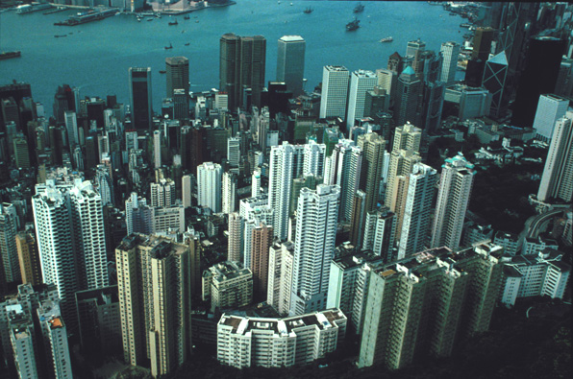
Quaternary Industry: Hong Kong (Central)

Slide 45
Quaternary Industry: Hong Kong (Central)
Because of its natural harbor and accessibility, Hong Kong has functioned as an entreport since 1841 and is also a major financial center. This is the view from Victoria Peak on Hong Kong Island across the harbor to the Kowloon peninsula.

Slide 46
Quaternary Industry: Hong Kong (Central)
The rose-colored buildings at top center house the stock exchange, offices and shops. The adjacent Jardine House, once the tallest building in Asia, is the center for travel and tourism.
The Hongkong Bank is to the right of the green-roofed structure and I.M. Pei’s Bank of China skyscraper is further right.

Slide 47
Quaternary Industry: Hong Kong (Central)
Their dramatic architecture reflects the significance of banking in this post-industrial city. Luxury apartments dominate the foreground. Most manufacturing, mainly labor-intensive, is in the peripheral New Territories, and increasingly in China’s Guangdong Province.

Slide 48
Quaternary Industry: Hong Kong (Central)
Multiplier leakage occurs as many corporate headquarters and related activities remain in the Hong Kong.
Hong Kong reverted from Britain to join China as an autonomous region in 1997.

Slide 49
Quaternary industry
Postindustrial society is organized around knowledge and innovation used to acquire profits and exert social control
Impact of computers is changing world dramatically, with implication for spatial organization of all human activities
Many quaternary industries depend on a highly skilled, intelligent, creative, and imaginative labor force

Slide 50
Quaternary industry
If seen on a local scale information-generating industries seem to coalesce around major universities and research centers
Stanford and University of California at Berkeley helped make San Francisco Bay area a major center of such industry
Similar foci developed near Harvard and M.I.T. in New England
Triuniversity Raleigh-Durham-Chapel Hill “Research Triangle” of North Carolina

Slide 52
Quaternary industry
If seen on a local scale information-generating industries seem to coalesce around major universities and research centers
These high tech corridors, or “silicon landscapes,” are highly focused geographically, contributing to an uneven development spatially
In Europe, emerging core is more confined geographically than earlier concentration of manufacturing

Slide 54
Quinary industry
One of the most rapidly expanding activities is tourism
By 1992
Generated $3 trillion in income
Employed 1 in 14 workers worldwide
Importance trend has continued in spite of tourist attacks
Importance varies greatly from one region and country to another

Slide 55
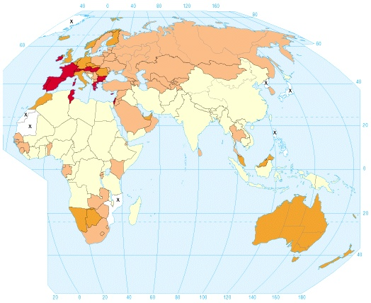
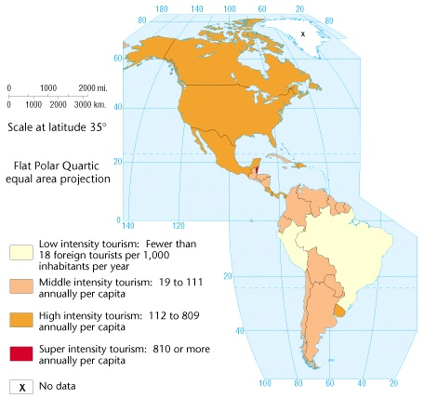

Slide 56
Quinary industry
Some countries, particularly those in tropical island locations, depend principally on tourism to support their national economies
One advantage is that it is disproportionately focused in industrial peripheries rather than the core
Disproportionately focused in industrial peripheries than the core
Somewhat alleviates problem of uneven development
Multiplier leakage typically drains most profits back to core

Slide 57
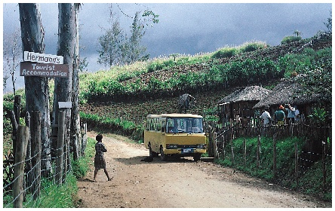
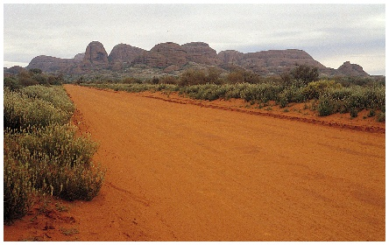

Slide 58
Quinary industry
Tourism can be categorized into major types
One major flow is — from interior locations-to-seacoasts
Second major movement is — from lowlands-to-highlands
Third major flow — urban-to-rural
People seek vacations away from crowded cities
Acquisition of vacation homes in isolated places
In rural Norway, about 40 percent of all farmers take in summer guest to supplement income

Slide 59
Quinary industry
Tourism can be categorized into major types
Third major flow — urban-to-rural
Ecotourism — visits to very remote areas, particularly wilderness regions
Fourth flow is directed to places of cultural and historical importance
Most modern tourism involves multiple destinations
Europeans, in general, prefer a single destination for the summer
Americans generally seek multiple destinations

Slide 60
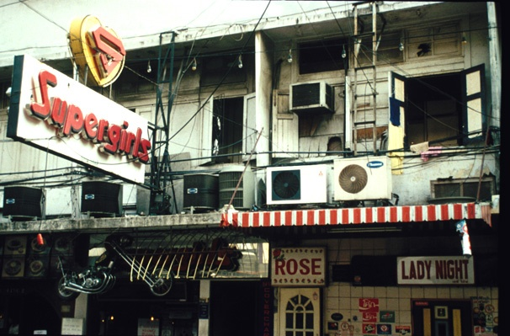
Quinary Industry: Sex Tourism, Bangkok

Slide 61
Quinary Industry: Sex Tourism, Bangkok
Like Manila, Taipei, and (increasingly) Saigon, Bangkok is one of the “sex capitals” of the world. Desperate men and women enter into prostitution as a last resort to survive or to feed a drug habit.
There is also an active slave trade from Mynmar (Burma).

Slide 62
Quinary Industry: Sex Tourism, Bangkok
Destitute families in urban squatter settlements and poor villages are enticed to sell their children (primarily girls) to middlemen who promise to find them employment with a rich family who will send them to school.
These children are enslaved and forcibly turned into prostitutes by whatever means necessary including physical abuse and drug addiction.

Slide 63
Quinary Industry: Sex Tourism, Bangkok
This is Patpong Street, notorious for its sex shows, brothels, and related services. AIDS has reached critical proportions, but the industry continues to thrive on tourism. Planned sex tours are widely available from around the world and are especially popular with Japanese businessmen.

Slide 64
Culture Regions
Industrial Regions
Diffusion of the Industrial Revolution
Industrial Ecology
Industrial Cultural Integration
Industrial Landscapes

Slide 65
Introduction
World map of formal industrial regions provides a good measure of how far the Industrial Revolution has spread
Generally, people resist substantial changes in their basic cultural patterns
The Industrial Revolution offered personal benefit, causing many people from many cultures to discard tradition

Slide 67
Introduction
Life before the Industrial Revolution
People were concerned with the most basic of primary economic activities
Acquired the necessities of survival from the land
Society and culture was overwhelmingly rural and agricultural
Before 1700 virtually all manufacturing was carried on in two systems, cottage and guild industries, both depended on hand labor and human power

Slide 68
Introduction
Cottage industry
Most common, was practiced in farm homes and rural villages
Usually a sideline to agriculture
Objects for family use were made in each household
Most villages had a cobbler, miller, weaver, and smith who worked part-time at home
Skills passed from parents to children with little formality

Slide 69
Introduction
Guild industry
Consisted of professional organizations of highly skilled, specialized artisans engaged full time in their trades and based in towns and cities
Membership came after a long apprenticeship
Was a fraternal organization of artisans skilled in a particular craft

Slide 70
Origins of the Industrial Revolution
Arose among back-country English cottage craftspeople in the early 1700s
First: human hands were replaced by machines in fashioning finished products
Rendered the word manufacturing (“made by hand”) obsolete
Weavers no longer sat at a hand loom, instead large mechanical looms were invented to do the job faster and more economically

Slide 71
Origins of the Industrial Revolution
Second: Human power gave way to various forms of inanimate power
Machines were driven by water power, burning of fossil fuels, and later hydroelectricity and the energy of the atom
Men and women became tenders of machines instead of producers of fine handmade goods
Within 150 years, the Industrial Revolution greatly altered the first three sectors of industrial activity

Slide 72
Origins of the Industrial Revolution
Textiles
Initial breakthrough occurred in the British cotton textile cottage industry, centered in the Lanchashire district of western England
First changes were modest and on a small scale
Mechanical looms, powered by flowing water were invented
Industries remained largely rural
Diffused hierarchically to sites of rushing streams
Later in the eighteenth century invention of the steam engine provided a better source of power
In the United states, textile plants were also the first factories

Slide 73
Origins of the Industrial Revolution
Metallurgy
Traditionally, metal industries had been small-scale, rural enterprises
Situated near ore sources
Forests provided charcoal for smelting process
Chemical changes that occurred in steel making remained mysterious even to craftspeople who used them
Techniques had changed little since the beginning of the Iron Age, 2500 years before

Slide 74
Origins of the Industrial Revolution
Metallurgy
In the 1700s, inventions by iron makers in the Coalbrookdale of English Midlands, created a new scientific, large-scale industry
Coke, nearly pure carbon, which is derived from nearly pure coal, replaced charcoal in the smelting process
Large blast furnaces replaced the forge
Efficient rolling mills took the place of hammer and anvil
Mass production of steel resulted

Slide 75
Origins of the Industrial Revolution
Mining
First to feel effects of new technology was coal mining
Adoption of steam engine necessitated huge amounts of coal to fire boilers
Conversion to coke further increased demand for coal
Fortunately, Britain had large coal deposits
New mining techniques and tools were invented
Coal mining became a large-scale mechanized industry

Slide 76
Origins of the Industrial Revolution
Mining
Because coal is heavy and bulky, manufacturing industries began flocking to the coal fields, to be near supplies
Similar modernization occurred in mining of iron ore, copper, and other metals needed by growing industries

Slide 77
Origins of the Industrial Revolution
Railroads
Wooden sailing ships gave way to steel vessels driven by steam engines
Canals were built
British-invented railroad came on the scene
Need to move raw materials and finished products from place to place, cheaply and quickly, was main stimulus leading to transportation breakthroughs

Slide 78
Origins of the Industrial Revolution
Railroads
Impact of the Industrial Revolution would have been minimized if distribution of goods and services had not been improved
British revolutionized shipbuilding industry and dominated it from their Scottish shipyards even into the twentieth century
New modes of transport fostered additional cultural diffusion
New industrial-age popular culture could easily penetrate previously untouched areas

Slide 79
Diffusion from Britain
For a century, Britain held a virtual monopoly on its industrial innovations
Government actively tried to prevent diffusion
Gave Britain enormous economic advantage
Contributed greatly to growth and strength of British Empire

Slide 80
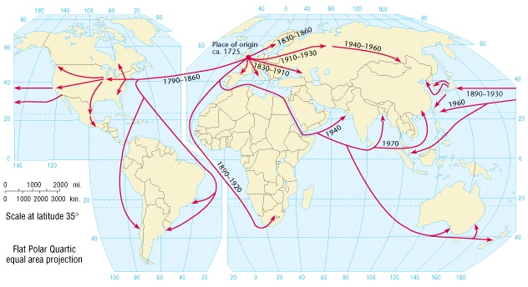

Slide 81
Diffusion from Britain
The technology finally diffused beyond the British Isles
Continental Europe first received its impact in last half of the nineteenth century
Took firm root hierarchically in coal fields of Germany, Belgium, and other nations of northwestern and Central Europe
Diffusion of railroads provides a good index

Slide 82
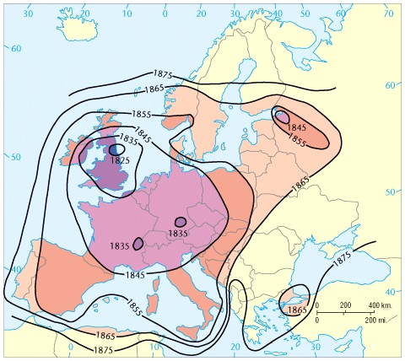

Slide 83
Diffusion from Britain
The technology finally diffused beyond the British Isles
United States began rapid adoption of new technology about 1850
About 1900, Japan was the first major non-Western country to undergo full industrialization
In the first third of the 1900s, diffusion spilled into Russia and Ukraine
Recently, countries such as Taiwan, South Korea, China, Indian, and Singapore joined the manufacturing age

