Slide 1
Trade – fair and unfair.
(Pages 204-205, Understanding GCSE Geography)
Learning objectives.
1. To examine the pattern of trade between developed and developing countries.
2. To understand how fair trade works and how it can help with development.

Slide 2
Starter.
Using the “Countries at different stages of development” sheet to help you, sort the 20 country cards into five categories based on wealth:
1. Rich industrialised countries
2. Oil-exporting countries
3. Newly industrialising countries
4. Former centrally planned economies
(previously Communist countries).
5. Heavily indebted poor countries.
Notes:
2

Slide 3
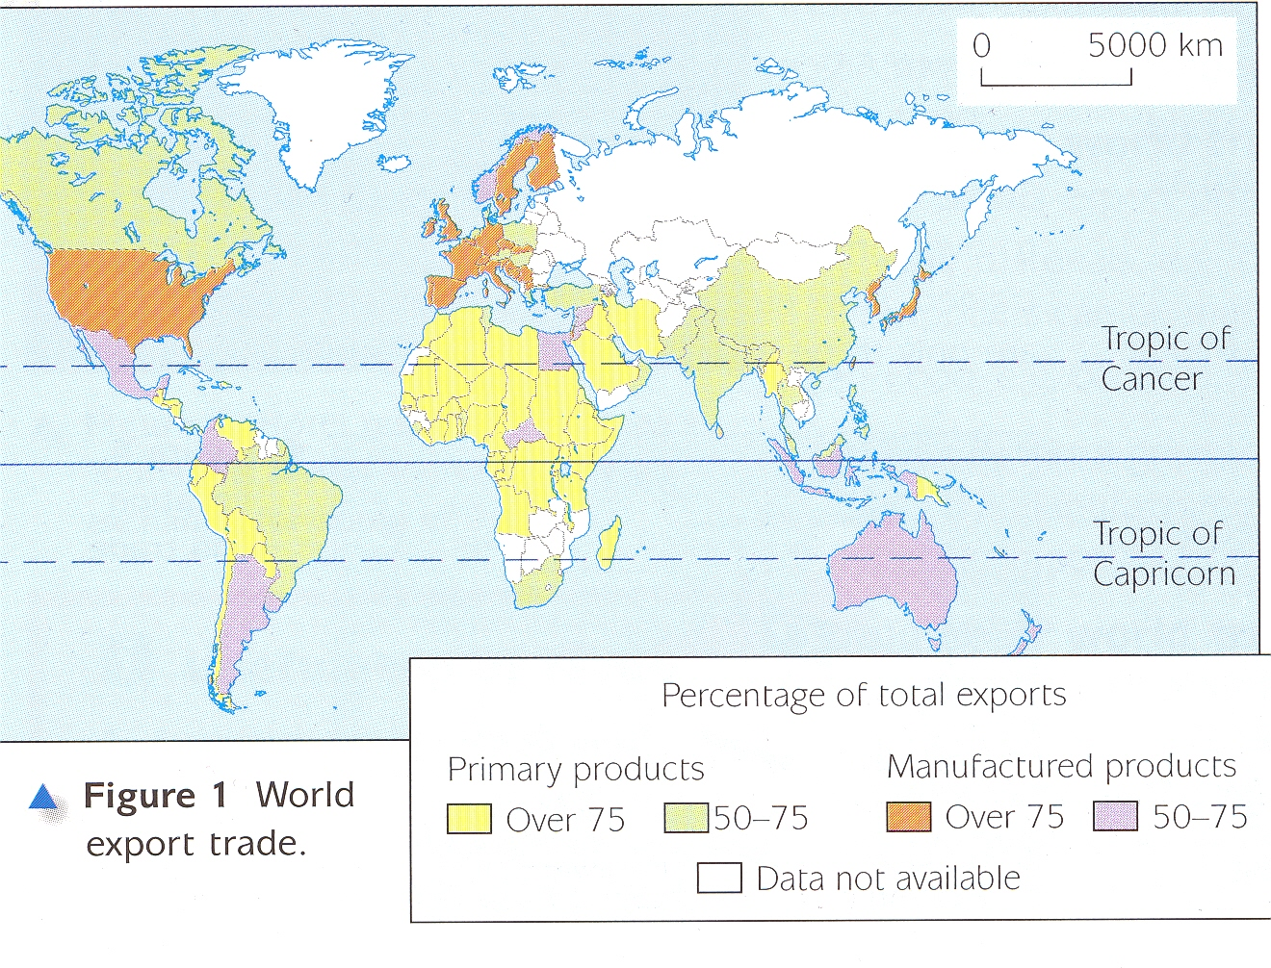
Trade between developed and developing countries' forms only a small part of total world trade and is mainly richer countries obtaining the raw materials and the fuels it needs for it’s manufacturing.

Slide 4
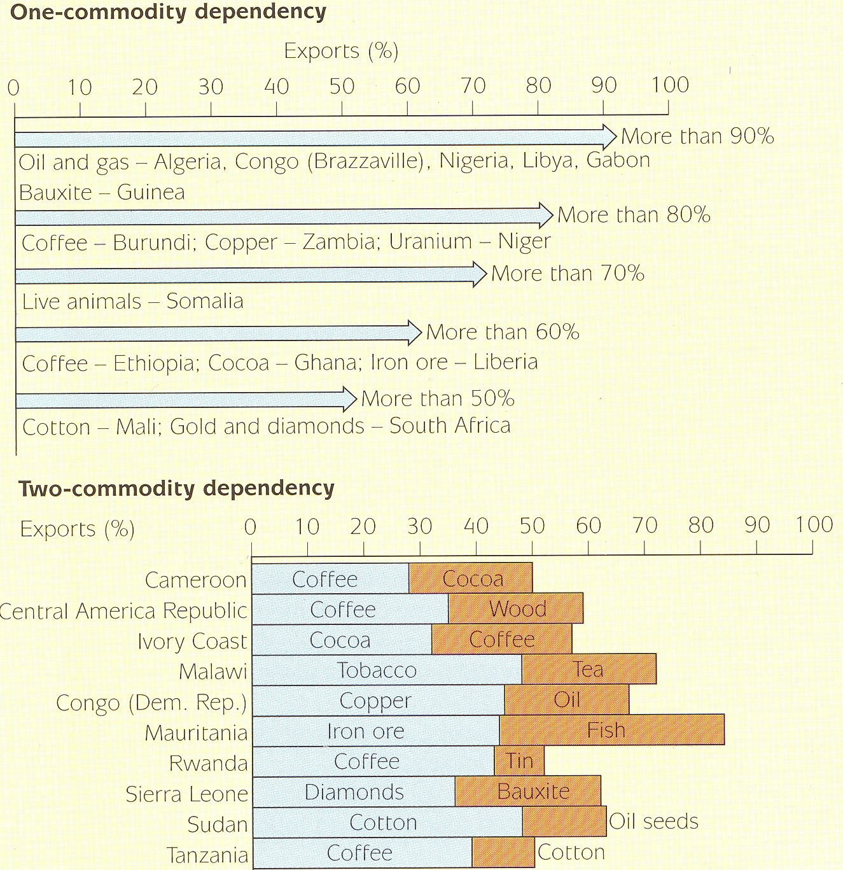
Dependence upon a limited range of exports by countries in Africa.
Overdependence on one or two commodities is dangerous for an economy but is common in developing countries.

Slide 5
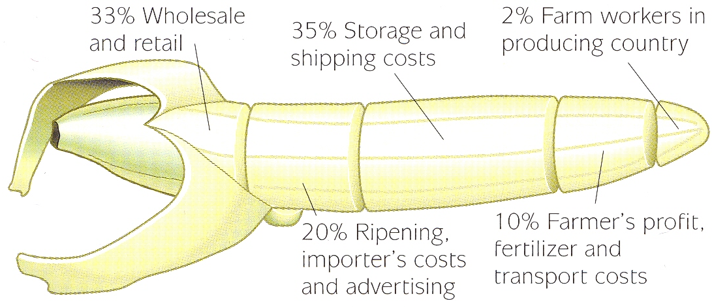
Rich pickings – but for whom?
Primary products fetch low prices. Only a small part of the price you pay for bananas goes to the farmers and his workers in a developing country.

Slide 6
Task.
Do activity 1 from page 205, Understanding GCSE Geography.

Slide 7
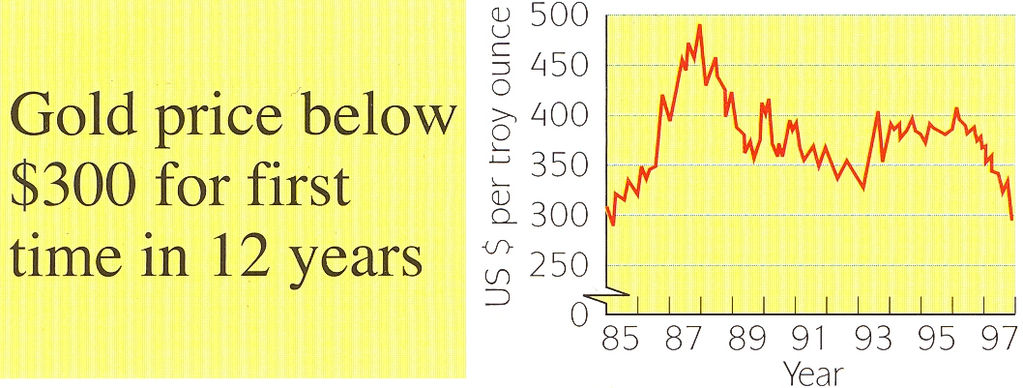
Primary products go up and down in price.
Gold price information from the Financial Times, 27th November 1997.
This was not good news for South Africa, the worlds largest gold producer.

Slide 8
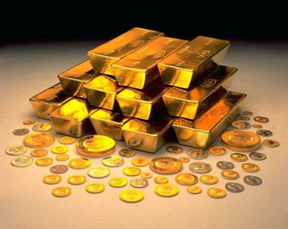
Primary products go up and down in price.
In March 2008 the price of gold reached the all-time high of $1,000 per ounce.
This was good news for South Africa, the worlds largest gold producer!

Slide 9
Key points for you to know for revision.
Developed countries need the raw materials and energy supplies that are found in developing countries (in particular, oil). Developing countries need the manufactured goods they can’t make themselves to be made in developed countries. They are interdependent.
Developing countries often have an over-dependence on just a few commodities.
The problem is that primary products have low prices and the prices fluctuate (go up and down).
When raw materials are processed value is added.
World trade means that developing countries export low price primary products. They import high price goods from developed countries. So developing countries often have big debts.

Slide 10
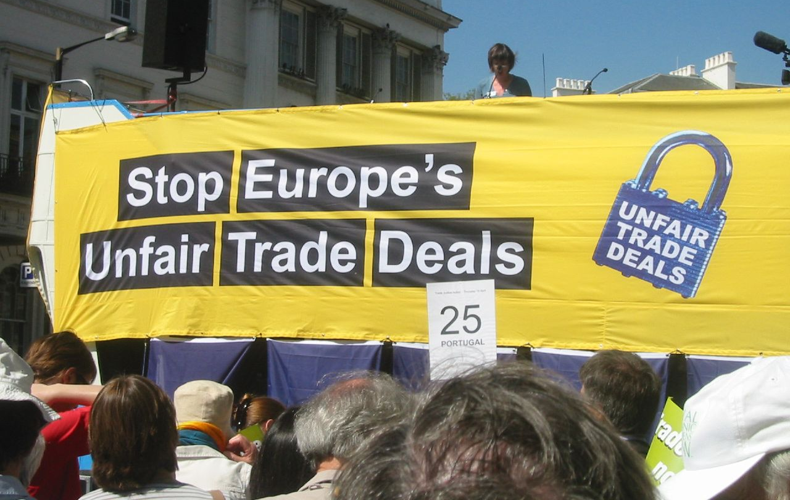
Unfair trade.
International trade has grown massively in the last 50 years but it has mainly benefited the developed world. Free trade should make everyone wealthier, but developed countries often seem to have an unfair advantage.
Notes:
10

Slide 11
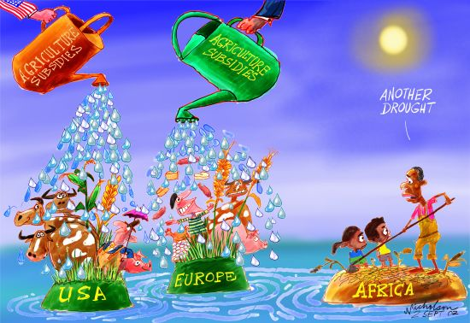
For example, farmers in the EU and USA have a powerful political voice, and they are supported in a number of ways:
- Many are subsidised to produce food, making it cheaper to export (sometimes to developing countries).
Notes:
11

Slide 12
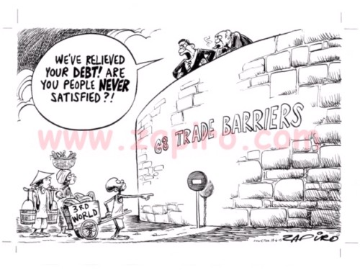
- They are protected by quotas, which restrict food imports, and tariffs, which make imports from developing countries more expensive.
Notes:
12

Slide 13

The World Trade Organisation (WTO) sets the rules of trade, and it has reduced some subsidies, quotas and tariffs. But developing countries complain that it is really dominated by the most powerful countries, and their corporations. If developing countries' products reach developed countries, the farmers often see little of the final sales price.
Notes:
13

Slide 14

Fair trade.
One way for small farmers in developing countries to get a better deal is to join a fair trade scheme or trading group. Fair trade gives them a fairer price and protects them against very low prices.
Notes:
14

Slide 15
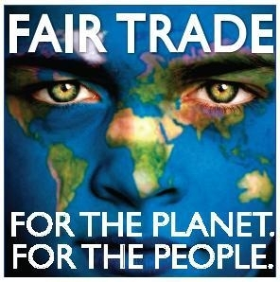
Fair trade agreements also aim to protect the environment and strengthen the local community, so they are also an example of sustainable development.
Notes:
15

Slide 16

Around the world, people spent £1.6 billion on fair trade products in 2007. Seven million farmers, workers and their families benefited in 58 countries.
Notes:
16

Slide 17
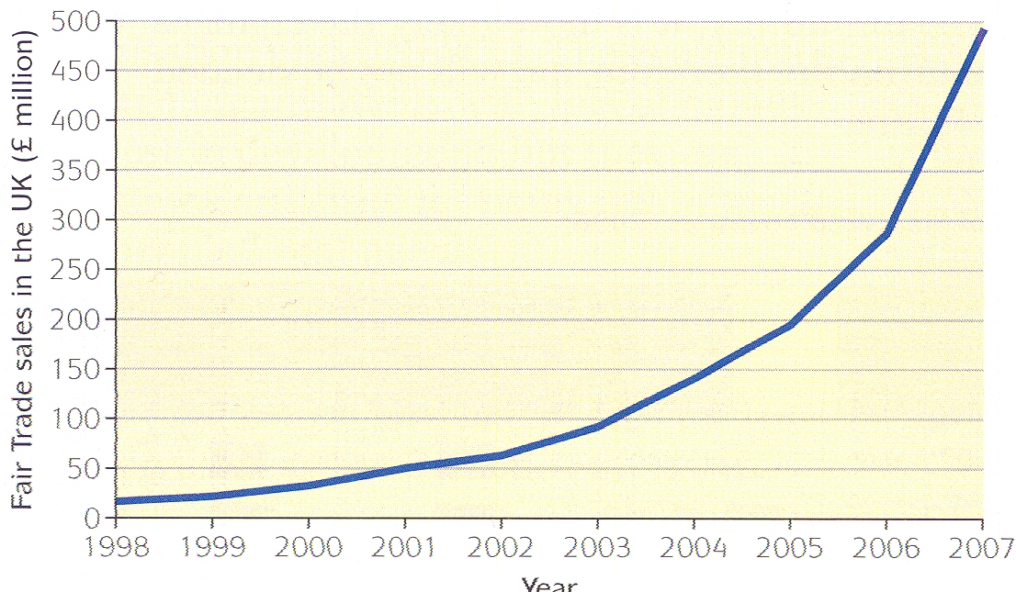
Fair trade products are often more expensive to buy, and retailers still take a big share of the price. But sales in the UK have grown every year - in 2007 they were worth nearly £500 million.
Graph of Fair Trade sales in the UK.
Notes:
17

Slide 18

Most fair trade products are foods like coffee and bananas, but the fair trade idea has spread to other goods. For example, fair trade clothes have led to improved working conditions for garment workers in places like Bangladesh.
Notes:
18

Slide 19
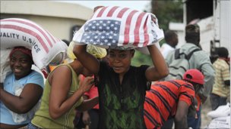
Free trade?
Rice farmers in the USA are supported by government subsidies, which help keep their prices down ($530 million in 2006). They grow more rice than the USA needs - the surplus is exported to countries like Honduras. The imported rice is cheaper than the rice local farmers grow, putting them out of business and increasing the country's import bill.
Notes:
19

Slide 20
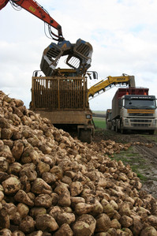
In 2006 EU sugar farmers got a guaranteed price for their sugar of €670 a tonne, three times the world market price. They exported the surplus sugar, costing 12,000 sugar workers in Swaziland their jobs.
Sugar beet.
Notes:
20

Slide 21
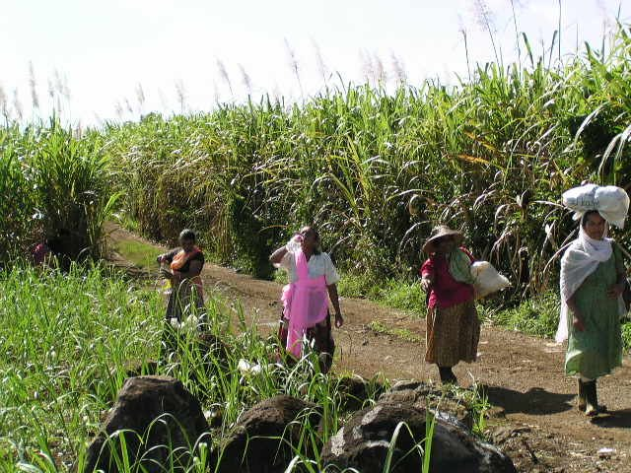
Even though Mozambique's sugar costs €280 a tonne, tariffs stopped its sugar exports to the EU, losing €l00 million a year. Meanwhile EU consumers paid an extra €800 million for their sugar.
Sugar cane plantation in Mozambique.
Notes:
21

Slide 22
Task.
Do activity 3 from page 205, Understanding GCSE Geography, using the writing frame.
Notes:
22

Slide 23
Key points for you to know for revision.
The increase in world trade has mostly benefitted the developed countries.
Subsidies (payments made to farmers), quotas (limits on food imports) and tariffs (taxes on imports) make it hard for poor countries to compete.
The WTO (World Trade Organisation) is accused of being dominated by rich countries and TNC’s.
Fair trade gives a fairer price, protects the environment and helps develop the local community.
Most fair trade products are food like coffee and bananas, but it is spreading to other things like clothes.
Notes:
23

