Slide 1


Chapter
8
Regional Economic Integration

Slide 2
Case: Increasing competition in the European automotive market
In 2002 significant variances remained in price of Automobiles across different countries
Primary reasons for price differentials is the Bloc exemption clause
In 2002 European commission scrapped the clause and introduced new legislation to encourage competition
New rules aimed at weakening control of auto companies on pricing in different markets

Slide 3
Levels of economic integration
Free trade area
Customs union
Common market
Economic union
Political union

Slide 4
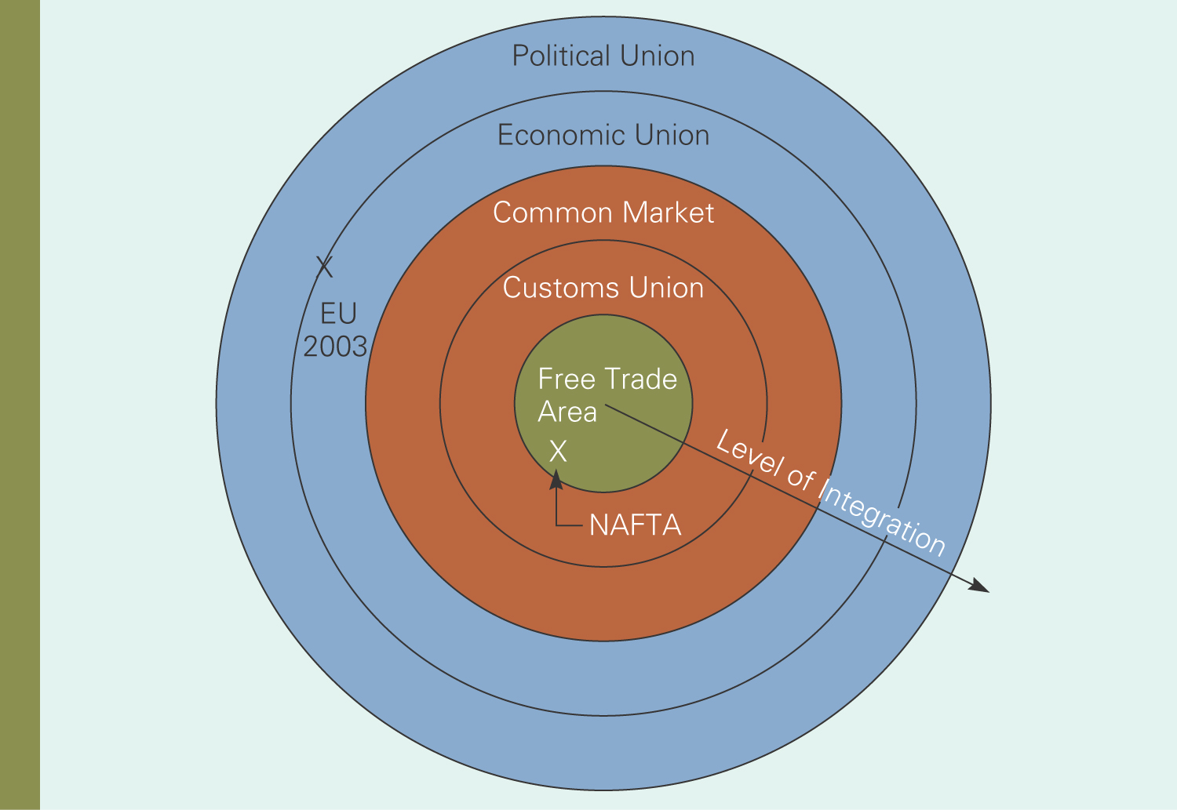
Levels of economic integration
Fig 8.1

Slide 5
Economic case for integration
Stimulates economic growth in countries
Increases FDI and world production
Countries specialize in those goods and services efficiently produce.
Additional gains from free trade beyond the international agreements such as GATT and WTO
  Because they may be easier to negotiate outside of the GATT and WTO

Slide 6
The political case for integration
Economic interdependence creates incentives for political cooperation
  This reduces potential for violent confrontation.
Together, the countries have more economic clout to enhance trade with other countries or trading blocs

Slide 7
Impediments to integration
Integration is hard to achieve and sustain
  Nation may benefit but groups within countries may be hurt
  Potential loss of sovereignty and control over domestic issues

Slide 8
Regional economic integration in Europe
Europe has two trade blocks
European Union
  Seen as the emerging power with almost 25 members
European Free Trade Association
  Has only four members

Slide 9
Evolution of the European Union
Product of two political factors:
  Devastation of WWI and WWII and desire for peace
  Desire for European nations to hold their own, politically and economically, on the world stage
1951 - European Coal and Steel Community.
1957- Treaty of Rome establishes the European Community
1994 - Treaty of Maastricht changes name to the European Union

Slide 10
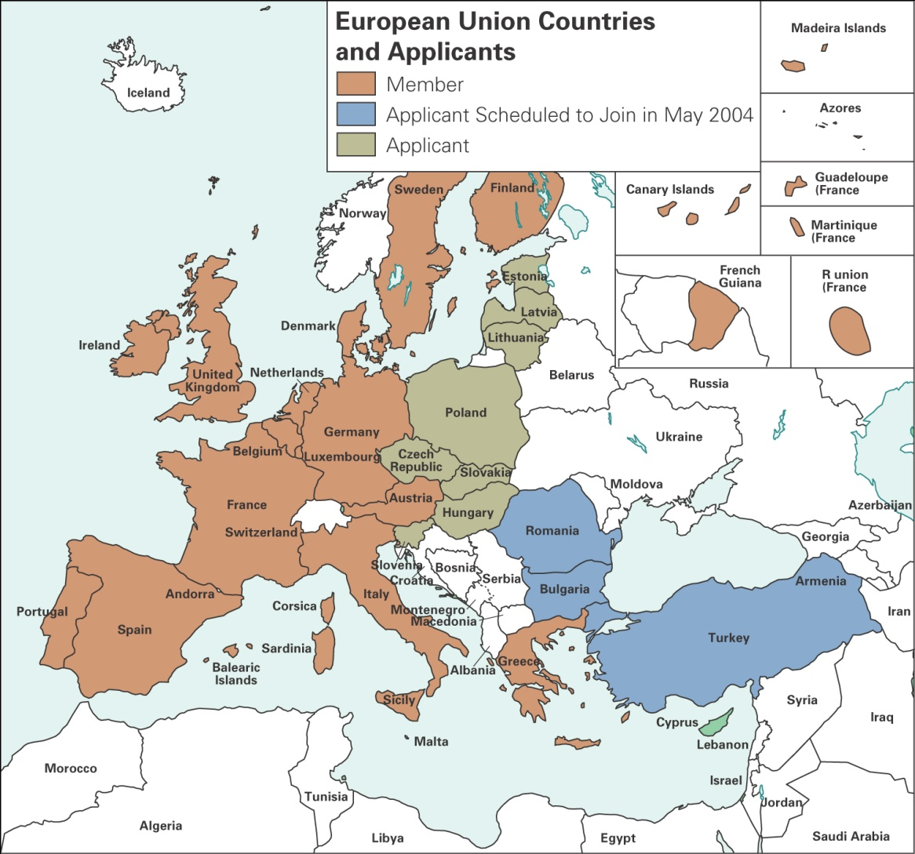
European Union countries
Map 8..1

Slide 11
Political structure of the European Union
European council
  Heads of state and commission
  President resolves policy issues and sets policy direction
European Commission
  20 Commissioners appointed by members for 4 year terms
  Proposing, implementing and monitoring legislation

Slide 12
Political structure of the European Union
European parliament
  630 directly elected members
  Propose amendments to legislation, veto power over budget and single-market legislation, appoint commissioners
Court of justice
Council of ministers

Slide 13
Political structure of the European Union
European council
  Heads of state and commission
  President resolves policy issues and sets policy direction
European commission
  20 Commissioners appointed by members for 4 year terms
  Proposing, implementing and monitoring legislation
European parliament
  630 directly elected members
  Propose amendments to legislation, veto power over budget and single-market legislation, appoint

Slide 14
Political structure of the European Union
Court of justice
  One judge from each country
  Hears appeals of EU laws
Council of ministers
  One representative from each member country
  Ultimate controlling authority
  No EU laws without approval

Slide 15
European Act: The causes
  Disharmony among the EC member countries:
    Trade policy
    Technical standards
  Resulted in establishment of the Delors Commission in 1985
    Basis for Single European Act

Slide 16
European Act
Single market program predicted to give EC firms greater opportunities to exploit economies of scale
Removal of trade barriers increases competition forces EC firms to be more efficient
Name changed to EU

Slide 17
Establishment of the EU
Objectives:
  Remove frontier controls
  “Mutual recognition” of product standards
  Open public procurement to non nationals
  Lift barriers to banking and insurance competition
  Remove restrictions on foreign exchange transactions
  Abolish cabotage restrictions

Slide 18
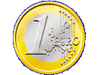
The Euro: Benefits and costs
Benefits:
  Savings from using only one currency
  Easy to compare prices, resulting in lower prices
  Forces efficiency and slashing costs.
  Creates liquid pan-Europe capital market.
  Increases range of investments for individuals and institutions
  As of 2004 Euro strong against the dollar and expected to rise

Slide 19
The Euro: Costs and benefits
Costs:
  Countries lose monetary policy control.
  European Central Bank controls policy for the “Euro zone”
  EU is not an” optimal currency area”.
  Country economies are different
  Euro puts the economic cart before the political horse
  Strong Euro (2004) makes it harder for Euro zone exporters to sell their goods

Slide 20
Enlargement of the EU
EU in 2004 is the single largest market with a population greater than the US
10 new countries formally accepted into EU in 2002
  Population of EU will increase to 450 million
  Create European barriers to trade from the outside?
  Might effect EU bureaucracy and decision making process

Slide 21
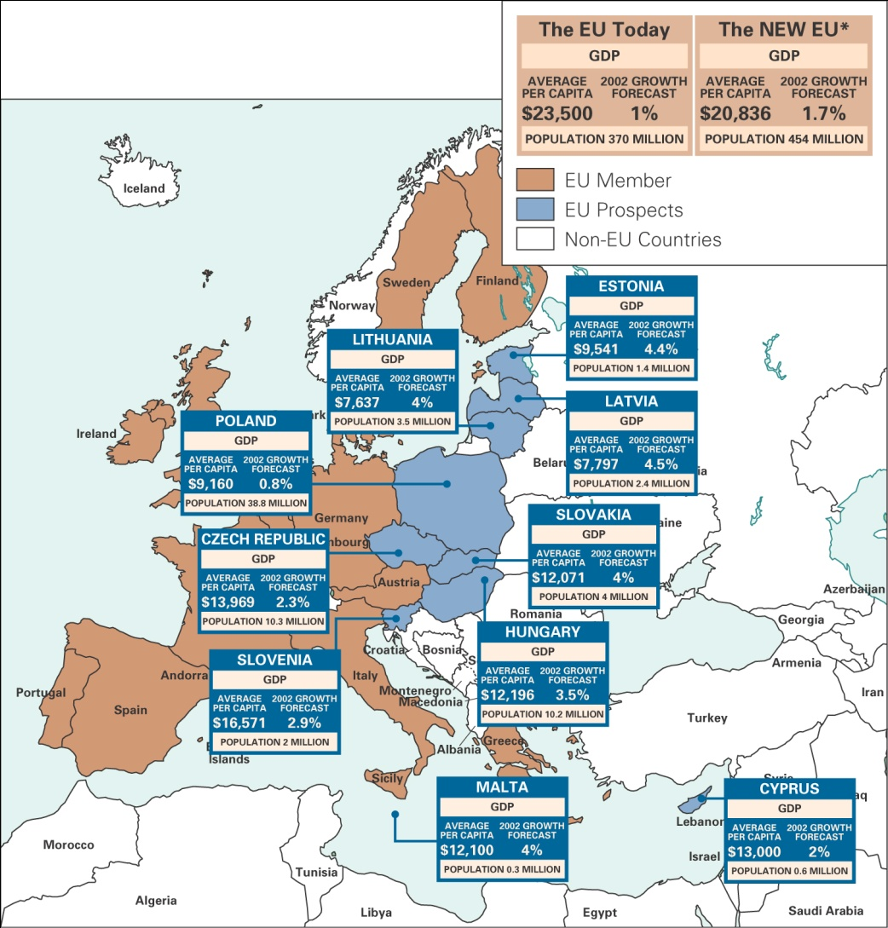
EU after enlargement
Map 8.2

Slide 22
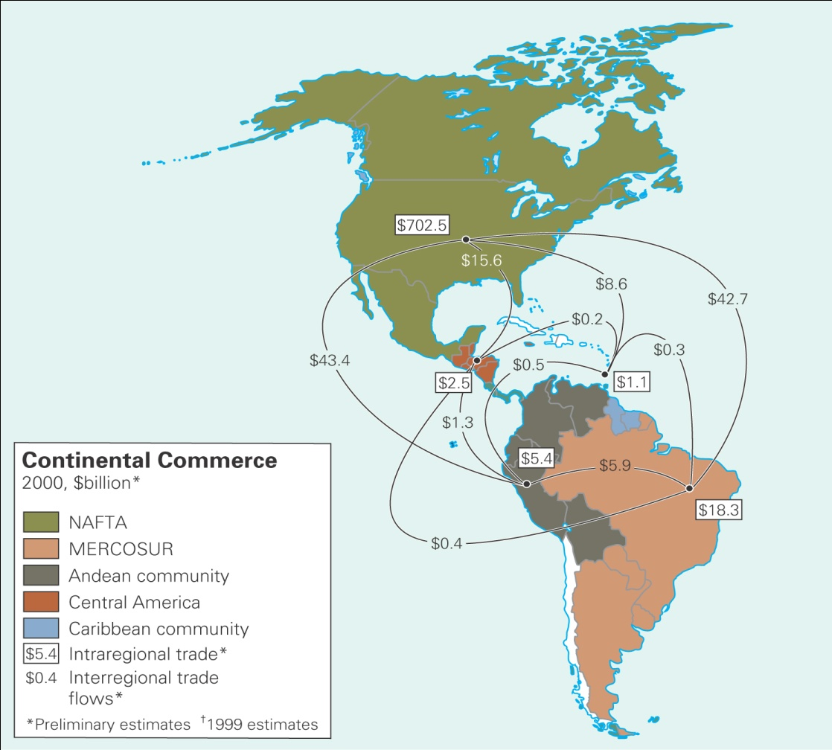
Regional economic integration of the Americas
Regional economic integration is on the rise in the Americas
NAFTA
MERCOSUR
Plans for FTAA
Map 8.3

Slide 23
NAFTA
Enforced in January, 1994,
Over 10 year period: tariffs reduced (99% of goods traded)
Removal of most barriers on cross border flow of services
Removal of restrictions on FDI except in certain sectors
  Mexican railway and energy
  US airline and radio communications
  Canadian culture

Slide 24
NAFTA
Protection of intellectual property rights
Applies national environmental standards
Establishment of commission to police violations

Slide 25
PROS
NAFTA
CONS
Enlarged and productive regional base
Labor-intensive industries move to Mexico
Mexico gets investment and employment
Increased Mexican income to buy US/Canada goods
Demand for goods increases jobs
Consumers get lower prices
Loss of jobs to Mexico
Mexican firms have to compete against efficient US/Canada firms
Mexican firms become more efficient
Environmental degradation
Loss of national sovereignty

Slide 26
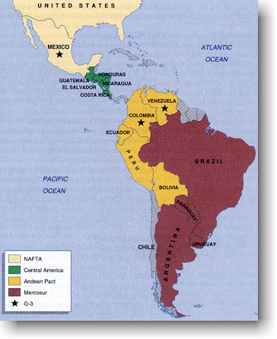
ANCOM: Andean Pact
Bolivia, Colombia, Ecuador, Peru, Venezuela
Nearly failed. Rejuvenated in 1990 in the Galapagos Declaration
  Changed from FTA to customs union in 1992
Still has many political and economic problems

Slide 27
Mercosur
1988: Argentina, Brazil. 1990: Paraguay, Uruguay
1995: Agreed to move toward a full customs union
Trade quadrupled between 1990-1998
Has significant trade diversion issues
Revival in 2003 by Brazil’s president to be modeled after EU with common currency and elected parliament

Slide 28
Other Hemisphere Associations
Central American Common Market
  1960s: Costa Rica, El Salvador, Guatemala, Honduras, Nicaragua.
  Collapsed in 1969
CARICOM
  1973: English-speaking Caribbean countries
  191: Failed for third time to establish common external tariff
Free Trade Area of the Americas
  1998: 34 heads of state met in Santiago, Chile and inaugurated talks to create a FTAA by 2005

Slide 29
Regional trade blocs in Asia : ASEAN
Created in 1967
Objective to achieve free trade between member countries and achieve cooperation in their industrial
Brunei, Indonesia, Laos, Malaysia, the Philippines, Myanmar, Singapore, Thailand and Vietnam
Progress limited by Asian financial crisis of the 90’s

Slide 30
Regional trade blocs in Asia : APEC
Founded in 1990 to ‘promote open trade and practical economic cooperation’
  ‘Promote a sense of community’
  18 members
  50% of world’s GNP
  40% of global trade
Despite slow progress, if successful, could become the world’s largest free trade area

Slide 31
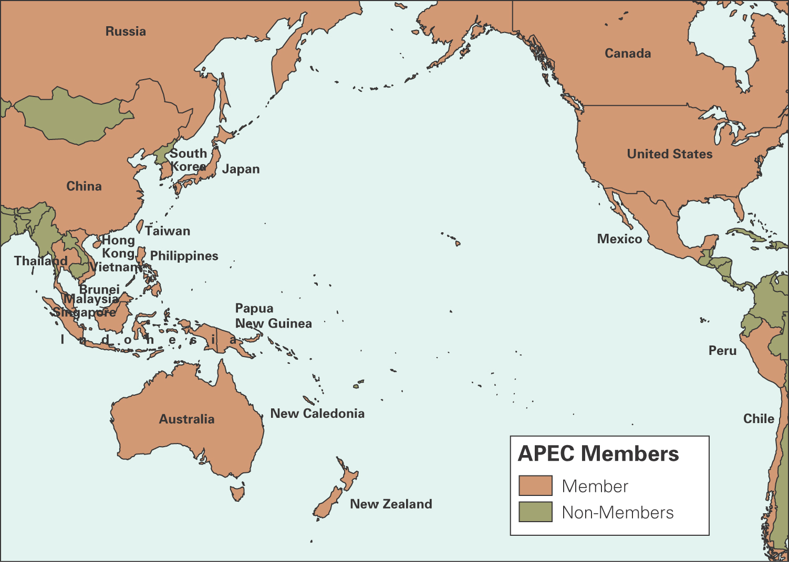
APEC members
Map 8.4

Slide 32
Regional trade blocs in Africa
9 trade blocs on the continent
  Many countries are members of more than one group
Progress slow due to political turmoil and deep suspicion of free trade
    Less developed, less diversified economies need “protection”
In 2001 Kenya, Uganda and Tanzania relaunched the East African Community (EAC) to establish a customs union 24 years after it had collapsed

Slide 33
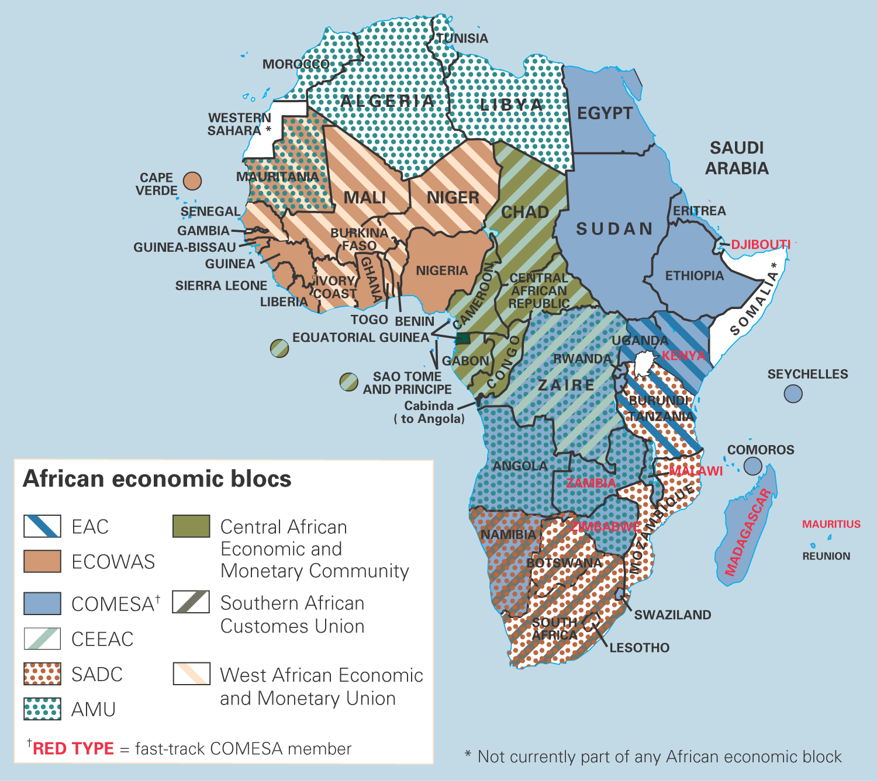
Regional trade blocs in Africa
Map 8.5

Slide 34
Impact on business
Opportunities: Creation of single markets
  Protected markets, now open
  Lower costs doing business in single market
Threats:
  Differences in culture and competitive practices make realizing economies of scale difficult
  More price competition
  Outside firms shut out of market
  EU intervention in mergers and acquisitions

