Slide 1
Modifying a database
Modify simply stands for making minor (partial) changes or to adjust – simply to improve it or to make it less extreme
//It here I mean features of a database like a table, query, form and report

Slide 2
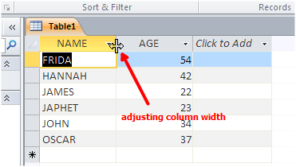
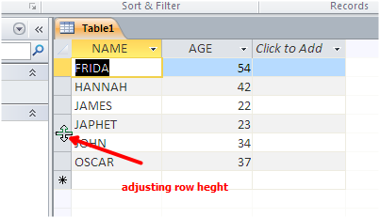
Modifying a datasheet
Taking you back to word processors, on tables, we adjust the rows and columns in a datasheet just we used to adjust with tables.
To adjust column width or row height, point to the column or row border- until the cursor turns into a double sided arrow and drag to the magnitude of your choice
// how did you find it? Simple isn’t it?
As simple as a Kenyan traffic police officer collecting bribes from Matatu touts

Slide 3
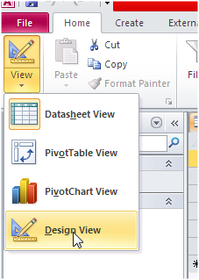
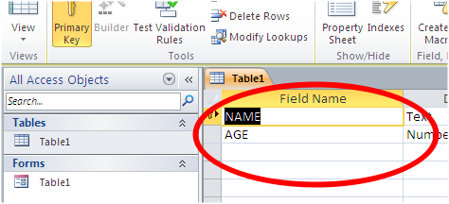
Modify the table structure
Modifying the structure of the table means: add or removing fields, changing data types and their properties
All these can be done by use of design view platform.
To turn a table into design view,
Click the table filename
Click the home tab on the command tabs of the ribbon
On the left group of the ribbon, below the file tab, click view then select design view
You can now proceed to make your desired changes.
// you can apply the same procedures to queries, forms and reports.

Slide 4
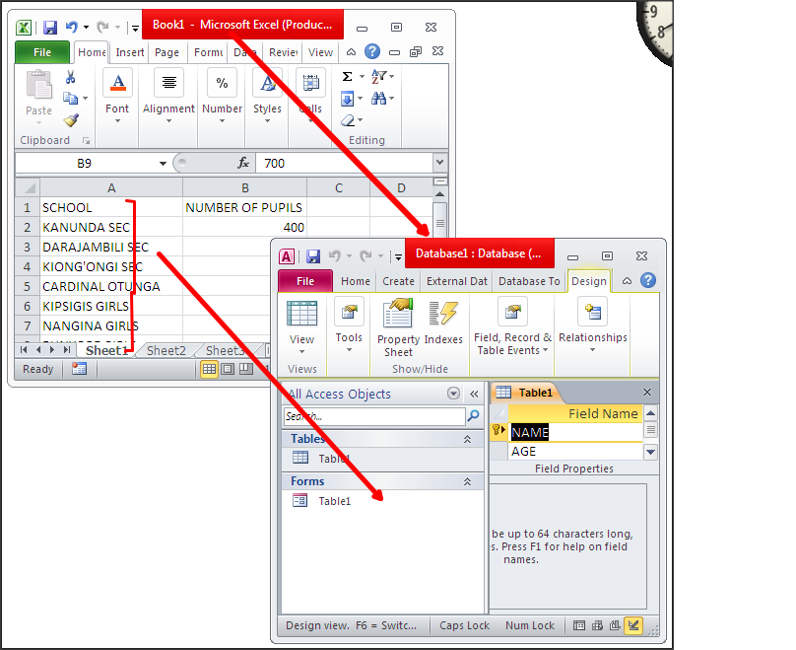
Importing tables
Click the external data tab
Select the application where your data is stashed from the ribbon e.g MS EXCEL, MS WORD, TEXT FILE ETC.
// go the next slide to see

Slide 5
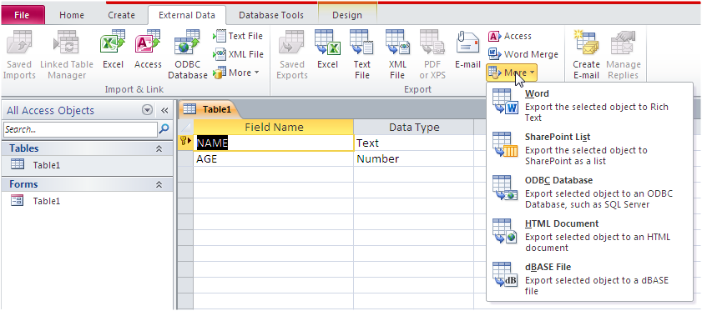
IMPORTING TABLES

