Slide 1
CS162
Operating Systems and
Systems Programming
Lecture 17
Disk Management and
File Systems
October 31, 2005
Prof. John Kubiatowicz
http://inst.eecs.berkeley.edu/~cs162

Slide 2
Review: Want Standard Interfaces to Devices
Block Devices: e.g. disk drives, tape drives, Cdrom
  Access blocks of data
  Commands include open(), read(), write(), seek()
  Raw I/O or file-system access
  Memory-mapped file access possible
Character Devices: e.g. keyboards, mice, serial ports, some USB devices
  Single characters at a time
  Commands include get(), put()
  Libraries layered on top allow line editing
Network Devices: e.g. Ethernet, Wireless, Bluetooth
  different enough from block/character to have own interface
  Unix and Windows include socket interface
    Separates network protocol from network operation
    Includes select() functionality
  Usage: pipes, FIFOs, streams, queues, mailboxes

Slide 3
Review: How Does User Deal with Timing?
Blocking Interface: “Wait”
  When request data (e.g. read() system call), put process to sleep until data is ready
  When write data (e.g. write() system call), put process to sleep until device is ready for data
Non-blocking Interface: “Don’t Wait”
  Returns quickly from read or write request with count of bytes successfully transferred
  Read may return nothing, write may write nothing
Asynchronous Interface: “Tell Me Later”
  When request data, take pointer to user’s buffer, return immediately; later kernel fills buffer and notifies user
  When send data, take pointer to user’s buffer, return immediately; later kernel takes data and notifies user

Slide 4
Review: How does the processor talk to the device?
Processor Memory Bus
Regular
Memory
CPU
Bus
Adaptor
Bus
Adaptor
Device
Controller
Address+
Data
Other Devices
or Buses
Bus
Interface
Hardware
Controller
Interrupt
Controller
Interrupt Request
read
Addressable
Memory
and/or
Queues
write
CPU interacts with a Controller
  Contains a set of registers that
  can be read and written
  May contain memory for request
  queues or bit-mapped images
Regardless of the complexity of the connections and buses, processor accesses registers in two ways:
  I/O instructions: in/out instructions
    Example from the Intel architecture: out 0x21,AL
  Memory mapped I/O: load/store instructions
    Registers/memory appear in physical address space
    I/O accomplished with load and store instructions
control
status
Registers
(port 0x20)
Memory Mapped
Region: 0x8f008020

Slide 5
Review: Memory-Mapped Display Controller Example
Memory-Mapped:
  Hardware maps control registers and display memory to physical address space
    Addresses set by hardware jumpers or programming at boot time
  Simply writing to display memory (also called the “frame buffer”) changes image on screen
    Addr: 0x8000F000—0x8000FFFF
  Writing graphics description to command-queue area
    Say enter a set of triangles that describe some scene
    Addr: 0x80010000—0x8001FFFF
  Writing to the command register may cause on-board graphics hardware to do something
    Say render the above scene
    Addr: 0x0007F004
Can protect with page tables
0x80020000
Graphics
Command
Queue
0x80010000
Display
Memory
0x8000F000
0x0007F004
Command
0x0007F000
Status
Physical Address
Space

Slide 6
Goals for Today
Finish Discussing I/O Systems
  Hardware Access
  Device Drivers
Disk Performance
  Hardware performance parameters
  Queuing Theory
File Systems
  Structure, Naming, Directories, and Caching
Note: Some slides and/or pictures in the following are
adapted from slides ©2005 Silberschatz, Galvin, and Gagne

Slide 7
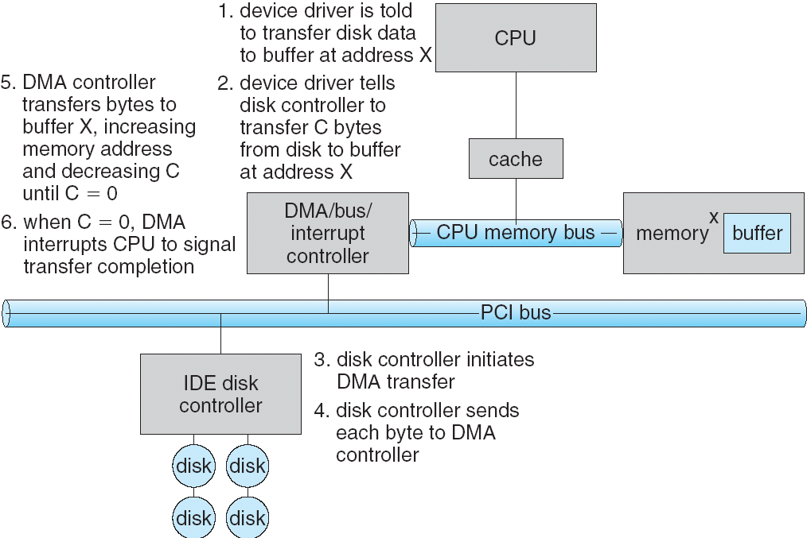
Transfering Data To/From Controller
Programmed I/O:
  Each byte transferred via processor in/out or load/store
  Pro: Simple hardware, easy to program
  Con: Consumes processor cycles proportional to data size
Direct Memory Access:
  Give controller access to memory bus
  Ask it to transfer data to/from memory directly
Sample interaction with DMA controller (from book):

Slide 8
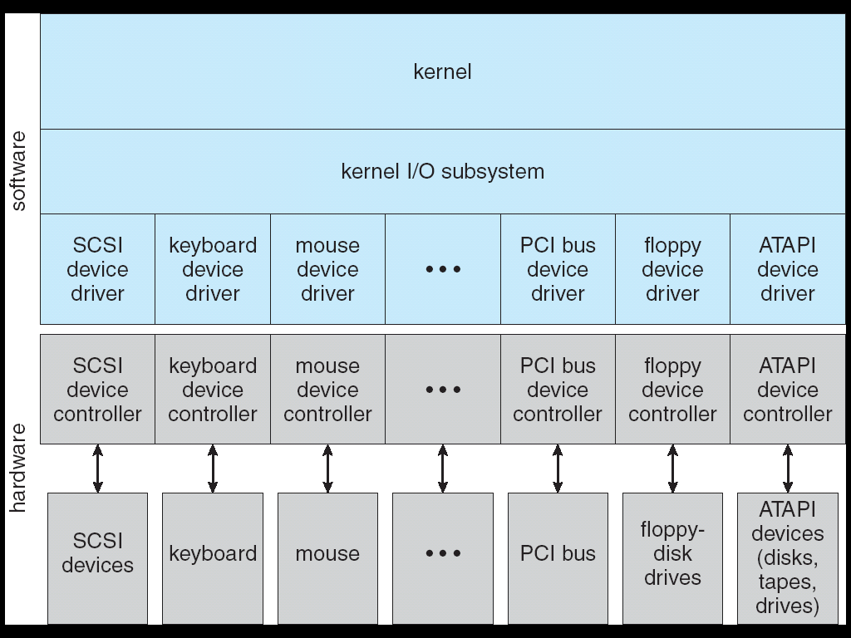
A Kernel I/O Structure

Slide 9
Device Drivers
Device Driver: Device-specific code in the kernel that interacts directly with the device hardware
  Supports a standard, internal interface
  Same kernel I/O system can interact easily with different device drivers
  Special device-specific configuration supported with the ioctl() system call
Device Drivers typically divided into two pieces:
  Top half: accessed in call path from system calls
    implements a set of standard, cross-device calls like open(), close(), read(), write(), ioctl(), strategy()
    This is the kernel’s interface to the device driver
    Top half will start I/O to device, may put thread to sleep until finished
  Bottom half: run as interrupt routine
    Gets input or transfers next block of output
    May wake sleeping threads if I/O now complete

Slide 10
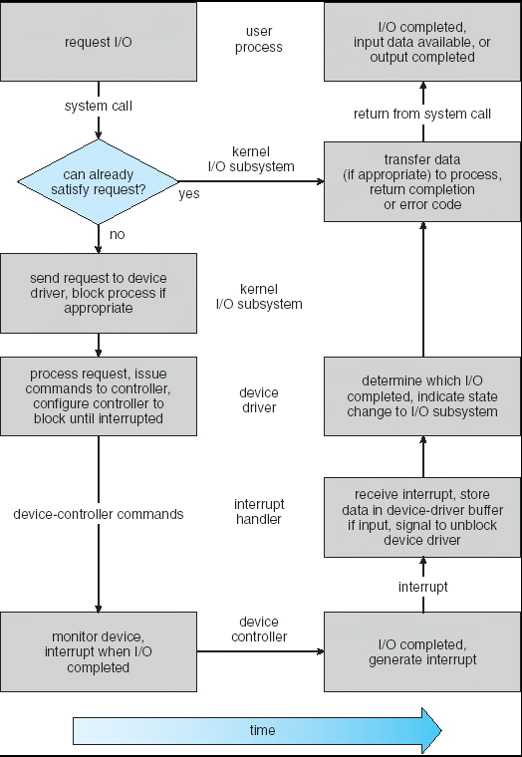
Life Cycle of An I/O Request
User
Program
Kernel I/O
Subsystem
Device Driver
Top Half
Device Driver
Bottom Half
Device
Hardware

Slide 11
I/O Device Notifying the OS
The OS needs to know when:
  The I/O device has completed an operation
  The I/O operation has encountered an error
I/O Interrupt:
  Device generates an interrupt whenever it needs service
  Handled in bottom half of device driver
    Often run on special kernel-level stack
  Pro: handles unpredictable events well
  Con: interrupts relatively high overhead
Polling:
  OS periodically checks a device-specific status register
    I/O device puts completion information in status register
    Could use timer to invoke lower half of drivers occasionally
  Pro: low overhead
  Con: may waste many cycles on polling if infrequent or unpredictable I/O operations
Actual devices combine both polling and interrupts
  For instance: High-bandwidth network device:
    Interrupt for first incoming packet
    Poll for following packets until hardware empty
Notes:
After the OS has issued a command to the I/O device either via a special I/O instruction or by writing to a location in the I/O address space, the OS needs to be notified when:
(a) The I/O device has completed the operation.
(b) Or when the I/O device has encountered an error.
This can be accomplished in two different ways: Polling and I/O interrupt.
+1 = 58 min. (Y:38)

Slide 12
Administrivia
Not much to say today
  Better get started on Project 3

Slide 13
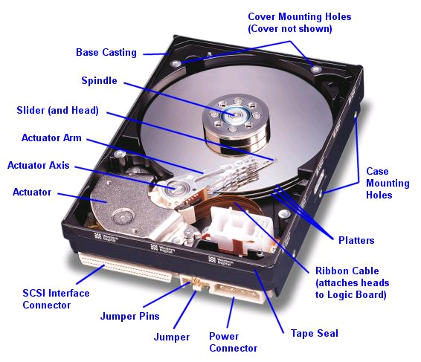
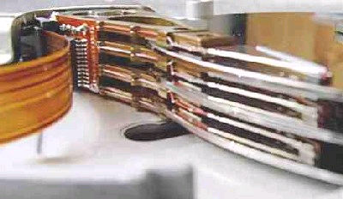
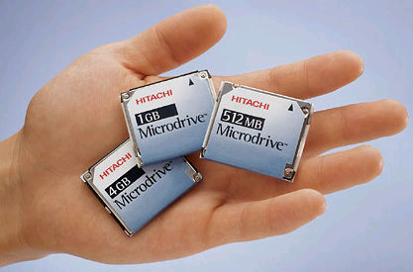
Hard Disk Drives
Read/Write Head
Side View
Western Digital Drive
http://www.storagereview.com/guide/
IBM/Hitachi Microdrive

Slide 14
Properties of a Hard Magnetic Disk
Sector
Platters
Track
Properties
  Independently addressable element: sector
    OS always transfers groups of sectors together—”blocks”
  A disk can access directly any given block of information it contains (random access). Can access any file either sequentially or randomly.
  A disk can be rewritten in place: it is possible to read/modify/write a block from the disk
Typical numbers (depending on the disk size):
  500 to more than 20,000 tracks per surface
  32 to 800 sectors per track
    A sector is the smallest unit that can be read or written
Zoned bit recording
  Constant bit density: more sectors on outer tracks
  Speed varies with track location
Notes:
Here is a primitive picture showing you how a disk drive can have multiple platters.
Each surface on the platter are divided into tracks and each track is further divided into sectors. A sector is the smallest unit that can be read or written.
By simple geometry you know the outer track have more area and you would thing the outer tack will have more sectors.
This, however, is not the case in traditional disk design where all tracks have the same number of sectors. Well, you will say, this is dumb but dumb is the reason they do it .
By keeping the number of sectors the same, the disk controller hardware and software can be dumb and does not have to know which track has how many sectors.
With more intelligent disk controller hardware and software, it is getting more popular to record more sectors on the outer tracks. This is referred to as constant bit density.
+2 = 32 min. (Y:12)

Slide 15
Disk I/O Performance
300
Response
Time (ms)
Controller
User
Thread
Disk
200
Queue
[OS Paths]
100
Response Time = Queue+Disk Service Time
0
0%
100%
Throughput (Utilization)
(% total BW)
Performance of disk drive/file system
  Metrics: Response Time, Throughput
  Contributing factors to latency:
    Software paths (can be loosely modeled by a queue)
    Hardware controller
    Physical disk media
Queuing behavior:
  Can lead to big increases of latency as utilization approaches 100%

Slide 16
Magnetic Disk Characteristic
Track
Sector
Cylinder: all the tracks under the
head at a given point on all surface
Read/write data is a three-stage
process:
  Seek time: position the head/arm over the proper track (into proper cylinder)
  Rotational latency: wait for the desired sector
  to rotate under the read/write head
  Transfer time: transfer a block of bits (sector)
  under the read-write head
Disk Latency = Queueing Time + Controller time +
Seek Time + Rotation Time + Xfer Time
Highest Bandwidth:
  transfer large group of blocks sequentially from one track
Head
Cylinder
Platter
Software
Queue
(Device Driver)
Hardware
Controller
Media Time
(Seek+Rot+Xfer)
Request
Result
Notes:
To read write information into a sector, a movable arm containing a read/write head is located over each surface.
The term cylinder is used to refer to all the tracks under the read/write head at a given point on all surfaces.
To access data, the operating system must direct the disk through a 3-stage process.
(a) The first step is to position the arm over the proper track. This is the seek operation and
the time to complete this operation is called the seek time.
(b) Once the head has reached the correct track, we must wait for the desired sector to
rotate under the read/write head. This is referred to as the rotational latency.
(c) Finally, once the desired sector is under the read/write head, the data transfer can begin.
The average seek time as reported by the manufacturer is in the range of 12 ms to 20ms and is calculated as the sum of the time for all possible seeks divided by the number of possible seeks.
This number is usually on the pessimistic side because due to locality of disk reference, the actual average seek time may only be 25 to 33% of the number published.
+2 = 34 min. (Y:14)

Slide 17
Typical Numbers of a Magnetic Disk
Average seek time as reported by the industry:
  Typically in the range of 8 ms to 12 ms
  Due to locality of disk reference may only be 25% to 33% of the advertised number
Rotational Latency:
  Most disks rotate at 3,600 to 7200 RPM (Up to 15,000RPM or more)
  Approximately 16 ms to 8 ms per revolution, respectively
  An average latency to the desired information is halfway around the disk: 8 ms at 3600 RPM, 4 ms at 7200 RPM
Transfer Time is a function of:
  Transfer size (usually a sector): 1 KB / sector
  Rotation speed: 3600 RPM to 15000 RPM
  Recording density: bits per inch on a track
  Diameter: ranges from 1 in to 5.25 in
  Typical values: 2 to 50 MB per second
Controller time?
  Depends on controller hardware—need to examine each case individually
Notes:
As far as rotational latency is concerned, most disks rotate at 3,600 RPM or approximately 16 ms per revolution.
Since on average, the information you desired is half way around the disk, the average rotational latency will be 8ms.
The transfer time is a function of transfer size, rotation speed, and recording density.
The typical transfer speed is 2 to 4 MB per second.
Notice that the transfer time is much faster than the rotational latency and seek time.
This is similar to the DRAM situation where the DRAM access time is much shorter than the DRAM cycle time.
***** Do anybody remember what we did to take advantage of the short access time versus cycle time? Well, we interleave!
+2 = 36 min. (Y:16)

Slide 18
Introduction to Queuing Theory
Controller
Arrivals
Disk
Departures
Queue
Queuing System
What about queuing time??
  Let’s apply some queuing theory
  Queuing Theory applies to long term, steady state behavior ⇒ Arrival rate = Departure rate
Little’s Law:
Mean # tasks in system = arrival rate x mean response time
  Observed by many, Little was first to prove
  Simple interpretation: you should see the same number of tasks in queue when entering as when leaving.
Applies to any system in equilibrium, as long as nothing in black box is creating or destroying tasks
  Typical queuing theory doesn’t deal with transient behavior, only steady-state behavior
Notes:
Old and New Testament by Kleirock
Regret skipping as grad student

Slide 19
Background: Use of random distributions
Mean
(m1)
Server spends variable time with customers
  Mean (Average) m1 = Σp(T)×T
  Variance σ² = Σp(T)×(T-m1)² = Σp(T)×T²-m1
  Squared coefficient of variance: C = σ²/m1²
  Aggregate description of the distribution.
Important values of C:
  No variance or deterministic ⇒ C=0
  “memoryless” or exponential ⇒ C=1
    Past tells nothing about future
    Many complex systems (or aggregates)
    well described as memoryless
  Disk response times C ≈ 1.5 (majority seeks < avg)
Mean Residual Wait Time, m1(z):
  Mean time must wait for server to complete current task
  Can derive m1(z) = ½m1×(1 + C)
    Not just ½m1 because doesn’t capture variance
  C = 0 ⇒ m1(z) = ½m1; C = 1 ⇒ m1(z) = m1
σ
Distribution
of service times
mean
Memoryless

Slide 20
A Little Queuing Theory: Mean Wait Time
Queue
Server
Arrival Rate
λ
Service Rate
μ=1/T_{ser}
Parameters that describe our system:
  λ: mean number of arriving customers/second
  T_{ser}: mean time to service a customer (“m1”)
  C: squared coefficient of variance = σ²/m1²
  μ: service rate = 1/T_{ser}
  u: server utilization (0≤u≤1): u = λ/μ = λ × T_{ser}
Parameters we wish to compute:
  T_{q}: Time spent in queue
  L_{q}: Length of queue = λ × T_{q} (by Little’s law)
Basic Approach:
  Customers before us must finish; mean time = L_{q} × T_{ser}
  If something at server, takes m1(z) to complete on avg
    m1(z): mean residual wait time at server= T_{ser} × ½(1+C)
    Chance server busy = u ⇒ mean time is u × m1(z)
Computation of wait time in queue (T_{q}):
  T_{q} = L_{q} × T_{ser} + u × m1(z)

Slide 21
A Little Queuing Theory: M/G/1 and M/M/1
Computation of wait time in queue (T_{q}):
T_{q} = L_{q} × T_{ser} + u × m1(z)
  T_{q} = λ × T_{q} × T_{ser} + u × m1(z)
  T_{q} = u × T_{q} + u × m1(z)
  T_{q} × (1 – u) = m1(z) × u ⇒ T_{q} = m1(z) × u/(1-u) ⇒
  T_{q} = T_{ser} × ½(1+C) × u/(1 – u)
Notice that as u→1, T_{q}→∞ !
Assumptions so far:
  System in equilibrium; No limit to the queue: works First-In-First-Out
  Time between two successive arrivals in line are random and memoryless: (M for C=1 exponentially random)
  Server can start on next customer immediately after prior finishes
General service distribution (no restrictions), 1 server:
  Called M/G/1 queue: T_{q} = T_{ser} x ½(1+C) x u/(1 – u))
Memoryless service distribution (C = 1):
  Called M/M/1 queue: T_{q} = T_{ser} x u/(1 – u)
Little’s Law
Defn of utilization (u)

Slide 22
A Little Queuing Theory: An Example
Example Usage Statistics:
  User requests 10 x 8KB disk I/Os per second
  Requests & service exponentially distributed (C=1.0)
  Avg. service = 20 ms (From controller+seek+rot+trans)
Questions:
  How utilized is the disk?
    Ans: server utilization, u = λT_{ser}
  What is the average time spent in the queue?
    Ans: T_{q}
  What is the number of requests in the queue?
    Ans: L_{q}
  What is the avg response time for disk request?
    Ans: T_{sys} = T_{q} + T_{ser}
Computation:
λ (avg # arriving customers/s) = 10/s
T_{ser} (avg time to service customer) = 20 ms (0.02s)
u (server utilization) = λ x T_{ser}= 10/s x .02s = 0.2
T_{q} (avg time/customer in queue) = T_{ser} x u/(1 – u)
= 20 x 0.2/(1-0.2) = 20 x 0.25 = 5 ms (0 .005s)
L_{q} (avg length of queue) = λ x T_{q}=10/s x .005s = 0.05
T_{sys} (avg time/customer in system) =T_{q} + T_{ser}= 25 ms

Slide 23
Disk Scheduling
Disk can do only one request at a time; What order do you choose to do queued requests?
FIFO Order
  Fair among requesters, but order of arrival may be to random spots on the disk ⇒ Very long seeks
SSTF: Shortest seek time first
  Pick the request that’s closest on the disk
  Although called SSTF, today must include
  rotational delay in calculation, since
  rotation can be as long as seek
  Con: SSTF good at reducing seeks, but
  may lead to starvation
SCAN: Implements an Elevator Algorithm: take the closest request in the direction of travel
  No starvation, but retains flavor of SSTF
S-SCAN: Circular-Scan: only goes in one direction
  Skips any requests on the way back
  Fairer than SCAN, not biased towards pages in middle
User
Requests
2,2
5,2
7,2
3,10
2,1
2,3
Head
3
Disk Head
2
1
4

Slide 24
Building a File System
File System: Layer of OS that transforms block interface of disks (or other block devices) into Files, Directories, etc.
File System Components
  Disk Management: collecting disk blocks into files
  Naming: Interface to find files by name, not by blocks
  Protection: Layers to keep data secure
  Reliability/Durability: Keeping of files durable despite crashes, media failures, attacks, etc
User vs. System View of a File
  User’s view:
    Durable Data Structures
  System’s view (system call interface):
    Collection of Bytes (UNIX)
    Doesn’t matter to system what kind of data structures you want to store on disk!
  System’s view (inside OS):
    Collection of blocks (a block is a logical transfer unit, while a sector is the physical transfer unit)
    Block size ≥ sector size; in UNIX, block size is 4KB

Slide 25
Translating from User to System View
File
System
What happens if user says: give me bytes 2—12?
  Fetch block corresponding to those bytes
  Return just the correct portion of the block
What about: write bytes 2—12?
  Fetch block
  Modify portion
  Write out Block
Everything inside File System is in whole size blocks
  For example, getc(), putc() ⇒ buffers something like 4096 bytes, even if interface is one byte at a time
From now on, file is a collection of blocks

Slide 26
Disk Management Policies
Basic entities on a disk:
  File: user-visible group of blocks arranged sequentially in logical space
  Directory: user-visible index mapping names to files (next lecture)
Access disk as linear array of blocks. Two Options:
  Identify blocks as vectors [cylinder, surface, sector]. Sort in cylinder-major order. Not used much anymore.
  Logical Block Addressing (LBA). Every block has integer address from zero up to max number of cylinders.
  Controller translates from address ⇒ physical position
    First case: OS/BIOS must deal with bad blocks
    Second case: hardware shields OS from structure of disk
Need way to track free disk blocks
  Link free blocks together ⇒ too slow today
  Use bitmap to represent free space on disk
Need way to structure files: File Header
  Track which blocks belong at which offsets within the logical file structure
  Optimize placement of files disk blocks to match access and usage patterns

Slide 27
Designing the File System: Access Patterns
How do users access files?
  Need to know type of access patterns user is likely to throw at system
Sequential Access: bytes read in order (“give me the next X bytes, then give me next, etc”)
  Almost all file access are of this flavor
Random Access: read/write element out of middle of array (“give me bytes i—j”)
  Less frequent, but still important. For example, virtual memory backing file: page of memory stored in file
  Want this to be fast – don’t want to have to read all bytes to get to the middle of the file
Content-based Access: (“find me 100 bytes starting with KUBIATOWICZ”)
  Example: employee records – once you find the bytes, increase my salary by a factor of 2
  Many systems don’t provide this; instead, databases are built on top of disk access to index content (requires efficient random access)

Slide 28
Designing the File System: Usage Patterns
Most files are small (for example, .login, .c files)
  A few files are big – nachos, core files, etc.; the nachos executable is as big as all of your .class files combined
  However, most files are small – .class’s, .o’s, .c’s, etc.
Large files use up most of the disk space and bandwidth to/from disk
  May seem contradictory, but a few enormous files are equivalent to an immense # of small files
Although we will use these observations, beware usage patterns:
  Good idea to look at usage patterns: beat competitors by optimizing for frequent patterns
  Except: changes in performance or cost can alter usage patterns. Maybe UNIX has lots of small files because big files are really inefficient?
Digression, danger of predicting future:
  In 1950’s, marketing study by IBM said total worldwide need for computers was 7!
  Company (that you haven’t heard of) called “GenRad” invented oscilloscope; thought there was no market, so sold patent to Tektronix (bet you have heard of them!)

Slide 29
How to organize files on disk
Goals:
  Maximize sequential performance
  Easy random access to file
  Easy management of file (growth, truncation, etc)
First Technique: Continuous Allocation
  Use continuous range of blocks in logical block space
    Analogous to base+bounds in virtual memory
    User says in advance how big file will be (disadvantage)
  Search bit-map for space using best fit/first fit
    What if not enough contiguous space for new file?
  File Header Contains:
    First sector/LBA in file
    File size (# of sectors)
  Pros: Fast Sequential Access, Easy Random access
  Cons: External Fragmentation/Hard to grow files
    Free holes get smaller and smaller
    Could compact space, but that would be really expensive
Continuous Allocation used by IBM 360
  Result of allocation and management cost: People would create a big file, put their file in the middle

Slide 30
How to organize files on disk (continued)
Second Technique: Linked List Approach
  Each block, pointer to next on disk
  Pros: Can grow files dynamically, Free list same as file
  Cons: Bad Sequential Access (seek between each block), Unreliable (lose block, lose rest of file)
  Serious Con: Bad random access!!!!
  Technique originally from Alto (First PC, built at Xerox)
    No attempt to allocate contiguous blocks
MSDOS used a similar linked approach
  Links not in pages, but in the File Allocation Table (FAT)
    FAT contains an entry for each block on the disk
    FAT Entries corresponding to blocks of file linked together
  Compare with Linked List Approach:
    Sequential access costs more unless FAT cached in memory
    Random access is better if FAT cached in memory
File Header
Null

Slide 31
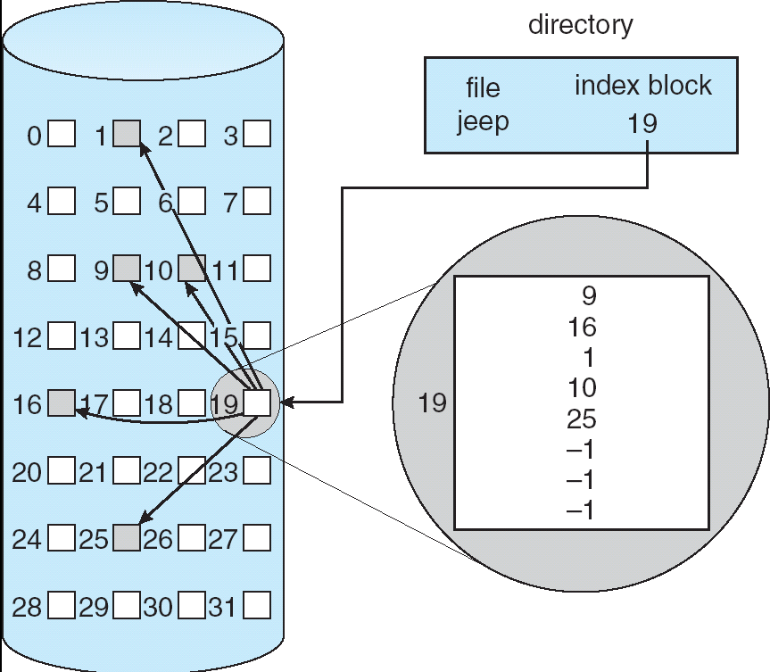
How to Organize Files on Disk (continued)
Third Technique: Indexed Files (Nachos, VMS)
  System Allocates file header block to hold array of pointers big enough to point to all blocks
    User pre-declares max file size;
  Pros: Can easily grow up to space allocated for index Random access is fast
  Cons: Clumsy to grow file bigger than table size
  Still lots of seeks: blocks may be spread over disk

Slide 32
Where do we still have to go?
Still don’t have good internal file structure
  Want to minimize seeks, maximize sequential access
  Want to be able to handle small and large files efficiently
Don’t yet know how to name/locate files
  What is a directory?
  How do we look up files?
Don’t yet know how to make file system fast
  Must figure out how to use caching
Will address these issues next time….

Slide 33
Summary
I/O Controllers: Hardware that controls actual device
  Processor Accesses through I/O instructions, load/store to special physical memory
  Report their results through either interrupts or a status register that processor looks at occasionally (polling)
Disk Performance:
  Queuing time + Controller + Seek + Rotational + Transfer
  Rotational latency: on average ½ rotation
  Transfer time: spec of disk depends on rotation speed and bit storage density
Queuing Latency:
  M/M/1 and M/G/1 queues: simplest to analyze
  As utilization approaches 100%, latency → ∞
  T_{q} = T_{ser} x ½(1+C) x u/(1 – u))
File System:
  Transforms blocks into Files and Directories
  Optimize for access and usage patterns
  Maximize sequential access, allow efficient random access

