Slide 1
Storage Management
Lecture 7

Slide 2
Disk Storage Types
Basic – uses static partitions (physical disk divisions) that can’t span physical drives. Use industry-standard partitioning and formatting and can contain up to 4 primary and 1 extended partitions, as well as logical drives
Dynamic – uses volumes that can span physical drives. Supports advanced options, including fault-tolerance. Unlimited number of volumes. No other O/S can access dynamic storage; not supported on laptops.

Slide 3
Upgrading Disk from Basic to Dynamic
In cases where a volume crosses multiple disks, all related disks must be upgraded
Any other O/S located on a partition will be rendered inoperable
Removable media can’t be upgraded
Can’t convert back from dynamic to basic

Slide 4
Basic Disks
Partitioning
  A process that blocks a group of tracks and sectors to be used by a particular file system, such as NTFS
Formatting
  A process that creates a table containing file and folder information for a specific file system in a partition

Slide 5
Basic Disks (continued)
MBR and GPT support
  When a drive is partitioned, a Master Boot Record (MBR) and a partition table are created
    At the beginning track and sectors on the disk
  The MBR is located in the first sector and track of the hard disk
    Has startup information about partitions and how to access the disk
  The partition table contains information about each partition created

Slide 6
Basic Disks (continued)
  Globally Unique Identifier (GUID) Partition Table or GPT
    A newer way to partition disks, without imposing the same type of limits on the number of partitions as with MBR
  GPT is one element of the Extensible Firmware Interface (EFI) approach
    Offered by the Unified EFI Forum
  GPT disks store partition information in each partition using main and backup tables

Slide 7
Partition Management
Primary - from which you can boot an OS, such as MS-DOS or Win2K Server. Can only have 4 per disk.
Extended – serves to overcome limit of 4 primary partition, is not bootable. Can only have 1 per disk.
System – contains O/S boot files. Can only exists on a primary
Boot – contains O/S system files. Can exist on a primary or extended.
Partition needs to be formatted with a file system after it’s created, and it can then be assigned a drive letter.
  At least 1 partition needs to be marked active , that’s where your computer will look for the hardware-specific files to start the operating system

Slide 8
Dynamic Disks
A dynamic disk does not use traditional partitioning
  Makes it possible to set up a large number of volumes on one disk
  Provides the ability to extend volumes onto additional physical disks
The number of disks that can be incorporated into one spanned volume is limited to 32
Plan to convert basic disks to dynamic disks after you install Windows Server 2008

Slide 9
Volume Management
Dynamic disks support 5 volume types:
- Simple
- Spanned
- Striped
- Mirrored
- Raid-5
The volume containing boot files is called system volume, the volume containing system files (WINDOWS folder ) – boot volume

Slide 10
RAID
Redundant Array of Inexpensive (Independent) Disks
  A set of standards for lengthening disk life provide better performance and FT
Software or Hardware RAID
RAID levels – 0 through 6
Server 2008 supports RAID levels 0, 1 and 5 through software

Slide 11
Software RAID vs. Hardware RAID
Software RAID implements fault tolerance through the server’s operating system
Hardware RAID is implemented through the server hardware
  Independent of the operating system
Advantages over software RAID:
  Faster read and write response
  The ability to place boot and system files on different RAID levels
  The ability to ‘‘hot-swap’’ a failed disk
  More setup options to retrieve damaged data

Slide 12
Simple Volume
A portion of a disk or an entire disk that is setup as a dynamic disk
Can be extended with an unallocated space
Doesn’t provide FT

Slide 13
Spanned Volume
Method of combining free space on 2 to 32 physical disks into a single volume with available space on each of the spanned disks of varying size
Storage is accomplished by filling the space on one disk and moving to each subsequent spanned disk
Not FT
Can be extended (only those formatted with NTFS)

Slide 14
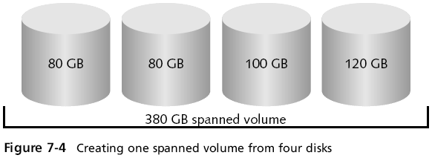

Slide 15
Striped Volume – RAID 0
Similar to spanned in that both permit 2-32 disks combined.
Logically distributes the information simultaneously across all the disks, unlike spanned which sequentially store data. This architecture provides faster I/O
Not FT
Free space areas on each disk need to be of equal size.

Slide 16
RAID-5 Volume
Similar to striped, but is fault-tolerant
Logically distributes the information simultaneously across all 3 or more disks, one of which stores parity
If 1 disk fails, data can be reconstructed, but if more than 1 – it can’t.
Writing is slower than striped, but reading is the same. When 1 disk fails performance degrades
Calculate usable space: parity takes 1/n of the data, where n= number of disks in the volume.
Free space areas on each drive need to be of equal size.

Slide 17
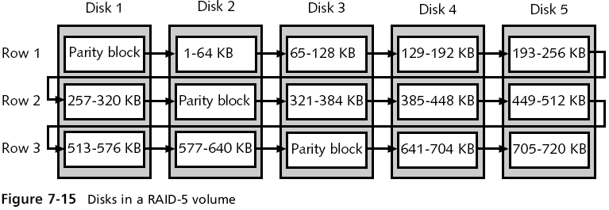

Slide 18
Mirrored Volume – RAID 1
Creating a shadow copy of data on a backup disk
Requires 2 disks
Most guaranteed FT, but less efficient use of disk space
Read performance is the same as on any single disk drive, Write is slower than on single disk, but faster than RAID-5. No performance degradation when 1 disk fails.
Disk Duplexing – 2 drives/2 controllers

Slide 19
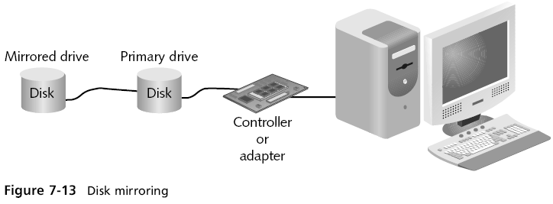
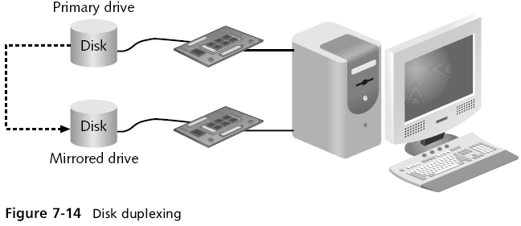

Slide 20
Shrinking a volume
  Windows Server 2008 comes with the ability to shrink a basic or dynamic disk volume
  Shrinking a volume enables you to create a new partition when one is needed and you don’t have extra disks
  When you shrink a volume, Windows Server 2008 starts from the end of that volume
    Works its way back through contiguous space to create unallocated disk space
  You can specify the amount of space to recover

Slide 21
Mounting a Drive
Windows Server 2008 enables you to mount a drive as an alternative to giving it a drive letter
Mounted drive
  One that appears as a folder and is accessed through a path like any other folder
You can mount a basic or dynamic disk drive, a CD/DVD drive, or a removable drive

