Slide 1
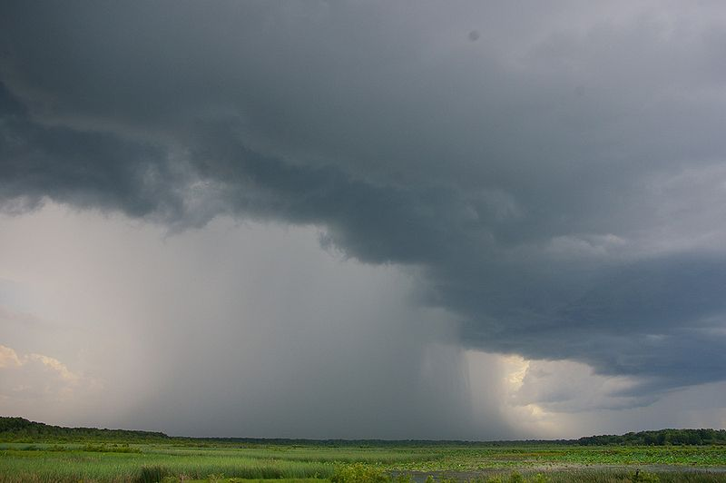
Weather and Climate

Slide 2
Weather and Climate
How many people know what the weather is going to be the next three days?
How do you know?
Can you predict the weather?

Slide 3
Weather and Climate
Tip:
Start watching the weather reports in the news, looking at the weather reports in the paper and checking online.

Slide 4
Weather and Climate
Why is it important to study the weather?

Slide 5
Unit 1: Weather and Climate
Task 1:
What is the difference between weather and climate? (2 minutes to discuss)

Slide 6
Unit 1: Weather and Climate
Weather:
The state of the atmosphere at any given time. (Look out the window and view the weather)
Climate:
The atmosphere of an area recorded over a given time period (often 30 years)

Slide 7
Weather Elements:
Write down as many different weather elements that you can remember.
Hint: temperature is one.

Slide 8
Weather Elements:
Precipitation
Temperature
Wind Speed
Wind Direction
Sunshine
Humidity
Air Pressure
Cloud Cover
Visibility

Slide 9
Recording the weather
As well as knowing all of the elements of the weather you must also know how we record each one.
How do we record the weather?

Slide 10
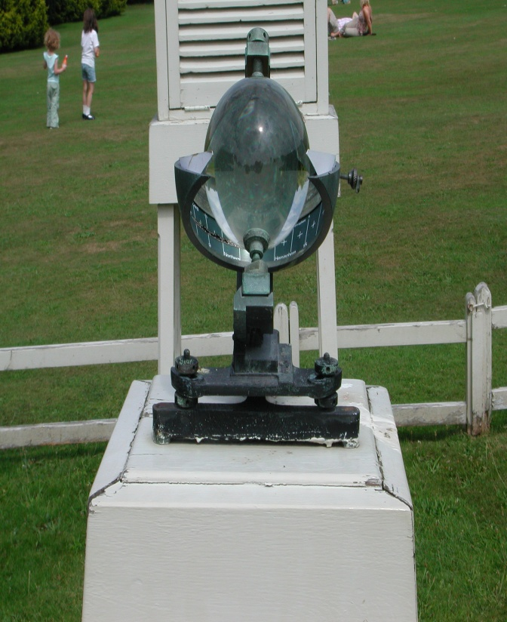
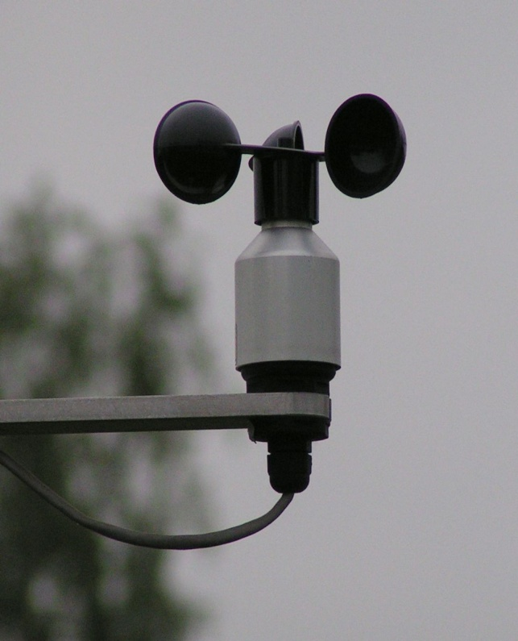
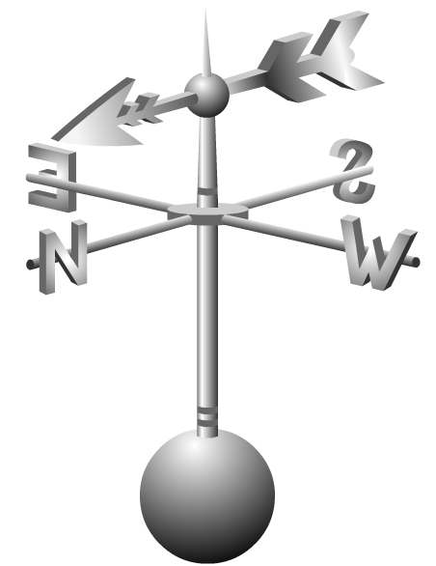
Recording the weather
The name of each weather recording instrument.
What the measure.
The unit that they measure in.

Slide 11
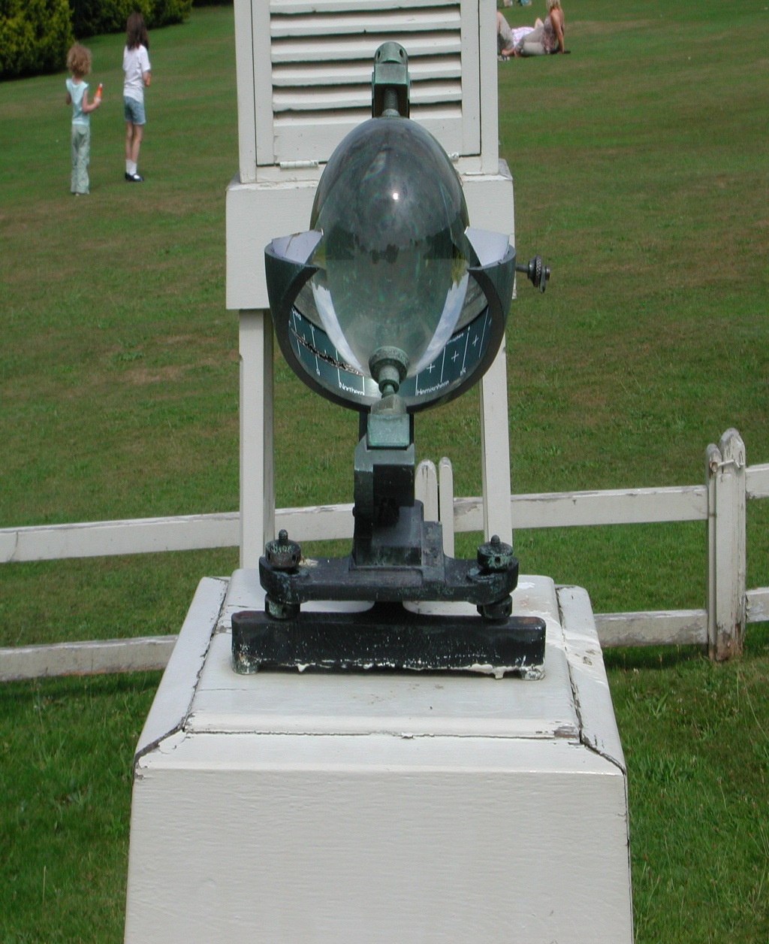
Instrument:
Sunshine recorder
What does it measure:
Hours of Sunshine
What unit does it measure in:
Hours

Slide 12
Instrument:
Rain Gauge
What does it measure:
Precipitation
What unit does it measure in:
mm

Slide 13
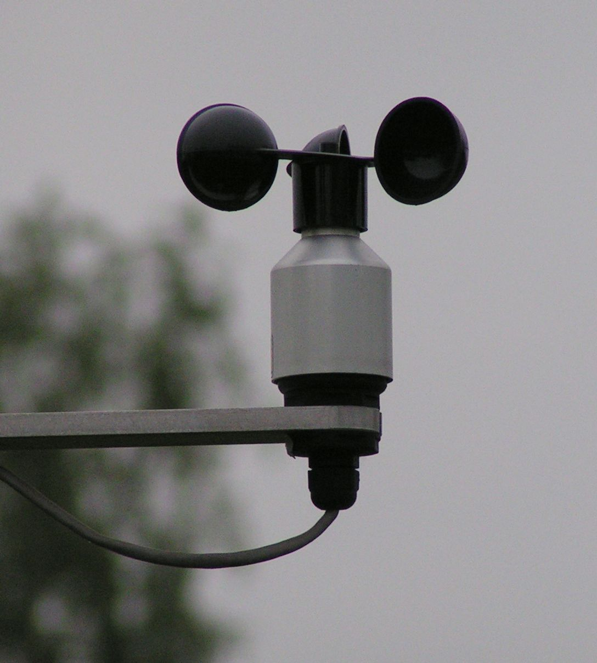
Instrument:
Anemometer
What does it measure:
Wind speed
What unit does it measure in:
MPH

Slide 14
Instrument:
Wind vain
What does it measure:
Wind direction
What unit does it measure in:
Compass points (N,S,E,W)

Slide 15
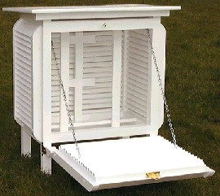
This also measures humidity
Instrument:
Stevenson Screen
What does it measure:
It houses thermometers
to measure air temperature.
What unit does it measure in:
°C

Slide 16
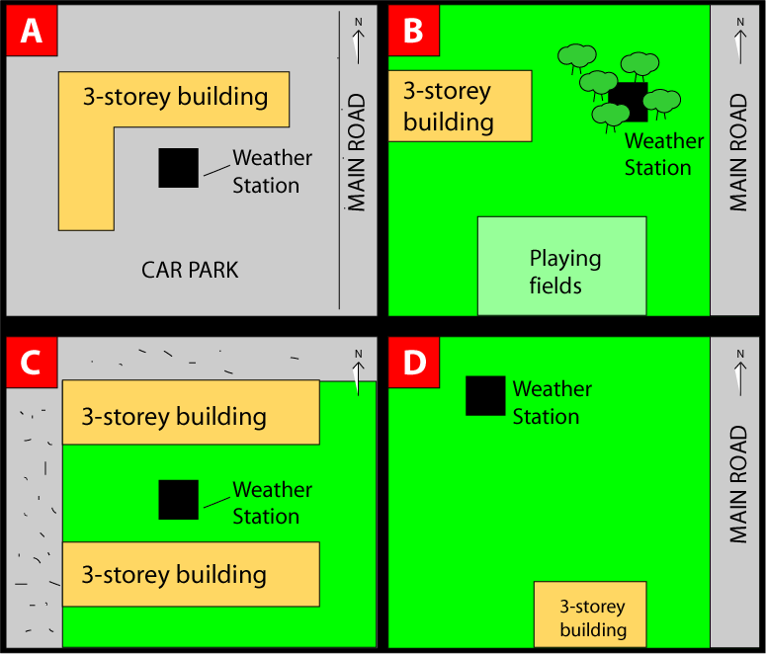
Location of a weather station
For each of the following site
write down the positives
and negatives of each.

Slide 17
Fieldwork:
Things to remember.
The weather station must have:
A Stevenson screen
A Barometer
A Anemometer
A Wind vane
A Sunshine recorder
A Rain Gauge
You must think about all of these when you are picking the site.

Slide 18
Factors that influence the weather.
Latitude
Altitude
Proximity to sea
Ocean currents
Rainshadow
Aspect

Slide 19
Latitude:
The suns rays are most concentrated at the equator, and they have less of a distance to cover here too. This means the closer to the equator you are the hotter it will be. The further you are the colder it will be.

Slide 20
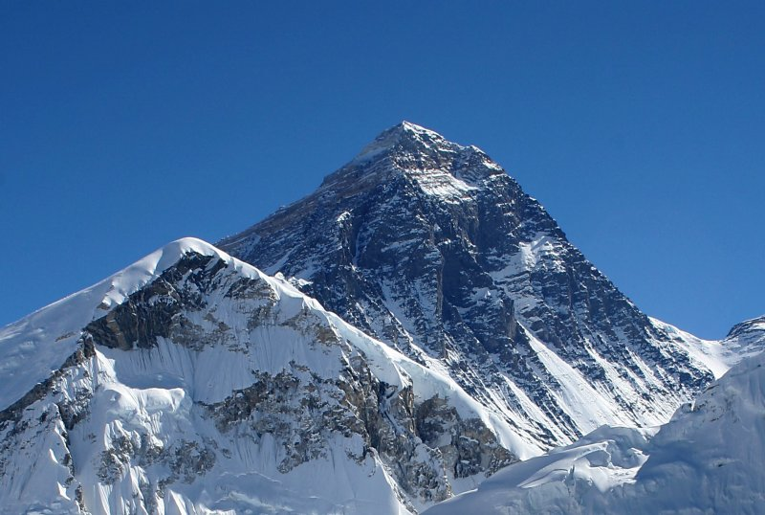
Altitude:
The higher up you are the colder it is.
For every 100m you climb it goes down roughly 0. 6°C. This is called the lapse rate.
Very cold due to
massive height

Slide 21
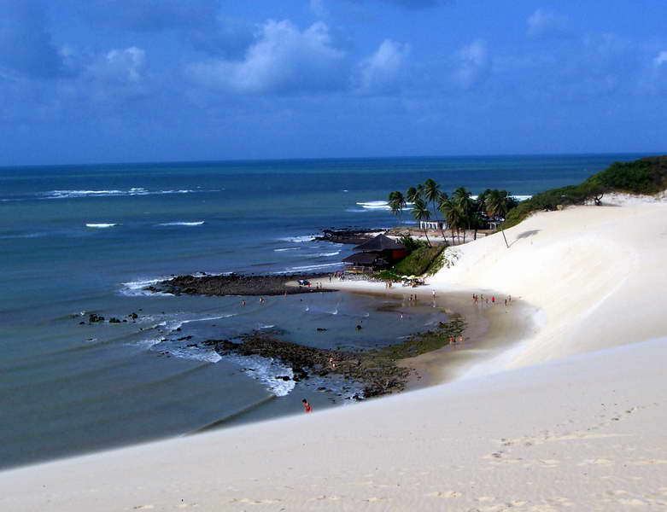
Proximity to the sea
The sea cools down and warms up slower than the land.
This means it helps keep places close to the sea cool in the summer and warmer in the winter.
Stays cool
in the summer
and
warm in
the winter.
Land heats
and cools much
more
quickly than
the sea.

Slide 22
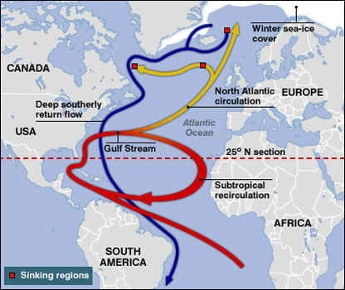
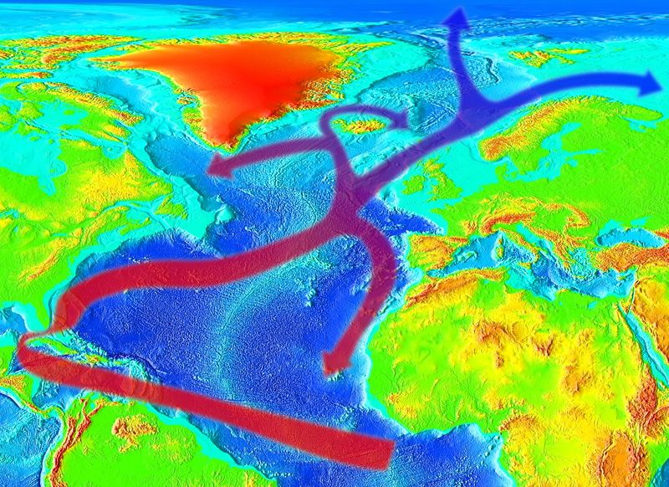
Ocean currents.
Ocean currents can cool or warm the land. The UK is kept warm due to the North Atlantic Drift (or Gulf Stream) coming from S.American water.
Thermal
images show
the warm
current

Slide 23
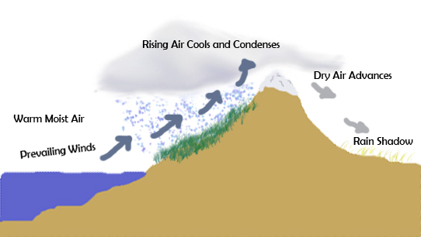
Rainshadow
The Rainshadow is caused due to areas of high land.
The moist air from the sea is blown over mountains and therefore many clouds are formed, and there is lots of rain.
This means that the area after the mountains will have a dry period.
This is known as the rainshadow.
Copy this
diagram

Slide 24
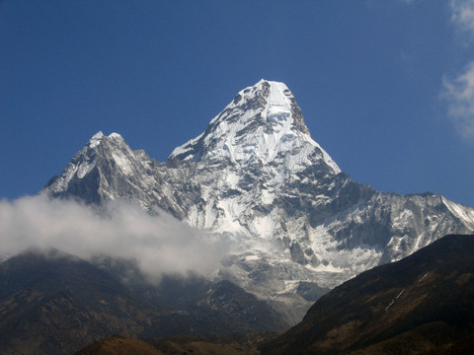
Aspect – in the northern hemisphere south facing slopes receive more sunshine than north facing slopes. North facing slopes are in the shade and so will be colder than south facing slopes. Snow tends to last longer on north facing slopes.
South
This will be
warmer in the
northern
hemisphere
North:
This will be
cooler in the
northern
hemisphere

Slide 25
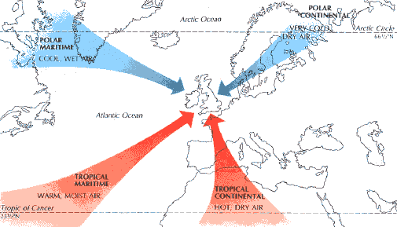
Air masses
Arctic Maritime
Air masses also affect the weather greatly.
The UK is affected by 5 main air masses.

Slide 26
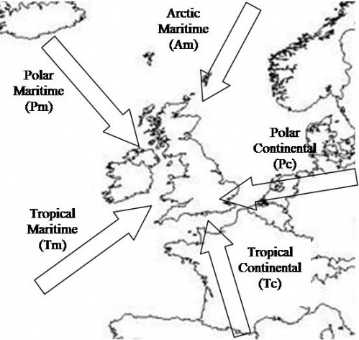

Slide 27
Air masses
Polar
= cold
This may seem complicated but it is actually pretty easy.
You just have to know what each word means, and it is easy to work out.
Tropical
= hot
Maritime
= wet
Continental
= dry

Slide 28
Air masses
Now just add them together.
Polar continental =
Polar maritime =
Tropical continental =
Tropical maritime =
Arctic =
Cold and dry weather
Cold and wet weather
Hot and dry weather
Hot and wet weather.
Extremely cold weather

Slide 29
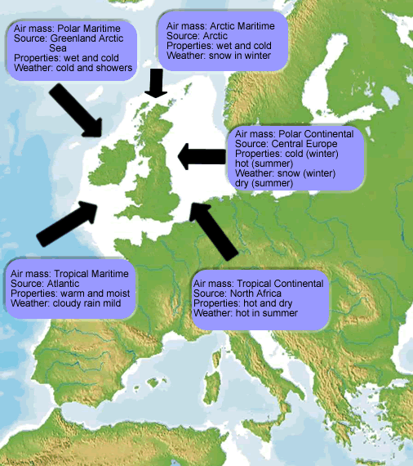

Slide 30
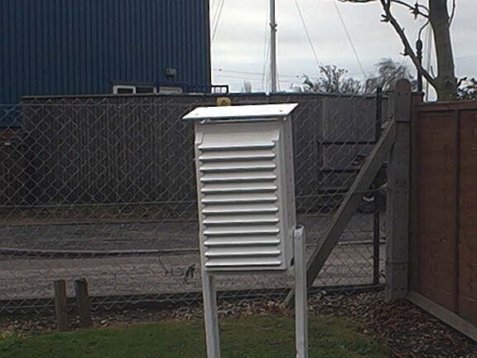

Slide 31
Stevenson Screen:
You have been given a handout with a diagram of a Stevenson Screen on it.
You must explain why it has each of it’s features.

Slide 32
Inside the Stevenson screen
What is inside a Stevenson screen?
Maximum and minimum thermometer.
Wet and dry bulb thermometer. (to measure humidity)

Slide 33
Sloped roof
Painted White
Slated sides
1m long legs
Placed on grass

Slide 34
Stevenson Screen: homework
Why does it have each of these features?
Features:
1m long legs.
Placed on grass.
Slanted roof.
Slats in the side of the main box.
Painted white.

Slide 35
Final task:
Get packed away, then…..
Tell the person next to you 5 things you know about the weather topic.

Slide 36
Weather
Depressions are low pressure systems.
These affect the UK for much of the year.
These bring cloud, rain, wind and generally unsettled conditions.

Slide 37
Depressions – how are they formed?
Depressions form where warm air meets cold air
The boundary between the two air masses is called a front
Along a front there will usually be thick cloud and heavy rain

Slide 38
A Depression
Warm Front
Cold Front

Slide 41
Passage of a depression
Notes:
Please Note
These animations and exercises would also be suitable for use at KS4 and KS5.

Slide 42
Living graph of a depression.
Copy the diagram on the white board then place the numbers on it:
1. Weather getting warmer with only a little drizzle.
2. Weather for T-shirt, shorts and sun glasses.
3. Warm clothes but you can leave the umbrella at home.
4. Umbrella and wellies needed! Warm clothes too.

Slide 43
Anticyclones – high pressure

Slide 44
High pressure synoptic chart
The word high is written in the middle of the high pressure area
The isobars are widely spaced
The value of the isobars get higher towards the centre of the anticyclone

Slide 45
Anticyclone weather - Summer
Dry and hot days with little or no cloud.
Early morning dew and mist.
Nights are cool due to lack of cloud during the day.

Slide 46
Anticyclone weather - Winter
Fog that may last all day.
Mostly clear skies.
Frost in the mornings.
Freezing nights.
Dry.

