Slide 1
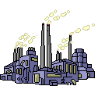
Site,Settlement and Situation Unit

Slide 2
Why is it important to study settlement?
Geography involves the study of landscapes. Landscapes can be physical landscapes such as (mountains and rivers) or human landscapes (landscapes made by people).
Urban studies are studies of towns and cities. Towns and cities are one of the more striking ways in which people have changed and shaped the landscape.

Slide 3
For the standard grade exam I need to know:
Where settlements first began
The reasons why settlements have grown
The different functions of settlements
The spheres of influence of settlements and services
The main land use in towns and their locations
The changes in land use at the edge of towns
The causes of and solutions to traffic congestion
The causes of and solutions to urban decay

Slide 4
You will also need to know the following enquiry skills:
How and where to gather information on towns, by undertaking surveys and questionnaires
How to process this information, by drawing bar graphs and scatter graphs
How to analyse the information

Slide 5
Learning intentions:
To learn what we mean by settlement.
To learn what we mean by site.
To lean what makes a “good” site for a settlement.

Slide 6
What are settlements?
‘Settlements are places where people live and work’

Slide 7
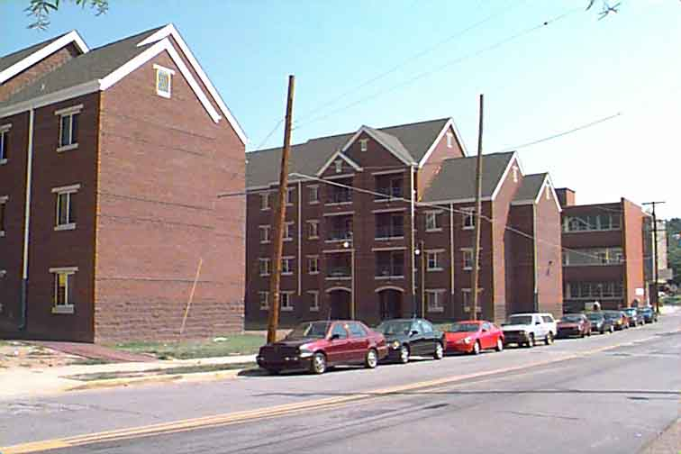
Image 1

Slide 8
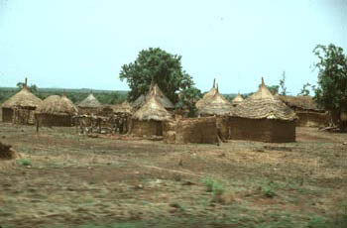
Image 2

Slide 9
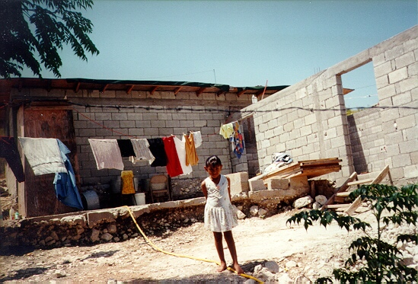
Image 3

Slide 10
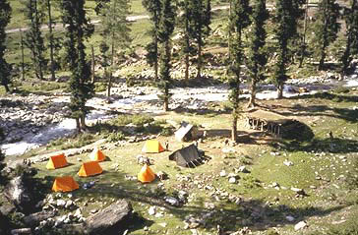
Image 4

Slide 11
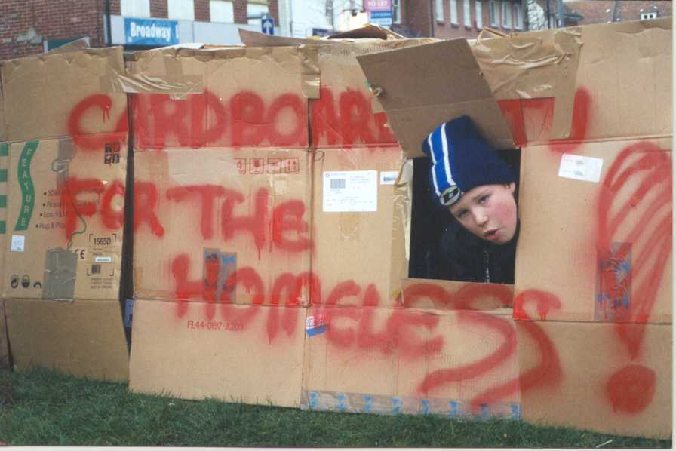
Image 5

Slide 12
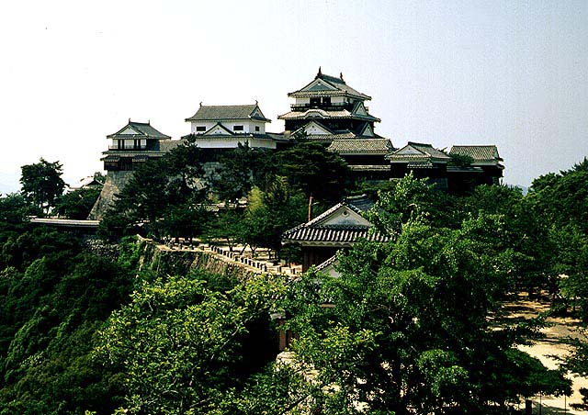
Image 6

Slide 13
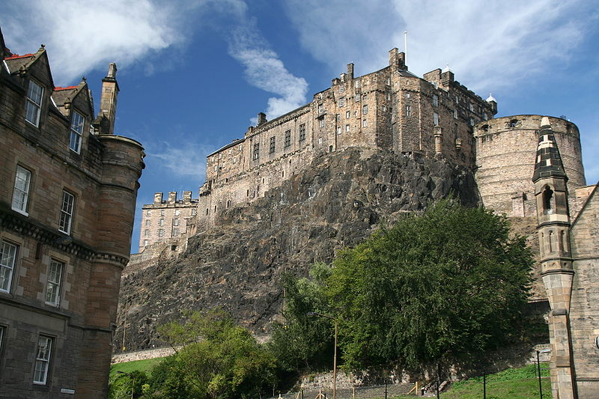
Image 7

Slide 14
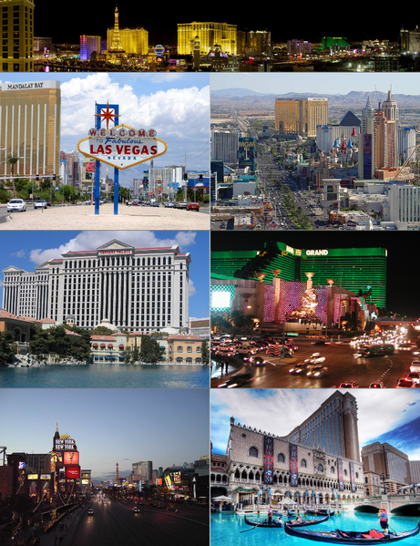
Image 8

Slide 15
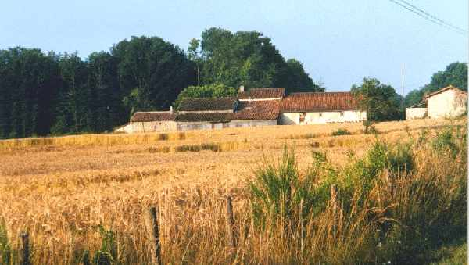
Image 9

Slide 16
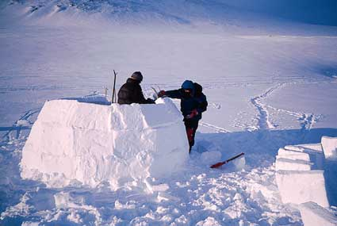
Image 10

Slide 17
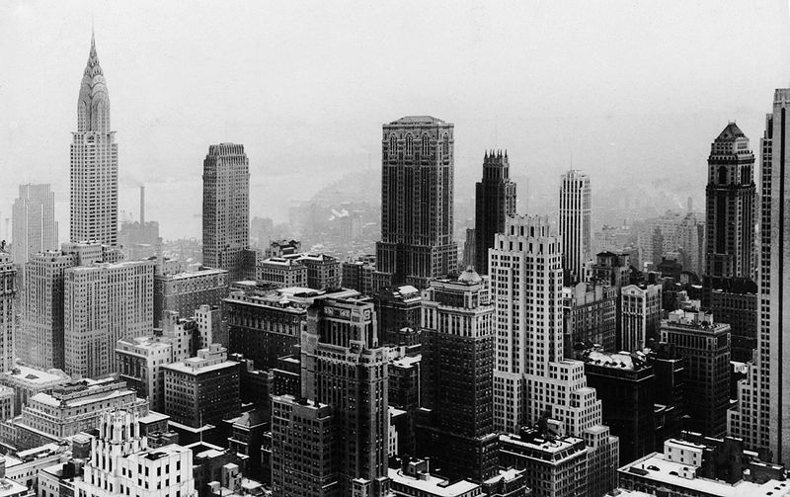
Image 11

Slide 18
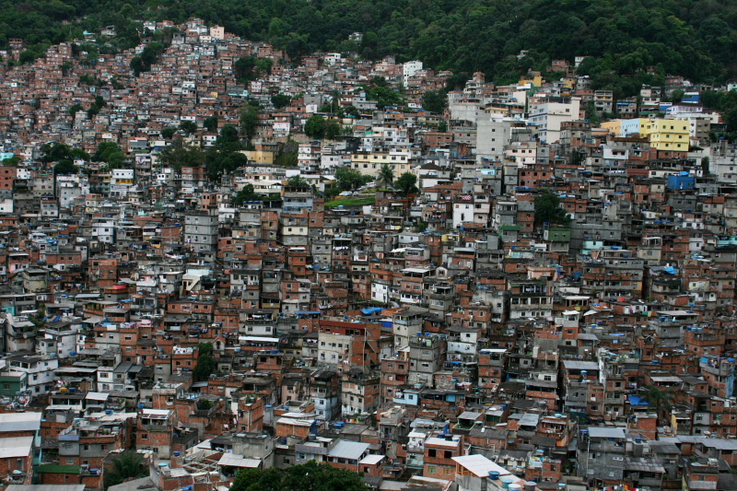
Image 12

Slide 19
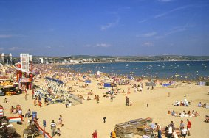
Image 13

Slide 20
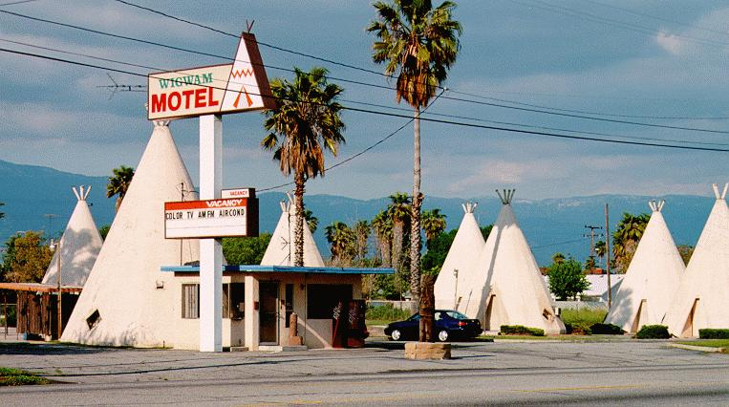
Image 14

Slide 21
Remember!
Settlements are places where people live and work.
There is many different types of settlement.
The land on which a settlement is built is called its site.

Slide 22
Site: The land that a settlement is built on.
But what makes a good site?

Slide 23
Site: The land that a settlement is built on.
Imagine you were alive hundreds of years ago and you had to choose a site for your settlement. What sort of things would be important to you?
(3 minutes discuss and write down)

Slide 24

Easy to defend?
Factors to consider when choosing a site for a settlement
Near water?

Slide 25

How did the first settlements start?

Slide 26
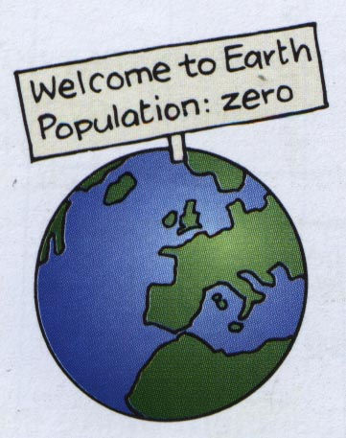
The Earth was empty for billions of years. But life evolved. And about 2 million years ago…

Slide 27
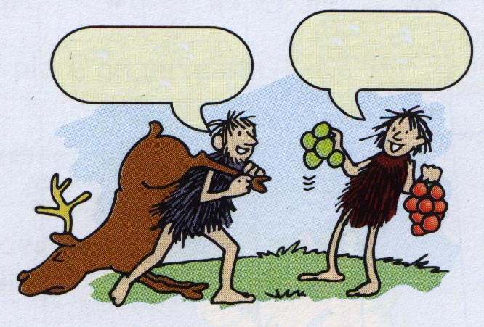
Look what we found!
Look what we found!
… our ancestors appeared. They lived by eating fruit and berries, and hunting…

Slide 28
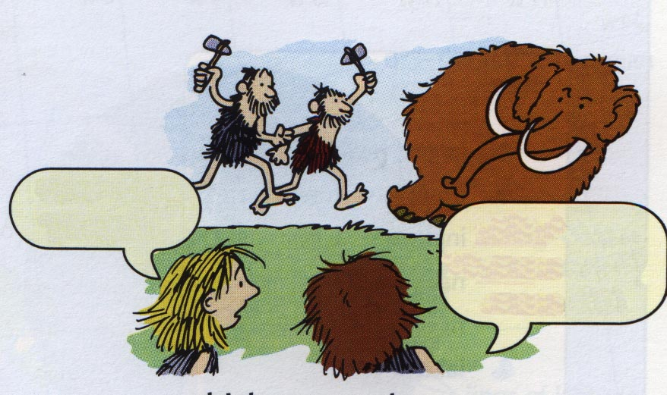
There they go again.
Oh please, not more woolly mammoth!
… which meant they were always on the move, chasing dinner…

Slide 29
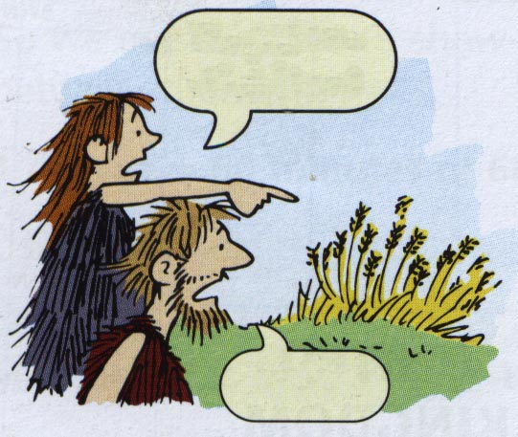
Do you see what I see?
What?
Then, one day, they noticed something amazing: where they dropped seeds, plants grew!

Slide 30
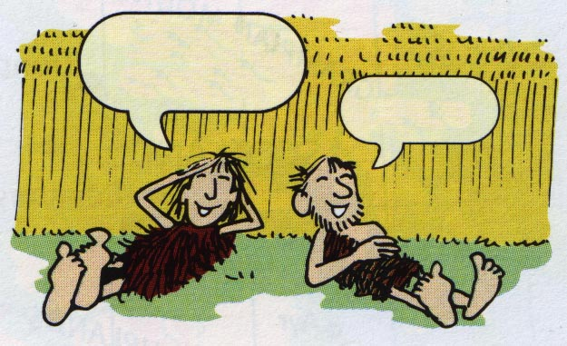
This is the life!
Urrrrrr
So they began to settle down in one place and grow their food. These were the first farmers.

Slide 31
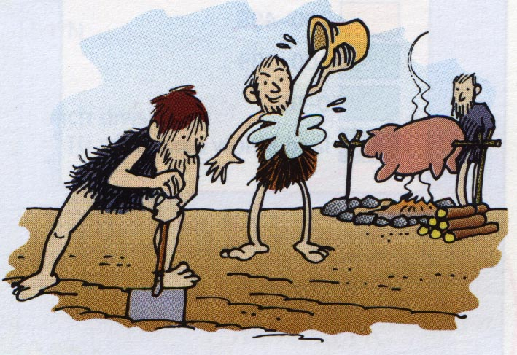
They chose a place for a site that had what they needed. Like good flat land… water… wood for fuel…

Slide 32
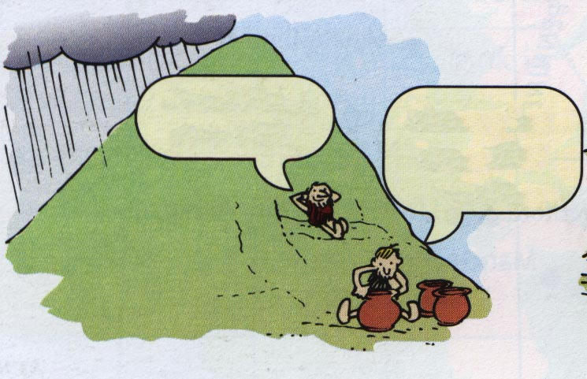
What a nice
day!
Some of us have work to do.
… shelter from the wind and rain… materials for making things (clay, sand, iron ore, tin…)

Slide 33
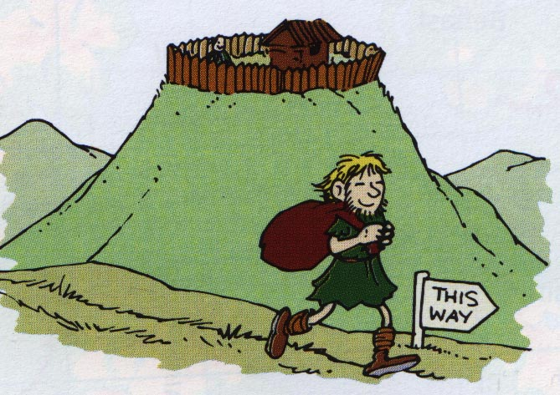
… easy access to other places for trading… and protection from their enemies.

Slide 34
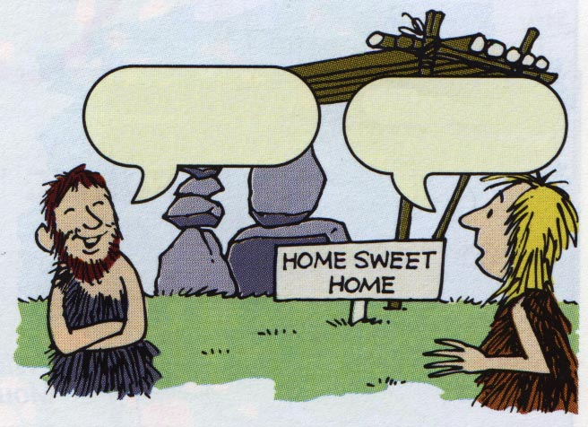
What do you think then?
What exactly is it?
They cleared the land and planted crops and put up dwellings. The result – a settlement.

Slide 35
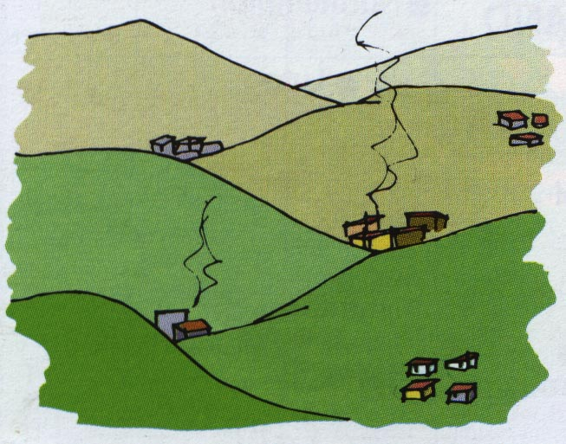
Years passed. The number of humans grew. More and more settlements appeared.

Slide 36
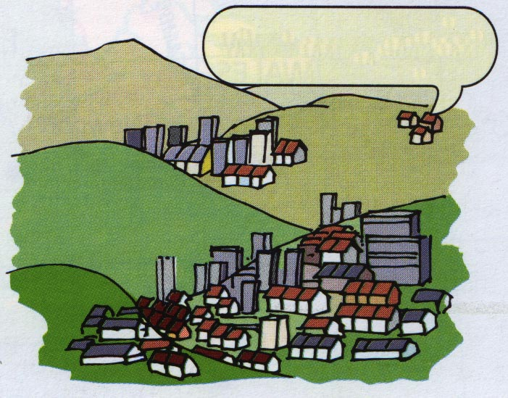
What’s wrong with us?
Some grew larger… and larger… and larger.

Slide 37
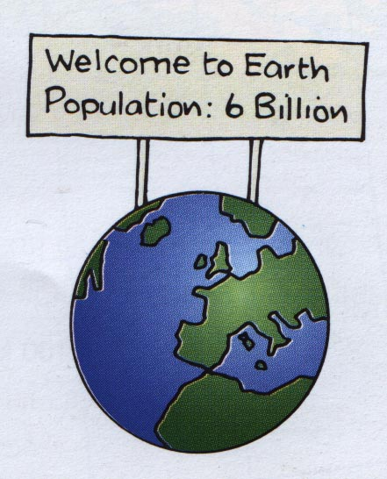
7
Now there are over 7 billion people on the earth, and half of them live in cities.

Slide 38
To be near woodland
Easy to defend
Factors to consider when choosing a site for a settlement
To be avoid marshland
To be near farmland (Fertile soil)
Near water

Slide 39
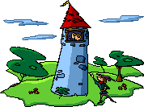
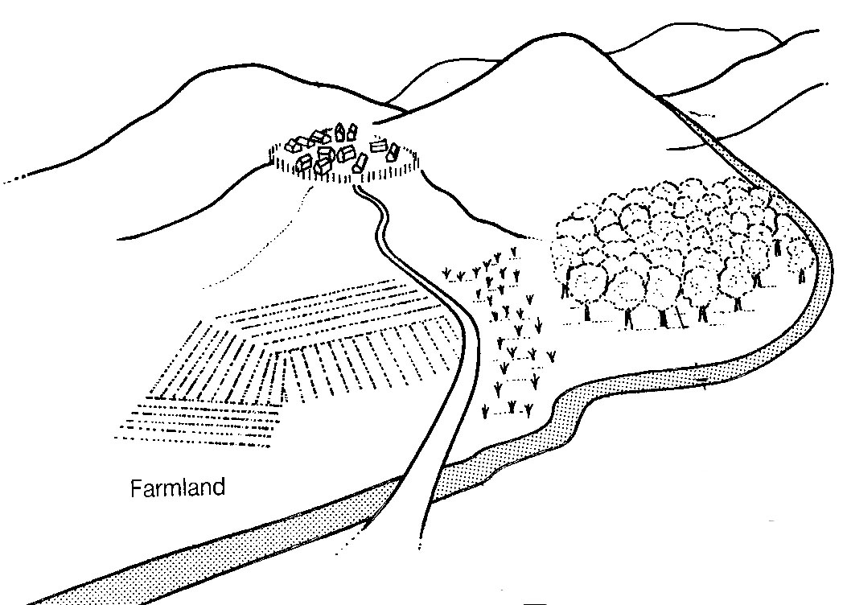

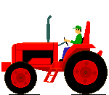

When people first built settlements hundreds of years ago, they chose things which provided the five things they needed the most :
Fuel and building materials
Sheltered
Good
defence
On dry land
Water supply
Farmland

Slide 40
How do you think that London has changed over the years to become a site with many advantages?
London was a route centre this meant that many people used it and it grew very quickly.

Slide 41
Route centre
A place where many roads/paths cross.
Many years ago this meant that it was the best place for trade to happen.

Slide 42
So far we have covered:
What a settlement is.
What a site is.
What makes a good site.
Reasons for the first sites coming about.
What a route centre is.

Slide 43
Today: Learning Intentions
To look at different types of settlements.
To learn what we mean by function
To find out why Glasgow first became a settlement.

Slide 44
Settlement Sizes
You get settlements of different sizes, from the very large to the very small

Slide 45
A settlement pyramid
Size
Frequency
Very large
Few
eg: Edinburgh
City
eg: Haddington
Town
eg: East Linton
Village
eg : Gladsmuir
Hamlet
Very small
Many

Slide 46
Other types of settlement
Isolated – A single house or dwelling (eg: farm house)
Megalopolis – A densely populated region with several major cities.

Slide 47

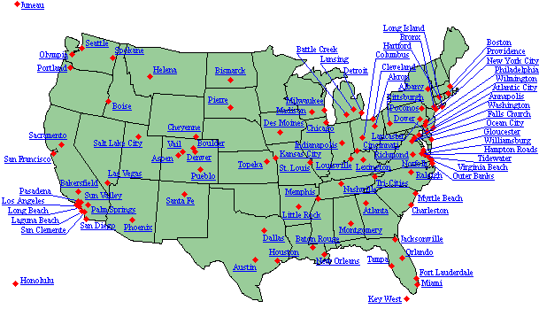
Megalopolis Example - Boswash

Slide 48
Function of a settlement.
The Function of a settlement:
  This is the economic function of a town.
  When settlements first came about they would usually only have one function.
  Over time they may have gained more functions and this is how large cities have grown.

Slide 49
Functions:
Who can think of a function for a settlement?
Market town
Industrial town
Port based settlement
Defensive stronghold
Tourist town/attraction (for example a costal town)

Slide 50
Learning intentions.
To learn how to use maps to identify sites and settlements.
To learn about different settlement shapes.

Slide 51
Sites on a map.
This is HARD!
You must look at all the information that you have been given (i.e what is on the map)

Slide 52
Defensive points:
On raised ground
Surrounded by water

Slide 53
Wet point sites
Beside water
Access to fresh water, streams + lakes.

Slide 54
Dry point site
On high ground close to water.
Marsh land below may be prone to flooding but high ground is not.

Slide 55
Transport routes/bridging points
All routes/roads go through there.
Possibly due to the landscape
Will be the only point to cross a river/stream.

Slide 56
Task
For each of the slides you are going to be shown:
Write what type of site you think it is and……..
The reason why you think this.

Slide 57
Nucleated settlements
Settlement is located with buildings grouped close to each other.
This may be for defensive or social reasons.
Makes it easy for settlement to grow and develop.

Slide 58
Dispersed settlement
Buildings are scattered.
Farm houses will be scattered around so it is easier to go from one to another.
No need to return to one point all the time.

Slide 59
Composite settlement
Is a mixture of both Nucleated and Dispersed.

Slide 60
Shaped on a map.
First off map basics!
4 Figure grid references.

Slide 61
Use the OS Map to find
An isolated settlement
A hamlet
A village
A town
Don’t forget to write a 4 or 6 figure grid reference with each example.

Slide 62
The growth of towns
A settlements functions are activities that take place there.
Smaller settlements have few functions (perhaps just a church, a shop, a public house etc…)
Bigger settlements have more functions, which is why more people choose to live in towns and cities.

