Slide 1

Databases
Unit 4.3.0

Slide 2

Objectives:
Candidates should have an understanding of how organizations use ICT, including
  sequential file systems (batch processing e.g. payroll);
  Indexed sequential & random access files (e.g. . payroll and personnel records.
  Relational database systems (e.g. customer database linked to sales records)
You should be able to describe these systems, giving the hardware and software requirements and examples of where they are used.

Slide 3

Background
Data is the lifeblood of most businesses and organizations. Why do they collect and store data?
  Because data is processed (sorted, filtered, searched) to give us

Slide 4

A database is a collection of data that is stored in an organized or logical manner so that data can be processed effectively or retrieved quickly and efficiently.
You should recall the following from GCSE:
  Tables
  Fields
  Records

Slide 5

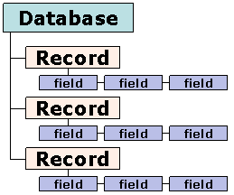
Databases and data storage
Some databases exist solely to process data automatically – for example databases held by utility companies
Some databases exist to give us information when we need it: for example, the school database.
The purpose of the database obviously affects the way that data is stored, organized and retrieved.

Slide 6
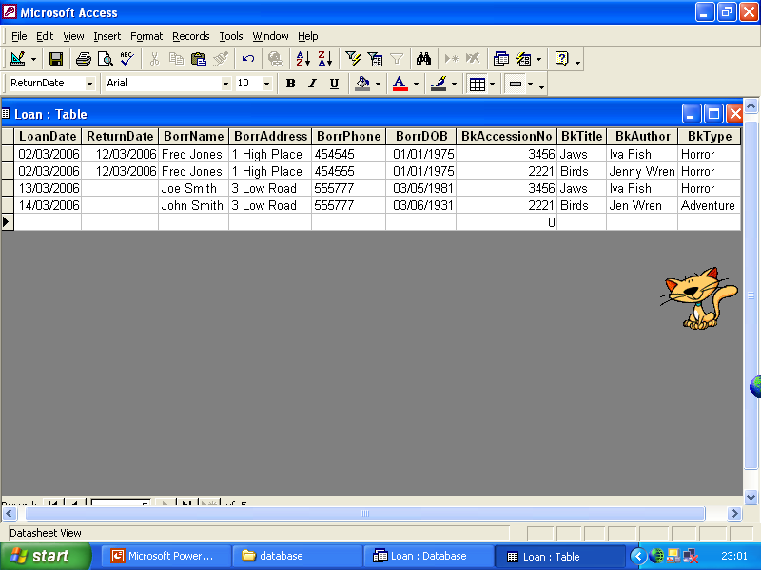
Different Person?
Which phone No is right?
Jargon
Inconsistent?
A Flat File is one data file containing a two dimensional table. It generally contains data duplication as each record is self contained.
Q. How many records are in this flat file?
A record is one row of a table and contains all the data related to a particular person or thing e.g. a loan record for Joe Smith
Q. How many fields are there in this flat file?
A field is one column of a table and contains one piece of data about a person or thing e.g BorrowerName
Why does the above flat file store data inefficiently?

Slide 7
Flat Files
A flat file may contain data duplication where the same data item is stored in two or more different locations.
Unnecessary duplication is known as data redundancy.
Redundancy often leads to inconsistency where the same data item is stored differently in different places. Eg BorrPhone 454545,454555 due to typing errors or being updated in one place but not another.
Flat files can be turned into more efficient related tables through a process of normalisation and put into a database

Slide 8
Separating data and making relationships
Take out any repeating groups of data and put them in a separate table.
Make sure one field is present in both tables to form a link or relationship between them.
Generally this field is unique to one of the tables (its primary key).
Separate tables only tend to contain data about one kind of thing.
Question: Identify the repeating groups in the flat file above.
It contains 2 repeating groups, what are they?
These details can be taken out into separate tables. What fields should be left behind in the original table?

Slide 9
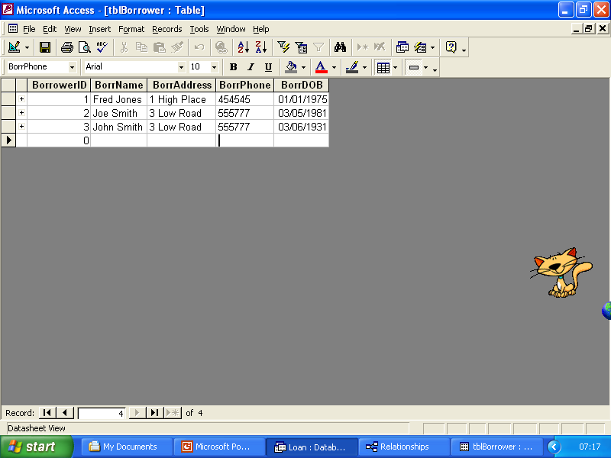
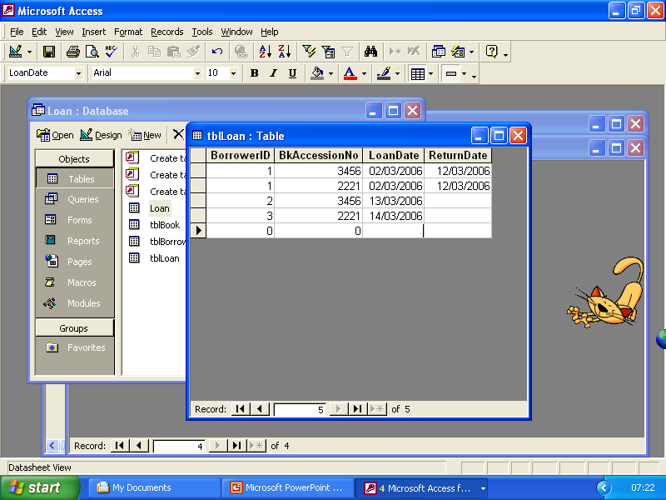
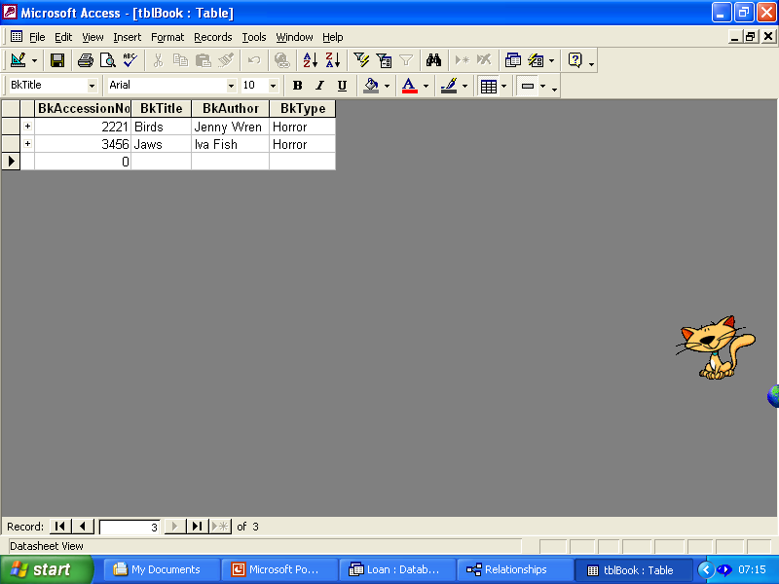
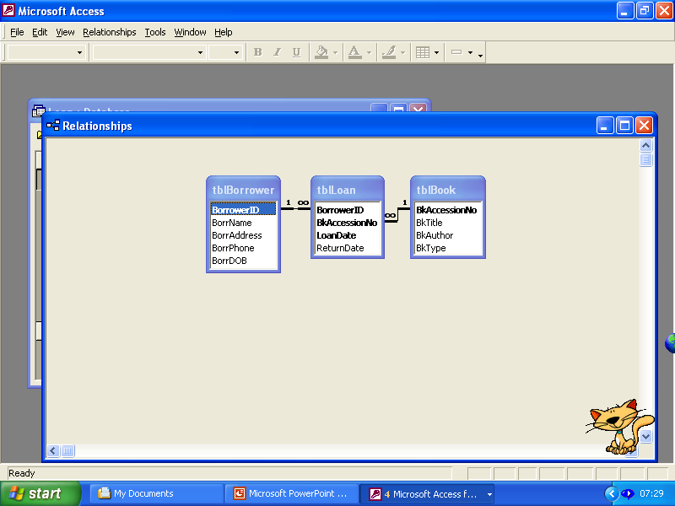
A Flat File becomes related tables
Original Loan Flat File
BORROWER TABLE
LOAN TABLE (Original)
BOOK TABLE
Relational Diagram
NB. Need to add borrowerID to give the borrower table a unique key.

Slide 10
Problems with the traditional file approach:-
Data redundancy - same data duplicated in many different files
Data inconsistency - when the same items of data are held in
several different files, the data should be updated in each file
when it changes (if not -> data inconsistency)
Program-data dependence - file format (i.e. which data fields
constitute a record) must be specified in each program.
Changes to the format of the data fields mean that every file
which uses that program has to be changed.
Lack of flexibility - for non-routine data it could take weeks to
assemble data from various files and write new programs to
produce the required reports
Non-sharable data - if two departments need the same data,
either a second copy of the data would be made (-> data
inconsistency) or the same file used (adding extra fields would
mean programs would need to be changed to reflect the new
file structure)

Slide 11
Relational databases
A relational database consists of a number of separate tables
For example a payroll table and a staff table
Tables are linked to each other…
… using a key field
For example the employee ID
This field is part of other table(s)
Data from one table combined with data from other table(s) when producing reports.
Can select different fields from each table for output
SQL is used for queries and producing reports

Slide 12
Advantages of relational databases over flat files
Tables are designed to reduce duplicate data to a minimum and therefore remove any redundant data
No redundant data means data only has to be input once ensuring faster data entry and consistency of data
Changes in the structure of the database do not affect programming that accesses other parts of the database. This is called Data Independence from the program. Eg Adding a new field called Gender to the Borrower table doesn’t mean you have to reprogram the Loans Report. (You would have to do this on a flat file)
Data Pool can be accessed by several different applications
Information held more than once (Key fields acting as links between tables) are automatically updated by the system
Increased productivity as users can use report generators to customise reports to meet particular needs.
Different access rights available for different parts of database

Slide 13

Disadvantages of relational databases over flat files
As all data for a range of applications is held in one place there are greater security and confidentiality issues.
  Eg Many users need to view and update different combinations of tables or records or fields in a database.
  Eg Very important to back up this data as all data will be lost if a natural disaster occurs.
Backup and restoration processes are more complex for databases than flat files

Slide 14
Relationship
A relationship is a link or association between entities
The links (relationships) may be...
one-to-one
Products and bar-codes in a supermarket.
one-to-many
One video club member may loan a number
of videos.
many-to-many
Pupils and Teachers in a school.

Slide 15



Entity-relationship diagram - diagrammatic way of representing the relationship between entities in a database.
An entity-relationship diagram shows the links between tables.
One-to-one | E.g. Products in a supermarket each have a unique barcode number.
One-to-many | E.g. A video club member may hire out a number of videos.
Many-to-many | Teachers and pupils in a school. Each teacher teaches many pupils and each pupil has many teachers.

Slide 16
DBMS
The DBMS (Database Management System) is a program which allows the user access to data.
It must...
allow users to create and edit the data and provide facilities to search the data using a query language.
allow other applications to use the data.
create and maintain the data dictionary

Slide 17
maintain the integrity of the database. On a multi-access system, this is done by locking a record or table when a user is editing it. This means that another user is unable to edit it at the same time. When the data is saved it is unlocked.
check passwords of individual users and only allow that user access to certain parts of the database.
ensure that recovery is possible if the database is corrupted.

Slide 18

Types of file organization
There are four types of file organization that you need to know about:
Serial
Sequential
Indexed Sequential
Direct /Random Access

Slide 19
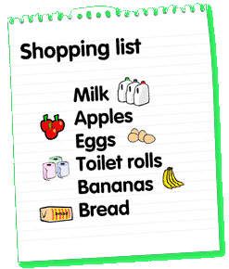
Serial File Organization
A serial file is one in which the records have been stored in the order in which they have arisen. They have not been sorted into any particular order.
A shopping list is an example of a non-computerised serial file.
    A collection of records
    No particular sequence

Slide 20
Serial files
An example of a serial file is an unsorted transaction file (more on this in a minute ☺).
Cannot be used as master
Used as temporary transaction file
Records stored in the order received

Slide 21

Sequential File Organization
A sequential file is one in which the records are stored in sorted order of one or more key fields.

Slide 22

Sequential File Organization
Sequential access means that data is accessed in a predetermined, ordered sequence.
Sequential access is sometimes the only way of accessing the data, for example if it is on a tape.

Slide 23
Sequential File Organization
It may also be the access method we need to use if the application requires processing a sequence of data elements in order.
Records are usually stored on tape and processed one after the other – for example when utility companies issue bills, or when businesses produce pay slips for their workers at the end of each month.

Slide 24
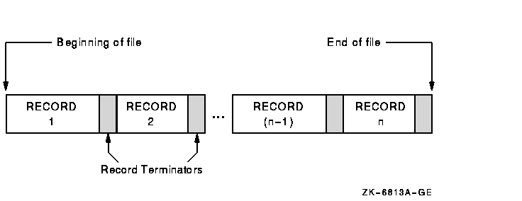
Sequential file

Slide 25

Sequential File Organization
A collection of records
Stored in key sequence
Adding/deleting record requires making new file (so that the sequence is maintained)
Used as master files

Slide 26

Master files & transaction files
Serial files are often used as transaction files.
Sequential files are used as master files.
  A company’s master file might hold all the data about every employee

Slide 27

  A transaction file might hold a list of all the employees who have gotten married this month and changed their names.

Slide 28
The master file would be read one record at a time
The transaction file would be used to update the master file
Potter
Federer
Cole
Windsor
Hermione Granger
Cheryl Tweedy
Britney Spears
Kate Middleton

Slide 29

Advantages
Simple file design
Very efficient when most of the records must be processed e.g. Payroll
Very efficient if the data has a natural order
Can be stored on inexpensive devices like magnetic tape.

Slide 30


Disadvantages
Entire file must be processed even if a single record is to be searched.
Transactions have to be sorted before processing
Overall processing is slow, because you have to go through each record until you get to the one you want!

Slide 31

Indexed sequential file
Each record of a file has a key field which uniquely identifies that record.
An index consists of keys and addresses, just like an index in a book:
  The pages in a book are stored sequentially, so you can read through it page by page
  OR
  You can look up the page you want
  in the index and flick straight to it

Slide 32

Indexed sequential file
An indexed sequential file is a sequential file (i.e. sorted into order of a key field) which has an index.
A full index to a file is one in which there is an entry for every record.
Because each record has an index, we can access individual records directly, without having to scroll through all the other records first.

Slide 33
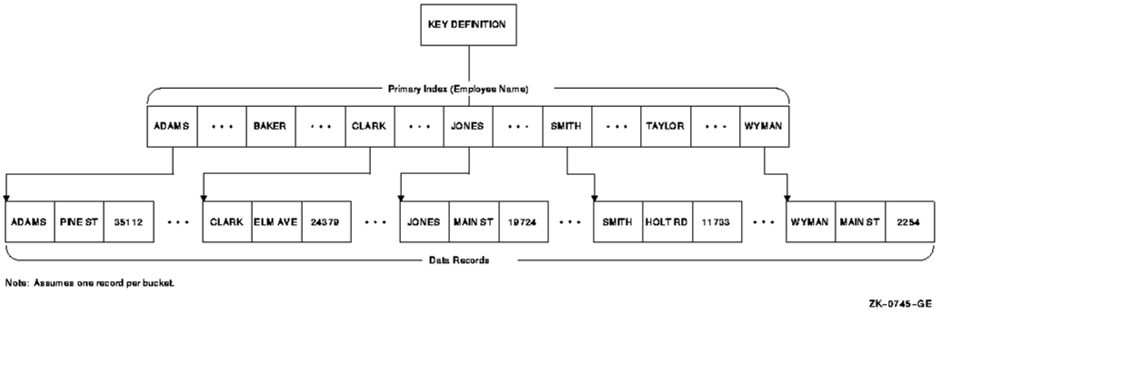
Indexed sequential file

Slide 34
Indexed sequential file
Indexed sequential files are important for applications where data needs to be accessed.....
  sequentially , one record after another
  OR
  randomly using the index.

Slide 35

An example of an Indexed Sequential file
A company may store details about its employees as an indexed sequential file. Sometimes the file is accessed....
sequentially. For example when the whole of the file is processed to produce pay slips at the end of the month.

Slide 36

An example of an Indexed Sequential file
Sometimes the file is accessed....
randomly. Maybe an employee changes address, or a female employee gets married and changes her surname.

Slide 37
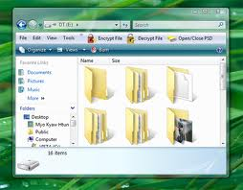
Indexed sequential file
An indexed sequential file can only be stored on a random access device e.g. magnetic disc or CD.
This is because we need a device that will allow us direct access to random files, rather than the sequential access that magnetic tape allows.

Slide 38

Advantages
Provides flexibility for users who need both type of access with the same file
Faster than sequential

Slide 39
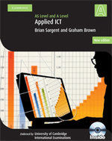
Disadvantages
Extra storage space for the index is required, just like in a book: your text book would be 372 pages without the index (go on, check!) but is 380 pages with the index.

Slide 40

Direct (Random) File Organization
Records are read directly from or written on to the file.
The records are stored at known address.
The address is calculated by applying a mathematical function to the key field.

Slide 41

Direct (Random) File Organization
A random file would have to be stored on a direct access backing storage medium e.g. magnetic disc, CD, DVD
Example : Any information retrieval system. Eg Train timetable system.

Slide 42
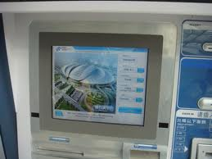
Advantages
Any record can be directly accessed.
Speed of record processing is very fast.
Up-to-date file because of online updating.
Concurrent processing is possible.

Slide 43

Disadvantages
More complex than sequential
Does not fully use memory locations
More security and backup problems

