Slide 1
Word Processing
Software
Notes:
Photo credit: © 2007 JupiterImagesCorporation

Slide 2
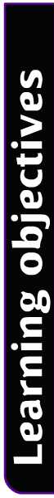

Learning objectives
Know the basic features of word processing software.
Be able to identify these features as they appear in a word processing document.
Understand what a spell checker does and why it is not 100% reliable.
Know some of the advanced features of word processors.
2 of 21

Slide 3
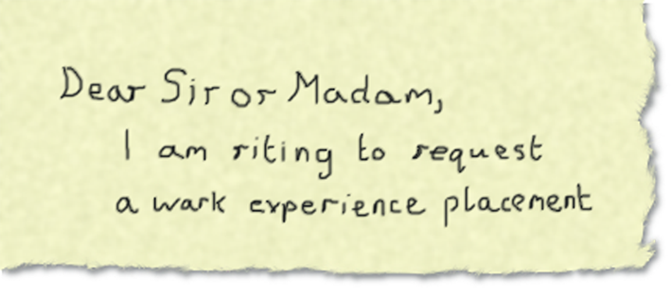
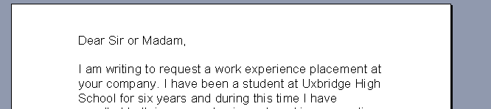
Word processing
Word processing is the software most people use for
text-based documents because it can turn this:
into this:
It’s still the same words, but now it looks so much better.

Slide 4
What are its basic features?
A word-processed document can be formatted (choosing the way the document looks) by:
changing the font size, style and colour of the words
laying text out in tables or columns
making lists like this one using bullets or numbers
adding pictures and borders
adding headings that automatically appear on every page (headers)
adding page numbers and footnotes.

Slide 5
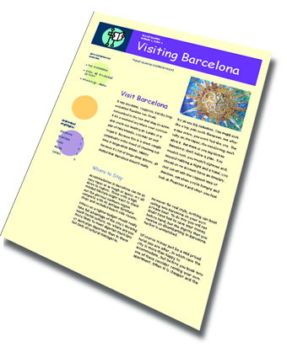
Columns
You can arrange the way the text on your document is laid out by splitting it into columns.
This is useful when you are making a newsletter with lots of information in it.

Slide 6
Bullets and numbering
Making a list with numbers or bullet points is a good way of making information easy to follow.
You can even change the way the bullet looks, choosing circles, squares, arrows or even your own picture. You can choose different ways of numbering lists too.
Box bullet
Numbered list
Circle Bullet
Coloured Roman numeral
Picture bullet
Lower case Roman numeral
Symbol bullet
Coloured letter
Tick bullet
Letters in brackets

Slide 7
Alignment
Aligning text controls where it appears on the page.
This text is aligned left, which is the format used on most body text.
Centred text is often used for headings and titles.
Right align is mostly used for addresses in letters.
Justify aligns the text on both the right and left edges by altering the spaces between the words and characters, so that the document appears straight on both sides, like this.

Slide 8
Altering text
As well as changing where your text is positioned on the page, you can alter the format of the text.
You can choose:
and size of the text.
font
colour
The most commonly used formats are bold, italic and
underline, although there are many other decorative options
such as shadow and emboss.
One useful feature is ^{superscript}, where some of the text
is made smaller and positioned above the usual line. This is
used mostly in maths and science. X² and °C are good examples.

Slide 9
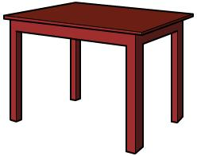
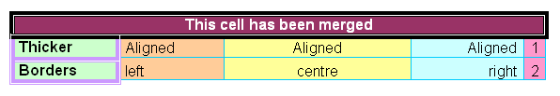
Making tables
Creating tables is easy in a word processing document but you need to be sure you create the right table to suit your purpose.
You need to choose the number of rows and columns and also set the size of them so they best display your data.
The table can be set to automatically adjust to fit your text. You can choose text alignment and use sort functions to arrange the data. Merging and shading cells and changing the colours and thickness of the borders allows you to create a really attractive table to display your data.

Slide 10
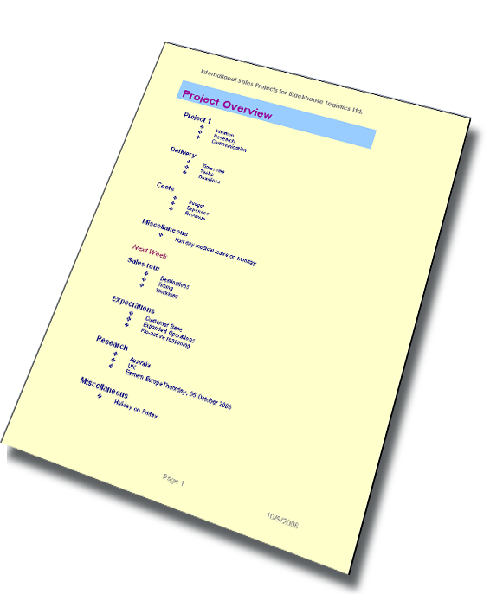
Headers and footers
Headers and footers are blank spaces that sit at the top and bottom of the document. You can write what you like in them and they will appear on every page. You could include your name, the date and the page number.
Header with
company name
Footer with page
number and date
Your computer can automatically work out the
date and page number for you.

Slide 11
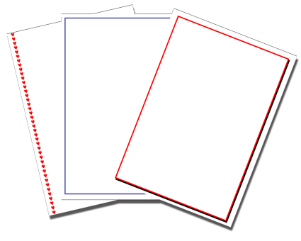
Margins and borders
If you look at a book you’ll notice that the writing inside doesn’t reach the edge of the page. Margins are the spaces that surround the edge of your text.
Borders can be added to the whole page or just some of the text. The borders can have different appearances. They can:
  have lines around them.
  have an embossed effect so that the work looks like it is standing out (3D)
  be made up of pictures instead of lines.

Slide 12
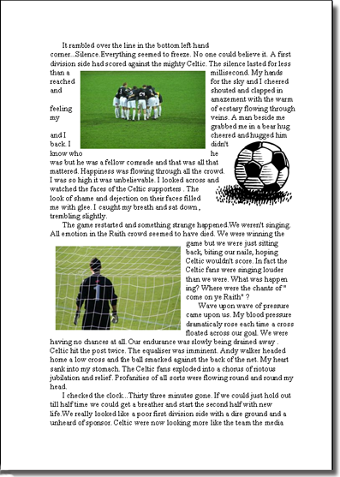
Pictures
Word processors allow you to insert images into your work, and then move them around and resize them.
If you don’t have your own image, word processors have their own library of images built into the program. This is called clip art.
Word wrap can be used to arrange words around images.

Slide 13

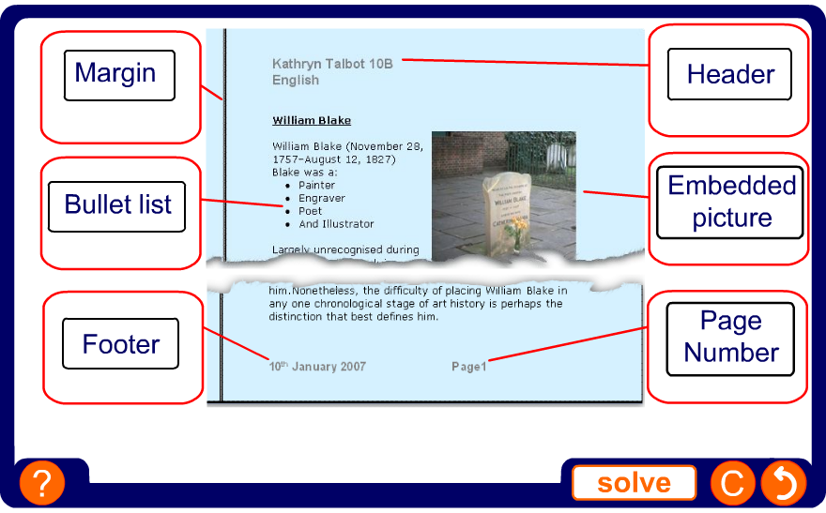
Identify the features

Slide 14

Using the tools
Word processors allow you to select text and then to use
the cut, copy and paste functions.
Cut – removes the text from the page and places it on a clipboard. A clipboard is a simple program designed to hold small pieces of data for short periods of time.
Copy – also places the text on the clipboard, but without
removing the original from the document.
Paste – retrieves the text from the clipboard and places it
back into the document. Paste does not remove the text
from the clipboard so you can paste in the same piece of
text over and over again.

Slide 15
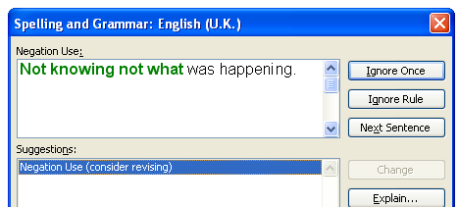
Editing and checking
A benefit of using word processing software is that documents can be edited. Editing means to look over a document and rethink it and correct it.
The software comes with a dictionary which will spell check the document. Words can usually be added to the dictionary.
A grammar check can be done which will look at the way each sentence is written. Suggestions are made if the grammar does not comply to the set of rules programmed into the software.
The thesaurus is a very useful feature. When you prefer not to use a certain word, the thesaurus can suggest an alternative.

Slide 16
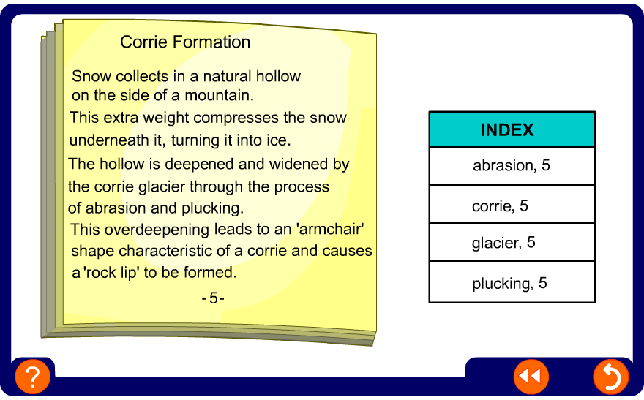
Indexing

Slide 17
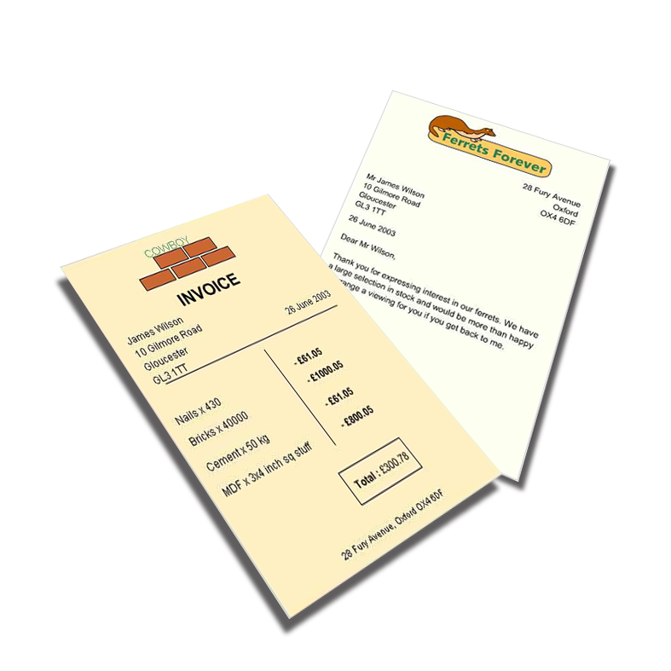
What can it be used for?
Word processors are used in producing just about any kind of document:
Letters, invoices
and memos
Essays
Reports
What others can you think of?

Slide 18
Summary
Word processing software is most commonly used for text-based documents.
Documents can be formatted and different fonts and font styles used.
Documents can be edited with the help of tools such as spell and grammar check.
A number of features, including setting styles and templates, ensure consistency within documents.
Tables can be added and formatted in many different ways.
Other features, such as mail merge and producing a table of contents or an index, can save users a lot of time and improve the presentation of documents.

