Slide 1
Bar Graphs Line Graphs & Picto-Graphs
Tables, charts and graphs are convenient ways to clearly show your data.

Slide 2
The cafeteria wanted to collect data on how much milk was sold in 1 week. The table below shows the results. We are going to take this data and display it in 3 different types of graphs.

Slide 3
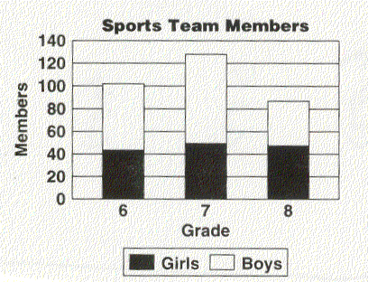
Scale / Intervals
Counting by a number is the scale of a graph. Scales can be counting by 2’s, 3’s,4’s, 5’s 10’s …
Intervals should be equal. Like 100, 200, 300 units.

Slide 4
Bar Graph
A bar graph is used to show relationships between groups.
The two items being compared do not need to affect each other.
It's a fast way to show big differences. Notice how easy it is to read a bar graph.

Slide 5
Line Graph
A line graph is used to show continuing data; how one thing is affected by another.
It's clear to see how things are going by the rises and falls a line graph shows.

Slide 6
Bar Graph
The same data displayed in 3 different types of graphs.
Circle (Pie) Graph
Line Graph

Slide 7
On what day did they sell the most chocolate milk?
Wednesday

Slide 8
On what day did they have a drop in chocolate milk sales?
Thursday

Slide 9
Choosing the Right Graph
Use a bar graph if you are not looking for trends (or patterns) over time; and the items (or categories) are not parts of a whole.
Use a line graph if you need to see how a quantity has changed over time. Line graphs enable us to find trends (or patterns) over time.

Slide 10
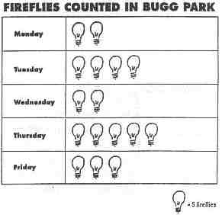
Pictograph
Days of the Week
Fireflies

Slide 11
Pictograph
All pictographs have a title.
Rows and columns shape the pictograph.
Label each row and column.
Use pictures to show the data.
Each picture equals a certain amount of data.
Pictographs need a key.

Slide 12
Name that graph

Slide 13
Double Bar Graph
The purpose of a double bar graph is to compare two or more sets of data.
Uses bars to show the data.
Double bar graphs must include:
- Title
- Labeled X and Y axes
- Equal intervals are used on the Y axis
- Pairs of bars are equally spaced, but the compared bars are not
- Key

Slide 14
Name that Graph

Slide 15
Double Line Graph
A double line graph is used to compare two groups of related data over time.
Double line graphs need:
- Title
- Labeled X and Y axes
- Equal Intervals
- Data displayed by points connected into lines
- Key

Slide 16
Bar Graph
The purpose of a bar graph is to display and compare data.
Bar graphs use bars to show the data.
A bar graph must include:
- a title
- labeled X and Y axes
- equal intervals are used on the Y axis
- the bars are evenly spaced apart from each other

Slide 17
Line Graph
A line graph is used to illustrate change over time.
Line graphs need:
- Title
- Labeled X and Y axes
- Equal Intervals
- Data displayed by points connected into lines

Slide 18
Bar Graphs Line Graphs & Picto-Graphs
Tables, charts and graphs are convenient ways to clearly show your data.

