Slide 1
Computer Security

Slide 2

Computer Crime and Cybercrime
Computer crimes occur when intruders gain unauthorized access to computer systems
Cybercrime is crime carried out over the Internet
Cyberlaw tracks and combats computer related crime

Slide 3

Computer Crime and Cybercrime
Types of Computer Crime
  Identity Theft
  Computer Viruses
  More Rogue Programs
  Fraud and Theft
  Forgery
  Blackmail

Slide 4
Identity Theft
Identity theft – dishonestly taking the identity details of another person (i.e. name, date of birth, current or previous address) without their consent.
How identity theft is executed
Searching trash bins for documents of individuals. Can use individuals credit or debit card statements to get a person’s bank account details then use it to gain access to one’s account.

Slide 5
Look over people’s shoulders as they are filling in application forms
Listening to phone conversations where personal details are discussed in public
Picking credit or debit card receipts that have been thrown away by individuals
Use of skimming devices – a card can be swiped through a legal device and immediately swiped through another, “skimming device” that records and stores one’s details

Slide 6
Computer Viruses
A Computer virus is a hidden code within a program that may damage or destroy the infected files.
Viruses replicate and attach themselves to programs in the system
There are more than 20,000 different computer viruses with the number growing daily

Slide 7
Phishing refers to the act of a “phisher” sending e-mails or setting up a Web site that appears to be from a legitimate company in an attempt to obtain personal information such as your social security number, user name, password, or account numbers. Because the communication looks legitimate, you may comply, thus providing the phisher with access to your accounts.
Spear phishing, similar to phishing, also uses fake e-mails and social engineering to trick recipients into providing personal information to enable identity theft; however, spear phishing attempts are targeted to specific people rather than randomly.

Slide 8
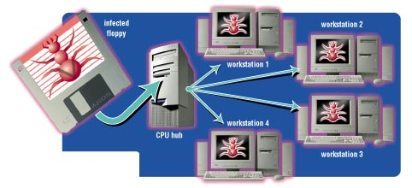
How Virus Infections Spread
Virus Infections spread by:
  Inserting a disk with an infected program and then starting the program
  Downloading an infected program from the Internet
  Being on a network with an infected computer
  Opening an infected e-mail attachment

Slide 9
Types of Viruses
File Infectors
  Attach themselves to program files
  Spread to other programs on the hard drive when the program is executed
  Are the most common type of virus
Boot Sector Viruses
  Attach themselves to the boot sector of a hard drive
  Execute each time the computer is started
  May lead to the destruction of all data

Slide 10
Types of Viruses
Macro Viruses
  Take advantage of the automatic command capabilities created by macros
  Attach themselves to the data files in word processing, spreadsheet, and database programs
  Spread when the data files are exchanged between users

Slide 11

More Rogue Programs
Time Bombs
  Also called logic bombs
  Harmless until a certain event or circumstance activates the program
Worms
  Resemble a virus
  Spread from one computer to another over computer network.
  Control and use the resources of infected computers to attack other networked computers

Slide 12

More Rogue Programs
Denial of Service Attack (DoS)
  Also called Syn flooding
  Overload an Internet server with a large number of requests
Trojan Horses
  cover up themselves as useful programs
  Contain hidden instructions to perform malicious tasks
  May erase data or cause other damage

Slide 13

Fraud and Theft
Salami Shaving
  Programmer alters a program to take a small amount of money out of an account
Data Diddling
  Data is altered to hide theft
  Insiders modify data by altering accounts

Slide 14
Forgery and Blackmail
Forgery
  Internet data can appear to be coming from one source when its really coming from another
  Forged e-mail and Web pages
Blackmail
  Confronting publicity fears have been used to blackmail financial institutions

Slide 15
Meet the Attackers
Hackers
  Computer hobbyists
  Find weaknesses and loopholes in computer systems
  Rarely destructive
  Adhere to the hacker’s code of ethics
Crackers
  Also called black hats
  Obsessed with entering secure computer systems
  Rarely destructive
  Leave calling cards on the systems they enter

Slide 16
Meet the Attackers
Virus Authors
  Usually teenage males
  Push the boundaries of antivirus software
  Create viruses that are very damaging
Cyber Gangs
  Group of hackers and crackers working together to coordinate attacks on the Internet

Slide 17
More Attackers
Swindlers
  Use the Internet to scam money from people
  Typically create bogus work at home opportunities, illegal pyramid scheme, chain letters, get rich quick scheme, etc.

Slide 18
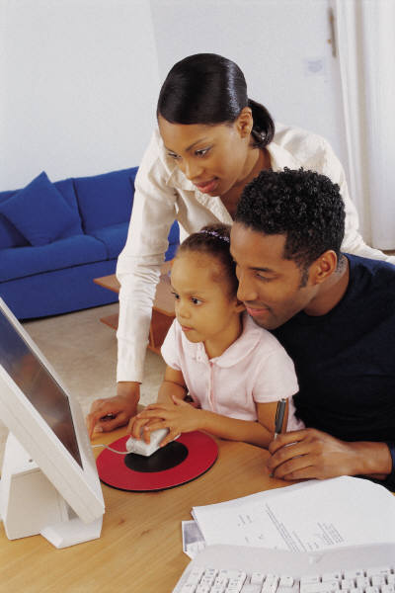
More Attackers
Shills
  Use Internet auctions
  Secret operatives who bid on a seller’s item to drive up the bid
Cyberstalkers and Sexual Predators
  Using the Internet to repeatedly harass or threaten
  Children are at risk from sexual predators

Slide 19
Encryption
Encryption is the coding and scrambling process by which a message is made unreadable except by the intended recipient
Encryption is needed for electronic commerce
The potential for encryption's misuse troubles law enforcement officials

Slide 20
Encryption Basics
I LOVE YOU
A readable message is called plaintext
An encryption key is a formula used to make plaintext unreadable
The coded message is called ciphertext
An encryption technique called rot-13 is used in chat rooms and Usenet discussions
V YBIR LBH

Slide 21
Encryption Basics
Symmetric key encryption are encryption techniques that use the same key to encrypt and decrypt a message
Strong encryption refers to encryption methods that are used by banks and military agencies and are nearly impossible to break

Slide 22
The Problem of Key Interception
Rot-13 is not a secure encryption system
Symmetric key encryption systems are vulnerable to key interception, or having their key stolen

Slide 23
Public Key Encryption
Public key encryption uses two different keys
  Public key is the encryption key
  Private key is the decryption key
They are used in e-commerce transactions
A secure channel for information is provided when the keys are used

Slide 24
Digital Signatures and Certificates
Public key can be used to implement digital signature
Digital signatures are a technique used to guarantee that a message has not been tampered with
Digital certificates are a technique used to validate one’s identity
Secure Electronic Transactions (SET) are online shopping security standards used to protect merchants and customers from credit card fraud

Slide 25
Summary
Many websites collect and store information about Web users
Cookies and GUIDs are used to collect data
Computer crime and cybercrime
  Identity theft
  Computer viruses
  Rogue programs
  Forgery
  Blackmail

Slide 26
Summary
Computer criminals
  Crackers
  Cybergangs
  Virus authors
  Swindlers
  Shills
  Cyberstalkers
Encryption refers to coding or scrambling data
Thank you.

