Slide 1
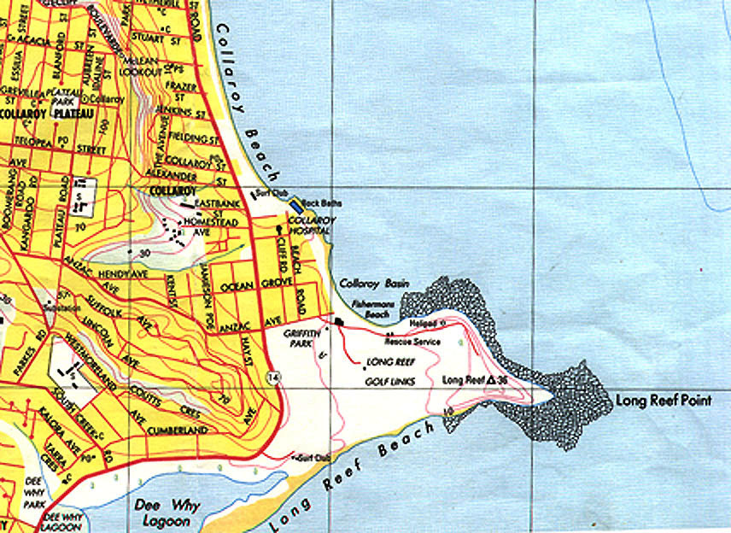
Map Reading
&
Navigation

Slide 2
Presentation Overview
Types of maps used within SES
How to use various maps
  Scale, Grid references, Ground shape, Gradient etc
Compasses & Bearings
Cross country navigation
Remote area preparedness – (supplement)

Slide 3
Aim of Map Reading...
To navigate & recognise features on the ground & map.
To picture the ground even though it hasn’t been seen, and.
To understand and pass information quickly.
Determine and plan a safe route.

Slide 4
Definition of a Map…
Its a scaled representation of the earths surface shown on a plane surface.
It shows natural and/or artificial features.
Used as a form of communication, used to convey land features.
However, its only accurate at time of aerial photo or field revision.

Slide 5

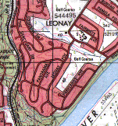
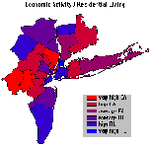
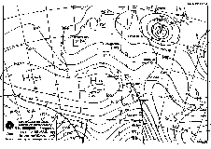
Types of Maps...
Street directory
Topographic map
Thematic
Scientific
Mud Map

Slide 6

Street Directory
Edition
Key map
Suburb index
Facility index
Street index
Map & reference

Slide 7
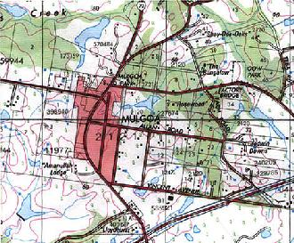
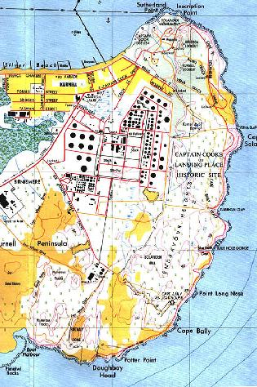
Topographic Maps

Slide 8
Map Care & Folding…
Deterioration - dirt, grime, pens/markers & unnecessary opening & folding.
Protecting the map - map case, clear contact, plastic bag or map boards.
Map folding
    Fold in half (detail facing outward)
    Concertina into equal sections
    Fold in half (title showing)
TIP
Don’t fully open maps in
the wind or in
the vehicle.

Slide 9


Marginal Information...
Printed around the margin of the map to aid in using the map.
E.g.. Title, scale, type, legend of symbols, edition & sheet number, adjoining maps, contour interval, magnetic variation, grid reference block,

Slide 10
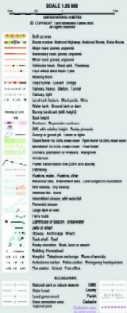
Conventional Symbols…
Water features
Structures
Boundaries
Road & Rail
Land features

Slide 11
Mapping Datum
All mapping & coordinate systems are based on a datum
It’s a mathematical surface (overlay) that best fits the shape of the earth.
AGD66 = Aust Geodetic Datum 1966 – Aust region only
AGD84 = Updated version of AGD66 - USED ON 2ND EDITION TOPO MAPS
TIP
See map for datum
conversions
GDA94 = Geocentric Datum of Australia
- Adopted cause it best fits the earths surface as a whole
- USED ON 3RD EDITION TOPO MAPS
WGS84 = Used for Satellite based navigation
WGS84 & GDA94 for practical purposes are the same

Slide 12

Scale…
Scale is expressed in 3 methods.
  In words (One cm = One km)
  Representative fraction. (RF)
    1:25000 E.g 1cm = 25000cm or 250m.
    TRICK - REMOVE LAST 2 ZEROS TO GET
    ACTUAL SIZE ON GROUND IN METRES
    1:10,000 to 1:100,000 are small scale
    1:250,000 to 1:10 million are large scales
  Linear scale - scaled ruler.
TIP
As the second number increases,
detail shown on the
map decreases

Slide 13
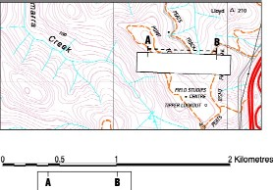
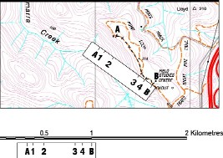
Measuring Distance…
Measuring straight line distance (map)
  Paper
  Divider
  Ruler
Measuring distance along a road/track (map)
  Curved paper
  Length of string

Slide 14
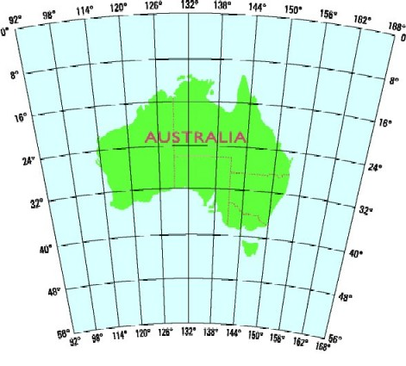
Map Coordinates
2 Types
  Geographical coordinates given as latitude and longitude
  Grid coordinates given as Eastings & Northings
Latitude & Longitude
Uses degrees, minutes, minutes
  Each degrees & minutes is divided into 60 graduations
Horizontal lines (Parallels of latitude)
  (N or S of equator)
Vertical lines (Meridians of longitude)
  (E or W of Greenwich)
S31⁰ 51’ 0” E115⁰ 54’ 3”
Note: All Australian Lat & Long coord’s are south & east

Slide 15
Grid Coordinates
Used to accurately locate/position objects on a map.
Two sets of numbered parallel lines (vertical & horizontal) intersecting at right angles to form squares on a map.
Superimposed over the map to provide a reference system.
Grid squares are generally 1km^{2.}
Grid lines are defined as ‘Eastings’ & ‘Northings.’

Slide 16
Cont’…
TIP
Across first, then up
Or
E before N
Eastings are the vertical lines, numbered left to right.
99 00 01 02 03
03
02
01
00
99
Northings are the horizontal lines numbered bottom to top.
Read ‘Eastings’ first, then ‘Northings’.

Slide 17
4 Figure Area References…
The co-ordinates represent the whole square, not just the single point.
E.G 1201 - represents 1km²
Find ‘12 easting’ first.
Find ‘01 northing’ second.
11 12 13
03
02
01
00

Slide 18
6 & 8 Figure Grid References…
A 6 figure reference is 1/100th the size of a 4 figure reference.
  E.G 122016 - represents 100m²
12 13
1 2 3 4 5 6 7 8 9
02
9
8
7
6
5
4
3
2
1
01
8 Figure Grid References
Romers

Slide 19
GPS…
Global Positioning System (satellite based navigation)
  Features included:
    Your position on the Earth’s surface
    Your current height - ASL
    Your speed and direction of travel
    Lat/Long or UTM
    Different world datums
      WGS84
Developed by US Defence system
Uses 24 satellites orbiting the Earth twice a day
Signal doesn’t penetrate buildings or thick scrub.
Uses triangulation principle to pinpoint location.
Minimum of 4 satellites are needed for an accurate 3D position
Typical accuracy is within 30m - 95% of the time
Interfaces with your PC and mapping software
Consult users guide for operating instructions

Slide 20
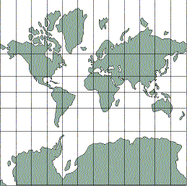
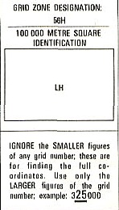
Universal Grid References…
Also known as UTM – Universal transverse Mercator
A grid system is superimposed over the world map.
Each square is uniquely identified. E.G 56h
Every square is further bisected by another 100 squares. E.G 56hlh
So forth until the squares are bisected into 100sq metres.
E.G 56hlh10
    56hlh1201
    56hlh122016

Slide 21
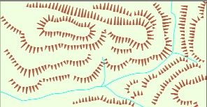
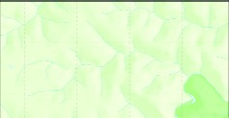
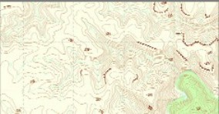
Ground Shape…
Allows the user to visualise the surroundings
Ground shape is referred to as relief.
Relief can be shown as:
  Hachures
  Hill shading &
  Contours

Slide 22
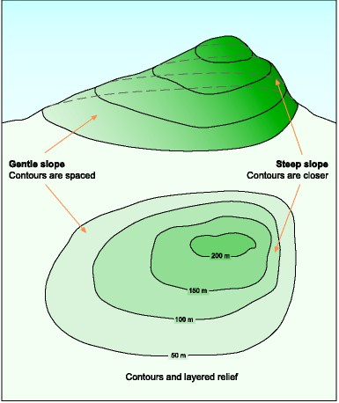
Contours…
A contour is a line that joins points of equal elevation
Contour interval is the vertical distance between contour lines
See legend for contour interval

Slide 23
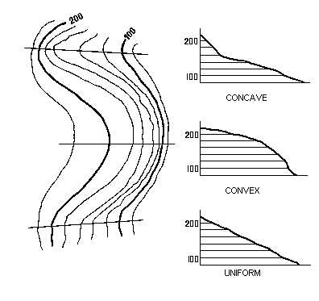
Contour Patterns…
Contour lines close together show steep slopes
Contour lines far apart show gentle slopes
Contour lines evenly spaced show uniform slope
If the spacing decreases when going from high to low, the slope is convex
If the spacing increases when going from high to low, the slope is concave

Slide 24
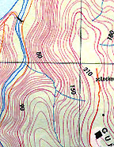
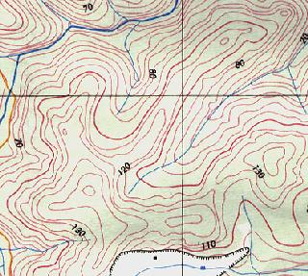
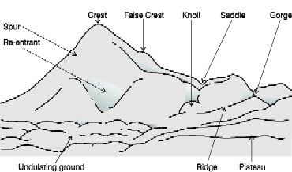
Land Features…
Representation of height
  Bench mark, trig station, spot height
Physical features
  Knoll
  Saddle
  Spur, ridge
  Valley, gorge
  Escarpment
  Re-entrant
  Crest
  Plateau

Slide 25
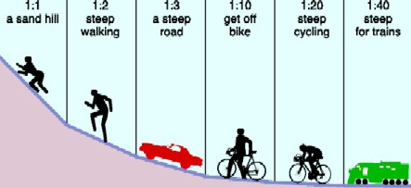
Gradient…
A method of expressing ground slope.
Gradient = Contour interval (height)
  ^{Horizontal Distance}
  1:10 = 1 unit up or down / 10 units across.
  1:1 is a 45⁰
  Simplify to smallest fraction = 20 = 1 = 1:6
  ¹²⁰ ⁶

Slide 26
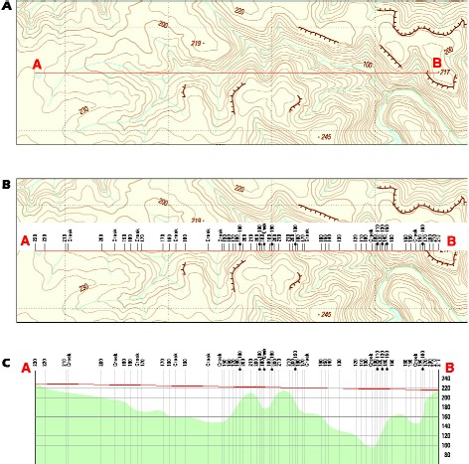
Intervisibility – Line of sight
Used to determine the location of radio repeaters (particularly VHF) & fire lookout towers

Slide 27
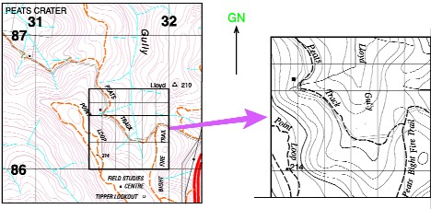
Map Enlarging
Map enlarging produces a portion of map at a larger scale. (see learners guide)

Slide 28
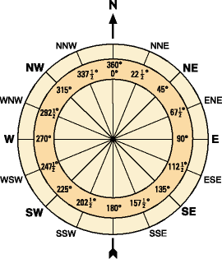
Compass…
Degree system - (360⁰ circle)
  North = 0/360⁰
  South = 180⁰
  East = 90⁰
  West = 270⁰
Cardinal points
  32 in total,
  only 16 are used.

Slide 29
Bearings…
The purpose of a bearing is to give an accurate indication of direction from one point to another.
Simply, a bearing is an angle.
It is the angle measured clockwise from a fixed zero line, generally north.
Grid bearings
  Used when bearings are taken from or to the map.
Magnetic bearings
  Used in conjunction with a compass. This type of bearing is for field operation.
Bearings are measured using a protractor or compass.

Slide 30
Bearings - Cont’
N
A
X
31
B
0a = 37 0
0b = 75
AB = 31 if ‘A’ is specified
0c = 304
N
C
304
0
N
A
37
0
N
75 b
0

Slide 31
North Points…
True north - TN
  Earth spins on this axis
Magnetic north - MN
  Compass needle points to magnetic north
  Its a location in the far north of Canada
Grid north – GN
  The vertical lines overlayed on a map point to grid north – (eastings)
  Not exactly true north.
  Difference between TN & GN is called convergence
In map reading we only use GN & MN

Slide 32
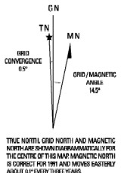
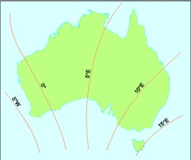
Magnetic Variation…
The difference between ‘grid north’ & ‘magnetic north’ is called magnetic variation.
The magnetic north pole is not fixed, it moves continually
Easterly & westerly variation
Check map for accuracy of variation

Slide 33
Converting Bearings
Mag’ bearings must be converted to Grid bearings for plotting.
Grid Bearings taken from map must be converted to Mag’ for compass work
To convert bearings – simply add or subtract variation
GMS = Grid to Magnetic – Subtract (GrandMa Sux)
MGA = Magnetic to Grid – Add (My Green Apple)
Grid bearings are always larger than a magnetic bearing with an easterly variation

Slide 34
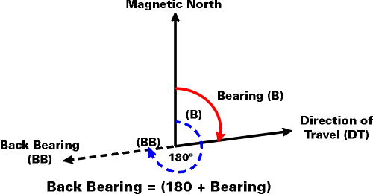
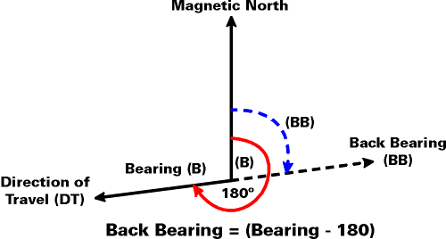
Back Bearings…
A back bearing is the bearing immediately opposite the current bearing
Add 180⁰ if bearing is smaller than 180⁰
Subtract 180⁰ if bearing is larger than 180⁰
Reversing compass

Slide 35

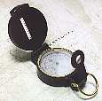
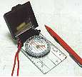
Compasses…
Many types & shapes.
  Prismatic, reflective & Silva
Consist of
  Magnetised needle
  A non ferrous or plastic box
  A graduated 360⁰ circle and
  Sometimes an aiming point

Slide 36
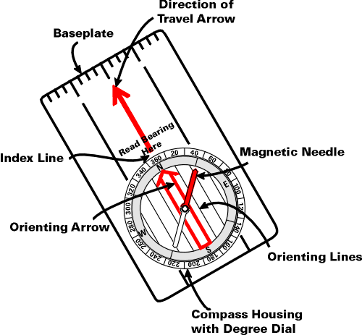
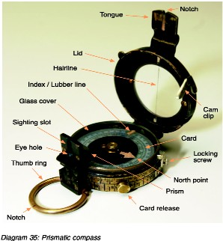
Parts of a Compass…
Silva Compass
Prismatic Compass

Slide 37
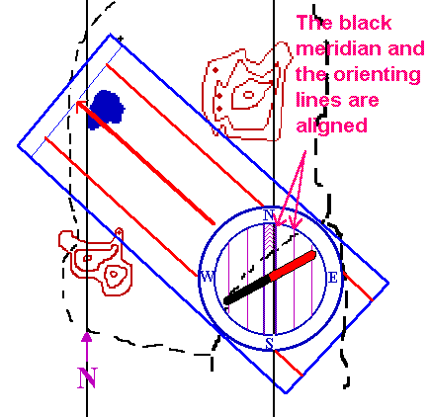
Taking a Grid Bearing…
Using a compass & map.
  Place edge of compass along intended bearing.
  Direction arrow points the way you want to travel
  Turn housing so meridian lines are parallel to easting lines
  Read grid bearing where housing and index intersect
Note: This bearing must be converted to mag’ bearing if intended for field use.
TIP
Ignore the needle when
using compass as a
protractor

Slide 38
Magnetic Bearings
Setting a Magnetic bearing
  Hold compass flat in palm
  Set bearing on compass by rotating housing
  Turn yourself till red needle lines up with north
  Now walk in direction of directional arrow
Taking a Magnetic bearing
  Hold compass with directional arrow pointing at intended object/direction
  Rotate housing till north aligns with red arrow
  Read bearing where index lines intersects

Slide 39
Magnetic Bearings cont…
Compass back bearings
  Face the opposite direction, turn compass around & walk with directional arrow pointing towards you.
  Or use white needle as directional indicator
Compass Error
  Individual compasses
  Local magnetic attraction due to steel/iron ore
    Transmission lines = 80m
    Car = 60m
    Wire fence = 10m
    Pick, Axe or shovel = 3m
TIP
The desk you’re sitting at
has local magnetic attraction

Slide 40
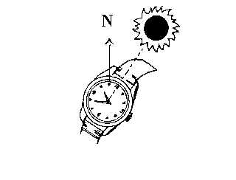
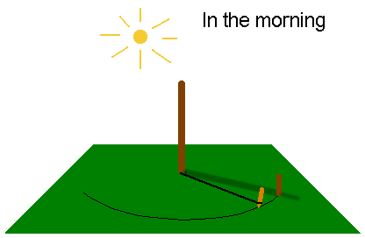
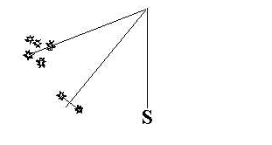
Cross-country Navigation
Factors influencing C-C navigation
  Weather, terrain, vegetation, visibility
  Team composition, fatigue
  Access restrictions, boundaries, route choice
Improvised direction finding
  By shadow stick & sun
  By the stars
  By using a watch & sun
  Bushman's method – kangaroos
  GPS

Slide 41
Cross Country Navigation cont…
Predicted walking time
  5km/hr easy going
  3km/hr easy scrambling
  1.5km/hr rough country, snow, sand or thick bush
  Add 1hr for every 500m up or 1000m down
  Every 5 hrs allow an 1hr for fatigue.
Distance travelled - pacing & time
  Average step is 75cm
  Approx’ 650-660 right steps = 1km
Judging distance - See Learners Guide for object sizing P79
  Unit of measure (Good up to 400m – Sports fields or swimming pools)
  Appearance (Takes a lot of practice – compare with surroundings)
  Bracketing (Greater than 200m, Less than 600m)

Slide 42
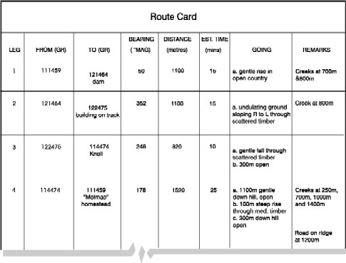
Planning…..
Route planning – Map study
  Essential, you must have a good plan before setting off.
  Have an alternate plan & route
  Break route down into individual legs.
  Each leg should terminate at recognisable objects or within an hour
Consider
    Grain of country
    Ridges
    Rivers
    Dense scrub
    Access

Slide 43
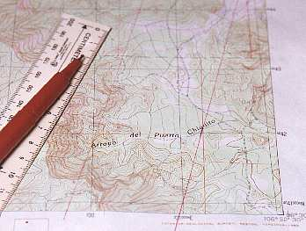
Map Orientation…
A simple way to read a map is to orientate the map to its surroundings.
Using land features
  Lay the map on the ground. Rotate map till features on ground align with those on map.
Using a compass (grid)
  Determine & set mag’ variation on compass
  Align compass edge with ‘N-S’ meridian lines
  Rotate map & compass till compass needle is aligned
Using a compass (mag)
  Draw mag’ variation lines on map
  Set compass to mag’ ‘N’
  Align compass edge with drawn lines
  Rotate map & compass till compass needle is aligned
  All compass bearings can now be taken directly from the map

Slide 44
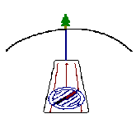
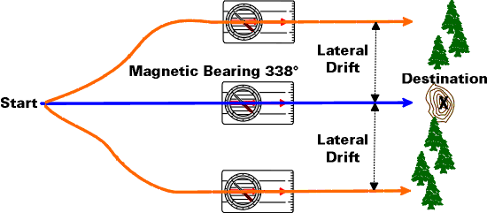
Lateral Drift
Is when you drift away from the given destination, but you remain on the same bearing.
The compass alone, is not enough to eliminate lateral drift.
Spot a feature (tree, knoll) on the set bearing, walk to that feature, then reassess. Continue until destination is reached.

Slide 45
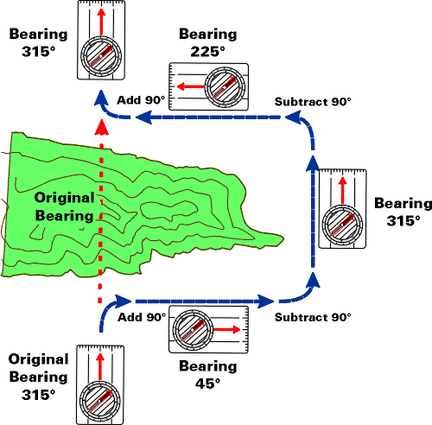
Avoiding an Obstacle
Used to traverse around cliffs, knolls, swamps etc
Pacing at 90⁰ intervals
Leg 1 and 3 need to be of equal distance

Slide 46
Checking…
Catching features
  Easily identified features. Eg fences, creeks roads
  Should prevent you from walking too far
Attack points
  Used when navigating to less identifiable features
  Easier to find an attack point than a specific reference
  A well defined location
  Gets you close to your given destination
  E.G. Road junctions, man made structures, prominent knolls etc.
Aiming off
  Aiming left or right of given bearing or location
  Used so you don’t overshoot the mark
  E.G. Creek junction - aim for creek, then walk up or downstream till you hit the creek junction
Aspect of slope & Hand rails

Slide 47
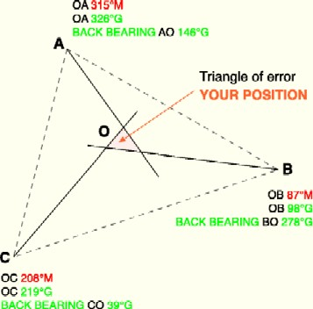
Position Fixing – Resection…
Used when you’re unable to fix your position from the ground to that on the map.
Find 2 or 3 prominent features.
Take magnetic bearing of features & convert to grid bearing.
Change to back bearing & plot all bearings on map.
Your position is where the back bearings intersect.

Slide 48
Action If Lost!!!
Don’t PANIC, remain calm
Re-think route & confirm ground covered
Position fixing -resection
Identify a bearing (track junction) & head for safety
Unable to identify your position, set up camp & wait for rescue
Initiate any distress beacons
TIP
You’re never lost, just
geographically
misplaced

Slide 49
Remote Area Section…
This section is not pitched at any level of expertise. Everyone should be well prepared before entering the bush.
6 P’s = prior preparation and planning prevents poor performance.
Learn the area before departing
Have a navigational route planned
  Group details
  Route details
  Intended camp locations
  ETD and ETA

Slide 50
Basic Requirements for Survival…
Water
  Minimum 2ltr/day
  Is there water in the area
  Carrying capacity
  Quality
Shelter
  Tent or hutchie
  Ground sheet
  Improvisation
    E.G. Caves, overhangs, huts, sheds
Warmth
  Dry clothes
  Thermals
  Matches/lighter
  Strategies/procedures to cope with the cold
Food
  Enough food/nourishing
  Hunting & gathering food
  Rationing
  Cooking/disease

Slide 51
Navigational Tips - (Generalised)
Sparse & scratchy vegetation along ridges & spurs
Thicker vegetation through gullies & valleys
South facing terrain is thicker vegetation
Slower moving through creek beds
Night navigation - use of lighting and the moon
Pack light, pack right
You’re only as fast as your slowest team member
Continue relating features from the ground to the map
Carry safety equipment & have knowledge of remote first aid
Know your limitations - be mentally & physically prepared

Slide 52
Pack Checklist…
Clothing
  Boots & socks
  Underwear & thermal
  Trousers/shorts
  Shirts
  Jumper/jacket
  Headgear & gloves
  Wet weather jacket & pants
  Gaiters
Personal equipment
  Backpack
  Sleeping bag
  Sleeping mat
  Toiletries
  Toilet paper
  Water bottle & water
  Food & utensils
  Insect repellent/sunscreen
  Light source batteries

Slide 53
Pack Checklist…
Emergency equipment
  Maps & map case
  Watch
  Compass
  Whistle
  Fire starters
  Knife
  Note book & pen
  GPS
Group equipment
  Tent or hutchie
  Ground sheet
  Stove & fuel
  Water filter
  Plastic shovel
  Cordage
The End

