Slide 1
Computer Security

Slide 2
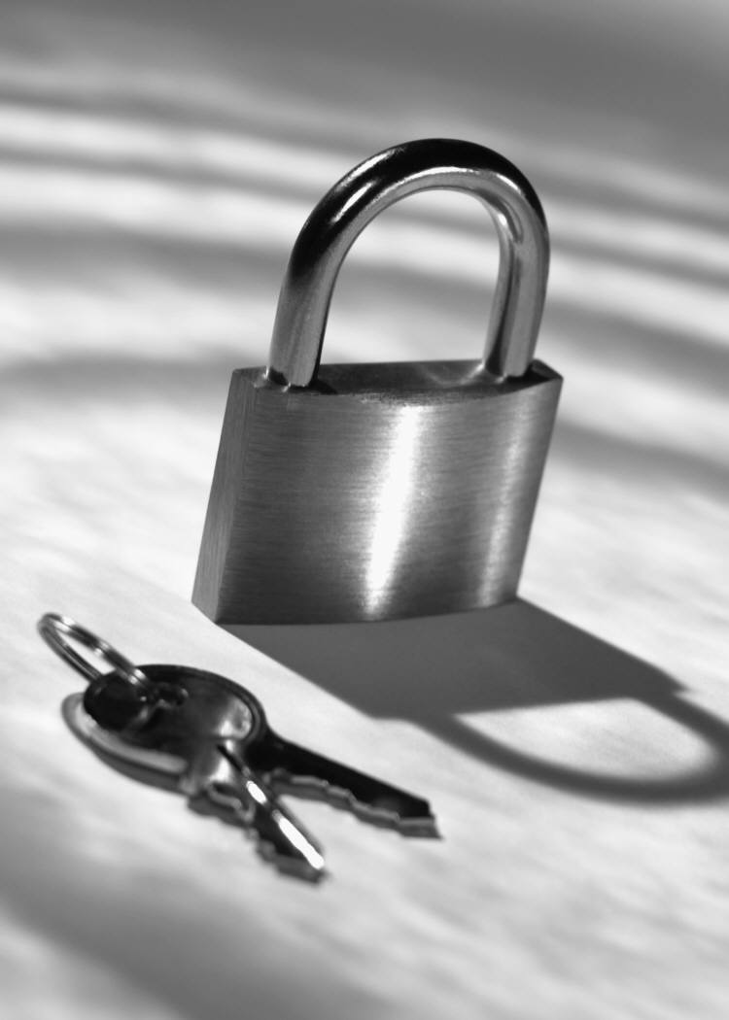
Computer Crime and Cybercrime
Computer crimes occur when intruders gain unauthorized access to computer systems
Cybercrime is crime carried out over the Internet
Cyberlaw tracks and combats computer related crime

Slide 3
Computer Crime and Cybercrime
Types of Computer Crime
Identity Theft
Computer Viruses
More Rogue Programs
Fraud and Theft
Forgery
Blackmail

Slide 4
Identity Theft
Identity theft is one of the fastest growing crimes in the United States and Canada
Identity theft occurs when enough information about an individual is obtained to open a credit card account in their name and charge items to that account
Examples of information needed are name, address, social security number, and other personal information

Slide 5
Computer Viruses
A Computer virus is a hidden code within a program that may damage or destroy the infected files.
Viruses replicate and attach themselves to programs in the system
There are more than 20,000 different computer viruses with the number growing daily

Slide 6
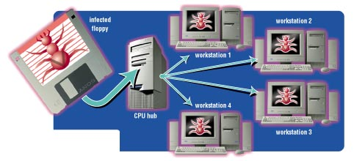
How Virus Infections Spread

Slide 7
Types of Viruses
File Infectors
Attach themselves to program files
Spread to other programs on the hard drive when the program is executed
Are the most common type of virus
Boot Sector Viruses
Attach themselves to the boot sector of a hard drive
Execute each time the computer is started
May lead to the destruction of all data

Slide 8
Types of Viruses
Macro Viruses
Take advantage of the automatic command capabilities created by macros
Attach themselves to the data files in word processing, spreadsheet, and database programs
Spread when the data files are exchanged between users

Slide 9
More Rogue Programs
Time Bombs
Also called logic bombs
Harmless until a certain event or circumstance activates the program
Worms
Resemble a virus
Spread from one computer to another over computer network.
Control and use the resources of infected computers to attack other networked computers

Slide 10
More Rogue Programs
Denial of Service Attack (DoS)
Also called Syn flooding
Overload an Internet server with a large number of requests
Trojan Horses
cover up themselves as useful programs
Contain hidden instructions to perform malicious tasks
May erase data or cause other damage

Slide 11
Fraud and Theft
Salami Shaving
Programmer alters a program to take a small amount of money out of an account
Data Diddling
Data is altered to hide theft
Insiders modify data by altering accounts

Slide 12
Forgery and Blackmail
Forgery
Internet data can appear to be coming from one source when its really coming from another
Forged e-mail and Web pages
Blackmail
Confronting publicity fears have been used to blackmail financial institutions

Slide 13
Meet the Attackers
Hackers
Computer hobbyists
Find weaknesses and loopholes in computer systems
Rarely destructive
Adhere to the hacker’s code of ethics
Crackers
Also called black hats
Obsessed with entering secure computer systems
Rarely destructive
Leave calling cards on the systems they enter

Slide 14
Meet the Attackers
Virus Authors
Usually teenage males
Push the boundaries of antivirus software
Create viruses that are very damaging
Cyber Gangs
Group of hackers and crackers working together to coordinate attacks on the Internet

Slide 15
More Attackers
Swindlers
Use the Internet to scam money from people
Typically create bogus work at home opportunities, illegal pyramid scheme, chain letters, get rich quick scheme, etc.

Slide 16
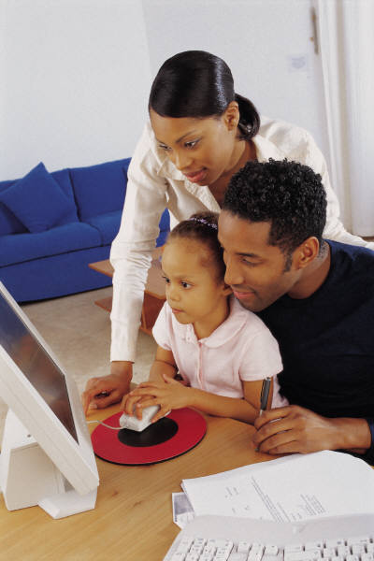
More Attackers
Shills
Use Internet auctions
Secret operatives who bid on a seller’s item to drive up the bid
Cyberstalkers and Sexual Predators
Using the Internet to repeatedly harass or threaten
Children are at risk from sexual predators

Slide 17
Encryption
Encryption is the coding and scrambling process by which a message is made unreadable except by the intended recipient
Encryption is needed for electronic commerce
The potential for encryption's misuse troubles law enforcement officials

Slide 18
Encryption Basics
I LOVE YOU
A readable message is called plaintext
An encryption key is a formula used to make plaintext unreadable
The coded message is called ciphertext
An encryption technique called rot-13 is used in chat rooms and Usenet discussions
V YBIR LBH

Slide 19
Encryption Basics
Symmetric key encryption are encryption techniques that use the same key to encrypt and decrypt a message
Strong encryption refers to encryption methods that are used by banks and military agencies and are nearly impossible to break

Slide 20
The Problem of Key Interception
Rot-13 is not a secure encryption system
Symmetric key encryption systems are vulnerable to key interception, or having their key stolen

Slide 21
Public Key Encryption
Public key encryption uses two different keys
Public key is the encryption key
Private key is the decryption key
They are used in e-commerce transactions
A secure channel for information is provided when the keys are used

Slide 22
Digital Signatures and Certificates
Public key can be used to implement digital signature
Digital signatures are a technique used to guarantee that a message has not been tampered with
Digital certificates are a technique used to validate one’s identity
Secure Electronic Transactions (SET) are online shopping security standards used to protect merchants and customers from credit card fraud

Slide 23
Summary
Many websites collect and store information about Web users
Cookies and GUIDs are used to collect data
Computer crime and cybercrime
Identity theft
Computer viruses
Rogue programs
Forgery
Blackmail

Slide 24
Summary
Computer criminals
Crackers
Cybergangs
Virus authors
Swindlers
Shills
Cyberstalkers
Encryption refers to coding or scrambling data
Thank you.

