Slide 1
Adaptation
How have these animals these adapted to their environment?

Slide 2
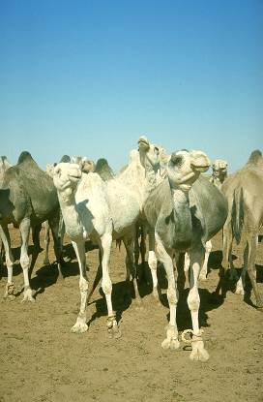
Camel
Has long legs to keep body away from hot sand
Can store fat in hump.
Can go for long periods without water.

Slide 3
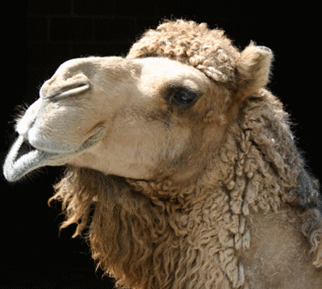
Camel
Can close nostrils to keep out sand.
Has long eyelashes to keep out sand.
Many blood vessels just under the skin to cool the blood.

Slide 4
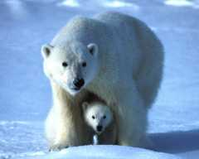
Polar Bear
Has white fur for camouflage.
Each hair is hollow for extra insulation.
Has sharp teeth and claws to catch and eat prey.
Has ridged foot pads to prevent slipping.

Slide 5
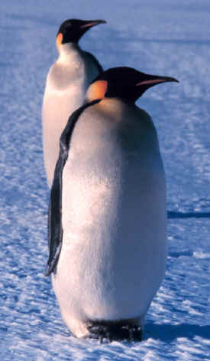
Penguin
Has thick layer of fat to keep warm.
Produces oil to keep feathers waterproof.
Stream lined body for swimming.

Slide 6
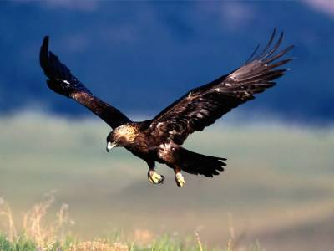
Golden Eagle
Large wing span for gliding.
Sharp talons for catching and holding prey.
Hooked beak for tearing meat.
Large eyes for spotting prey from great distances.

Slide 7
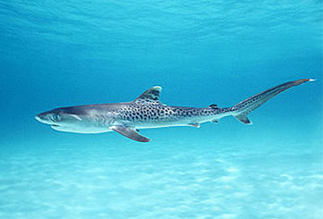
Shark
Stream lined body for swimming.
Fins to propel through the water.
Sharp teeth.
Gills to breath under water.

Slide 8
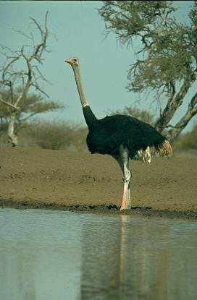
Ostrich
Long legs to run fast.
Large eyes to see long distances.
Long feathers to provide more shade to eggs and to keep body warm at night.

