Slide 1
PIA 2574: Week Three
African Development Seminar:
Conflict, Governance and Development

Slide 2
Themes for the Day
I. African Colonial History, State Failure and Violence (Ethnicity and Violence?)
II. African Nationalism in Perspective(Too Strong or Too Weak- Excessive politicization)
III. Patterns of Government in Africa- (Too Soft or too hard- large cumbersome bureaucracy?)

Slide 3
I. African Colonial History, State Failure and Violence
ORIGINS AND MYTHS
Conflict and cultural-sub-nationalism?
Processes, values and Institutions?
KEY TO UNDERSTANDING
AFRICAN UNDERDEVELOPMENT?

Slide 4
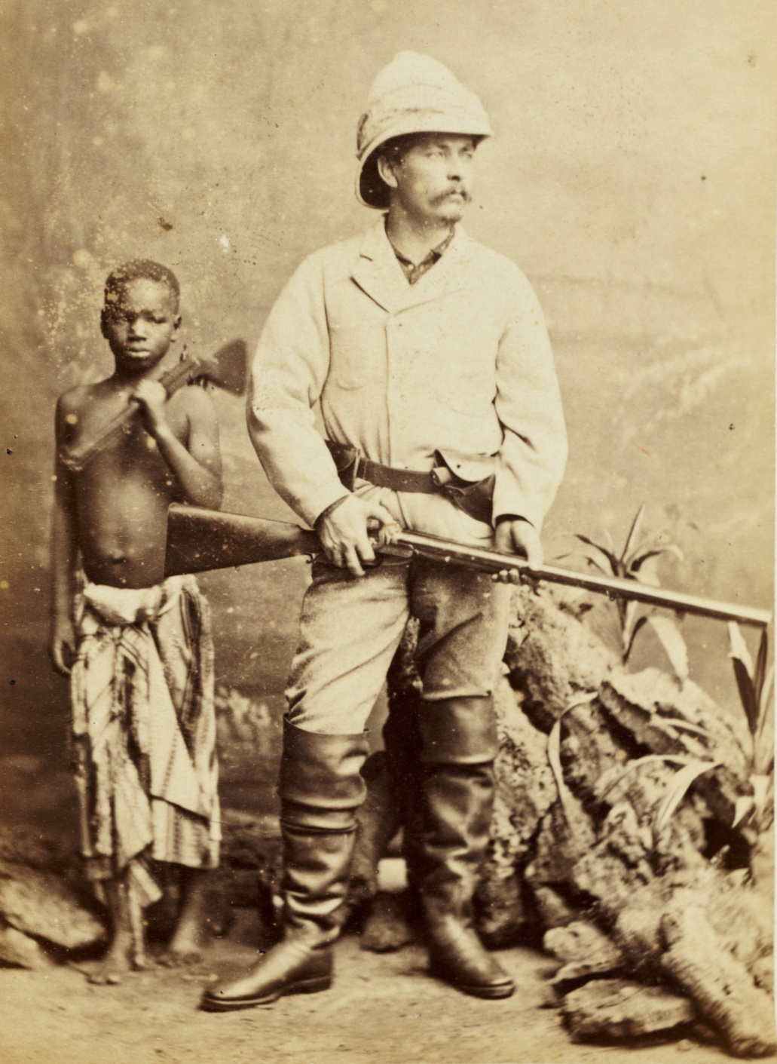
Remembering Bula Matare

Slide 5
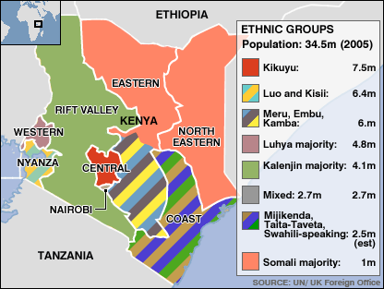
Ethnicity in Kenya

Slide 6
Discussion of the Week
Why Men (and Women) Rebel? Africa Style
Ted Gurr. Why Men Rebel (Princeton, NJ: Princeton University Press. 1970).
Gurr’s Response: Relative deprivation- The discrepancy between what they think they deserve and what they think they will get.

Slide 7
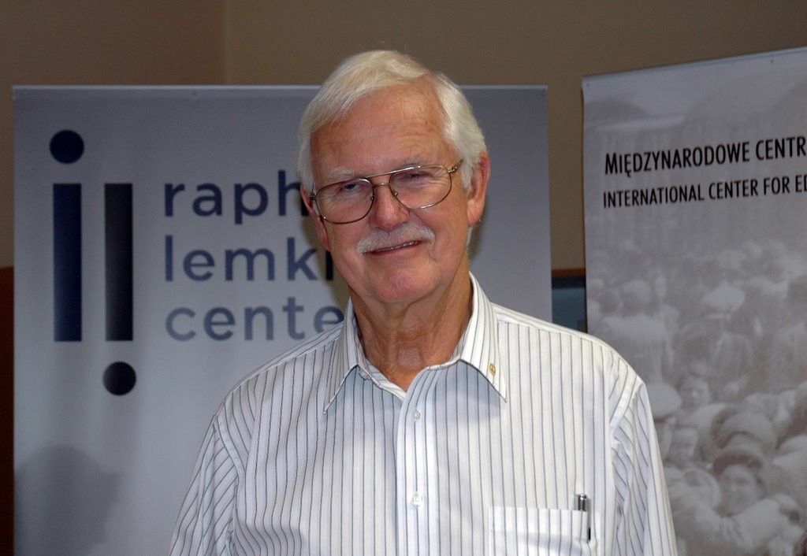
Ted Robert Gurr, Born 1936

Slide 8
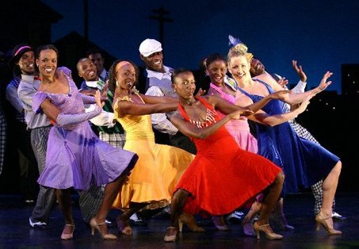
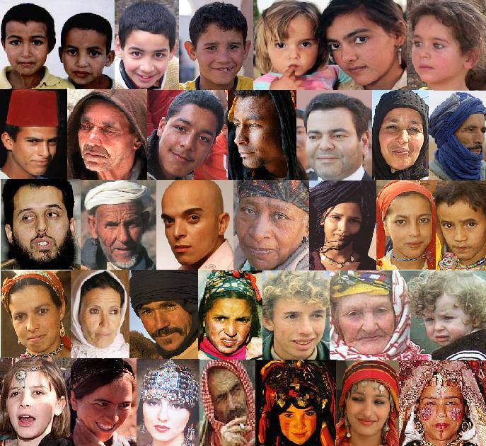
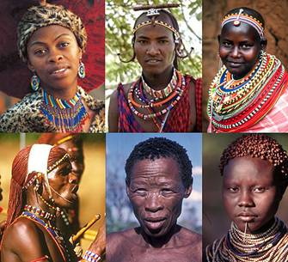
Ethnic Images and African Footprint

Slide 9
Theories of State Failure and the rise of Sub-national Violent Political Groups
Ethnic Identity, Culture/religious Clash and Violent conflict
Authoritarianism: One Party Systems and Military Regimes
Over-expansion of state’s economic management function
Violation of social contract with middle class

Slide 10
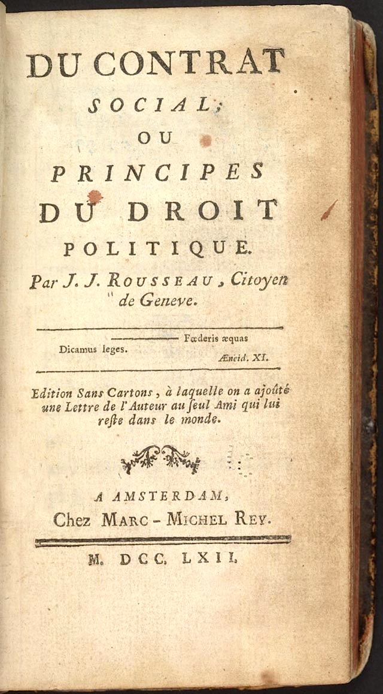
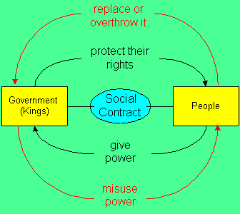
The Social Contract

Slide 11
Theories of violence in Africa
Elite Predation- corruption and diversion of public resources
Aid dependence and externalization of public sector management
Debate over Islamic Fundamentalist Groups

Slide 12
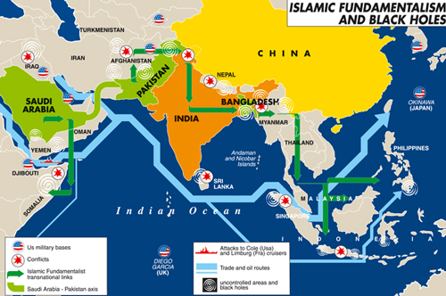
Islam
One View
Moving into
Africa

Slide 13
II. AFRICAN NATIONALISM IN PERSPECTIVE (Too Strong or Too Weak)
Typology of state centric Nationalism in Africa
Pre-Colonial African States- North Africa and the Horn; Southern Africa: Lesotho, Swaziland
Cultural Sub-Nationalism- Ashanti, Buganda, KwaZulu
Colonial Creations

Slide 14
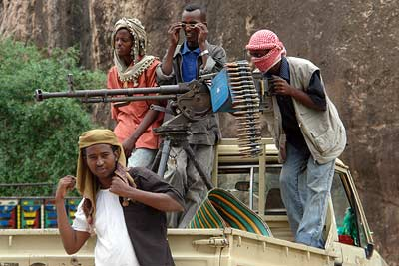
Somalia: One Nationality with Clans

Slide 15
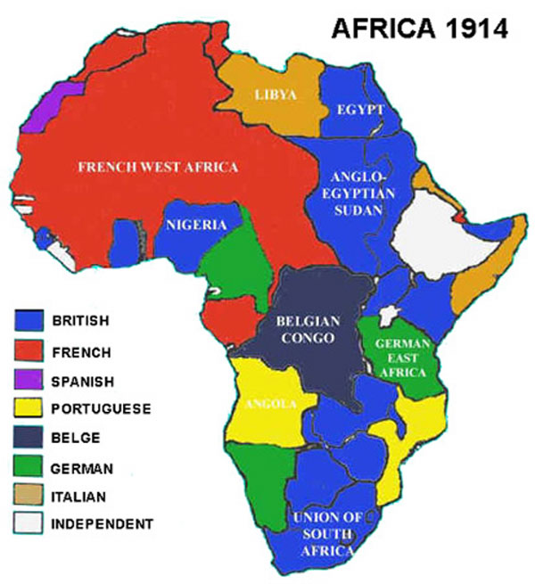
Nationalism Defined?

Slide 16
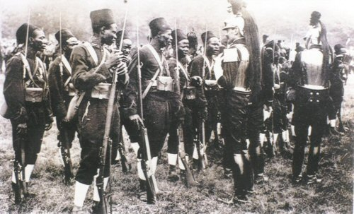
French Africa 1914

Slide 17
Post-Colonial Regimes- French Redux
Egypt and North Africa
France and WWII- Vichy and Anti-Vichy
Socialist Governments and Quasi-socialist empire
Permanent Association not Assimilation

Slide 18
France: Concept of the French Union
Algeria, Vietnam and French Association
Francophone Africa and the French Fifth Republic
West Africa- 5th Republic Metropol- Francophonie
plus Tradition, Revolution and Islam, North Africa

Slide 19
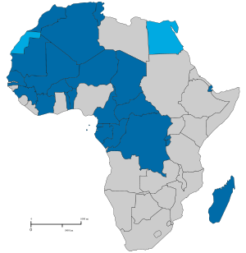
Francophone Africa

Slide 20
French Decolonization and National Identity
Collapse of Federation- Loi Cadre 1956
1960 and Controlled independence
De Gaulle and the 1958 Referendum
Belgian Congo Rwanda and Burundi
Congo Disaster- The Central Africa Problem

Slide 21
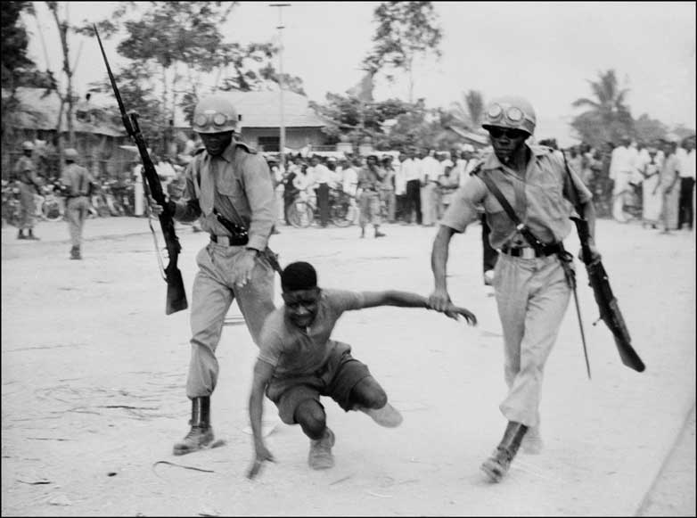

Slide 22
Britain- Origins of Nationalism in Anglophone Africa
Aborigines Rights Protection Society- Gold Coast, 1898
African Peoples Union, - Nigeria,1908
African National Congress, 1912
British West African Congress, 1918

Slide 23
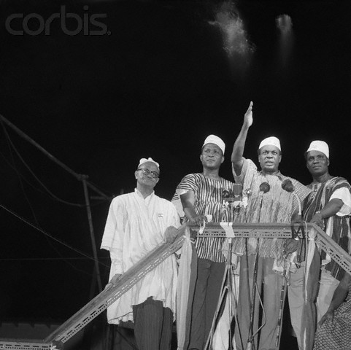
Gold Coast Nationalists 1950s

Slide 24
Nationalist Movements
Young Kikuyu Association- Kenya, 1921
Young Baganda Association, (Sons of Kintu), 1922
Tanganyika Civil Servant Association, 1924
African National Congress- Rhodesia, 1957

Slide 25
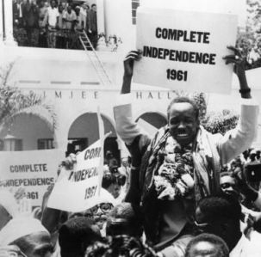
Julius Nyerere 1960

Slide 26
Early Civil Society Associations
“Tribal” Associations-
Trade Unions
Producers Cooperatives
Middle Class Civil Rights Associations

Slide 27
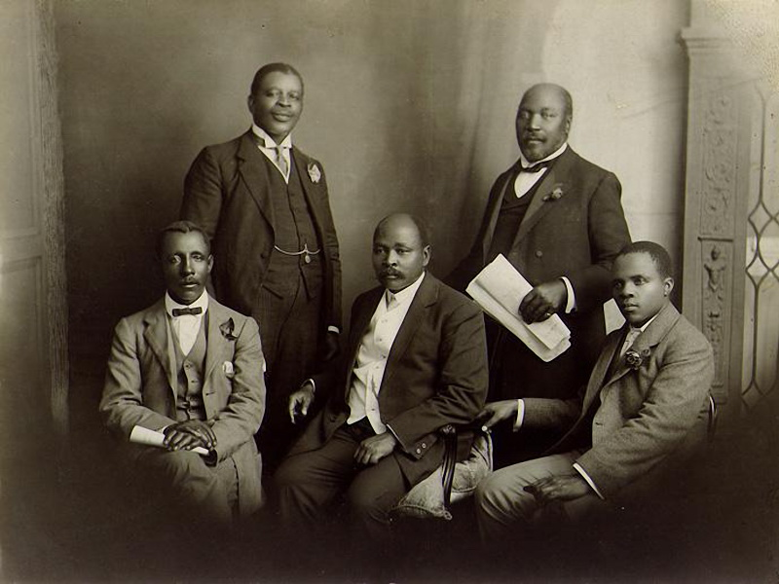
South African Native National Congress Leadership 1914

Slide 28
Inter-war Associations:
Civil Service Associations
Citizens Unions- urban
Prototype Nationalist Movements
World War II and Militancy of Groups

Slide 29
Cheikh Anta Diop (Born 29 Dec. 1923 in Thieytou, Senegal and Died 7 Feb. 1986 in Dakar)
Debate about “the Negro Myth” and African History
Afrocentric view of history
Discussion?

Slide 30
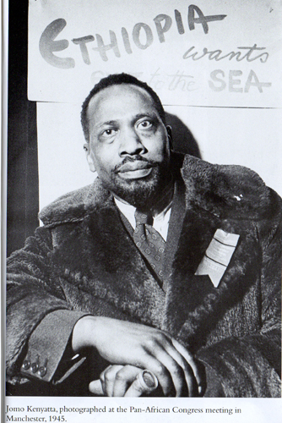
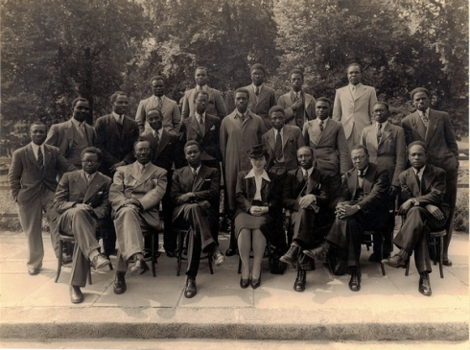
Af Pan African Congress in Manchester, 1945

Slide 31
The Rise of Nationalism
Gandhi, the Congress Movement and India
The Atlantic Charter, 1941- Independence for Captured Europe but not the colonies
Japan and East Asia Co-Prosperity Sphere

Slide 32
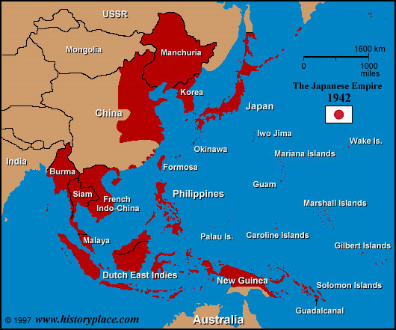
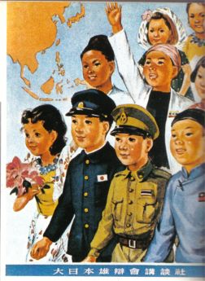
Greater East Asia Co-prosperity Sphere (1942-43)

Slide 33
The Rise of Nationalism-2
World War Two: Japanese Victories
Sukarno, Ho Chi Minh and Revolutionary Nationalism
African Soldiers in a European War
Rise of Mass Mobilization Movements

Slide 34
French African Soldiers, WWII

Slide 35
Transitions
Early Middle Class Movements- prior to WWII-Professional and Middle Class
Shift to Mass Movements- World War II, Japanese victories and the collapse of empires (Congress Model vs. Metropol Parties vs. revolutions)
Federations and their collapse- West and Central Africa, East African Community, Central African Federation
Special Problem of Settler States

Slide 36
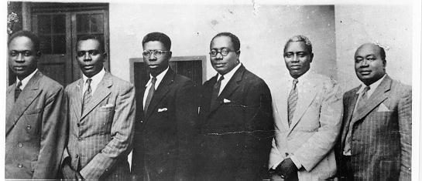
United Gold Coast Convention (UGCC) was the first nationalist movement with the aim of self-government " in the shortest possible time.” Founded in August 1947 by educated Africans such as J.B. Danquah, A.G. Grant, R.A. Awoonor-Williams, and Edward Akufo Addo.

Slide 37
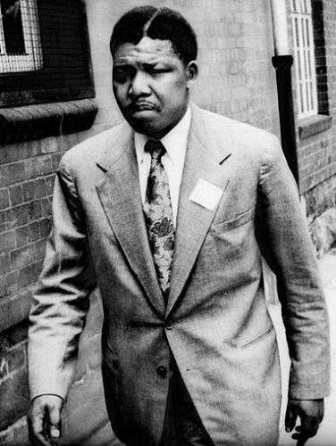

Slide 38
From Gold Coast to Southern Sudan: Kwame Nkrumah and False Promises
The mass movement and the slogan "Seek ye first the Political Kingdom" This goal was articulated by Kwame Nkrumah and his Convention People's Party. This is the origin of what some call the false “development Promises.”
The implication was that economic development would follow. The basis of change would be state manipulation of the national economy. The assumption was that control of the state apparatus was essential to economic betterment
The Problem: It didn’t happen

Slide 39
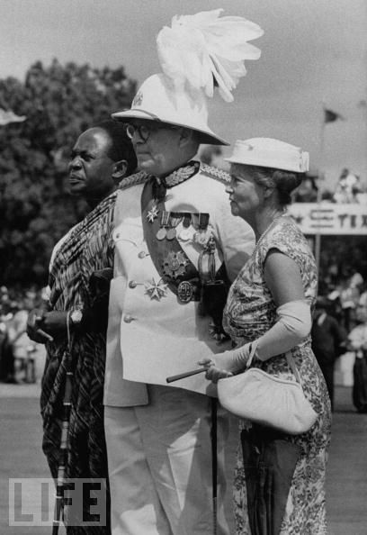
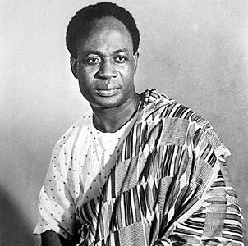
Kwame Nkrumah and Independence Day

Slide 40
Coffee Break
Ten Minutes
http://www.youtube.com/watch?v=b2903pxjYrc&feature=related

Slide 41
III. Patterns of Government in Africa- Too Soft or Too Hard

Slide 42
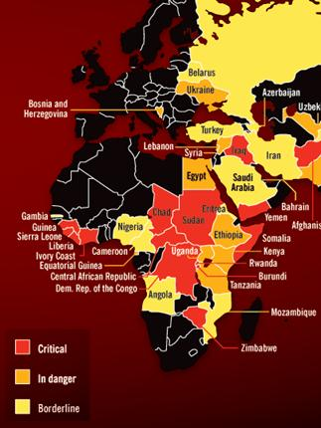
Weak States

Slide 43
Britain
Anglophone Africa and the Westminster Model- Fused Government
Strong Cultural Influences, eg. The Anglophone Mandela
Bi-product: One Party Regimes and the Military

Slide 44
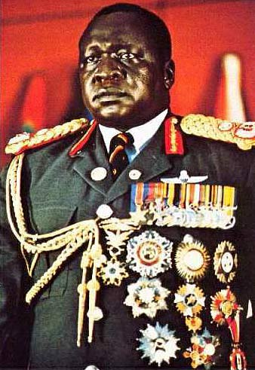
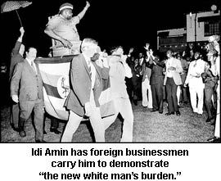
"His Excellency President for Life, Field Marshal Al Hadji Doctor Idi Amin, VC, DSO, MC, Lord of all the Beasts of the Earth and Fishes of the Sea, and Conqueror of the British Empire in Africa in General and Uganda in Particular"

Slide 45
Other Post-Colonial Regimes
Francophonie- Executive Presidency- Fifth Republic
Post-Revolutionary States- Lusophone
Belgian Legacy- DRC, Rwanda and Burundi
Italy and Spain- Remnants of Empires- Somalia, Eritrea, Equatorial Guinea

Slide 46
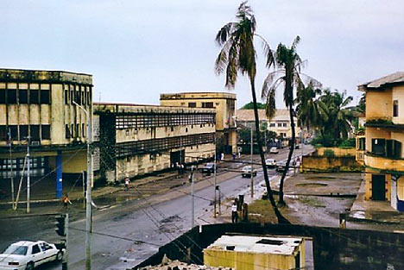
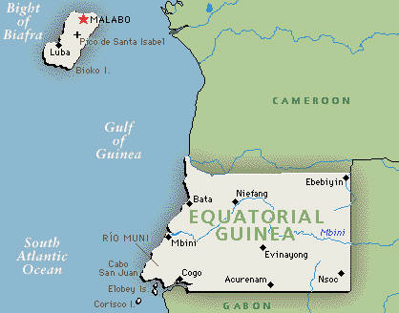
Black Beach Prison Equatorial Guinea

Slide 47
Traditional REGIMES
Traditional Elements: Ethiopia- 1960s, Swaziland, Somalia,
Neo-Traditional: Botswana, Buganda, Northern Nigeria, KwaZulu-Natal, Lesotho
Patrimonialism: Strong Presidential Models and Neo-traditionalsim

Slide 48
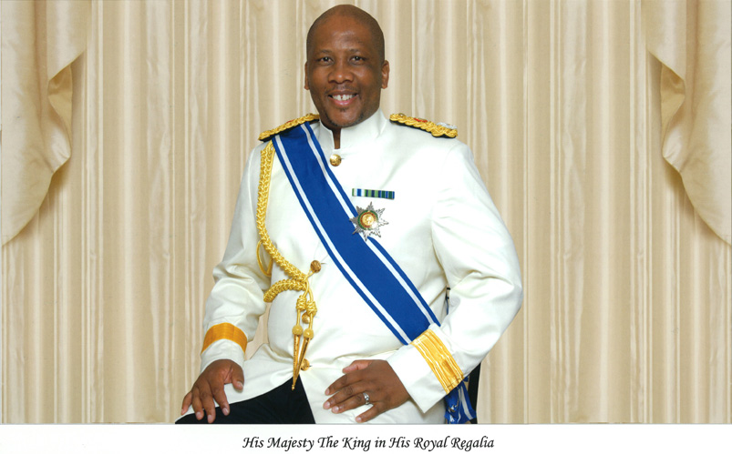
King Letsie III of Lesotho

Slide 49
Independence and One Party States
Attempts at Intra-Party democracy: Ghana, Tanzania, Zambia- 1970s to 1980s.
Grass roots and periphery: Soft States
Elections within the party
Question: contained political systems?

Slide 50
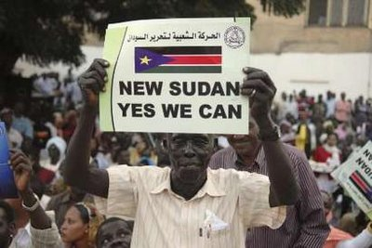
The Newest One Party State July 9, 2011

Slide 51
Afro-Marxist Vanguard Parties and Leninism
Angola, Mozambique in 1980s
Ethiopia under the Dergue, 1969-1991
Benin and Congo Brazzaville, 1970s-1980s

Slide 52
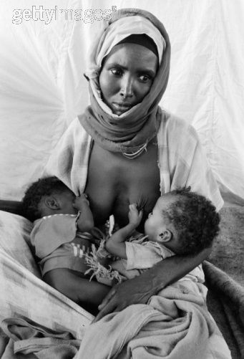
Ethiopia- The Derg, 1974-1991

Slide 53
"No" Party Administrative States
One Party States where the party is a shell
Kenya, Ivory Coast in 1970s
Uganda in the 1990s; Eritrea, Rwanda (Claim non-party)

Slide 54
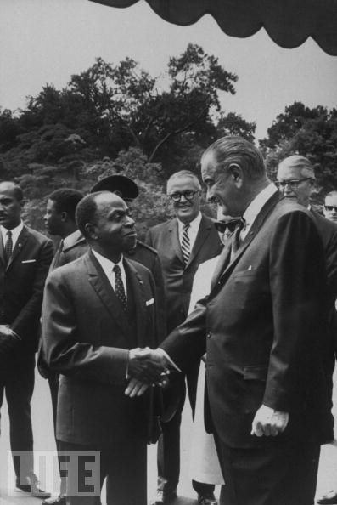
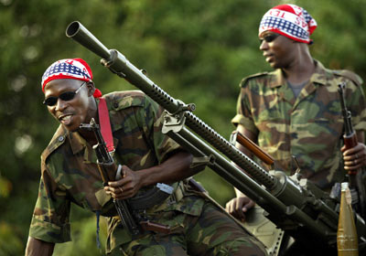
Felix Houphouet-Boigny, President for Life, 1958-1993 and Ivory Coast Today on the verge of Civil War

Slide 55
Post-Colonial Regimes
Post Settler Regimes: Home Rule
Zimbabwe
Namibia
South Africa

Slide 56
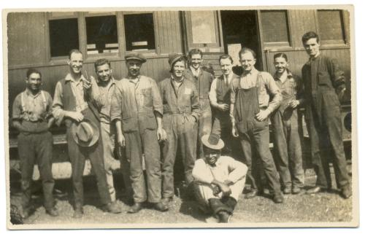
Early Rhodesian Settlers

Slide 57
IV. Post-Colonial Regimes and the Impact of Colonialism
Ethnic Identification
Overseas Language
Metropol Values
Administrative Process
Political Shell
Economic/ Trade links- primary products and markets

Slide 58
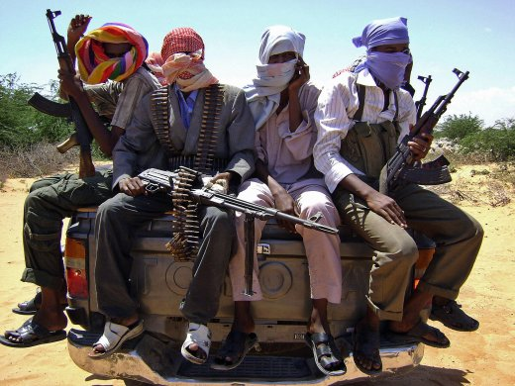
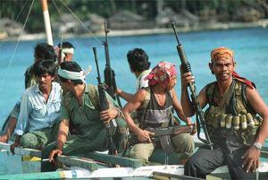
The Result: Somalia

Slide 59
Issues: Facing Post-Colonial Africa
Power and Class- Continuity vs. Change in Africa
Why was the Colonial state so destructive- “Bula Matari”
Underdevelopment Africa vs Asia?
Regional Differences: Anglophone, Francophone and Southern Africa
North Africa, the Horn, “Settler” Africa

Slide 60
GOVERNANCE ISSUES
Nature of the Administrative State-the Bureaucracy evolved over time
but political institutions tacked on a few years before independence
Causes of Institutional Weakness: Too strong a bureaucracy weakens institutions and decline of political party (ies)
Result: Corruption, Patronage and clientelism

Slide 61
GOVERNANCE ISSUES: Leonard Binder- UCLA Political Science
Problem: Confront all FIVE crises at once
1. Identity
2. Legitimacy
3. Participation
4. Distribution
5. Penetration

Slide 62
Bureaucratic Interests- Middle Class
Organizational Bourgeoisie
No private sector, few interest groups
Public sector economic strategy
Little or No civil society
Corruption and the End of the Social Contract

Slide 63
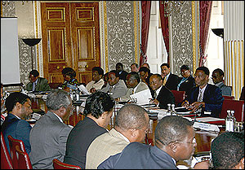
African Bureaucrats and Smuggled Goods

Slide 64
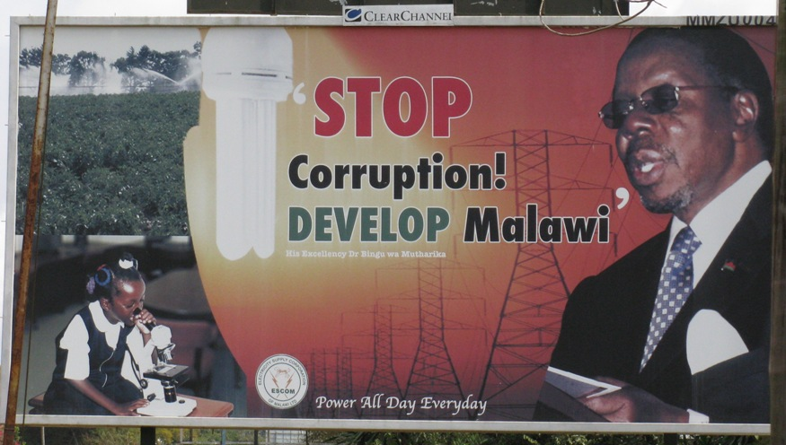
The Problem?

Slide 65
Discussion- Cases
Colonialism, Nationality and Ethnicity

Slide 66
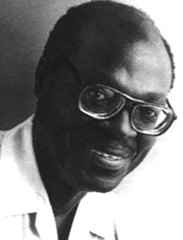
Discussion: Cases
Sylvain Bemba, The Dark Room, (DRC- 1934-1995)
James Mathews, “The Park” (29 May 1929 (Cape Town (1929-05-29) (age 81)

Slide 67
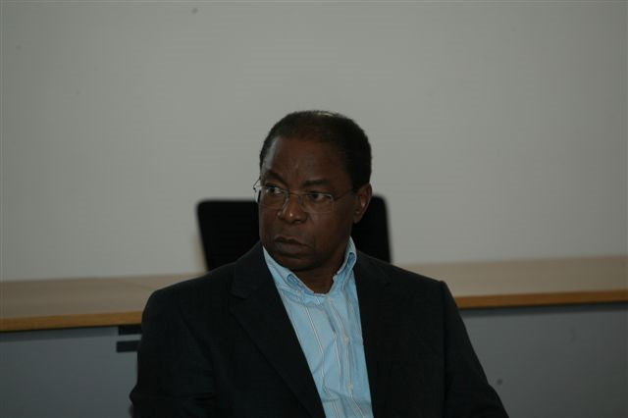
Luis Bernardo Honwana, “Dina”
(Maputo, Mozambique, Born 1942)

Slide 68
Discussion Books
Ousmane Sembane, God’s Bits of Wood- Pictured
Joseph Conrad, Heart of Darkness
Neil Parsons, King Khama

Slide 69
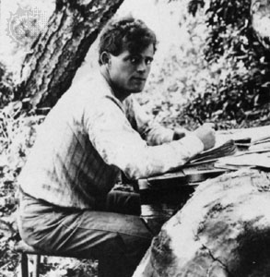
Book Discussions- Neil Parsons, University of Botswana) and Jack London (1876-1916)

Slide 70
Discussion
January 20-
Each group should be able to discuss these issues based on your readings.

Slide 71
Syndicate Questions
Syndicate One- Francophone Africa. What argument does each of our authors make about the nature of colonialism? What major similarities do you see between and among our authors.
Syndicate Two- Anglophone. What picture of European influence over Africa does the reading give us? What major differences do you see between and among our authors?
Syndicate Three- Southern Africa. What picture of African resistance and strength does the reading give us? Comment on the Impact of “Settlers.”

Slide 72
Syndicate Questions
Horn of Africa- To what extent is the Horn of Africa different then our other regions? What are the important questions to be asking according to our Authors?
North Africa- Is North Africa a part of Africa or the Middle East. What are the historical governance issues noted by our writers.

