Slide 1
IX: AGRARIAN CHANGES IN EARLY-MODERN EUROPE
C: English Agriculture: Technological and Institutional Changes: the New Husbandry, 1560 – 1740
revised 1 and 8 February 2012

Slide 2
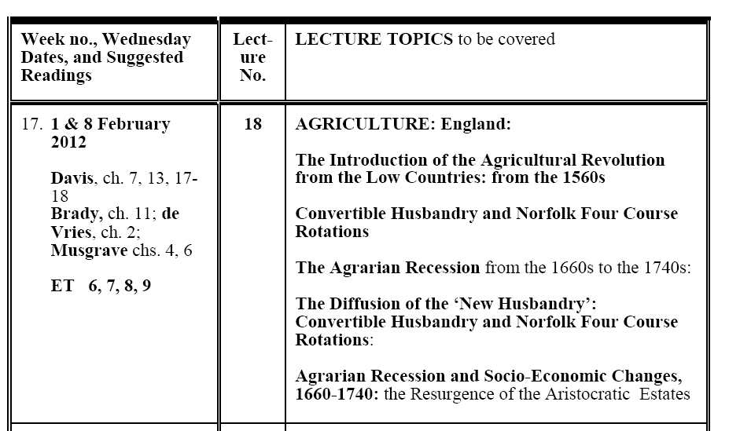

Slide 3
Origins of the Modern Agricultural Revolution - 1
(1) Three-fold goal of this lecture:
a) to understand the origins and the diffusions of new agricultural techniques that came to be known as the ‘Agricultural Revolution’
- origins in the Low Countries: with its introduction and diffusion into 16th-century England, as the ‘New Husbandry’
b) to demonstrate why Enclosures were necessary for the ‘New Husbandry’:
in terms of organization, technology, capital investment

Slide 4
Origins of the Modern Agricultural Revolution - 2
c) to demonstrate why modern economic development and urban industrialization has fundamentally depended on a radical transformation of the agricultural sector
- but also how and why agrarian changes leading to increased productivity depend heavily on the growth of uban markets
- and thus to demonstrate the inherent symbiotic relationship between agrarian changes and urban growth (ultimatly: urban industrialization)

Slide 5
Origins of the Modern Agricultural Revolution - 3
(2) When did this Agricultural Revolution Take Place?
(a) during and following the Industrial Revolution?
-most specifically from 1815 to 1850 (ECO 303Y): oldest, traditional view, still predominant (economists)
(b) in the century before the Industrial Revolution? from ca. 1660 – ca. 1740, during ‘General Crisis’ era:
now favoured theory, for many but not all historians
(c) in Tudor & early Stuart England? in Tawney’s Century, 1540 – 1640: Eric Kerridge’s theory: but little support for this view, though changes were important

Slide 6
Origins of the Modern Agricultural Revolution - 4
(3) The Role of the Low Countries: origins of England’s New Husbandry in 16th century
a) the Low Countries (Flanders, Brabant, Holland) had the most advanced agriculture in medieval northern Europe:
- many advanced techniques found there by the early 14th century (but some also in England: in East Anglia: especially Norfolk)
-b) product of high population densities with extensive urban markets in medieval Flanders: for specialised agricultural products

Slide 7
Origins of the Modern Agricultural Revolution - 5
c) How were the more advanced techniques introduced into 16th century England from the Low Countries?
i) printing press: Antwerp as the publishing capital (Gutenberg: 1400-58)
ii) commercial relations with England: especially from rise of the Antwerp market in 1460s: its expansion, to the 1560s
iii) Revolt of the Low Countries from 1568: flood of Flemish refugees into England, especially into East Anglia
iv) role of the Tudor-Stuart Enclosures from the 1460s
v) Population Growth, urbanization, and growth of the London market

Slide 8
The New Husbandry: Convertible Husbandry - 1
(1) Most advanced form of mixed-farming agriculture before modern fertilizers
- system recommended in The Boke of Husbandry by Master Fitzherbert, in 1534 (citing experience of Flanders and Brabant)
- in conjunction with enclosures
(2) This new system meant the alternation in use of land between arable and pasture, about every five years - in contrast to medieval open field agriculture, with a permanent division between arable and pasture

Slide 9
The New Husbandry: Convertible Husbandry - 1
(3) About half the land is in arable and the other half is put into pasture
(4) Called also ‘Up and Down Husbandry’: every 5 years
- the farmer ploughs up the pasture lands for arable (crops)
- and puts down to grass the arable lands for pasture (livestock)
- repeats this alteration in use of land every five years

Slide 10
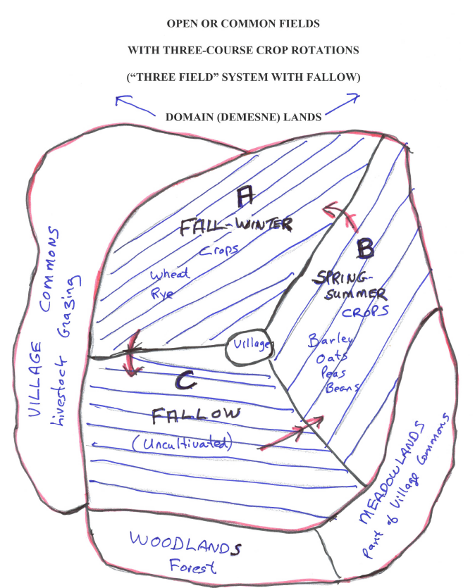

Slide 11
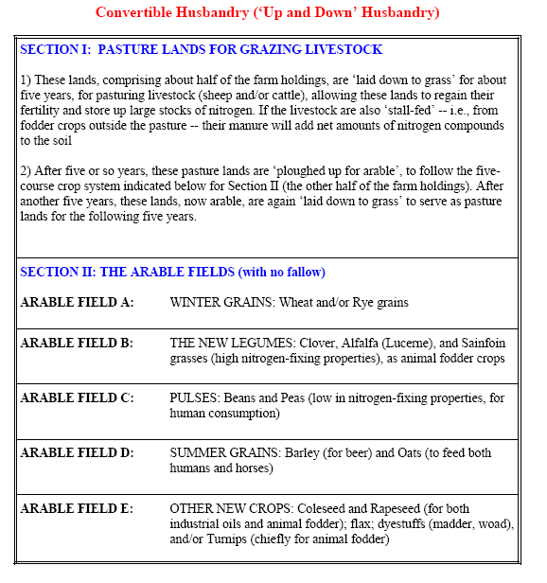

Slide 12
The New Husbandry: Convertible Husbandry (2)
(5) Productivity Gains in Arable Farming:
a) former pasture lands released large amounts of stored nitrogen
- properly maintained pastures with good grass covers adds nitrogen:
- deposits plant follicles and remains into soil as ‘green manuring’
- root systems host insects that absorb and deposit nitrogen
- grass cover inhibits the growth of other plants and organisms that consume nitrogen

Slide 13
The New Husbandry: Convertible Husbandry - 3
b) multiple course crop rotations: without fallow. HOW?
- orientation away from grains, which absorb large amounts of nitrogen and other nutrients from the soil
- addition of rotations of new legumes that FIX far more nitrogen to the soil than traditional legumes or pulses (peas, beans, vetches):
- new nitrogen-fixing legumes: clover, alfalfa (lucerne), sainfoin:
- elimination of the fallow: permitted nitrogen to benefit next rotation
- legumes: served as fodder crops for feeding livestock: for manure

Slide 14
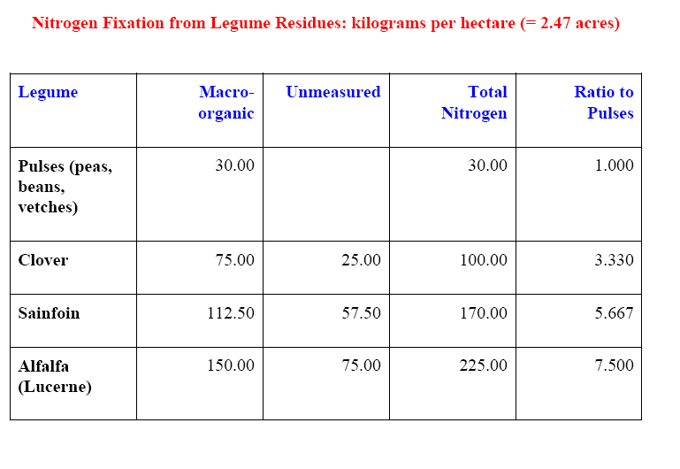

Slide 15
The New Husbandry: Convertible Husbandry - 4
(6) Productivity Gains in Pastoral Farming:
a) ensure proper ratio of livestock to pastures to prevent overgrazing
b) pasture improvements with better grasses
- some of which were nitrogen-fixing
c) more lands devoted to meadows for hay production: as fodder crops

Slide 16
The New Husbandry: Convertible Husbandry - 5
(6) Productivity Gains in Pastoral Farming:
d) more fodder crops from the arable: for stall-feeding, especially for winter-feeding
e) better ability to breed livestock: selective breeding
- segregated flocks and herds, for breeding: though already a function of enclosures
- impossible to engage in such breeding with communal and thus intermixed ivestock

Slide 17
The New Husbandry: Convertible Husbandry - 6
(7) Economic gains from Convertible Husbandry:
a) productivity gains: as noted in both arable and livestock agriculture
b) increased agricultural diversification: with wider variety of crops:
- provided greater income stability by reducing risks: in that crop failures, insect or animal pests, bad markets, etc., affected a relatively smaller range of agricultural activities
- wider variety of crops: each taking nutrients from different soil levels

Slide 18
The New Husbandry: Convertible Husbandry - 7
c) improved nutrition with more balanced and more secure diet ➔ virtual disappearance of famines in England by early 17th century vs. chronic, repeated famines in France
d) New Industrial Crops: specialized cash crops
- flax for linen textiles
- rapeseed and coleseed: for industrial oil
- various dye plants: madder (red), woad (blue), weld (yellow)
- livestock fodder: from their leaves and stalks

Slide 19
The New Husbandry: Convertible Husbandry - 8
(8) Problems with Convertible Husbandry:
a) greatest gains came in early phases of adoption of this system: from pent-up nitrogen in converting permanent pastures into arable
- but overtime, such nitrogen gains and productivity fell -- in some regions, at least

Slide 20
The New Husbandry: Convertible Husbandry - 9
(8) Problems with Convertible Husbandry:
b) increased soil acidity (combatted with lime):
- soil acidity impeded bacterial action in breaking down livestock manures
- soil acidity also impeded ability of crops to absorb nutrients and nitrogen from the soil
c) incentives to adopt alternative New Husbandry systems: in Norfolk Four Course Rotations

Slide 21
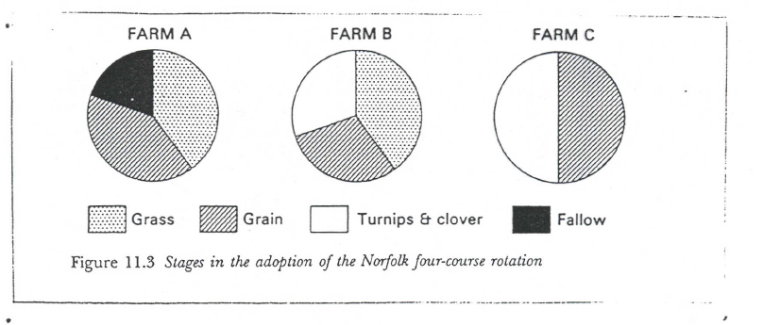
Norfolk Four-Course Rotations

Slide 22
The New Husbandry: Norfolk Four Course Rotations
(1) Explanation of the graph:
- FARM A: traditional (medieval) 3-course rotations, with permanent division between arable and pasture
- FARM B: No fallow: former fallow fields devoted to cultivation of turnips, clover, and other nitrogen-fixing legumes (alfalfa, sainfoin)
- FARM C: Ideal Norfolk Four-Course system
- eliminates both fallow and pasture: all in arable
- increases grain and other crop production
- livestock: stall-fed from cultivation of both turnips and legumes, without resort to pasture lands

Slide 23
The New Husbandry: Norfolk Four Course Rotations - 2
(2) Importance of Turnips: popularized by Viscount Charles Townshend: known as ‘Turnip Townshend’ of Norfolk
a) turnips: not a legume, but still very important
b) chief purpose: as a fodder crop ➔ feed livestock ➔ produce more manure for fertilization
c) Turnip cultivation: intensive, with roe-planting and hoeing ➔ smother weeds and provide better soil aeration, to benefit next rotation of crops

Slide 24
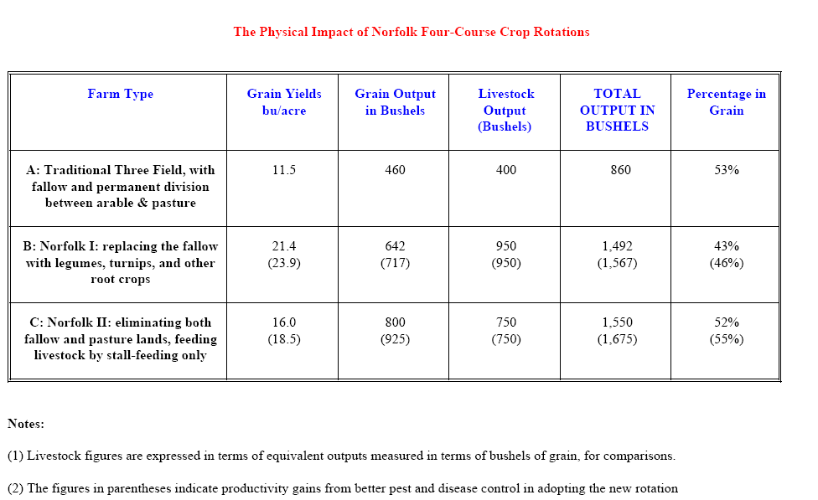

Slide 25
Indices of English Agricultural Outputs, 1500 - 1750
The following tables and graphs provide some estimates of the success of the early phase of the English Agricultural Revolution, up to 1750
The sources are:
(1) Mark Overton, Agricultural Revolution in England: The Transformation of the Agrarian Economy, 1500 - 1800, Cambridge Studies in Historical Geography (Cambridge and New York: Cambridge University Press, 1996).
(2) Bruce M. S. Campbell and Mark Overton, ‘A New Perspective on Medieval and Early Modern Agriculture: Six Centuries of Norfolk Farming, c.1250 - c.1850’, Past & Present, no. 141 (November 1993), 38 - 105.
(3) Robert Allen, ‘Tracking the Agricultural Revolution in England’, The Economic History Review, 2nd ser., 52:2 (May 1999): 209-35.
(4) Robert C. Allen, ‘The Two English Agricultural Revolutions, 1450 - 1850’, in Bruce M. S. Campbell and Mark Overton, eds., Land, Labour and Livestock: Historical Studies in European Agricultural Productivity (Manchester and New York: Manchester University Press, 1991), pp. 236 - 54.

Slide 26
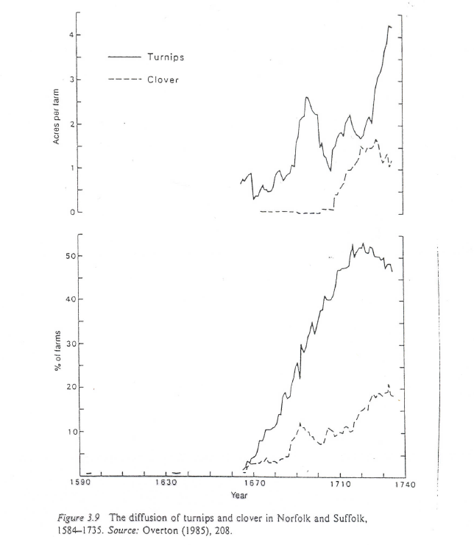

Slide 27
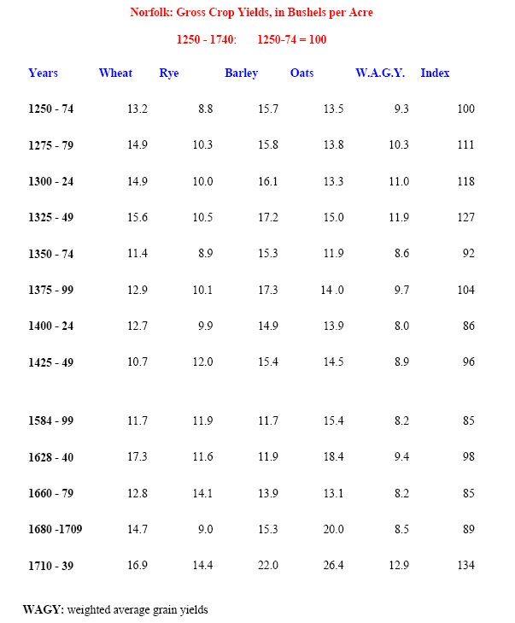

Slide 28
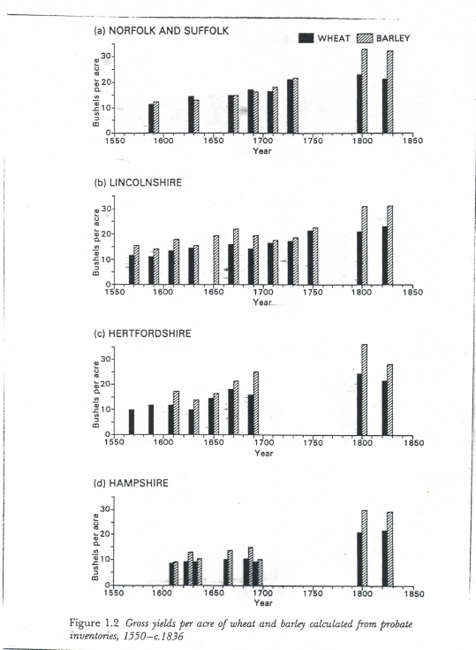

Slide 29
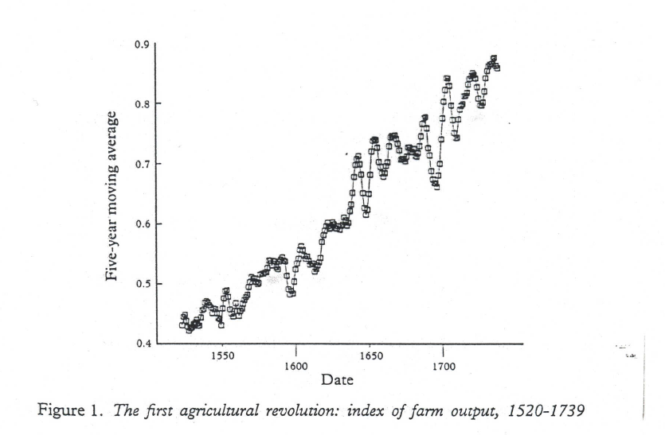

Slide 30
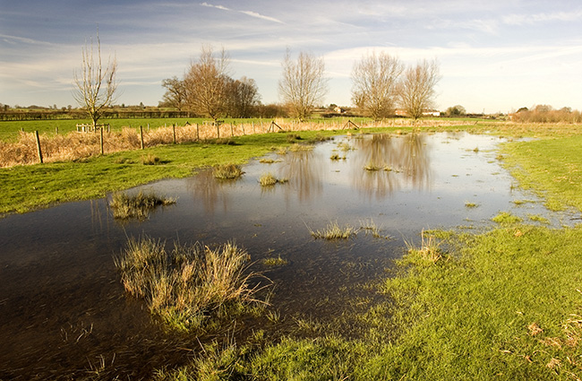
Redbournby Water Meadow

Slide 31
The New Husbandry: Water Meadows
New method of agricultural irrigation: from the later 16th century
a) applicable only for farmlands with streams or rivers: generally in the hilly west of England
b) system of irrigation canals and pipelines: to flood the meadow, pasture, or arable lands from late Fall to early Spring
c) Purpose of Water Meadows:
i) key importance: to provide a protective layer of water underneath the winter ice, as a thermal blanket: to protect the soil from freezing, to promote earlier germination of grasses and crops
ii) provide the soil with layers of alluvial (river) silt: nutrients
iii) to ensure sufficient moisture for the soil in growing summer crops

Slide 32
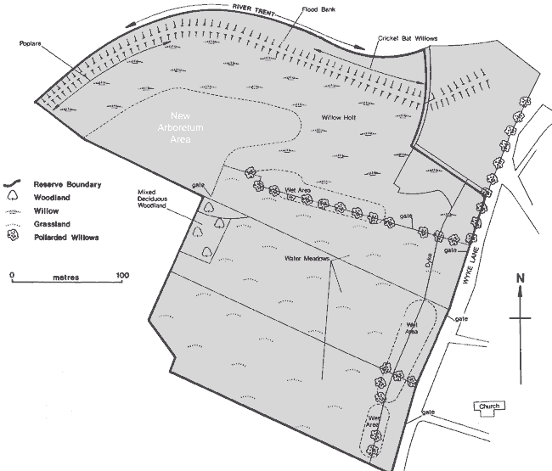
The Reserve Water Meadow

Slide 33
New Husbandry & Enclosures - 1
(1) Were enclosures necessary for adopting the New Husbandry?
- NO: say Havinden and Allen (lecture notes)
(2) My reply to Havinden & Allen
-a) they provide no evidence that full-fledged Convertible Husbandry or Norfolk rotations were applied to common fields in 18th-century Oxfordshire: only evidence for advanced rotations
b) Open Field farmers were rarely innovators: but would adopt advanced techniques that proved profitable, without disrupting the system

Slide 34
New Husbandry & Enclosures - 2
c) Convertible Husbandry impossible to impose on Open Field farms, without totally disrupting the layout of the scattered tenancy strips in the permanent arable fields-
- how would the new tenancy strips be allocated on newly created arable fields, from ploughing up former pasture lands?
d) Convertible Husbandry required very large scale farming units
e) Convertible Husbandry required very large capital investments, normally available only from mortgages (see previous discussion)

Slide 36
Industrial Importance of the New Husbandry (by 1660) – 1
(1) Textile Industries: greatest beneficiary
a) worsted industry: revival & growth:
- both improved livestock feeding and selective breeding ➔ larger sheep (for urban meat markets) ➔ longer, coarser wools, better fit for worsteds than woollens
b) other textile industries:
- new linen industry: from flax cultivation
- dyestuffs (madder – red; woad – blue): for various textiles

Slide 37
Industrial Importance of the New Husbandry (by 1660) – 2
2) Brewing industries: industrialization of grains (barley)
3) Other Livestock Products: hides (leather); bone; fat (soap-making)
4) Increased urbanization:
- from labour released from agriculture
- from increased supplies of food + industrial raw materials
5) Increased capital investments in industry:
from agricultural rents, and especially from
rising Ricardian rents (with rising grain prices)

Slide 38
The Agrarian Recession of 1660 – 1740 (1)
(1) Importance of this period, coinciding with part of the ‘General Crisis’ era:
-a) a majority of historians now view this to be the crucial era for the dissemination and spread of the ‘New Husbandry’: i.e., the foundations of the (subsequent) Agricultural Revolution that reached its fruition after 1815
- major historians: Slicher-van Bath, Eric Jones, Ann Kussmaul, Robert Allen, R.V. Jackson

Slide 39
The Agrarian Recession of 1660 – 1740 (1)
b) importance of the agrarian recession:
i) both deflation and
a related price-cost scissors (falling prices with rising costs)
ii) both together provided key incentives to adopt the New Husbandry techniques:
especially Convertible Husbandry and the Norfolk Four-Course crop rotations

Slide 40
The Agrarian Recession of 1660 – 1740 (3)
2) Agrarian Recession: grain & livestock prices:
c) grain sector: still predominant – thus the sector experiencing the most severe recession
i) two features of price changes:
(1) general deflation: consequences to be noted
(2) differential falls – in real agricultural prices

Slide 41
The Agrarian Recession of 1660 – 1740 (4)
ii) English & European grain prices generally fell from 1660s to 1740s: except for war-time years of the 1690s – with bad harvests as well
- lowest point came on eve of Industrial Revolution in 1750s
iii) livestock prices: did not fall nearly as much:
- actually rose relative to grain prices (in real terms): compare the regression coefficients for least-squares trend-lines
- same was largely true for industrial crops

Slide 42
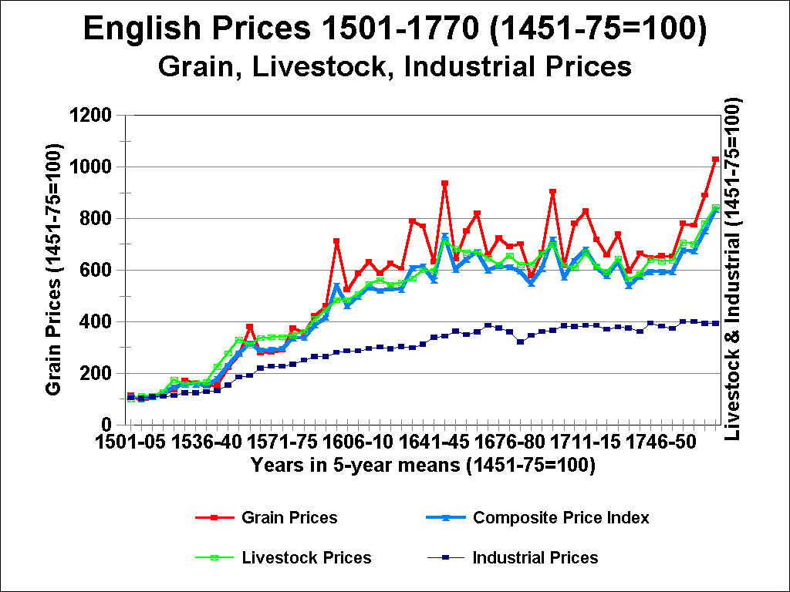

Slide 43
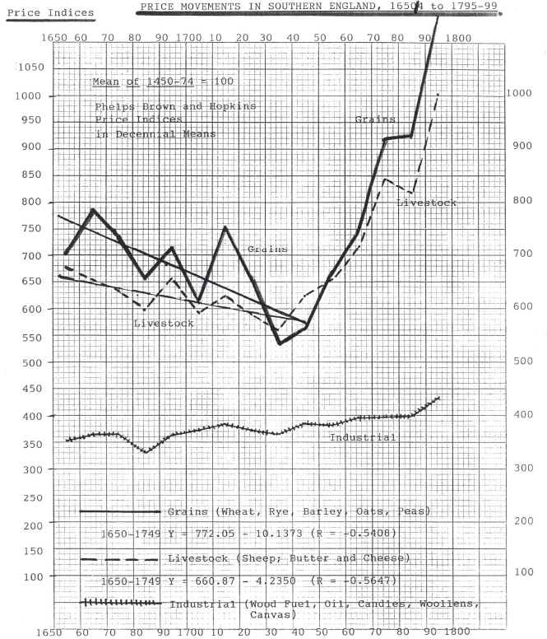

Slide 44
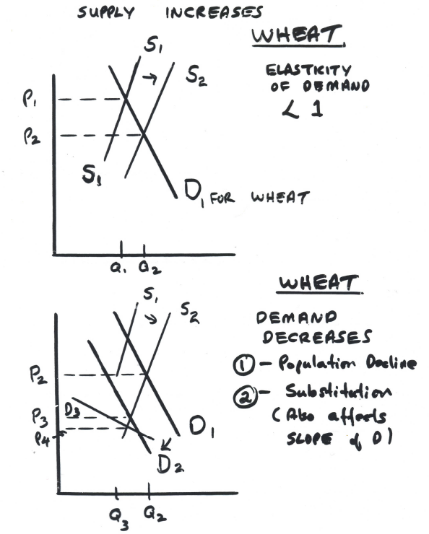

Slide 45
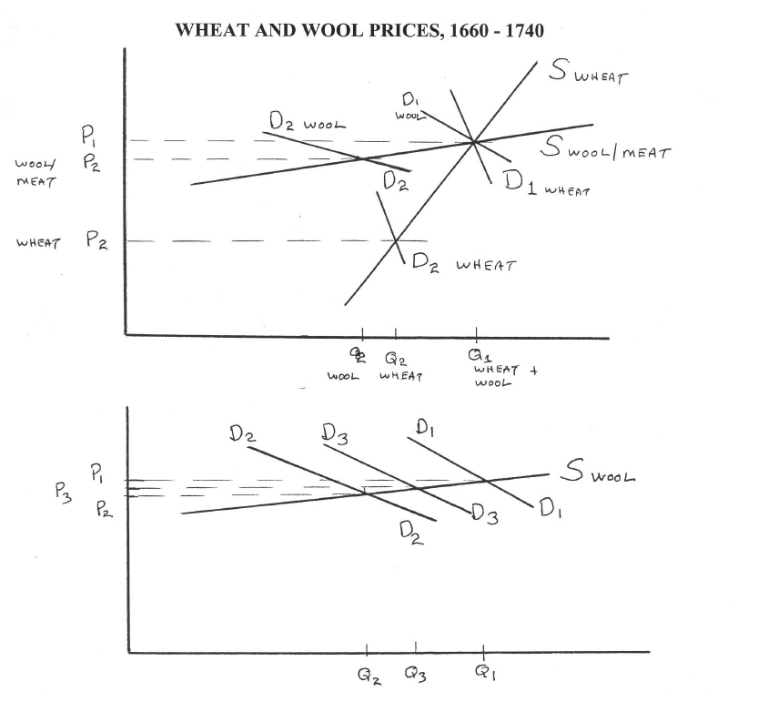

Slide 46
The Agrarian Recession of 1660 – 1740 (5)
(3) Explanations for Relative-Price Changes:
a) demographic decline & stagnation: as already seen (in previous lectures)
i) see graphs for grain & wool prices:
ii) Demand falls from D(1) to D(2) with fall in population:
grain prices fall much more than livestock prices because of different supply elasticities

Slide 47
The Agrarian Recession of 1660 – 1740 (6)
iii) Falling grain prices, with inelastic demand & supply ➔ liberates Δ consumer income to be spent on other food products with greater demand elasticities
both price & income elasticities of demand:
especially for livestock products – meat, butter, cheese, other dairy products + vegetable and industrial crops (derived demand): Δ D as price falls or real income rises

Slide 48
The Agrarian Recession of 1660 – 1740 (7)
iv) the income effect: shifts demand schedule upward for such livestock products (etc) from D2 to D3
v) Greater Elasticity of supply for Livestock products: flatter-sloped supply curves
with alternative uses, and with ability to retain or postpone disposition,
while grain, once planted, had to be harvested and sold (without storage granaries).

Slide 49
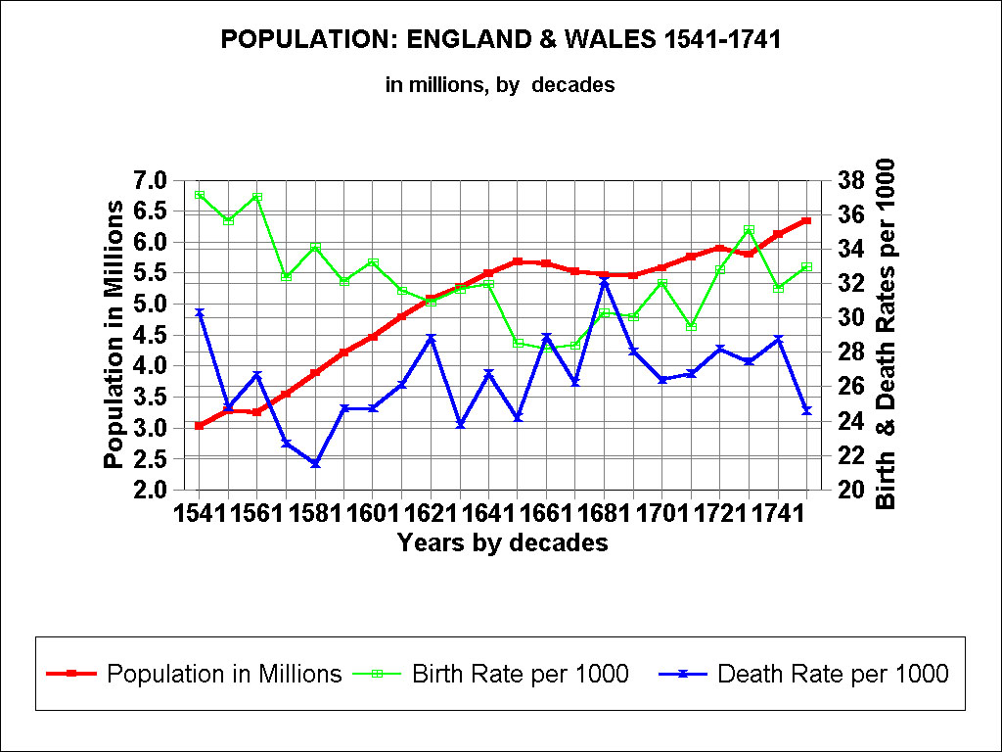

Slide 50
The Agrarian Recession of 1660 – 1740 (8)
(3) Explanations for Relative-Price Changes:
b) Expanded grain supplies: European markets
i) essential problem: European + English grain shipments to export markets > than demand
ii) Note that England had suddenly become a major grain exporter from 1650s – indicating success of New Husbandry
iii) Now competing with the Dutch, cutting into their Baltic grain exports, which did not fall as English grain exports rose: see tables

Slide 51
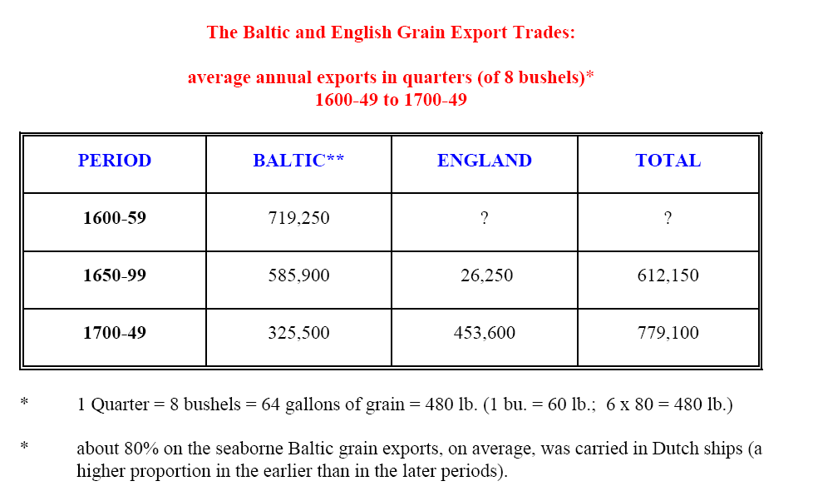

Slide 52
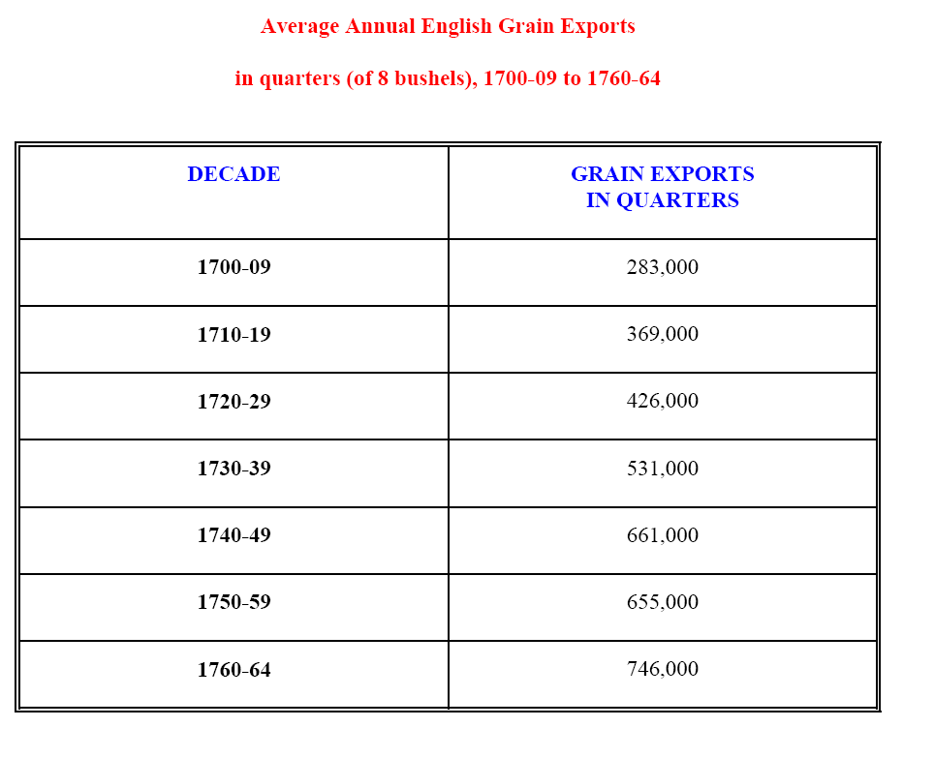

Slide 53
The Agrarian Recession of 1660 – 1740 (9)
(3) Explanations for Relative-Price Changes:
c) New competition: other carbohydrates
- increased production and European trade in new crops, as alternatives to grains:
- rice, corn (maize), and potatoes (later 17th)
- note a major factor in changing demand elasticities:
new substitutes ➔ shifting demand, altering slope of the demand curve (more elastic)

Slide 54
Consequences of Agrarian Recession of 1660 – 1740 (1)
(1) In arable farming, with sharply falling grain prices:
a) Agricultural Production: shift in relative prices ➔ favoured production of livestock products and non-grain arable crops ➔ thus major incentive to shift away from grain-based agriculture
i) advantages of Convertible Husbandry: increased supply and lowered relative costs of livestock and non-grain arable products
ii) Convertible Husbandry + Norfolk Farming: eliminated the fallow (NF: also eliminated pasture) ➔ greatly increasing productivity of both arable and pastoral farming

Slide 55
Consequences of Agrarian Recession of 1660 – 1740 (2)
(1) In arable farming, with sharply falling grain prices:
- b) Price-Cost Squeeze for grain farmers:
- i) while prices were falling, costs were not - were rising in real terms
- ii) historic problem of deflation for factor costs:
- factor-cost stickiness ➔ rise in real cost of labour (wages), capital (interest), land (rent)
- iii) price-cost squeeze ➔ powerful incentive to adopt New Husbandry, with lower costs + Δ productivity:
- increased productivity with lower costs, while producing products with more stable, often higher prices

Slide 56
Consequences of Agrarian Recession of 1660 – 1740 (3)
- c) advantages of Convertible Husbandry:
i) alternation in use of land (every 5 years) between arable and pasture (vs. fixed arable + pasture lands) ➔ increased productivity of both arable and pasture (livestock) lands
- ii) relative shift to pasture + livestock, with better product prices
- iii) more arable devoted to legumes & industrial crops, in response to better product prices.

Slide 57
Consequences of Agrarian Recession of 1660 – 1740 (4)
- c) advantages of Convertible Husbandry:
- iv) all crops provided more livestock fodder ➔ Δ manure
- v) new legumes: clover, alfalfa (lucerne), sainfoin: ➔ more powerful nitrogen fixing agents ➔ greater productivity, at lower costs
- vi) elimination of fallow ➔ Δ land in productive, much more profitable use
- vii) greater agricultural diversification ➔ Δ income security
- viii) disappearance of famines in England, by 1620s:

Slide 59
Consequences of Agrarian Recession of 1660 – 1740 (5)
(2) Decline of the Yeomanry (small farmers)
a) Yeomanry had reached height of its landholdings by the 1690s: thereafter ➔ downhill for most yeomen farmers (see table)
b) The ill winds of the Agrarian Recession: ➔ forced many yeomen (not engaged in New Husbandry) to sell lands to the aristocracy and upper gentry
c) Many Yeoman lacked adequate capitals, lands, and expertise to engage in New Husbandry ➔
- easiest route to economic security was to sell off lands (see following table).

Slide 60
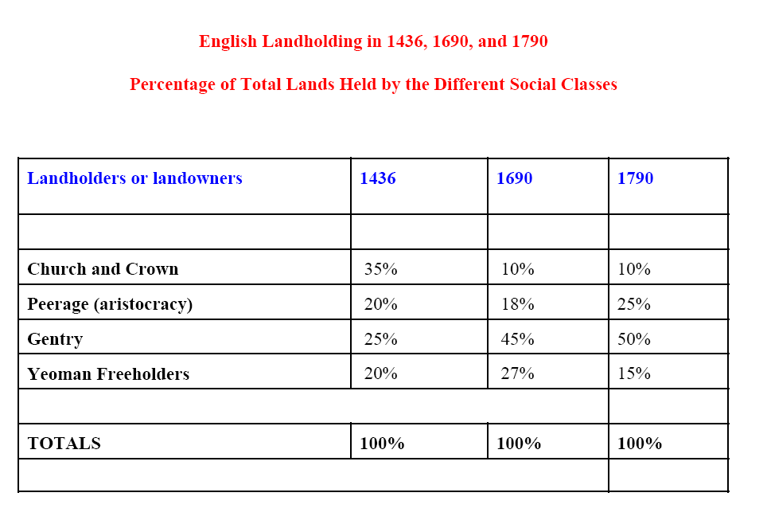

Slide 61
Consequences of Agrarian Recession of 1660 – 1740 (6)
3) Resurgence of Aristocracy & Great Landowners, 1660s to 1740s:
a) from Restoration of Monarchy in 1660: when king Charles II (d. 1685) gave or sold peerages to many of the upper gentry
b) Refutation of the Tawney ‘Rise of the Gentry’ thesis? No:
see reasons given in the previous lecture
- many of the new aristocracy were still ‘gentry’ in their outlooks, market-orientation, profit-maximizing
c) consider Habukkuk’s article: written the year before Tawney’s article

Slide 62
H.J. Habakkuk, ‘English Land Ownership, 1680-1740,’ Economic History Review, 1st ser. 10 (1940), 2-17.
Harrington, writing at the end of the Commonwealth period [under Cromwell in the 1650s, before the restoration of the monarchy in 1660] found the key to the Civil War in the shift of property from the Church, the Crown, and above all from the great semi-feudal landowners to the squires [the gentry].
This notion of the rise of the squirearchy [gentry] has become the organising conception of English social history between the Dissolution of the Monasteries and 1640 [outbreak of the Civil War].......

Slide 63
H.J. Habakkuk, ‘English Land Ownership, 1680-1740,’ Economic History Review, 1st ser. 10 (1940), 2-17.
Yet at the very time when continental observers were most vigorous in their praise of the squirearchy [in the early eighteenth century], it no longer represented the most important elements in English rural society.
The general drift of property in the sixty years after 1690 was in favour of the large estate and the great lord;
and while the movement was probably not so decisive as that which, in the hundred years before 1640, consolidated the squirearchy [gentry], it clearly marks one of the great changes in the disposition of English landed property.

Slide 64
Consequences of Agrarian Recession of 1660 – 1740 (7)
3) Resurgence of Aristocracy & Great Landowners, 1660s to 1740s:
d) Activities of the ‘rejuvenated’ aristocracy:
i) buying up lands of small landholders: yeomen and small gentry, who were in dire circumstances
ii) engaging in enclosures
iii) adopting New Husbandry: Convertible Husbandry and Norfolk Four Course systems
iv) investing in mining & metallurgical industries on their estates

Slide 65
Consequences of Agrarian Recession of 1660 – 1740 (8)
3) Resurgence of Aristocracy & Great Landowners, 1660 to 1740s
e) Introduction of Entail Land Settlements:
- i) entail law: important legal measure assisting great landlords:
- to protect integrity of inherited estates (patrimony): prevented any subdivisions or land sales – prevented land alienation
- ii) advantage: made entailed estates more attractive to mortgage lenders ➔ enabled landlords to borrow (mortgages) more cheaply

Slide 66
Consequences of Agrarian Recession of 1660 – 1740 (9)
e) Introduction of Entail Land Settlements:
iii) if landowner defaulted: mortgage holder acquired rights to income (‘fruits’) of the land, but not the land itself
iv) most landowners never paid off their mortgages: continuous refinancing at relatively low interest rates (when real rates were rising)
v) enabled great landowners to buy lands of small holders and to invest in the New Husbandry

Slide 67
Consequences of Agrarian Recession of 1660 – 1740 (9)
3) Resurgence of Aristocracy & Great Landowners
f) Equity of Redemption: ancillary measure (from early 17th century): related to Entail Settlements
- made mortgages negotiable, transferable assets ➔ so that mortgage holder, needing capital, could sell the mortgage to a third party (who collected the interest)
- importance: encouraged mortgage lending and enabled landowners to postpone indefinitely paying off (redeeming) mortgages
➔ allowing great landowners to borrow large sums quite cheaply

Slide 68
Consequences of Agrarian Recession of 1660 – 1740 (10)
4) Capital Intensive Farming on Large Estates:
a) Enclosures, Convertible Husbandry, Norfolk Farming: all very capital intensive ➔ requiring large investments
b) Enclosed estates with the New Husbandry: - offered best prospects for profiting during (or even surviving) during the post-1660 agrarian recessions

Slide 69
Consequences of Agrarian Recession of 1660 – 1740 (11)
4) Capital Intensive Farming on Large Estates:
c) Capital Intensive farming: also aided by post-1660 development of new financial institutions ➔ led to fall in long-term interest rates (see subsequent lectures)
d) Enclosures continued, unabated, in century 1660 – 1740: but process accelerated during the ensuing Industrial Revolution era:
- Parliamentary Enclosures (expropriations)

Slide 70
Agrarian changes before and during the Industrial Revolution
(1) The paradox of economic development: agriculture and industry
a) historical record demonstrates that both economic growth and modern industrialization depend upon radical changes in the agrarian structures
b) necessary changes for agrarian and economic growth:
i) replace feudal and communal tenures, rights & uses of land, with private-property forms of both ownership and land use: unified management, especially with enclosures (as seen in England)
ii) create free and efficient markets in land, labour, and capital

Slide 71
Agrarian changes before & during the Industrial Revolution - 2
iii) liberate labour, land, and capital from the agrarian sector and rural society to be utilized or invested more productively in other sectors of the economy: industry, trade, finances, transportation, services sector, etc.
iv) supply requisite increased supplies of foodstuffs and raw materials (as well as labour) to permit the growth of industrial towns: to permit and foster modern urban industrialization
v) increase rural demand for urban industrial products & services

Slide 72
Agrarian changes before & during the Industrial Revolution - 3
c) the historical paradox:
i) lies in the fact that historically the chief stimulus for positive agrarian changes, in both land use & technology, has always comes from increased urban demand -- and not just population growth (as in the Boserup model)
ii) historically, from the 12th century, European towns have grown and prospered from the symbiotic union of commerce, finance, and industry

Slide 73
Agrarian changes before & during the Industrial Revolution - 4
2) The historical record of the modern Industrial Revolutions in Great Britain, Germany, the US:
a) that modern Agricultural Revolutions were long drawn out processes - that both preceded and accompanied modern urban industrialization:
the agrarian and urban industrial changes mutually fostered and promoted each other, in each country
b) historical record of 19th century economic development in both France and Russia
reveals how serious defects in their agrarian structures impeded the processes of modern urban industrialization (as opposed to Britain & Germany)

