Slide 1
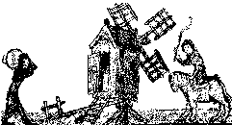
The Agricultural Revolution
Britain needed more food
Farms were still run on the medieval strip system
new ideas and machinery were being developed
By Mrs Sims-King
Downloaded from www.SchoolHistory.co.uk
Notes:
Introduce the theme of change and revolution – draw out the pattern of the countryside into strips. Review Year 8 topic of French revolution and Napoleonic wars and how this affected food supplies

Slide 2
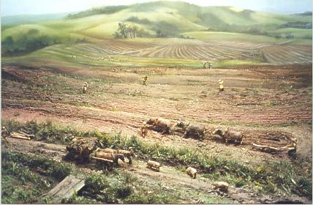
Disadvantages of the old system
People have to walk over your strips to reach theirs
Field left fallow
Difficult to take advantage of new farming techniques
No hedges or fences
No proper drainage
Because land in different fields takes time to get to each field
Animals can trample crops and spread disease
Notes:
Show picture first and ask for ideas about what the problem might be. Introduce and explain – encourage note taking at this stage in brief bullet points

Slide 3
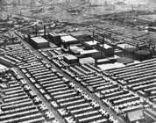
So what?
So this is an inefficient system and only produces enough food to feed you and your family, there is very little extra.
Towns are growing, the people in towns need feeding so extra food is needed.
No corn is being imported because of the war with France, so more corn is needed
Notes:
Develop the theme of more people in towns fewer in villages and that the present system does not produce enough

Slide 4
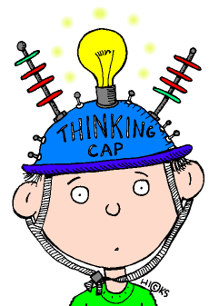
What is a Revolution and how can you have a farming revolution?
But what has
that got to
do with farming?
A revolution is any fundamental
change or reversal of conditions,
a great and sometimes violent change
or innovation
Notes:
Encourage brainstorm to produce definition before introducing this version. Discuss different types of revolution.

Slide 5
All right,so there was going to be a great change...
What exactly was this great change?
Great changes, you mean - and innovations
All right CHANGES..
First of all, there was enclosure, then there was the new machinery such as the seed drill and horse plough, not to mention marling and selective breeding…..
Notes:
Explain that there was not just the one change.

Slide 6
Enclosures?
This meant enclosing the land.
The open fields were divided up and everyone who could prove they owned some land would get a share. Dividing the open land into small fields and putting hedges and fences around them. Everyone had their own fields and could use them how they wished.
Open land and common land would also be enclosed and divided up.
Notes:
Encourage own research of the enclosures, what it meant both good and bad.

Slide 7
So what’s wrong with that?
Nothing - if you could
prove you owned the land,
if you had the money for
fences and hedges and if you
could afford to pay the
commissioners to come
and map the land,
not to mention the cost of an Act
of Parliament.

Slide 8
So did people want to enclose their land?
Well, some did and some didn’t. If they did not agree it was hard luck. If the owners of four fifths of the land agreed they could force an Act of Parliament- there was a great increase in the number of these in the eighteenth century, from 30 a year to 60, then from 1801 to 1810 there were 906, nearly 3 million hectares were enclosed.

Slide 9
Were there winners and losers?
Yes, the better off farmers and landowners gained the most - the rich got richer and the poor got poorer. People who had no written proof of ownership lost their land altogether. Some couldn’t afford to pay for fences and had to sell their land. These people either became labourers on other peoples land or headed for the towns to try and get a job.
One farm labourer said: ‘All I know is that I had a cow and an Act of Parliament has taken it from me.’ There were riots in some villages.
Notes:
Look at the research already done and ask if they could understand what the farm labourer meant.

Slide 10
Selective Breeding?
Some farmers such as Robert
Bakewell and the Culley
brothers concentrated on selective breeding.
This meant only allowing the fittest and strongest of their
cattle, sheep, pigs and horses to mate.
You can tell how successful they were:
In 1710 the average weight for cattle was
168 Kg by 1795 - it was 363 Kg
Notes:
Find pictures of the animals they bred – do they look healthy by today’s standards, what does it tell us about how they thought of their achievements that they had portraits painted.

Slide 11
What other new ideas were there?
Marling
Crop rotation
Seed drill
Publicity
New ploughs
and hoes
Notes:
Give a brief explanation of each of these points and encourage own research of them

Slide 12
Publicity?!
Yeah, books were written on farming, there were model farms set up - George III set up one at Windsor.
The Board of Agriculture was set up and Arthur Young, the new secretary, went round the country recording the progress of the revolution and others could read his report to find out more.
Agricultural shows with competitions were held and people could exchange ideas and see the latest things.

Slide 13
But it wasn’t all good news
New machines meant less people were needed to work the land - so there was unemployment, enclosure meant people lost land - this meant losing their homes as they had nowhere to grow food and there was little work- so they moved to towns.
In addition there were change in the
way the land looked from
open fields to a sort of patchwork quilt.
Changes in the shape of a village
as people could build on their own land

Slide 14
Was it a revolution?
Well, there were some dramatic and
rapid changes in some villages but
really the whole thing was quite gradual. After
all farming had been changing slowly
for a long time. Enclosures had been
happening even in Tudor
times. So perhaps it was more evolution than
revolution.
Notes:
Review year 7 understanding of immediate and gradual change – was revolution the right word.

Slide 15

Your tasks
1. Find out about crop rotation, what were the crops
and how did they rotate? Who had the idea?
2. Agricultural shows - who had the idea? How did he encourage his tenants to use the new fangled ideas?
3. What is marling?
4. Jethro Tull - who is he and why is 1701 significant?
5. New ploughs and hoes? How were they different?
And finally
How did farming change between 1701 and 1850?
Notes:
These questions can be used to plan the final question, treat the final question as an essay if time otherwise summary paragraph

