Slide 1
9
Soil and Agriculture
Part A
PowerPoint® Slides prepared by
Jay Withgott and Kristy Manning
Copyright © 2006 Pearson Education, Inc., publishing as Benjamin Cummings

Slide 2
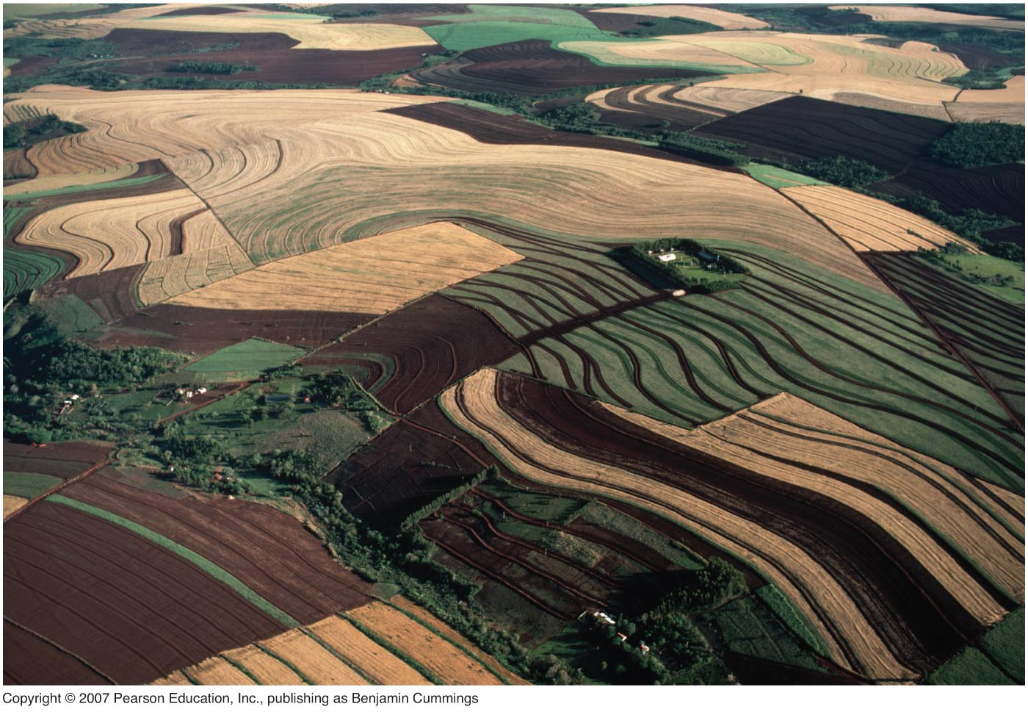
This lecture will help you understand:
Soils and agriculture
A brief history of agriculture
Soil science fundamentals
Soil erosion and degradation
Soil conservation principles

Slide 3
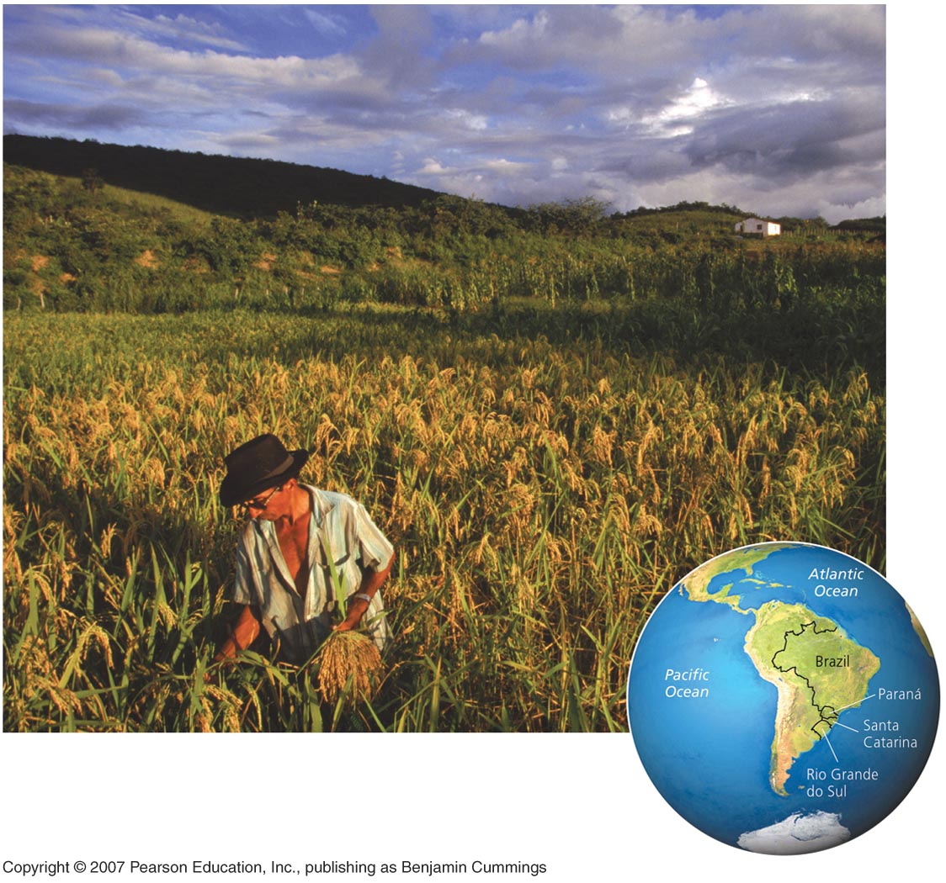
Central Case: No-Till Agriculture in Brazil
Southern Brazil’s farmers were suffering falling yields, erosion, and pollution from agrichemicals.
They turned to no-till farming, which bypasses plowing.
Erosion was reduced, soils were enhanced, and yields rose greatly. No-till methods are spreading worldwide.

Slide 4
Agriculture today
We have converted 38% of Earth’s surface for agriculture, the practice of cultivating soil, producing crops, and raising livestock for human use and consumption.
Croplands (for growing plant crops) and rangelands (for grazing animal livestock) depend on healthy soil.

Slide 5
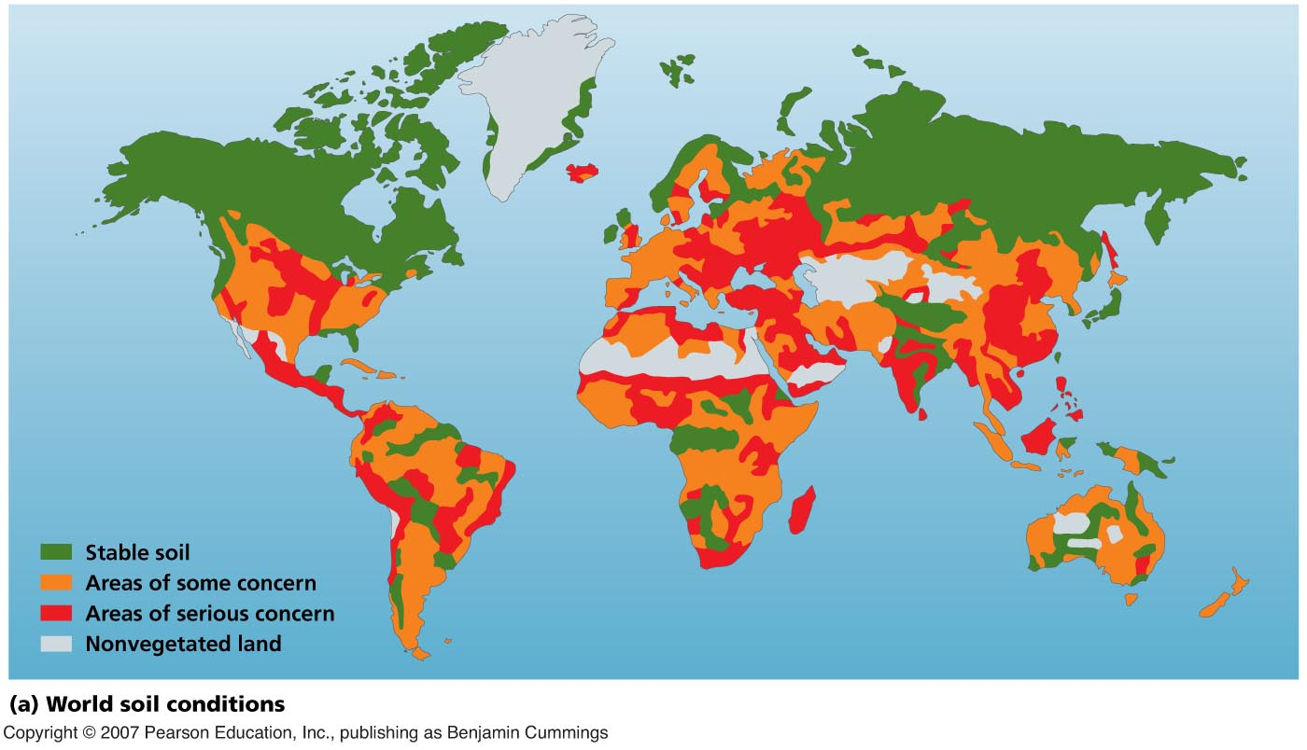
World soil conditions
Soils are becoming degraded in many regions.

Slide 6
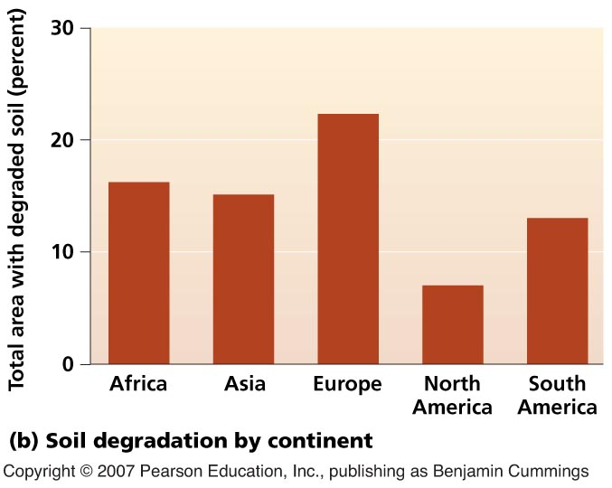
Soil degradation by continent
Europe’s land is most degraded because of its long history of intensive agriculture.
But Asia’s and Africa’s soils are fast becoming degraded.

Slide 7
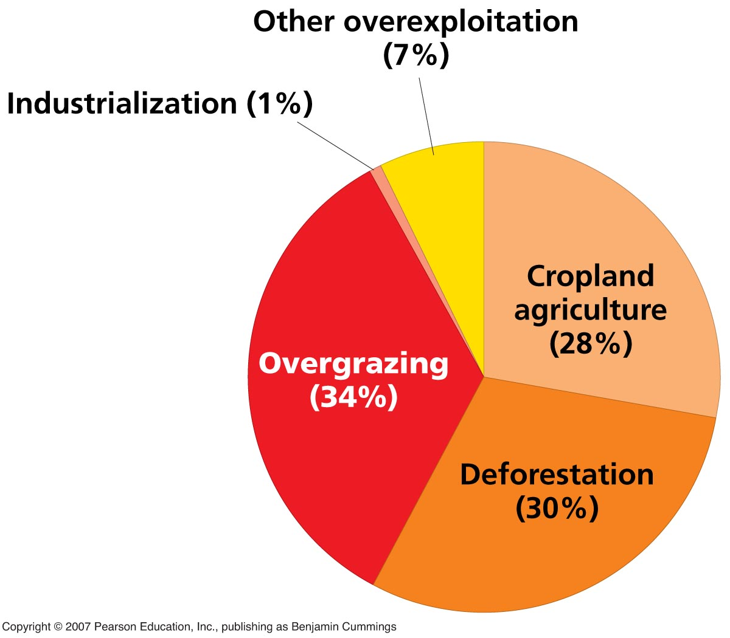
Causes of soil degradation
Most soil degradation is caused by:
Livestock overgrazing
Deforestation
Cropland agriculture

Slide 8
Prehistory of agriculture
People began shifting from hunting and gathering to agriculture about 10,000 years ago.
It probably began thus:
People brought back to camp the best wild fruits and seeds they could gather.
Some were dropped or disposed of nearby.
Plants grew near encampments.
Plants with favored qualities were selected and bred by proto-farmers (artificial selection).

Slide 9
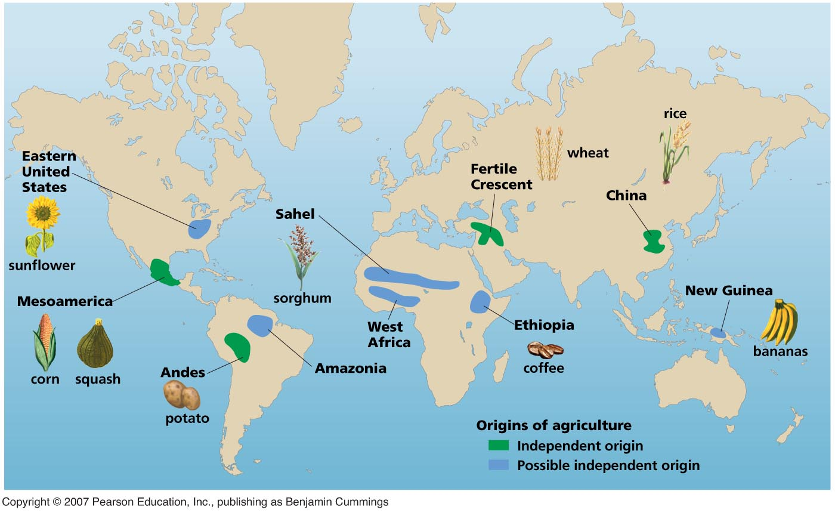
Origins of agriculture
Agriculture originated independently in several regions.

Slide 10
Traditional agriculture
Agriculture by muscle power, animals, hand tools, simple machines
Subsistence agriculture = family produces only enough for itself
Intensive traditional agriculture = family uses animals, irrigation water, and fertilizer to produce enough to sell at market

Slide 11
Industrialized agriculture
Modern intensive agriculture demands that vast fields be planted with single types of crops.
Monoculture is the uniform planting of a single crop.

Slide 12
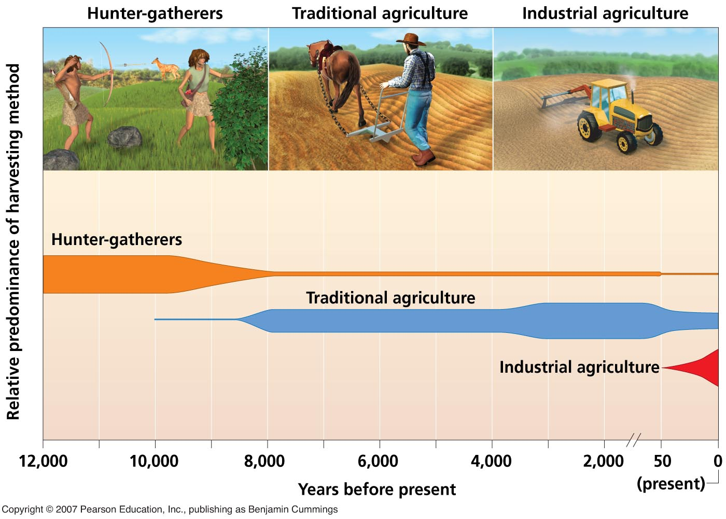
History of agriculture
Industrialized agriculture is displacing traditional farming, just as traditional farming displaced hunting and gathering.

Slide 13
The green revolution
An intensification of industrialization of agriculture, which has produced large yield increases since 1950.
Increased yield per unit of land farmed.
Begun in U.S. and other developed nations; exported to developing nations like India and those in Africa.

Slide 14
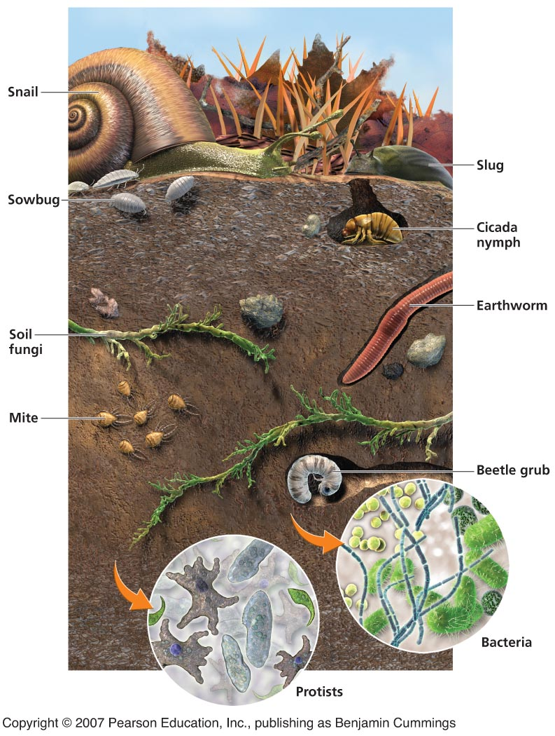
Soil as a system
Soil is a complex mixture of organic and inorganic components.

Slide 15
Soil formation
Parent material: starting material affects composition of the resulting soil.
It can include bedrock, the solid rock that makes up the Earth’s crust.
Weathering: the processes that break down rocks and minerals, and the first step in soil formation.
Erosion: the movement of soil from one area to another.

Slide 16
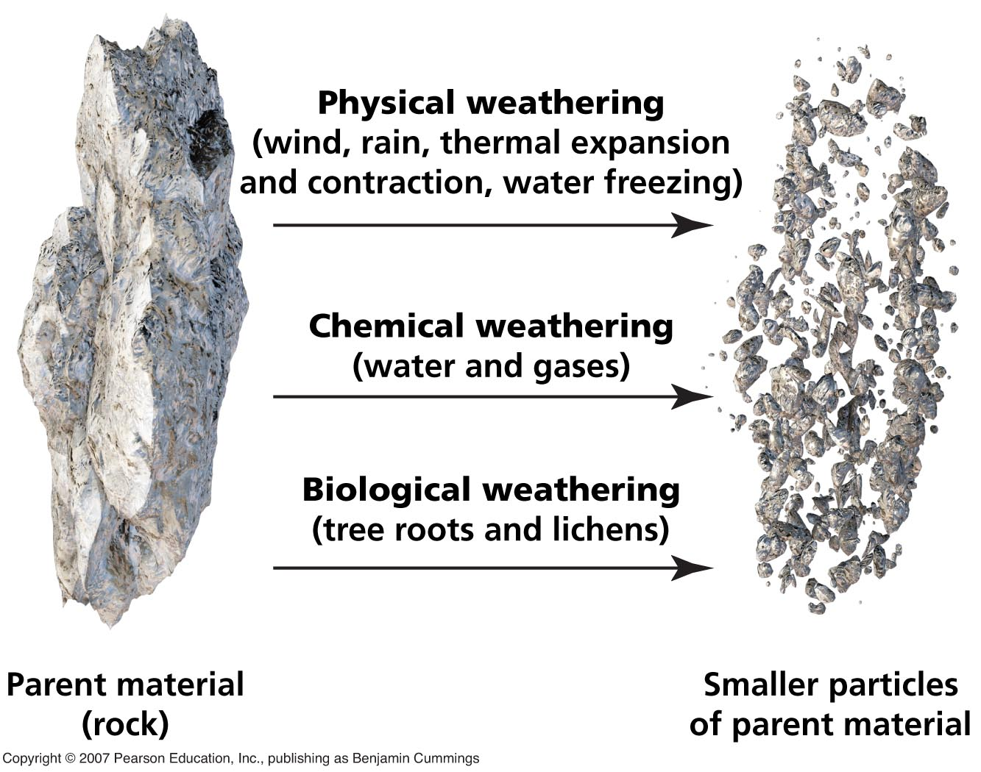
Three kinds of weathering
Physical or mechanical
Chemical
Biological

Slide 17
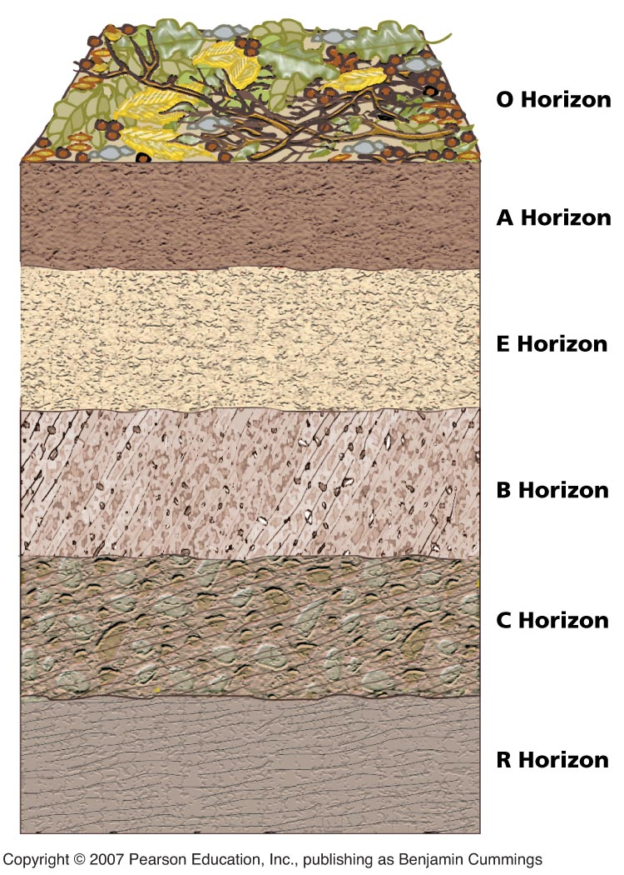
Soil profile
Consists of layers called horizons
Simplest:
A = topsoil
B = subsoil
C = parent material
But most have O, A, E, B, C, and R

Slide 18
Soil profile
O Horizon: Organic or litter layer
A Horizon: Topsoil; mostly inorganic minerals with some organic material and humus mixed in; crucial for plant growth
E Horizon: Eluviation horizon; loss of minerals by leaching, a process whereby solid materials are dissolved and transported away
B Horizon: Subsoil; zone of accumulation or deposition of leached minerals and organic acids from above
C Horizon: Slightly altered parent material
R Horizon: Bedrock

Slide 19
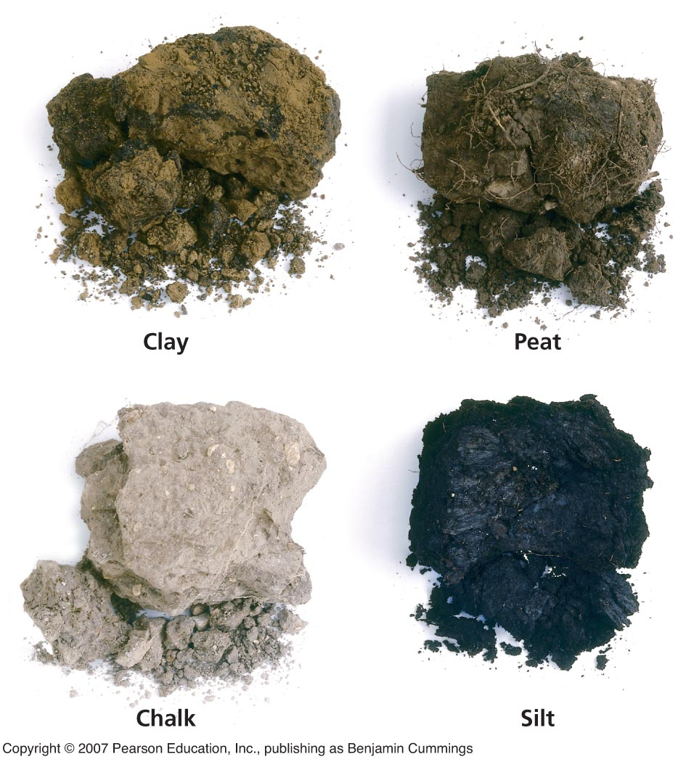
Soil characterization
Soil can be characterized by color and several other traits:
Texture
Structure
pH

Slide 20
Soil texture
Determined by size of particles
Three main categories:
Clay = particles < 0.002 mm diameter
Silt = particles 0.002–0.05 mm diameter
Sand = particles 0.05–2.0 mm diameter
Best for plant growth is loam, an even mix of these three types.

Slide 21
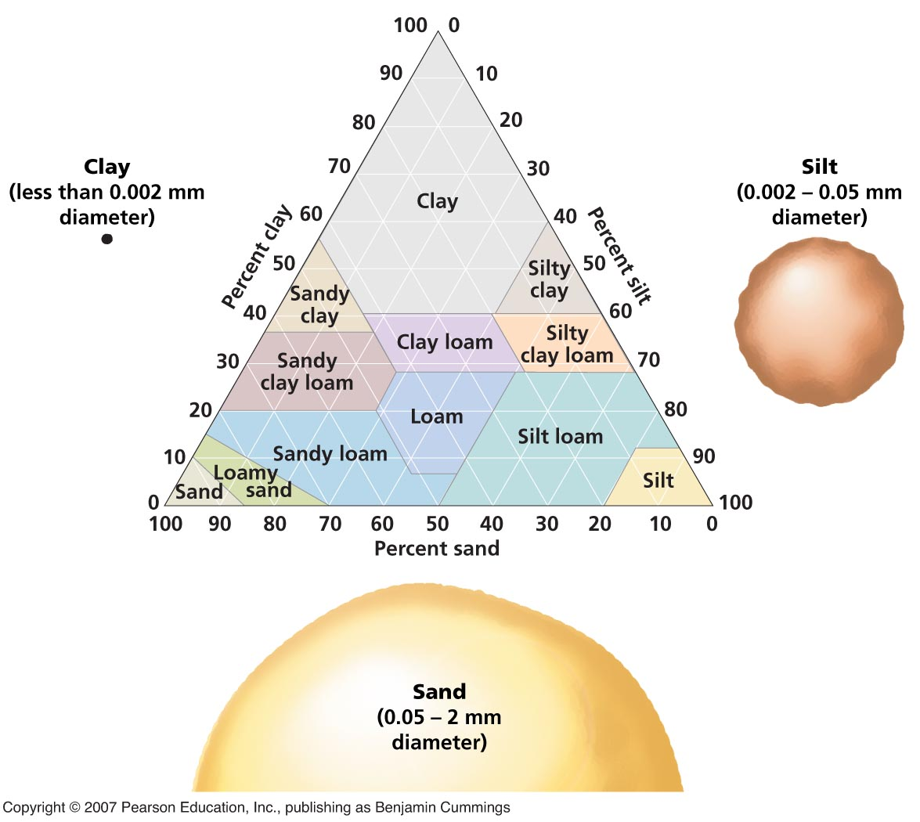
Soil texture

Slide 22
Soil structure
Soil structure: a measure of the “clumpiness” of the soil
Soil pH: the degree of acidity or alkalinity, which influences a soil’s ability to support plant growth

Slide 23
Regional soil differences and agriculture
Soil and soil profiles vary from place to place, with implications for agriculture.
Amazonian rainforest soil = lots of rain; leaches nutrients from topsoil out of reach of plant roots. Other nutrients taken up by lush vegetation, leaving little in soil.
Thus when farmed, soil gives out after a few years.
Kansas prairie soil = low rainfall keeps nutrients in topsoil, where plants take them up and recycle them back into soil when they die. Topsoil rich and productive.

Slide 24
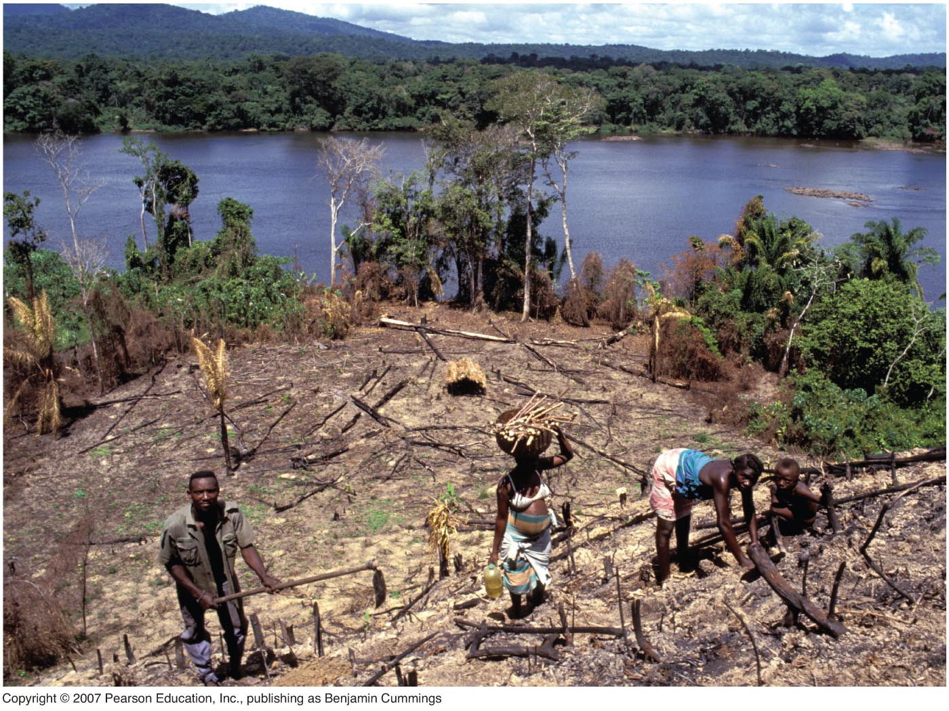
Swidden agriculture
In swidden agriculture, tropical forest is cut, the plot is farmed for 1-2 years, and the farmer moves on to clear another plot, leaving the first to regrow into forest.

Slide 25
Erosion and deposition
Erosion = removal of material from one place and its transport elsewhere
by wind
or water
Deposition = arrival of eroded material at a new location
These processes are natural, and can build up fertile soil.
But where artificially sped up, they are a big problem for farming.

Slide 26
Erosion
Commonly caused by:
• Overcultivating, too much plowing, poor planning
• Overgrazing rangeland with livestock
• Deforestation, especially on slopes

Slide 27
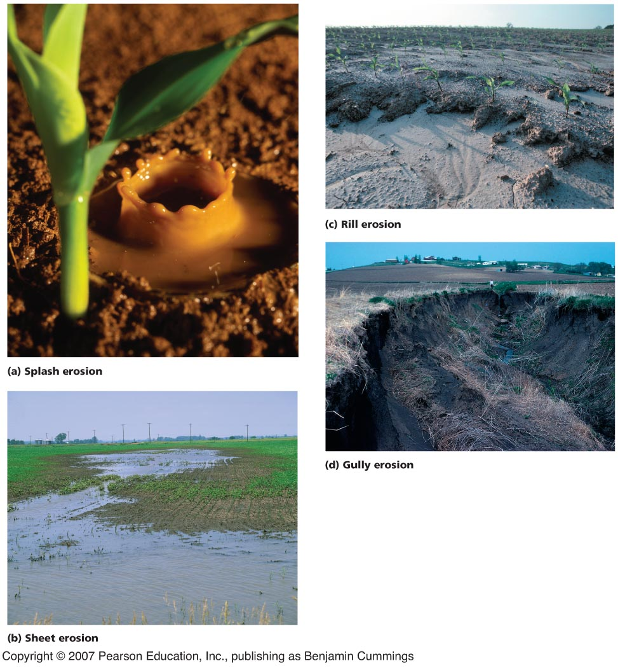
Types of soil erosion

Slide 28
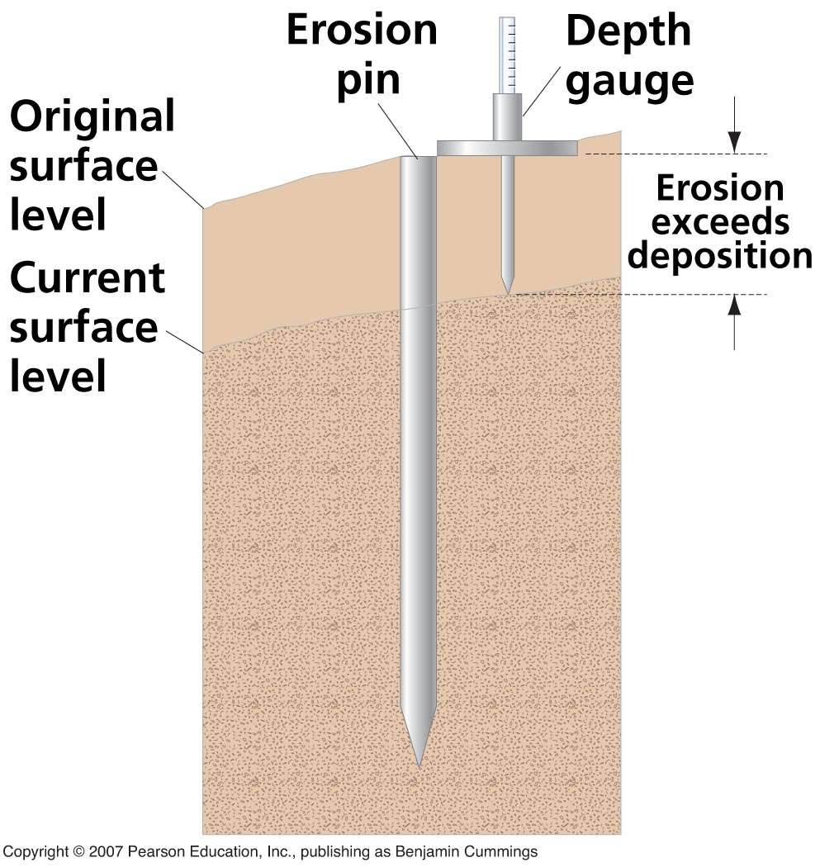
Measuring soil erosion
Low-tech but effective method
Exposure of pin shows amount of erosion since it was placed in ground, level with surface.

Slide 29
Soil erosion
Soil erosion is a global problem.
Coupled with rapid population growth, these two forces spell crisis for the future of agriculture.
Humans are the primary cause of erosion.
Humans are over 10 times more influential at moving soil than are all other natural processes combined.

Slide 30
Desertification
A loss of more than 10% productivity due to:
Erosion
Soil compaction
Forest removal
Overgrazing
Drought
Salinization
Climate change
Depletion of water resources
etc.
When severe, there is expansion of desert areas, or creation of new ones, e.g., the Middle East, formerly, “Fertile Crescent.”

Slide 31
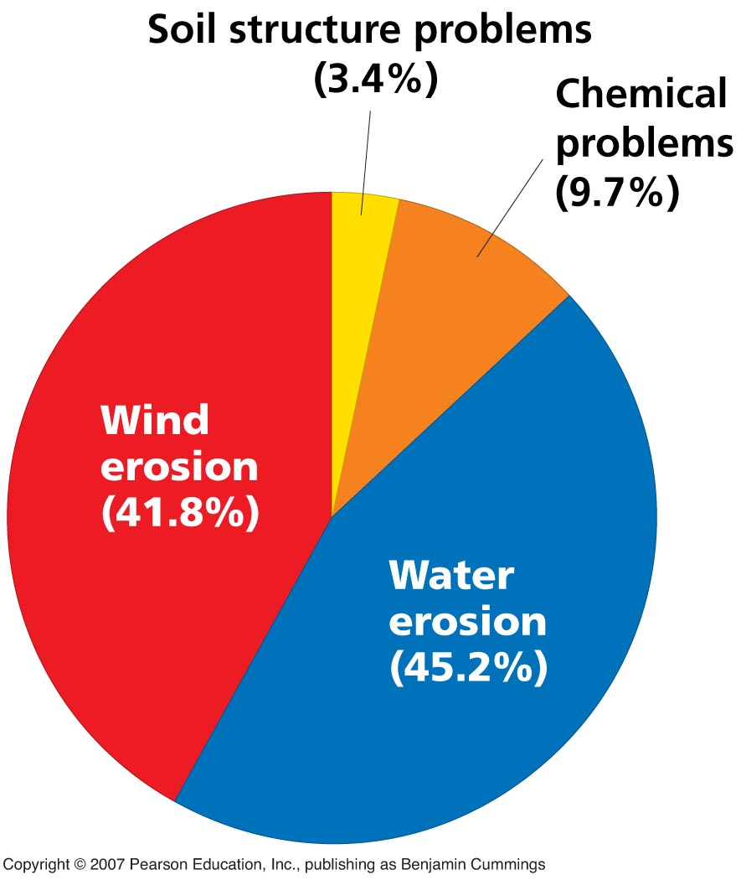
Soil degradation on drylands
Caused mostly by wind and water erosion

Slide 32
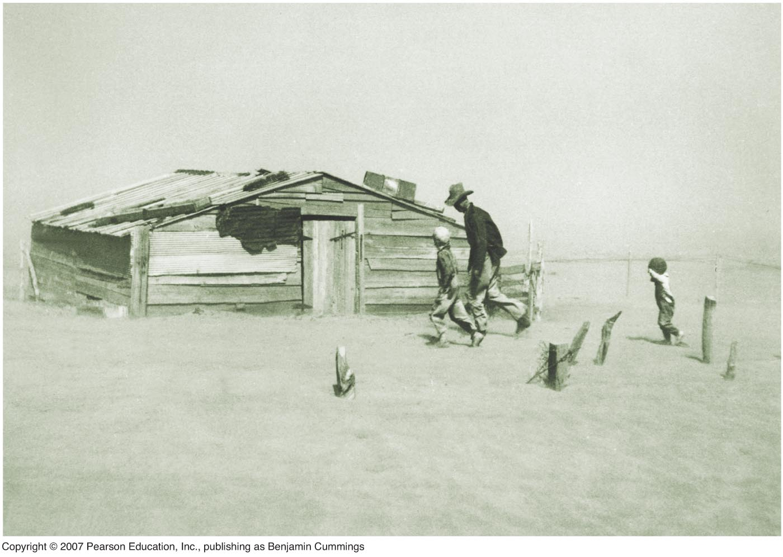
The Dust Bowl
Drought and degraded farmland produced the 1930s Dust Bowl.
Storms brought dust from the U.S. Great Plains all the way to New York and Washington, and wrecked many lives.

Slide 33
Soil conservation
As a result of the Dust Bowl,
the U.S. Soil Conservation Act of 1935 and
the Soil Conservation Service (SCS) were created.
SCS: local agents in conservation districts worked with farmers to disseminate scientific knowledge and help them conserve their soil.

Slide 34
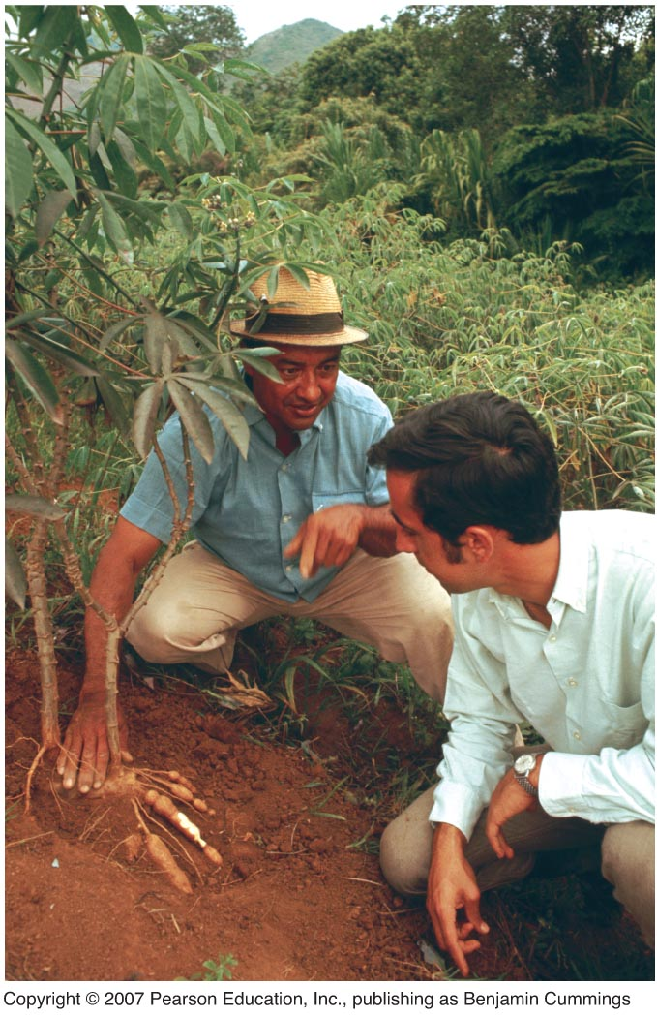
Soil conservation
Many nations followed the U.S. lead:
Today local soil conservation agents help farmers in many places in the world.
Brazil’s no-till effort is based on local associations.
Farmer and extension agent in Colombia

Slide 35
Preventing soil degradation
Several farming strategies to prevent soil degradation:
• Crop rotation
• Contour farming
• Intercropping
• Terracing
• Shelterbelts
• Conservation tillage

Slide 36
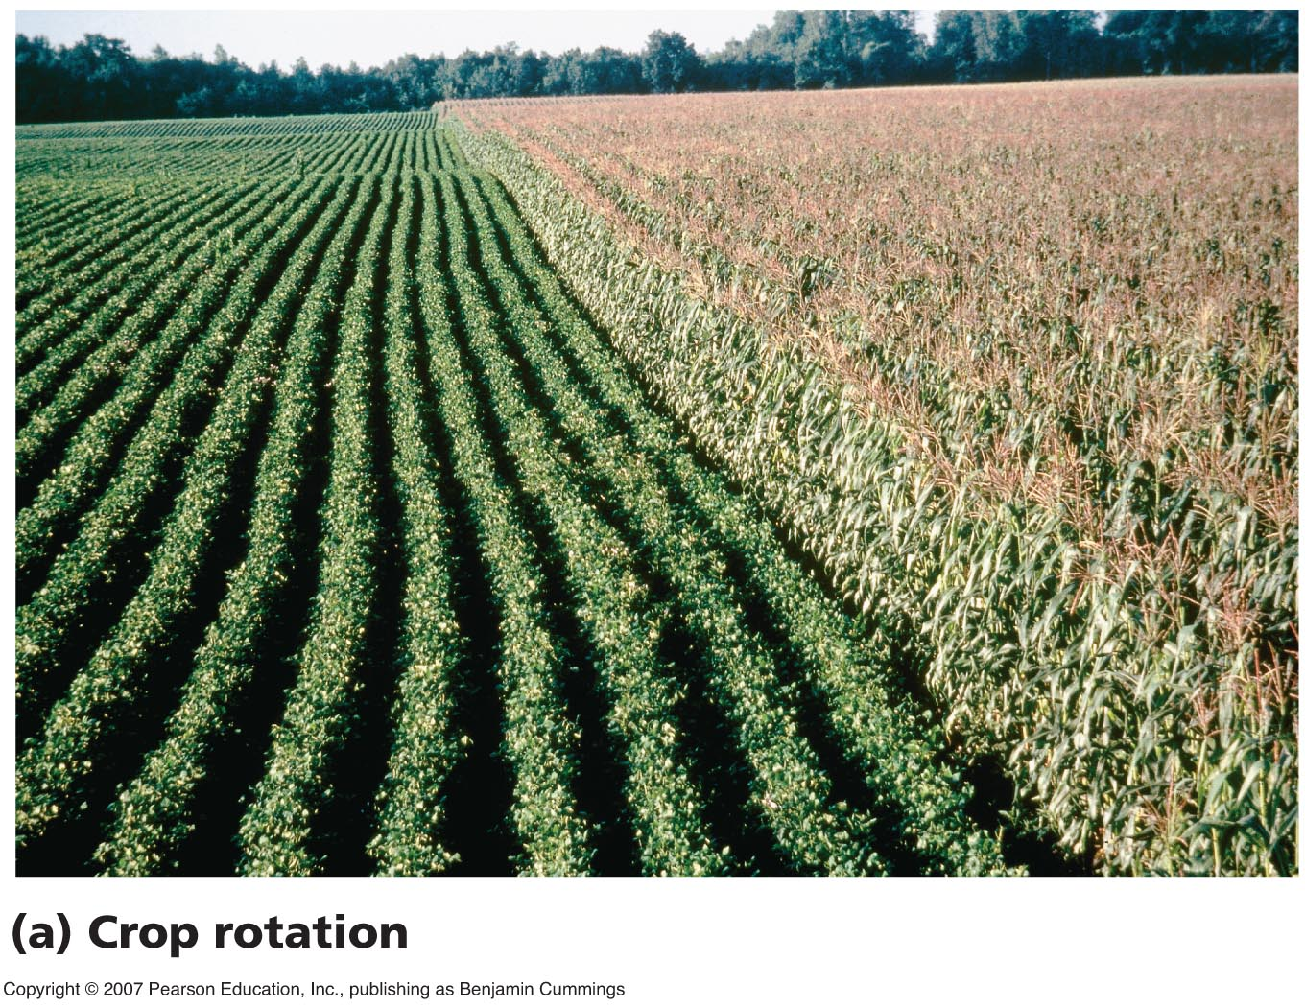
Crop rotation
Alternating the crop planted (e.g., between corn and soybeans) can restore nutrients to soil and fight pests and disease.

Slide 37
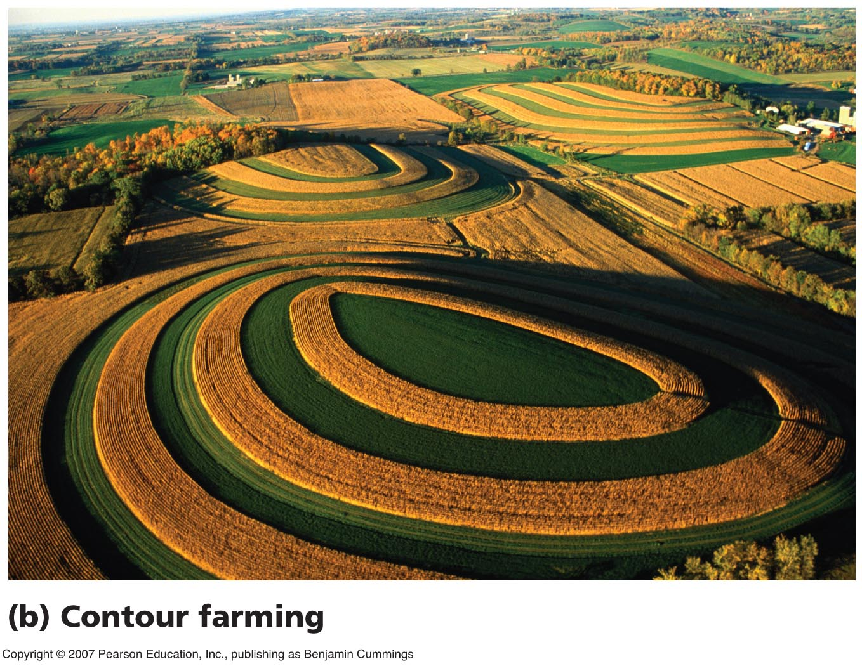
Contour farming
Planting along contour lines of slopes helps reduce erosion on hillsides.

Slide 38
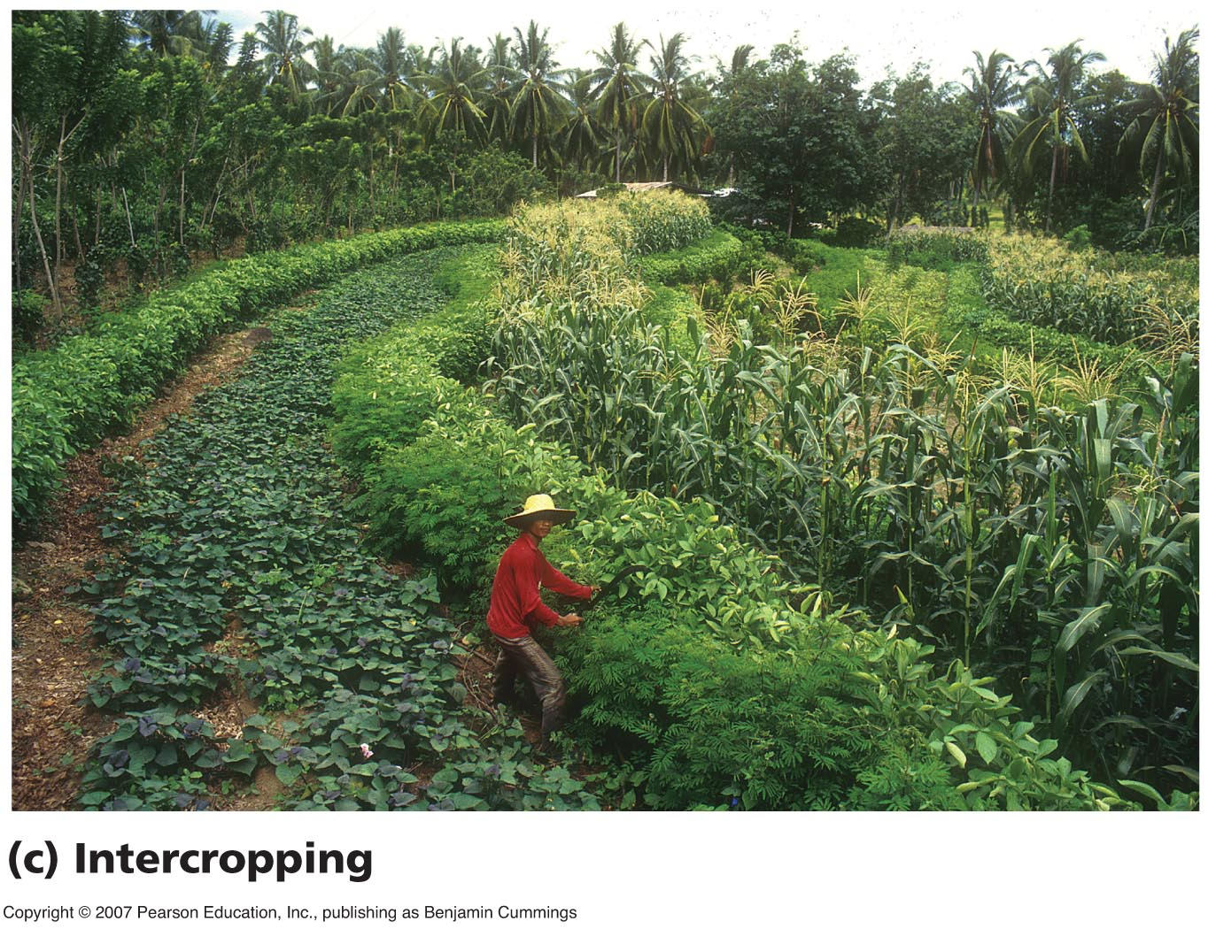
Intercropping
Mixing crops such as in strip cropping can provide nutrients and reduce erosion.

Slide 39
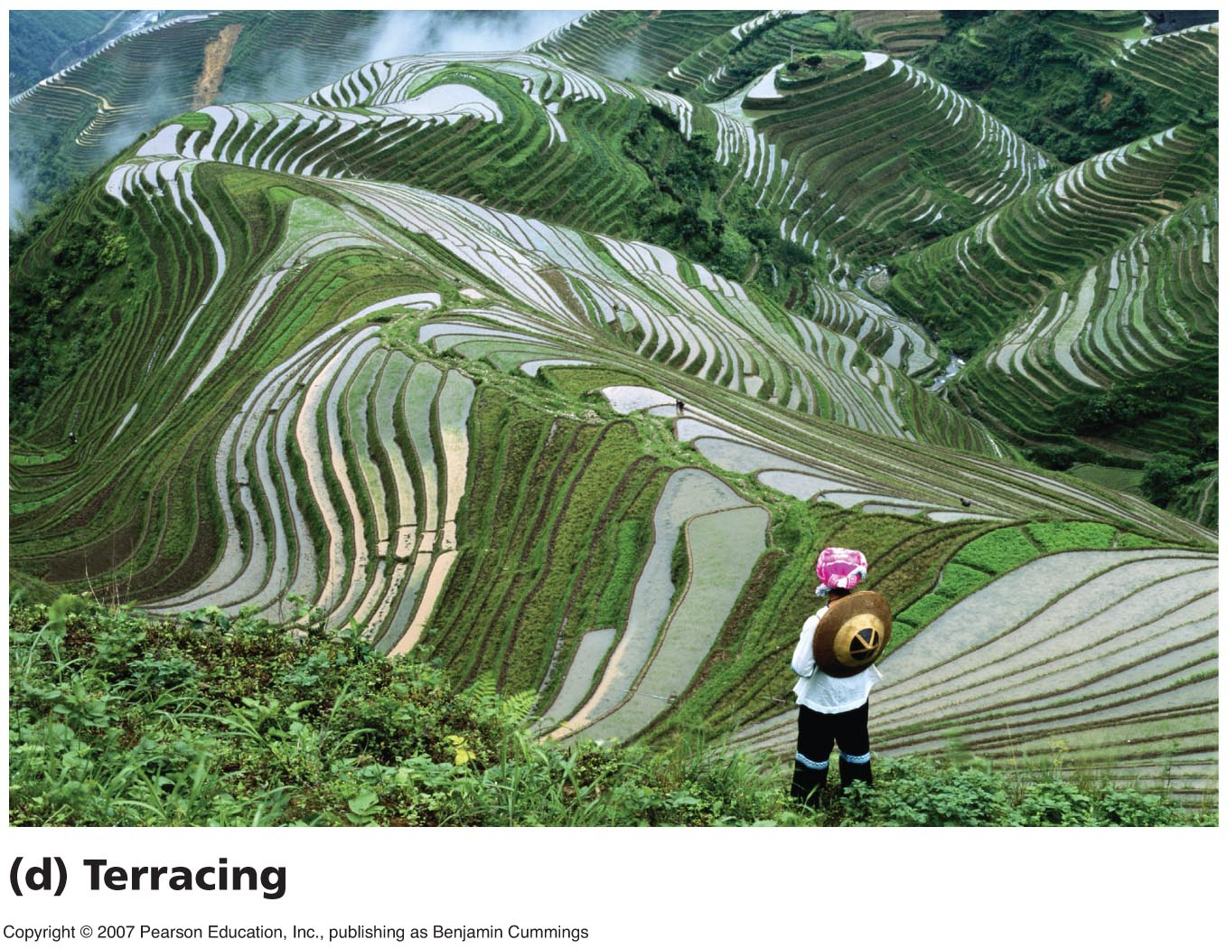
Terracing
Cutting stairsteps or terraces is the only way to farm extremely steep hillsides without causing massive erosion. It is labor-intensive to create, but has been a mainstay for centuries in the Himalayas and the Andes.

Slide 40
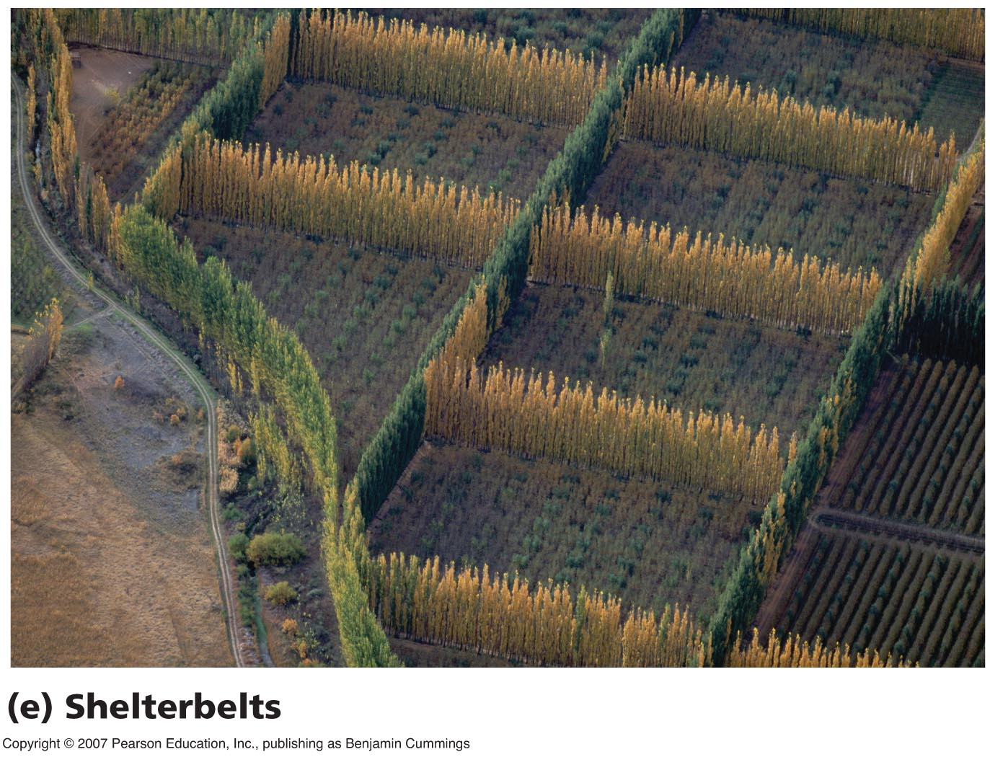
Shelterbelts
Rows of fast-growing trees around crop plantings provide windbreaks, reducing erosion by wind.

Slide 41
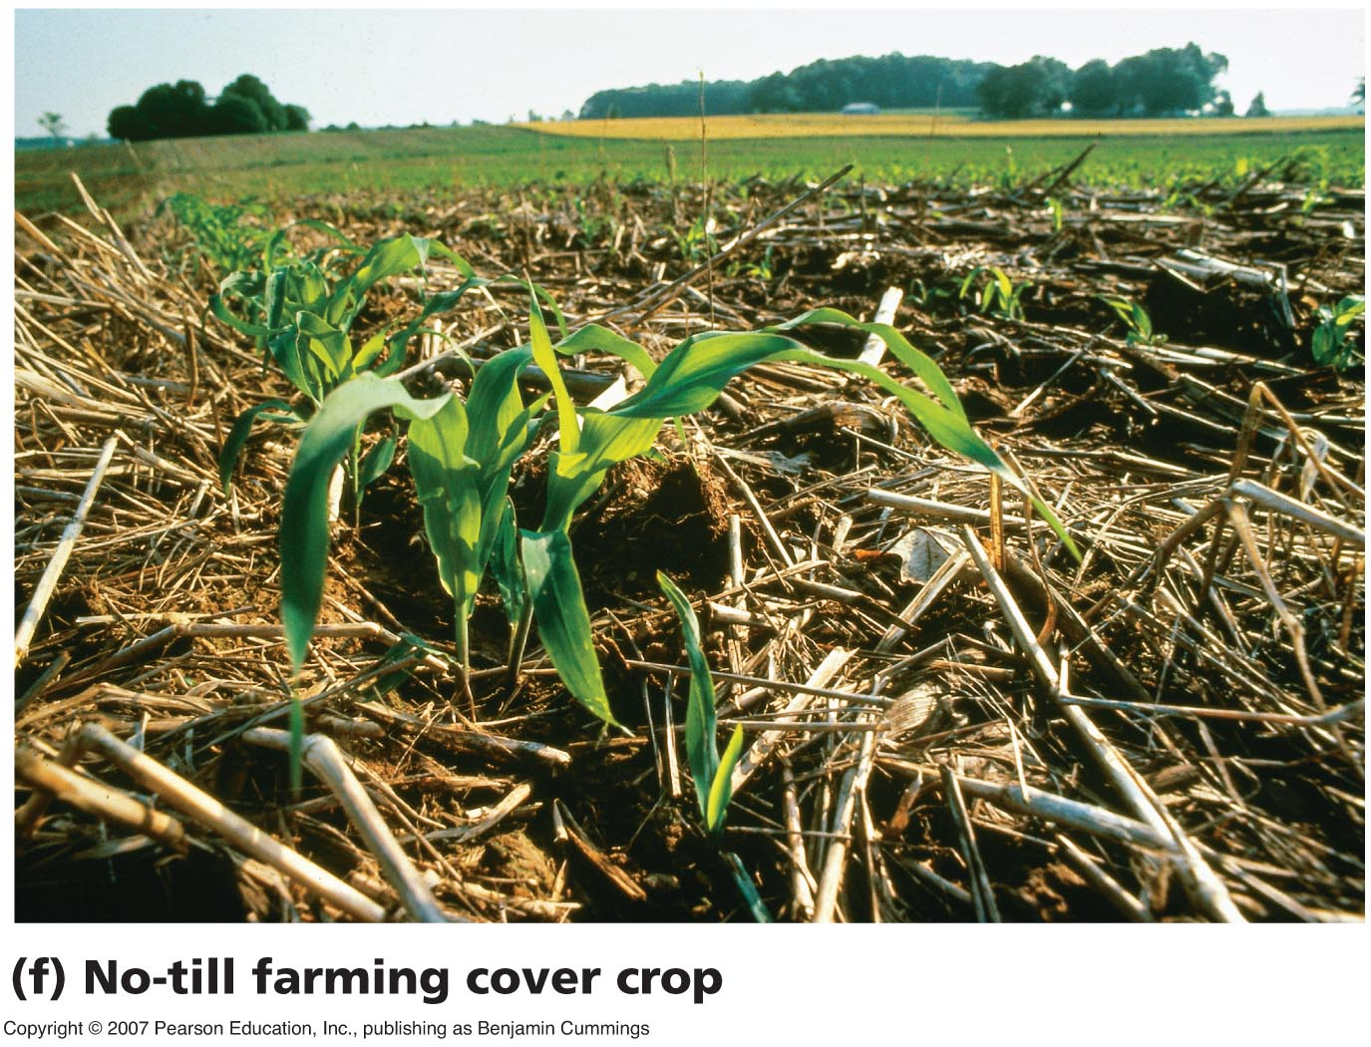
Conservation tillage
No-till and reduced-tillage farming leaves old crop residue on the ground instead of plowing it into soil. This covers the soil, keeping it in place.
Here, corn grows up out of a “cover crop.”

Slide 42
Conservation tillage
Conservation tillage is not a panacea for all crops everywhere.
It often requires more chemical herbicides (because weeds are not plowed under).
It often requires more fertilizer (because other plants compete with crops for nutrients).
But legume cover crops can keep weeds at bay while nourishing soil, and green manures can be used as organic fertilizers.

Slide 43
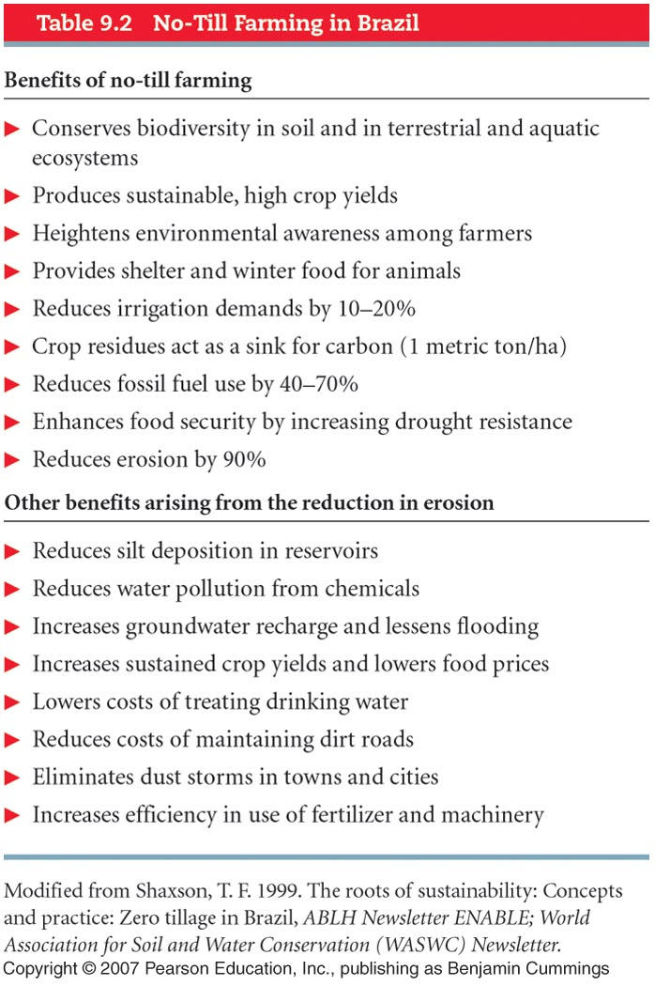
Benefits of no-till in Brazil

Slide 44
Irrigation
The artificial provision of water to support agriculture.
70% of all freshwater used by humans is used for irrigation.
Irrigated land globally covers more area than all of Mexico and Central America combined.
Irrigation has boosted productivity in many places … but too much can cause problems.

Slide 45
Waterlogging and salinization
Overirrigation can raise the water table high enough to suffocate plant roots with waterlogging.
Salinization (buildup of salts in surface soil layers) is a more widespread problem.
Evaporation in arid areas draws water up through the soil, bringing salts with it. Irrigation causes repeated evaporation, bringing more salts up.

Slide 46
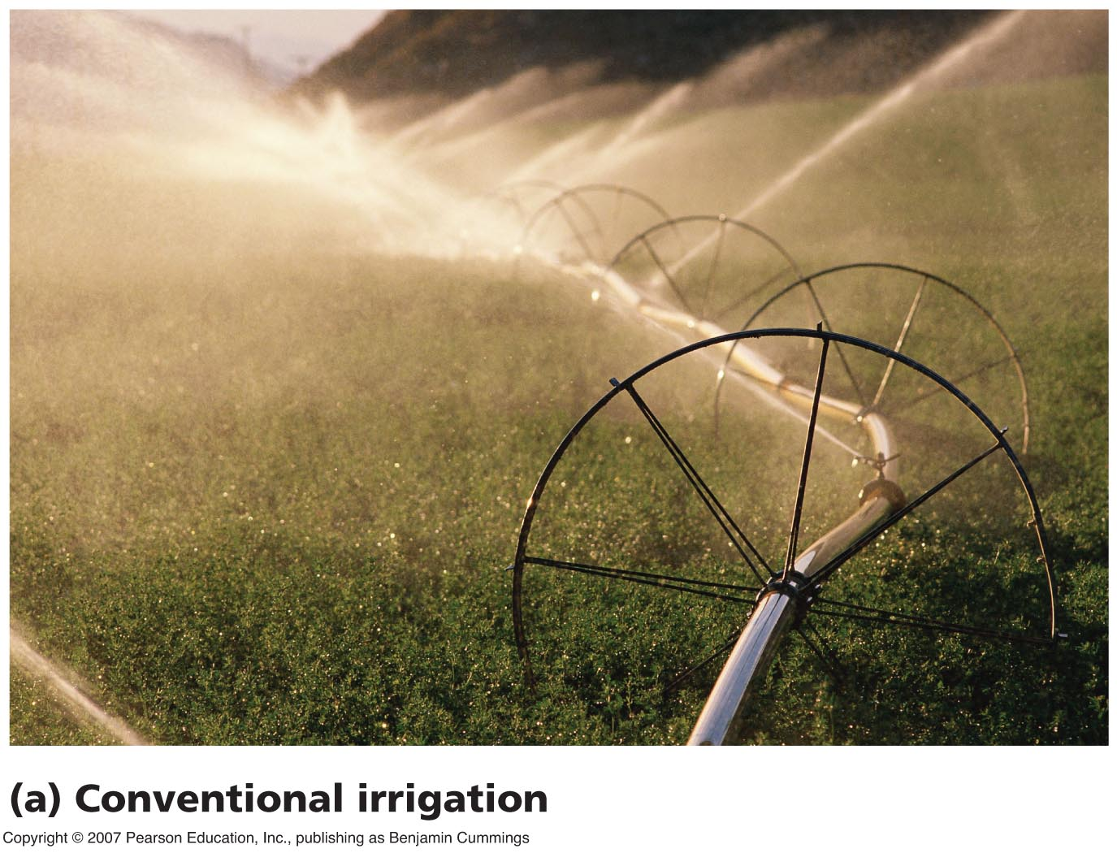
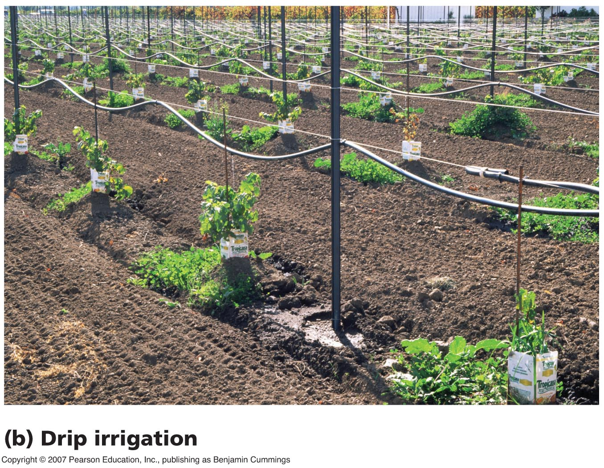
Improved irrigation
In conventional irrigation, only 43% of the water reaches plants.
Efficient drip irrigation targeted to plants conserves water, saves money, and reduces problems like salinization.

Slide 47
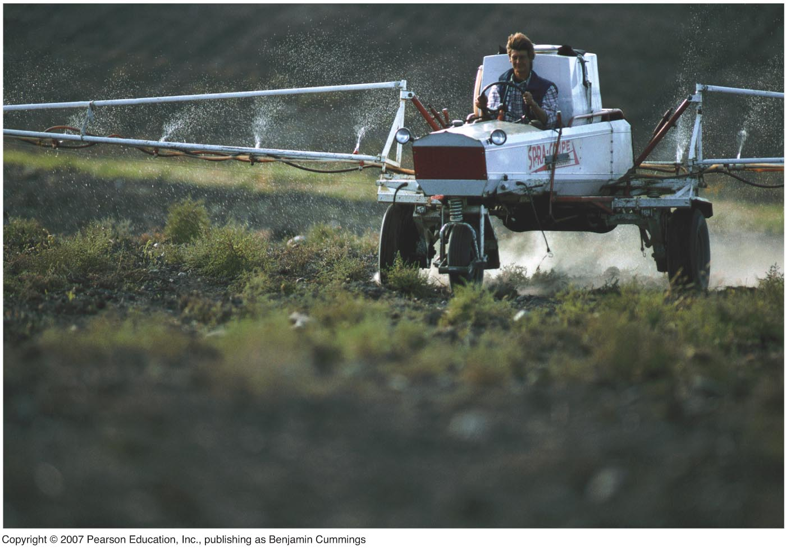
Fertilizers
Supply nutrients to crops
Inorganic fertilizers = mined or synthetically manufactured mineral supplements
Organic fertilizers = animal manure, crop residues, compost, etc.

Slide 48
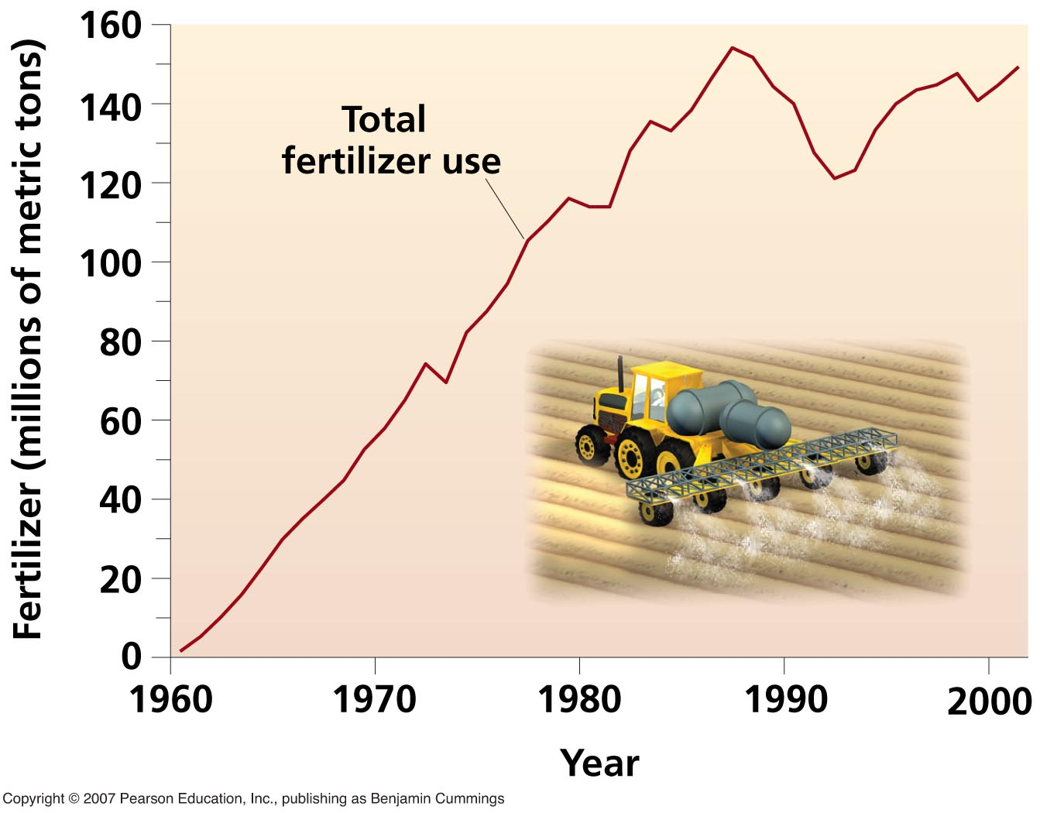
Global fertilizer usages
Fertilizer use has risen dramatically in the past 50 years.

Slide 49
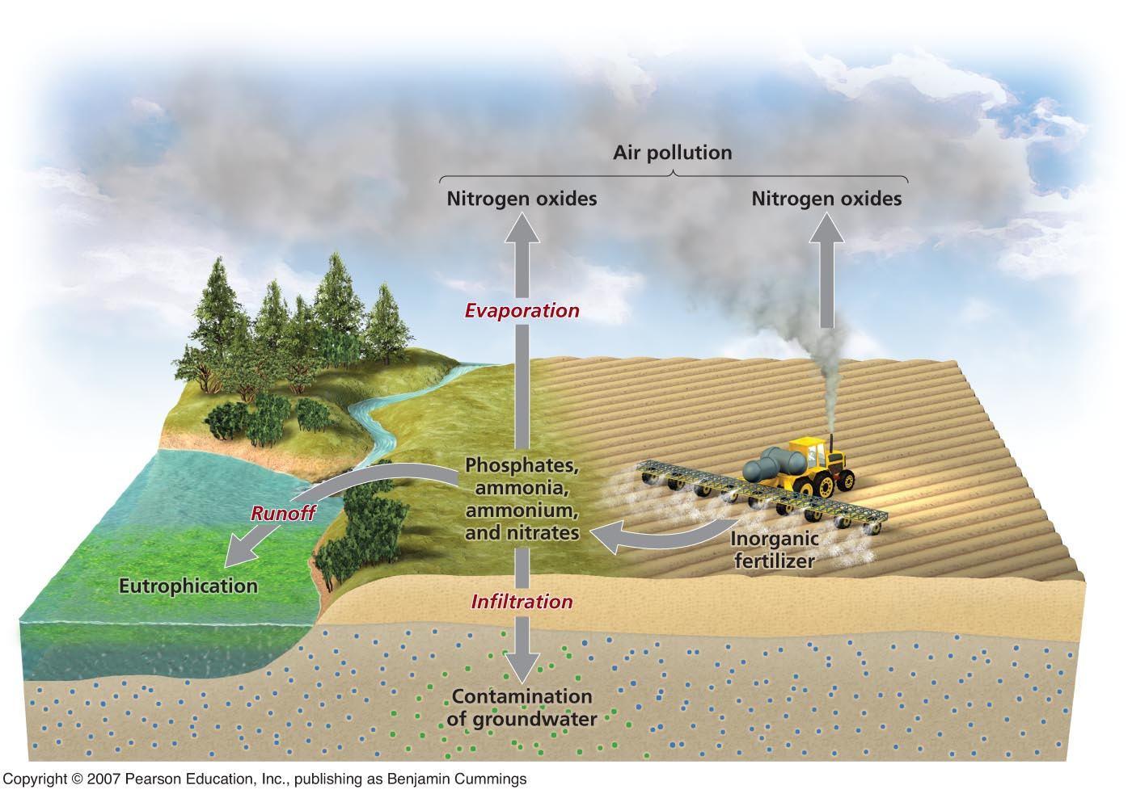
Fertilizer runoff
Overapplied
fertilizer can
run off into local water bodies, infiltrate into aquifers, and evaporate into air.
Nitrates and phosphates can cause health problems.

Slide 50
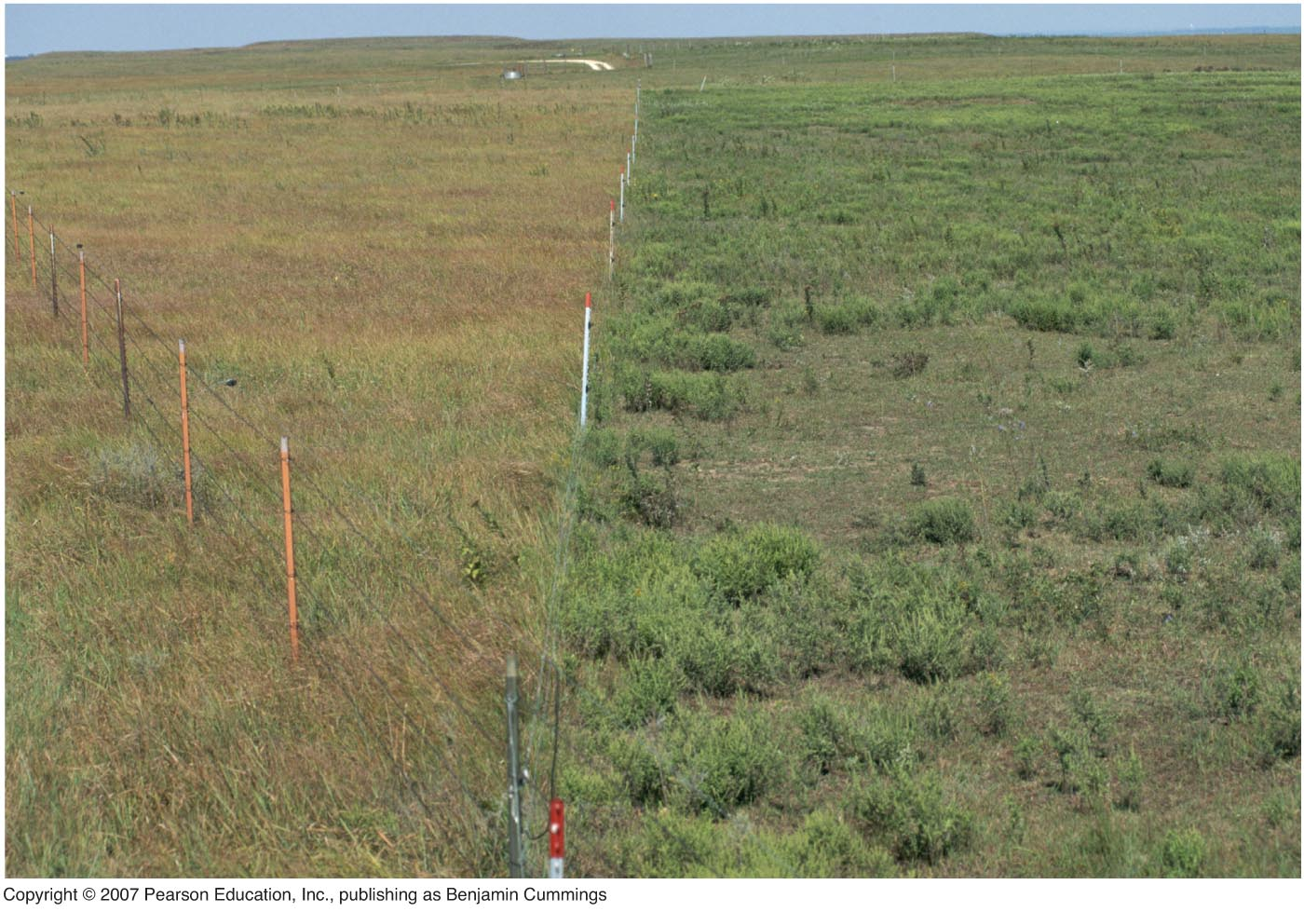
Overgrazing
When livestock eat too much plant cover on rangelands, impeding plant regrowth
The contrast between ungrazed and overgrazed land on either side of a fenceline can be striking.

Slide 51
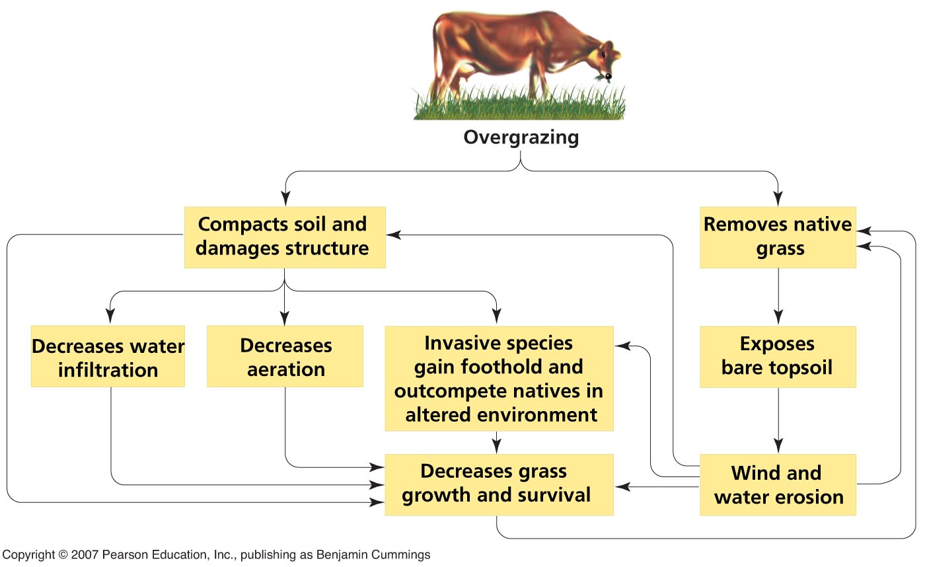
Overgrazing
Overgrazing can set in motion a series of positive feedback loops.

Slide 52
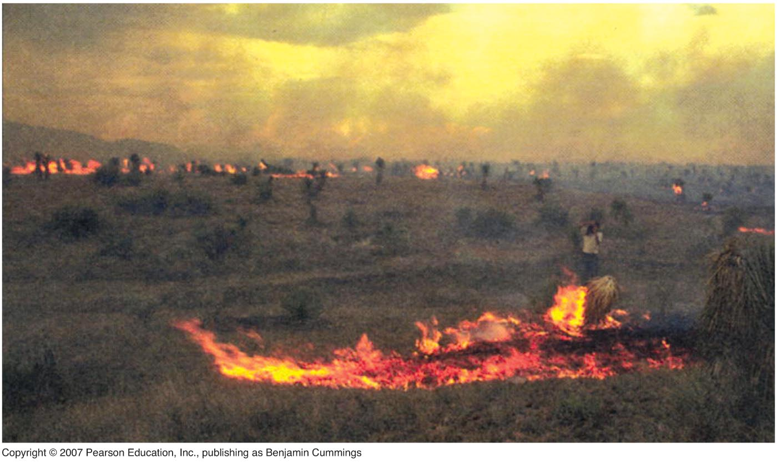
Responsible grazing
Not all grazing is harmful. Responsible ranchers maintain the productivity of their soil and grass.
Ranchers of the Malpai Borderlands of Arizona and New Mexico have enlisted scientists to study their land, and have concluded that prescribed fire is what’s needed to restore their grasslands.

Slide 53
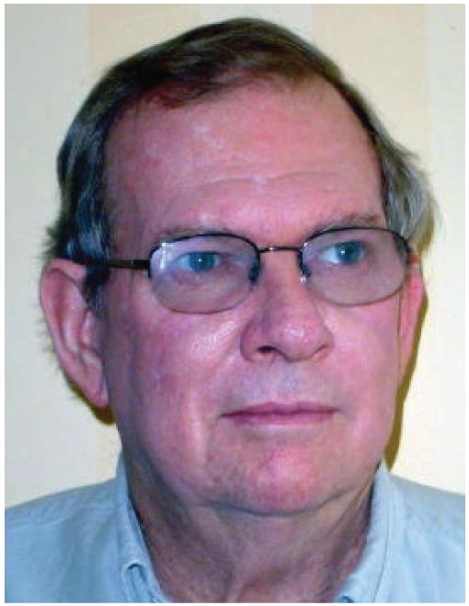
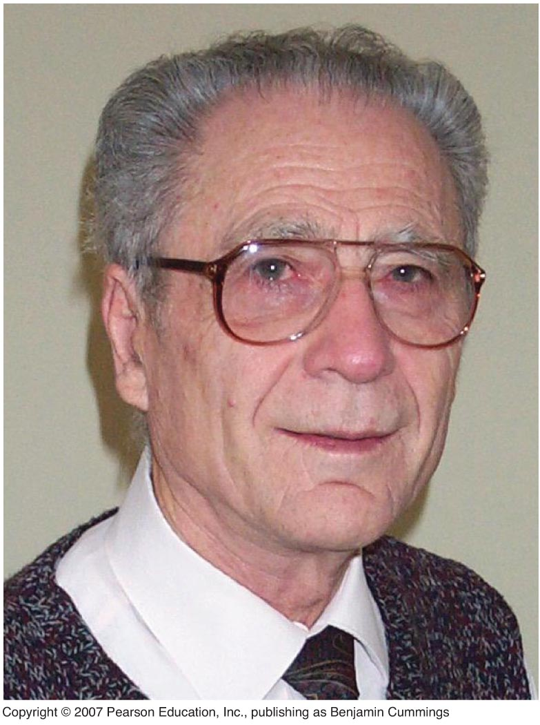
Viewpoints: Soil conservation
Jock Anderson
Frederick Troeh
“Soil conservation is a problem that must be approached from all sides. The most important factor will be to secure legally protected property rights for resource users. Farmers must have the right to own their own land resource.”
“Tillage can now be reduced or even eliminated by using modern no-till equipment. … But most important for sustainable productivity is a fervent desire to be good land stewards.”

Slide 54
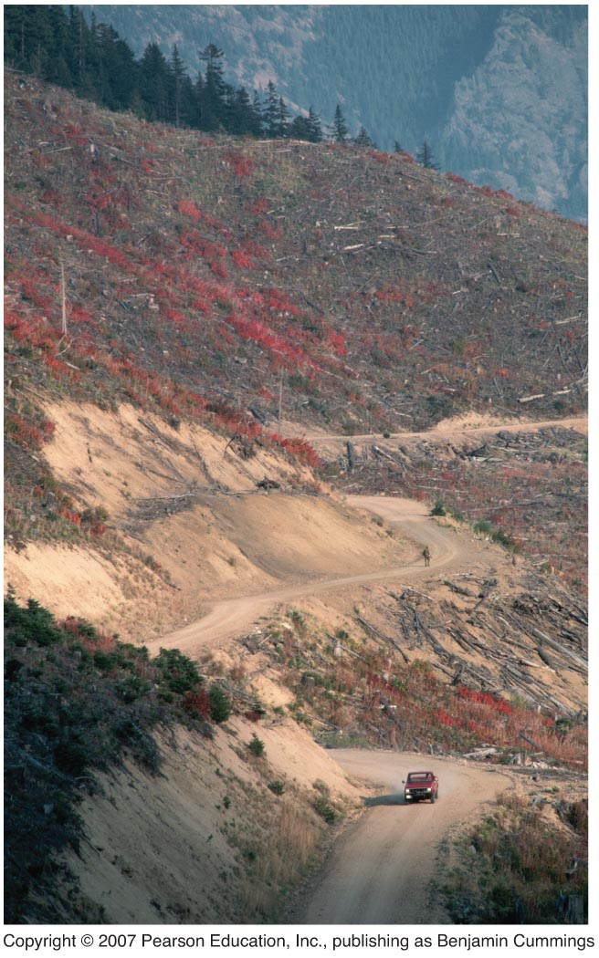
Logging
Careless forestry practices can also cause erosion and soil degradation.
Logging on steep slopes is a primary cause.

Slide 55
Recent soil conservation laws
The U.S. has continued to pass soil conservation legislation in recent years:
Food Security Act of 1985
Conservation Reserve Program, 1985
Freedom to Farm Act, 1996
Low-Input Sustainable Agriculture Program, 1998
Internationally, there is the UN’s “FAR” program in Asia.

Slide 56
Conclusion
Despite conservation successes, soil is still being degraded at an unsustainable rate.
Soil conservation programs need research, education, funding, and commitment from farmers and governments.
We will need better technology and wider adoption of soil conservation to avoid an eventual food crisis.

Slide 57
QUESTION: Review
Which statement is NOT correct?
a. Soil consists of disintegrated rock, organic matter, nutrients, and microorganisms.
b. Healthy soil is vital for agriculture.
c. Soil is somewhat renewable.
d. Soil is lifeless dirt.
e. Much of the world’s soil has been degraded.
Notes:
Answer: d

Slide 58
QUESTION: Review
The A horizon in a soil profile… ?
a. Is often called the “zone of accumulation”
b. Is often called “topsoil”
c. Contains mostly organic matter
d. Is the lowest horizon, deepest underground
Notes:
Answer: b

Slide 59
QUESTION: Review
Erosion occurs through… ?
a. Deforestation
b. Excessive plowing
c. Overgrazing rangelands
d. All of the above
Notes:
Answer: d

Slide 60
QUESTION: Review
Drip irrigation differs from conventional irrigation in that … ?
a. It is much less efficient
b. It can cause salinization
c. Water is precisely targeted to plants
d. About 40% is wasted
Notes:
Answer: c

Slide 61
QUESTION: Weighing the Issues
You are farming an extremely steep slope that is sunny and very windy. What strategies would you consider using?
a. Crop rotation
b. Contour farming
c. Intercropping
d. Terracing
e. Shelterbelts
f. No-till farming
Notes:
Answer: any

Slide 62
QUESTION: Interpreting Graphs and Data
Soil that is 20% clay, 60% silt, and 20% sand is… ?
a. Silty clay
b. Silty loam
c. Sandy loam
d. Sandy clay
Notes:
Answer: b

Slide 63
QUESTION: Interpreting Graphs and Data
Fertilizer use has… ?
a. Risen sharply over 50 yrs
b. Fallen sharply
c. Decreased since 1980
d. Increased since 1995
Notes:
Answer: a

Slide 64
QUESTION: Viewpoints
How can we best protect the condition of soil while we farm?
a. Pass soil conservation laws.
b. Increase the number of agricultural extension agents working with farmers.
c. Give incentives for farmers to use strategies like no-till, contour farming, and shelterbelts.
d. Make sure all farmland is privately owned, giving owners incentive to treat soil with care.
Notes:
Answer: any

