Slide 1
AGROFORESTRY: TOPICS
Definition and concepts
Origins
Types of agroforestry systems
Potential advantages and disadvantages
Analogs of natural ecosystems
Evaluation: Land Equivalent Ratio (LER)
Nutrient, water, and energy cycling

Slide 2
Agroforestry: What is it?

Slide 3
“Agroforestry is often described in terms of what it should be, not necessarily what it is.” (MacDicken and Vergara, 1990)
Many assumptions
Not a panacea
Lack of empirical evidence
Complex systems
Multiple criteria of success (ecological, social, economic)

Slide 4
Agroforestry (ICRAF 1982)
Agroforestry denotes a sustainable land and crop management system that strives to increase yields on a continuing basis, by combining the production of woody forestry crops (including fruit and other tree crops) with arable or field crops and/or animals simultaneously or sequentially on the same unit of land, and applying management practices that are compatible with the cultural practices of the local population.

Slide 5
Agroforestry: basics
Combination of woody perennial crops with agricultural crops and/or livestock in space or time on a single unit of land.

Slide 6
Origins of Agroforestry
Biblical references (Genesis) – gardens with trees
7000 B.C. – homegardens, Near East
Slash-and-burn agriculture (7000 B.C.) – forerunner of present-day agroforestry?

Slide 7
Types of Agroforestry Systems

Slide 8
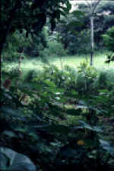
Homegardens: Humid Tropics
Mimics structure & diversity of
tropical forests
Multiple products:
    Fuelwood
    Building materials
    Fruit
    Vegetables
    Cash crops
    Spices
    Medicinal plants
    Ornamentals
Notes:
http://www.agroecology.org/cases/homegardens.htm

Slide 9
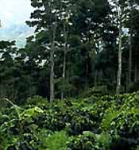
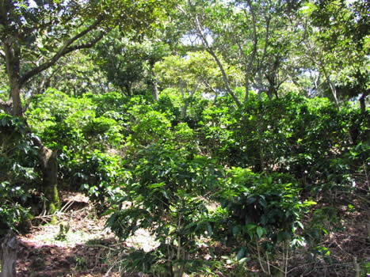
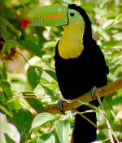
Humid & Seasonal
Tropics
Intensive intercropping
Shade tree-crop mixtures
Notes:
http://www.eartheasy.com/eat_shadegrown_coffee.htm
http://www.tesdelsol.com/shade-grown.htm
http://www.unl.edu/nac/afnotes/ff-1/

Slide 10
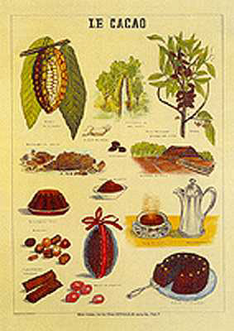
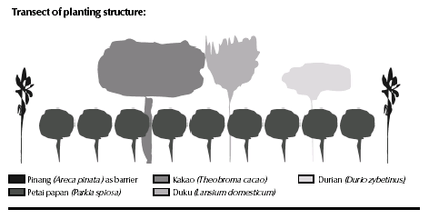
Shade tree-crop mixtures
Cacao production:
Sumatra, Indonesia
Notes:
http://www.killerplants.com/renfields-garden/20020213.asp
http://www.ileia.org/2/16-3/28.PDF

Slide 11
Taungya System: SE Asia
Long-term goal = timber production
Origin: Teak (Tectona grandis) plantations
Cultivation of food crops between tree seedlings planted as a timber plantation
Crops: dryland rice, maize, soybeans
Cropping period = 2-5 years depending on spacing
Belize: mahogany
Successional processes emphasized

Slide 12
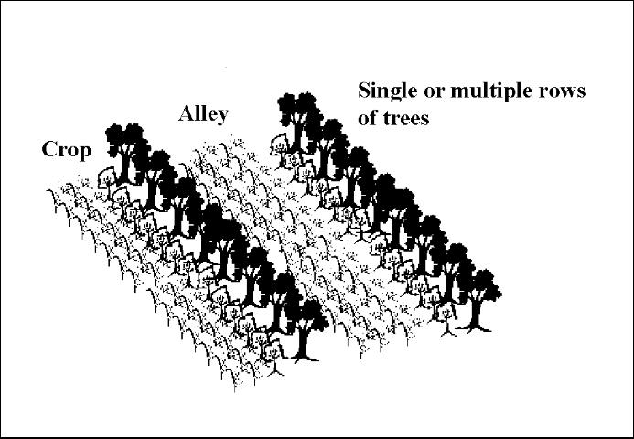
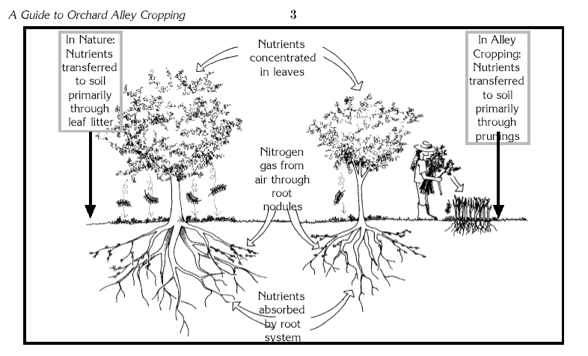
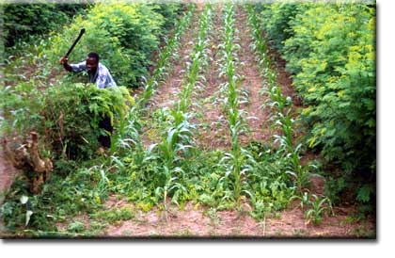
Alley Cropping
Long-term goal = food crop
Trees in hedgerows
Crops in alleys
Trees pruned
  reduce shading
  green mulch
Legumes favored

Slide 13
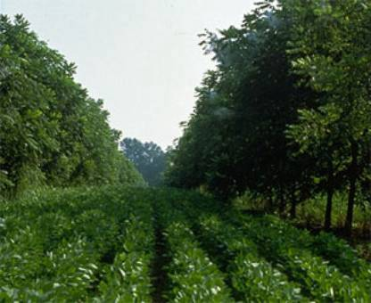
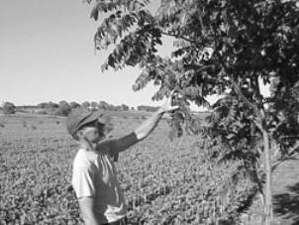
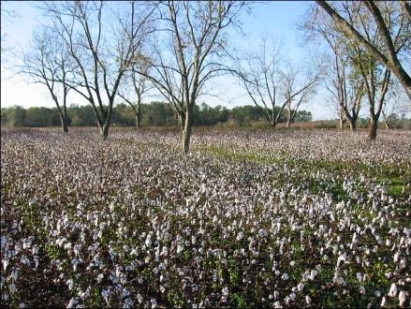
Alley cropping: temperate zone
Walnut &
Pecan –
Missouri
SE Nebraska
Walnut, pecan, corn,
soybeans
30 x 60 ft spacing
Grafting of cultivars
Agricultural soils
Fertilizers, herbicides
Pecans &
Cotton –
Florida
Notes:
http://www.missouri.edu/~afta/About_AF/TAarticles/Arts_Heskett.htm
http://edis.ifas.ufl.edu/FR142
http://www.solutions-site.org/cat11_sol108.htm

Slide 14
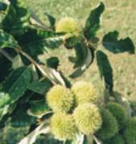
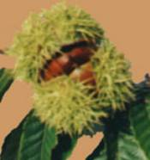
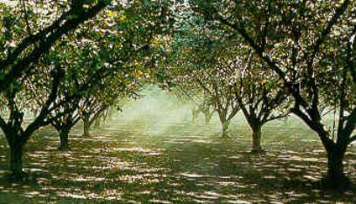
Hybrid chestnuts:
cross between American and Chinese chestnuts
(“Badgersett”)
large nut size, high quality
produce nuts early (2-5 yrs)
resistant to Chestnut blight (~80%)
cold hardiness
tree vigor and health
problem: frost injury
Hybrid Hazelnuts
(filberts)
2 N. American species;
1 European species
Crosses between all 3 spp.
Windbreaks
Notes:
http://oregonhazelnuts.org/handbook.htm
http://chestnut.acf.org/resources.htm
Holstein Cow vs. Bison

Slide 15
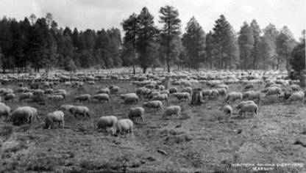
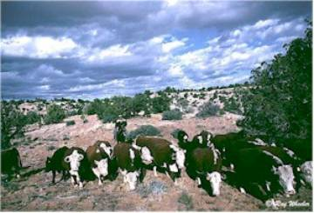
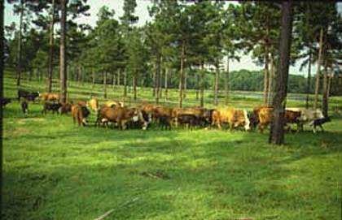
Silvopastoral Systems
Sheep & cattle grazing in
Ponderosa pine forests,
Rocky Mountains
Loblolly pine & cattle
Louisiana
Notes:
http://www.missouri.edu/~afta/About_AF/TAarticles/Arts_hillfarm.htm

Slide 16
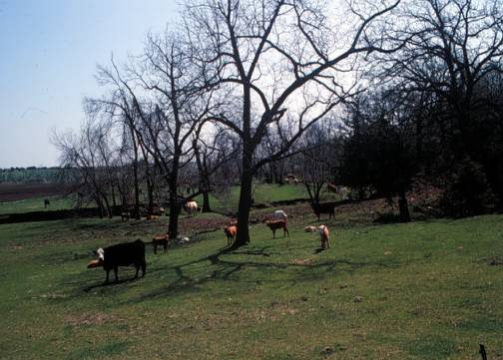
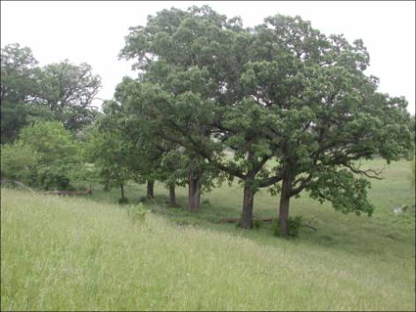
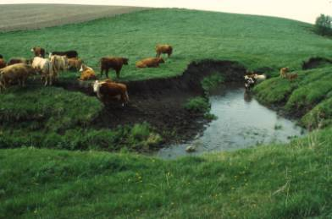
Silvopastoral
systems in the
Midwest:
Rotational grazing
& restoration?

Slide 17
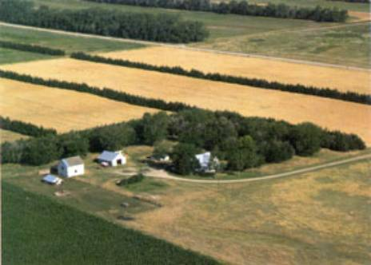
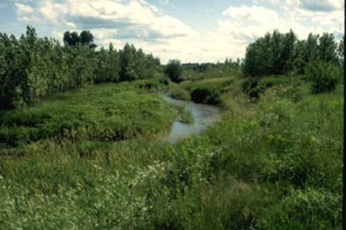
Windbreaks & Riparian Buffers
Notes:
http://www.missouri.edu/~afta/About_AF/WB1.htm
http://www.missouri.edu/~afta/About_AF/RB1.htm

Slide 18
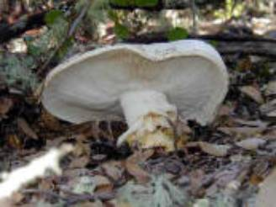
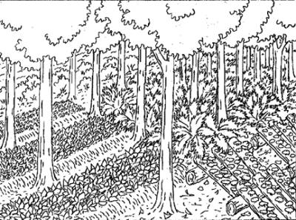
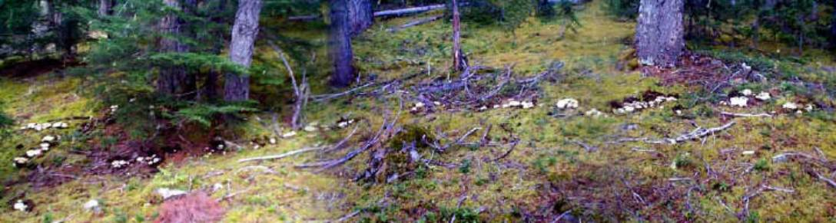
Forest Farming
Timber
Mushrooms
Berries
Herbs
Wildlife
* Mimic natural forest processes
Matsutake Mushroom
Notes:
http://www.matsiman.com/gallery/visitorpix/visitormatsipoto.htm

Slide 19
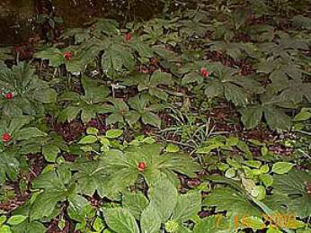
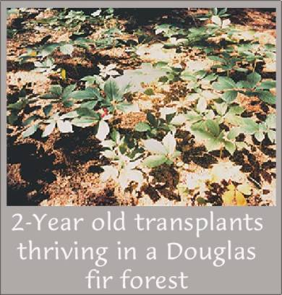
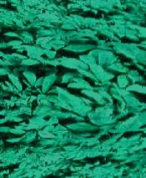
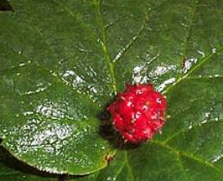
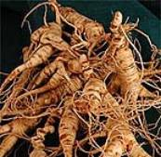
Wildcrafting: medicinal plants
American ginseng
(Panax quinquefolium)
Goldenseal
(Hydrastis canadensis)
Notes:
http://www.hardingsginsengfarm.com/golden.htm
http://www.hardingsginsengfarm.com/cultivate.htm
GOLDENSEAL: lowers blood pressure, antibacterial (antiseptic), tonic for inflammation and wounds, ringworm
GINSENG: (from China) - stimulation, added energy, sense of well being (panacea for maintaining good health)

Slide 20
Temperate Agroforestry: Economics
Wild ginseng: $200-$400/lb
Cultivated ginseng: $15/lb
Goldenseal: $50/lb
Shiitake mushrooms: $10/lb
Market: Mushroom harvesting in Pacific NW = 41.1 million (1992)
International markets (1998)
  Pecans: $48 million
  Foliage: $20 million
  Ginseng: $138 million

Slide 21
Defend one of the following statements:
Conventional farmer: Agroforestry systems can never be as productive or economically viable as monocultures. Conventional agriculture is sustainable if managed well.
Agroforestry farmer: Agroforestry systems improve overall economic, ecologic, and social benefits obtained from the land. Polycultures with woody plant species are more sustainable than monocultures.

Slide 22
Conventional Farmer
Monocultures have greater yields ($$)
Better economically
Easier and cheaper to manage (economies of scale)
Nutrient cycling easier (management of inputs) – automated
Government programs
Markets more secure (cash crops)
Conservation threats lower
Production time shorter
Greater control of system
Conservation practices = sustainable
Greater yield????
Cash flow more rapid -

Slide 23
Agroforestry Farmer
Multiarchitectural rooting and canopy systems to decrease competition for water, nutrients, and sunlight, while increasing productivity.
Distribute production over time (year).
Distributing risks.
Doesn’t require high external financial inputs (labor intensive)
The need to increase size in order to maintain competitiveness is lower (pay off debts)
Greater intellectual involvement (complexity)
Complementarity and diversity = increased stability/sustainability
Capitalize on natural assets
Higher ratio between biomass removal and income per pound biomass
  Higher income/area
  Higher income/biomass

Slide 24
Ecosystems as analogs for designing and evaluating agroforestry systems
Species interactions
Productivity: land equivalent (ratio)
Stand development – successional processes

Slide 25
Species Interactions
Competition
  Plants utilize the same resource, the growth of one or both is reduced.
  Monocultures – intense competition (genetically similar – same resource requirements)
  Threshold – increasing density, production constant
  Exceed threshold – add different species

Slide 26
Species Interactions
Complementarity
  Niche differentiation – plants utilize different growing space or have different resource requirements.
  Species mixtures = more complete/efficient resource use = increased productivity
  Theory: ↑ Species diversity = ↑ productivity
  * Empirical evidence lacking (contradictory)
  Key: a few species from different life forms

Slide 27
Species Interactions
Facilitation
  One species directly benefits another growing in a mixture
  Nutrient cycling efficiency
  Soil structure – water & nutrient retention
  Soil moisture status – hydraulic lift
  Reduction of loss to pests, pathogens, weeds
Balance: maintain facilitative functions and reduce competition

Slide 28
Land Equivalent Ratio (LER)
Compares the yield of polycultures with monocultures of each of the component species.
LER = RY_{(a)} + RY _{(b)} … etc.
Example:
* Note: LER does not separate out the effects of different interactions (e.g., facilitation, competition)
** LER does not account for other social and economic factors in addition to yield
Agroforestry Components | Density (% of monoculture) | RY (no change) | RY (actual)
Tree crop | 0.2 | 0.2 | 0.4 ( ↓competition)
Herbaceous crop | 0.8 | 0.8 | 0.9 (↑ facilitation + ↑ competition)
LER |  | 1.0 | 1.3
Notes:
TREE: CROP:
Monoculture = 100 Monoculture = 100
Polyculture = 20 Poly = 80
Increased poly = 40 Poly = 90

Slide 29
HOMEWORK
Diagram the potential competitive and facilitative interactions for resources (light, moisture, nutrients) in the following agroforestry systems:
  Alley cropping
  Homegarden
  Shade tree-crop system
  Silvopastoral system
  Forest farming
  Windbreaks
  Riparian buffers
How might these interactions affect productivity of the agroforestry system compared to monocultures (i.e., the Land Equivalent Ratio)?
High Nutrients
High Moisture
Low Nutrients
High Moisture
High Nutrients
Low Moisture
Low Nutrients
Low Moisture

Slide 30
Agroforestry as an analog of forest ecosystems
Ecology – successional processes
Silviculture – stand development
Theories and models – apply to agroforestry
Four stages of stand development:
  Stand initiation
  Stem exclusion
  Understory reinitiation
  Old growth
Agroforestry systems:
  Focused on creating a particular stand structure & composition
  “Arresting succession” – gain benefits of species interactions

Slide 31
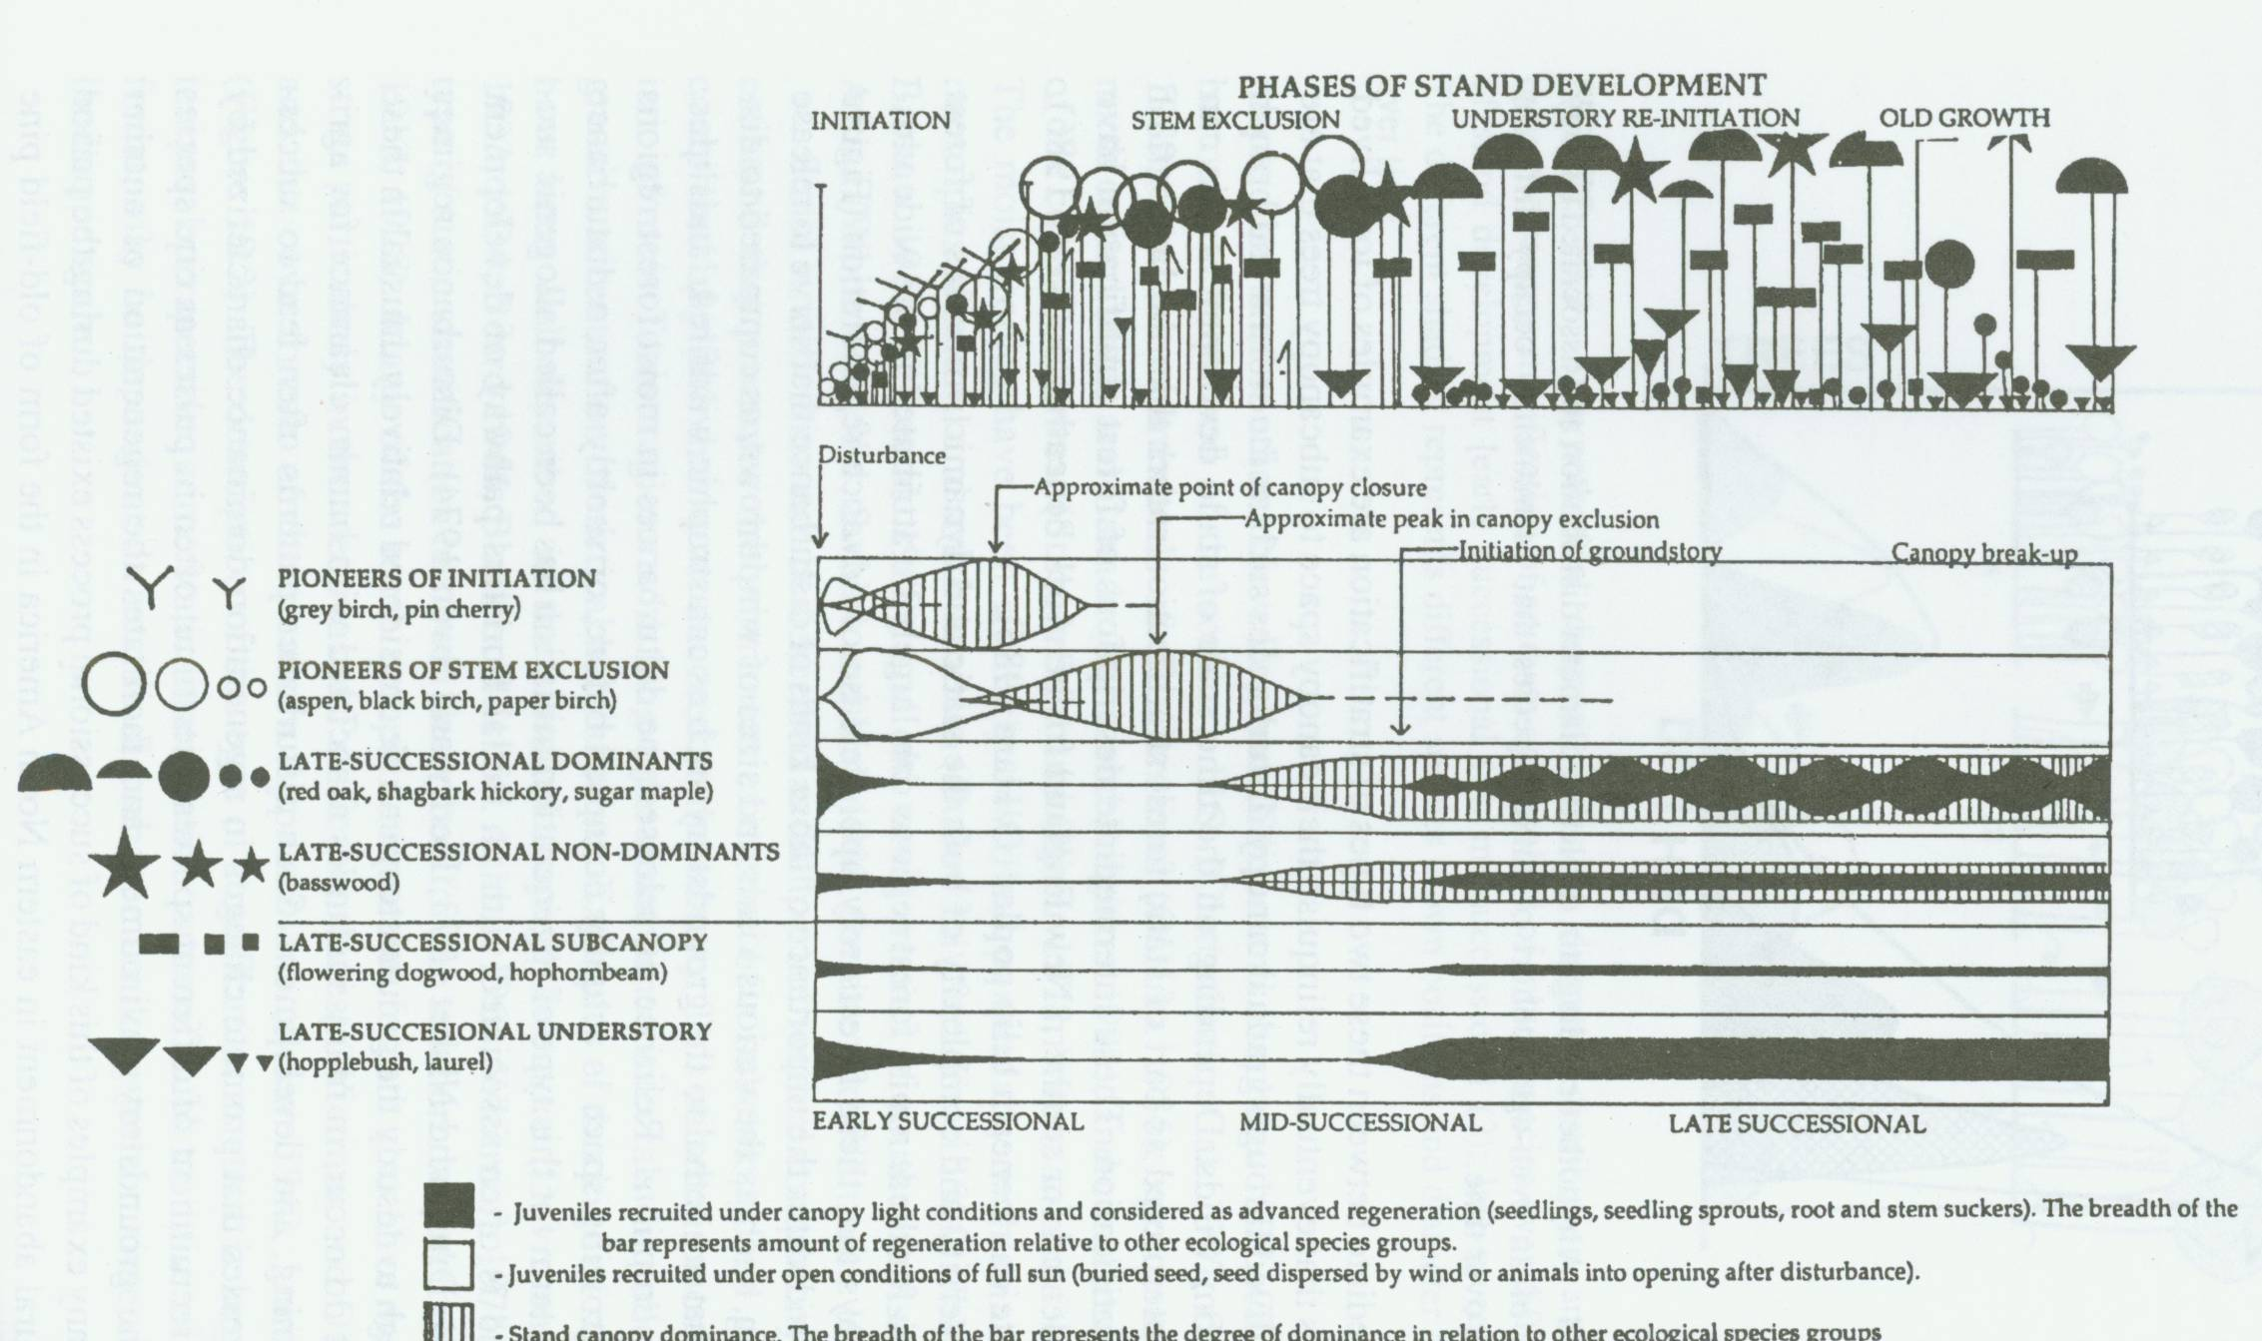
Phases of Forest Stand Development

Slide 32
Stand Initiation Stage
After a major disturbance removes the canopy vegetation
New trees establish (seedlings, sprouts)
Dominant species:
  Shade-intolerant trees and shrubs
  Herbaceous plants
Agroforestry examples:
  Alley Cropping
  Taungya

Slide 33
Stem Exclusion Stage
Trees grow to form a closed canopy
Growing space (resources) completely utilized
  Reduction of understory vegetation (low light)
Intense competition among canopy trees
  Size differentiation
  Suppression and mortality
Examples:
  Tree gardens: timber, fuelwood, fruit trees
  Modified taungya system (land reform)
  Walnut, pecan trees – thinning operations
Dry climates:
  Competition belowground occurs before “stem exclusion”

Slide 34
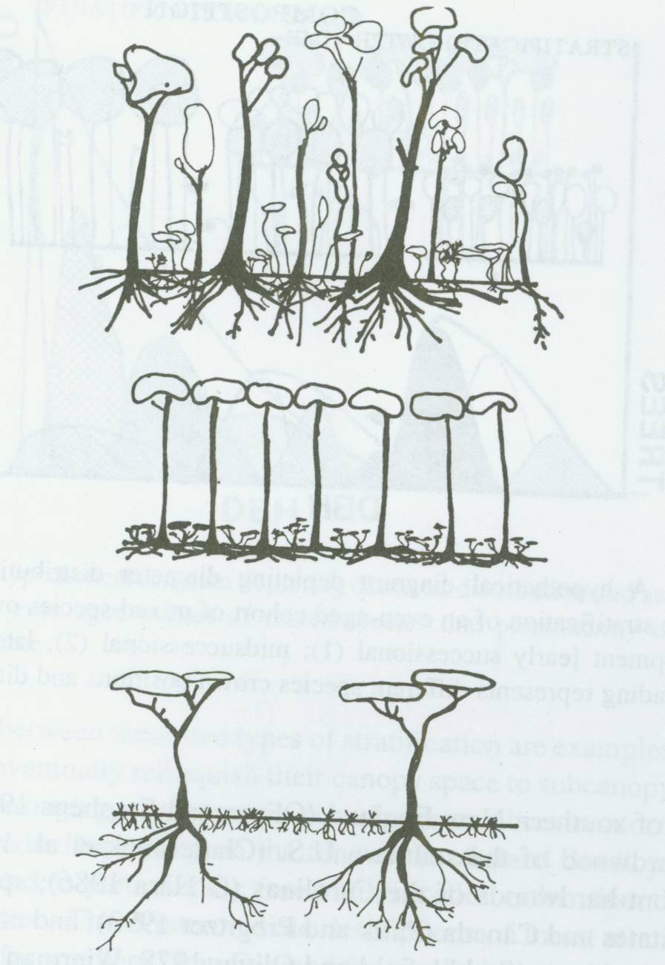
Stand Structure and Climate
Humid
Seasonal
Dry

Slide 35
Understory Re-initiation Stage
Small breaks in canopy = increased light
Decomposition = increased nutrients
Establishment of shade-tolerant trees, shrubs, herbs, vines
Examples:
  Shade tree-crop combinations (coffee, cacao, tea, cassava)
  Acacia and millet (nutrients, shade)
  Facilitative & competitive interactions
  Threshold: 800 – 1,000 mm annual rainfall
  Shade tolerant vs. intolerant understory species

Slide 36
Old Growth Stage
Formation of canopy gaps - old trees die
Establishment of light-demanding species
Development of uneven-aged stand structure, multiple canopy layers
Examples:
  Homegardens
  Forest farming

Slide 38
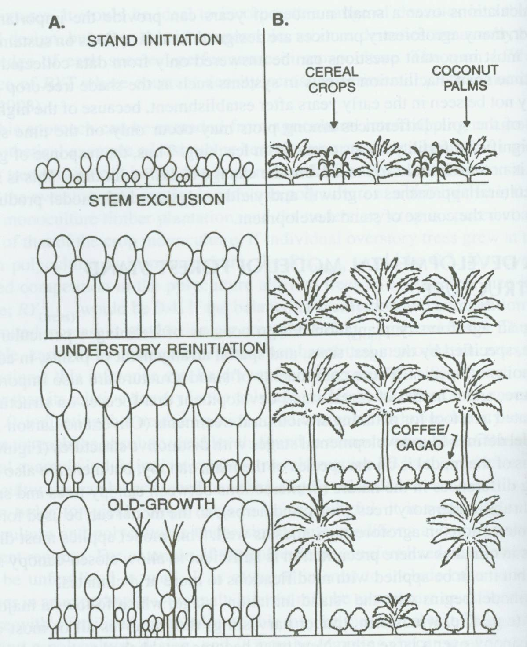

Slide 39
Evaluating Success of Agroforestry
Crop yield: competitive reduction usually greater than facilitation effects
Complementarity of yield: non-tree and tree products with high value (timber, fruit)
Moderately reduced crop yield compensated by:
  High value product from tree component
  Long term sustainability of crop yield
  Reduced costs of external inputs
  Environmental services/quality (financial return?)

Slide 52
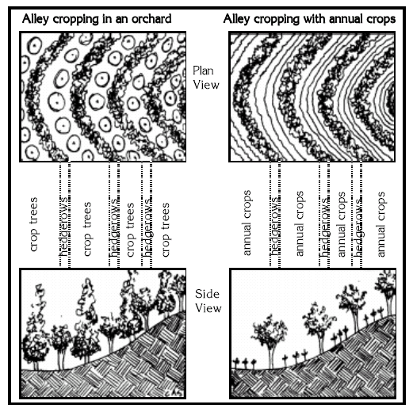
Notes:
http://agroforestry.net/pubs/oachbk.pdf

