Slide 1
Animal Skulls
Teeth & Eating:

Slide 2
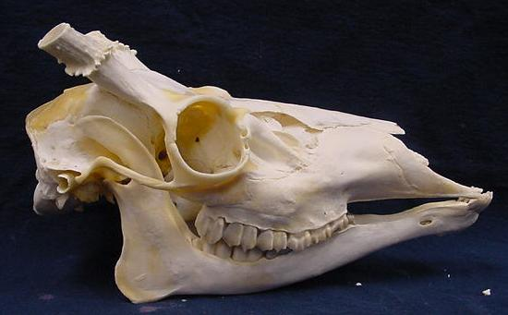

Slide 3
Deer - Herbivore

Slide 4
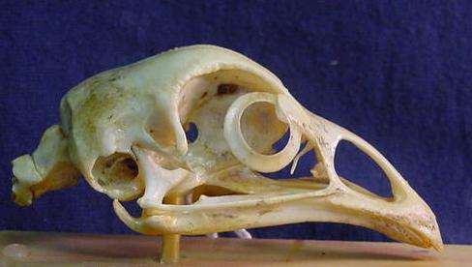

Slide 5
Chicken - herbivore

Slide 6
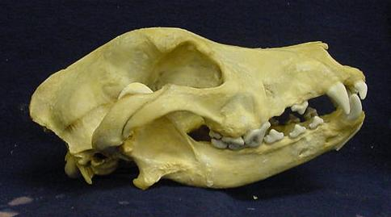

Slide 7
Dog - Carnivore

Slide 8
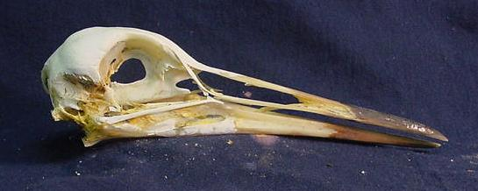

Slide 9
Heron - carnivore

Slide 10
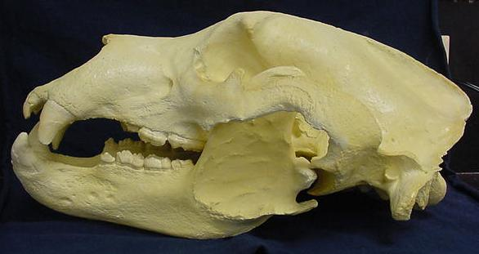

Slide 11
Bear - omnivore

Slide 12
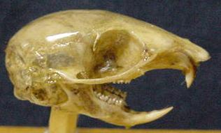

Slide 13
Chipmunk - herbivore

Slide 14
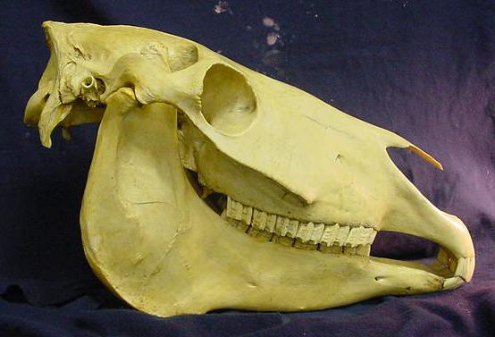

Slide 15
Horse - herbivore

Slide 16
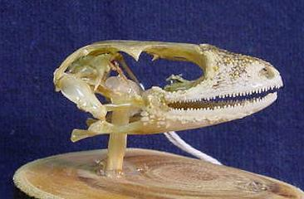

Slide 17
Gecko - omnivore

Slide 18
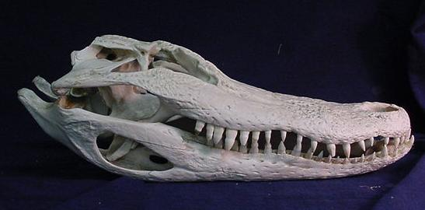

Slide 19
Alligator - carnivore

Slide 20
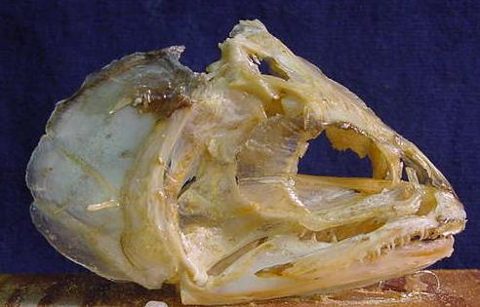

Slide 21
Trout - omnivore

Slide 22
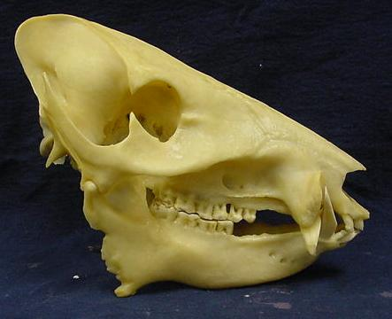

Slide 23
Peccary - omnivore

Slide 24
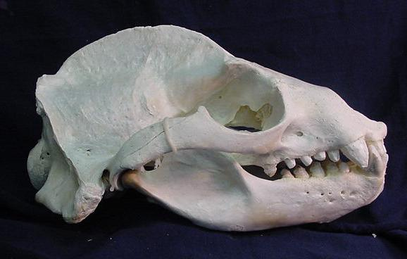

Slide 25
Sealion – carnivore

Slide 26
Photographs taken from:
http://www.d91.k12.id.us/skyline/teachers/robertsd/skulls.htm
Used with permission.

