Slide 1
Animal Survival
WALT: to know that animal survival is under threat

Slide 2
Some facts
In 1950, 15% of the world was covered by rainforest. By 2000 it is estimated that only 7% of the rainforest will remain.
By 2042 no rainforests will exist
60% of all living things are found in the Rainforest
There will be no tigers left in the world in 20 years

Slide 3
Introduction
There has been animal and plant life on the Earth for millions of years
There have been many changes in climate, animals and plants
This has led to the extinction of many animals
Since humans emerged animals and plants are dying out at a greater rate

Slide 4
Endangered or Extinct?
The number of people in the world is growing at an alarming rate.
But this is not true for all animals.
In some cases, there are only a few of one type of animal left in the wild.
These animals are endangered.
If they die out completely, they become extinct.

Slide 5
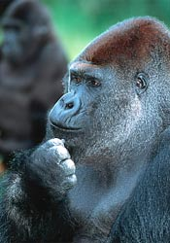
Apes
Considered humans' closest relatives, great apes are among the world's most fascinating species.
Unfortunately, they are also among its most threatened. Great apes of Africa and Asia could face extinction in the next few decades if more is not done to conserve them.

Slide 6
They live in war-torn regions and are threatened by hunting for the commercial bushmeat trade.
Their habitats are being destroyed and diseases such as Ebola.
The orangutan, is also losing much of its habitat to deforestation and deliberate burning to make way for agriculture and oil palm plantations.

Slide 7
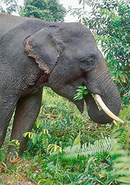
Elephant
Elephants are the largest living land animals, with adults sometimes weighing six tons or more.
Elephants are threatened by shrinking living space and poaching for the ivory trade.
As habitat shrinks, their huge appetite can bring them more frequently into conflict with people.

Slide 8
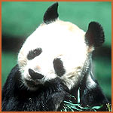
Pandas
It is estimated that as few as 1,600 pandas remain in the wild today.

Slide 9
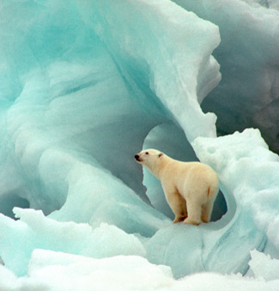
Polar bear
Climate change is causing the disappearance of sea ice from which polar bears hunt their prey.
With less time on the ice to hunt for food and store leaves polar bears hungry.

Slide 10
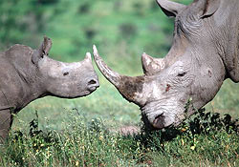
Rhino
But the existence of this species is increasingly threatened, due to poaching and habitat loss.

Slide 11
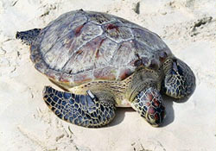
Marine Turtles
Threats like hunting for meat, shell and eggs; habitat destruction; fisheries bycatch; pollution; boat strikes; and introduced predators have wiped out entire turtle populations

Slide 12
Why are these animals facing extinction?
War torn countries
Hunting and poaching (for sport, their fur, tusks or meat).
Disease
Pollution/chemicals poison the animals.
New predators
Climate change
Destruction of habitat (woodlands cut down, rivers drying up, hedgerows removed).

Slide 13
Caring for the Environment
It is in our own best interests to look after the world we live in.
If a habitat is lost or damaged, it has an effect on everything else, even if we do not see or understand it straight away.
Remember - once something becomes extinct, it’s gone forever!

Slide 14
Near us
Are habitats destroyed where we live?
YES! To make room for motorways and housing estates
What creatures can be hunted for sport?
Rare creatures are still caught and sold as pets

Slide 15
What is happening to help?
Zoos, national parks and breeding in captivity means that species of animals are being preserved

Slide 16
What can you do?
Don’t leave litter behind
Don’t damage or destroy trees, hedges and wild grassland- animals have homes too!

Slide 17
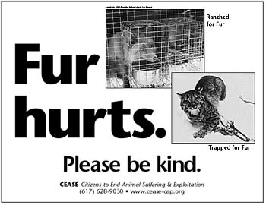

Slide 18

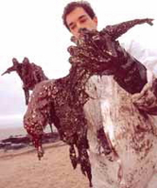
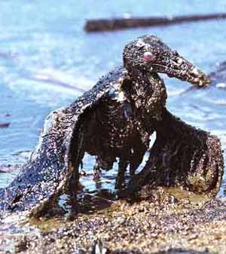

Slide 19
