Slide 1

Ants

Slide 2
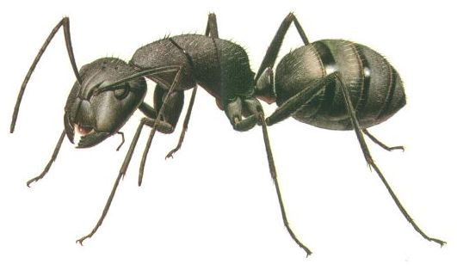
Ant Body Parts
Ants are insects. They have 3 body parts…..
Head
Thorax
Abdomen

Slide 3
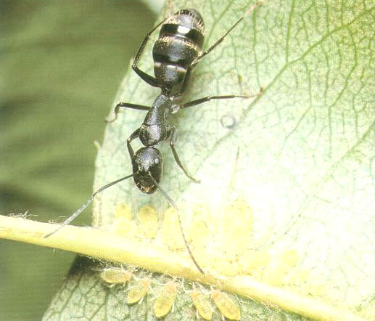

Slide 4
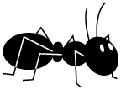
Ant Stomachs
An ant has two stomachs.
One is for food for himself. The other is for food that he will share with the other ants.

Slide 5
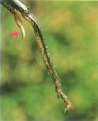
Ant Legs
Ants have 6 legs which are covered in tiny
hairs.
There is a sharp claw at the
end of each leg, which is why
the ant does not fall off when
hanging upside down!

Slide 6
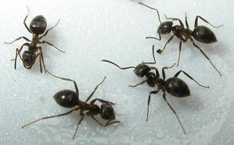
Antennae
Ants have 2 antennae. They use them for
touching, smelling and hearing. Their eyes
don’t work very well.

Slide 7
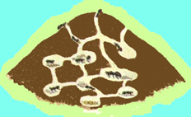
Ant Nests
Ants live in a nest. It has lots of chambers
for different things…rubbish, food, larvae
and babies.

Slide 8
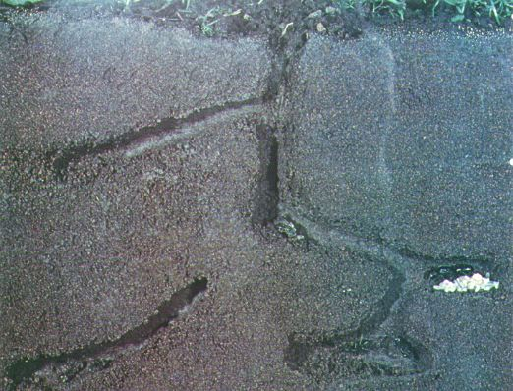

Slide 9
Ant Family
Most ants in a nest are workers. They make
the nest bigger, fight enemies and carry
food. At night, the worker ants carry the
eggs and larvae deep into the ground to
keep them warm.

Slide 10
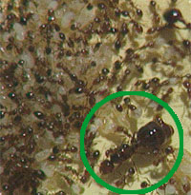
The Queen Ant
There can be lots of female ants in a nest,
but there is only one Queen. Her job is to
lay eggs which the worker ants look after.
Her wings fall off because she doesn’t need
them any more. She is much
bigger than the other ants.

Slide 11
Ant Life Cycle
The Queen ant lays some eggs.
These hatch into grubs or larvae.
The worker ants feed them.
They make a cocoon.
In a few more weeks they become an ant.

Slide 12
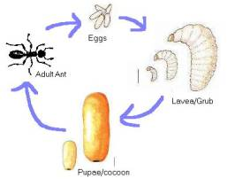

Slide 13
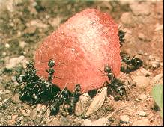
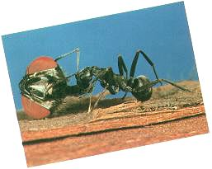
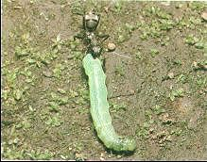
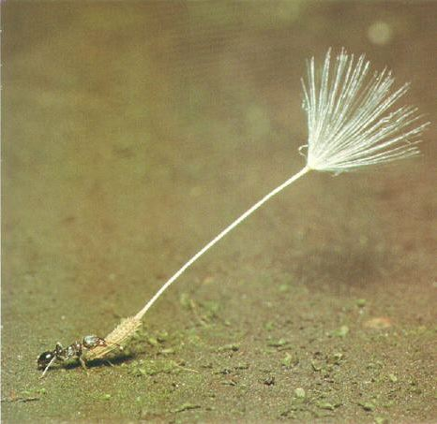
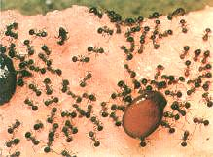
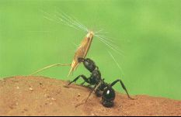
Ant Food
Ants love insects, seeds and sweet sticky food.

