Slide 1

Beekeeping /
Apiculture
By Rebecca Lindquist

Slide 2

Outline
Background
History
State of beekeeping today
  Problems
  Benefits
Beekeeping and sustainability

Slide 3

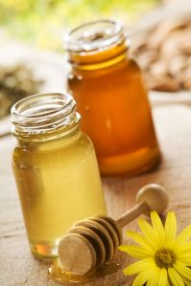
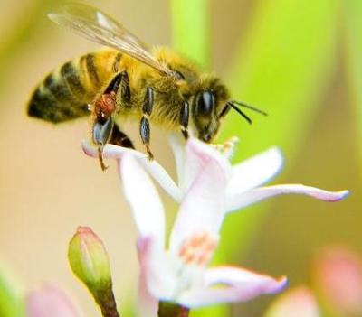
Background: what is beekeeping?
Five products:
Honey
Beeswax
Pollination
Queen bees
Packaged bees
http://differenceisreal.wordpress.com/2009/03/29/honey-and-skin-care/
http://blogs.fortlewis.edu/greenfreedom/2009/11/04/honeybees-and-ice-cream/

Slide 4

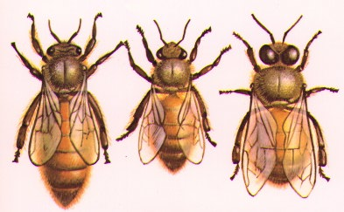
A hive: “the birds and the bees”?
50,000 female workers
Hundreds of drones
1 queen
And a beekeeper
http://ag.arizona.edu/pubs/insects/ahb/act3.html

Slide 5
Outline
Background
History
State of beekeeping today
  Problems
  Benefits
Beekeeping and sustainability

Slide 6
History of beekeeping: evolution
Bees’ ancestors evolved 207 to 220 million years ago
Now: 22,000 species of bees
  9 species of honeybee

Slide 7
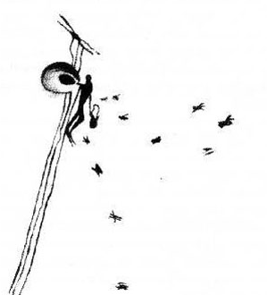
History of beekeeping: gathering honey
Ancient times: cave paintings
Hunter-gatherers today (or at least during the late 1900s)
  !Kung: a “sacramental adventure”
  Mbuti: hunting season as a time of festivity and magic
Mesolithic rock painting showing honey collection from a wild nest
Valencia, Spain
http://www.mdbee.com/articles/cavepainting.html

Slide 8
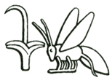
History of beekeeping: early beekeeping
Egypt: 2400 BC
  Food for the wealthy
  Importance of the bee for the Pharoah
Greeks and Romans
  Offered to the gods
  Aristotle and Virgil described beekeeping
http://dodona777.wordpress.com/2009/03/26/honey-bees-about-to-become-extinct/

Slide 9
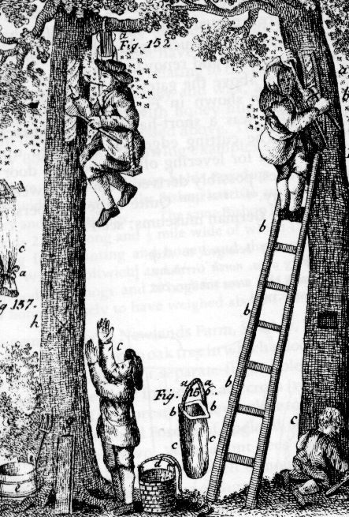
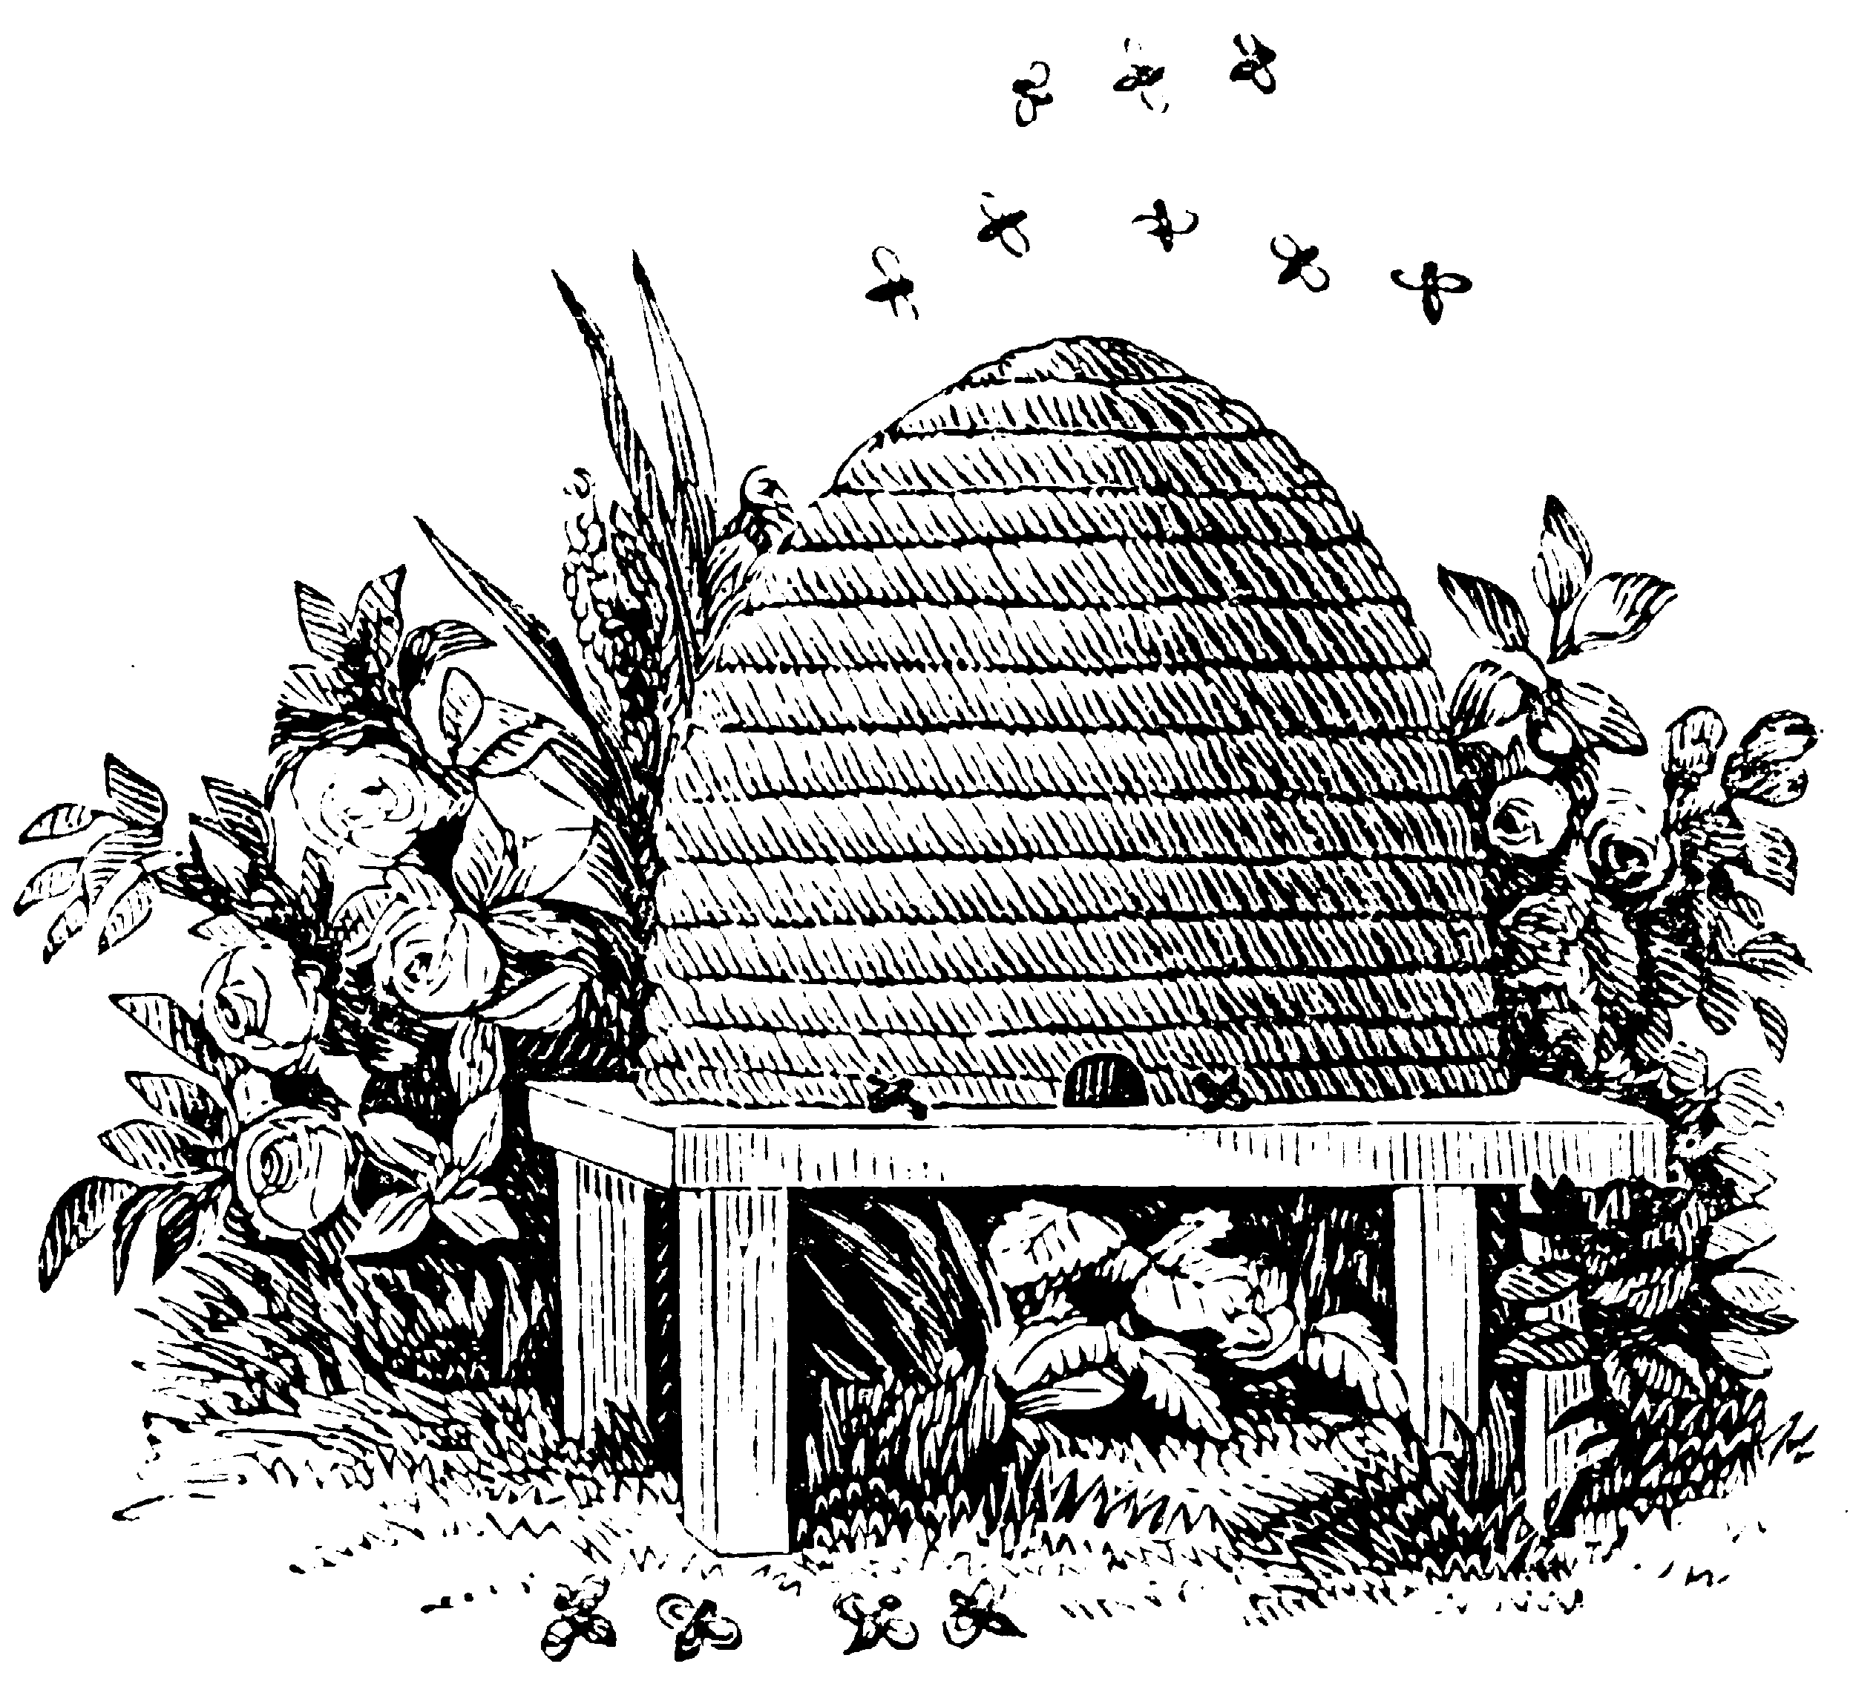
History of beekeeping: early beekeeping
Europe and Russia
  Holes in trees or hanging hollow logs, AD 400
  The skep
  Beeswax and Christianity
  Mead
After 1800, honey became more expensive than sugar
http://www.beeclass.com/dts/briefhistory.htm
http://www.biobees.com/british_beekeeping/british_beekeeping.html

Slide 10
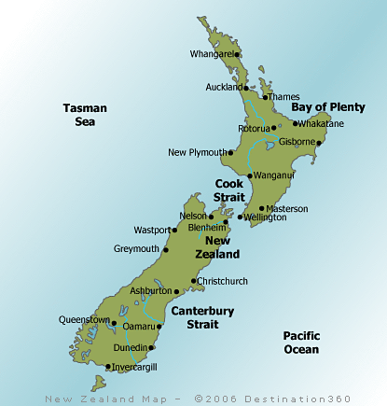
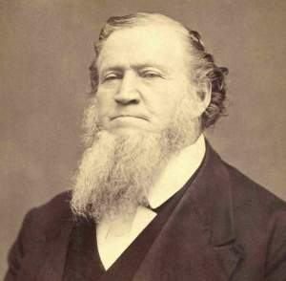
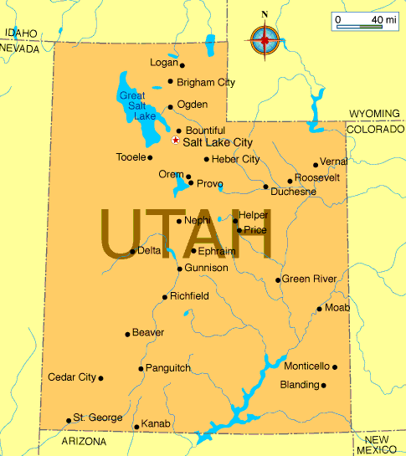
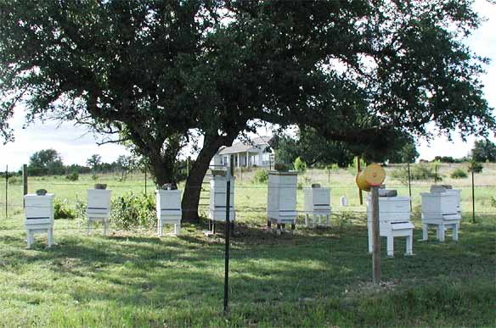
History of beekeeping: early bee migration
North America
  Honey and maple syrup
  Mormons
  Brigham Young
New Zealand
http://www.my-discount-hotels.com/beekeeping-supplies-new-zealand.html

Slide 11
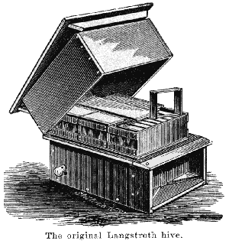

History of beekeeping: the road to industrial beekeeping
Skeps replaced by wooden boxes
1851: Lorenzo Langstroth’s supers
1870: first national beekeepers’ convention
1873: Moses Quinby’s bellows
http://outdoorplace.org/beekeeping/history1.htm

Slide 12
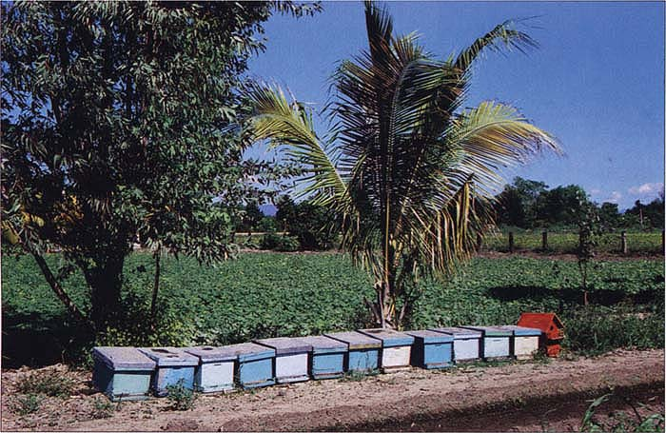
History of beekeeping: the road to industrial beekeeping
John Harbison and California
  1857: 67 colonies transported by boat
  1870: 2,000 colonies
  1884: California produced 2,000,000 lbs/year
1909: first bees rented for pollination in New Jersey
http://ucanr.org/repository/CAO/landingpage.cfm?article=ca.v050n04p24&fulltext=yes

Slide 13
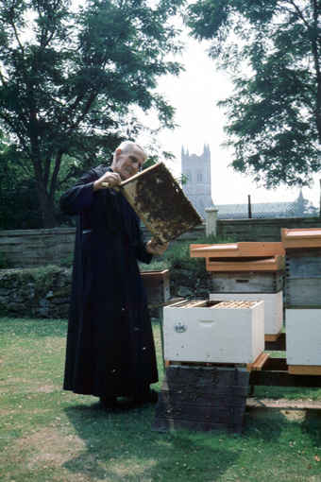
Scientific Beekeeping
Tracheal mite outbreak throughout Europe 1904
Brother Adam, German beekeeping monk
  Artificial insemination
  Breeds for good colonies, high production, and disease resistance
Chemicals for pest control beginning in 1940s
  Honey contamination
http://perso.fundp.ac.be/~jvandyck/homage/artcl/EO99princBAen.html

Slide 14
Outline
Background
History
State of beekeeping today
  Problems
  Benefits
Beekeeping and sustainability

Slide 15
Beekeeping Today: U.S.
6 million colonies 1940s, 2.3 million today
70% decrease in total number of beekeeping operations since 1982
Today, 87.7% of colonies are in 1,400 commercial operations
U.S. government provides price supports, since 1949

Slide 16
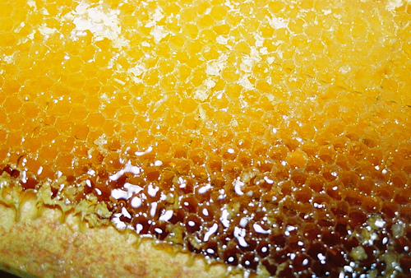
Honey Production Today: U.S.
Yield increasing 0.5 pound per colony per year
  About 50 pounds
Profits: $50 per hive per year
Time input: about 5 hours per hive per year
Original input can be paid off in second year
Nectar from alfalfa and clover, especially Michigan to Montana, also Florida and Texas
http://www.flickr.com/photos/23385633@N03/2803270650/in/set-72157606685957698/

Slide 17
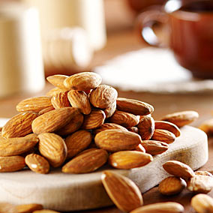
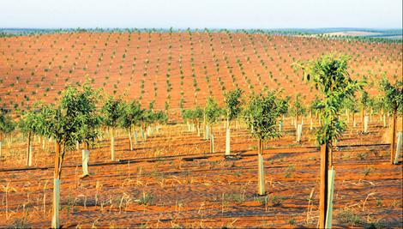
Pollination Today: U.S.
Still the most efficient way to pollinate crops that need pollination:
  Almonds, plums, cherries, alfalfa, avocados, vegetable seed, melons, sunflowers, apples, prunes
  1/3 of our diet comes from bee-pollinated crops
  900,000 colonies
Wemen almond farm, the second largest almond farm in the world, Australia
http://www.utsc.utoronto.ca/~wellness/wpp/nutri/main_resources_aa.html
http://www.theage.com.au/news/national/drought-dries-up-timbercorps-plans/2007/11/23/1195753307266.html

Slide 18
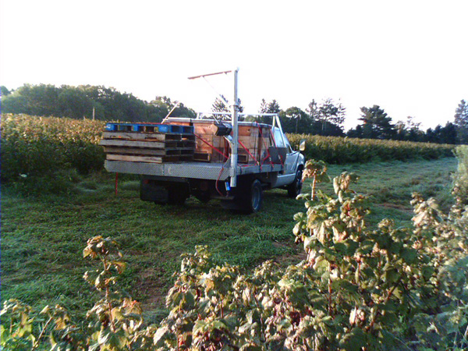
Pollination Today: U.S.
Migratory cycles in Pacific Northwest and East Coast
  2.42 rentals per hive per year
http://www.fullbloomapiaries.com/pollination.html

Slide 19
Trade
Honey: usually blend of honeys, flash-heated, micro-filtered
  Growing interest in rarer honeys through organic movement
Falling U.S. honey production
  U.S. imports 50% more honey that produced

Slide 20
Global Trade: top 10 (2004)
Honey exports Honey imports
Country | Weight (thousand metric tons) | Percentage of total
China | 81.3 | 24.2%
Argentina | 65.2 | 18.6%
Mexico | 23.4 | 6.9%
Germany | 22.4 | 6.6%
Brazil | 21 | 6.2%
Vietnam | 15.6 | 4.6%
Hungary | 15 | 4.4%
Canada | 14 | 4.2%
Uruguay | 13.4 | 4%
India | 10.4 | 3.1%
Country | Money Spent (millions of US dollars) | Percentage of total
Germany | 230.7 | 27.5%
United States | 149.6 | 17.8%
U.K. | 75.1 | 8.9%
Japan | 65 | 7.7%
France | 54.5 | 6.5%
Italy | 41.6 | 5%
Spain | 31.5 | 3.7%
Saudi Arabia | 26 | 3.1%
Switzerland | 23.1 | 2.8%
Netherlands | 56 | 3.7%

Slide 21
Outline
Background
History
State of beekeeping today
  Problems
  Benefits
Beekeeping and sustainability

Slide 22
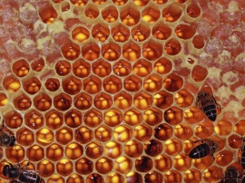
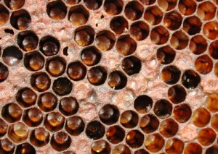
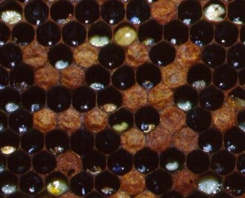
Bee diseases and mites
1980s: bee mite parasites
Varroa mite
Foul brood
Healthy Honeycomb American Foul Brood European Foul Brood
http://wallpaperstock.net/honeycomb-wallpapers_w4679.html
http://www.honeybeekeeping.co.uk/cms/beekeeping-news/american-foulbrood-hits-scotland/

Slide 23
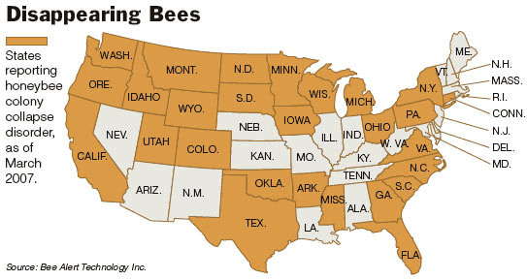
CCD: Colony Collapse Disorder
What causes CCD?
  Multiple viruses and mites
  Pesticides
  Lack of natural forage
About 1/3 of colonies in US lost each year since 2006
  Industrial beekeepers make up losses by splitting colonies or buying new queens
  So far, prices have not been affected
http://momomax.wordpress.com/2007/04/27/honey-stop-fucking-with-the-environment/

Slide 24
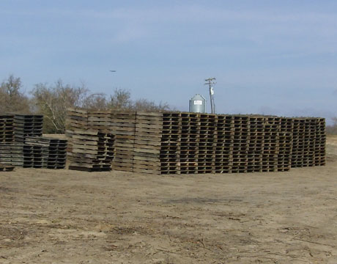
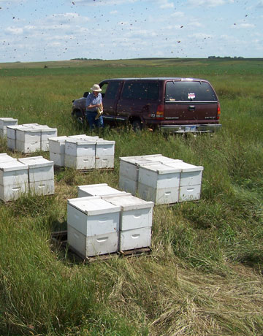
CCD
This beekeeper used to own 18,000 colonies
  Costs $200 per year to maintain a colony to be able to pollinate an almond crop
  These pallets’ bees are dead
  This represents $500,000 lost (2500 hives)

Slide 25
Pesticide Issues
Pesticides harm bees’ immune systems, lower learning abilities, make them disoriented, and kill them
Growing resistance by bee pests
Pollination: pesticides kill 11% of California’s bees per year

Slide 26
Bee diseases and pesticides: the future
Bee migration and trade make diseases hard to contain
Growing resistance to pesticides
  More pesticides on crops
  More pesticides in colonies

Slide 27
Outline
Background
History
State of beekeeping today
  Problems
  Benefits
Beekeeping and sustainability

Slide 28
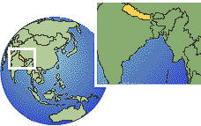
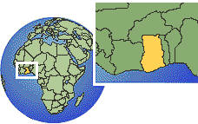
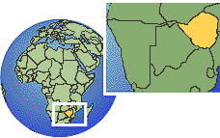
Additional source of income
Nepal: honey earns 3.62 times more than crop farming
  Important where land holdings are not sufficient for feeding a family
Ghana: Netherlands Development Organization
  Ghana imports 30 tons honey annually
  Lower risks, low initial investment, break even in second year
Zimbabwe: “land of milk and honey”
  300 communal farmers earn $1 million per year ($3,000 per farmer)
  Relies on local resources: land, trees, bees

Slide 29
Gender Roles: in past
Hunter-gatherer: men
Ancient Egypt, Greece, Rome: men
Medieval Europe: women, even high class women
  Books by men

Slide 30
Gender Roles: Today
Tropical Africa: men, except for women with honey pots on ground
Muslim women in purdah: hives in house walls
U.S.: women mostly hobbyists
  Moriah Yetter: Idaho commercial beekeeper

Slide 31
Outline
Background
History
State of beekeeping today
  Problems
  Benefits
Beekeeping and sustainability

Slide 32
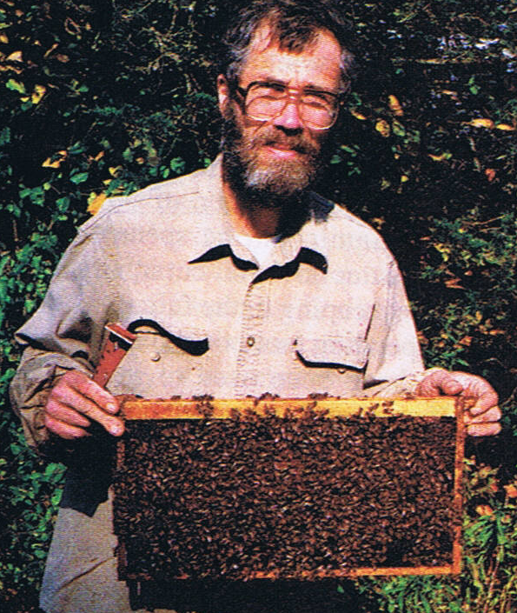
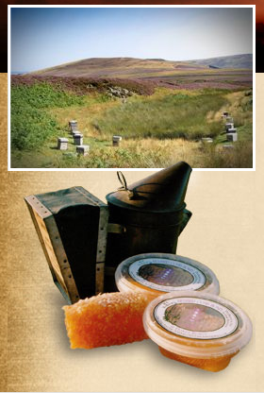
Sustainable Agriculture
Kirk Webster:
  Wildness and biodiversity
  Horizontal breeding and selection
  Mindset
Willie Robson: British beekeeper
  Chain Bridge Honey Farm
  15 employees
  Deliver to 350 shops: honey and other products
http://outdoorplace.org/beekeeping/history1.htm
http://www.chainbridgehoney.co.uk/

Slide 33

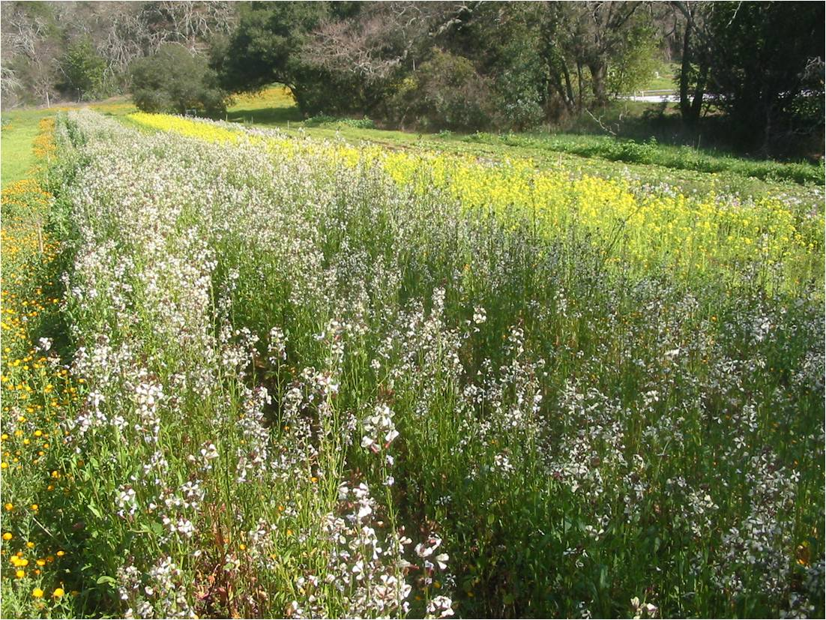
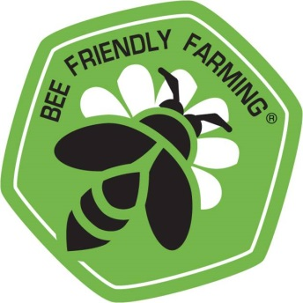
Partners for Sustainable Pollination
  Encourages farmers to provide more flowering plants to native honey bees and native pollinators
  Encourages bee friendly farming certification
  Does not mention farmers using pesticides. Hmm…
http://www.pfspbees.org/index.htm

Slide 34
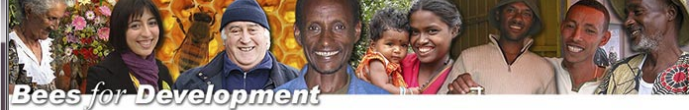
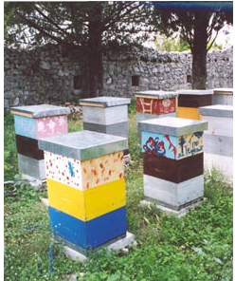

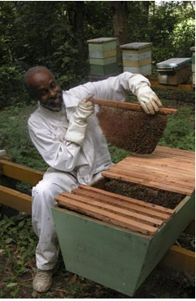
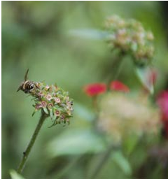
Sustainable Agriculture
Bees for Development promotes sustainable beekeeping to support livelihoods and to conserve biodiversity.
They aim to assist people living in poor and remote areas of the world, and to raise awareness about the value of beekeeping for sustainable development.
http://www.beesfordevelopment.org/index

Slide 35
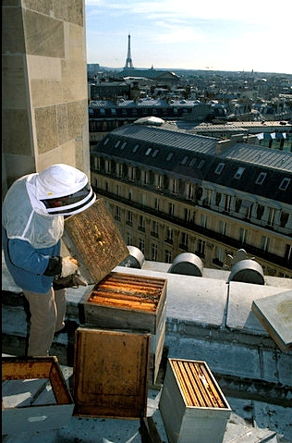
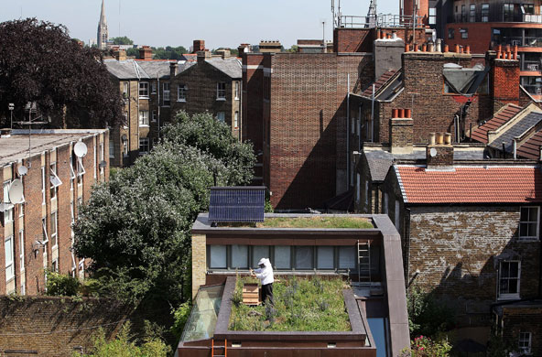
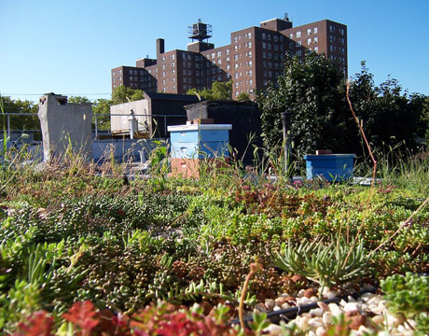
Sustainable Agriculture
Locally produced honey
Urban beekeeping
  Paris: 300 hives
  London
  Manhattan
http://www.guardian.co.uk/environment/gallery/2009/jul/02/week-in-wildlife?picture=349691930
http://www.thedailygreen.com/environmental-news/blogs/bees/
http://www.cityfarmer.info/2009/08/25/paris-rooftops-swarm-with-bees-as-urban-honey-industry-takes-off/

Slide 36
Conclusions
Trend toward industrial beekeeping
Growing resistance to antibiotics, threats of pesticides
More sustainable options

Slide 37
Works Cited
2009a Ghana; Reducing Poverty Through Beekeeping. Africa News, September 15.
2009b Zimbabwe; Beekeeping Can Contribute to Poverty Alleviation. Africa News, November 16.
Borst, Peter L.
2009 What's new in beekeeping. Part two - scientific beekeeping. American bee journal 149(4):349-351.
Burgett, Michael, et al.
2010 U.S. pollination markets: Recent changes and historical perspective. American bee journal 150(1):35-41.
Connor, Larry
2010 The traveling beekeeper: Time for resistant bees--a plan for the individual beekeeper. American bee journal 150(1):66-67.
Crane, Eva
1999 The World History of Beekeeping and Honey Hunting. New York: Routledge.
Daberkow, Stan, et al.
2009 U.S. honey markets: Recent changes and historical perspective. American bee journal 149(12):1125-1129.
Ellis, Hattie
2004 Sweetness & Light: the Mysterious History of the Honeybee. New York: Harmony Books.
Ezenwa, Sylvia A.
2009 Continuing efforts to safeguard U.S. honey imports. Part 1. American bee journal 149(4):366-368.
Flottum, Kim
2010 The Cost of Colony Collapse Disorder, as You've Never Seen It Calculated Before. In The Beekeeper, Vol. 2010: The Daily Green: The consumer's guide to the green revolution.
Hicks, Cecil
2010 Moriah Yetter- Idaho commercial beekeeper. American bee journal 150(1):71-73.
New Crop Opportunities Center
2005 Beekeeping and Honey Production. U.o. Kentucky, ed.
Partners for Sustainable Pollination
2009 Partners for Sustainable Pollination, Vol. 2010.
Pokhrel, Suroj
2008 The Ecological Problems and Possible Solutions of Beekeeping in Hills and Terai of Chitwan, Nepal. The Journal of Agriculture and Environment 9:23-33.
—
2009 Comparative Benefits of Beekeeping Enterprise in Chitwan, Nepal. The Journal of Agriculture and Environment 10:39-50.
Shrestha, Jagadish Bhakta
2008 Honeybees: The Pollinator Sustaining Crop Diversity. The Journal of Agriculture and Environment 9:90-92.
Siebert, John W.
1980 Beekeeping, Pollination, and Externalities in California Agriculture. American Journal of Agricultural Economics 62(2):165-171.
Webster, Kirk
2008 A New Paradigm for American Beekeeping. American bee journal:257-259.
—
2009 What's missing from the current discussion and work related to bees that is preventing us from making good progress? Part I. American bee journal 149(4):359-362.
Wilson, Bee
2004 The Hive: The Story of the Honeybee and Us. New York: Thomas Dunne Books.
Workman, Daniel
2007 Top Honey Exporting Countries: Re-labelled Bee Product Scams Scream Out for WTO Controls: suite101.com.

