Slide 1
Resiliency
Assertive Communication

Slide 2
Mission and Vision
Mission: Implements the Comprehensive Soldier Fitness Program, identifies and trains Master Resiliency Trainers (MRTs) and commences annual resiliency sustainment training in order to enhance overall performance, improve unit level readiness, and sustain a balanced, healthy, campaign capable, expeditionary army
End state: Will improve unit readiness and performance by implementing the Resiliency Training program. The end state will see a more balanced, healthy and capable Brigade Combat Team
POC: ASC MRT, DSN 793-4847
2
Notes:
MRT Instructor:
Ask a participant to read the mission statement.
Ask for questions regarding the purpose of the course.

Slide 3
Task, Conditions, Standards
Task: Learn to communicate clearly and with respect. Use the IDEAL model to communicate in a Confident, Clear, and Controlled manner.
Conditions: Within a classroom environment and 90 minute timeframe.
Standards: Understand that Connection is a primary target of Assertive Communication
POC: ASC MRT, DSN 793-4847
3
Notes:
MRT Instructor:
1. Discuss what it means to establish connections between people.

Slide 4

Assertive Communication
POC: ASC MRT, DSN 793-4847
4
Notes:
MRT Instructor:
Introduce Assertive Communication.

Slide 5
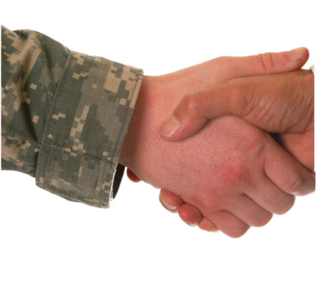
Key Principles
Takes practice: Assertive Communication takes practice.
Flexibility: Match your style of communication to the situation/person you are communicating with.
Skill, not personality: Communication styles are skills, not personality styles.
Retreat, refuel, return: Take a break from the conversation. Relax/rethink and then try again.
Connection: Assertive Communication
builds all of the MRT competencies;
Connection is a primary target.
POC: ASC MRT, DSN 793-4847
5
Notes:
MRT Instructor:
Review the key principles.
Ask for questions or comments.
Clarify any misconceptions.
Ask participants if there are any other key principles they would add to the list.
Key Points:
Assertive Communication helps to build the MRT competency of Connection.
Assertive Communication is a skill and takes practice.
You can choose which style of communication best fits the situation/context.

Slide 6
Bottom Line Up Front
Assertive Communication helps to build Connection.
Assertive Communication helps you solve problems by remaining Confident, Clear, and Controlled.
POC: ASC MRT, DSN 793-4847
6
Notes:
MRT Instructor:
Review the B.L.U.F. statements.
Ask for questions/comments.
Key Points:
Assertive Communication helps to build Connection.
Assertive Communication is Confident, Clear, and Controlled (3 Cs).

Slide 7
Assertive Communication:
Applications
When is Assertive Communication appropriate or not appropriate in the Army?
What gets in the way of Assertive Communication?
How will your relationships benefit through the use of Assertive Communication?
POC: ASC MRT, DSN 793-4847
7
Notes:
MRT Instructor:
Discuss the application ideas generated by the participants.
Remind participants to record application ideas on the Applications page in the Participant Guide.
Point out that barriers can include thoughts or Icebergs that get in the way of Assertive Communication, timing issues (e.g., it’s not the right time to have that conversation), or rank issues.

Slide 8
Communication Skill Set
Assertive Communication: Communicate clearly and with respect.
Active Constructive Responding: Respond to others to build strong relationships.
Praise: Praise to build mastery and winning streaks.
POC: ASC MRT, DSN 793-4847
8
Notes:
MRT Instructor:
Review the skills taught in Module Four.

Slide 9
Communication Styles
In small groups, discuss what makes communication effective.
POC: ASC MRT, DSN 793-4847
9
Notes:
Total recommended time: 15 mins
Setup: 1 min
Practice: 10 mins
Debrief: 4 mins
MRT Instructor:
Refer participants to the Participant Guide.
Ask participants to share what they identified and discuss.
MRT Activity Instructions:
In small groups, participants discuss what makes communication effective (MRT Participant Guide, page 103)

Slide 10
Communication Styles
Complete the chart on the Communication Styles worksheet.
What are the descriptors of each style?
What are Icebergs that contribute to each style?
What are the messages that each style sends to the other person?
POC: ASC MRT, DSN 793-4847
10
Notes:
Total recommended time: 30 mins
Setup: 1 min
Practice: 20 mins
Debrief: 9 mins
MRT Instructor:
Refer participants to the Participant Guide.
After participants complete the worksheet, review and discuss.
MRT Activity Instructions:
Participants work in small groups.
Participants list descriptors, Icebergs, and messages associated with Aggressive, Passive, and Assertive Communication styles (MRT Participant Guide, page 104).

Slide 11
Debrief
What did you learn?
What are the descriptors of each style?
What are Icebergs that contribute to each style?
What are the messages that each style sends to the other person?
POC: ASC MRT, DSN 793-4847
11
Notes:
MRT Instructor:
Ask participants what they learned through this activity and record critical points on a flip chart.
As you discuss each style (Aggressive, Passive, Assertive Communication), advance to the relevant slides to review the key points.

Slide 12
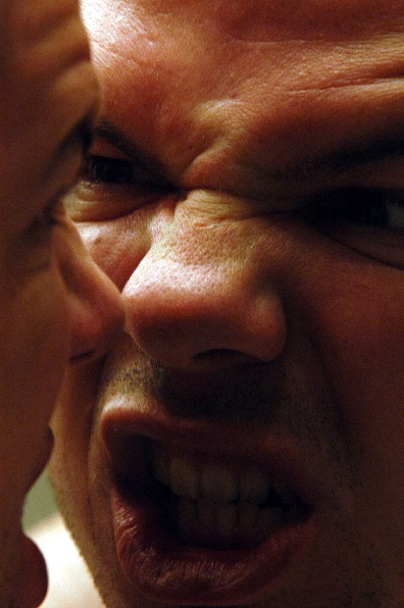
Aggressive Communication
Must have the last word
Talking over the other person
Out of control emotion
Blaming
Talking down
POC: ASC MRT, DSN 793-4847
12
Notes:
MRT Instructor:
Review points on slide and discuss those that do not come out during the activity debrief.
Avoid labeling Aggressive Communication as bad. Instead focus on the outcome of Aggressive Communication and its effectiveness.
Key Points:
Aggressive Communication is often blaming, talking down, and not controlled or respectful.

Slide 13
Icebergs beneath
Aggressive Communication
The best defense is a strong offense.
You’ve got to be loud and strong if you want to win.
Never back down from a fight.
Any sign of weakness and you’ll be taken advantage of.
I want it and deserve it now!
POC: ASC MRT, DSN 793-4847
13
Notes:
MRT Instructor:
Review Icebergs that might lead to Aggressive Communication and discuss.

Slide 14
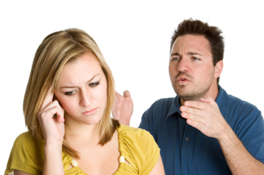
Passive Communication
Quiet
No eye contact
Withdrawn
Sulking
Submissive
Fearful
Appeasing
POC: ASC MRT, DSN 793-4847
14
Notes:
MRT Instructor:
Review points on slide and discuss those that do not come out during the activity debrief.
Avoid labeling Passive Communication as bad. Instead focus on the outcome of Passive Communication and its effectiveness.
Key Points:
Passive Communication is usually submissive, appeasing, fearful, and lacking in clarity.

Slide 15
Icebergs beneath
Passive Communication
It’s wrong to complain.
I don’t really care. It doesn’t matter.
I’ll make enemies if I speak my mind.
No one ever really changes anyway.
It’s more important that people like me, than to be right.
I don’t like conflict.
POC: ASC MRT, DSN 793-4847
15
Notes:
MRT Instructor:
Review Icebergs that might lead to Passive Communication and discuss.

Slide 16
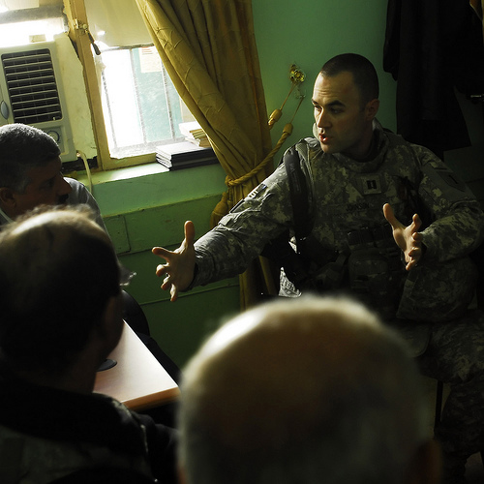
Assertive Communication
(3 Cs)
Confident, Clear, Controlled
Seek to understand
Important in dealing with family and colleagues (communication that works in combat or, with your Platoon doesn't work at home)
POC: ASC MRT, DSN 793-4847
16
Notes:
MRT Instructor:
Review points on slide and discuss those that do not come out during the activity debrief.
Underscore the 3 C mnemonic to help the participants remember the critical ingredients of Assertive Communication.
Emphasize that the goal of this unit is to increase participants’ flexibility in communication so that they are able to choose and use the style of communication that is most appropriate in any given situation.
Key Points:
Assertive Communication is Confident, Clear, and Controlled.

Slide 17
3 Cs: Confident, Clear, and Controlled
Confident: You believe in your ability to handle the situation and are composed.
Clear: The message is easy to understand and is not exaggerated.
Controlled: You are “tracking” the other person and modulate yourself if necessary.
POC: ASC MRT, DSN 793-4847
17
Notes:
MRT Instructor:
Review the definitions of Confident, Clear, and Controlled.

Slide 18
Icebergs that Hinder the 3 Cs
I’m not that strong.
I’m not a good Soldier.
I don’t measure up.
POC: ASC MRT, DSN 793-4847
18
Notes:
MRT Instructor:
Review Icebergs that might hinder to Assertive Communication and discuss.

Slide 19
Icebergs that Promote the 3 Cs
We can work this out.
I trust you and respect you.
I can express myself clearly and confidently.
What I believe matters.
POC: ASC MRT, DSN 793-4847
19
Notes:
MRT Instructor:
Review Icebergs that might promote Assertive Communication and discuss.

Slide 20
The IDEAL Model
I = Identify and understand the problem.
D = Describe the problem objectively and accurately.
E = Express your concerns and how you feel (when appropriate).
A = Ask the other person for his/her perspective and then ask for a reasonable change.
L = List the outcomes.
POC: ASC MRT, DSN 793-4847
20
Notes:
MRT Instructor:
Introduce the IDEAL Model for Assertive Communication.
Underscore that the “I” in IDEAL is internal (i.e., the person’s thought process) and that before communicating anything, the person should first take time to accurately understand the problem.
The skills from Module Two are helpful in identifying and understanding the problem, particularly Problem Solving.

Slide 21

Tips for IDEAL
I = Identify and understand the problem
  ATC and check for Thinking Traps
  Detect Icebergs (if necessary)
  Put It In Perspective (if necessary)
POC: ASC MRT, DSN 793-4847
21
Notes:
MRT Instructor:
Review points on the slide and discuss.
Point out that the mirror indicates that this step focuses on Self-awareness.

Slide 22
Tips for IDEAL
Once you’ve identified the problem, then you can move to communication.
D = Describe the problem objectively and accurately
  Who, what, when, where
  Specific, recent
  Minimize exaggeration
E = Express your concerns and how you feel (when appropriate)
  “I” rather than “you”
  Minimize exaggeration
POC: ASC MRT, DSN 793-4847
22
Notes:
MRT Instructor:
Review points on the slide and discuss.
Point out that the “who, what, when, where” in the “D” in IDEAL draws from the skill of ATC.
Emphasize the importance of being specific and recent in the description of the problem. Being specific and recent grounds the conversation in something both parties can address.
Emphasize the importance of not exaggerating. Exaggeration causes the other person to say “I do not do that ALL the time!” and the conversation gets off track.

Slide 23
Tips for IDEAL
A = Ask the other person for his/her perspective…
  What and How questions, not Why questions
  Repeat back what you heard to check that you’re hearing him/her accurately
…and then ask for a reasonable change
  “Good Faith” test (reasonable, doable)
  Work towards a win-win
POC: ASC MRT, DSN 793-4847
23
Notes:
MRT Instructor:
Review points on the slide and discuss.
Point out that “What” and “How” questions vs. “Why” questions draws from the skill of Detect Icebergs.
Explain that the “good faith” test is to check that what you are asking is something that the other individual could in good faith agree to. For example, no one could in good faith agree to “Never say an unkind thing again.” They could in good faith agree to “Be more respectful of me and if you do or say something disrespectful, own up to it and apologize.”

Slide 24
Tips for IDEAL
L = List the outcomes
  Positive rather than negative
  Consider appropriateness
POC: ASC MRT, DSN 793-4847
24
Notes:
MRT Instructor:
Review points on the slide and discuss.
Emphasize that rewards work better than punishments so naming a positive outcome is typically more effective than threatening a negative outcome.

Slide 25
Assertive Communication Practice
Activities:
  In Scenarios 1 and 2, practice Assertive Communication with your group.
    Person 1 initiates Assertive Communication.
    Person 2 responds within role-play.
  In Scenario 3, practice Assertive Communication with a partner.
  In Scenario 4, practice the IDEAL model on a situation of your own.
POC: ASC MRT, DSN 793-4847
25
Notes:
Total recommended time: 30 mins
Setup: 5 mins
Practice: 20 mins
Debrief: 5 mins
MRT Instructor:
Describe the activities for Assertive Communication.
Select volunteers for the first two scenarios and ask participants to work with a partner for the last two scenarios.
MRT Activity Instructions:
Participants role-play Scenarios 1 and 2: Person 1 initiates Assertive Communication and Person 2 responds within the role-play.
Participants work in pairs in Scenario 3.
In Scenario 4, participants choose a situation from their own lives and use the IDEAL model to develop an Assertive Communication plan.

Slide 26
Communication Scenario 1
Participants Role-play in Group:
  One of your fellow Soldiers keeps using your iPod without your permission and running down the battery.
POC: ASC MRT, DSN 793-4847
26
Notes:
MRT Instructor:
Identify two participants to do the role-play and assign roles: Person 1 initiates Assertive Communication and Person 2 responds within the role-play.
Ask the participants acting in the role-play to first model aggressive and passive styles of communication before modeling Assertive Communication.
Periodically stop the role-play and ask participants to identify the style of communication being used as well as the response prompted by using that style.
Ask for suggestions for how to make the response more effective (e.g., be more specific, don’t yell, look him in the eye).

Slide 27
Communication Scenario 2
Participants Role-play in Group:
  Your spouse/significant other is spending too much money on things you don’t consider essential.
POC: ASC MRT, DSN 793-4847
27
Notes:
MRT Instructor:
Identify two participants to do the role-play and assign roles: Person 1 initiates Assertive Communication and Person 2 responds within the role-play.
Ask the participants acting in the role-play to first model aggressive and passive styles of communication before modeling Assertive Communication.
Periodically stop the role-play and ask participants to identify the style of communication being used as well as the response prompted by using that style.
Ask for suggestions for how to make the response more effective (e.g., be more specific, don’t yell, look him in the eye).

Slide 28
Communication Scenario 3
Participants Role-play in Pairs: In pairs, practice Assertive Communication in the following scenario (Person 1 initiates Assertive Communication and Person 2 responds):
  Your battle buddy has started drinking alcohol more than usual and has been seen several times drinking and driving.
POC: ASC MRT, DSN 793-4847
28
Notes:
MRT Instructor:
Ask participants to work in pairs: Person 1 initiates Assertive Communication and Person 2 responds within the role-play.

Slide 29
Communication Scenario 4
Choose a scenario from your own life.
Use the IDEAL model to develop your Assertive Communication plan.
POC: ASC MRT, DSN 793-4847
29
Notes:
Total recommended time: 50 mins
Setup: 5 mins
Practice: 30 mins
Debrief: 15 mins
MRT Instructor:
Refer participants to the Participant Guide.
Ask participants to complete the IDEAL model with a current situation.
MRT Activity Instructions:
Participants complete the IDEAL model with a current situation (CSF Communication Scenario, IDEAL Model, page 24).

Slide 30
Debrief
What did you learn from this activity?
What if you use Assertive Communication and still don’t get what you want?
What if you use Assertive Communication and the other person doesn’t react positively?
POC: ASC MRT, DSN 793-4847
30
Notes:
MRT Instructor:
Ask participants what they learned through this activity and record critical points on a flip chart.
Remind participants that using Assertive Communication doesn’t guarantee that you’ll get what you want. However, Assertive Communication does help you express your concerns and what you want, even when you don’t reach the outcome you’d like or the other person doesn’t react in the way you wanted.
Explain that by using Assertive Communication, you leave the door open to talking about it again at a time when the other person might be more receptive.
Point out that even if you don’t get the outcome you wanted, when you use Assertive Communication you can be confident that you handled the situation with integrity and respect for the other individual. This enables strong relationships even when you and the other person don’t see eye to eye.

Slide 31
Assertive Communication:
Applications
When is Assertive Communication appropriate or not appropriate in the Army?
What gets in the way of Assertive Communication?
How will your relationships benefit through the use of Assertive Communication?
POC: ASC MRT, DSN 793-4847
31
Notes:
MRT Instructor:
Discuss the application ideas generated by the participants.
Remind participants to record application ideas on the Applications page in the Participant Guide.
Point out that barriers can include thoughts or Icebergs that get in the way of Assertive Communication, timing issues (e.g., it’s not the right time to have that conversation), or rank issues.

Slide 32
Check on Learning
What is the skill? Assertive Communication is a method of communication that is Confident, Clear, and Controlled.
When do I use it? Use Assertive Communication when confronting someone about a conflict or challenge (and is the most appropriate style in that situation).
How do I use it? Use the IDEAL model: I = Identify and understand the problem, D = Describe the problem objectively and accurately, E = Express your concerns and how you feel (when appropriate), A = Ask the other person for his/her perspective and ask for a reasonable change, L = List the outcomes.
POC: ASC MRT, DSN 793-4847
32
Notes:
MRT Instructor:
Ask each question. (Note that the slide builds.)
Check to make sure the participants are giving accurate answers.
Clarify misconceptions as necessary.

Slide 33
Resiliency
Questions

Slide 34
AAR
What went well
1.
2.
3.
What can be improved
1.
2.
3.
As of 25 Oct 10
POC: ASC MRT, DSN 793-4847
Notes:
MRT Instructor:
Conduct the After Action Review.
Ensure when training ends Soldiers Sound off with the motto for the quarter.
“Shoulder to Shoulder”

