Slide 1
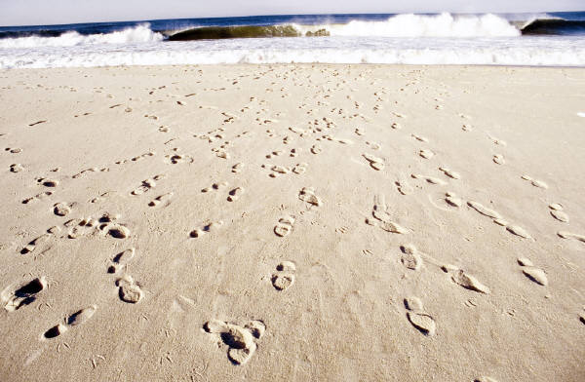
At the Seaside

Slide 2
Which things would you see at the seaside?

Slide 3
sand

Slide 4
bed

Slide 5
starfish

Slide 6
bucket and spade

Slide 7
television

Slide 8
fish

Slide 9
sandcastle

Slide 10
speed boat

Slide 11
parasol

Slide 12
rabbit

Slide 13
deck chair

Slide 14
sea

Slide 15
shell

Slide 16
tractor

Slide 17
dinghy

Slide 18
sun cream

Slide 19
crab

Slide 20
beach ball

Slide 21
elephant

Slide 22
sunglasses

Slide 23
wellies

Slide 24
bikini

Slide 25
What would you see at the seaside?

