Slide 1
Breeds of Beef & Dairy Cattle
Mrs. Gilbreath

Slide 2
Today you will be able to…
Identify characteristics of Major Beef Cattle Breeds, Dual-Purpose and Dairy Breeds.

Slide 3
Cattle Today
Worldwide there are more than 250 breeds of cattle
Over 60 of these breeds are present in the United States
Less than 20 of those breeds constitute the major breeds used in US breeding programs.

Slide 4
Terms
Composite breed – a breed that is formed by crossing two or more breeds
Hybrid Vigor – Increased growth rate often noted in cattle resulting from crossbreeding
Polled – Naturally without horns; the polled trait is dominant over the horned trait

Slide 5
Terms Cont.
Terminal Breed – Breed used in crossbreeding system which progeny, both male and female are marketed.
Dual-Purpose Breeds – A Breed of any animal that can be used for dual uses. (Ex. Beef and Milking)

Slide 6
2 Biological Types of Cattle
Bos Indicus – Humped cattle, adapt to tropical and sub-tropical environments
Brahman
Brangus
Beefmaster
Santa Gertrudis
Environmental adaptability to…
Stresses of heat
Humidity
Parasites
Digestible forages

Slide 7
Bos Taurus:
AKA: Continental or Exotic
Sub-divided into 2 groups
Known for weight gain and cut-ability
Large in size, lean muscular and vary in adaptability to hot climates
Charolais
Chianina
Gelbvieh
Limousin
Maine-Anjou
Salers
Simmental
Texas Longhorn

Slide 8
Bos Taurus:
British Breeds
Or “English Breeds”
Smaller than Continental breeds
Increased fleshing and marbling ability
These are the foundation of the United States beef herds.
Angus
Hereford
Red Angus
Red Poll
Shorthorn

Slide 9
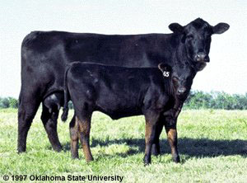
Black Angus
Originated in Scotland
Imported to U.S. in 1873
Solid black in color
Naturally polled
Consumer preference led to Certified Angus Beef
British Breed

Slide 10
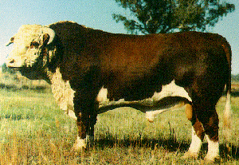
Hereford
Originated in Hereford, England
Red with white head, legs, and underline
Horned
Early maturing
“Mothering” breed
British Breed

Slide 11
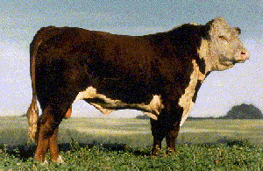
Polled Hereford
Developed in Iowa by Warren Gammon
Naturally hornless
Red with white face, legs and underline

Slide 12
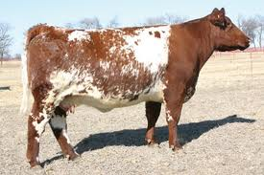
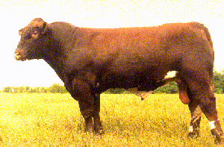
Shorthorn
Originated in England
Red; red & white or roan in color
Originally used as a dual purpose breed for meat and milk
Sometimes called the Durham breed
Early maturing, excellent milkers
Dual-Purpose

Slide 13
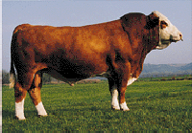
Simmental
Originated in Switzerland
Oldest breed of cattle in the world
Large, powerful breed
Known for both growth traits and maternal traits
Vary from red and white spotted to dark red to black
Continental Breed

Slide 14
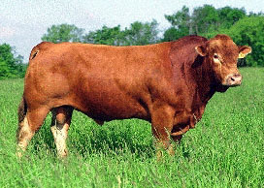
Gelbvieh
Originated in Germany
Red in color
Noted for superior fertility and mothering ability
Tend to be extra fleshy under the throat

Slide 15
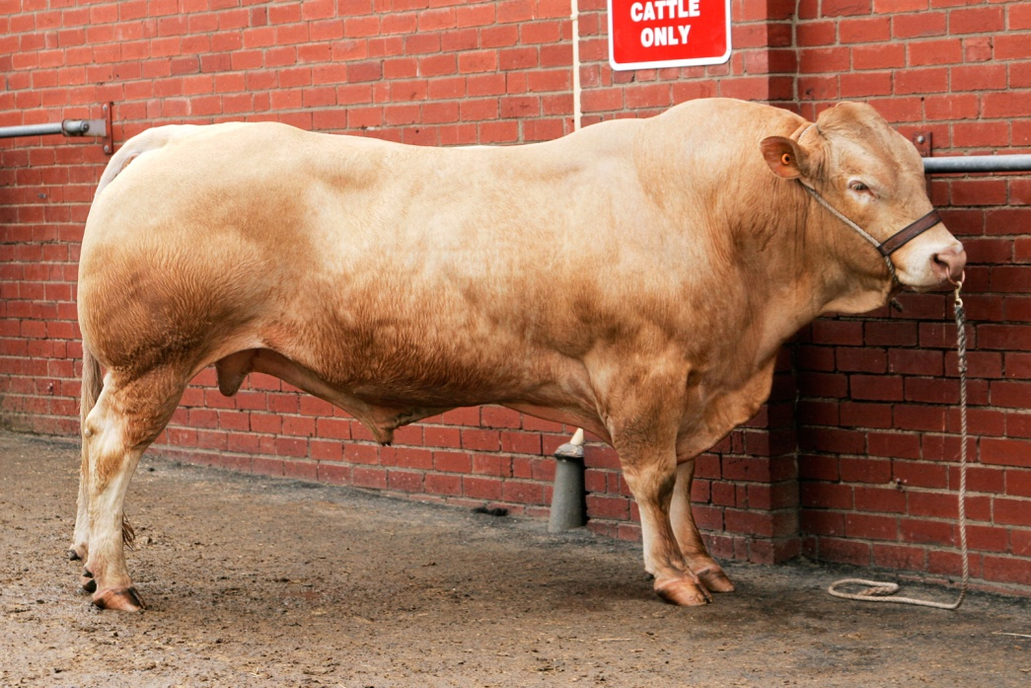
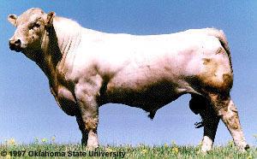
Charolais
Originated in France
Traditionally white in color
Long bodied, large cattle
Heavily muscled
Coarse looking
Horned or Polled
Fast growth rate, and feed efficiency

Slide 16
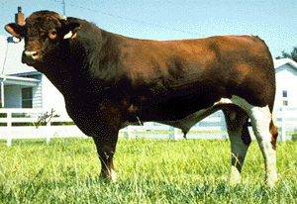
Maine Anjou
Originated in France
Dark red with white markings or black
Can be horned or polled
Yield extremely lean, muscular carcasses
Bos Taurus

Slide 17
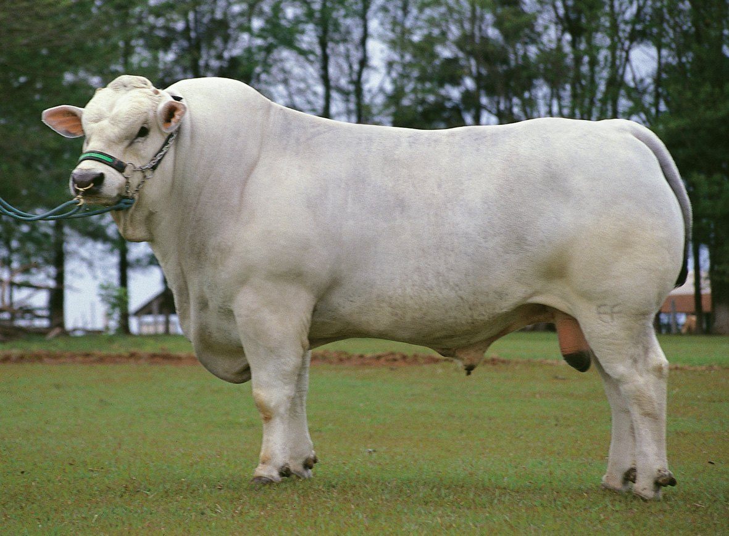
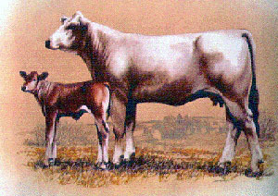
Chianina
Originated in Italy
One of the oldest breeds of cattle
One of the largest breeds with some bulls weighing over 3000 lbs.
Short hair that is white to steel gray
Terminal breed
Low milk production

Slide 18
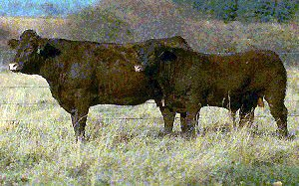
Salers
Originated in France
Fastest growing breed in the United States
Mahogany red to black in color
One of the last breeds to be imported into the United States in 1972
Adapt to rough terrain and harsh climates

Slide 19
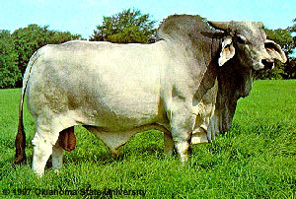
Brahman
Originated in India
Able to survive on very little, poor feed
Insect & heat resistant
Excess skin and large hump on back
White to gray, red to black
Sweat glands
Bos Indicus

Slide 20
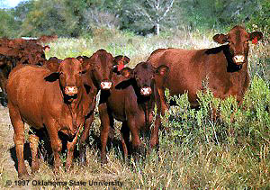
Santa Gertrudis
Developed on the King Ranch in Texas
All Santa Gertrudis are descendants of the bull, Monkey
They were created by crossing shorthorn cows and Brahman bulls

Slide 21
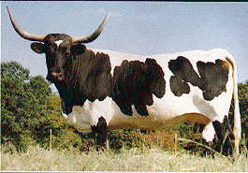
Texas Longhorn
Developed entirely by nature in North America
Known for its long horns
High fertility
Were near extinction in 1927

Slide 22
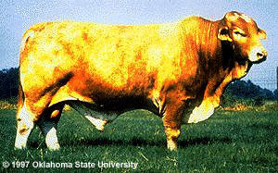
Beefmaster
Developed on Lasater Ranch in our home state. TX
No color standard, predominantly red or dun
Composite breed,
½ Brahman, ¼ Shorthorn, ¼ Hereford
Possess reproductive traits and high milking potential

Slide 23
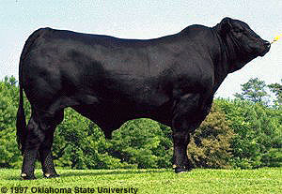
Brangus
Composite Breed 3/8 Brahman, 5/8 Angus
Black in color and are Polled
Heat tolerance, muscularity, early maturity, quality beef
Bos Indicus
Composite Breed

Slide 24
Dual-Purpose Breed
Dual-Purpose Breeds – A group of cattle that are very large to extremely large in size, high to very high milkers, with heavy muscle expression.
These breeds tend to be early to medium maturing in spite of there size, presumably because of there selection for dairy use.

Slide 25
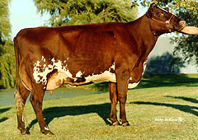
Milking Shorthorn
Red and white or any combination of red and white
Dual purpose breed
Medium sized
Average milk producer
Split from the American Shorthorn Assoc. in 1949

Slide 26
Dairy Cattle

Slide 27
Dairy Breeds and Selection
Terms
Dairy character -
characteristics indicating the animal will be useful in the dairy industry
Butterfat (milkfat)-
percent of fat in the milk
Milk production -
amount in pounds of milk that a cow produces during a lactation period
Lactation -
span of time that a cow is giving milk
Pedigree -
register of lines of ancestry
Dairy Herd Improvement records (DHI)-
production records kept on producing dairy cattle

Slide 28
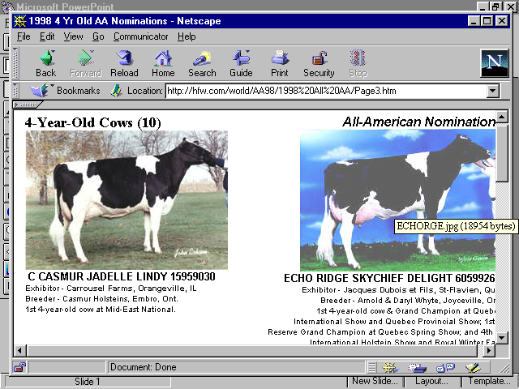
Holstein
Black and White or Red and White color pattern
Large sized
Heavy milk producers

Slide 29
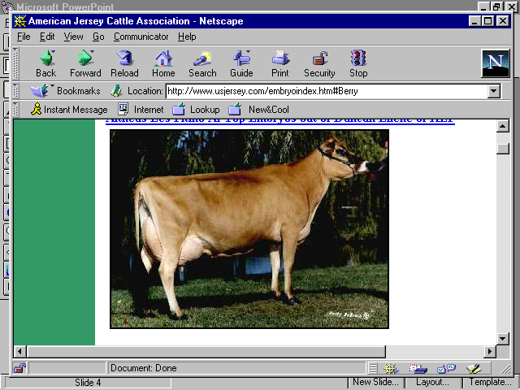
Jersey
Color varies (light gray to a dark fawn being darker around the head and hips)
Medium sized
Produces more pounds of milk per body weight than any other dairy breed.

Slide 30
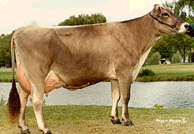
Brown Swiss
Solid brown, varying from very light to dark
Large sized
Light colored band around the muzzle
One of the oldest Dairy breeds
Above average milkfat content

Slide 31
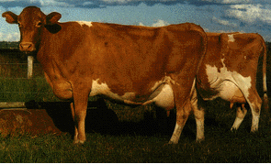
Guernsey
Red (Fawn) and White in color
Medium sized
High milk production to feed intake ratio
Milk is high in protein and beta-carotene
Yellow colored milk

Slide 32
Review Breeds

Slide 36
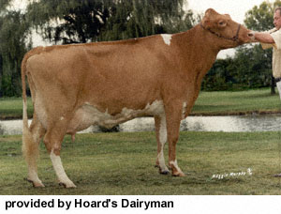

Slide 39
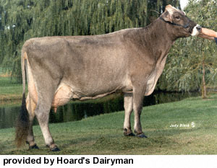

Slide 41
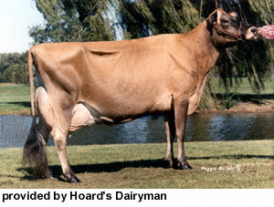

Slide 43
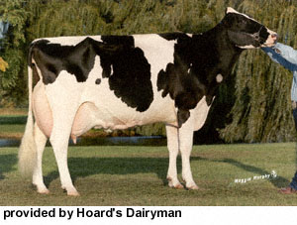

Slide 46
References
IMS
Oklahoma State University – Animal Science Dept.

