Slide 1
The BFG
What did he say?

Slide 2
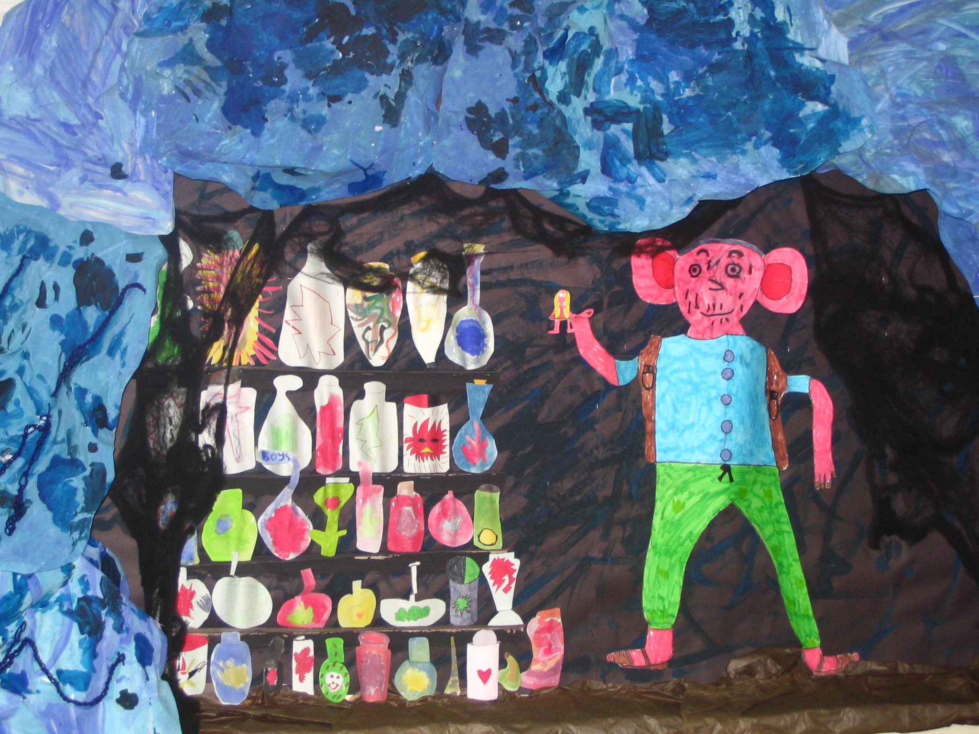
I is the BFG. What is your name?
My name is Sophie!

Slide 3
I is the BFG. What is your name?
My name is Sophie!
The giant said, “I is the BFG. What is your name?”
Sophie said, “My name is Sophie!”

Slide 4
What sort of human beings do you eat?
I is never guzzling human beans! I is a friendly giant.

Slide 5
What sort of human beings do you eat?
I is never guzzling human beans! I is a friendly giant.
Sophie asked, “What sort of human beings do you eat?”
The BFG replied, “I is never guzzling human beans! I is a friendly giant.”

Slide 6
Is you warm enough in your nightie?
I’m fine, thank you.

Slide 7
Is you warm enough in your nightie?
I’m fine, thank you.
“Is you warm enough in your nightie?” asked the BFG.
“I’m fine, thank you,” replied Sophie.

