Slide 1
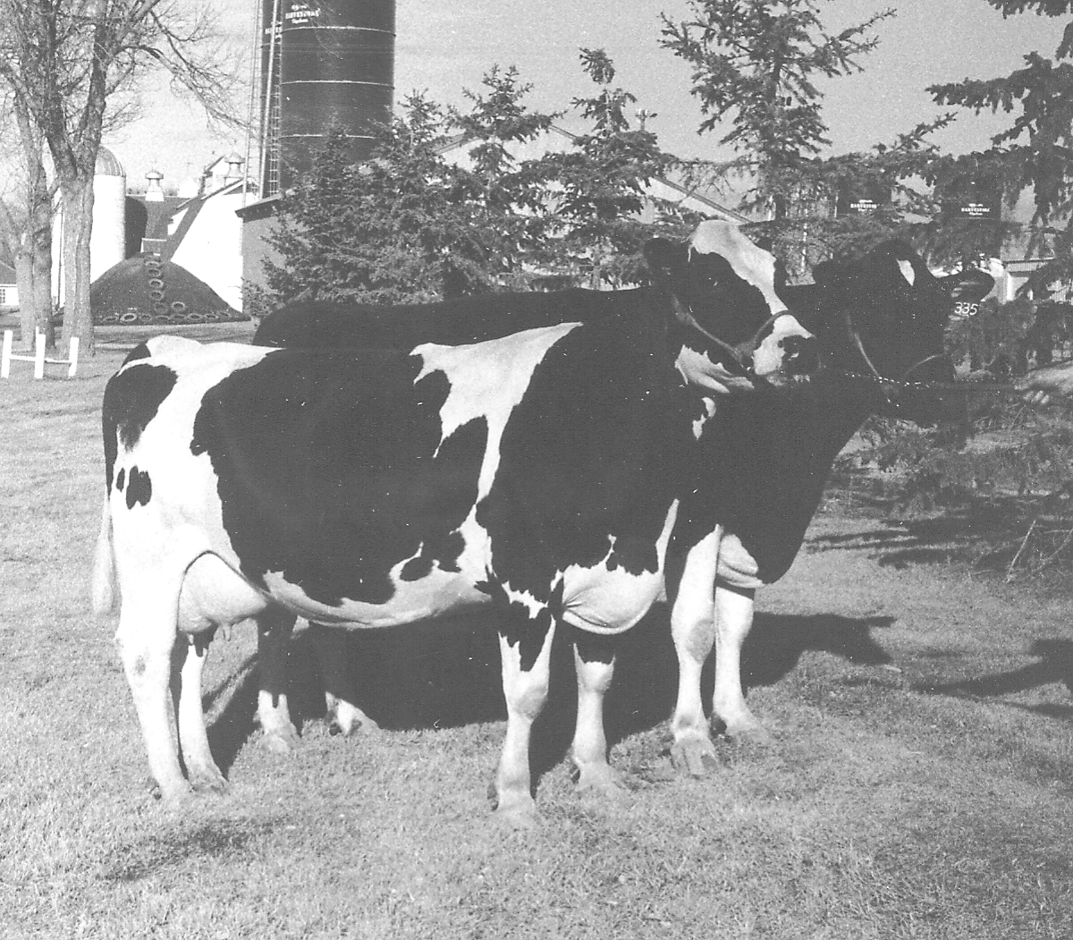
Principles of Dairy Cattle Breeding

Slide 2
Genetic Control of Milk Production
The many genes controlling “milk production” actually control the expression of:
Growth hormone (and receptors)
IGF-1 (and receptors)
Melatonin (and receptors)
Blood flow
Etc., etc., etc.
COMPLEX set of genes controlling multiple factors that affect milk synthesis and letdown

Slide 3
Genetic Potential
Determined by combination of genes encoded by DNA
Genetic expression – determined by the genes that are present and affected by methylation patterns (affect how and when proteins encoded by genes are produced)
Methylation patterns affected by environment
Genetic transmission – only affected by the genes that are present
Expression and transmission can be vastly different in the same animal

Slide 4
Imprinting or Programming
Environmental factors can permanently alter the ability of a gene to encode proteins
More dramatic alterations occur during transition periods (homeorrhetic adjustment periods)
Early embryonic development
Perinatal period (around birth)
Around puberty
Transition period around calving

Slide 5
Altered Expression
Conception potential (70,000 lbs of milk)
embryo quality uterine conditions
Blastocyst potential (60,000 lbs of milk)
maternal nutrition placental function, dystocia
Birth (45,000 lbs. of milk)
passive immunity early nutrition
Weaning (37,000 lbs. of milk)
nutrition parturition
Lactating Cow (32,000 lbs. of milk)

Slide 6
Genetic Expression
Management decisions and environmental quality during fetal stages, calfhood, and up UNTIL calving provide the FOUNDATION for the ability (or inability) of a lactating cow to produce milk (determines % of genetic potential that is lost)
The management of the lactating cow is NOT the most important factor impacting milk production, it is simply the part that SHOWS the most
Even though you can’t always see the foundation, it determines the “quality of the house” (or lactational performance) that can be supported…

Slide 7
Genetic Progress
50% from sire, 50% from dam
- Sire choices – best in the world
- Dam choices – best in the herd
- after culling and replacement losses
- involuntary culling rate (mastitis, reproduction, mastitis, death losses) determines potential for voluntary culling
- voluntary culling rate determines dam side of genetic progress
Nationally, 94% of genetic progress is from sire side, 6% is from dam side

Slide 8
Population Gene Flow
76% by bull studs
Sires to sons – 43%
Cows to sons – 33%
24% by producers
Sires to daughters – 18%
Cows to daughters – 6%
~ 9 million cows, ~ 600 bulls

Slide 9
Genetic Transmission
Since we don’t harvest our full genetic potential from cows, should we not worry about genetic progress (use cheaper bulls) until management “catches up”????
Transmission losses are a % of genetic potential
In well-managed herds, 100 lbs PTA milk difference provides about 170 lbs actual milk
In average managed herds, 100 lbs PTA milk difference provides about 100 lbs actual milk

Slide 10
Genetic Progress
Determinants of genetic progress:
Accuracy of selection (A)
Intensity of selection (I)
Genetic variation (G)
A x I x G = genetic progress per generation
A x I x G/GI = genetic gain per year
If GI is generation interval

Slide 11
Genetic Progress
Genetic variation is beyond control of producer
Accuracy is determined by breed studs
Studs select the parents of young sires
Producer affects genetic change by controlling the intensity of selection
Controls rate of this by controlling generation interval
Fast turnover best for genetic progress, not necessarily best for profitability
Takes 1.5 lactations (on average) to pay off heifer raising costs
- increased longevity makes cows more profitable
- allows more “voluntary” sales of heifers or cows
Average cow leaves the herd after 2.7 lactations nationally (only 1.7 lactations on average in California!!)

Slide 12
“Official” Dairy Records
Dairy Herd Improvement Association (DHIA)
1/3 of all cows enrolled
Records production and other performance data
Forms foundation of genetic evaluations
Beef is by breed associations
Swine is by genetic companies like PIC
Use monthly data to estimate lactation yields
Standardized to 305-2x-ME
Adjusts for age at calving, month of calving, times milked per day, management group, days in milk, region of US, days open in previous lactation

Slide 13
Natural Service vs. AI
Economic advantages of AI
Higher producing daughters
Lower cost per insemination
Feed, housing costs of bull far exceed AI costs
Safety issues
Convenience (often favors natural service)
Training (favors natural service)

Slide 14
Proven vs. Young Sires
Proven sires are 7-8 years old when first proofs arrive, have “life expectancy” in service of about 2-3 years
PTA’s increase in accuracy as Reliability increases
Young sires first sampled at less than 2 years old
Pedigree Indexes VERY accurate for the group, can be inaccurate for any individual
Select individual, highly reliable proven sires and groups of young sires to minimize risk
Requires 10 young sires to produce 1 proven sire that makes the line-up
$250,000 investment per proven sire available

Slide 15
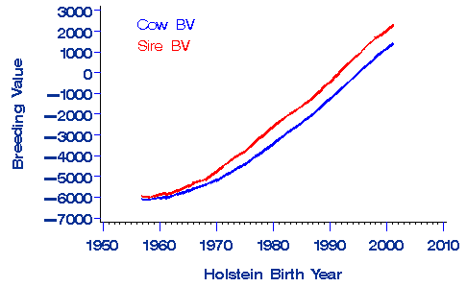
From USDA-AIPL: http://www.aipl.arsusda.gov/dynamic/trend/current/trndx.html
Fig 9-3. Historic trends for breeding values illustrate the speed of genetic progress and the value of young sires. (Courtesy of USDA)

Slide 16
Breeding Issues in Dairy
Identification issues
Estimated 10-12% of all registered animals are improperly identified
Inbreeding issues
Jersey average 6-7%
Holstein average 7%
Losses include heifer mortality, health, reproduction, and milk production
50-80 lbs of milk per point, 2 lbs fat and protein
24 distinct genetic lines in Holstein breed
Fewer available in colored breeds

Slide 17
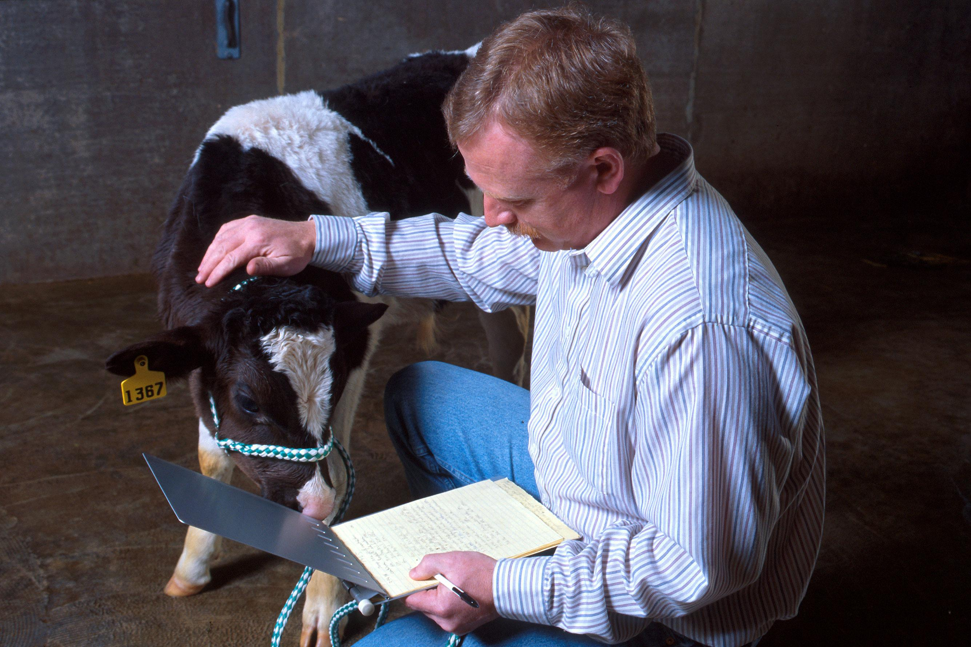
Fig 10-1. Marcus Kehrli tests a calf that has bovine leukocyte adhesion deficiency (BLAD) (Courtesy of USDA-ARS)

Slide 18
Crossbreeding
Improves milk production, reproduction, health, heifer mortality (above average of two breeds crossed)
Interval from calving to first heat, days open and calving interval all improved by about a week
Greatest heterosis apparent early in life, decreases with age

Slide 19
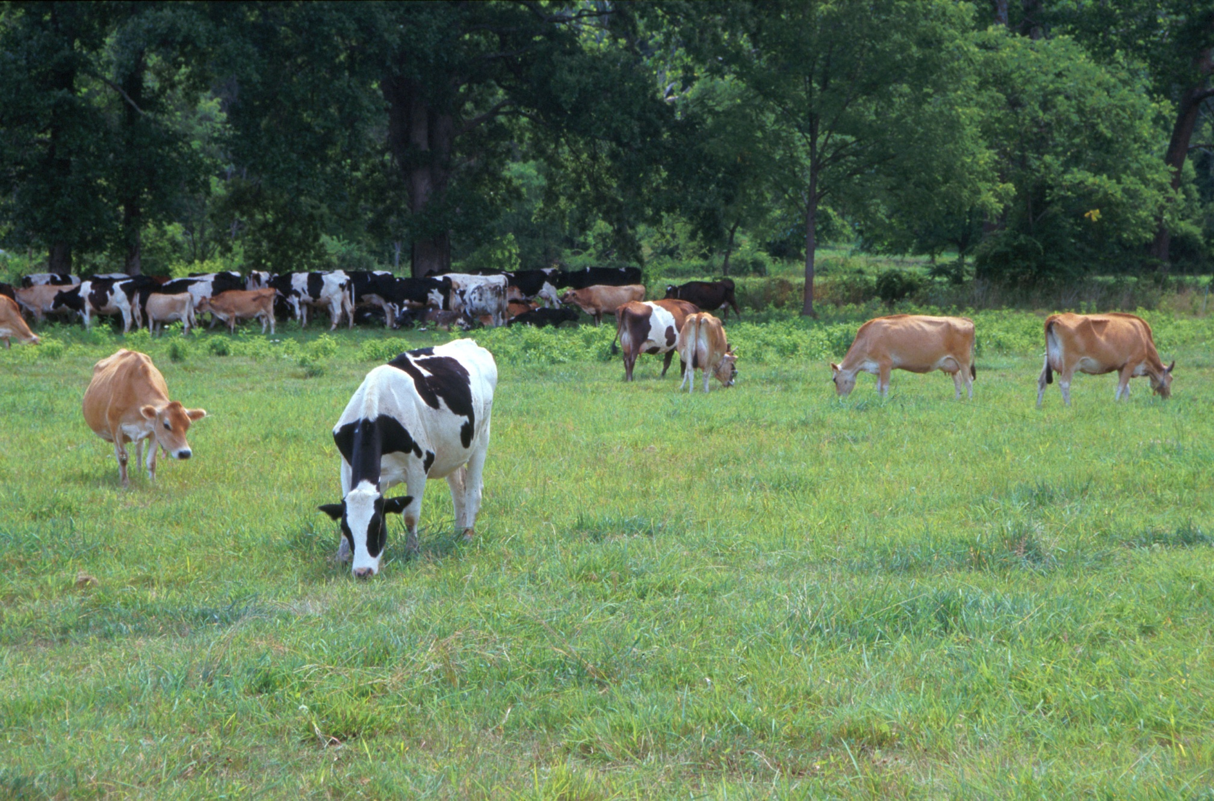
Fig 10-2. Holstein and Jersey crossbred cows graze in south-central Pennsylvania. (Courtesy of USDA-ARS)

Slide 20
Goal of a Breeding Program
Make $$$$$$ (where is most income derived?)
For most herds, production associated traits are most important
For some herds, type traits become very important (marketing cows vs. marketing milk)
90% of herds derive more than 90% of income from sale of milk

Slide 21
Type vs. Productive Life
Type
Trait
Productive Life

Slide 22
Traits of Importance
Milk
Health or SCS
Reproduction
Type traits
Udder composite
Feet and legs composite
Stature (big or small????)
Calving ease

Slide 23
Factors to Consider
Economic value
Does it have a value??
Will it improve profitability??
Heritability
How fast can this trait change?
Genetic control vs. environmental or management control
Heritability is 100% if expression of trait varies solely because of inheritance
Genetic variation/(genetics + environment) = h₂
Reduce management or environmental variation in population, heritability increases

Slide 25
Heritability
Milk ~30%
Protein and fat ~ 50%
Reproduction ~ 10%
Health ~ 10%
Type traits between 15 to 40%
Stature highest
Feet and legs low

Slide 26
Calculating Improvements
Use STA’s
Based on linear scores
Scored between 1 and 50 on a biological basis
Midpoint is zero, each increment represents one standard deviation
Score does not indicate “better” or “worse”
Convert STA’s to actual change in a trait per generation or per year
High heritability = rapid change
Low heritability = slow change
Allows ranking of importance of selection traits

Slide 28
Selection Strategies
Individual traits - milk, protein, stature, etc.
Selection Indexes – multitrait indexes
TPI or PTI – production/type indexes
Productive Life (PL) – 1st crop daughters estimated from type and production traits, 2nd crop mostly direct from culling info
Others include SCS, FL composite, udder composite, body size composite
Net Merit $ - additional net profit that a daughter will produce over her lifetime
Usually best index for profit of a commercial dairy

Slide 29
Corrective Mating Strategies
Many mating services available
Can you take your cow with excessive set to her legs, mate her to a bull with excessively straight legs, and create a daughter with perfect legs??
Corrective mating strategies, over a 30 year period, did not improve type traits any faster than randomly selecting bulls from the same group

Slide 30
Genomic Selection
Uses relatively inexpensive DNA screening for thousands of locations along the 30 pairs of chromosomes
A “chip” is used to identify specific patterns of DNA at over 50,000 locations along the cattle chromosomes
Variability at these locations across the chromosomes is identified by single nucleotide changes at the locations
3 billion pairs of nucleotides in DNA of cattle
The specific nucleotides present at these locations (called single nucleotide polymorphisms or SNPs – pronounced “snips”) used to predict expression of entire genes because they represent important segments of the chromosomes where the actual genes reside
High-density assay of SNP traces even small genetic effects
Genomic prediction improves reliability by tracing the inheritance of genes even with small effects

Slide 31
Genomic Markers
In 1994, experts predicted that we would soon be able to select bulls without progeny data
Genomic predictions combine genotypic, phenotypic, and pedigree data to increase the accuracy of estimates of genetic merit and to decrease generation interval
Adding genomic information increases reliability of predictions by about 24% in young sires, much less in older sires with progeny information
Can reduce generation interval by using more young sires at earlier ages
Predicted to increase rate of genetic improvement by up to 50%, especially in traits that took a long time to estimate (daughter pregnancy rates)
Current rate of genetic improvement in milk production is ~200 lbs/year

Slide 32
Genomic Selection
Predictions:
Increased rate of genetic progress
Increased use of young sires
Better reliability for traits with low heritability and traits that take a long time to measure (daughter pregnancy rate, productive life)
Reduced parentage identification errors
Improved selection of young sires to test in progeny programs
Concerns
Increase inbreeding problems in industry?
Only effective to use for Holsteins (about 50% as effective in Jerseys, no improvements in predictive values for any other breeds)
Populations of bulls in these breeds is too small for accurate predictions

Slide 33
Fig 9-2. Curt Van Tassell loads a high-capacity DNA sequencer to find more genetic markers for screening dairy bulls (Courtesy of USDA-ARS)

Slide 34
Summary
Focus breeding strategies on traits that improve profitability the most and have the most opportunity for change
Net Merit is probably the best selection index currently available for commercial herds – select bulls that are above the 90th percentile for Net Merit $$
Registered herds that derive a significant portion of income from cattle sales are more complicated
Cull bulls from that group for calving ease issues or other major “flaws”
Minimize culling
Sample groups of young sires on “groups’ of unselected cows (all 3rd service, etc.)
Restrict young sire use to multiparous cows

